Slide 1
III
THE DATA OF MACROECONOMICS

Slide 2
5
Measuring a Nation’s Income

Slide 3
Microeconomics and Macroeconomics
Microeconomics is the study of how individual households and firms make decisions and how they interact with one another in markets
Macroeconomics is the study of the economy as a whole
Its goal is to explain the economic changes that affect many households, firms, and markets at once

Slide 4
Macroeconomics
Macroeconomics deals with questions like these:
Why is average income high in some countries and low in others?
Why do prices rise rapidly in some time periods while they are more stable in others?
Why do production and employment expand in some years and contract in others?
But before any analysis can begin, it makes sense to spend time with data

Slide 5
The Role of Data
To see whether there’s a problem, you need data

Slide 6
The Role of Data
In macroeconomics, data are crucial
Data help policy makers see what problems, if any, need to be addressed
Data help macroeconomists identify the theories that make correct predictions and the theories that make incorrect predictions
Data often reveal interesting puzzles that macroeconomic theories need to solve

Slide 7
Total Income
To detect a country’s macroeconomic problems, we need to measure its macroeconomic health
When judging whether an economy is doing well or poorly, it is natural to look at the total income that people are earning

Slide 8
Total Income
We can temporarily enjoy a high standard of living even if total income is low
How? By borrowing from others.
But we can’t keep borrowing forever
At some point we’ll have to repay—with interest—what we’d borrowed
At that point, we will have to repay out of our income
This is why a nation’s standard of living depends heavily on its total income

Slide 9
Gross Domestic Product
Gross Domestic Product (GDP) is one measure of a country’s total income
There are other measures of total income, but GDP is the most popular measure

Slide 10
Gross Domestic Product

Slide 11
Gross Domestic Product
GDP is the total market value of all final goods and services produced within a country in a given period of time.
GDP is also the total expenditure on all final goods and services produced within a country in a given period of time.
GDP is also the total income earned from all productive activity in the domestic economy
I will focus on the first of these definitions
Why “final goods and services”?
Notes:
There are other measures

Slide 12
“Final” Goods and Services
Final goods are those goods sold to their final users
Final goods are those goods that do not disappear in the process of the production of some other for-sale good
Goods that disappear in the process of the production of some other for-sale good are called intermediate goods

Slide 13
“Final” Goods and Services
A pencil is a final good because, once produced, it is ready for use by its final users
The wood, the graphite, and the other materials that disappeared in the pencil are not final goods
Their market value is counted when the market value of the pencil is counted
So, counting them separately in GDP would be counting them twice

Slide 14
What is Gross Domestic Product (GDP)?
Video: https://youtu.be/mjJmo5mN5yA

Slide 15
The Components of GDP

Slide 16
Components of GDP
We need to pay attention not only to the total expenditure on all final goods and services made in a country (that is, GDP), we also need to watch where the expenditure is coming from
That way, when there’s a recession, we’ll know which sector needs the most attention

Slide 17
Components of GDP
Expenditure on “Made in USA” final goods and services can come from only the following four sources:
Households (Consumption expenditure)
Businesses (Investment expenditure)
Government entities (Government purchases)
Foreigners (Exports)
So, one might think …
GDP = Consumption Spending + Investment Spending + Government Spending + Exports
But that would be incorrect!

Slide 18
Components of GDP
GDP = Consumption Spending + Investment Spending + Government Spending + Exports – Imports
Q: Why do we subtract imports?
A: GDP is the market value of all final “Made in USA” goods. But consumption, investment, and government purchases all include spending on foreign goods. Therefore, to make the two sides of the equation the same, we must take out all the imports.
Exports – Imports is called Net Exports

Slide 19
The Components Of GDP
Consumption (C):
The spending by households on goods and services, with the exception of purchases of new housing.
Investment (I):
The spending on capital equipment, inventories, and structures, including new housing.

Slide 20
The Components Of GDP
Government Purchases (G):
The spending on goods and services by local, state, and federal governments.
Does not include transfer payments because they are not made in exchange for currently produced goods or services.
Net Exports (NX):
Exports minus imports.

Slide 21
National Income Accounting Identity
GDP = Consumption Spending + Investment Spending + Government Spending + Exports – Imports
Y = C + I + G + NX

Slide 22
Table 1 GDP and Its Components
This table shows total GDP for the U.S. economy in 2021 and the breakdown of GDP among its four components. When reading this table, recall the identity Y = C + I + G + NX.
Source: U.S. Department of Commerce. Parts may not sum to totals due to rounding.
 | Total (in billions of dollars) | Per Person (in dollars) | Percent of Total
Gross domestic product, Y | $22,994 | $69,386 | 100%
Consumption, C | 15,750 | 47,528 | 68
Investment, I | 4,108 | 12,396 | 18
Government purchases, G | 4,052 | 12,226 | 18
Net exports, NX | –916 | –2,764 | –4
Note that Y = C + I + G + NX.

Slide 23
Gross Domestic Product and its components, 2017
Source: Bureau of Economic Analysis, U.S. Department of Commerce, bea.gov
Last Revised on: March 28, 2018 - Next Release Date April 27, 2018
 |  | Total | Percent of GDP | Per Person
 |  | $ millions | % | $
1 | Gross domestic product | 19,390,605 | 100 | 59,483.49
2 | Personal consumption expenditures | 13,395,505 | 69.1 | 41,092.65
3 | Goods | 4,295,313 | 22.2 | 13,176.49
4 | Durable goods | 1,473,802 | 7.6 | 4,521.10
5 | Nondurable goods | 2,821,511 | 14.6 | 8,655.39
6 | Services | 9,100,192 | 46.9 | 27,916.16
7 | Gross private domestic investment | 3,212,828 | 16.6 | 9,855.81
8 | Fixed investment | 3,197,164 | 16.5 | 9,807.76
9 | Nonresidential | 2,449,581 | 12.6 | 7,514.44
10 | Structures | 560,180 | 2.9 | 1,718.43
11 | Equipment | 1,098,360 | 5.7 | 3,369.38
12 | Intellectual property products | 791,040 | 4.1 | 2,426.63
13 | Residential | 747,583 | 3.9 | 2,293.32
14 | Change in private inventories | 15,664 | 0.1 | 48.05
15 | Net exports of goods and services | -571,563 | -2.9 | -1,753.35
16 | Exports | 2,343,988 | 12.1 | 7,190.52
17 | Goods | 1,546,843 | 8 | 4,745.16
18 | Services | 797,146 | 4.1 | 2,445.36
19 | Imports | 2,915,551 | 15 | 8,943.87
20 | Goods | 2,381,754 | 12.3 | 7,306.37
21 | Services | 533,797 | 2.8 | 1,637.50
22 | Government consumption expenditures and gross investment | 3,353,834 | 17.3 | 10,288.37
23 | Federal | 1,260,656 | 6.5 | 3,867.24
24 | National defense | 744,421 | 3.8 | 2,283.62
25 | Nondefense | 516,235 | 2.7 | 1,583.63
26 | State and local | 2,093,178 | 10.8 | 6,421.13
 | Population (midperiod, thousands) | 325,983
Notes:
Downloaded on April 5, 2018 Sources: BEA.GOV Tables
Nominal GDP and its components: Table 1.1.5
Real GDP and its components: Table 1.1.6
Percentage Shares of Gross Domestic Product: Table 1.1.10
Population: Table 7.1

Slide 24
Gross Domestic Product and Its Components, 2022
Bureau of Economic Analysis; https://www.bea.gov/itable/
Downloaded on September 14, 2023
 |  | Total | % of GDP | Per Capita
Line |  | $ Billions | % | $
Line
1 | Gross domestic product | 25462.7 | 100.00 | 76328.18
2 | Personal consumption expenditures | 17357.2 | 68.17 | 52030.76
3 | Goods | 5941.3 | 23.33 | 17809.92
4 | Durable goods | 2185.5 | 8.58 | 6551.36
5 | Nondurable goods | 3755.9 | 14.75 | 11258.86
6 | Services | 11415.8 | 44.83 | 34220.54
7 | Gross private domestic investment | 4632.5 | 18.19 | 13886.60
8 | Fixed investment | 4473.6 | 17.57 | 13410.27
9 | Nonresidential | 3347 | 13.14 | 10033.12
10 | Structures | 651.3 | 2.56 | 1952.37
11 | Equipment | 1322.3 | 5.19 | 3963.79
12 | Intellectual property products | 1373.4 | 5.39 | 4116.97
13 | Residential | 1126.6 | 4.42 | 3377.15
14 | Change in private inventories | 158.9 | 0.62 | 476.33
15 | Net exports of goods and services | -975 | -3.83 | -2922.71
16 | Exports | 2975.8 | 11.69 | 8920.40
17 | Goods | 2064.2 | 8.11 | 6187.74
18 | Services | 911.6 | 3.58 | 2732.65
19 | Imports | 3950.9 | 15.52 | 11843.40
20 | Goods | 3277.2 | 12.87 | 9823.89
21 | Services | 673.7 | 2.65 | 2019.51
22 | Government consumption expenditures and gross investment | 4448.1 | 17.47 | 13333.83
23 | Federal | 1646.7 | 6.47 | 4936.23
24 | National defense | 924.9 | 3.63 | 2772.52
25 | Nondefense | 721.7 | 2.83 | 2163.40
26 | State and local | 2801.4 | 11.00 | 8397.61
 | Population (midyear | 333,595,000

Slide 25
Splitting GDP
Video: https://youtu.be/ChnRwedmO64

Slide 26
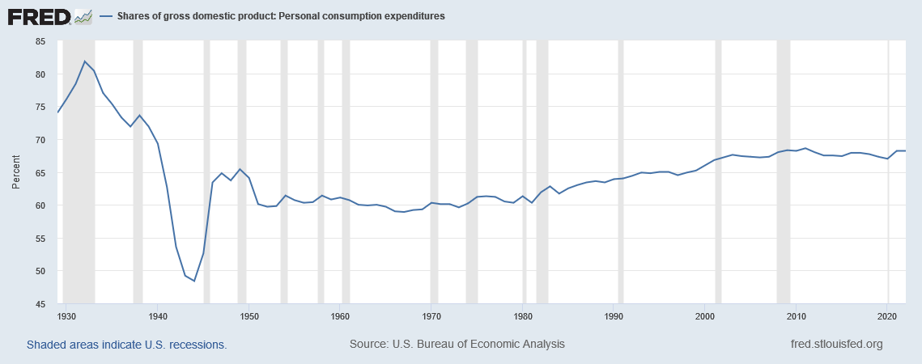
Consumption, as a share of GDP 1929 – 2022
Notes:
Source: https://fred.stlouisfed.org/series/DPCERE1A156NBEA

Slide 27
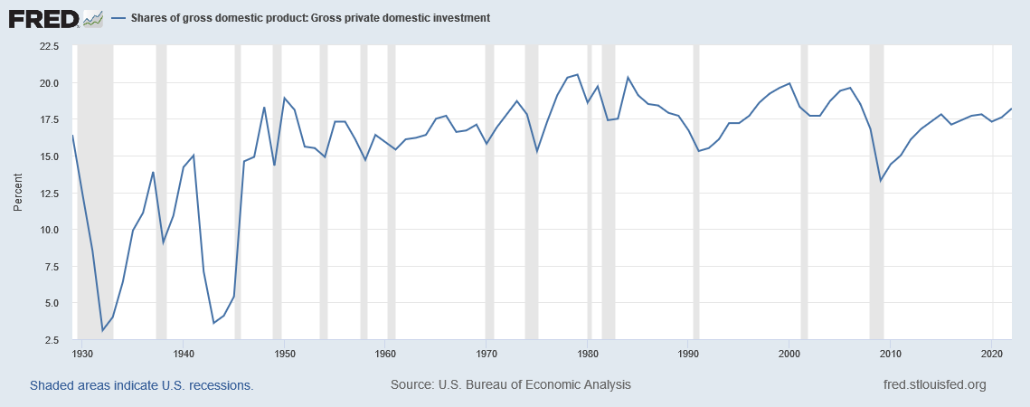
Investment, as a share of GDP 1929 – 2022
Notes:
Source: https://fred.stlouisfed.org/series/A006RE1A156NBEA

Slide 28
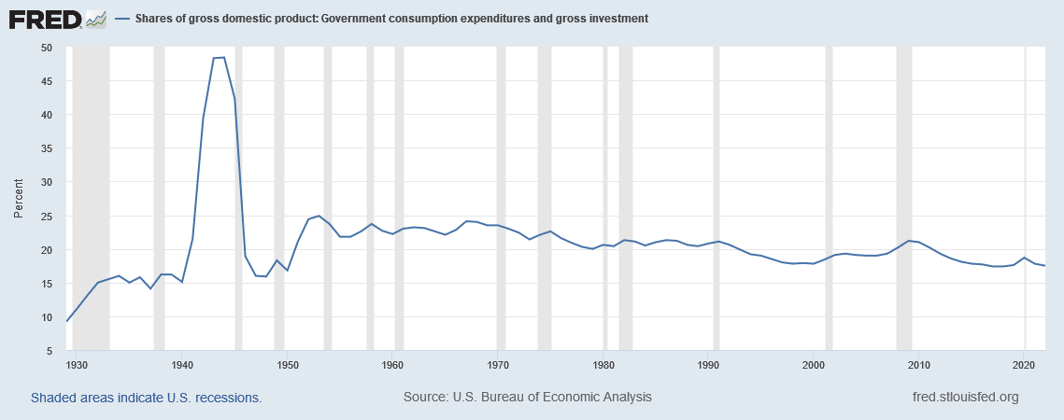
Government Purchases, as a share of GDP 1929 - 2022
Notes:
Source: https://fred.stlouisfed.org/series/A822RE1A156NBEA

Slide 29
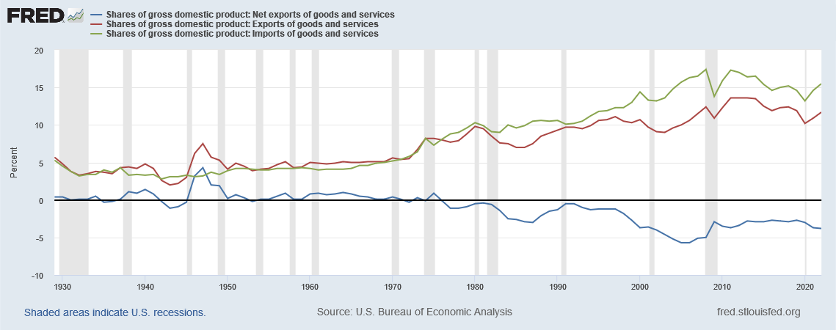
Exports, Imports, Net Exports, as a share of GDP 1929 - 2022
Notes:
Source: https://fred.stlouisfed.org/series/B020RE1A156NBEA (exports), https://fred.stlouisfed.org/series/B021RE1A156NBEA (imports), and https://fred.stlouisfed.org/series/A019RE1A156NBEA (net exports).

Slide 30
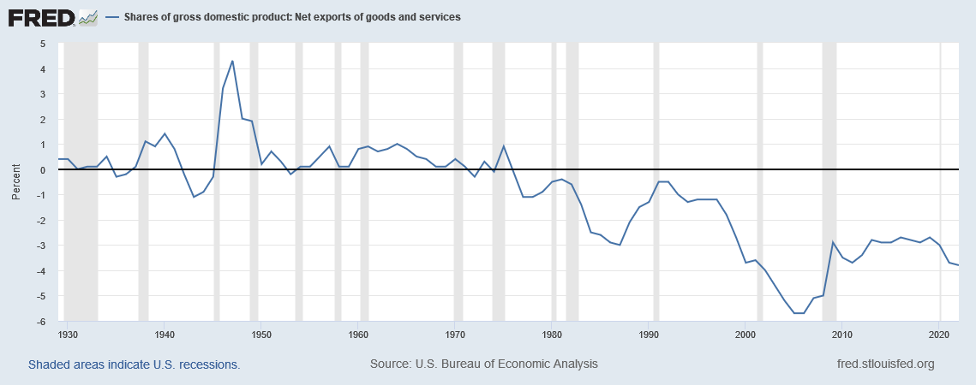
Net Exports, as a share of GDP 1929 - 2022
Notes:
Source: https://fred.stlouisfed.org/series/A019RE1A156NBEA

Slide 31
Where to find US data
Bureau of Economic Analysis, U.S. Department of Commerce: http://bea.gov
Federal Reserve Bank of St. Louis: http://research.stlouisfed.org/fred2/categories/18

Slide 32
Nominal and Real GDP
How can we measure a nation’s productive activity so that the numbers can be compared across time?

Slide 33
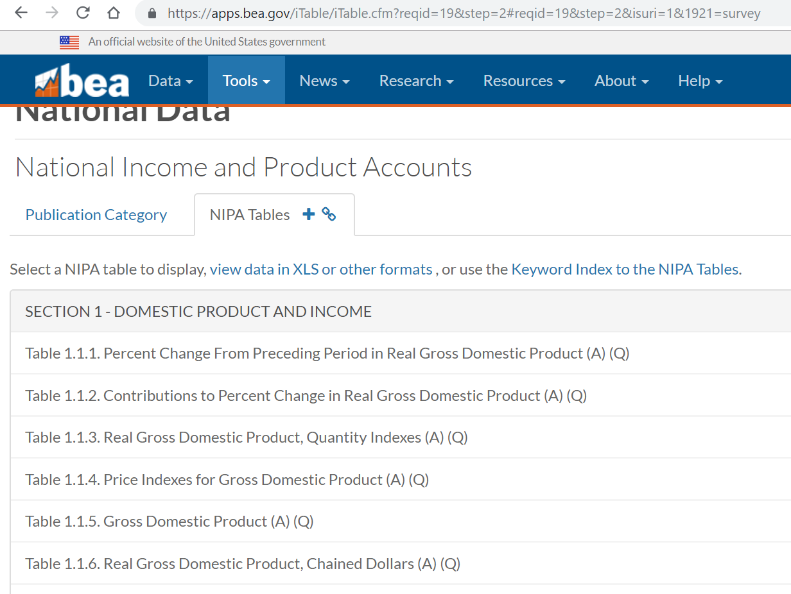

Slide 34
GDP: nominal and real
GDP comes in two flavors:
Nominal GDP (also called GDP at current prices), and
Real GDP (also called GDP at constant prices)
So, when you see or hear a discussion of GDP, be sure to ask, “Nominal or real?”

Slide 35
Gross Domestic Product, Nominal
Nominal GDP is the total market value of all final goods and services produced within a country in a given period of time.
The market value is calculated using current prices, the prices that prevailed when the production took place.
For example, the nominal GDP of the United States in 2022 was $25,462.7 billion, according to the U.S. Department of Commerce
Given a mid-year population of 333,595,000 (est.) the per capita nominal GDP was $76,328.
Notes:
Sources: GDP: Table 1.1.5 at https://apps.bea.gov/iTable/iTable.cfm GDP per capita and mid-year population: Table 7.1 Data downloaded on September 14, 2023
This is also available at https://fred.stlouisfed.org/series/GDPA.

Slide 36
Gross Domestic Product, Real
Real GDP is the total market value of all final goods and services produced within a country in a given period of time.
The market value is calculated using constant prices, which are the prices that prevailed in a benchmark year called the base year.
For example, the real GDP of the United States in 2022 was $20,014.1 billion in 2012 dollars, according to the U.S. Department of Commerce
Given a mid-year population of 333,595,000 (est.) the per capita real GDP was $59,995 in 2012 dollars
Notes:
Sources: GDP: Table 1.1.6 at https://apps.bea.gov/iTable/iTable.cfm GDP per capita and mid-year population: Table 7.1 Data downloaded on September 14, 2023
This is also available at https://fred.stlouisfed.org/series/GDPCA.

Slide 37
Nominal and Real GDP
 | Apples |  | Oranges
 | Price ($) | Quantity | Price ($) | Quantity
2015 | 50 | 10 | 20 | 50
2016 | 100 | 20 | 30 | 100
2017 | 150 | 20 | 50 | 200
 | Nominal GDP |  |  | $
2015 | ($50 ✕ 10) + ($20 ✕ 50) = |  |  | 1500
2016 | ($100 ✕ 20) + ($30 ✕ 100) = |  |  | 5000
2017 | ($150 ✕ 20) + ($50 ✕ 200) = |  |  | 13000
 | Real GDP (Base year 2015) |  |  | 2015 $
2015 | ($50 ✕ 10) + ($20 ✕ 50) = |  |  | 1500
2016 | ($50 ✕ 20) + ($20 ✕ 100) = |  |  | 3000
2017 | ($50 ✕ 20) + ($20 ✕ 200) = |  |  | 5000
Note that the base year’s nominal and real GDP must be the same.

Slide 38
Nominal and Real GDP
 | Apples |  | Oranges
 | Price ($) | Quantity | Price ($) | Quantity
2015 | 50 | 10 | 20 | 50
2016 | 100 | 20 | 30 | 100
2017 | 150 | 20 | 50 | 200
 | Nominal GDP |  |  | $ | Growth Rate (%)
2015 | ($50 ✕ 10) + ($20 ✕ 50) = |  |  | 1500
2016 | ($100 ✕ 20) + ($30 ✕ 100) = |  |  | 5000 | 100 ✕ [(5000 – 1500)/ 1500] = 233
2017 | ($150 ✕ 20) + ($50 ✕ 200) = |  |  | 13000 | 100 ✕ [(13000 – 5000)/ 5000] = 160
 | Real GDP (Base year 2015) |  |  | 2015 $
2015 | ($50 ✕ 10) + ($20 ✕ 50) = |  |  | 1500
2016 | ($50 ✕ 20) + ($20 ✕ 100) = |  |  | 3000 | 100 ✕ [(3000 – 1500)/ 1500] = 100
2017 | ($50 ✕ 20) + ($20 ✕ 200) = |  |  | 5000 | 100 ✕ [(5000 – 3000)/ 3000] = 67

Slide 39
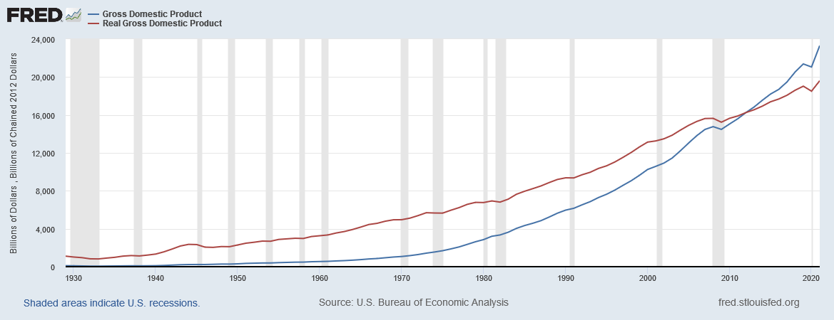
U.S. Nominal and Real GDP, 1929-2021
Real GDP: https://fred.stlouisfed.org/series/GDPCA
Nominal GDP: https://fred.stlouisfed.org/series/GDPA
Notes:
Downloaded from http://research.stlouisfed.org/fred2/ on January 19, 2023.
Notice that the red line (nominal GDP) is steeper than the blue line (real GDP). That’s because prices generally rise over time. So, nominal GDP grows at a faster rate than real GDP.
Question: What is the significance of the two lines crossing in 2012?
Answer: 2012 is the base year for this real GDP data, so RGDP = NGDP in 2012. Before 2012, RGDP > NGDP. After 2012, RGDP < NGDP. This is intuitive if you think about it for a minute: Take 1970. When the economy’s output of 1970 is measured in the (then) current prices, GDP is about $1 trillion. Between 1970 and 2000, most prices have risen. Hence, if you value the country’s 1970 using the higher year-2000 prices (to get real GDP), you get a bigger value than if you measure 1970’s output using the low 1970 prices (nominal GDP). This explains why real GDP is larger than nominal GDP in 1970 (as in most or all years before the base year).

Slide 40
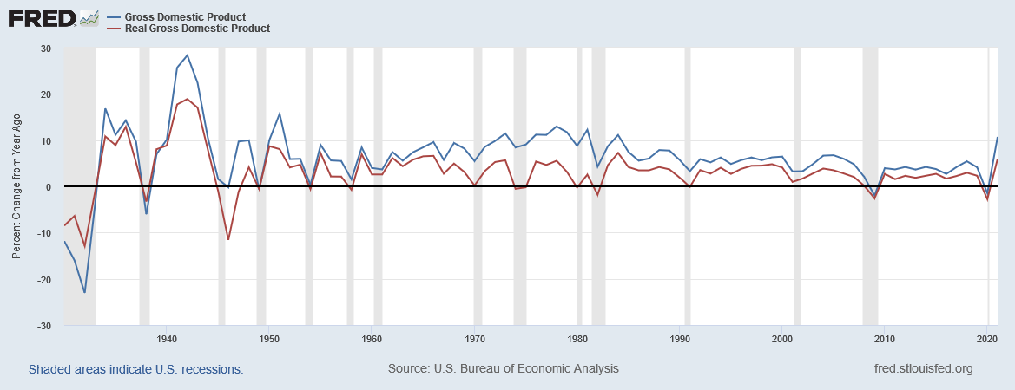
Growth Rate of Nominal and Real GDP, USA
Notes:
Downloaded from FRED on Janruary 19, 2023. Real Gross Domestic Product Growth Rate (A191RL1A225NBEA)
https://fred.stlouisfed.org/series/A191RL1A225NBEA
Gross Domestic Product Growth Rate (A191RP1A027NBEA)
https://fred.stlouisfed.org/series/A191RP1A027NBEA

Slide 41
Nominal vs. Real GDP
Video: https://youtu.be/rGqhTQyY6g4

Slide 42
International GDP comparisons
How can we measure national productive activity so that the numbers can be compared across nations?

Slide 43
International Comparisons
When the GDP numbers for various countries’ are compared, the same currency units must be used
There are two ways of converting from national currencies to a common currency, such as the US dollar
Use market exchange rates
Use a common set of prices (PPP)

Slide 44
Market Exchange Rate Method
Step 1: Look up Mexico’s GDP in Mexico’s currency, the peso
Step 2: Look up how many US dollars one Mexican peso is worth
Step 3: Multiply the numbers in Steps 1 and 2
This gives you Mexico’s GDP in US dollars
If the GDPs of two countries are both expressed in US dollars, they can be compared head to head
There’s another way to calculate Mexico’s GDP in US dollars …

Slide 45
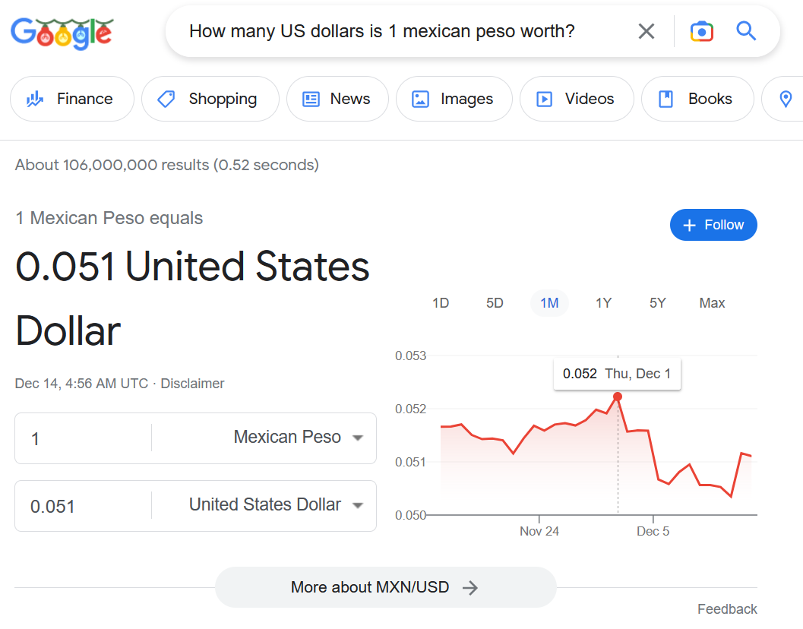
Market Exchange Rate Method
As on December 13, 2022
Notes:
Information accessed on December 13, 2022

Slide 46
Purchasing Power Parity Method
Step 1: Find out the quantities of all the final goods that were produced in Mexico during 2016
Step 2: Find out the prices of those goods in the United States—not Mexico—in 2016.
These prices are in US dollars
Step 3: Calculate Mexico’s GDP in US dollars, by
Step 3a: multiplying the quantities in Step 1 by the corresponding prices in Step 2 and
Step 3b: then adding the results obtained in Step 3a

Slide 47
Let’s Compare GDP!
country | GDP 2021 (2021 US$ billions) |  | country | GDP.PPP 2021 (2021 international $ billions)
United States | 22,996 |  | China | 27,313
China | 17,734 |  | United States | 22,996
Japan | 4,937 |  | India | 10,219
Germany | 4,223 |  | Japan | 5,397
United Kingdom | 3,187 |  | Germany | 4,815
India | 3,173 |  | Russian Federation | 4,785
France | 2,937 |  | Indonesia | 3,566
Italy | 2,100 |  | Brazil | 3,436
Canada | 1,991 |  | France | 3,424
Korea, Rep. | 1,799 |  | United Kingdom | 3,344
Russian Federation | 1,776 |  | Italy | 2,713
Brazil | 1,609 |  | Mexico | 2,610
Australia | 1,543 |  | Turkiye | 2,591
Spain | 1,425 |  | Korea, Rep. | 2,428
Mexico | 1,293 |  | Canada | 1,992
Indonesia | 1,186 |  | Spain | 1,930
Netherlands | 1,018 |  | Saudi Arabia | 1,751
Saudi Arabia | 834 |  | Australia | 1,436
Turkiye | 815 |  | Poland | 1,417
Switzerland | 813 |  | Egypt, Arab Rep. | 1,388

Slide 48
Let’s Compare GDP per capita!
country | GDP.per.cap 2021 (2021 US$) |  | country | GDP.per.cap.PPP 2021 (2021 international $) |  | country | GDP.per.cap 2021 (2021 US$) |  | country | GDP.per.cap.PPP 2021 (2021 international $)
Luxembourg | 135,683 |  | Luxembourg | 134,754 |  | Burkina Faso | 918 |  | Ethiopia | 2600
Bermuda | 110,869 |  | Singapore | 116,486 |  | Mali | 918 |  | Rwanda | 2494
Ireland | 99,152 |  | Ireland | 106,456 |  | Tajikistan | 897 |  | Burkina Faso | 2462
Switzerland | 93,457 |  | Qatar | 93,521 |  | Uganda | 858 |  | Mali | 2447
Norway | 89,203 |  | Bermuda | 85,192 |  | Gambia, The | 836 |  | Zimbabwe | 2444
Singapore | 72,794 |  | Norway | 79,201 |  | Rwanda | 834 |  | Gambia, The | 2434
United States | 69,288 |  | Switzerland | 77,324 |  | Guinea-Bissau | 813 |  | Uganda | 2398
Iceland | 68,384 |  | Macao SAR, China | 73,802 |  | Sudan | 764 |  | Togo | 2380
Denmark | 67,803 |  | United States | 69,288 |  | Chad | 696 |  | Guinea-Bissau | 2057
Qatar | 61,276 |  | Brunei Darussalam | 66,620 |  | Yemen, Rep. | 691 |  | Sierra Leone | 1816
Sweden | 60,239 |  | Hong Kong SAR, China | 65,973 |  | Liberia | 673 |  | Malawi | 1658
Australia | 59,934 |  | Denmark | 64,651 |  | Malawi | 643 |  | Madagascar | 1635
Netherlands | 58,061 |  | Netherlands | 63,767 |  | Niger | 595 |  | Chad | 1591
Finland | 53,983 |  | Sweden | 59,324 |  | Congo, Dem. Rep. | 584 |  | Liberia | 1553
Austria | 53,268 |  | Belgium | 58,931 |  | Sierra Leone | 516 |  | Mozambique | 1342
Canada | 52,051 |  | Austria | 58,427 |  | Madagascar | 515 |  | Niger | 1310
Belgium | 51,768 |  | Germany | 57,928 |  | Central African Republic | 511 |  | Somalia | 1302
Israel | 51,430 |  | Iceland | 57,646 |  | Mozambique | 500 |  | Congo, Dem. Rep. | 1219
Germany | 50,802 |  | Australia | 55,807 |  | Somalia | 446 |  | Central African Republic | 1021
Hong Kong SAR, China | 49,661 |  | Finland | 55,007 |  | Burundi | 237 |  | Burundi | 793
Comparing by market exchange rates, the average resident of Luxembourg earns 572 times what the average resident of Burundi earns.
Comparing by purchasing power parity, the average resident of Luxembourg earns 170 times what the average resident of Burundi earns.

Slide 49
Growth Matters a Lot
There are huge differences in growth rates too
And differences in growth rates can matter a lot over time
country | year.beg | year.end | GDP.per.cap.PPP.beg | GDP.per.cap.PPP.end | GDP.per.cap.PPP.growth
Bosnia and Herzegovina | 1994 | 2021 | 901.39 | 16,846.46 | 11.45
Equatorial Guinea | 1990 | 2021 | 653.21 | 18,127.19 | 11.32
China | 1990 | 2021 | 981.42 | 19,338.23 | 10.09
Myanmar | 1990 | 2021 | 400.09 | 4,344.94 | 8.00
Lithuania | 1995 | 2021 | 5,927.33 | 42,665.32 | 7.89
Vietnam | 1990 | 2021 | 1,165.42 | 11,553.07 | 7.68
Nauru | 2004 | 2021 | 4,389.81 | 15,102.66 | 7.54
Estonia | 1995 | 2021 | 6,476.33 | 42,191.51 | 7.47
Latvia | 1995 | 2021 | 5,514.67 | 34,468.60 | 7.30
Lao PDR | 1990 | 2021 | 1,024.63 | 8,674.03 | 7.13
Gabon | 1990 | 2021 | 12,381.91 | 15,597.52 | 0.75
Oman | 1990 | 2020 | 26,185.95 | 31,117.76 | 0.58
Brunei Darussalam | 1990 | 2021 | 55,853.61 | 66,619.87 | 0.57
Congo, Rep. | 1990 | 2021 | 3,471.17 | 3,616.86 | 0.13
Cayman Islands | 2006 | 2020 | 71,482.57 | 72,481.01 | 0.10
Qatar | 2000 | 2021 | 96,713.11 | 93,521.44 | -0.16
Curacao | 2000 | 2020 | 21,888.35 | 20,681.24 | -0.28
United Arab Emirates | 1990 | 2020 | 87,131.68 | 66,766.05 | -0.88
Kuwait | 1995 | 2020 | 59,865.10 | 47,303.13 | -0.94
South Sudan | 2008 | 2015 | 2,913.32 | 1,234.73 | -11.54
 |  | Years From Today
Annual Growth % | Today | 20 | 100 | 200
1 | 100 | 122.02 | 270.48 | 731.60
2 | 100 | 148.59 | 724.46 | 5248.49
So, even small increases in annual growth rates can make a big difference if sustained over a long time.

Slide 50
Data Sources
GDP (current US$): https://data.worldbank.org/indicator/NY.GDP.MKTP.CD
GDP, PPP (current international $): https://data.worldbank.org/indicator/NY.GDP.MKTP.PP.CD
GDP per capita (current US$): https://data.worldbank.org/indicator/NY.GDP.PCAP.CD
GDP per capita, PPP (current international $): https://data.worldbank.org/indicator/NY.GDP.PCAP.PP.CD
GDP growth (annual %): https://data.worldbank.org/indicator/NY.GDP.MKTP.KD.ZG
GDP per capita growth (annual %): https://data.worldbank.org/indicator/NY.GDP.PCAP.KD.ZG

Slide 51
Basic Facts of Wealth
Video: https://youtu.be/PzAr_mL0Qd8

Slide 52
Is GDP a good measure of economic well-being?
No, but it is the best one-number measure we have

Slide 53
There’s a lot that’s missing in GDP
Where to begin!
Inequality, work done in home, volunteer work, illegal work, leisure, environment, disasters, …

Slide 54
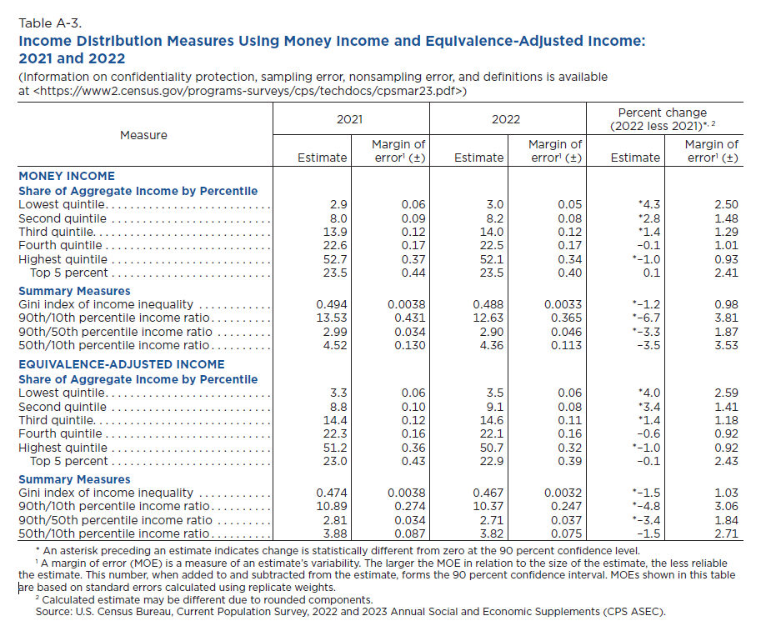

Slide 57
Leisure Reduces GDP

Slide 58
GDP Doesn’t Count Illegal Work
Jesse: “All this hard work, Mr. White! What’s the point? They won’t even count it in GDP!”

Slide 59
GDP Doesn’t Count Work at Home

Slide 60
GDP Doesn’t Count Volunteer Work

Slide 61
GDP Ignores Environmental Damage

Slide 62
GDP Ignores Consumer Surplus
Free digital technology
Free Apps, Google, Google maps, Wikipedia, OpenOffice, YouTube
Freely available education
Khan Academy, Coursera
None of this adds to GDP
Users would be willing to pay but don’t. They get Consumer Surplus

Slide 63
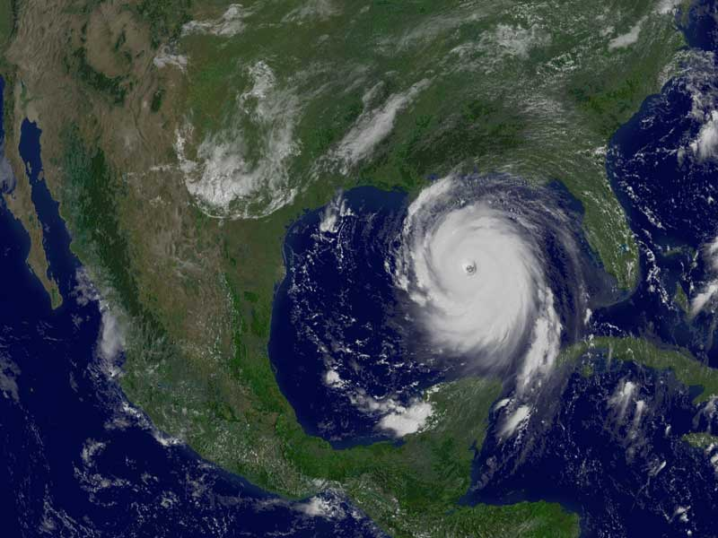
Disasters May Raise GDP

Slide 64
GDP And Economic Well-being
GDP is the best single measure of the economic well-being of a society.
GDP per person tells us the income and expenditure of the average person in the economy.

Slide 65
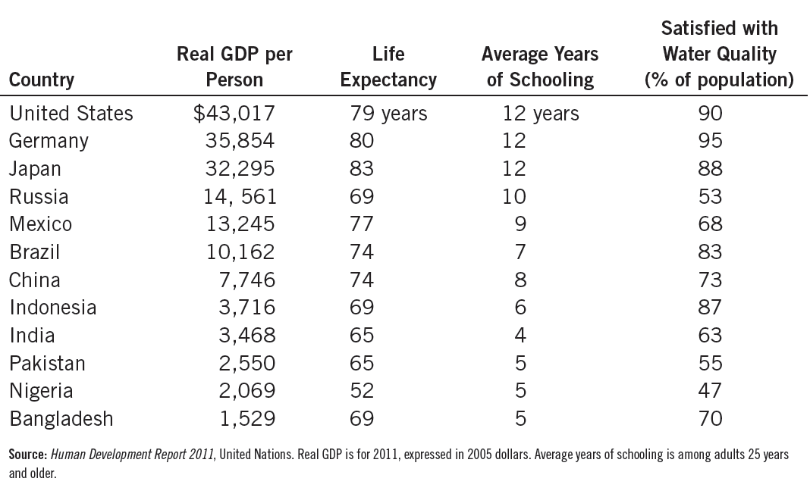
Table 3: GDP and the Quality of Life
The table shows GDP per person and three other measures of the quality of life for twelve major countries.

Slide 66
Robert Kennedy on GDP
[Gross Domestic Product] does not allow for the health of our children, the quality of their education, or the joy of their play. It does not include the beauty of our poetry or the strength of our marriages, the intelligence of our public debate or the integrity of our public officials. It measures neither our courage, nor our wisdom, nor our devotion to our country. It measures everything, in short, except that which makes life worthwhile, and it can tell us everything about America except why we are proud that we are Americans.

Slide 67
Real GDP Per Capita and the Standard of Living
Video: https://youtu.be/Z0qHA93oOSc

Slide 68
Any questions?

Slide 69
Summary
Because every transaction has a buyer and a seller, the total expenditure in the economy must equal the total income in the economy.
Gross Domestic Product (GDP) measures an economy’s total expenditure on newly produced goods and services and the total income earned from the production of these goods and services.

Slide 70
Summary
GDP is the market value of all final goods and services produced within a country in a given period of time.
GDP is divided among four components of expenditure: consumption, investment, government purchases, and net exports.

Slide 71
Summary
Nominal GDP uses current prices to value the economy’s production. Real GDP uses constant base-year prices to value the economy’s production of goods and services.
The GDP deflator—calculated from the ratio of nominal to real GDP—measures the level of prices in the economy.

Slide 72
Summary
GDP is a good measure of economic well-being because people prefer higher to lower incomes.
It is not a perfect measure of well-being because some things, such as leisure time and a clean environment, aren’t measured by GDP.

