Slide 1
6
Measuring the Cost of Living

Slide 2
Prerequisites
These are some of the things you need to know to understand this chapter:
GDP, nominal and real

Slide 3
The Cost of Living
We need all sorts of things to live
These things are typically not free
How are we to measure the cost of living the way we actually live?

Slide 4
The Cost of Living
Q: Why do we need to know the cost of living?
A: To see whether our incomes are keeping up with the cost of living

Slide 5
The Cost of Living
We need one number that represents the overall level of the prices of all goods that a typical consumer buys
This is the Consumer Price Index

Slide 6
The Consumer Price Index
The Consumer Price Index (CPI) is a measure of the overall cost of the goods and services bought by a typical consumer.
When the CPI rises, the typical family has to spend more dollars to maintain the same standard of living.
The Bureau of Labor Statistics (BLS) reports the CPI each month:
https://www.bls.gov/news.release/cpi.toc.htm
It is used to monitor changes in the cost of living over time.

Slide 7
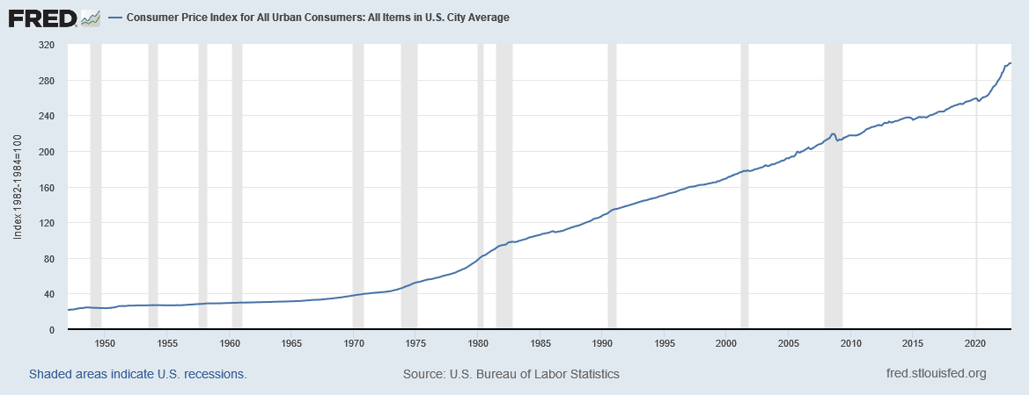
http://research.stlouisfed.org/fred2/series/CPIAUCSL

Slide 8
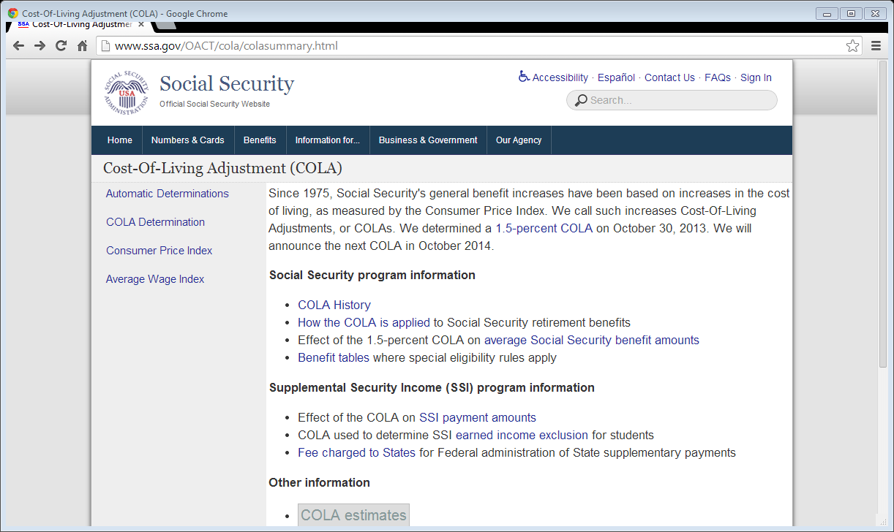
Senior citizens in the U.S. get social security pensions from the U.S. government. By law, these pensions rise in sync with the CPI.
Notes:
Screenshot taken on February 12, 2014.

Slide 9
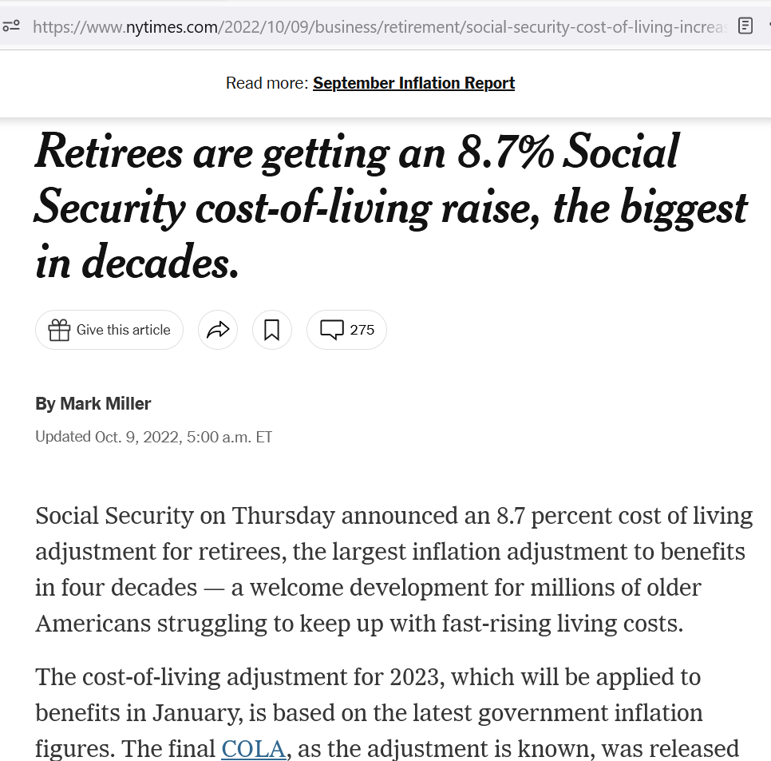
Senior citizens in the U.S. get social security pensions from the U.S. government. By law, these pensions rise in sync with the CPI.
Source: https://www.nytimes.com/2022/10/09/business/retirement/social-security-cost-of-living-increase.html?smid=url-share

Slide 10
How the consumer price index is calculated
We need one number that represents the overall level of the prices of all goods that a typical consumer buys

Slide 11
The Basic Idea: Compare the Market Value of a Particular Basket of Goods Under Two Sets of Prices
The prices of a large number goods and services may change in many ways between Situation A and Situation B
You can take a specific basket of goods and services and measure its market value under:
the prices in Situation A and
the prices in Situation B
A comparison of the two market value numbers then gives a single number that compares prices in the two situations

Slide 12
How the CPI Is Calculated [BLS]
Fix the basket: figure out what’s in the “basket” of goods that the typical consumer buys
Find the prices paid by the typical consumer for the goods in the “basket”
Compute the basket’s cost
Choose a base year and compute the CPI for all years
Compute the inflation rates for all years

Slide 13
How the Consumer Price Index Is Calculated
Fix the basket: determine what “basket” of goods the typical consumer buys.
The Bureau of Labor Statistics (BLS) identifies a market basket of goods and services the typical consumer buys.
The BLS conducts monthly consumer surveys to set the weights for the prices of those goods and services.

Slide 14
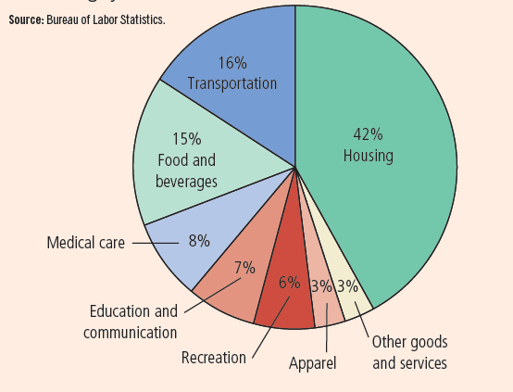
Figure 1: The Typical Basket of Goods and Services
This figure shows how the typical consumer divides spending among various categories of goods and services. The Bureau of Labor Statistics calls each percentage the “relative importance” of the category.

Slide 15
How the Consumer Price Index Is Calculated
Find the Prices: Find the prices of each of the goods and services in the typical consumer’s basket at each point in time.
These prices are the prices paid by the typical consumer

Slide 16
How the Consumer Price Index Is Calculated
Compute the Basket’s Cost: Use the data on prices to calculate the cost of the typical consumer’s basket in different years.

Slide 17
How the Consumer Price Index Is Calculated
Choose a Base Year and Compute the CPI:
Designate a particular year as the base year, making it the benchmark against which other years are compared.
Compute the CPI for a given year as follows:
divide the cost of the typical consumer’s basket in the given year by its cost in the base year
multiply the result by 100

Slide 18
How the Consumer Price Index Is Calculated
Compute the inflation rate: The inflation rate for a given year is the percentage increase in the CPI from the preceding period.

Slide 19
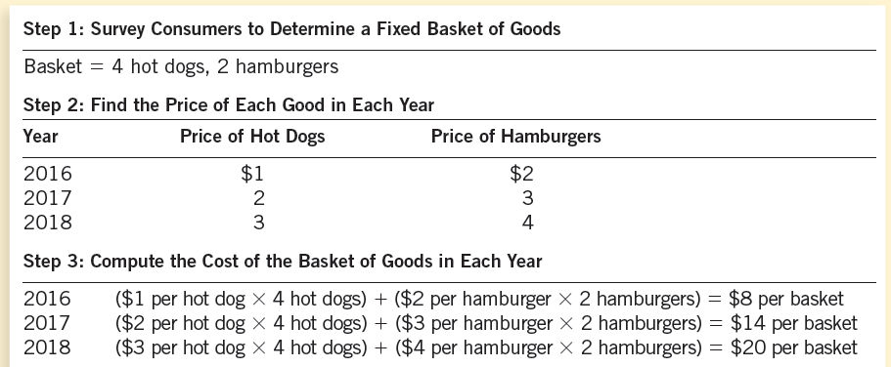

Slide 20
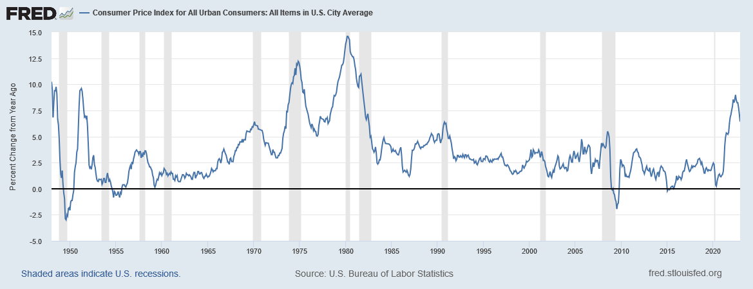
http://research.stlouisfed.org/fred2/series/CPIAUCSL

Slide 21
How the Consumer Price Index Is Calculated: Another Example
Base Year is 2002
Basket of goods in 2002 costs $1,200
The same basket in 2004 costs $1,236
CPI for 2004 = ($1,236/$1,200) × 100 = 103
Prices increased 3 percent between 2002 and 2004

Slide 22
Video: Measuring Inflation
https://youtu.be/0jJKjgE3qfE

Slide 23
The cpi is a biased measure of the cost of living

Slide 24
Problems in Measuring the Cost of Living
The CPI is an accurate measure of the selected goods that make up the typical bundle, but it is not a perfect measure of the cost of living.

Slide 25
Problems in Measuring the Cost of Living
Substitution bias
Introduction of new goods
Unmeasured quality changes

Slide 26
Problems in Measuring the Cost of Living: Substitution Bias
The basket does not change to reflect consumer reaction to changes in relative prices.
Consumers substitute toward goods that have become relatively less expensive.
The index overstates the increase in cost of living by not considering consumer substitution.

Slide 27
Substitution Bias in CPI
Suppose Red Apples and Green Apples are the only two commodities and are identical except for color.
Suppose the typical consumer’s basket has, for many years, contained 10 of each type.
Suppose the prices in 2015 (the base year) were $2 per apple for both types. So, the cost of the consumer’s basket was $40 in 2015.
Suppose the prices in 2016 are $4 for a Red Apple and $2 for a Green Apple. So, the cost of the consumer’s basket is $60 in 2016.
Therefore, the CPI for 2016 is (60/40) × 100 = 150, indicating a 50% increase in the cost of living
But has the cost of living really increased?
No. The consumer can switch to zero Red Apples and 20 Green Apples and enjoy the same satisfaction as always without any increase in cost.
Therefore, the CPI exaggerates the true cost of living.

Slide 28
Problems in Measuring the Cost of Living: Introduction of New Goods
The basket does not reflect the change in purchasing power brought on by the introduction of new products.
New products result in greater variety, which in turn makes each dollar more valuable.
Consumers need fewer dollars to maintain any given standard of living.

Slide 29
Problems in Measuring the Cost of Living: Unmeasured Quality Changes
If the quality of a good rises from one year to the next, the value of a dollar rises, even if the price of the good stays the same.
If the quality of a good falls from one year to the next, the value of a dollar falls, even if the price of the good stays the same.
The BLS tries to adjust the price for constant quality, but such differences are hard to measure.

Slide 30
Problems in Measuring the Cost of Living
The substitution bias, introduction of new goods, and unmeasured quality changes cause the CPI to overstate the true cost of living.
The issue is important because many government programs use the CPI to adjust for changes in the overall level of prices.
The CPI overstates inflation by about 1 percentage point per year.

Slide 31
Using the cpi to compare dollar amounts from different dates

Slide 32
Correcting Economic Variables For The Effects Of Inflation
The Consumer Price Index is used to correct for the effects of inflation when comparing dollar figures from different eras.
See the BLS’s inflation calculator

Slide 33
Quick Quiz
CPI in 1914 = 10
CPI in 2012 = 230
Henry Ford paid his workers $5 a day in 1914
Q: How much is that in 2012 dollars?

Slide 34
Quick Quiz
CPI in 1914 = 10
CPI in 2012 = 230
Henry Ford paid his workers $5 a day in 1914
Q: How much is that in 2012 dollars?
A: $115
CPI rose by a multiple of 23 (= 230/10) from 1914 to 2012
So, the 2012 equivalent of the 1914 salary would have to be 23 times the 1914 salary = 23 × $5 = $115

Slide 35
Correcting Economic Variables For The Effects Of Inflation
If you know a dollar amount in year a, what is the equivalent dollar amount—in purchasing power—in year b?
$\text{Year} \text{b} \text{amount}=\text{Year} \text{a} \text{amount}×\frac{\text{CPI} \text{in} \text{Year} \text{b}}{\text{CPI} \text{in} \text{Year} \text{a}}$

Slide 36
Babe Ruth’s Salary
CPI in 1931 = 15.2
CPI in 2012 = 229.5
Therefore, prices rose by a multiple of 229.5/15.2 = 15.1 from 1931 to 2012
Babe Ruth earned $80,000 in 1931
The equivalent salary in 2012 is, therefore, 15.1 times his 1931 salary, or $80,000 ✕ 15.1 = $1,207,894

Slide 37
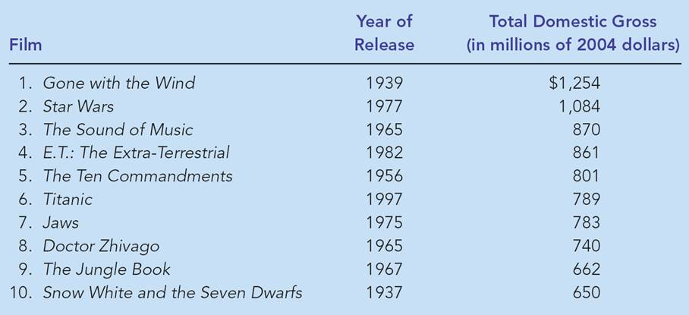
FYI: Mr. Index Goes to Hollywood

Slide 38
Quick Check Multiple Choice
If the consumer price index is 200 in the year 1980 and 300 today, then $600 in 1980 has the same purchasing power as ___ today.
$400
$500
$700
$900

Slide 39
Quick Check Multiple Choice
If the consumer price index is 200 in the year 1980 and 300 today, then $600 in 1980 has the same purchasing power as ___ today.
$400
$500
$700
$900
As prices have risen by a multiple of 1.5 (= 300/200) since 1980, any amount in 1980 dollars must increase by a multiple of 1.5 in order to have the same purchasing power

Slide 40
Indexation
When some dollar amount is automatically corrected for inflation by law or contract, the amount is said to be indexed for inflation.

Slide 41
Using the cpi to adjust interest rates for inflation

Slide 42
Real and Nominal Interest Rates
Interest represents a payment in the future for a receipt of money in the past.

Slide 43
Real and Nominal Interest Rates
The nominal interest rate is the interest rate usually mentioned in borrowing or lending contracts.
It is not corrected for inflation.
It is the interest rate that a bank pays.
The real interest rate is the interest rate that is corrected for the effects of inflation.

Slide 44
Real and Nominal Interest Rates
Suppose you borrowed $1,000 for one year
Suppose the nominal interest rate was 15%
Suppose that, during the year, inflation was 10%
Real interest rate = Nominal interest rate – Inflation
= 15% - 10% = 5%

Slide 45
Real and Nominal Interest Rates
You loan $100 to a friend at the nominal interest rate of 15%
A year later, you will get back $115
Inflation turns out to be 10% during the loan period.
In particular, let’s say the price of gold increased 10%.
Had you instead bought gold with your $100, a year later you could have sold it for $110
So, by lending $100 to your friend, you actually earned $5, over and above inflation
So, your real interest rate was 5%

Slide 46
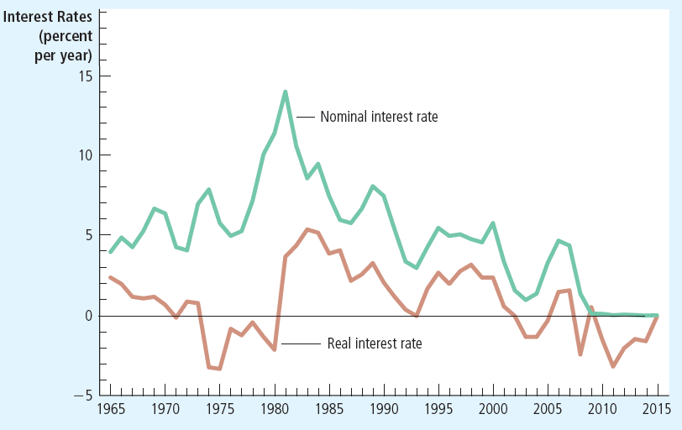
Figure 3: Real and Nominal Interest Rates
This figure shows nominal and real interest rates using annual data since 1965. The nominal interest rate is the rate on a 3-month Treasury bill. The real interest rate is the nominal interest rate minus the inflation rate as measured by the consumer price index. Notice that nominal and real interest rates often do not move together.
Notes:
See https://www.frbsf.org/education/publications/doctor-econ/2003/august/real-nominal-interest-rate/

Slide 47
Quick Check Multiple Choice
You deposit $2,000 in a savings account, and a year later you have $2,100. Meanwhile, the consumer price index rises from 200 to 204. In this case, the nominal interest rate is ___ percent, and the real interest rate is ___ percent.
1; 5
3; 5
5; 1
5; 3

Slide 48
Quick Check Multiple Choice
You deposit $2,000 in a savings account, and a year later you have $2,100. Meanwhile, the consumer price index rises from 200 to 204. In this case, the nominal interest rate is ___ percent, and the real interest rate is ___ percent.
1; 5
3; 5
5; 1
5; 3

Slide 49
The GDP Deflator
This topic is discussed in another chapter of this course’s textbook: “Measuring a Nation’s Income.”
How do we come up with one number—one number!—that can represent the overall level of prices? We’ve already seen that the CPI is just such a number. But there’s another measure of the overall level of prices:

Slide 50
The Basic Idea: Compare the Market Value of a Particular Basket of Goods Under Two Sets of Prices
The prices of a large number goods and services may change in many ways between Situation A and Situation B
You can take a specific basket of goods and services and measure its market value under:
the prices in Situation A and
the prices in Situation B
A comparison of the two market value numbers then gives a single number that compares prices in the two situations

Slide 51
The GDP Deflator
The GDP Deflator for the year yyyy (for a specified base year) is calculated as follows: ${\text{GDP} \text{Deflator}}_{yyyy}=\frac{{\text{Nominal} \text{GDP}}_{yyyy}}{{\text{Real} \text{GDP}}_{yyyy}}×100$

Slide 52
The GDP Deflator
 | Apples |  | Oranges
 | Price ($) | Quantity | Price ($) | Quantity
2015 | 50 | 10 | 20 | 50
2016 | 100 | 20 | 30 | 100
2017 | 150 | 20 | 50 | 200
 | Nominal GDP |  |  | $ | GDP Deflator
2015 | ($50 ✕ 10) + ($20 ✕ 50) = |  |  | 1500 | 100 × 1500 / 1500 = 100
2016 | ($100 ✕ 20) + ($30 ✕ 100) = |  |  | 5000 | 100 × 5000 / 3000 = 167
2017 | ($150 ✕ 20) + ($50 ✕ 200) = |  |  | 13000 | 100 × 13000 / 5000 = 260
 | Real GDP (Base year 2015) |  |  | 2015 $
2015 | ($50 ✕ 10) + ($20 ✕ 50) = |  |  | 1500
2016 | ($50 ✕ 20) + ($20 ✕ 100) = |  |  | 3000
2017 | ($50 ✕ 20) + ($20 ✕ 200) = |  |  | 5000
$${\text{GDP} \text{Deflator}}_{yyyy}=\frac{{\text{Nominal} \text{GDP}}_{yyyy}}{{\text{Real} \text{GDP}}_{yyyy}}×100$$

Slide 53
The GDP Deflator
The GDP deflator is a measure of the overall level of the prices of the final goods and services produced within a country during a given period of time
And its growth rate is, therefore, a measure of the rate of inflation.

Slide 54
The GDP Deflator and the Inflation Rate
 | Apples |  | Oranges
 | Price ($) | Quantity | Price ($) | Quantity
2015 | 50 | 10 | 20 | 50
2016 | 100 | 20 | 30 | 100
2017 | 150 | 20 | 50 | 200
 | Nominal GDP |  |  | $ | GDP Deflator
2015 | ($50 ✕ 10) + ($20 ✕ 50) = |  |  | 1500 | 100 × 1500 / 1500 = 100
2016 | ($100 ✕ 20) + ($30 ✕ 100) = |  |  | 5000 | 100 × 5000 / 3000 = 167
2017 | ($150 ✕ 20) + ($50 ✕ 200) = |  |  | 13000 | 100 × 13000 / 5000 = 260
 | Real GDP (Base year 2015) |  |  | 2015 $ | Inflation (%)
2015 | ($50 ✕ 10) + ($20 ✕ 50) = |  |  | 1500
2016 | ($50 ✕ 20) + ($20 ✕ 100) = |  |  | 3000 | 100 × (167 – 100) / 100 = 67
2017 | ($50 ✕ 20) + ($20 ✕ 200) = |  |  | 5000 | 100 × (260 – 167) / 167 = 55.69

Slide 55
Market value of all domestically produced final goods and services produced in 2019 at 2019 prices
GDP Deflator for 2019 with base year 2012
=
× 100
Market value of all domestically produced final goods and services produced in 2019 at 2012 prices
$600
=
× 100
$200
=
300

Slide 56
Market value of all domestically produced final goods and services produced in 2019 at 2019 prices
GDP Deflator for 2019 with base year 2012
=
× 100
Market value of all domestically produced final goods and services produced in 2019 at 2012 prices
Why are the goods produced in 2019 worth 3 times as much at 2019 prices as at 2012 prices?
It must be that 2019 prices are, on average, 3 times as high as 2012 prices.
$600
=
× 100
$200
This is what the GDP Deflator is saying.
=
300

Slide 57
Market value of all domestically produced final goods and services produced in 2019 at 2019 prices
GDP Deflator for 2019 with base year 2012
=
× 100
Market value of all domestically produced final goods and services produced in 2019 at 2012 prices
The GDP Deflator is 300. This indicates that the 2019 prices of domestically produced final goods and services were on average 300 percent of the corresponding prices in 2012, the base year.
$600
=
× 100
$200
=
300

Slide 58
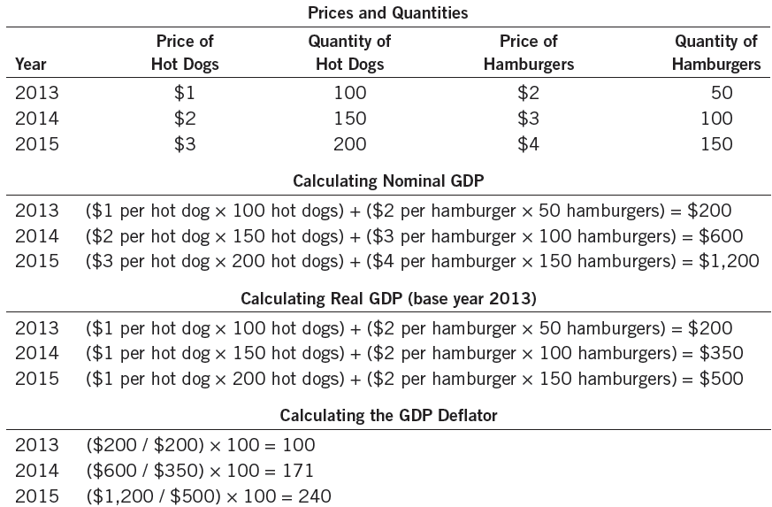
Table 2: Real and Nominal GDP
This table shows how to calculate real GDP, nominal GDP, and the GDP deflator for a hypothetical economy that produces only hot dogs and hamburgers.

Slide 59
The GDP Deflator, USA, 2021
Recall that:
Nominal GDP in 2021 was $22,993.471 billion
Confirm this at https://fred.stlouisfed.org/series/GDPA.
Real GDP in 2021 with base year 2012 was $19,427.205 billion
Confirm this at https://fred.stlouisfed.org/series/GDPCA.
Therefore, the GDP Deflator for 2021 (with base year 2012) was 100 × 22,993.471 / 19,427.205 = 118.36
Confirm this at https://fred.stlouisfed.org/series/A191RD3A086NBEA.
Notes:
Downloaded February 1, 2022

Slide 60
The GDP Deflator, USA, 2021
The GDP Deflator tells us how the overall level of prices in a particular year compare to the overall level of prices in the base year.
USA data: https://fred.stlouisfed.org/series/A191RD3A086NBEA
The GDP Deflator for 2021 compared to base year 2012 was 118.36.
This means that, for domestically produced final goods and services, prices in 2021 were, on average, 18.36 percent higher than in 2012.
In this way, the overall level of prices for various years can be compared (by comparing each year’s prices to the base year).
Notes:
Downloaded February 1, 2022

Slide 61
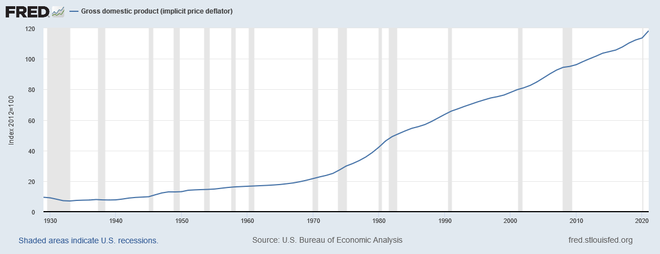
GDP Deflator: USA (Price Level)
Notes:
Downloaded February 1, 2022

Slide 62
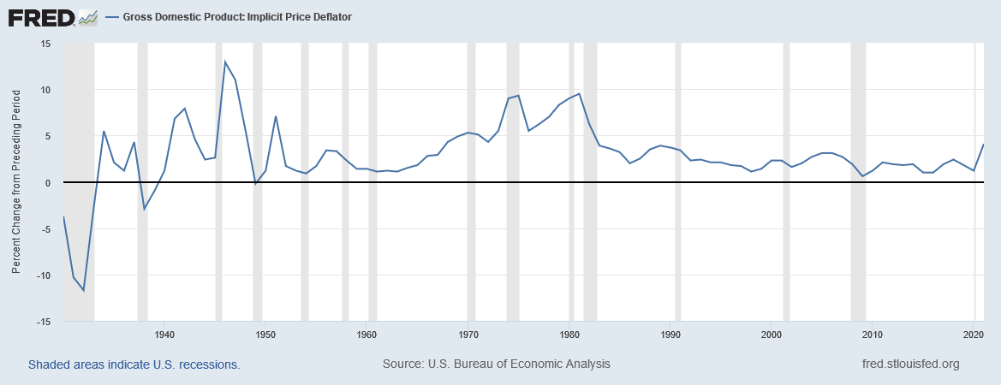
GDP Deflator: USA (Price Inflation)
Notes:
Downloaded February 1, 2022

Slide 63
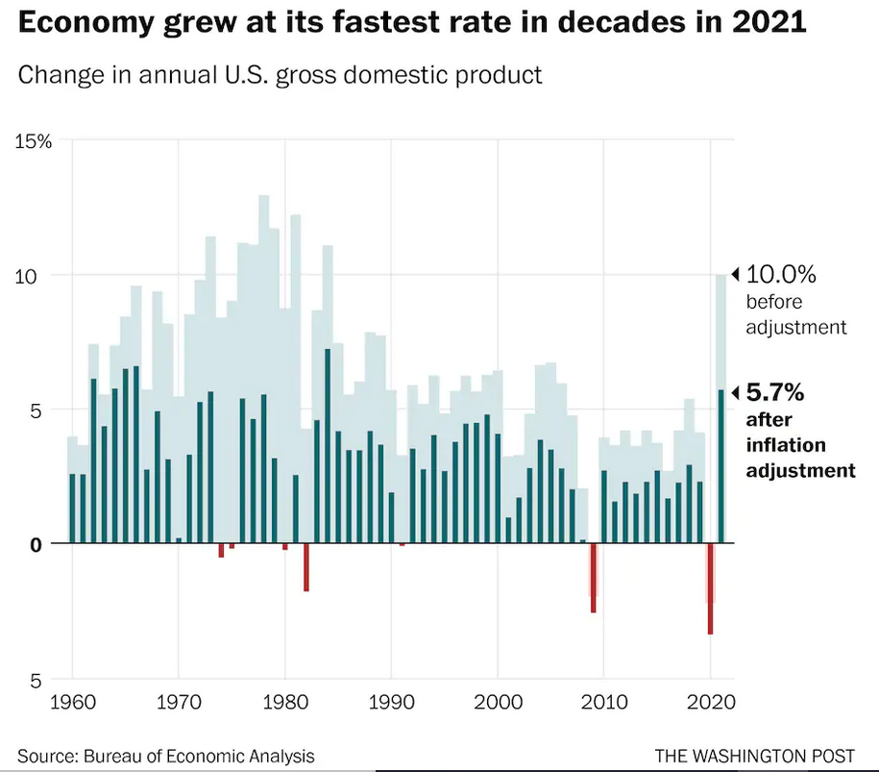
Growth of Nominal and Real GDP, USA, 2021
Notes:
Source: https://www.washingtonpost.com/business/2022/01/27/gdp-2021-q4-economy/

Slide 64
The GDP Deflator
Why call it a deflator?
Nominal GDP changes from one year to the next partly because of inflation
Real GDP, on the other hand, changes because of changes in production alone
The GDP Deflator can convert Nominal GDP to Real GDP by deflating the effect of inflation in Nominal GDP

Slide 65
Converting Nominal GDP to Real GDP
We just saw that ${\text{GDP} \text{Deflator}}_{YYYY}=\frac{{\text{Nominal} \text{GDP}}_{YYYY}}{{\text{Real} \text{GDP}}_{YYYY}}×100$
Therefore, ${\text{Real} \text{GDP}}_{yyyy}=\frac{{\text{Nominal} \text{GDP}}_{yyyy}}{{\text{GDP} \text{Deflator}}_{yyyy}}×100$
Therefore, if you know the Nominal GDP and the GDP Deflator, you can calculate the Real GDP

Slide 66
Cpi and gdp Deflator: comparing the two measures of the overall price level

Slide 67
The GDP Deflator Versus the Consumer Price Index
Economists and policymakers monitor both the GDP deflator and the consumer price index to gauge how quickly prices are rising.
There are, however, two important differences between the indexes

Slide 68
The GDP Deflator Versus the Consumer Price Index
We discussed the GDP deflator in Chapter 5 (Measuring a Nation’s Income)
The GDP deflator is calculated as follows:

Slide 69
Market value of all final goods and services produced in 2019 at 2019 prices
GDP Deflator for 2019 with base year 2012
=
× 100
Market value of all final goods and services produced in 2019 at 2012 prices
$600
=
× 100
$200
=
300

Slide 70
Market value of all final goods and services produced in 2019 at 2019 prices
GDP Deflator for 2019 with base year 2012
=
× 100
Market value of all final goods and services produced in 2019 at 2012 prices
Why are the goods produced in 2019 worth 3 times as much at 2019 prices as at 2012 prices?
It must be that 2019 prices are, on average, 3 times as high as 2012 prices.
$600
=
× 100
$200
This is what the GDP Deflator is saying.
=
300

Slide 71
Market value of all final goods and services produced in 2019 at 2019 prices
GDP Deflator for 2019 with base year 2012
=
× 100
Market value of all final goods and services produced in 2019 at 2012 prices
The GDP Deflator is 300. This indicates that the 2019 prices of domestically produced final goods and services were on average 300 percent of the corresponding prices in 2012, the base year.
$600
=
× 100
$200
=
300

Slide 72
Basic Idea: Compare same basket under two sets of prices
GDP Deflator
CPI
Market value of all final goods and services produced in 2019 at 2019 prices
Market value of the typical consumer’s basket at 2019 prices
GDP Deflator for 2019 with base year 2012
CPI for 2019 with base year 2012
=
× 100
=
× 100
Market value of all final goods and services produced in 2019 at 2012 prices
Market value of the typical consumer’s basket at 2012 prices
The basket is unchanging for each year but changes from one year to the next
The basket is unchanging for each year and is also unchanging from one year to the next
Market value of all final goods and services produced in 2018 at 2018 prices
Market value of the typical consumer’s basket at 2018 prices
GDP Deflator for 2018 with base year 2012
CPI for 2018 with base year 2012
=
× 100
=
× 100
Market value of all final goods and services produced in 2018 at 2012 prices
Market value of the typical consumer’s basket at 2012 prices
The basket includes all final goods and services
The basket includes only consumer goods and services
Market value of all final goods and services produced in 2017 at 2017 prices
Market value of the typical consumer’s basket at 2017 prices
GDP Deflator for 2017 with base year 2012
CPI for 2017 with base year 2012
=
× 100
=
× 100
Market value of all final goods and services produced in 2017 at 2012 prices
Market value of the typical consumer’s basket at 2012 prices

Slide 73
CPI vs. GDP Deflator
Prices of non-consumer goods and services:
included in GDP deflator (if produced domestically)
excluded from CPI
Prices of imported consumer goods and services:
included in CPI
excluded from GDP deflator
The basket of goods and services:
CPI: fixed
GDP deflator: changes every year

Slide 74
The GDP Deflator Versus the Consumer Price Index
The BLS calculates other prices indexes:
The index for different regions within the country.
The producer price index, which measures the cost of a basket of goods and services bought by firms rather than consumers. [BLS]

Slide 75
The GDP Deflator Versus the Consumer Price Index
The GDP deflator reflects the prices of all final goods and services produced domestically, whereas...
…the consumer price index reflects the prices of all final goods and services bought by consumers.

Slide 76
The GDP Deflator Versus the Consumer Price Index
The Consumer Price Index compares the price of a fixed basket of goods and services to the price of the basket in the base year (only occasionally does the BLS change the basket)...
…whereas the GDP deflator compares the price of currently produced goods and services to the price of the same goods and services in the base year.

Slide 77
Quick Check Multiple Choice
If a Pennsylvania raises the price of rifles it sells to the U.S. Army, its price hikes will increase
Both the CPI and the GDP deflator
Neither the CPI nor the GDP deflator
The CPI but not the GDP deflator
The GDP deflator but not the CPI

Slide 78
Quick Check Multiple Choice
If a Pennsylvania raises the price of rifles it sells to the U.S. Army, its price hikes will increase
Both the CPI and the GDP deflator
Neither the CPI nor the GDP deflator
The CPI but not the GDP deflator
The GDP deflator but not the CPI

Slide 79
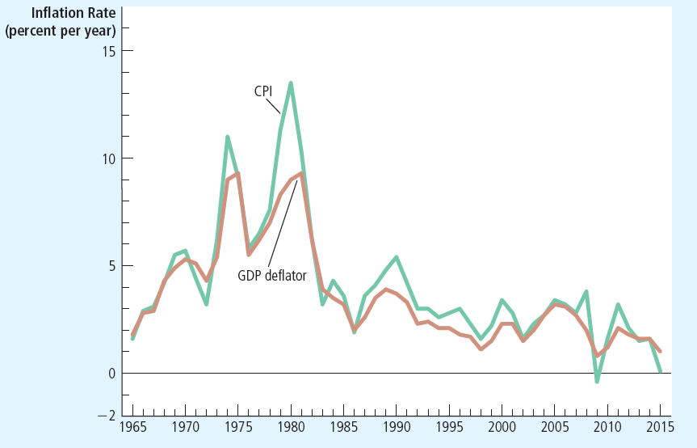
Figure 2: Two Measures of Inflation
This figure shows the inflation rate—the percentage change in the level of prices— as measured by the GDP deflator and the consumer price index using annual data since 1965. Notice that the two measures of inflation generally move together.

Slide 80
Any questions?

Slide 81
Summary
The consumer price index shows the cost of a basket of goods and services relative to the cost of the same basket in the base year.
The index is used to measure the overall level of prices in the economy.
The percentage change in the CPI measures the inflation rate.

Slide 82
Summary
The consumer price index is an imperfect measure of the cost of living for the following three reasons: substitution bias, the introduction of new goods, and unmeasured changes in quality.
Because of measurement problems, the CPI overstates annual inflation by about 1 percentage point.

Slide 83
Summary
The GDP deflator differs from the CPI because it includes goods and services produced rather than goods and services consumed.
In addition, the CPI uses a fixed basket of goods, while the GDP deflator automatically changes the group of goods and services over time as the composition of GDP changes.

Slide 84
Summary
Dollar figures from different points in time do not represent a valid comparison of purchasing power.
Various laws and private contracts use price indexes to correct for the effects of inflation.
The real interest rate equals the nominal interest rate minus the rate of inflation.

