Slide 1
8
SHORT-RUN ECONOMIC FLUCTUATIONS

Slide 2
15
Aggregate Demand and Aggregate Supply
Notes:
This is Chapter 15 in “Brief Principles of Macroeconomics” and Chapter 33 in “Principles of Economics”

Slide 3
Aggregate Demand and Aggregate Supply
This chapter focuses on short-run fluctuations in macroeconomic activity
Chapter 16 (The Influence of Monetary and Fiscal Policy on Aggregate Demand) focuses on these questions:
What, if anything, can the government do to stop GDP from falling and unemployment from rising?
And if the government can’t stop the occurrence of bad times, can it at least make them less damaging in terms of duration and severity?

Slide 4
Aggregate Demand and Aggregate Supply
Economic activity fluctuates from year to year.
Real GDP increases in most years.
On average over the past 50 years, real GDP in the U.S. economy has grown by about 3 percent per year
Real GDP per person has grown at the rate of about 2 percent per year over the past century
In some years normal growth does not occur, causing a recession.

Slide 5
Short-Run Economic Fluctuations
A recession is a period of declining real incomes, and rising unemployment.
A depression is a severe recession.
An expansion is a period of increasing real incomes, and falling unemployment.
A boom is a strong expansion

Slide 6
Three key Facts about economic fluctuations

Slide 7
THREE KEY FACTS ABOUT ECONOMIC FLUCTUATIONS
Economic fluctuations are irregular and unpredictable.
Fluctuations in the economy are often called the business cycle.
Most macroeconomic variables fluctuate together.
As output falls, unemployment rises.

Slide 8
THREE KEY FACTS ABOUT ECONOMIC FLUCTUATIONS: 1: Economic Fluctuations are Irregular and Unpredictable
Recessions start at the peak of a business cycle and end at the trough.
The length of a business cycle may be measured by the time between one peak and the next or the time between one trough and the next.
The peaks and troughs of the US business cycle are officially registered by the NBER.
During 1945-2009, there have been 11 cycles in the US.
The average recession lasted 11 months and the average expansion lasted 59 months, thereby making the average cycle roughly 70 months long.

Slide 9
THREE KEY FACTS ABOUT ECONOMIC FLUCTUATIONS: 1: Economic Fluctuations are Irregular and Unpredictable
See Figure 1 (a), next slide
In the US, there were recessions in 1980 and 1982, just two years apart
On the other hand, there were no recessions between 1991 and 2001

Slide 10
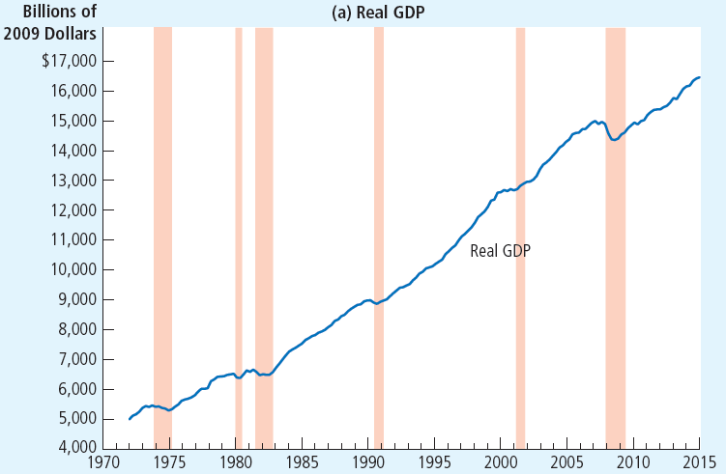
Figure 1 A Look at Short-Run Economic Fluctuations (a)
This figure shows real GDP in panel (a), investment spending in panel (b), and unemployment in panel (c) for the U.S. economy. Recessions are shown as the shaded areas. Notice that real GDP and investment spending decline during recessions, while unemployment rises.

Slide 11
THREE KEY FACTS ABOUT ECONOMIC FLUCTUATIONS: 2: Most Macroeconomic Variables Fluctuate Together
When real GDP falls in a recession, so do many other variables:
personal income, corporate profits, consumption spending, investment spending, industrial production, retail sales, home sales, auto sales, etc.
However, investment fluctuates a lot more than other variables.
Even though investment is about one-seventh of GDP, much of the fall in GDP during recessions is due to the fall in investment spending.
See Figure 1 (b), next slide

Slide 12
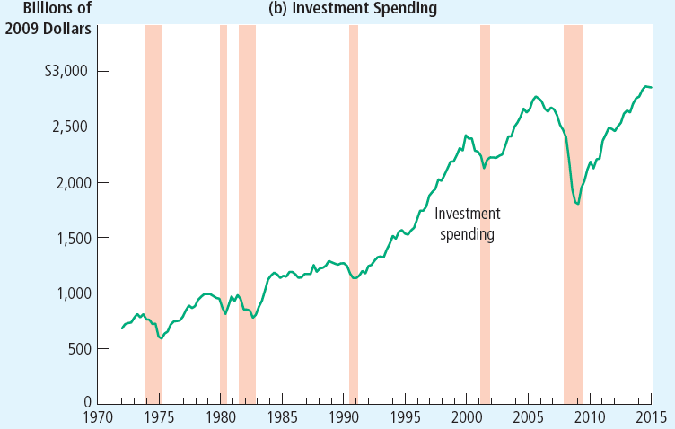
Figure 1 A Look at Short-Run Economic Fluctuations (b)
This figure shows real GDP in panel (a), investment spending in panel (b), and unemployment in panel (c) for the U.S. economy. Recessions are shown as the shaded areas. Notice that real GDP and investment spending decline during recessions, while unemployment rises.

Slide 13
THREE KEY FACTS ABOUT ECONOMIC FLUCTUATIONS: 3: As Output Falls, Unemployment Rises
The unemployment rate never approaches zero; instead it fluctuates around its natural rate, which itself fluctuates between 5 and 6 percent.
See Figure 1 (c), next slide

Slide 14
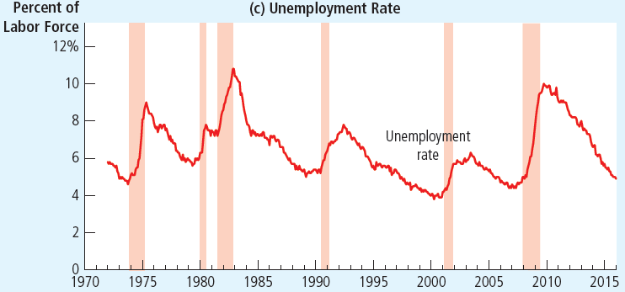
Figure 1A Look at Short-Run Economic Fluctuations (c)
This figure shows real GDP in panel (a), investment spending in panel (b), and unemployment in panel (c) for the U.S. economy. Recessions are shown as the shaded areas. Notice that real GDP and investment spending decline during recessions, while unemployment rises.

Slide 15
Explaining short-run economic fluctuations
This is the theory of Aggregate Demand and Aggregate Supply

Slide 16
Review of long-run macroeconomics
Chapter 7: GDP depends on
number of workers
physical capital per worker
human capital per worker
natural resources per worker
technological knowledge
laws, government policies, and their enforcement
Chapter 8: saving, investment, and the real interest rate depend on the supply and demand for loanable funds
Chapter 10: unemployment depends on
how well the labor market matches unemployed workers to job vacancies, and
how close the wage is to the equilibrium wage
Chapter 12: the price level depends on the quantity of money, and the rate of inflation depends on the growth rate of the quantity of money
The factors that affect the real interest rate (Ch. 8) and the inflation rate (Ch. 12) together determine the nominal interest rate

Slide 17
Explaining short-run economic fluctuations: The Reality of Short-Run Fluctuations
Most economists believe that the long run theory we’ve studied in previous chapters does not explain short run fluctuations
in the long run, changes in the money supply affect nominal variables but not real variables.
This is monetary neutrality; see chapter 12.
But most economists believe that monetary neutrality is not true in the short run
Most economists believe that the central bank’s monetary policy
Has no effect on real variables (especially real GDP and unemployment) in the long run, but
Has significant effects on real variables in the short run

Slide 18
Video
Intro to Business Fluctuations, https://youtu.be/vnUo82ZCo5s , Marginal Revolution University, YouTube, April 11, 2017

Slide 19
Explaining short-run economic fluctuations: The Model of Aggregate Demand and Aggregate Supply
Economists use the model of aggregate demand and aggregate supply to explain short-run fluctuations in economic activity around its long-run trend.

Slide 20
Explaining short-run economic fluctuations: The Model of Aggregate Demand and Aggregate Supply
Aggregate demand and aggregate supply are two ways in which real GDP and the overall price level are linked in the short run.
Real GDP (Y)
see Ch. 5 Measuring a Nation’s Income
Overall Price Level (P)
GDP Deflator
see Ch. 5
Consumer Price Index
see Ch. 6 Measuring the Cost of Living

Slide 21
Figure 2 Aggregate Demand and Aggregate Supply
The aggregate-demand curve shows the market value of “Made in USA” final goods and services that buyers—households, firms, the government, and foreigners—want to buy at each price level.
Price
Level
Aggregate
demand
0
Quantity of
Output

Slide 22
Figure 2 Aggregate Demand and Aggregate Supply
The aggregate-supply curve shows the market value of “Made in USA” final goods and services that sellers want to produce at each price level.
Price
Level
Aggregate
supply
I will later refer to the aggregate supply curve as the short-run aggregate supply curve, to distinguish it from the long-run aggregate supply curve.
Aggregate
demand
0
Quantity of
Output

Slide 23
Figure 2 Aggregate Demand and Aggregate Supply
The intersection of the aggregate-demand curve and the aggregate-supply curve determines the short-run equilibrium values of output (Y) and the price level (P).
Price
Level
Aggregate
supply
Equilibrium
price level
Aggregate
demand
0
Equilibrium
Quantity of
output
Output

Slide 24
Explaining short-run economic fluctuations: The Model of Aggregate Demand and Aggregate Supply
The aggregate-demand curve shows the market value of “Made in USA” final goods and services that buyers—households, firms, the government, and foreigners—want to buy at each price level.
The aggregate-supply curve shows the market value of “Made in USA” final goods and services that sellers want to produce at each price level.

Slide 25
The Aggregate-demand curve
The aggregate-demand curve shows the market value of the domestically-produced final goods and services that buyers—households, firms, the government, and foreigners—want to buy at each price level.

Slide 26
Recap: Chapter 5, GDP = Total Expenditure
We saw earlier that GDP is the actual total expenditure on final goods and services made within a country in a given period of time.
Therefore, GDP = actual consumption spending + actual investment spending + actual government spending + actual exports – actual imports

Slide 27
Aggregate Demand = Desired Total Expenditure
Now, aggregate demand is the desired total expenditure on final goods and services made within a country in a given period of time.
So, aggregate demand = desired total expenditure = desired consumption spending (C) + desired investment spending (I) + desired government spending (G) + desired exports – desired imports (NX)

Slide 28
The Aggregate-demand curve: Why the Aggregate-Demand Curve Slopes Downward
Aggregate Demand = C + I + G + NX
In Ch. 5 we interpreted C, I, G, and NX as the actual amounts of consumption, investment, government purchases, and net exports.
Now, we interpret C, I, G, and NX as the desired amounts of consumption, investment, government purchases, and net exports.

Slide 29
Figure 3 The Aggregate-Demand (AD) Curve is downward sloping
Q: Why is the AD curve downward sloping?
To simplify, if all prices—and I do mean all prices—fall by, say, ten percent, why would the demands for all “Made in USA” goods and services increase?
Price Level
P
P₂
1. A decrease
Aggregate Demand (AD)
in the price
C + I + G + NX
level . . .
0
Y
Y₂
Quantity of
Output
2. . . . increases the quantity of
goods and services demanded.

Slide 30
Bonus slide: Why the microeconomic demand curve can’t explain the macroeconomic AD curve
The demand curve for an individual commodity is downward sloping because of two effects:
Substitution effect: when the price of ice cream decreases and all other prices are unchanged, people buy more ice cream because they switch from eating frozen yogurt (a substitute)
Income effect: when price of ice cream falls and income is unchanged, people feel richer and, so, buy more ice cream
Review Chapter 4 The Market Forces of Supply and Demand
But if all prices decrease, there can be no substitution effect

Slide 31
Bonus slide: Why the microeconomic demand curve can’t explain the macroeconomic AD curve
The demand curve for an individual commodity is downward sloping because of two effects:
Substitution effect: when the price of ice cream decreases and all other prices are unchanged, people buy more ice cream because they switch from eating frozen yogurt (a substitute)
Income effect: when price of ice cream falls and income is unchanged, people feel richer and, so, buy more ice cream
Review Chapter 4 The Market Forces of Supply and Demand
Also if all prices decrease, one can’t assume incomes are unchanged

Slide 32
The Aggregate-demand curve: Why the Aggregate-Demand Curve Slopes Downward
The Wealth Effect: a lower price level boosts consumption spending by households (C)
The Interest-Rate Effect: a lower price level boosts investment spending by businesses (I)
The Exchange-Rate Effect: a lower price level boosts net exports (NX)
As a result, a lower price level boosts aggregate demand (C + I + G + NX)

Slide 33
The Aggregate-demand curve: Why the Aggregate-Demand Curve Slopes Downward: The Price Level and Consumption: The Wealth Effect
If all prices fall (P↓), the purchasing power of consumers’ monetary wealth increases
This causes consumption spending to rise (C↑)
Besides, if the price decline is perceived to be temporary it makes sense to buy now (while prices are still low)
The rise in consumption spending (C↑) raises aggregate demand (C + I + G + NX ↑)

Slide 34
Bonus slide: Wealth Effect Controversy
P↓ causes the real burden of the monetary debts of debtors↑
This causes debtors’ consumption ↓
Therefore, if the decrease in debtors’ consumption exceeds the increase in the consumption of others, it is possible that C↓
Therefore, P↓ could cause aggregate demand (C+I+G+NX) ↓
For this reason, the economist Paul Krugman has argued that the AD curve may be upward rising!

Slide 35
The Aggregate-demand curve: Why the Aggregate-Demand Curve Slopes Downward: The Price Level and Investment: The Interest-Rate Effect
When all prices fall, people need less cash for shopping needs.
They lend the unneeded cash.
The increased availability of loans reduces the interest rate.
See Ch. 16 for more on this.
A lower interest rate encourages greater investment spending by businesses (I↑)
The rise in investment spending (I↑) raises aggregate demand (C + I + G + NX↑)

Slide 36
The Aggregate-demand curve: Why the Aggregate-Demand Curve Slopes Downward: The Price Level and Net Exports: The Exchange-Rate Effect
We saw in the previous slide that lower prices lead to a lower interest rate
Disappointed by the lower interest rate, people with money in US banks look for ways to move their money to foreign banks
These people sell their dollars and buy foreign currencies
The value of the dollar falls (say, from €2 per $ to €1 per $)
As a result, US goods become cheaper relative to foreign goods.
This makes U.S. net exports increase (NX↑)
NX↑ means aggregate demand increases (C + I + G + NX↑)

Slide 37
Shifts in the Aggregate Demand Curve
We have seen why the AD curve is negatively sloped. We know that aggregate demand (C + I + G + NX) increases (say, from Y₁ to Y₂) when the price level decreases (say, from P₁ to P₂).
Price
Level
P₁
P₂
Aggregate
demand, D₁
0
Y₁
Y₂
Quantity of
Output

Slide 38
Shifts in the Aggregate Demand Curve
But what are the reasons why the AD curve might shift? In other words, what are the reasons why aggregate demand might increase from Y₁ to Y₂ even if the price level stays unchanged at P₁?
Expansionary fiscal policy:
1. increase in government spending (G↑)
2. a decrease in taxes leads to higher consumption spending (C↑)
Either way, aggregate demand increases (C + I + G + NX↑) even though the price level is unchanged.
Price
Level
P₁
P₂
D₂
Aggregate
demand, D₁
0
Y₂
Y₁
Y₂
Quantity of
Output

Slide 39
Shifts in the Aggregate Demand Curve
But what are the reasons why the AD curve might shift? In other words, what are the reasons why aggregate demand might increase from Y₁ to Y₂ even if the price level stays unchanged at P₁?
Expansionary monetary policy:
The central bank increases the money supply. This reduces the interest rate. Lower interest rate leads to higher investment spending (I↑).
So, aggregate demand increases (C + I + G + NX↑) even though the price level is unchanged.
Price
Level
P₁
P₂
D₂
Aggregate
demand, D₁
0
Y₂
Y₁
Y₂
Quantity of
Output

Slide 40
Shifts in the Aggregate Demand Curve
But what are the reasons why the AD curve might shift? In other words, what are the reasons why aggregate demand might increase from Y₁ to Y₂ even if the price level stays unchanged at P₁?
Shocks:
C↑: asset prices rise, optimism
I↑: technological progress, optimism
NX↑: foreign GDP rises, speculative currency trading reduces the exchange value of domestic currency
In these cases, aggregate demand increases (C + I + G + NX ↑) even though the price level is unchanged.
Price
Level
P₁
P₂
D₂
Aggregate
demand, D₁
0
Y₂
Y₁
Y₂
Quantity of
Output

Slide 41
The Aggregate-demand curve: Why the Aggregate-Demand Curve Might Shift
Shifts arising from
Consumption: consumer optimism, tax rates, prices of assets (stocks, bonds, real estate)
Investment: technological progress, business confidence, tax rates, money supply
Government Purchases
Net Exports: foreign GDP, expectations about exchange rates
P
Y

Slide 42
Table 1 The aggregate-demand curve: summary (a)
Why Does the Aggregate-Demand Curve Slope Downward?
1. The Wealth Effect: A lower price level increases real wealth, which stimulates spending on consumption.
2. The Interest-Rate Effect: A lower price level reduces the interest rate, which stimulates spending on investment.
3. The Exchange-Rate Effect: A lower price level causes the real exchange rate to depreciate, which stimulates spending on net exports

Slide 43
Table 1 The aggregate-demand curve: summary (b)
Why Might the Aggregate-Demand Curve Shift?
1. Shifts Arising from Consumption: An event that makes consumers spend more at a given price level (a tax cut, a stock-market boom) shifts the aggregate-demand curve to the right. An event that makes consumers spend less at a given price level (a tax hike, a stock-market decline) shifts the aggregate-demand curve to the left.
2. Shifts Arising from Investment: An event that makes firms invest more at a given price level (optimism about the future, a fall in interest rates due to an increase in the money supply) shifts the aggregate-demand curve to the right. An event that makes firms invest less at a given price level (pessimism about the future, a rise in interest rates due to a decrease in the money supply) shifts the aggregate-demand curve to the left.
3. Shifts Arising from Government Purchases: An increase in government purchases of goods and services (greater spending on defense or highway construction) shifts the aggregate-demand curve to the right. A decrease in government purchases on goods and services (a cutback in defense or highway spending) shifts the aggregate-demand curve to the left.
4. Shifts Arising from Net Exports: An event that raises spending on net exports at a given price level (a boom overseas, speculation that causes an exchange-rate depreciation) shifts the aggregate-demand curve to the right. An event that reduces spending on net exports at a given price level (a recession overseas, speculation that causes an exchange-rate appreciation) shifts the aggregate-demand curve to the left
.

Slide 44
Video
The Aggregate Demand Curve, https://youtu.be/jL94Fdcdv1Y, Marginal Revolution University, YouTube, April 18, 2017
This treatment has the growth rate of real GDP on the horizontal axis and the growth rate of the price level (that is, inflation) on the vertical axis.

Slide 45
The Aggregate-supply curve(S)
Here, I discuss long-run and short-run aggregate supply curves. The aggregate-supply curves show the market value of final goods and services that domestic sellers would like to produce and sell at each price level.

Slide 46
THE AGGREGATE-SUPPLY CURVE
The upward-sloping aggregate supply curve that we saw earlier is more precisely called the short-run aggregate-supply (SRAS) curve
The long-run aggregate-supply (LRAS) curve, on the other hand, is vertical

Slide 47
Figure 4 The Long-Run Aggregate-Supply Curve
Price
Level
Long-run
aggregate
supply
The natural rate of output is also called long-run output or potential output or full-employment output.
P
P₂
2. . . . does not affect
1. A change
the quantity of goods
in the price
and services supplied
level . . .
in the long run.
0
Natural rate
Quantity of
of output (Y_{N})
Output

Slide 48
Long-Run Aggregate Supply
In the long run, the price level increases when the quantity of money increases (see Ch. 12).
When the price level increases, it helps to assume, for simplicity, that all prices rise by the same proportion.
Assumption: a producer’s incentives are not affected one way or the other when all prices rise by the same proportion.
Consequently, in the long run, aggregate supply should not change when the price level increases.
P
LRAS
True also when “increase” is replaced by “decrease” everywhere.
Y

Slide 49
The Aggregate-SUPPLY curve: Why the Aggregate-Supply Curve Is Vertical in the Long Run
An economy’s long-run output of goods and services
is also called the natural rate of output or potential output or full-employment output
See Chapter 7
Long-run output depends on:
labor
physical capital
human capital
natural resources
Technology
Laws, government policies, and their enforcement
The price level does not affect these variables in the long run.
P
LRAS
Y

Slide 50
The Aggregate-SUPPLY curve: Why the Long-Run Aggregate-Supply Curve Might Shift
Any change in the economy that increases the natural rate of output will shift the long-run aggregate-supply curve to the right.
Labor: population growth, immigration, lower natural rate of unemployment
Capital, physical or human
Natural Resources: cheaper imported oil
Technology
Laws, government policies
Recall Chapter 7 (Production and Growth)
P
LRAS₁
LRAS₂
Y_{N1}
Y_{N2}
Y

Slide 51
Video
The Long-Run Aggregate Supply Curve, https://youtu.be/xqPpjR5X0ZY, Marginal Revolution University, YouTube, April 25, 2017
This LRAS has the growth rate of real GDP on the horizontal axis and the growth rate of the price level (inflation) on the vertical axis

Slide 52
The Aggregate-SUPPLY curve: Why the Aggregate-Supply Curve Slopes Upward in the Short Run
Assumption: In the short run, an increase in the overall level of prices (P) increases the market value of all final goods and services that sellers want to sell (Y).
Conversely, a decrease in the overall level of prices decreases the market value of all final goods and services that sellers want to sell.
Consequently, SRAS is a rising curve
Why? What could justify this assumption?
SRAS
P
140
120
50
75
Y

Slide 53
The Aggregate-SUPPLY curve: Why the Aggregate-Supply Curve Slopes Upward in the Short Run
In the short run, why would producers want to produce more if the prices of all final goods and services increase by 3 percent?
I’m simplifying by assuming that, if the overall price level increases by, say, 3 percent, then all prices increase by 3 percent
Conversely, why would producers want to produce less if all prices decrease by 3 percent?
That is, why would the SRAS curve be upward sloping?

Slide 54
Aggregate Supply: Long Run v. Short Run
Recall that in long-run macroeconomics it is assumed that if the prices of all final goods and services change by the same proportion then businesses will not change their behavior
That’s why the LRAS curve is vertical
Why does short-run macroeconomics assume that producers want to increase production if the prices of all final goods and services increase by 3 percent?
The textbook discusses three reasons: sticky wages, sticky prices, and misperceptions
I’ll discuss only the sticky wages theory

Slide 55
Figure 6 The Short-Run Aggregate-Supply Curve
Price
Level
Short-Run Aggregate-Supply
P
P₂
1. A decrease
2. . . . reduces the quantity
3. But why? One answer is the sticky wages theory.
in the price
of goods and services
level . . .
supplied in the short run.
0
Y₂
Y
Quantity of
Output

Slide 56
Sticky Wages → Upward Sloping SRAS Curve
Assume the hiring for 2021 jobs is done in 2020.
All workers are aware of the conditions of a job
Conditions of a job
(2020 job market)
1. The job is for 2021.
2. We all think that in 2021 the price level will be 135. (In symbols, P^{e} = 135.) If the actual price level in 2021 turns out to be equal to what we now expect (P = P^{e} = 135) then you will be employed full-time (8 hours a day, 5 days a week).
3. If the actual price level in 2021 turns out to be more than what we now expect (P > P^{e} = 135) then you will work extra hours: 10 hours a day, 5 days a week.
4. If the actual price level in 2021 turns out to be less than what we now expect (P < P^{e} = 135) then you will fewer hours: 6 hours a day, 5 days a week.
5. The wage at which you are hired in 2020 cannot be renegotiated in 2021.

Slide 57
Sticky Wages → Upward Sloping SRAS Curve
Assume the hiring for 2021 jobs is done in 2020.
Assume all workers and all businesses expect that in 2021 the price level will be, say, 135. (In symbols, P^{e} = 135.)
During all the hiring in 2020, it is understood by all workers who get jobs for 2021 that:
if the actual price level in 2021 turns out to be equal to the expected price (P = P^{e} = 135) then they will be employed full-time at the equilibrium wage that was determined by supply and demand in the labor market for 2021 jobs that took place in 2020.

Slide 58
Sticky Wages → Upward Sloping SRAS Curve
If the actual price level in 2021 turns out to be more than the expected price (P > P^{e} = 135) then they may have to work more than full-time at the equilibrium wage that was determined by supply and demand in the labor market for 2021 jobs that took place in 2020.
If the actual price level in 2021 turns out to be less than the expected price (P < P^{e} = 135) then they may have to work less than full-time at the equilibrium wage that was determined by supply and demand in the labor market for 2021 jobs that took place in 2020; they may even lose their jobs.
Also, once the 2021 wage is decided in 2020 it cannot be re-negotiated in 2021.

Slide 59
Sticky Wages → Upward Sloping SRAS Curve
Based on this understanding of what a job entails:
workers form a labor supply curve, and
businesses form a labor demand curve
The wage is determined by supply and demand in the usual manner.
That is, the wage will be the equilibrium wage that makes the quantity of labor demanded equal to the quantity of labor supplied.
Wage
Supply
$15/hour
Equilibrium
Demand
10,000
Labor

Slide 60
Sticky Wages → Upward Sloping SRAS Curve
Suppose this equilibrium wage is $15 an hour.
Suppose further that, in this equilibrium, the quantity of labor supplied is 10,000 workers, as is the quantity of labor demanded.
Wage
Supply
$15/hour
Equilibrium
Demand
10,000
Labor

Slide 61
Sticky Wages → Upward Sloping SRAS Curve
When 2021 comes along, if P = P^{e} = 135, as was expected, then all 10,000 workers would have full-time jobs at $15 per hour as was promised in 2020.
This would be a full-employment outcome and the resulting output will be the full-employment output (Y = Y_{N}).
Wage
Supply
$15/hour
Equilibrium
Demand
10,000
Labor

Slide 62
Sticky Wages → Upward Sloping SRAS Curve
If, in 2021, it turns out that P > P^{e} = 135, it would be a pleasant surprise for businesses
… and an unpleasant surprise for workers because the $15 per hour wage can no longer be re-negotiated.
Production will be more profitable for businesses than they had expected back in 2020.
They will require workers to work extra hours at $15 per hour.
The resulting output will exceed the full-employment output (Y > Y_{N}).

Slide 63
Sticky Wages → Upward Sloping SRAS Curve
Conversely, if, in 2021, P < P^{e} = 135, production will be less profitable for businesses than they had expected back in 2020.
They will reduce workers' hours and may even let some workers go.
The resulting output will be less than the full-employment output (Y < Y_{N}).

Slide 64
Sticky Wages → Upward Sloping SRAS Curve
To summarize:
at P = P^{e} = 135 we have Y = Y_{N},
at P > 135 we have Y > Y_{N}, and
at P < 135 we have Y < Y_{N}.
Thus we see that the short-run aggregate supply curve is upward-sloping (SRAS₁).
SRAS₁
P
P^{e} = 135
Y_{N}
Y

Slide 65
How price expectations affect the SRAS curve
Now, how would the SRAS curve look like if, back in 2020, all workers and all businesses had expected that the price level in 2021 would be only 105 instead of 135?
(That is, what if P^{e} = 105?)
SRAS₁
P
P^{e} = 135
105
Y_{N}
Y

Slide 66
How price expectations affect the SRAS curve
Conditions of a job
(2020 job market)
1. The job is for 2021.
2. We all think that in 2021 the price level will be 105. (In symbols, P^{e} = 105.) If the actual price level in 2021 turns out to be equal to what we now expect (P = P^{e} = 105) then you will be employed full-time (8 hours a day, 5 days a week).
3. If the actual price level in 2021 turns out to be more than what we now expect (P > P^{e} = 105) then you will work extra hours: 10 hours a day, 5 days a week.
4. If the actual price level in 2021 turns out to be less than what we now expect (P < P^{e} = 105) then you will fewer hours: 6 hours a day, 5 days a week.
5. The wage at which you are hired in 2020 cannot be renegotiated in 2021.
Wage
Supply
$15/hour
$12/hour
Equilibrium
Demand
10,000
Labor

Slide 67
How price expectations affect the SRAS curve
By applying the same reasoning we used earlier, we can say that
at P = P^{e} = 105 we have Y = Y_{N},
at P > 105 we have Y > Y_{N}, and
at P < 105 we have Y < Y_{N}.
This is shown as the upward-sloping SRAS curve (SRAS₂).
SRAS₁
P
SRAS₂
165
135
P^{e} = 105
Y_{N}
Y
Thus, we see that when the expected price level decreases by some amount, the SRAS curve shifts downwards by the same amount.

Slide 68
How long-run output affects the SRAS curve
Finally, let us return to the assumption that P^{e} = 135 and consider two different values of the full-employment output.
If Y_{N} = $1 million, we can say that
at P = P^{e} = 135 it must be that Y = Y_{N} = $1 million,
at P > 135 it must be that Y > $1 million, and
at P < 135 it must be that Y < $1 million.
This is the upward-sloping SRAS curve (SRAS₁) we saw earlier.
SRAS₁
P
P^{e} = 135
Y_{N} = $1m
Y

Slide 69
How long-run output affects the SRAS
On the other hand:
If Y_{N} = $2 million, we can say that
at P = P^{e} = 135 it must be that Y = Y_{N} = $2 million,
at P > 135 it must be that Y > $2 million, and
at P < 135 it must be that Y < $2 million.
This is shown as SRAS₃.
SRAS₁
P
SRAS₃
P^{e} = 135
Y_{N} = $2m
Y
Thus, we see that if the full-employment output increases by some amount, the SRAS curve shifts rightward by the same amount.

Slide 70
The Aggregate-SUPPLY curve: Why the Aggregate-Supply Curve Slopes Upward in the Short Run: The Sticky-Wage Theory
Sticky Wages, https://youtu.be/IbiPQI0wMAk, Marginal Revolution University, YouTube, May 2, 2017

Slide 71
The Aggregate-SUPPLY curve: Why the Aggregate-Supply Curve Slopes Upward in the Short Run
In addition to the Sticky-Wage Theory, the textbook considers two other theories why the SRAS curve is upward sloping
The Sticky-Price Theory (skip)
The Misperceptions Theory (skip)
These are three different arguments, but they all reach the same conclusion:
$\text{Short} \text{Run} \text{Output}=\text{Long} \text{Run} \text{Output}+a×\left(\text{Price} \text{Level}−\text{Expeted} \text{Price} \text{Level}\right)$
Y = Y_{N} + a ✕ (P – P^{e})

Slide 72
Short-Run Aggregate Supply (SRAS)
$\text{Short} \text{Run} \text{Output}=\text{Long} \text{Run} \text{Output}+\text{Fluctuation}$
Output
Long-Run Output (Y_{N})
Short-Run Output (Y)
Fluctuation < 0
Long-Run Output (Y_{N})
Short-Run Output (Y)
2008 recession
Time

Slide 73
Short-Run Aggregate Supply (SRAS)
$\text{Short} \text{Run} \text{Output}=\text{Long} \text{Run} \text{Output}+\text{Fluctuation}$
Output
Long-Run Output (Y_{N})
Fluctuation > 0
Short-Run Output (Y)
Short-Run Output (Y)
Long-Run Output (Y_{N})
2004 expansion
Time

Slide 74
Short-Run Aggregate Supply (SRAS)
$\text{Short} \text{Run} \text{Output}=\text{Long} \text{Run} \text{Output}+\text{Fluctuation}$
The Fluctuation depends on how much the price level at a given moment (P) exceeds what people in the past had thought the price level would be at that moment (P^{e})
$\text{Fluctuation}=a×\left(\text{Price} \text{Level}−\text{Expe}\text{c}\text{ted} \text{Price} \text{Level}\right)$
So, the short-run aggregate supply depends on how pleasant a surprise the sellers get
The higher the actual price level relative to the price level that had been expected, the higher the aggregate supply

Slide 75
Short-Run Aggregate Supply (SRAS)
$\text{Short} \text{Run} \text{Output}=\text{Long} \text{Run} \text{Output}+\text{Fluctuation}$
$\text{Fluctuation}=a×\left(\text{Price} \text{Level}−\text{Expeted} \text{Price} \text{Level}\right)$
Output
Long-Run Output (Y_{N})
Short-Run Output (Y)
Fluctuation < 0 a × (P – P^{e}) < 0 Recession
2008 recession
Time

Slide 76
Short-Run Aggregate Supply (SRAS)
$\text{Short} \text{Run} \text{Output}=\text{Long} \text{Run} \text{Output}+\text{Fluctuation}$
$\text{Fluctuation}=a×\left(\text{Price} \text{Level}−\text{Expeted} \text{Price} \text{Level}\right)$
Output
Long-Run Output (Y_{N})
Fluctuation > 0 a × (P – P^{e}) > 0 Expansion
Short-Run Output (Y)
2004 expansion
Time

Slide 77
Table 2: The Short-Run Aggregate-Supply Curve: Summary
Skip

Slide 78
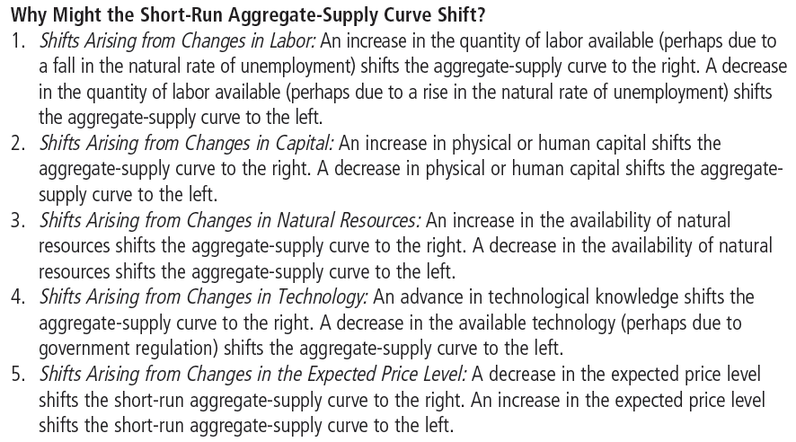
Table 2: The Short-Run Aggregate-Supply Curve: Summary
Natural Output Y_{N}
Expected Price P^{e}

Slide 79
Video
The Short-Run Aggregate Supply Curve, https://youtu.be/8oQxzHgceBA, Marginal Revolution University, YouTube, May 9, 2017
In this treatment, the SRAS has the growth rate of real GDP on the horizontal axis and the growth rate of the price level (inflation) on the vertical axis

Slide 80
Two causes of economic fluctuations
Now we focus on (a) long-run equilibrium, (b) short-run equilibrium after a disturbance throws the economy off the long-run equilibrium, and (c) the readjustment to a new long-run equilibrium after the disturbance

Slide 81
Figure 7 The Long-Run Equilibrium
The short-run equilibrium is at the intersection of the SRAS and AD curves.
The long-run equilibrium is at the intersection of the LRAS and AD curves.
If the economy is at A, it is both a short-run equilibrium and a long-run equilibrium.
Price
Level
Long-run
aggregate
supply
Short-run
aggregate
supply
Equilibrium
A
price
Aggregate
demand
0
Natural rate
Quantity of
of output
Output

Slide 82
Demand-driven recessions and expansions
Price
Level
Long-run aggregate supply LRAS
Outcome B shows a recession, with short-run output below the natural rate of output. It is a short-run equilibrium but not a long-run equilibrium. Outcome C shows a expansion, with short-run output above the natural rate of output. Like B, it is a short-run equilibrium but not a long-run equilibrium. Outcome A is both short-run and long-run equilibrium.
Short-run Aggregate Supply SRAS
C
expansion
Long-run Equilibrium Price
full employment
A
recession
B
AD₃
Aggregate Demand, AD₁
AD₂
0
Natural rate
Quantity of Output
of output

Slide 83
Supply-driven recessions and expansions
Price
Outcome B shows a recession, with short-run output below the natural rate of output. It is a short-run equilibrium but not a long-run equilibrium. Outcome C shows a expansion, with short-run output above the natural rate of output. Like B, it is a short-run equilibrium but not a long-run equilibrium. Outcome A is both short-run and long-run equilibrium.
Level
Long-run Aggregate Supply
Short-run
AS₂
aggregate
supply,
AS₁
AS₃
recession
B
Long-run Equilibrium Price
A
Full employment
C
expansion
Aggregate demand
0
Natural rate
Quantity of Output
of output

Slide 84
Economic fluctuations caused by fluctuations in aggregate demand

Slide 85
Figure 8 A Contraction in Aggregate Demand (Temporary)
2. . . . causes output to fall in the short run . . .
The contraction in aggregate demand causes a recession, with output falling to Y₂.
If the contraction in AD is temporary, the AD curve will soon go back to AD₁, the recession will be over, and the economy will be back to the original long-run equilibrium at A. (A → B → A)
But what if the contraction in AD is permanent?
Price
Level
Long-run
Short-run Aggregate Supply SRAS
aggregate
supply
P
A
P₂
B
1. A decrease in
P₃
C
aggregate demand . . .
Aggregate Demand
AD₁
AD₂
0
Y₂
Y
Quantity of
Output

Slide 86
Figure 8 A Contraction in Aggregate Demand (Permanent)
2. . . . causes output to fall in the short run . . .
Assuming the contraction from AD₁ to AD₂ is permanent, we consider two possibilities:
The government does not intervene
The government uses expansionary fiscal policies and expansionary monetary policies to push the aggregate demand curve back to AD₁.
Price
Level
Long-run
Short-run aggregate
aggregate
supply,
AS
supply
P
A
P₂
B
1. A decrease in
P₃
C
aggregate demand . . .
Aggregate
demand,
AD
AD₂
0
Y₂
Y
Quantity of
Output

Slide 87
A Permanent Contraction in Aggregate Demand, No Government Intervention
If the shock to AD is permanent, the economy will stay at B for a while and the recession will show no signs of ending.
But eventually the economy will begin to heal itself.
The continued high unemployment will cause (i) wages to fall. So, people will (ii) expect the price level to fall (P^{e}↓).
We saw earlier that P^{e}↓ causes (iii) AS to fall, say, to AS₂. The new short run equilibrium will be at B* and output will begin to recover.
At B*, the recession will continue, causing steps (i), (ii) and (iii) to repeat … until the economy reaches a new long-run equilibrium at C and the recession ends.
2. . . . causes output to fall in the short run . . .
Price
Level
Long-run
Short-run aggregate supply, AS₁
aggregate
supply
AS₂
AS₃
P
A
P₂
B
B*
1. A decrease in
P₃
C
aggregate demand . . .
Aggregate
demand,
AD
AD₂
0
Y₂
Y
Quantity of
Output

Slide 88
A Permanent Contraction in Aggregate Demand, No Government Intervention
2. . . . causes output to fall in the short run . . .
So, when there is a fall in aggregate demand, the economy goes from A to B in the short run, and from A to B to C in the long run.
Price
Level
Long-run
Short-run aggregate
aggregate
supply,
AS
supply
AS₂
3. . . . but over
time, the short-run
P
A
aggregate-supply
curve shifts . . .
P₂
B
1. A decrease in
P₃
C
aggregate demand . . .
Aggregate
demand,
AD
AD₂
0
Y₂
Y
Quantity of
5. The government could also use expansionary monetary/fiscal policies to push AD back to AD₁.
4. . . . and output returns
Output
to its natural rate.

Slide 89
Two causes of economic fluctuations: The Effects of a Shift in Aggregate Demand
Contraction (leftward shift) in Aggregate Demand
In the short run,
output decreases,
the overall price level decreases, and
the unemployment rate increases
In the long run,
the overall price level decreases,
but output and the unemployment rate remain unchanged at their long-run levels.
The economy heals itself. But it is unclear how long this might take.

Slide 90
Two causes of economic fluctuations: The Effects of a Shift in Aggregate Demand
If production and employment take too long to return to their long-run levels, the government could step in to hasten the process
The government could push the aggregate demand curve back where it was by:
increasing the money supply (expansionary monetary policy)
Cutting taxes or increasing government spending (expansionary fiscal policy)

Slide 91
Government Intervention Can Reverse a Contraction in Aggregate Demand
Price
Level
Long-run
Short-run aggregate
As we saw in our discussion of the shifts of the AD curve, government intervention in the form of expansionary fiscal policy and expansionary monetary policy can shift the aggregate demand curve back to AD₁.
This would end the recession.
A → B → A.
aggregate
supply,
AS
supply
P
A
P₂
B
Aggregate
demand,
AD
AD₂
0
Y₂
Y
Quantity of
Output

Slide 92
Case study: History of demand-driven fluctuations
Great Depression, WWII Boom, Great Recession of 2008

Slide 93
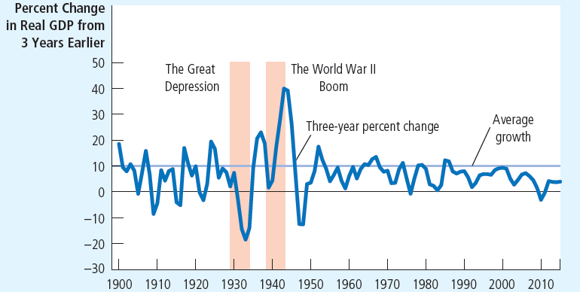
Figure 9 U.S. real GDP growth since 1900
Over the course of U.S. economic history, two fluctuations stand out as especially large. During the early 1930s, the economy went through the Great Depression, when the production of goods and services plummeted. During the early 1940s, the United States entered World War II, and the economy experienced rapidly rising production. Both of these events are usually explained by large shifts in aggregate demand.

Slide 94
Case Study: Two big shifts in aggregate demand: Great Depression and World War II
The Great Depression of the early 1930s was by far the worst economic downturn in US history
From 1929 to 1933
Real GDP fell by 27%
Unemployment rose from 3 to 25%
Price level fell by 22%

Slide 95
Case Study: Two big shifts in aggregate demand: Great Depression and World War II
Cause of the Great Depression: most historians blame a decrease in aggregate demand
Cause of the decrease in aggregate demand: most historians blame the 28% fall in the money supply
People lost faith in the banking system and began to withdraw their money. Banks did not have the money to lend to businesses. Starved of loans, businesses shut down. Other businesses had to abandon expansion plans.
The Fed could have printed money and loaned it to the banks, but that did not happen

Slide 96
Case Study: Two big shifts in aggregate demand: Great Depression and World War II
Cause of the Great Depression: most historians blame a decrease in aggregate demand
Another suggested cause of the fall in aggregate demand during the Great Depression:
Stock market crash → decrease in household wealth → decrease in consumption spending

Slide 97
Case Study: Two big shifts in aggregate demand: Great Depression and World War II
Early 1940s: large increase in real GDP
World War II
More resources to the military
Government purchases increased fivefold 1939 - 1944
Aggregate demand – increased 1939 - 1944
Doubled the economy’s production of goods and services
20% increase in the price level
Unemployment fell from 17% to 1%, lowest in US history

Slide 98
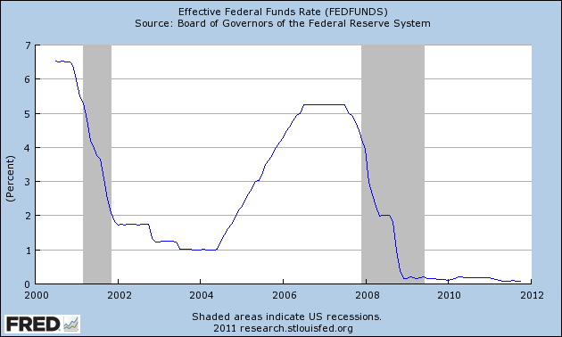
Case Study: The Great Recession of 2008-09
The crisis of 2008 may have been caused by the Fed’s overreaction to the recession of 2001
The Fed cut interest rates sharply kept them low for too long

Slide 99
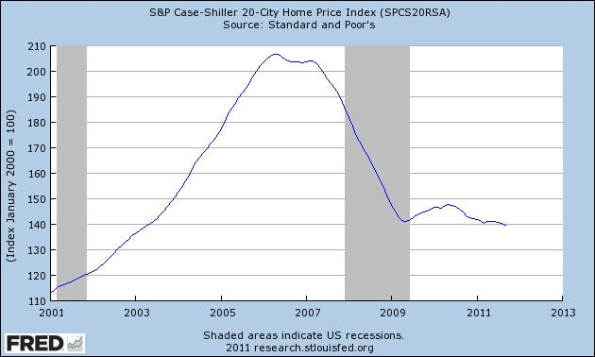
Case Study: The Great Recession of 2008-09
Those low interest rates may have fueled a ‘bubble’ in home prices

Slide 100
Case Study: The Great Recession of 2008-09
Developments in the mortgage market
Easier for subprime borrowers to get loans
Borrowers with a higher risk of default (income and credit history)
Securitization
Process by which a financial institution (mortgage originator) makes loan
Then (investment bank) bundles them together mortgage-backed securities

Slide 101
Case Study: The Great Recession of 2008-09
Developments in the mortgage market
Mortgage-backed securities
Sold to other institutions, which may not have fully appreciated the risks in these securities
Other issues
Inadequate regulation for these high-risk loans
Misguided government policy
Encouraged this high-risk lending

Slide 102
Case Study: The Great Recession of 2008-09
1995-2006
Increase in housing demand
Increase in housing prices
More than doubled
2006-2009, housing prices fell 30%
Substantial rise in mortgage defaults and home foreclosures
Financial institutions that owned mortgage-backed securities
Huge losses, stopped making loans

Slide 103
Case Study: The Great Recession of 2008-09
Large contractionary shift in AD
Real GDP fell sharply
By 4.2% between the forth quarter of 2007 and the second quarter of 2009
Employment fell sharply
Unemployment rate rose from 4.4% in May 2007 to 10.0% in October 2009

Slide 104
Case Study: The Great Recession of 2008-09
Three policy actions - aimed in part at returning AD to its previous level
The Fed
Cut its target for the federal funds rate
From 5.25% in September 2007 to about zero in December 2008
Started buying mortgage-backed securities and other private loans
In open-market operations
Provided banks with additional funds

Slide 105
Case Study: The Great Recession of 2008-09
Three policy actions
October 2008, Wall Street bailout $700 billion
For the Treasury to use to rescue the financial system
To stem the financial crisis on Wall Street
To make loans easier to obtain
Equity injections into banks
U.S. government – temporarily became a part owner of these banks

Slide 106
Case Study: The Great Recession of 2008-09
Three policy actions
January 2009, President Barack Obama
$787 billion stimulus bill, February 17, 2009
To be spent over two years
Economy
Recovery officially began June 2009
But slow: average annual growth was 2.1% during 2009Q2 – 2015Q4
Unemployment fell to 5.0% by end of 2015, but employment-population ratio was unchanged

Slide 107
Video
The Great Recession, https://youtu.be/dI6HNi5I8d4, Marginal Revolution University, YouTube, August 9, 2016

Slide 108
Economic fluctuations caused by fluctuations in aggregate supply

Slide 109
Two causes of economic fluctuations: The Effects of a Shift in Aggregate Supply
A leftward shift in Short-Run Aggregate Supply
Output falls below the natural rate of employment
Unemployment rises
The price level rises
If the government does nothing, the SRAS will gradually shift back to where it was.
The price level, total production and unemployment will be unaffected in the long run.
Stagflation!

Slide 110
Figure 10 An Adverse Shift in Aggregate Supply
1. An adverse shift in the short-
run aggregate-supply curve . . .
Price
Level
Long-run Aggregate Supply
Short-run
AS₂
aggregate
Stagflation!
supply,
AS
recession
B
P₂
A
P
Full employment
3. . . . and
the price
level to rise.
Aggregate demand
0
Y₂
Y
Quantity of Output
2. . . . causes output to fall . . .

Slide 111
Two causes of economic fluctuations: The Effects of a Shift in Aggregate Supply
Leftward shifts in aggregate supply cause stagflation—a period of recession and inflation.
Output falls and prices rise.
Policymakers can influence aggregate demand, but they cannot reverse both the fall in output and the rise in prices simultaneously.

Slide 112
Two causes of economic fluctuations: The Effects of a Shift in Aggregate Supply
Policy Responses to Supply-Shock Recession
Policymakers may respond to a recession in one of the following ways:
Do nothing and wait for the economy to heal itself through the automatic adjustment of prices and wages.
Take action to increase aggregate demand by using (expansionary) monetary and fiscal policy.

Slide 113
Policy Response to an Adverse Shift in Aggregate Supply: Do Nothing
1. An adverse shift in the short-
The economy starts at A. It is the intersection of the AD, SRAS, and LRAS curves; so it is a long-run equilibrium.
When SRAS shifts left, the economy moves from A to B in the short-run. This is stagflation.
If the government does nothing …
run aggregate-supply curve . . .
Price
Level
Long-run Aggregate Supply
Short-run
AS₂
aggregate
supply,
AS
B
P₂
A
P
3. . . . and
the price
level to rise.
Aggregate demand
0
Y₂
Y
Quantity of Output
2. . . . causes output to fall . . .

Slide 114
Policy Response to an Adverse Shift in Aggregate Supply: Do Nothing
1. An adverse shift in the short-
The economy will stay at B for a while and the recession will continue.
The high unemployment will eventually cause wages to fall.
So, people will expect prices to fall (P^{e}↓).
As we saw earlier, P^{e}↓ will shift SRAS curve back to AS₁.
So, in the long run, the economy will go from A to B to A again. The economy will heal itself.
run aggregate-supply curve . . .
Price
Level
Long-run Aggregate Supply
Short-run
AS₂
aggregate
supply,
AS
B
P₂
A
P
3. . . . and
the price
level to rise.
Aggregate demand
0
Y₂
Y
Quantity of Output
2. . . . causes output to fall . . .

Slide 115
Policy Response to an Adverse Shift in Aggregate Supply: Fight It!
1. When short-run aggregate
The economy starts at A. It is the intersection of the AD, SRAS, and LRAS curves; so it is a long-run equilibrium.
When SRAS shifts left, the economy moves from A to B in the short-run. This is stagflation.
supply falls . . .
Price
Level
Long-run
Short-run
aggregate
AS₂
aggregate
supply
supply,
AS
P₃
C
2. . . . policymakers can
P₂
B
fight the shift
A
by expanding aggregate
3. . . . which
P
demand . . .
causes the
price level
to rise
4. . . . but keeps output
AD₂
further . . .
at its natural rate.
Aggregate demand,
AD
0
Natural rate
Quantity of
of output
Output

Slide 116
Policy Response to an Adverse Shift in Aggregate Supply: Fight It!
1. When short-run aggregate
The government uses expansionary fiscal and monetary policy to shift the AD curve to the right (AD₂).
The economy goes from B to C.
So, output recovers.
But the inflation worsens.
supply falls . . .
Price
Level
Long-run
Short-run
aggregate
AS₂
aggregate
supply
supply,
AS₁
P₃
C
2. . . . policymakers can
P₂
B
fight the shift
A
by expanding aggregate
3. . . . which
P
demand . . .
causes the
price level
to rise
4. . . . but keeps output
AD₂
further . . .
at its natural rate.
Aggregate demand,
AD
0
Natural rate
Quantity of
of output
Output

Slide 117
Case Study: Oil and the economy
Economic fluctuations in the U.S. economy
Since 1970
Some: originated in the oil fields of the Middle East
Some event - reduces the supply of crude oil flowing from Middle East
Price of oil - rises around the world
Aggregate-supply curve – shifts left
Stagflation
Mid-1970s
Late-1970s

Slide 118
Case Study: Oil and the economy
Some event – increases the supply of crude oil from Middle East
Price of oil decreases
Aggregate-supply curve – shifts right
Output – rapid growth
Unemployment – falls
Inflation rate – falls

Slide 119
Case Study: Oil and the economy
Recent years: World market for oil – not an important source of economic fluctuations
Conservation efforts
Changes in technology
2008 - world oil prices – rising significantly
Increased demand from a rapidly growing China

Slide 120
John Maynard Keynes (1883-1946)
Our understanding of the short-run behavior of the economy grew out of economists’ attempts to understand why the Great Depression happened
Published in 1936, Keynes’s The General Theory of Employment, Interest and Money laid the foundations
TIME Cover, December 31, 1965

Slide 121
John Maynard Keynes (1883-1946)
“The long run is a misleading guide to current affairs. In the long run we are all dead. Economists set themselves too easy, too useless a task if in tempestuous seasons they can only tell us when the storm is long past, the ocean will be flat.”
A Tract on Monetary Reform (1923)

Slide 122
Video
Game of Theories: The Keynesians, https://youtu.be/cYNVB5iqydk, Marginal Revolution University, YouTube, November 7, 2017
Game of Theories: The Great Recession, https://youtu.be/_lsbJRmNcic, Marginal Revolution University, YouTube, December 5, 2017

Slide 123
Summary
All societies experience short-run economic fluctuations around long-run trends.
These fluctuations are irregular and largely unpredictable.
When recessions occur, real GDP and other measures of income, spending, and production fall, and unemployment rises.

Slide 124
Summary
Economists analyze short-run economic fluctuations using the aggregate demand and aggregate supply model.
According to the model of aggregate demand and aggregate supply, the output of goods and services and the overall level of prices adjust to balance aggregate demand and aggregate supply.

Slide 125
Summary
The aggregate-demand curve slopes downward for three reasons: a wealth effect, an interest rate effect, and an exchange rate effect.
Any event or policy that changes consumption, investment, government purchases, or net exports at a given price level will shift the aggregate-demand curve.

Slide 126
Summary
In the long run, the aggregate supply curve is vertical.
The short-run, the aggregate supply curve is upward sloping.
The are three theories explaining the upward slope of short-run aggregate supply: the misperceptions theory, the sticky-wage theory, and the sticky-price theory.
Notes:
Bullet three, move the misperceptions theory to the end.

Slide 127
Summary
Events that alter the economy’s ability to produce output will shift the short-run aggregate-supply curve.
Also, the position of the short-run aggregate-supply curve depends on the expected price level.
One possible cause of economic fluctuations is a shift in aggregate demand.

Slide 128
Summary
A second possible cause of economic fluctuations is a shift in aggregate supply.
Stagflation is a period of falling output and rising prices.

