Slide 1
V
MONEY AND PRICES IN THE LONG RUN
Notes:
This is Part 10 in “Principles of Economics”.

Slide 2
11
The Monetary System
Notes:
This is Chapter 29 in “Principles of Economics” and Chapter 16 in “Principles of Macroeconomics”.

Slide 3
The Monetary System: Outline
Definition of money
The uses of money
Medium of exchange
Double coincidence of wants required in barter
Unit of account
Store of value
Measurement of the quantity of money
Central bank and its effect on the quantity of money
Open market operations
Lender of last resort lending
Ordinary banks’ effect on the quantity of money
Bank lending and the quantity of money
Central bank’s control of banks’ lending
Central bank’s imperfect control over the quantity of money

Slide 4
Different Kinds of Money
Money is the set of assets that people commonly use in shopping
Historically money has been of two kinds:
Commodity money:
Takes the form of a commodity with intrinsic value
Examples: gold coins, cigarettes in POW camps
Fiat money:
Has no intrinsic value
Consists of coins, currency notes, and checks
Notes:
Intrinsic value means the commodity would have value even if it weren’t being used as money.
In the film “The Shawshank Redemption,” prisoners use cigarettes as money.
Fiat money is worthless—except as money. Yet, people are happy to accept your dollars (or euros or yen or whatever) because they know they will be able to spend the currency.

Slide 5
Fiat Money Runs on Faith
Nowadays we use fiat money
Fiat money is not directly useful (the way a pair of shoes is useful)
Nevertheless, it is universally accepted by sellers of goods and services as payment
Why?

Slide 6
Fiat Money Runs on Faith
An apple seller accepts money from her customers because she has faith that the money would be accepted by the banana seller when she needs to buy bananas
The banana seller will accept money from his customer because he has faith that when he needs to buy clothes the cloth seller will accept money as payment … and so on and on
A fiat money-based monetary system is a faith-based system

Slide 7
The Monetary System: Outline
Definition of money
The uses of money
Medium of exchange
Double coincidence of wants required in barter
Unit of account
Store of value
Measurement of the quantity of money
Central bank and its effect on the quantity of money
Open market operations
Lender of last resort lending
Ordinary banks’ effect on the quantity of money
Bank lending and the quantity of money
Central bank’s control of banks’ lending
Central bank’s imperfect control over the quantity of money

Slide 8
The Meaning of Money: The Functions of Money
Our faith in money makes it useful
Money has three uses:
Medium of exchange
Money is the item that buyers give to sellers when they want to purchase goods and services
Unit of account
Money is the yardstick people use to post prices and record debts
Store of value
Money is an item that people can use to transfer purchasing power from the present to the future

Slide 9
Barter System to Monetary System
Economic transactions originally used the barter system
In a barter system, people exchanged goods and services for other goods and services
But this was inconvenient, as it required a double coincidence of wants
Eventually we invented money
Thereafter, economic transactions have used the monetary system

Slide 10
Measuring the quantity of money

Slide 11
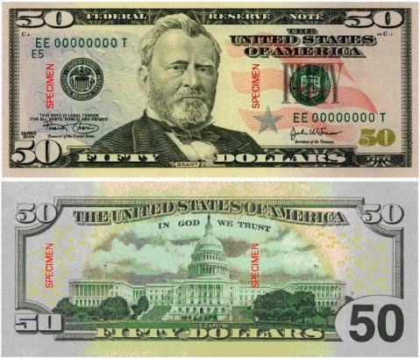
Measuring the Quantity of Money
The quantity of money in an economy needs to be measured.
Initially, this was easy: Quantity of money = currency with the public
But things changed when banking began
I discussed banks in an earlier discussion of the financial system

Slide 12
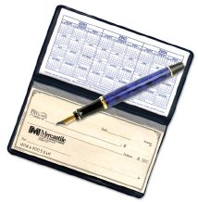
Measuring the Quantity of Money
Suppose you need to buy a new laptop
You could go to the store with cash
Alternatively, on the way to the store you could stop at a bank, open a checking account, deposit your cash in the account, ask for a checkbook, go to the store, and pay for the laptop with a check
There really is no difference between your cash and your checkbook when it comes to paying for a laptop

Slide 13
Measuring the Quantity of Money
A basic measure of the quantity of money is M1. It is:
Currency: the paper bills and coins in the hands of the public, plus
Demand deposits: balances in bank accounts that depositors can use as payment by writing a check.
And a few other less important things, such as travelers’ checks
Nowadays, another measure, M2, is more widely used.

Slide 14
Measuring the Quantity of Money: February 2018
 | $ Billions
Currency | 1,540.3
+ Traveler’s Checks | 1.9
+ Demand Deposits | 1,474.0
+ Other Checkable Deposits | 597.9
= M1 | 3,614.0
+ Savings Deposits | 9,121.9
+ Small-denomination Time Deposits | 415.8
+ Retail Money Market Mutual Funds | 706.6
= M2 | 13,858.3
Notes:
Data downloaded on March 18, 2018.
Currency: https://fred.stlouisfed.org/data/CURRSL.txt, https://fred.stlouisfed.org/series/CURRSL
Traveler’s Checks: https://fred.stlouisfed.org/data/TVCKSSL.txt, https://fred.stlouisfed.org/series/TVCKSSL
Demand Deposits: https://fred.stlouisfed.org/series/DEMDEPSL
Other Checkable Deposits: https://fred.stlouisfed.org/series/OCDSL
M1: https://fred.stlouisfed.org/series/M1SL
Savings Deposits: https://fred.stlouisfed.org/series/SAVINGSL
Small-denomination Time Deposits: https://fred.stlouisfed.org/series/STDSL
Retail Money Market Mutual Funds: https://fred.stlouisfed.org/series/RMFSL
M2: https://fred.stlouisfed.org/series/M2SL

Slide 15
Measuring the Quantity of Money: Liquidity
Whether a particular asset should be counted as money depends on the asset’s liquidity
Liquidity is the ease with which an asset can be converted into the economy’s medium of exchange.
When computers made it easy for banks to transfer cash from a person’s savings account to that person’s checking account, both types of accounts could be used to buy a laptop.
So, savings accounts became as liquid as checking accounts.
So, it made sense to include savings accounts in M2.

Slide 16
Video
What Is Money? https://youtu.be/r5eFObOFcME, Marginal Revolution University, YouTube, July 18, 2017

Slide 17
The Monetary System: Outline
Definition of money
The uses of money
Medium of exchange
Double coincidence of wants required in barter
Unit of account
Store of value
Measurement of the quantity of money
Central bank and its effect on the quantity of money
Open market operations
Lender of last resort lending
Ordinary banks’ effect on the quantity of money
Bank lending and the quantity of money
Central bank’s control of banks’ lending
Central bank’s imperfect control over the quantity of money

Slide 18
Central banks

Slide 19
Central Banks
In any monetary system today, currency is created by an institution called a central bank
Using its currency creation ability, a central bank can increase or decrease the economy’s quantity of money
The central bank has other functions:
It sets the regulations that banks and other financial institutions must obey
It serves as a clearing house for checks and other money transfers between banks

Slide 20
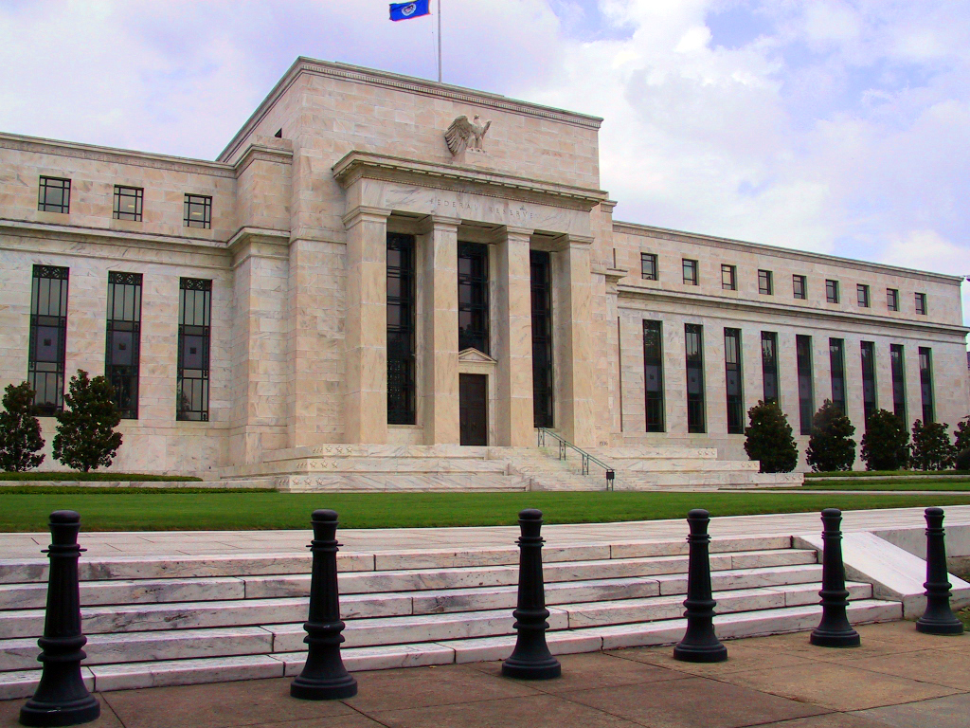
THE FEDERAL RESERVE SYSTEM
The Federal Reserve (The Fed) is the central bank of the United States.
It monitors and regulates the banking system (regulatory policy)
It adjusts the quantity of money in the economy (monetary policy)

Slide 21
The Central Bank and Commercial Banks
We discussed banks in Chapter 8 (Saving, Investment, and the Financial System).
Banks are intermediaries that take money from depositors and lend it to borrowers.
A central bank interacts with banks.
It does not interact directly with households and non-bank businesses.
A central bank may:
Lend money to a bank
Trade financial assets with a bank

Slide 22
Central Bank Buys Financial Assets From a Bank
Suppose the Fed—that is, the U.S. central bank—prints $100 and buys some financial securities from Bank A
In my discussion of banking in Chapter 8, I had explained that banks may use their funds to:
buy financial securities (such as stocks and bonds),
make loans, or
keep cash reserves
So, Bank A’s stash of securities decreases by $100 and its cash reserves increase by $100
Does this affect the economy’s quantity of money (say, M1)?

Slide 23
How Monetary Policy Works
Suppose the Fed prints $100 and buys some financial securities from Bank A
So, Bank A’s stash of securities decreases by $100 and its cash reserves increase by $100
Does this affect the economy’s quantity of money (say, M1)?
Recall: M1 = currency with public + money in checking accounts
No member of the public now has more currency or more money in checking accounts.
So, M1 is unchanged.

Slide 24
Central Bank Lends Directly to a Bank
The US central bank, the Fed, can print cash and lend it directly to a bank
This is called lending at the discount window
The Fed charges interest for any loan to a bank
This interest rate is the discount rate
So, the Fed can increase a bank’s cash reserves either by printing money and buying financial assets from the bank or by lending money to the bank at the Fed’s discount window.

Slide 25
How Monetary Policy Works
Bank A could continue to hold $100 of additional cash reserves
Or it could make new loans with some of that money
After all, lending is what banks do
How much of the additional reserves of $100 the bank will lend depends on the bank manager’s sense of the risks and rewards of making a loan
This is reflected in Bank A’s reserve-deposit ratio or reserve ratio
The higher the reserve ratio the lower the lending

Slide 26
When banks make loans, the quantity of money increases
Suppose Bank A, which now has $100 in additional cash reserves, gives $80 as a loan to Joe, a customer
Now currency with the public increases by $80
And checkable bank deposits, the other component of M, is unchanged
Therefore, the nation’s quantity of money (M = currency with public + money in checking accounts) increases by $80
So, banks can increase a nation’s quantity of money even though they can’t print money!

Slide 27
When banks make loans, the quantity of money increases
Bank A gave Joe a loan of $80
Joe picked up the cash at the teller window
Currency with the public increased by $80
But the loan that Joe received did not reduce the money in checking accounts held by anybody
This is why a bank loan increases the quantity of money even though the bank is simply taking money from Peter and lending it to Paul.

Slide 28
Lower reserve ratios lead to higher money creation
Had Bank A given Joe a $90 loan instead, the quantity of money would have increased by $90
Recall that a bank’s reserve ratio is the percent of its deposits that the bank keeps as cash reserves
The lower its reserve ratio, the more a bank lends
The more a bank lends, the more the quantity of money increases

Slide 29
Open Market Operations: Central Bank’s Main Weapon
Recall that the story of Joe’s loan began when the central bank printed $100 and used the money to buy financial assets from Bank A.
This demonstrates that a central bank can increase the economy’s quantity of money by printing cash and buying financial securities from a bank
This is called open market operations

Slide 30
How Monetary Policy Works: Open Market Operations
A central bank can increase the economy’s quantity of money by printing cash and buying financial securities from a bank
This replaces a bank’s securities with cash.
As banks don’t want to sit on cash, they use the newly acquired cash to make new loans.
These new loans cause the quantity of money to increase.
This whole process is called open market operations

Slide 31
How Monetary Policy Works: Direct Lending
While open market operations are the main tool of a central bank, the same result could also be achieved by direct lending to banks
These are loans given at the Fed’s discount window
And the interest rate charged is called the discount rate

Slide 32
How Monetary Policy Works: Let’s Continue the Example
We just saw that Joe got an $80 loan from Bank A and this made M increase by $80
If he soon decides to repay the loan, the economy’s quantity of money would decrease by $80 and return to its pre-loan level
We saw before that when loans are made M increases, and now we see that when loans are repaid M decreases
Therefore, if banks make new loans at a faster rate than the rate at which old loans are repaid, M increases.

Slide 33
The Money Multiplier
Let’s get back to Joe, who got the $80 loan from Bank A
Let’s say Joe buys $80 of food from Alice
If Alice keeps the $80 in her purse, the transaction between Joe and Alice would have no additional effect on the economy’s quantity of money (M)
Make sure you understand why
But what happens to M if Alice deposits the $80 in her checking account in, say, Bank B?

Slide 34
How Monetary Policy Works
When Alice hands over $80 to Bank B,
currency with the public decreases by $80 and
money in checking accounts increases by $80
So, M1 doesn’t change

Slide 35
The Money Multiplier
But Bank B, where Alice just deposited $80, now has $80 of additional cash reserves
If Bank B is so inclined, it could make a new loan of $60 to Jim, one of its customers
And, as was the case when Joe got a loan from Bank A, this loan from Bank B to Jim would again cause M to increase, this time by $60

Slide 36
The Money Multiplier
Note that Alice deposited $80 in Bank B and Bank B used Alice’s money to make a loan of $60 to Jim
Jim has $60 in cash in his hands that he is free to spend
And Alice continues to have $80 in her checking account that she is free to spend
(even though her deposit was used to give Jim a loan)
Together, Alice and Jim have $140 that they are free to spend
This is the strange way the quantity of money increases when a bank uses Alice’s deposit to make a loan to Jim

Slide 37
The Money Multiplier
Recall that our story began with a central bank that printed $100
As a result, Joe got a loan of $80 and then Jim got a loan of $60
As a result, the nation’s quantity of money increased by $140
… and the story may not end with Joe and Jim. It could continue with more an more people getting loans and the quantity of money increasing repeatedly
This process is called the money multiplier.

Slide 38
The role of households’ currency-deposit ratios
So, we see that:
when Alice takes the $80 she got by selling food to Joe and keeps it in her purse, the money multiplier process is halted, and M does not increase. But
when she deposits the $80 in her bank account, she triggers Bank B’s loan to Jim, the money multiplier process is activated, and M consequently increases.

Slide 39
The role of households’ currency-deposit ratios
The lesson is that the money multiplier is stronger and the economy’s quantity of money increases when people keep their money in their bank accounts (rather than in their purses and wallets)
That is, the money multiplier depends on the economy’s currency-deposit ratio.
The lower the currency-deposit ratio, the higher the money multiplier and the economy’s quantity of money.

Slide 40
How Monetary Policy Works: To Sum Up
When banks make new loans at a faster rate than the rate at which old loans are repaid, M increases
When banks’ reserve ratio decreases—that is, when banks keep fewer reserves and, so, make more loans—M increases
When the central bank prints cash and buys financial securities from banks, M usually increases
When the currency-deposit ratio of people decreases—that is, when people keep more of their wealth in bank deposits rather than in currency—M increases

Slide 41
Banks and the Money Supply: Fractional-Reserve Banking
When one bank loans money, that money generally ends up as a deposit in a second bank.
This creates more deposits and more reserves to be lent out by the second bank.
When the second bank makes a loan from its reserves, the money supply increases again.
And the process continues …

Slide 42
Video
The Money Multiplier, https://youtu.be/93_Va7I7Lgg, Marginal Revolution University, YouTube, July 25, 2017

Slide 43
How central banks control the economy’s quantity of money

Slide 44
THE FED’S TOOLS OF MONETARY CONTROL
The Fed influences the quantity of reserves in banks by:
Open-market operations
Fed lending to banks from its discount window
The Fed influences the reserve ratio—or reserve-deposit ratio—of banks by:
Paying interest on reserves

Slide 45
Fed’s Tools of Monetary Control: Open Market Operations
Open-market operations
Purchase and sale of U.S. government bonds by the Fed
To increase the money supply
The Fed buys U.S. government bonds
To reduce the money supply
The Fed sells U.S. government bonds

Slide 46
Fed’s Tools of Monetary Control: Discount Rate
Fed can print money and lend to banks from its discount window
Banks borrow and pay an interest rate called the discount rate
Lower discount rate leads to more borrowing by banks from the Fed which leads to higher quantity of money in the economy (remember the money multiplier process?)
Conversely, a higher discount rate leads to a lower quantity of money in the economy

Slide 47
Fed’s Tools of Monetary Control: Interest on Reserves
We saw earlier that the economy’s quantity of money is inversely related to the banks’ reserve ratio
Since the 2008 financial crisis, the Fed has been paying banks interest on their reserves
The higher this interest rate on reserves, the more reserves banks will choose to hold. This will:
Increase the reserve ratio
Lower the money multiplier
Lower the money supply

Slide 48
Fed’s Tools of Monetary Control: Problems in Controlling the Money Supply
The Fed’s control of the money supply is not precise.
The Fed must wrestle with two problems that arise.
The Fed does not control the amount of money that households choose to hold as deposits in banks (the currency-deposit ratio).
The Fed does not control the amount of money that bankers choose to lend (the reserve ratio).

Slide 49
Fed’s Tools of Monetary Control: Problems in Controlling the Money Supply
If people lose confidence in the banking system and decide to withdraw cash from their bank accounts to hold as currency, the banks would have less cash to lend and they will be forced to cut back on lending
This would cause the money supply to decrease
This actually happened during the Great Depression of the 1930s.

Slide 50
Fed’s Tools of Monetary Control: Problems in Controlling the Money Supply
If banks lose confidence in the economy they may be afraid to lend, fearing that in a bad economy borrowers would default on their loans.
So, banks may decide to make fewer loans and hold more reserves.
The rise in the reserve ratio would reduce the money multiplier and cause the money supply to decrease.
This too actually happened during the Great Depression of the 1930s.

Slide 51
Fed’s Tools of Monetary Control: Problems in Controlling the Money Supply
During the Great Depression both factors discussed in the two previous slides were in play
From 1929 to 1933, the US money supply fell by 28 percent, without the Federal Reserve doing anything to deliberately reduce the quantity of money
This emphasizes the point that the Fed’s control of the economy’s quantity of money (M) is imprecise.

Slide 52
What’s Next?
In this chapter we have discussed how an economy’s quantity of money is determined
Next, we need to see why the quantity of money matters
In the very next chapter, we’ll discuss the long-run effects of the quantity of money
In later chapters, we’ll discuss the short-run effects

Slide 53
Any Questions?

