Slide 1
12
Money Growth and Inflation

Slide 2
Things You Need to Know to Understand This Chapter
The theory of supply and demand (microeconomics)
The measurement of the overall price level (CPI) and of inflation (Ch. 6)
Real interest rate = nominal interest rate – inflation rate
The theory of long-run GDP (Ch. 7)
The long-run theory (loanable funds theory) of the real interest rate (Ch. 8)
Chapter on “The Monetary System” (Ch. 11), especially:
The economists’ definition of money
The measurement of the quantity of money
The functions of money
The control of the quantity of money by a country’s central bank

Slide 3
Money Growth and Inflation
In chapter 11, we saw how money is defined and measured.
In chapter 6 we saw how the price level and its rate of inflation are defined and measured.
In this chapter, we will see that the quantity of money determines the price level in the long run.
The quantity theory of money explains the long-run determinants of the price level and the inflation rate.

Slide 4
Money Growth and Inflation
More specifically, in this chapter, we will see that
The quantity of money in an economy determines its price level, and
The growth rate of the quantity of money determines the growth rate of the price level
The growth rate of the price level is also called the rate of inflation

Slide 5
Recap: The Meaning of Money
Money is the set of assets that people regularly use to buy things from other people.
The quantity of money in an economy consists mainly of:
Currency with the public, and
Money in checkable accounts
See Chapter 11 (The Monetary System).

Slide 6
Recap: Price Level and Inflation
The overall level of prices is usually measured by the consumer price index (CPI)
Inflation is the percentage increase in the overall level of prices:
$\text{Inflation} \text{in}\text{ 2022}=\frac{{\text{CPI}}_{2022}−{\text{CPI}}_{2021}}{{\text{CPI}}_{2021}}×100$
See Chapter 6 (Measuring the Cost of Living)

Slide 7
Introduction: Inflation in the U.S.
Over the past 80 years, prices have risen on average about 3.6 percent per year in the U.S.
Deflation, meaning decreasing average prices, occurred in the U.S. in the nineteenth century.
The price level was 23% lower in 1896 than in 1880
In the 1970s prices rose by 7.8 percent per year.
During 2005—2015, prices rose at an average rate of 1.2 percent per year.

Slide 8
Introduction: Inflation in Germany
Hyperinflation refers to very high rates of inflation, usually more than 50 percent per month
At such rates, prices increase more than 100-fold in one year
Germany experienced hyperinflation in the 1920s.
The price of a newspaper rose from 0.30 mark in January 1921 to 70,000,000 marks in November 1923, less than three years later
Notes:
Data Source: “Macroeconomics,” 9th edition, by N. Gregory Mankiw, page 128.

Slide 9
Introduction: Inflation in Germany
This does not mean that Germans suddenly felt that newspapers were incredibly wonderful things!
Instead, what this means is that money became less valuable to Germans.
We see from this example that price increases have more to do with the value of money than with the value of goods.
Therefore, if we understand the value of money, we will understand the prices of goods

Slide 10
The Classical Theory of Inflation
This is the mainstream theory of the overall price level and the rate of inflation in the long run. It is called “classical” because it was developed by some of the earlies economic thinkers.

Slide 11
Focus on the reasons for simultaneous and similar changes in all prices
We want to understand the reasons why an economy’s price level—as measured by, say, its consumer price index—may increase by, say, 5 percent
When the CPI increases by 5 percent, some goods’ prices may increase by 5 percent but the prices of other goods may increase by 7 percent or decrease by 10 percent, etc., because the CPI is only an average of the prices of numerous goods and services
Nevertheless, when want a macroeconomic understanding of the CPI, it is useful to imagine that all prices have increased by 5 percent and then ask why that might have happened

Slide 12
Focus on the reasons for simultaneous and similar changes in all prices
So, to understand why the CPI may increase by 5 percent, ask yourself what could cause all prices to increase by 5 percent

Slide 13
Imagine a market where people buy and sell money
We saw when discussing the German hyperinflation that a simultaneous and similar increase in the prices of all—or almost all—goods is probably the result of a decrease in the value of money
To understand the value (or price) of money, we can imagine a market in which people buy and sell money (rather than ice cream, shoes, etc.)
Instead of imagining markets in which people pay money to buy apples, oranges, ice cream, shoes, etc., imagine a market where people pay apples, oranges, ice cream, shoes, etc., to buy money
Just reverse the usual way you think of buying and selling

Slide 14
THE CLASSICAL THEORY OF INFLATION: The Level of Prices and the Value of Money
When the overall price level rises, the price of money falls.
Suppose the price of a gallon of ice-cream is $5.
Then, the price of a dollar is 1/5 gallons of ice-cream.
In general, let P denote the price level of goods and services.
So, P could be the Consumer Price Index or the GDP Deflator.
Then, 1/P is the value of money measured in units of goods and services
This is also the price of money and the purchasing power of money
So, when the overall price level rises, the value of money falls

Slide 15
THE CLASSICAL THEORY OF INFLATION: Money Supply, Money Demand, and Monetary Equilibrium
It is obvious that the quantity of money determined by the central bank must end up equal to the quantity of money held by the people as currency and checkable bank deposits
But in a free economy, people cannot be forced
Therefore, the quantity of money desired by the central bank must be equal to the quantity of money desired by the people as currency and checkable bank deposits
That is, the money supply must equal the money demand
What makes these two separate things equal?

Slide 16
THE CLASSICAL THEORY OF INFLATION: Money Supply, Money Demand, and Monetary Equilibrium
The classical theory of inflation assumes that the price or value of money (1/P) automatically reaches the level at which money supply is equal to money demand.

Slide 17
THE CLASSICAL THEORY OF INFLATION: Money Supply, Money Demand, and Monetary Equilibrium
Money supply is a policy variable that is controlled by the central bank.
Through instruments such as open-market operations, the central bank controls the quantity of money supplied.
In the US, the central bank is called the Fed.
Money Supply (Fed)
Value of Money, 1/P
Quantity of Money

Slide 18
THE CLASSICAL THEORY OF INFLATION: Money Supply, Money Demand, and Monetary Equilibrium
Money demand is the quantity of money that people wish to hold as currency and checkable bank deposits
Money has three main functions: medium of exchange, unit of account, and store of value
The classical theory assumes that in the long run people wish to hold money because it is a medium of exchange (and thereby makes shopping convenient)
The unit of account function doesn’t affect people much. And there are better stores of value than money that pay higher interest rates

Slide 19
THE CLASSICAL THEORY OF INFLATION: Money Supply, Money Demand, and Monetary Equilibrium
Although money demand has several determinants, including interest rates paid by non-money assets, the most important factor in the long run is the average level of prices in the economy.
People hold money because it is the medium of exchange.
The amount of money people choose to hold for shopping depends on the prices of goods and services.
The higher prices are, the more money the typical transaction requires, and the higher the amount of money people will choose to hold in their wallets and in their checking accounts.

Slide 20
Money Demand
Value of
Price
Money,
1
/
P
Level,
P
(High)
1
1
(Low)
3
/
4
1.33
1
/
2
2
1
/
4
4
Money
demand
(Low)
0
(High)
Quantity of
Money
Copyright © 2004 South-Western

Slide 21
THE CLASSICAL THEORY OF INFLATION: Money Supply, Money Demand, and Monetary Equilibrium
In the long run, the overall level of prices (P) adjusts to the level at which the demand for money equals the supply.
This is monetary equilibrium.

Slide 22
Figure 1 Money Supply, Money Demand, and the Equilibrium Price Level
Value of
Price
Money,
1
/
P
Money supply
Level,
P
(High)
1
1
(Low)
3
/
4
1.33
A
1
/
2
2
Equilibrium
Equilibrium
value of
price level
money
1
/
4
4
Money
demand
(Low)
0
(High)
Quantity fixed
Quantity of
by the Fed
Money
Copyright © 2004 South-Western

Slide 23
THE CLASSICAL THEORY OF INFLATION: The Effects of Monetary Injection
Value of
Price
Money,
1
/
P
MS₁
MS₂
Level,
P
(High)
1
1
(Low)
1. An increase
3
/
in the money
1.33
2. . . . decreases
4
supply . . .
the value of
3.
. . . and
mone
y . . .
A
increases
1
/
2
2
the price
level.
B
1
/
4
4
Money
demand
(Low)
(High)
0
M₁
M₂
Quantity of
Money
Copyright © 2004 South-Western

Slide 24
The Quantity Theory of Money
The classical theory of inflation is also called the quantity theory of money
The quantity theory of money says that:
The quantity of money available in the economy determines the value of money.
As the value of money is 1/P, when the value of money is determined, so is P.
The primary cause of inflation is the growth in the quantity of money.
Video: https://youtu.be/gi7jx5IJtik

Slide 25
Increase in long-run GDP
People find money useful as a medium of exchange. When GDP increases, more shopping gets done. This increases the demand for money.
Value of
Price
Money,
1
/
P
Money supply
Level,
P
(High)
1
1
(Low)
As a result, the price of money increases or, equivalently, the price level (CPI) decreases.
B
3
/
4
1.33
A
1
/
2
2
Equilibrium
Equilibrium
value of
price level
money
1
/
4
MD₂
4
MD₁
(Low)
0
(High)
Quantity fixed
Quantity of
by the Fed
Money
Copyright © 2004 South-Western

Slide 26
The Price Level in the Long Run: Summary
Any change in the money supply (that is, the quantity of money) makes the price level change in the same direction
Any change in real output (that is, real GDP) makes the price level change in the opposite direction

Slide 27
THE CLASSICAL THEORY OF INFLATION: The Adjustment Process
How exactly does growth in the quantity of money cause inflation?
Imagine that a lot of cash is dropped from helicopters all across the country. What will be the consequences?

Slide 28
THE CLASSICAL THEORY OF INFLATION: The Adjustment Process
If a lot of newly-printed cash is dropped from a helicopter …
People could try to spend the extra cash they pick up
Alternatively, they could put the cash in their bank accounts.
But even in this case, the banks will lend the money to borrowers and stimulate even more spending
Recall the money multiplier! Chapter 11 (The Monetary System)
But there isn’t any extra stuff to buy because productive capacity has not increased as a result of the money drop.
See Chapter 7 (Production and Growth).
Therefore, the only consequence is that prices will go up.

Slide 29
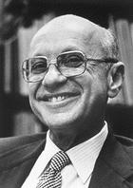
The Quantity Theory of Money
“Inflation is always and everywhere a monetary phenomenon”
Milton Friedman (1912- 2006).

Slide 30
THE CLASSICAL THEORY OF INFLATION: The Classical Dichotomy
Nominal variables are variables measured in monetary units.
Real variables are variables measured in physical units (and are adjusted for inflation).
Key Idea: According to the classical dichotomy, different economic forces affect real and nominal variables.

Slide 31
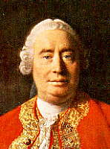
THE CLASSICAL THEORY OF INFLATION: Monetary Neutrality
Key Idea: According to David Hume (1711-1776) and others, real economic variables are not affected by changes in the money supply.
Changes in the money supply affect nominal variables but not real variables.
This feature of the classical theory of inflation is called monetary neutrality.

Slide 32
THE CLASSICAL THEORY OF INFLATION: Monetary Neutrality
The inability of changes in the quantity of money to affect real variables is called monetary neutrality.
Monetary neutrality is thought by most economists to prevail in the long run.
That is why we could study real variables, such as GDP, saving, investment, the real interest rate, the unemployment rate, etc., in an earlier part of our textbook (“The Real Economy in the Long Run”) before we began studying money in the current part (“Money and Prices in the Long Run”).

Slide 33
THE CLASSICAL THEORY OF INFLATION: Velocity and the Quantity Equation
The classical theory of inflation—also called the quantity theory of money—can also be expressed algebraically as the quantity equation.

Slide 34
THE CLASSICAL THEORY OF INFLATION: Velocity and the Quantity Equation
The velocity of money is the speed at which the typical dollar bill travels around the economy from person to person in a year.
Therefore, the velocity of money, V, is the number of times per year that a typical dollar bill is used to buy goods and services.
Therefore, V is the dollar value of the goods and services purchased with a single dollar bill in a year.
Therefore, if the economy’s quantity of money is M dollars, then the dollar value of the goods and services purchased with M dollars in a year must be M × V dollars.
Therefore, M × V must be equal to the country’s nominal GDP.

Slide 35
THE CLASSICAL THEORY OF INFLATION: Velocity and the Quantity Equation
Recall that the overall price level, P, can be interpreted as the GDP deflator
That is, P = GDP deflator = $\frac{\text{Nominal} \text{GDP}}{\text{Real} \text{GDP}}$.
Therefore, GDP deflator × Real GDP = Nominal GDP
Therefore, P × Y = Nominal GDP.

Slide 36
THE CLASSICAL THEORY OF INFLATION: Velocity and the Quantity Equation
As both M × V and P × Y must be equal to the country’s nominal GDP, we can write:
M × V = P × Y
This is the quantity equation.
Video: Quantity Theory of Money, https://youtu.be/q59tZKP0HME, Marginal Revolution University, YouTube, January 17, 2017.

Slide 37
THE CLASSICAL THEORY OF INFLATION: Velocity and the Quantity Equation
The quantity equation (M × V = P × Y) implies:
V = (P × Y) / M = Nominal GDP/Quantity of Money

Slide 38
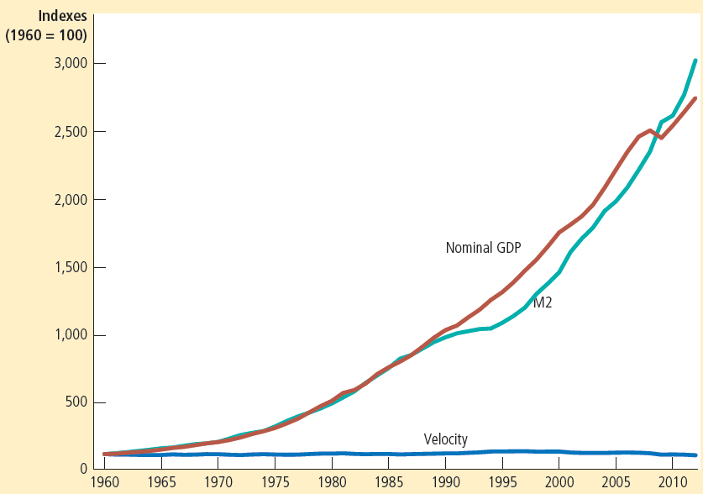
Figure 3: Nominal GDP, the Quantity of Money, and the Velocity of Money
This figure shows the nominal value of output as measured by nominal GDP, the quantity of money as measured by M2, and the velocity of money as measured by their ratio. For comparability, all three series have been scaled to equal 100 in 1960. Notice that nominal GDP and the quantity of money have grown dramatically over this period, while velocity has been relatively stable.

Slide 39
THE CLASSICAL THEORY OF INFLATION: Velocity and the Quantity Equation
The velocity of money (V) is relatively stable over time.
Also, as we saw in Chapter 7 (Production and Output), the quantity of money (M) does not affect output (Y). Therefore,
M × V = P × Y implies that:
Any change in M causes a proportionate change in P. Therefore,
Inflation is caused by rapid increases in the quantity of money.

Slide 40
Video
Causes of Inflation, https://youtu.be/gi7jx5IJtik, Marginal Revolution University, YouTube, January 24, 2018

Slide 41
The evidence on the quantity theory of money

Slide 42
CASE STUDY: Money and Prices during Four Hyperinflations
Hyperinflation is inflation that exceeds 50 percent per month.
Hyperinflation occurs in some countries because the government prints too much money to pay for its spending.
Notes:
Align text for second bullet.

Slide 43
Figure 4 Money and Prices During Four Hyperinflations
(a) Austria
(b) Hungary
Index
Index
(Jan. 1921 = 100)
(July 1921 = 100)
100,000
100,000
Price level
10,000
Price level
10,000
Money supply
1,000
1,000
Money supply
100
1921
1922
1923
1924
1925
100
1921
1922
1923
1924
1925
Copyright © 2004 South-Western

Slide 44
Figure 4 Money and Prices During Four Hyperinflations
(c) Germany
(d) Poland
Index
Index
(Jan. 1921 = 100)
(Jan. 1921 = 100)
100,000,000,000,000
Price level
10,000,000
1,000,000,000,000
1,000,000
Price level
10,000,000,000
Money
100,000,000
supply
100,000
Money
1,000,000
10,000
supply
10,000
1,000
100
1
100
1921
1922
1923
1924
1925
1921
1922
1923
1924
1925
Copyright © 2004 South-Western

Slide 45
THE CLASSICAL THEORY OF INFLATION: The Inflation Tax
Why do governments print so much money in hyperinflationary situations?
To pay for government spending when taxation or borrowing is not an option.
When the government raises revenue by printing money, it is said to impose an inflation tax.
An inflation tax is like a tax on everyone who holds money.
The inflation ends when the government institutes budgetary reforms—such as cuts in government spending—that ends the need to print money

Slide 46
Hyperinflation in Zimbabwe
During the 2000s, the Zimbabwe government was unable to cut spending enough or raise tax revenues enough to close its budget deficit
And it could not borrow, as nobody would lend it money
So, it printed money to cover its budget deficit
The result was rampant inflation

Slide 47
Hyperinflation in Zimbabwe
Before the hyperinflation began, the Zimbabwe dollar was worth a bit more than the US dollar
In January 2008, however, the Reserve Bank of Zimbabwe, the central bank, issued a note worth 10 million Zimbabwe dollars, which was then equivalent to about four (4) US dollars
A year later, a note worth 10 trillion Zimbabwe dollars, equivalent to three (3) US dollars, was issued

Slide 48
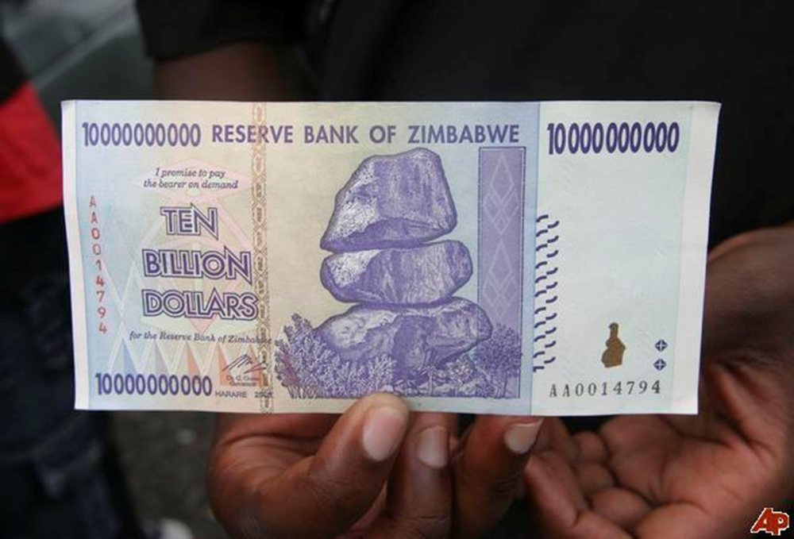
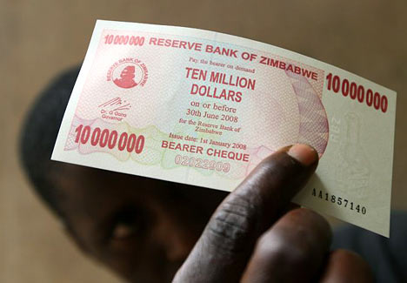
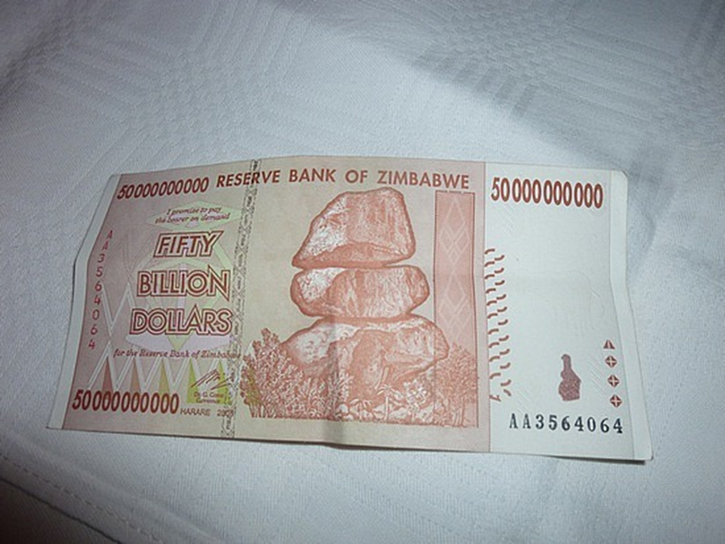
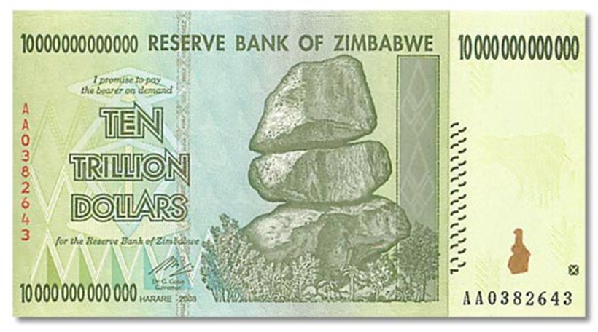
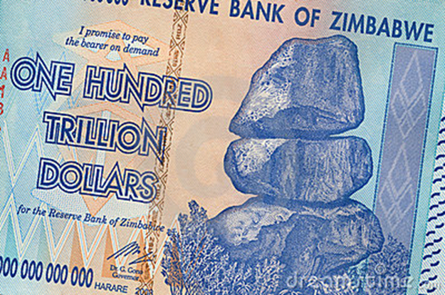
Hyperinflation in Zimbabwe

Slide 49
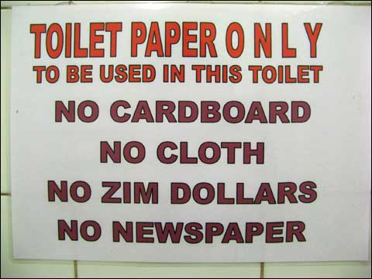
Hyperinflation in Zimbabwe
Sign in a restroom in South Africa
Source: http://www.freakonomics.com/2008/12/18/freak-shots-when-money-goes-down-the-toilet/ which estimated that the cost of one sheet of toilet paper had reached 3,600 Zimbabwe dollars

Slide 50
Hyperinflation in Zimbabwe
The Zimbabwe hyperinflation ended in 2009 when the Reserve Bank of Zimbabwe stopped printing Zimbabwe dollars and the nation began using foreign currencies such as the US dollar and the South African rand

Slide 51
Hyperinflation in Zimbabwe
Video: https://youtu.be/78-BlZXm7wA (Zimbabwe and Hyperinflation)
Video: https://youtu.be/E6A_WpUY2LI (Why Governments Create Inflation)

Slide 52
Quantity Theory in Normal Times
Recall the quantity equation: M × V = P × Y
This implies that: the growth rate of M + the growth rate of V = the growth rate of P + the growth rate of Y
Recall that we saw that, for the United States, the velocity of money (V) is basically constant over time
Assume that V is constant over time for all countries. Therefore, the growth rate of V = 0.
Therefore, Money Growth (%) = Inflation (%) + GDP Growth (%)
Equivalently, Inflation (%) = Money Growth (%) – GDP Growth (%)

Slide 53
Quantity Theory in Normal Times
Inflation (%) = Money Growth (%) – GDP Growth (%)
I used World Bank data on these three variables for roughly 160 countries. For most – though not all – countries, the data are from 1960 to 2020.
For each country, using all years of available data, I plotted Money Growth (%) – GDP Growth (%) on the horizontal axis and Inflation (%) on the vertical axis
See https://rpubs.com/udodartist/quantity_theory
I got a pretty good fit, indicating that the quantity theory of money holds up pretty well for the long run even in non-hyperinflationary conditions.

Slide 54
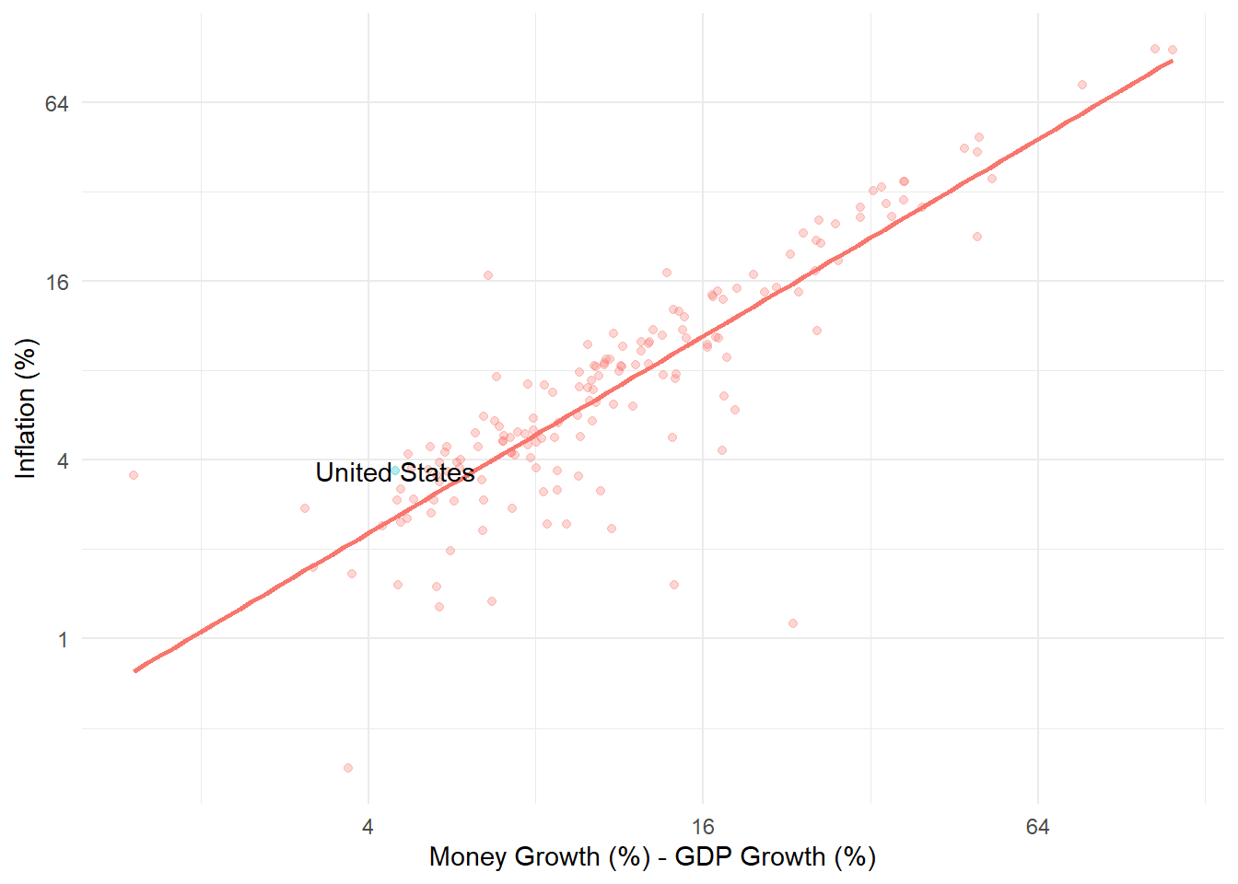
Source: https://rpubs.com/udodartist/quantity_theory

Slide 55
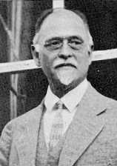
THE CLASSICAL THEORY OF INFLATION: The Fisher Effect
Real interest rate = nominal interest rate – inflation
Real interest rate + inflation = nominal interest rate
An increase in inflation is caused by an increase in money growth (This chapter)
An increase in money growth has no effect on the real interest rate, which is determined in the market for loanable funds. (Chapter 8)
Therefore, any change in inflation must be accompanied by an equal change in the nominal interest rate.
This is called the Fisher effect, after economist Irving Fisher (1867 – 1947).

Slide 56
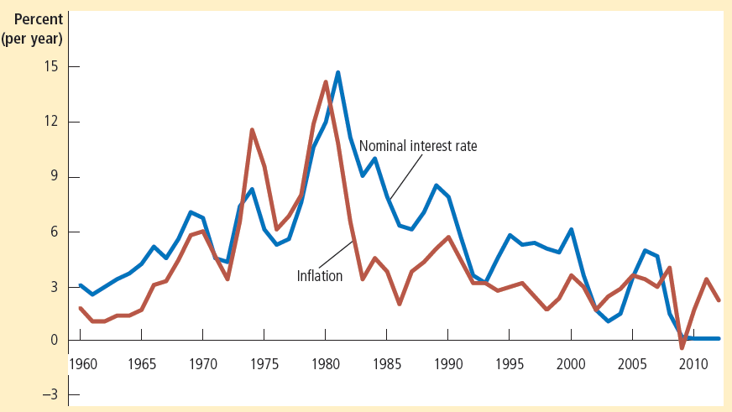
Figure 5: The Nominal Interest Rate and the Inflation Rate
This figure uses annual data since 1960 to show the nominal interest rate on three-month Treasury bills and the inflation rate as measured by the consumer price index. The close association between these two variables is evidence for the Fisher effect: When the inflation rate rises, so does the nominal interest rate.

Slide 57
The Costs of Inflation
Shoeleather costs, menu costs, relative price variability and misallocation of resources costs, inflation-induced tax distortions costs, confusion and inconvenience costs, arbitrary redistribution of wealth costs

Slide 58
THE COSTS OF INFLATION: A Common Fallacy
Inflation does not in itself reduce people’s real purchasing power.
Our standard of living depends on GDP, and inflation does not hurt our GDP in the long run
Recall from Chapter 7 (Production and Growth) that GDP is determined by other factors: technology, physical and human capital, natural resources, etc.
The printing of money causes prices to rise but has no effect on the determinants of real GDP
Recall that monetary neutrality prevails in the long run
However, there are other, more subtle costs of inflation

Slide 59
THE COSTS OF INFLATION
Shoe leather costs
Menu costs
Relative price variability
Tax distortions
Confusion and inconvenience
Arbitrary redistribution of wealth

Slide 60
Costs of Inflation
Video: https://youtu.be/Q_C3whhH2gc (Costs of Inflation: Price Confusion and Money Illusion)
Video: https://youtu.be/MfM1utsEEZA (Financial Intermediation Failure)

Slide 61
THE COSTS OF INFLATION: Shoeleather Costs
Shoeleather costs are the resources wasted when inflation forces people to live with minimal reserves of money.
Inflation reduces the purchasing power of money rapidly.
So people have an incentive to keep their wealth in non-money forms, such as stocks, bonds, real estate, gold, etc.

Slide 62
THE COSTS OF INFLATION: Shoeleather Costs
Living with minimal cash reserves requires more frequent trips to a financial institution to convert interest-bearing non-money assets into cash.
These extra trips to a financial institution are inconvenient and take time away from productive activities.

Slide 63
THE COSTS OF INFLATION: Menu Costs
Menu costs are the costs of adjusting prices
Printing new menus
Marketing costs of informing customers of the price changes
During inflationary times, it is necessary to frequently update price lists and other posted prices.
This is a resource-consuming process that takes away from other productive activities.

Slide 64
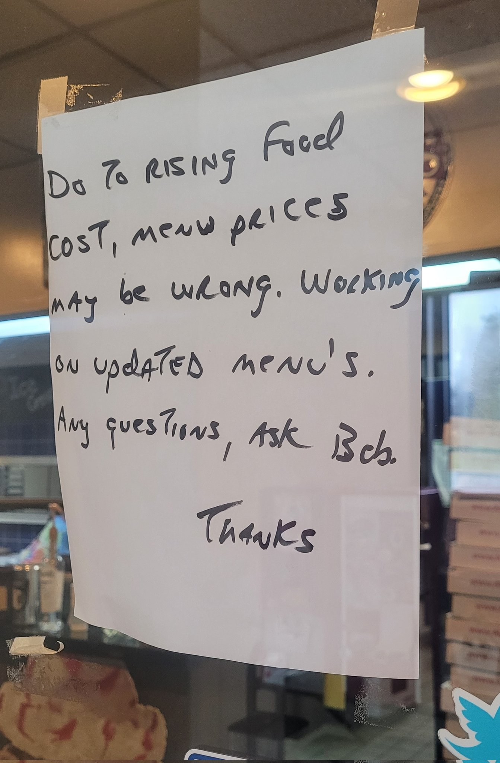
Menu Costs, IRL
Notes:
Source: https://twitter.com/Wootenomics/status/1447263440729411591

Slide 65
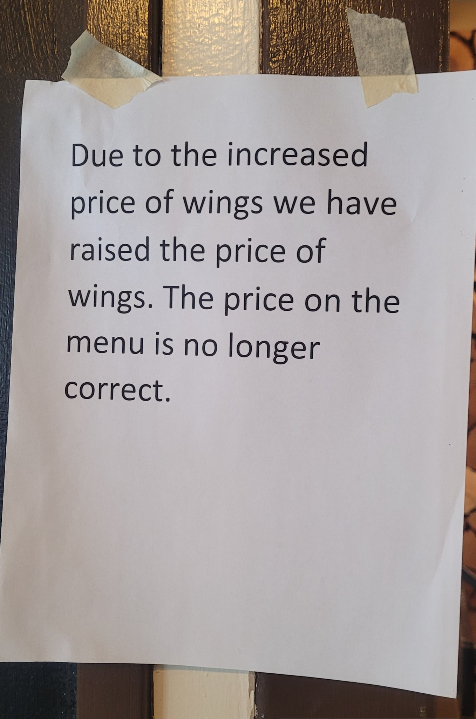
Menu Costs, IRL
Notes:
Source: https://twitter.com/Wootenomics/status/1447263440729411591

Slide 66
THE COSTS OF INFLATION: Relative-Price Variability and the Misallocation of Resources
We just saw that it is costly for firms to adjust their prices frequently in an inflationary situation
So, businesses will adjust their prices, but once in a while
And businesses do not coordinate with other businesses when they make these infrequent but large price adjustments
So, inflation affects relative prices (such as the price of chicken relative to turkey).
So, decisions of buyers and sellers get affected by inflation for no economically meaningful reason

Slide 67
THE COSTS OF INFLATION: Relative-Price Variability and the Misallocation of Resources
Changes in the relative price of, say, ice cream to apples are desirable when caused by
Demand-related factors (a rise in temperature makes people desire ice cream), and
Supply-related factors (a drought that reduces the production of apples)
Changes in relative prices that are caused by inflation affect the choices of buyers and sellers for no economically useful reasons

Slide 68
THE COSTS OF INFLATION: Inflation-Induced Tax Distortion
Inflation exaggerates the size of capital gains and increases the tax burden on this type of income.
This reduces the incentive to save for the future, and has a negative long-run effect on the economy.

Slide 69
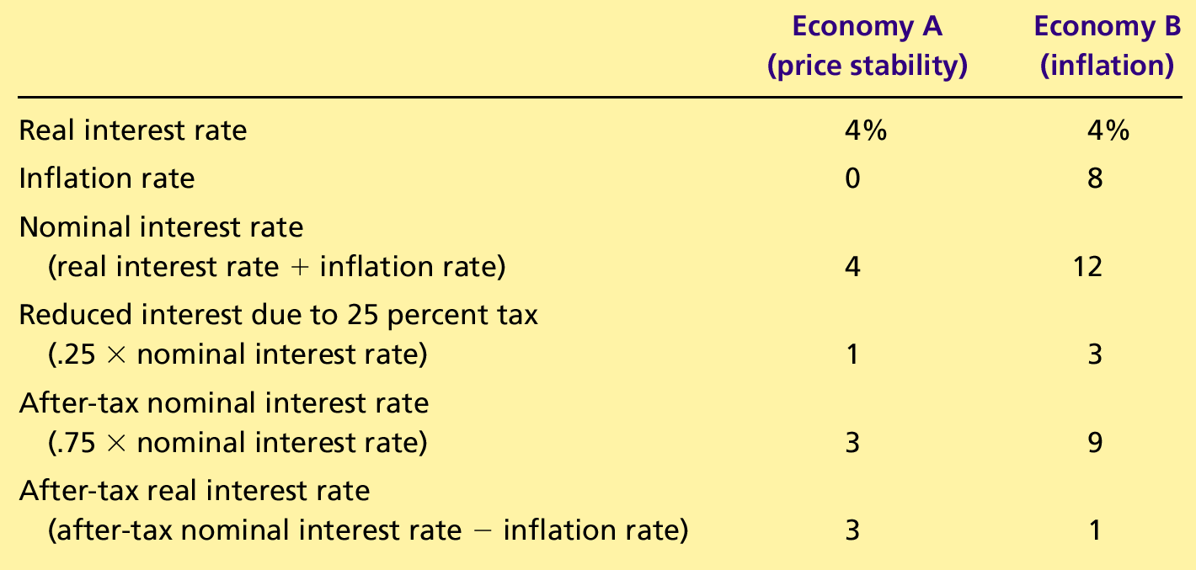
Table 1 How Inflation Raises the Tax Burden on Saving

Slide 70
THE COSTS OF INFLATION: Inflation-Induced Tax Distortion
The income tax system treats all of the nominal interest earned on savings as taxable income, even though part of the nominal interest rate merely compensates for inflation.
Consequently, when inflation increases the after-tax real interest rate falls, making saving less attractive.
The reduced incentive for saving in the high-inflation economy could be damaging in the long-run

Slide 71
THE COSTS OF INFLATION: Confusion and Inconvenience
When the Fed increases the money supply and creates inflation, it reduces the purchasing power of a dollar.
Inflation causes the purchasing power of a dollar to be different at different times.
Therefore, during rapid inflation, it is more difficult to compare revenues, costs, and profits over time in inflation-adjusted (or, real) units.
Therefore, it is more likely that people will make mistaken decisions.

Slide 72
THE COSTS OF INFLATION: A Special Cost of Unexpected Inflation: Arbitrary Redistribution of Wealth
When there’s unexpected inflation, lenders lose and borrowers gain
When there’s unexpected deflation, lenders gain and borrowers lose
These redistributions occur because many loans in the economy are specified in terms of the unit of account: money.
Unexpected inflation/deflation redistributes wealth among the population in a way that has nothing to do with either merit or need.

Slide 73
THE COSTS OF INFLATION: If Inflation is Bad, is Deflation Good?
Deflation is negative inflation (or falling prices)
The following costs of inflation, are also costs of deflation:
Menu costs
Relative-price variability and the misallocation of resources
Confusion and inconvenience
Arbitrary redistributions of wealth (unexpected deflation)

Slide 74
THE COSTS OF INFLATION: If Inflation is Bad, is Deflation Good?
However, the following costs of inflation are smaller in the case of deflation:
Shoeleather costs
Inflation-induced tax distortions
For this reason, Milton Friedman, an economist we met in an earlier slide, argued that central banks should aim for mild deflation in the long run (Friedman Rule)

Slide 75
THE COSTS OF INFLATION: If Inflation is Bad, is Deflation Good?
Recall that nominal interest rate = real interest rate + inflation
The Friedman Rule argues that, to keep shoeleather costs low, we should set nominal interest rate = 0.
Therefore, real interest rate + inflation = 0.
Therefore, inflation = – real interest rate, which is usually negative
So, to set the nominal interest rate at zero, we should aim for mild deflation.

Slide 76
THE COSTS OF INFLATION: If Inflation is Bad, is Deflation Good?
The Friedman Rule’s support of deflation applies in the long run.
In the short-run, deflation may be the symptom of a sick economy

Slide 77
THE COSTS OF INFLATION: Bonus: How to protect your savings from inflation
You can lend money to the US government without taking any inflation risk!
The U.S. Treasury sells inflation-protected bonds.
For these bonds, both interest payments and the principal that is repaid when the bond matures are adjusted for inflation.
So, buyers of these bonds are protected from inflation
These bonds are of two types:
Treasury Inflation-Protected Securities (TIPS)
I Savings bonds
These bonds can be bought directly from www.treasurydirect.gov
Inflation-indexed bonds are also sold by foreign governments and by private corporations

Slide 78
Any Questions?

Slide 79
Summary
The overall level of prices in an economy adjusts to bring money supply and money demand into balance.
When the central bank increases the supply of money, it causes the price level to rise.
Persistent growth in the quantity of money supplied leads to continuing inflation.

Slide 80
Summary
The principle of money neutrality asserts that changes in the quantity of money influence nominal variables but not real variables.
A government can pay for its spending simply by printing more money.
This can result in an “inflation tax” and hyperinflation.

Slide 81
Summary
According to the Fisher effect, when the inflation rate rises, the nominal interest rate rises by the same amount, and the real interest rate stays the same.
Many people think that inflation makes them poorer because it raises the cost of what they buy.
This view is a fallacy because inflation also raises nominal incomes.

Slide 82
Summary
Economists have identified six costs of inflation:
Shoeleather costs
Menu costs
Increased variability of relative prices
Unintended tax liability changes
Confusion and inconvenience
Arbitrary redistributions of wealth

Slide 83
Summary
When banks loan out their deposits, they increase the quantity of money in the economy.
Because the Fed cannot control the amount bankers choose to lend or the amount households choose to deposit in banks, the Fed’s control of the money supply is imperfect.
Notes:
I believe this slide is out of place. It belongs in the previous chapter. Delete it here.

