Slide 1
IV
THE REAL ECONOMY IN THE LONG RUN

Slide 2
Long Run and Short Run
Consider a president who is trying to ensure a bright future for the country and, thereby, his or her place in history.
This president will want to know about long-run economic theories.
Now consider a president who is simply trying to get the economy going quickly so that he or she will win the next election, which is six months away.
This president will want to know about short-run economic theories.

Slide 3
Long Run and Short Run
The solution to a macroeconomic problem depends on
whether you want a quick solution or
whether you are looking far into the future.
In the next several chapters, we will look at long-run problems and their solutions.

Slide 4
7
Production and Growth

Slide 5
Production and Growth
A country’s standard of living depends on its real GDP per capita
At any given point in time, there are vast differences in real GDP per capita—and its annual rate of growth—among countries
Why?
For any given country, real GDP per capita can change dramatically over time
Why?

Slide 6
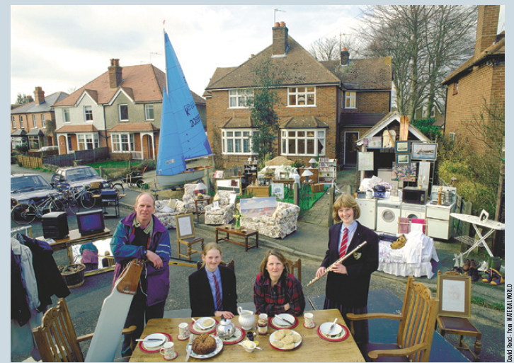
A Picture Is Worth a Thousand Statistics
The United Kingdom is an advanced economy. In 2011, its GDP per person was $36,010. A negligible share of the population lives in extreme poverty, defined here as less than $2 a day. A baby born in the United Kingdom can expect a relatively healthy childhood: Only 5 out of 1,000 children die before reaching age 5. Educational attainment is high: Among children of high school age, 98 percent are in school.

Slide 7
A Picture Is Worth a Thousand Statistics
Mexico is a middle-income country. In 2011, its GDP per person was $15,390. About 5 percent of the population lives on less than $2 a day, and 16 out of 1,000 children die before age 5. Among those of high school age, 71 percent are in school

Slide 8
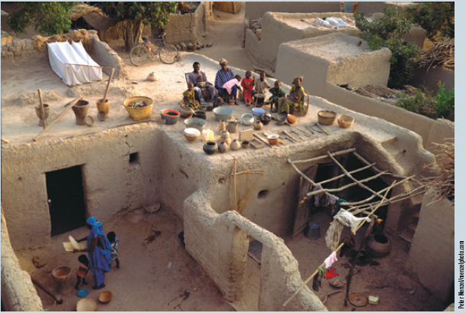
A Picture Is Worth a Thousand Statistics
Mali is a poor country. In 2011, its GDP per person was only $1,040. Extreme poverty is the norm: More than three-quarters of the population lives on less than $2 per day. Life is often cut short: 176 out of 1,000 children die before age 5. And educational attainment in Mali is low: Among those of high school age, only 31 percent are in school.

Slide 9
Basic Facts of Wealth
Video: https://youtu.be/PzAr_mL0Qd8

Slide 10
Growth Rates Are Crucial
Video: https://youtu.be/VNWGEIXSuEQ

Slide 11
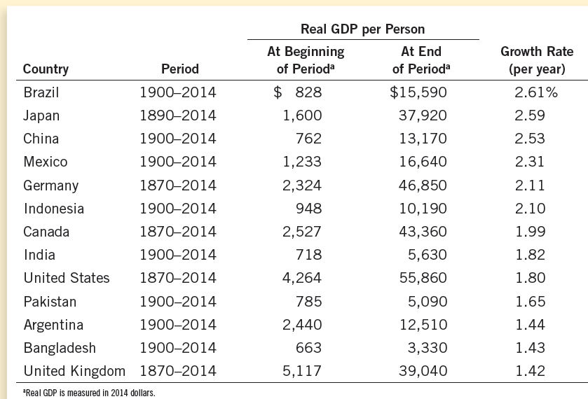
Table 1 The Variety of Growth Experiences
The highest number is 7.72 times the smallest.
The highest number is 16.77 times the smallest.

Slide 12
Economic Growth Around The World
The poorest countries have average levels of income that have not been seen in the United States for many decades.
What did the poor countries do wrong?
What did the US do right?

Slide 13
Economic Growth Around The World
Differences in annual growth rates that seem small become large when compounded for many years.
Compounding refers to the accumulation of a growth rate over a period of time.
This gives us hope. Even small increases in growth rates can have a significant effect in the end.

Slide 14
Productivity: Its Role and Determinants

Slide 15
Productivity is key
Productivity is the market value of a worker’s output in an hour of work.
The market value of a worker’s output depends on:
The quantities of the goods and services produced and
The market prices of the goods and services produced
Productivity plays a key role in determining living standards

Slide 16
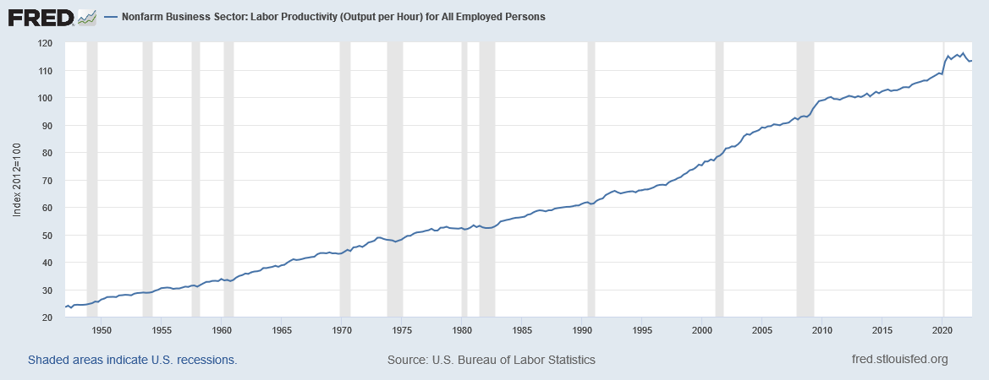
Productivity: Output per Hour
Notes:
Downloaded from https://fred.stlouisfed.org/series/OPHNFB on Feb. 2, 2023.

Slide 17
A Worker’s Productivity Depends on …
Factors of Production per worker
Physical capital per worker
Human capital per worker
Natural resources per worker
Technology in use
Government policies

Slide 18
Determinants of Productivity: Physical Capital
Physical Capital is the stock of equipment and structures that is used to produce goods and services.
Tools used to build or repair things.
Computer software
Office buildings, factory buildings, shopping malls, schools, etc.
Infrastructure, such as roads, railway lines, bridges, etc.
These are usually provided by governments

Slide 19
Determinants of Productivity: Physical Capital
Physical capital is a produced or human-made factor of production
Production of physical capital requires reduced production of consumer goods or reduced leisure
This is an unavoidable tradeoff

Slide 20
Determinants of Productivity: Human Capital
Human Capital is the human knowledge and ability that is necessary in productive activities
Workers acquire human capital through
education,
training, and
experience

Slide 21
Determinants of Productivity: Human Capital
Like physical capital, human capital raises a nation’s ability to produce goods and services
Like physical capital, at any given date human capital can be acquired only by sacrificing current consumption or leisure
This is an unavoidable tradeoff

Slide 22
Determinants of Productivity: Natural Resources
Natural Resources are inputs used in production that are provided by nature
Examples: land, rivers, and mineral deposits.
Renewable resources include trees and forests.
Nonrenewable resources include petroleum and coal.
The search for and retrieval of natural resources such as petroleum and coal—or the purchase of these resources from elsewhere—usually requires a sacrifice of consumption or leisure

Slide 23
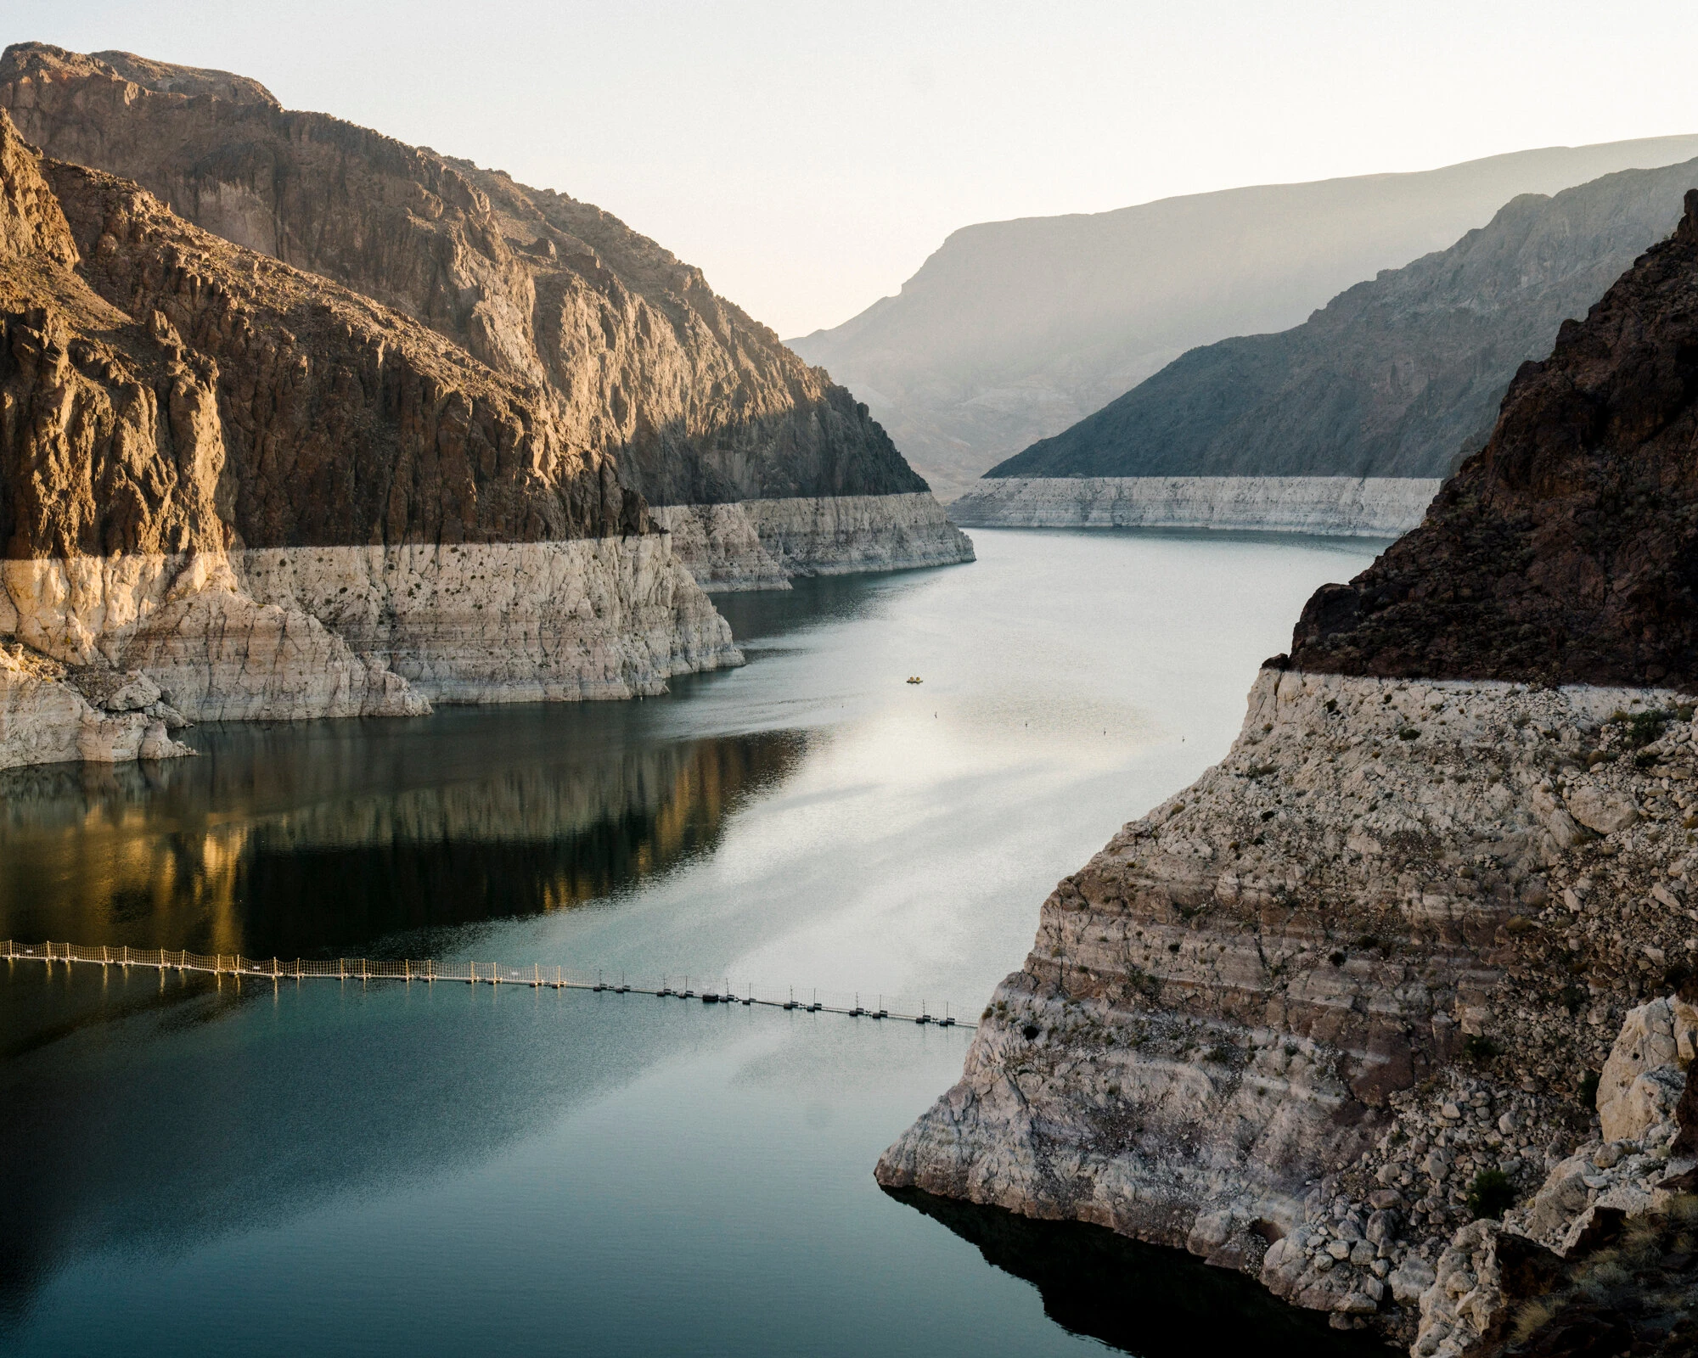
Determinants of Productivity: Natural Resources
In the news: https://www.nytimes.com/2021/08/27/sunday-review/colorado-river-drying-up.html?smid=url-share
Lake Mead has been losing water since the 1980s
“bathtub ring”
This is reducing water available for farming

Slide 24
Case Study: are natural resources a limit to economic growth?
Not necessarily
Innovation has enabled us to do more and more with less and less
Prices of most natural resources (adjusted for overall inflation) have actually been stable or falling
Innovation has enabled us to cope with the finite availability of natural resources

Slide 25
Determinants of Productivity: Technological Knowledge
Technological Knowledge refers to our scientific understanding of the best ways to produce various goods and services.
Increases in technological knowledge require investment in research and development
And further investment may be needed
to train workers to use the new technology and
to install the new machinery that embodies the new technology
All this usually requires a sacrifice of consumption and leisure

Slide 26
The Hockey Stick of Human Prosperity
Video: https://youtu.be/t9FSnvtcEbg

Slide 27
An Orgy of Innovation
Video: https://youtu.be/RRWKzVlbXEY

Slide 28
Puzzle of Growth: Rich Countries and Poor Countries
Video: https://youtu.be/u5P8AZRBLac

Slide 29
Determinants of Productivity: Government
The availability of physical capital, human capital, natural resources, and technology does not guarantee that these resources will be properly utilized
Government must:
provide proper incentives to households and firms in private sector
provide public goods
conserve common resources
ensure law and order

Slide 30
What Makes a Nation Rich?
According to Daron Acemoglu, an MIT economist, the answer is … government!
Poor people are poor because they made the wrong choices
They made the wrong choices because their governments gave them the wrong incentives
Fix government to fix poverty

Slide 31
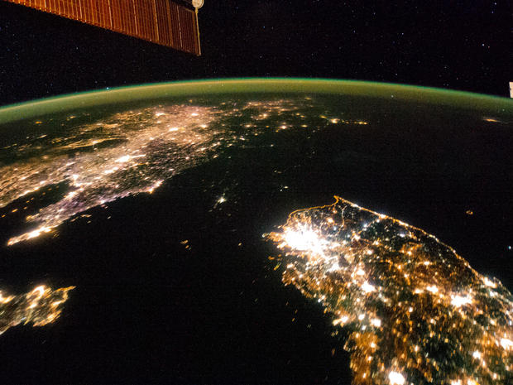
What Makes a Nation Rich?
This NASA image shows a night view of the Korean Peninsula.
Apart from a spot of light in Pyongyang, North Korea is mostly cloaked in darkness, with China (top left) and South Korea (bottom right) on either side.

Slide 32
The Importance of Institutions
Video: https://youtu.be/wdKBfXRpNsk

Slide 33
What Makes a Nation Rich?
The Mexico-USA border fence splits Nogales into two halves that are identical in every way except government
Median household income is $30,000 on the USA side and $10,000 on the Mexico side
China has been transformed in recent decades pretty much entirely because government policies have changed

Slide 34
Economic Growth And Public Policy
What can governments do to raise living standards in a permanent way?

Slide 35
Economic Growth And Public Policy
What can a government do to raise productivity and living standards?
Maybe the government should:
Encourage saving and investment.
Encourage investment from abroad.
Encourage education and invest in healthcare.
Secure property rights and maintain political stability.
Ensure free trade.
Encourage research and development.
Provide roads, bridges, and other infrastructure.
Have a population policy

Slide 36
The Importance of Saving and Investment
If we use fewer resources to produce consumption goods, we will have more resources to
Produce physical capital
Increase human capital through education
Increase technological knowledge through research and development
Increase exploration for natural resources

Slide 37
The Importance of Saving and Investment
But there is a trade-off: less current consumption for more future consumption
It is not clear whether government policies should encourage individuals to sacrifice current consumption for more future consumption

Slide 38
The Importance of Saving and Investment
Moreover, the accumulation of physical capital is subject to diminishing returns

Slide 39
Diminishing Returns and the Catch-up Effect
As a country’s stock of physical capital rises, the extra output produced from an additional unit of capital falls
this property is called diminishing returns.
Because of diminishing returns, an increase in the rate of investment in physical capital leads to higher growth but only for a while.

Slide 40
Illustrating Diminishing Returns
Output
per worker
1
2. When the economy has a
high level of capital, an
extra unit of capital leads to
a small increase in output.
1. When the economy has a low level of capital, an
extra unit of capital leads to a large increase in output.
1
Capital per
worker

Slide 41
Diminishing Returns
In the long run, a higher rate of investment in physical capital leads to a higher level of productivity and income, but not to faster growth of productivity and income.
Saving and investment must be used intelligently, not just to accumulate more and more physical capital, but to pay for education and research and automation.

Slide 42
Bonus: Diminishing Returns and the Catch-up Effect
Diminishing returns also leads to the catch-up effect
The catch-up effect implies that poorer countries would grow more rapidly than rich countries that are otherwise similar.
From 1960 to 1990, the United States and South Korea devoted a similar share of GDP to investment. Yet the United States experience mediocre annual growth of about 2%, while South Korea experienced spectacular growth of more than 6%.

Slide 43
Growth Miracles and Growth Disasters
Video: https://youtu.be/5X5v7vRYQjc

Slide 44
Economic Growth And Public Policy
What can a government do to raise productivity and living standards?
Maybe the government should:
Encourage saving and investment.
Encourage investment from abroad.
Encourage education and invest in healthcare.
Secure property rights and maintain political stability.
Ensure free trade.
Encourage research and development.
Provide roads, bridges, and other infrastructure.
Have a population policy

Slide 45
Investment from Abroad
Governments can increase capital accumulation and long-term economic growth by encouraging investment from foreign sources.

Slide 46
Investment from Abroad
For poor countries, foreign investment may be the only route to progress
If their incomes are barely enough to cover their essential consumption needs, then they would not be able to invest for their future needs
To attract foreign investment, governments must
protect the property rights of investors and
provide adequate infrastructure (roads, ports, etc.)

Slide 47
Investment from Abroad
Investment from abroad takes several forms:
Foreign Direct Investment
Businesses owned and operated by a foreign entity.
Foreign Portfolio Investment
Businesses financed with foreign money but owned and operated by domestic residents.

Slide 48
Investment from Abroad
Foreign investors will take their earnings—interest and profits—back to their own countries
Still, foreign investment creates jobs for domestic workers and raises their productivity and wages
Foreign direct investment is one way for poor countries to learn the use of state-of-the-art technologies

Slide 49
Economic Growth And Public Policy
What can a government do to raise productivity and living standards?
Maybe the government should:
Encourage saving and investment.
Encourage investment from abroad.
Encourage education and invest in healthcare.
Secure property rights and maintain political stability.
Ensure free trade.
Encourage research and development.
Provide roads, bridges, and other infrastructure.
Have a population policy

Slide 50
Education
For a country’s long-run growth, investment in human capital is at least as important as investment in physical capital.
In the United States, each year of schooling raises a person’s wage, on average, by about 10 percent.
In poor countries the payoff is even larger
Thus, one way the government can raise the standard of living is by building schools and providing subsidies to students

Slide 51
Education: A Question
But if education raises students’ incomes, wouldn’t the students (or their parents) use their own money (or borrowed money) to pay for education themselves?
Why should the government provide scholarships and other financial help?
Here we need to remember something taught in microeconomics: externalities

Slide 52
Education: A Beneficial Externality
An educated person might generate new ideas that might expand society’s pool of knowledge and provide an external benefit to others.
When deciding how much education to acquire, the typical individual pays attention to the prospect of earning higher wages but ignores the external benefit of his education to the rest of society.
Therefore, it makes sense for the government to give individuals a subsidy as an extra incentive to go to school.
This is like the government paying for Covid-19 vaccines

Slide 53
Education: Brain Drain
One problem facing some poor countries is the brain drain—the emigration of many of the most highly educated workers to rich countries.
If the recipient of education subsidies in a poor country emigrates to a rich country, the poor country loses its investment and the rich country gains a worker who was educated at another country’s expense

Slide 54
Economic Growth And Public Policy
What can a government do to raise productivity and living standards?
Maybe the government should:
Encourage saving and investment.
Encourage investment from abroad.
Encourage education and invest in healthcare.
Secure property rights and maintain political stability.
Ensure free trade.
Encourage research and development.
Provide roads, bridges, and other infrastructure.
Have a population policy

Slide 55
Health and Nutrition
Less healthy workers are less productive.
Less healthy workers impose an external cost on the rest of society: they can infect others
Countries can get caught in a vicious cycle.
This provides a justification for government efforts to encourage saving and investment to push economic growth
People cannot afford adequate health care and nutritious food.
People are poor

Slide 56
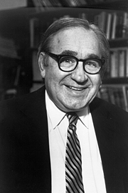
Robert Fogel’s Research
In Great Britain in 1780, about one in five people were so malnourished that they couldn’t do manual labor
As nutrition improved, so did productivity
The causation probably runs both ways: better nutrition makes us more productive and higher productivity makes better nutrition affordable.

Slide 57
Robert Fogel’s Research
As nations get richer, people eat more, and the population gets taller
From 1775 to 1975, the average caloric intake in Great Britain rose by 26 percent, and the height of the average man rose by 3.6 inches.
From 1962 to 1995, the average caloric intake in South Korea rose by 44 percent, and the height of the average man rose by 2 inches.
Studies have found that height is an indicator of productivity.
Taller workers tend to earn more, especially in poor countries.

Slide 58
Economic Growth And Public Policy
What can a government do to raise productivity and living standards?
Maybe the government should:
Encourage saving and investment.
Encourage investment from abroad.
Encourage education and invest in healthcare.
Secure property rights and maintain political stability.
Ensure free trade.
Encourage research and development.
Provide roads, bridges, and other infrastructure.
Have a population policy

Slide 59
Property Rights and Political Stability
Property rights refer to the ability of people to exercise authority over the resources they own.
Enforcement of property rights is an important prerequisite for the free-market system to work.
It is necessary for investors to feel that their investments are secure.
This requires a stable political and judicial system

Slide 60
Economic Growth And Public Policy
What can a government do to raise productivity and living standards?
Maybe the government should:
Encourage saving and investment.
Encourage investment from abroad.
Encourage education and training.
Secure property rights and maintain political stability.
Ensure free trade.
Encourage research and development.
Provide roads, bridges, and other infrastructure.

Slide 61
Free Trade
Trade is, in some ways, a type of technology.
A country that eliminates trade restrictions will experience the same kind of economic growth that would occur after a major technological advance.
Suppose a country’s opportunity cost of a ton of wheat is 5 tons of rice. If this country can import a ton of wheat by exporting 3 tons of rice, it is as if the country’s technology has improved

Slide 62
Free Trade
Some countries engage in . . .
. . . inward-orientated trade policies, avoiding interaction with other countries.
. . . outward-orientated trade policies, encouraging interaction with other countries.
A country that adopts inward-oriented policies will have to make everything it needs, including the things it can’t produce efficiently

Slide 63
Free Trade: Geography
Trade depends not only on government policy but also on geography
Countries with natural seaports and navigable waterways find it easier to trade and prosper
Many of the world’s major cities are located close to oceans
Africa has suffered because many of its countries are landlocked

Slide 64
Geography and Economic Growth
Video: https://youtu.be/B8z6XS2jieE

Slide 65
Economic Growth And Public Policy
What can a government do to raise productivity and living standards?
Maybe the government should:
Encourage saving and investment.
Encourage investment from abroad.
Encourage education and invest in healthcare.
Secure property rights and maintain political stability.
Ensure free trade.
Encourage research and development.
Provide roads, bridges, and other infrastructure.
Have a population policy

Slide 66
Research and Development
The advance of technological knowledge has led to higher standards of living.
Most technological advance comes from research by private firms and individual inventors.
Government can encourage the development of new technologies through research grants, tax breaks, and the patent system.
New knowledge has external benefits
Private researchers will consider only the gains that they can get from their innovations; they will ignore the external benefits
Therefore, it makes sense for the government to subsidize or fully fund research, especially on basic or fundamental science that is valuable but will not be done by private businesses

Slide 67
Economic Growth And Public Policy
What can a government do to raise productivity and living standards?
Maybe the government should:
Encourage saving and investment.
Encourage investment from abroad.
Encourage education and invest in healthcare.
Secure property rights and maintain political stability.
Ensure free trade.
Encourage research and development.
Provide roads, bridges, and other infrastructure.
Have a population policy

Slide 68
Population Growth
Population growth affects the per capita availability of other factors of production by:
Stretching natural resources
Diluting the capital stock
Promoting technological progress
The overall effect of population growth on economic growth is uncertain
It is, therefore, unclear whether a government should encourage or discourage population growth

Slide 69
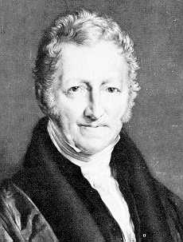
Population Growth: Stretching Natural Resources
Thomas Malthus (1766–1834) had argued that, because of diminishing returns in agriculture, food production could not keep pace with population growth, leading to widespread famines
Boy was he wrong!
Although the world’s population has increased six fold over the past two centuries, living standards are on average much higher today
Diminishing returns lost out to human ingenuity

Slide 70
Population Growth: Diluting the Capital Stock
If each family has a large number of children, it would be difficult to…
… Educate them all. The kids may grow up with less human capital, as a result.
… equip them all with the necessary physical capital
Partly for these reasons, China limits the number of children a family may have
Some people may consider this to be an unacceptable reduction of human freedom

Slide 71
Population Growth: Promoting Technological Progress
If there are more people,
There are more scientists, inventors, and engineers to contribute to technological advance
There is a larger market for innovative goods. This increases the incentive to innovate
Over the broad span of human history, the world’s rate of economic growth has increased as world population has.
Some countries are using economic incentives to encourage population growth. Example: Greece, Hungary, Italy (video)

Slide 72
Alternative perspectives on population growth: Michael Kremer

Slide 73
Melting of the Polar Ice Caps
The melting of the polar ice caps at the end of the Ice Age around 10,000 B.C. raised sea levels
This submerged land bridges that connected various land masses
This meant that some populations got isolated
The populations that happened to be in large connected areas back then were also the most successful ones around the year 1500 (when Columbus reached the Americas)

Slide 74
Population
So, a large population may be both bad and good for living standards
And it is not clear whether governments should encourage or discourage population growth

Slide 75
Any questions?

Slide 76
Summary
Economic prosperity, as measured by real GDP per person, varies substantially around the world.
The average income of the world’s richest countries is more than ten times that in the world’s poorest countries.
The standard of living in an economy depends on the economy’s ability to produce goods and services.

Slide 77
Summary
Productivity depends on the amounts of physical capital, human capital, natural resources, and technological knowledge available to workers.
Government policies can influence the economy’s growth rate in many different ways.

Slide 78
Summary
The accumulation of capital is subject to diminishing returns.
Because of diminishing returns, higher saving leads to a higher growth for a period of time, but growth will eventually slow down.
Also because of diminishing returns, the return to capital is especially high in poor countries.

Slide 79
GDP per capita, PPP (constant 2011 international $)
Country Name | 1990 | 2017 | Growth Multiple | Annual Growth(%)
Equatorial Guinea | 999.50 | 22,604.87 | 22.62 | 12.244
China | 1,526.41 | 15,308.71 | 10.03 | 8.914
Myanmar | 742.97 | 5,591.60 | 7.53 | 7.762
Vietnam | 1,452.88 | 6,171.88 | 4.25 | 5.503
India | 1,754.86 | 6,426.67 | 3.66 | 4.925
Korea, Rep. | 11,632.60 | 35,938.37 | 3.09 | 4.266
Mozambique | 378.53 | 1,136.10 | 3.00 | 4.155
Egypt, Arab Rep. | 5,909.16 | 10,550.21 | 1.79 | 2.170
World | 8,925.59 | 15,469.21 | 1.73 | 2.058
Iran, Islamic Rep. | 11,392.56 | 19,082.62 | 1.68 | 1.929
Israel | 20,520.41 | 33,132.32 | 1.61 | 1.790
Australia | 28,658.37 | 44,648.71 | 1.56 | 1.656
Sweden | 30,933.63 | 46,949.28 | 1.52 | 1.557
United Kingdom | 26,827.84 | 39,753.24 | 1.48 | 1.467
United States | 37,062.13 | 54,225.45 | 1.46 | 1.419
Germany | 31,287.07 | 45,229.25 | 1.45 | 1.374
Canada | 31,299.65 | 44,017.59 | 1.41 | 1.271
Brazil | 10,344.86 | 14,103.45 | 1.36 | 1.154
Mexico | 13,070.44 | 17,336.47 | 1.33 | 1.052
Japan | 30,582.43 | 39,002.22 | 1.28 | 0.905
Russian Federation | 20,639.00 | 24,765.95 | 1.20 | 0.677
Saudi Arabia | 42,457.11 | 49,045.41 | 1.16 | 0.536
Brunei Darussalam | 84,672.39 | 71,809.25 | 0.85 | -0.608
Tajikistan | 3,644.67 | 2,896.91 | 0.79 | -0.847
Ukraine | 10,463.96 | 7,894.39 | 0.75 | -1.038
Zimbabwe | 2,605.79 | 1,899.77 | 0.73 | -1.164
Central African Republic | 925.05 | 661.24 | 0.71 | -1.236
Burundi | 1,087.49 | 702.23 | 0.65 | -1.607
United Arab Emirates | 110,432.46 | 67,293.48 | 0.61 | -1.818
Congo, Dem. Rep. | 1,386.83 | 808.13 | 0.58 | -1.980
Source: https://data.worldbank.org/indicator/NY.GDP.PCAP.PP.KD Downloaded on January 16, 2019

Slide 80
GDP per capita, PPP (constant 2011 international $)
Country Name | 1990 | 2017 | Growth Multiple | Annual Growth(%)
United Arab Emirates | 110,432.46 | 67,293.48 | 0.61 | -1.818
Brunei Darussalam | 84,672.39 | 71,809.25 | 0.85 | -0.608
Saudi Arabia | 42,457.11 | 49,045.41 | 1.16 | 0.536
United States | 37,062.13 | 54,225.45 | 1.46 | 1.419
Canada | 31,299.65 | 44,017.59 | 1.41 | 1.271
Germany | 31,287.07 | 45,229.25 | 1.45 | 1.374
Sweden | 30,933.63 | 46,949.28 | 1.52 | 1.557
Japan | 30,582.43 | 39,002.22 | 1.28 | 0.905
Australia | 28,658.37 | 44,648.71 | 1.56 | 1.656
United Kingdom | 26,827.84 | 39,753.24 | 1.48 | 1.467
Russian Federation | 20,639.00 | 24,765.95 | 1.20 | 0.677
Israel | 20,520.41 | 33,132.32 | 1.61 | 1.790
Mexico | 13,070.44 | 17,336.47 | 1.33 | 1.052
Korea, Rep. | 11,632.60 | 35,938.37 | 3.09 | 4.266
Iran, Islamic Rep. | 11,392.56 | 19,082.62 | 1.68 | 1.929
Ukraine | 10,463.96 | 7,894.39 | 0.75 | -1.038
Brazil | 10,344.86 | 14,103.45 | 1.36 | 1.154
World | 8,925.59 | 15,469.21 | 1.73 | 2.058
Egypt, Arab Rep. | 5,909.16 | 10,550.21 | 1.79 | 2.170
Tajikistan | 3,644.67 | 2,896.91 | 0.79 | -0.847
Zimbabwe | 2,605.79 | 1,899.77 | 0.73 | -1.164
India | 1,754.86 | 6,426.67 | 3.66 | 4.925
China | 1,526.41 | 15,308.71 | 10.03 | 8.914
Vietnam | 1,452.88 | 6,171.88 | 4.25 | 5.503
Congo, Dem. Rep. | 1,386.83 | 808.13 | 0.58 | -1.980
Burundi | 1,087.49 | 702.23 | 0.65 | -1.607
Equatorial Guinea | 999.50 | 22,604.87 | 22.62 | 12.244
Central African Republic | 925.05 | 661.24 | 0.71 | -1.236
Myanmar | 742.97 | 5,591.60 | 7.53 | 7.762
Mozambique | 378.53 | 1,136.10 | 3.00 | 4.155
Source: https://data.worldbank.org/indicator/NY.GDP.PCAP.PP.KD
Data downloaded on January 16, 2019

