Slide 1
8
Saving, Investment, and the Financial System

Slide 2
Prerequisites
These are some of the things you need to know to understand this chapter:
GDP, its components, and the national income identity
Theory of supply and demand (microeconomics)
Measurement of the inflation rate
Real interest rate and nominal interest rate

Slide 3
What’s in This Chapter?
Why should we care about a country’s levels of saving and investment?
What is a nation’s financial system? What does it do and why does it matter?
Why are the levels of saving and investment high at some times (or, for some countries) and low at other times (or, for other countries)?
What can the government do to change a nation’s saving and investment levels?
What should the government do in this regard?

Slide 4
Importance of Saving and Investment
Our standard of living depends on our productivity
Our productivity depends on the availability of physical capital, human capital, natural resources and technology
Improvements in our standard of living (or, simply, economic growth) requires increases in the availability of the above resources
And that in turn requires saving and investment

Slide 5
Saving and Investment
In an earlier chapter (Ch. 5 Measuring a Nation’s Income) investment was defined as:
“the purchase of goods (called capital goods) that will be used in the future to produce more goods and services. Investment is the sum of purchases of business capital, residential capital, and inventories.”
In short, investment is spending by businesses on equipment, structures, and software, and spending by households on new homes

Slide 6
Saving and Investment
Saving is the part of income that is not spent on consumption. This unspent income is used to buy financial assets such as bank deposits, stocks, and bonds.
Warning: Non-economists usually refer to the purchase of stocks, bonds, etc., as investment. Economists call that saving.

Slide 7
The Financial System

Slide 8
The Financial System
The financial system consists of the institutions in the economy that help to match households’ saving with firms’ investment.
It moves the economy’s scarce resources from savers to investors (or, from lenders to borrowers).

Slide 9
Financial Institutions In The U.S. Economy
The financial system is made up of financial institutions that coordinate the actions of savers and borrowers.
Financial institutions can be grouped into two categories:
financial markets and
financial intermediaries.

Slide 10
Financial Institutions In The U.S. Economy
Financial markets are the institutions through which savers can directly provide funds to borrowers.
Financial intermediaries are financial institutions through which savers can indirectly provide funds to borrowers.

Slide 11
Financial Institutions In The U.S. Economy
Financial Markets
Stock Market
Bond Market
Financial Intermediaries
Banks
Mutual Funds

Slide 12
Financial Markets
The Bond Market
A bond is a certificate of indebtedness that specifies obligations of the borrower to the holder of the bond.
The sale of bonds to raise money is called debt financing.

Slide 13
Financial Markets
The Bond Market
Characteristics of a Bond
Term: The length of time until the bond matures.
Credit Risk: The probability that the borrower will fail to pay some of the interest or principal.
Tax Treatment: The way in which the tax laws treat the interest on the bond.
Municipal bonds are federal tax exempt.

Slide 14
Financial Markets
The Stock Market
Stock represents a claim to partial ownership in a firm and is therefore, a claim to the profits that the firm makes.
The sale of stock to raise money is called equity financing.
Compared to bonds, stocks offer both higher risk and potentially higher returns.

Slide 15
Financial Markets
The Stock Market
The most important stock exchanges in the United States are the New York Stock Exchange, the American Stock Exchange, and NASDAQ.
Most newspaper stock tables provide the following information:
Price (of a share)
Volume (number of shares sold)
Dividend (profits paid to stockholders)
Price-earnings ratio

Slide 16
Financial Intermediaries
Financial intermediaries are financial institutions through which savers can indirectly provide funds to borrowers.
Examples:
Banks
Mutual funds
Other

Slide 17
Financial Intermediaries
Banks
take deposits from people who want to save and use the deposits to make loans to people who want to borrow.
pay depositors interest on their deposits and charge borrowers slightly higher interest on their loans.

Slide 18
Financial Intermediaries
Banks
Banks help create money by allowing people to write checks against their deposits.
Money is anything that people can easily use as payment in transactions.
This facilitates the purchases of goods and services.

Slide 19
Financial Intermediaries
Mutual Funds
A mutual fund sells shares to the public and uses the proceeds to buy various types of stocks, bonds, and other financial assets.
The profits/losses are shared with the shareholders.
Mutual funds enable people with small amounts of money to easily diversify.

Slide 20
Financial Intermediaries
Other Financial Institutions
Credit unions
Pension funds
Insurance companies
Loan sharks

Slide 21
Saving And Investment In The National Income Accounts

Slide 22
Saving And Investment In The National Income Accounts
Recall that GDP is both total income in an economy and total expenditure on the economy’s output of goods and services:
Y = C + I + G + NX

Slide 23
Some Important Identities
In this chapter we assume a closed economy – one that does not engage in international trade.
In such an economy, net exports is zero: NX = 0.
Therefore, Y = C + I + G + NX becomes
Y = C + I + G
Now, subtract C and G from both sides of the equation: Y – C – G = I

Slide 24
Saving = Investment
Y – C – G = I
S = I
National Saving (S) is what’s left of total income (Y) after household consumption (C) and government purchases (G): S = Y – C – G
The saving of households ends up loaned to businesses, who then spend the borrowed money

Slide 25
National Saving = Private Saving + Public Saving
S = Y – C – G
The government’s net tax revenues are denoted T.
T = tax revenues – transfer payments
Y – T is total after-tax income or disposable income
S = Y – C – G – T + T
S = Y – T – C + T – G
Private Saving: S_{p} = Y – T – C
Public Saving: S_{g} = T – G
National Saving = Private Saving + Public Saving
S = S_{p} + S_{g}

Slide 26
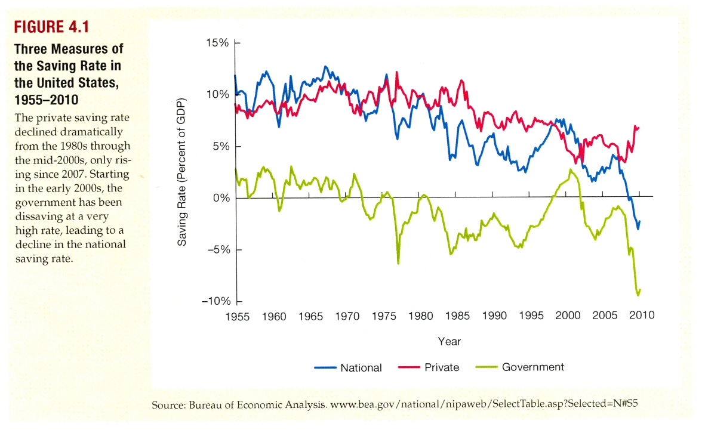
S = S_{p} + S_{g}
Notes:
Figure 4.1 of Macroeconomics: Policy and Practice by Frederic Mishkin

Slide 27
The Meaning of Saving and Investment
Budget Surplus and Budget Deficit
If T > G, the government runs a budget surplus because it receives more money than it spends.
T – G represents public saving.
If G > T, the government runs a budget deficit because it spends more money than it receives in tax revenue.
Fun fact: In the 2013 fiscal year, the US federal government ran a budget deficit of $680 billion (or, 4.1 percent of the GDP of the United States)
Notes:
For data, see http://www.cbo.gov/publication/45010 page 2.

Slide 28
The market for loanable funds
We have just seen that the amount of saving must be equal to the amount of investment. But what about desired saving and desired investment? They must be equal to their corresponding actual amounts, as households and businesses cannot be forced to do what they don’t want to do. So, what makes desired saving equal to desired investment?

Slide 29
The Market for Loanable Funds
We have seen that, for the economy as a whole, the amount of saving must be equal to the amount of investment:
S = I
As saving and investment are voluntary activities, this requires S_{desired} = I_{desired}.

Slide 30
The Market for Loanable Funds
As saving is done by the non-business sector—households and governments—and investment is done by the business sector, how would the desired saving of the non-business sector become equal to the desired investment by the business sector??

Slide 31
The Market for Loanable Funds
S_{desired} = I_{desired} is achieved in the market for loanable funds.
You have seen how the buyers’ desired quantity of ice cream is made equal to the sellers’ desired quantity of ice cream in the ice cream market.
A similar process in the market for loanable funds makes desired saving equal to desired investment

Slide 32
The Market For Loanable Funds
The market for loanable funds is the market in which
The supply of loans comes from the saving done by the non-business sector
The demand for loans comes from the investment spending done by businesses
The price of loans reaches an equilibrium at which the supply of loans becomes equal to the demand for loans
The process is not unlike what goes on in other markets, such as the market for ice cream

Slide 33
Supply and Demand for Loanable Funds
The interest rate is the price of a loan.
It represents the amount that borrowers to take a loan and the amount that lenders receive to make a loan.
More precisely, the price of a loan is the real interest rate.
The real interest rate is the inflation-adjusted interest rate
real interest rate = nominal interest rate – inflation rate
See the chapter “Measuring the Cost of Living” for a reminder

Slide 34
Figure 1 The Market for Loanable Funds
Real Interest Rate
Supply
5%
Demand
0
$1,200
Loanable Funds
(in billions of dollars)

Slide 35
Figure 1 The Market for Loanable Funds
Real Interest Rate
Supply
5%
The supply of loans comes from the desired saving of the non-business sector. This depends on:
The real interest rate
Tax incentives
Government saving (T – G)
Households’ incomes and optimism
0
$1,200
Loanable Funds
(in billions of dollars)

Slide 36
Figure 1 The Market for Loanable Funds
Real Interest Rate
Supply
The effect of the real interest rate on the supply of loans is shown in the demand curve itself.
5%
The supply of loans comes from the desired saving of the non-business sector. This depends on:
The real interest rate
Tax incentives
Government saving (T – G)
Households’ incomes and optimism
0
$1,200
Loanable Funds
(in billions of dollars)

Slide 37
Figure 1 The Market for Loanable Funds
Supply
Real Interest Rate
Supply
Supply
The effects of the other factors on the supply of loans is shown as shifts of the supply curve.
5%
The supply of loans comes from the desired saving of the non-business sector. This depends on:
The real interest rate
Tax incentives
Government saving (T – G)
Households’ incomes and optimism
0
$1,200
Loanable Funds
(in billions of dollars)

Slide 38
Figure 1 The Market for Loanable Funds
Real Interest Rate
The demand for loans comes from the desired investment spending of businesses. This depends on:
The real interest rate
Tax incentives
Arrival of new technologies
Businesses’ optimism
5%
Demand
0
$1,200
Loanable Funds
(in billions of dollars)

Slide 39
Figure 1 The Market for Loanable Funds
Real Interest Rate
The demand for loans comes from the desired investment spending of businesses. This depends on:
The real interest rate
Tax incentives
Arrival of new technologies
Businesses’ optimism
The effect of the real interest rate on the demand for loans is shown in the demand curve itself.
5%
Demand
0
$1,200
Loanable Funds
(in billions of dollars)

Slide 40
Figure 1 The Market for Loanable Funds
Real Interest Rate
The demand for loans comes from the desired investment spending of businesses. This depends on:
The real interest rate
Tax incentives
Arrival of new technologies
Businesses’ optimism
The effects of the other factors on the demand for loans is shown as shifts of the demand curve.
5%
Demand
0
$1,200
Loanable Funds
(in billions of dollars)

Slide 41
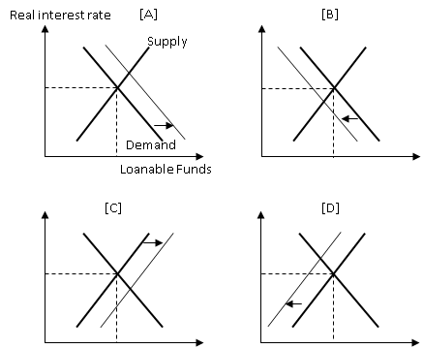
What could cause the change shown in: Panel [A]?
Panel [B]?
Panel [C]?
Panel [D]?

Slide 42
The effect of Government policies on saving and investment

Slide 43
Figure 1 The Market for Loanable Funds
Real Interest Rate
Supply
How can government policies affect this market?
5%
Demand
0
$1,200
Loanable Funds
(in billions of dollars)

Slide 44
Supply and Demand for Loanable Funds
Government Policies can affect Saving and Investment
Taxes can affect saving
Taxes can affect investment
Government budgets can affect saving

Slide 45
Policy 1: Saving Incentives
The interest earned on savings is considered taxable income
Taxes on interest income substantially reduce the future payoff from current saving
As a result, such taxes reduce the incentive to save.
Notes:
It may be a good idea to mention that the income effect counteracts and may even exceed the substitution effect.

Slide 46
Policy 1: Saving Incentives
An income tax cut increases the incentive for households to save, at any given interest rate.
The supply curve of loanable funds shifts to the right.
The equilibrium interest rate decreases.
The quantity of saving and investment increases.

Slide 47
Figure 2 An Increase in the Supply of Loanable Funds
Interest
Supply,
S₁
S₂
Rate
5%
1. Tax incentives for
saving increase the
4%
supply of loanable
fund
s . . .
2.
. . . which
Demand
reduces the
equilibrium
interest rat
e . . .
0
$1,200
$1,600
Loanable Funds
(in billions of dollars)
3.
. . . and raises the equilibrium
quantity of loanable funds.

Slide 48
Policy 2: Investment Incentives
Businesses pay taxes on their profits
The government may reduce a firm’s profits tax on the condition that it spends more on investment
This is called an investment tax credit
An investment tax credit increases the incentive firms have to borrow for investment purposes. So, it
Shifts the demand curve for loanable funds to the right.
The interest rate increases and saving and investment increase as well.

Slide 49
Figure 3 An Increase in the Demand for Loanable Funds
Interest
Rate
Supply
1. An investment
tax credit
6%
increases the
demand for
5%
loanable fund
s . . .
2.
. . . which
raises the
D₂
equilibrium
interest rate . . .
Demand,
D₁
0
$1,200
$1,400
Loanable Funds
(in billions of dollars)
3.
. . . and raises the equilibrium
quantity of loanable funds.

Slide 50
Policy 3: Government Budget Deficits and Surpluses
When the government spends more than it receives in tax revenues, T – G < 0.
the gap is called the budget deficit.
The government must borrow money in the market for loanable funds to fill the gap
The accumulation of past budget deficits is called the government debt.

Slide 51
Policy 3: Government Budget Deficits and Surpluses
Government borrowing to pay for its budget deficit reduces the supply of loanable funds available to pay for investment by households and firms (the private sector).
This fall in investment is referred to as crowding out.
The budget deficit borrowing crowds out private borrowers who are trying to find loans for investment.

Slide 52
Policy 3: Government Budget Deficits and Surpluses
An increase in the budget deficit decreases the supply of loanable funds.
The supply curve of loanable funds shifts to the left.
The interest rate increases.
Saving and investment decrease.

Slide 53
Figure 4: The Effect of a Government Budget Deficit
Interest
S₂
Rate
Supply,
S₁
6%
1. A budget deficit
decreases the
5%
supply of loanable
fund
s . . .
2.
. . . which
raises the
equilibrium
Demand
interest rat
e . . .
0
$800
$1,200
Loanable Funds
(in billions of dollars)
3.
. . . and reduces the equilibrium
quantity of loanable funds.

Slide 54
Policy 3: Government Budget Deficits and Surpluses
Conversely, an increase in the budget surplus increases the supply of loanable funds, reduces the interest rate, and increases the quantity of saving and investment.

Slide 55
Should a government use its policy tools to affect saving and investment?

Slide 56
Should a Nation’s Government Try to Change Its Levels of Saving and Investment?
There’s no clear answer
More saving and investment is not always good for us.
While the future is important, so is the present.
While saving and investment improve our future standard of living, they reduce our current standard of living

Slide 57
Should a Nation’s Government Try to Change Its Levels of Saving and Investment?
The level of saving and investment that comes out of the interactions of savers and investors in the market for loanable funds is usually—though not always—just right
The government should intervene only when
It is clear that the market is likely to malfunction, and
The government is reasonably sure that it would be able to do a better job than the market

Slide 58
The data

Slide 59
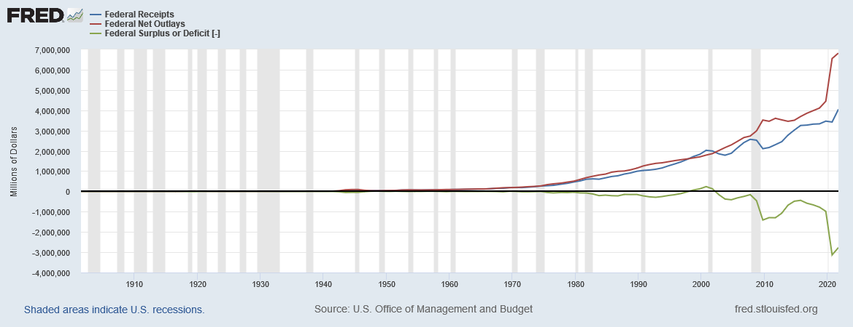
US Federal Government Budget
In fiscal year 2021 (October 1, 2020 -- September 30, 2021), the US federal government had $6,818,158 million in net outlays and $4,045,970 million in receipts. The difference was a budget deficit of $2,772,179 million.
Notes:
Sources: Federal Receipts: https://fred.stlouisfed.org/series/FYFR Federal Net Outlays: https://fred.stlouisfed.org/series/FYONET
Federal Surplus or Deficit: https://fred.stlouisfed.org/series/FYFSD Updated: 3/1/2022

Slide 60
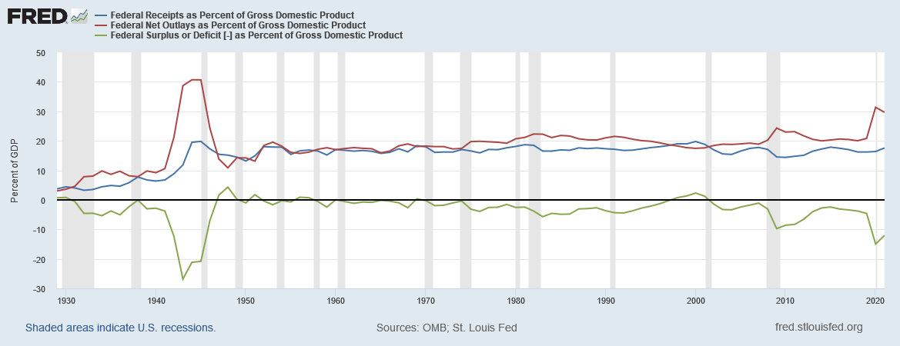
US Federal Government Budget
In fiscal year 2021 (October 1, 2020 -- September 30, 2021), the US federal government’s net outlays were 29.65% of GDP, and receipts were 17.59%. The difference was a budget deficit of 12.05% of GDP.
Notes:
Sources: Receipts: https://fred.stlouisfed.org/series/FYFRGDA188S
Outlays: https://fred.stlouisfed.org/series/FYONGDA188S
Surplus: https://fred.stlouisfed.org/series/FYFSGDA188S
Update: 3/1/2022

Slide 61
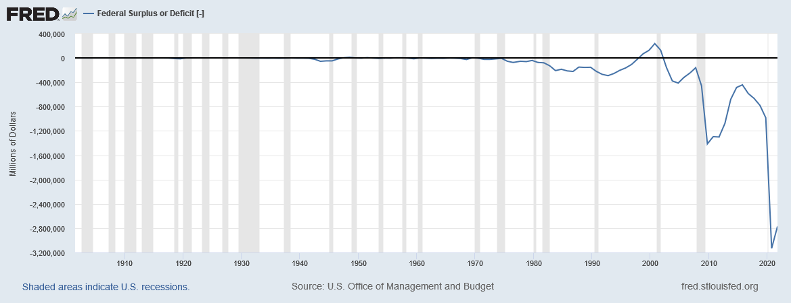
U.S. Federal Government Surplus/Deficit
Source: https://fred.stlouisfed.org/series/FYFSD
Notes:
Downloaded from https://fred.stlouisfed.org/series/FYFSD on 3/1/2022. The years are fiscal years, which begin on October 1 and end on September 30.

Slide 62
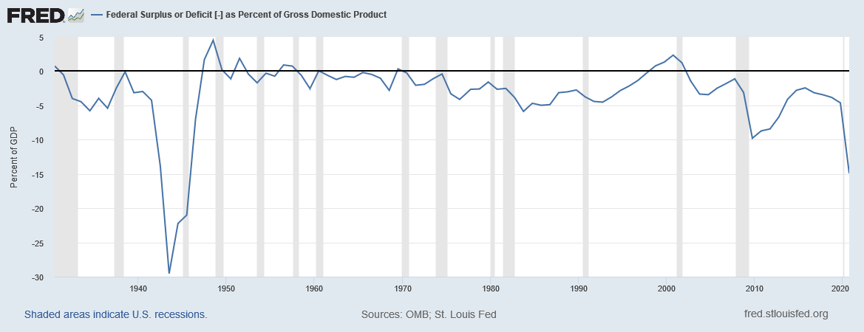
U.S. Federal Government Surplus/Deficit (% of GDP)
Source: https://fred.stlouisfed.org/series/FYFSDFYGDP
Notes:
Downloaded from https://fred.stlouisfed.org/series/FYFSDFYGDP on 3/1/2022. The years are fiscal years, which begin on October 1 and end on September 30.

Slide 63
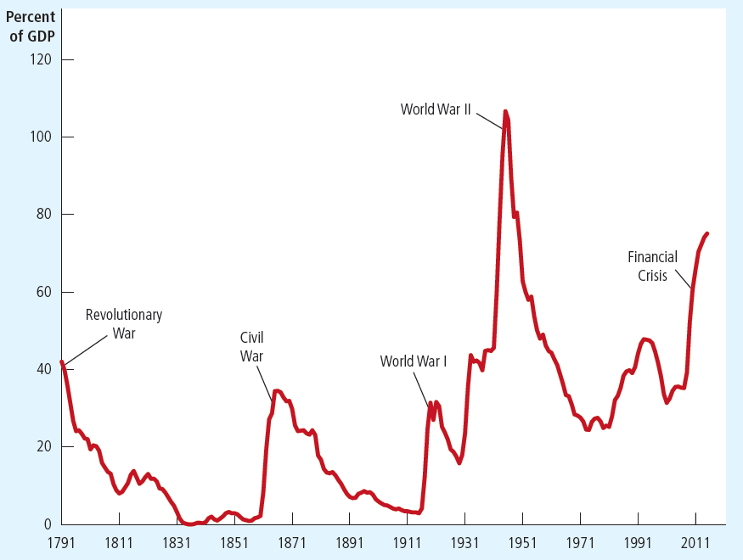
U.S. Government Debt as a Percentage of GDP, 1790–2012
The debt of the U.S. federal government, expressed here as a percentage of GDP, has varied throughout history. Wartime spending is typically associated with substantial increases in government debt. More recent data on next slide.
Notes:
The details below come from the case study ‘The history of U.S. government debt.’
Note that in recent years, debt/GDP is higher than at any time besides WW2, including all other wars.
From the beginning of this long time series until about 1980, the data show a clear pattern: the debt-GDP ratio jumps up during wartime, and comes back down during peacetime. (Also, the Great Depression caused revenues to plummet, and led to a rise in the debt ratio during the 1930s.)
There are two reasons why many economists believe it is appropriate to allow the debt ratio to climb during wars. First, it allows the government to keep tax rates smooth over time. Wars are expensive, and financing them solely with tax increases would be disruptive to the economy and would cause a substantial reduction in economic efficiency. Second, debt finance shifts part of the cost of the war to future generations. This is appropriate, one could argue, because future generations benefit when the government goes to war to defend the nation against foreign aggressors.
The pattern visible throughout most of history breaks down around 1980, when the debt ratio started climbing despite the lack of a major war. This was due to the Reagan tax cuts, and growth in federal entitlement outlays during the 1980s.
From 1992 to 2000, the longest expansion on record plus a strong stock market in 1995–2000 led to a surge in revenues, the first budget surpluses in many years, and a declining debt-GDP ratio.
From 2001–2005, the ratio to start climbing again due to the Bush tax cuts, the 2001 recession, and the wars (Afghanistan, Iraq, and the War on Terror).
The ratio shoots up dramatically in 2008–2012 due to the financial crisis and recession. (increase in the debt-to-GDP ratio from 39% in 2008 to 70% in 2012. )
After 2012, as the economy recovered, the budget deficits shrank, and the increases in the debt-to-GDP ratio became smaller
Sources: Same as text

Slide 64
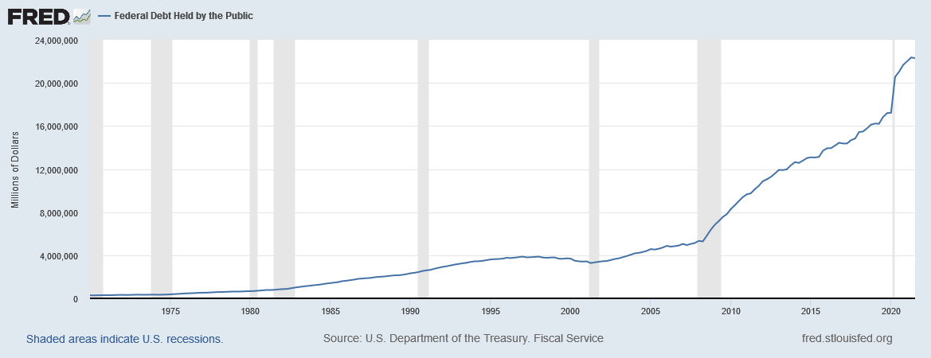
U.S. Federal Government Debt
Notes:
Downloaded from http://research.stlouisfed.org/fred2/series/FYGFDPUN on 3/1/2022.

Slide 65
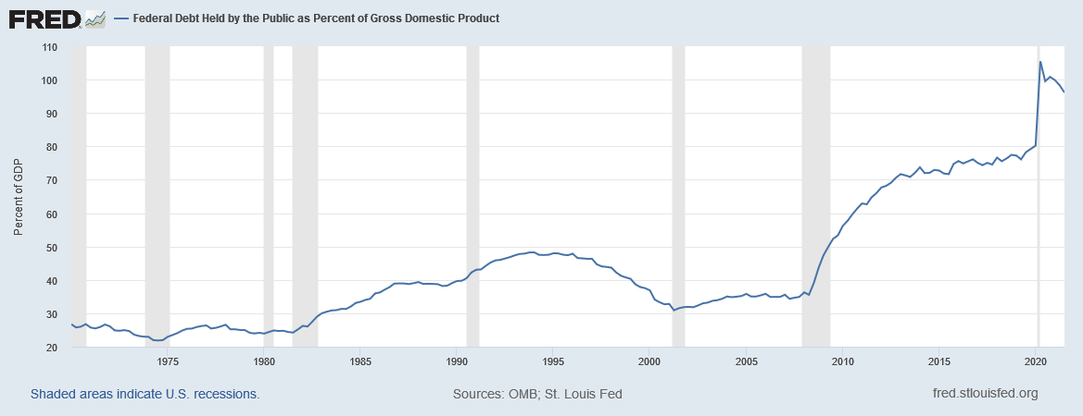
U.S. Federal Government Debt (% of GDP)
Source: https://fred.stlouisfed.org/series/FYGFGDQ188S
Notes:
Source: https://fred.stlouisfed.org/series/FYGFGDQ188S. Downloaded on 3/1/2022.

Slide 66
Any Questions?

Slide 67
Summary
The U.S. financial system is made up of financial institutions such as the bond market, the stock market, banks, and mutual funds.
All these institutions act to direct the resources of households who want to save some of their income into the hands of households and firms who want to borrow.

Slide 68
Summary
National income accounting identities reveal some important relationships among macroeconomic variables.
In particular, in a closed economy, national saving must equal investment.
Financial institutions attempt to match one person’s saving with another person’s investment.

Slide 69
Summary
The interest rate is determined by the supply and demand for loanable funds.
The supply of loanable funds comes from households who want to save some of their income.
The demand for loanable funds comes from households and firms who want to borrow for investment.

Slide 70
Summary
National saving equals private saving plus public saving.
A government budget deficit represents negative public saving and, therefore, reduces national saving and the supply of loanable funds.
When a government budget deficit crowds out investment, it reduces the growth of productivity and GDP.

