Slide 1
10
Unemployment
Notes:
Unemployment rate and LFPR, definitions and formulas; unemployment = natural + cyclical; natural unemployment = frictional + structural; frictional unemp depends on (a) stability of consumer prefs, (b) stability of comparative advantage, (c) geographical clustering of industries, and (d) unemployment insurance. Unemp insurance can increase fric unemp but it can have benefits too; struc unemp depends on (a) min wage laws, (b) unions, (c) efficiency wages. Pros and cons of min wage laws and unions. Unions have shrunk in the US. Efficiency wages paid to increase worker effort and worker productivity, and to attract talent.

Slide 2
Prerequisites
These are some of the things you need to know to understand this chapter:
Theory of supply and demand (microeconomics)

Slide 3
UNEMPLOYMENT
The problem of unemployment is usually seen as two separate problems:
The long-run problem, and
the short-run problem
Long-run unemployment is also called natural unemployment
Short-run unemployment is also called cyclical unemployment

Slide 4
IDENTIFYING UNEMPLOYMENT
Natural Rate of Unemployment
The natural rate of unemployment is unemployment that does not go away on its own even in the long run.
It is the amount of unemployment that the economy normally experiences.
This chapter focuses on the natural rate of unemployment

Slide 5
IDENTIFYING UNEMPLOYMENT
Cyclical Unemployment
Cyclical unemployment refers to the year-to-year fluctuations in unemployment around its natural rate.
It is associated with short-term ups and downs of the business cycle.
This chapter ignores cyclical unemployment

Slide 6
Outline
Unemployment rate: definition and calculation
Labor Force Participation Rate: definition and calculation
unemployment = natural unemployment + cyclical unemployment;
natural unemployment = frictional unemployment + structural unemployment;
frictional unemployment depends on:
(a) stability of consumer preferences,
(b) stability of comparative advantage,
(c) geographical clustering of industries, and
(d) unemployment insurance.
Unemployment insurance:
can increase frictional unemployment
but it can have benefits too;
structural Unemployment depends on:
(a) min wage laws,
(b) unions,
(c) efficiency wages.
min wage laws: pro and con
unions: pro and con
Unions have shrunk in the US.
Efficiency wages paid by businesses to:
increase worker effort
increase worker productivity, and
attract talent.

Slide 7
The data

Slide 8
UNEMPLOYMENT FACTS
Three Basic Questions:
How does government measure the economy’s rate of unemployment?
What problems arise in interpreting the unemployment data?
How long are the unemployed typically without work?

Slide 9
How Is Unemployment Measured?
Unemployment is measured in the US by the Bureau of Labor Statistics (BLS).
It surveys 60,000 randomly selected households every month.
The survey is called the Current Population Survey.

Slide 10
How Is Unemployment Measured?
Based on the answers to the survey questions, the BLS places each adult into one of three categories:
Employed
Unemployed
Not in the labor force
Labor force = employed + unemployed
Adult population = labor force + not in the labor force

Slide 11
How Is Unemployment Measured?
The BLS considers a person an adult if he or she is over 16 years old.
An adult is considered employed if he or she has spent most of the previous week working at a paid job.
An adult is considered unemployed if he or she
is on temporary layoff,
is looking for a job, or
is waiting for the start date of a new job.

Slide 12
How Is Unemployment Measured?
A person who is neither employed nor unemployed is not in the labor force
Examples:
a full-time student,
a homemaker, or
a retiree.

Slide 13
Figure 1 The Breakdown of the Population in August 2021
Unemployment Rate = 100 × 8.4 ÷ 161.5 = 5.2%
Employed
Labor Force
(153.2 million)
(161.5 million)
Adult
US data: Population: http://research.stlouisfed.org/fred2/series/CNP16OV
Labor Force: http://research.stlouisfed.org/fred2/series/CLF16OV
Employed: http://research.stlouisfed.org/fred2/series/CE16OV
Unemployed: http://research.stlouisfed.org/fred2/series/unemploy
Not in the Labor Force: http://research.stlouisfed.org/fred2/series/LNS15000000
Unemployment Rate: https://fred.stlouisfed.org/series/UNRATE
Labor Force Participation Rate: https://fred.stlouisfed.org/series/CIVPART
Population
(261.6 million)
Unemployed (8.4 million)
Labor Force Participation Rate = 100 × 161.5 ÷ 261.6 = 61.7%
Not in labor force
(100.1 million)

Slide 14
How Is Unemployment Measured?
The unemployment rate is the percentage of the labor force that is unemployed.

Slide 15
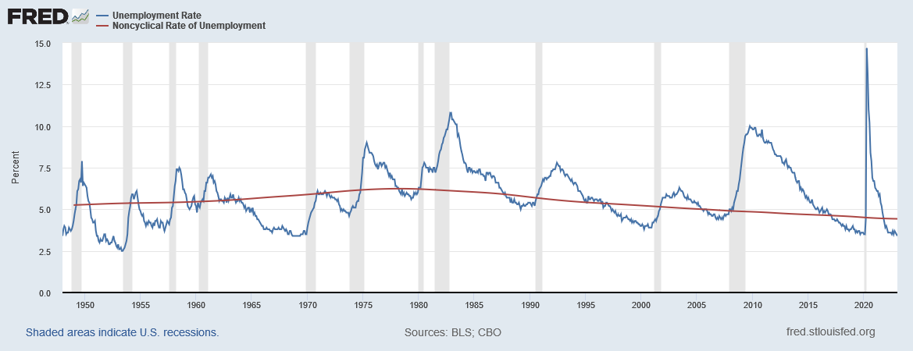
Figure 2: Unemployment Rate since 1950
Sources: Unemployment Rate: https://fred.stlouisfed.org/series/UNRATE Natural Unemployment Rate: https://fred.stlouisfed.org/series/NROU .
Notes:
Downloaded on Feb. 27, 2023

Slide 16
How Is Unemployment Measured?
The labor-force participation rate is the percentage of the adult population that is in the labor force.

Slide 17
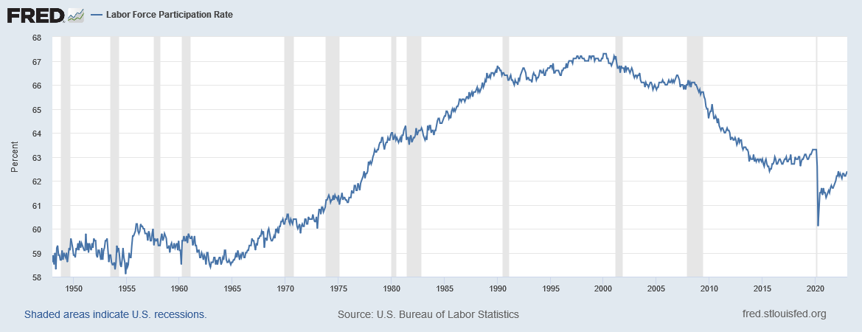
Civilian Labor Force Participation Rate
Participation Rate = 100 × Labor Force / Population
CIVPART = 100 × CLF16OV / CNP16OV
Source: http://research.stlouisfed.org/fred2/series/CIVPART
Notes:
Downloaded on Feb. 27, 2023

Slide 18
Keep and Eye on the Unemployment Rate and the Participation Rate
 | Population | Labor Force | Employed | Unemployed | Unemployment Rate (%) | Participation Rate (%)
Situation A | 10 | 10 | 9 | 1 | 10 | 100
Situation B | 10 | 9 | 9 | 0 | 0 | 90
In this made-up example, an unemployed person drops out of the labor force after repeated failures to find a job. (Such people are called discouraged workers.) The unemployment rate “improves”. But the labor market picture is unchanged. Lesson: A fall in the unemployment rate represents a genuine improvement only if the participation rate has not fallen at the same time.

Slide 19
Bonus: Variation across groups

Slide 20
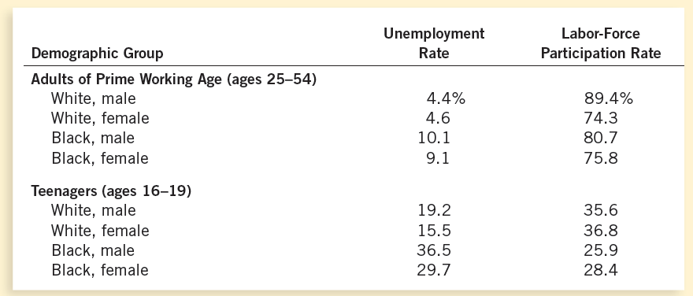
Table 1: The Labor-Market Experiences of Various Demographic Groups
This table shows the unemployment rate and the labor-force participation rate of various groups in the U.S. population for 2014.

Slide 21
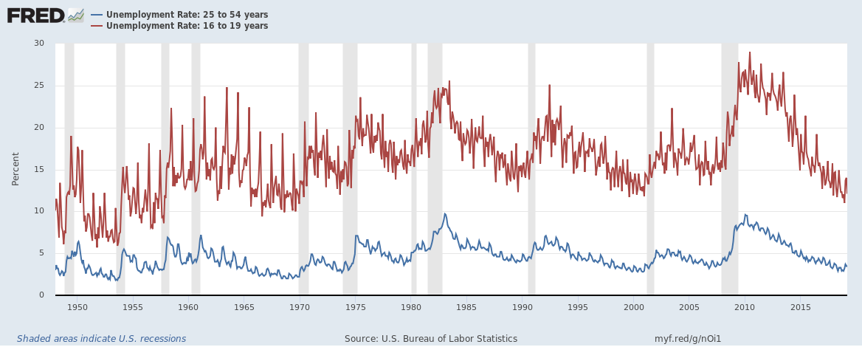
Unemployment and Age
Source: Unemployment Rate: 16 to 19 years https://fred.stlouisfed.org/series/LNU04000012.
Unemployment Rate: 25 to 54 years https://fred.stlouisfed.org/series/LNU04000060.
Neither series is seasonally adjusted.
Notes:
Unemployment Rate: 16 to 19 years https://fred.stlouisfed.org/series/LNU04000012.
Unemployment Rate: 25 to 54 years https://fred.stlouisfed.org/series/LNU04000060.
Neither series is seasonally adjusted.

Slide 22
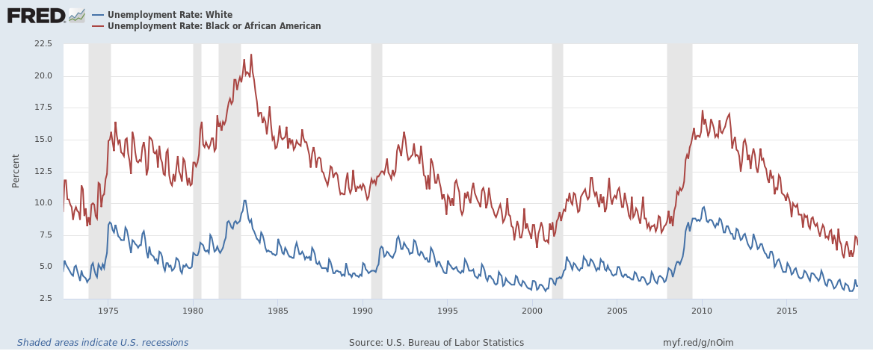
Unemployment and Race
Source: Unemployment Rate: Black or African American https://fred.stlouisfed.org/series/LNU04000006.
Unemployment Rate: White https://fred.stlouisfed.org/series/LNU04000003.
Neither series is seasonally adjusted.
Notes:
Unemployment Rate: Black or African American https://fred.stlouisfed.org/series/LNU04000006.
Unemployment Rate: White https://fred.stlouisfed.org/series/LNU04000003.
Not seasonally adjusted.

Slide 23
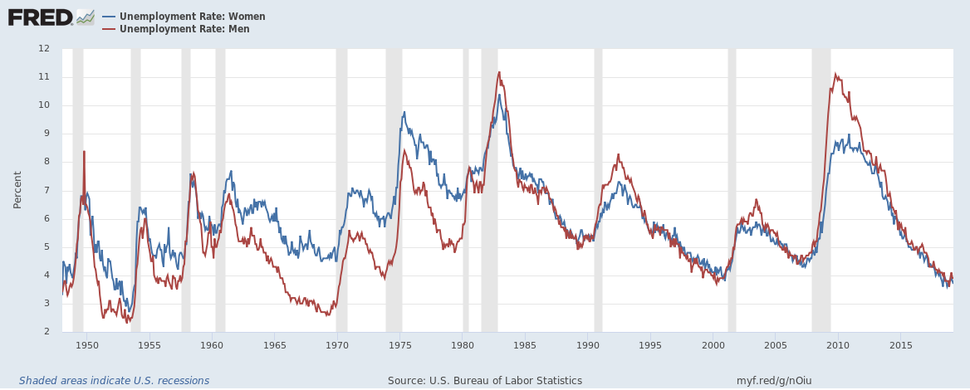
Unemployment and Sex
Source:
Unemployment Rate: Men https://fred.stlouisfed.org/series/LNS14000001.
Unemployment Rate: Women https://fred.stlouisfed.org/series/LNS14000002.
Seasonally adjusted.
Notes:
Unemployment Rate: Men https://fred.stlouisfed.org/series/LNS14000001.
Unemployment Rate: Women https://fred.stlouisfed.org/series/LNS14000002.
Seasonally adjusted.

Slide 24
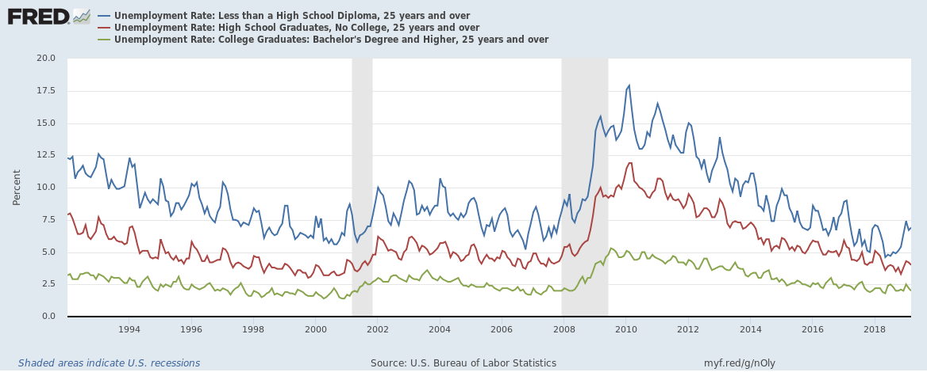
Unemployment and Education
Source: Unemployment Rate: College Graduates: Bachelor's Degree and Higher, 25 years and over https://fred.stlouisfed.org/series/LNU04027662.
Unemployment Rate: High School Graduates, No College, 25 years and over https://fred.stlouisfed.org/series/LNU04027660.
Unemployment Rate: Less than a High School Diploma, 25 years and over https://fred.stlouisfed.org/series/LNU04027659.
Not seasonally adjusted.
Notes:
Unemployment Rate: College Graduates: Bachelor's Degree and Higher, 25 years and over https://fred.stlouisfed.org/series/LNU04027662.
Unemployment Rate: High School Graduates, No College, 25 years and over https://fred.stlouisfed.org/series/LNU04027660.
Unemployment Rate: Less than a High School Diploma, 25 years and over https://fred.stlouisfed.org/series/LNU04027659.
Not seasonally adjusted.

Slide 25
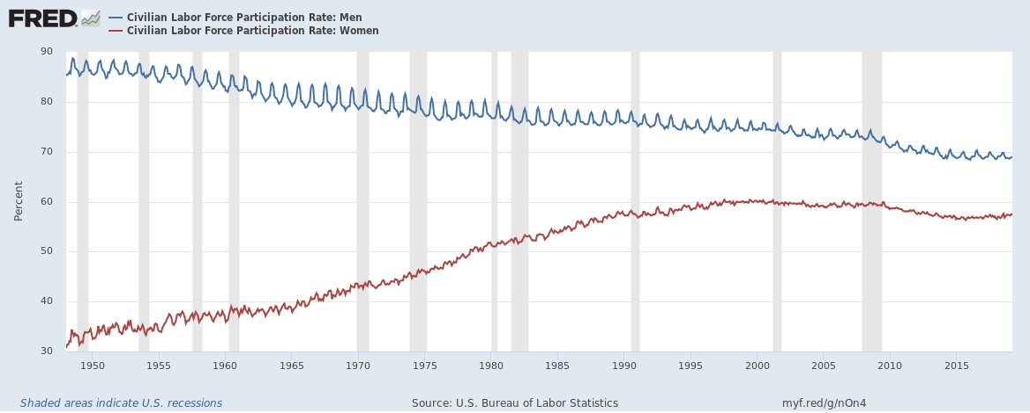
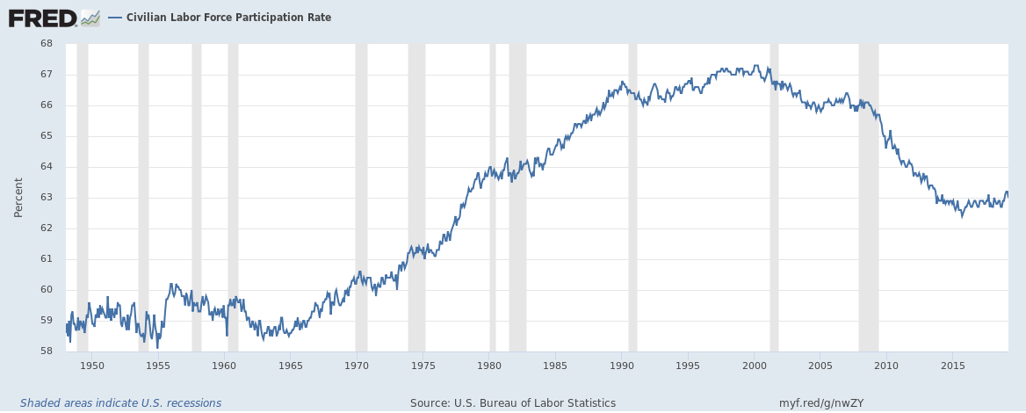
Figure 3: Labor Force Participation Rate: Sex
Source: Civilian Labor Force Participation Rate: Men https://fred.stlouisfed.org/series/LNU01300001.
Civilian Labor Force Participation Rate: Women https://fred.stlouisfed.org/series/LNU01300002
Notes:
Civilian Labor Force Participation Rate: Men https://fred.stlouisfed.org/series/LNU01300001.
Civilian Labor Force Participation Rate: Women https://fred.stlouisfed.org/series/LNU01300002

Slide 26
What explains the rise in the female participation rate?
New technology in the home
Women have more time available for paid work
Improved birth control
Fewer children to take care of
Changing political and social attitudes
Greater employment opportunities for educated women

Slide 27
What explains the fall in the male participation rate?
Longer schooling
Earlier retirement and longer lives
Higher female employment
More fathers stay home to raise children

Slide 28
Bonus: Does the unemployment rate accurately measure how hard it is to get a job?

Slide 29
Does the Unemployment Rate Measure What We Want It To?
It is difficult to distinguish between a person who is unemployed and a person who is not in the labor force.
Discouraged workers, people who would like to work but have given up looking for jobs after an unsuccessful search, don’t show up in unemployment statistics.
Other people may claim to be unemployed in order to receive financial assistance, even though they aren’t looking for work.

Slide 30
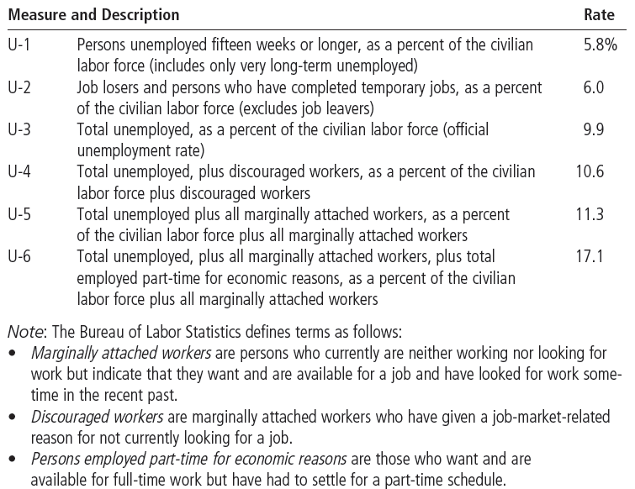
Table 2: Alternative Measures of Labor Underutilization
The table shows various measures of joblessness for the U.S. economy. The data are for April 2010.

Slide 31
How Long Are the Unemployed without Work?
Most spells of unemployment are short.
Most unemployment observed at any given time is long-term.
Most of the economy’s unemployment problem is attributable to relatively few workers who are jobless for long periods of time.

Slide 32
Outline
Unemployment rate: definition and calculation
Labor Force Participation Rate: definition and calculation
unemployment = natural unemployment + cyclical unemployment;
natural unemployment = frictional unemployment + structural unemployment;
frictional unemployment depends on:
(a) stability of consumer preferences,
(b) stability of comparative advantage,
(c) geographical clustering of industries, and
(d) unemployment insurance.
Unemployment insurance:
can increase frictional unemployment
but it can have benefits too;
structural Unemployment depends on:
(a) min wage laws,
(b) unions,
(c) efficiency wages.
min wage laws: pro and con
unions: pro and con
Unions have shrunk in the US.
Efficiency wages paid by businesses to:
increase worker effort
increase worker productivity, and
attract talent.

Slide 33
Persistent Unemployment: theory, causes and cures

Slide 34
Why Are There Always Some People Unemployed?
In an ideal labor market, wages would adjust to balance the supply and demand for labor, ensuring that all workers are fully employed.
Wage
Labor Supply
W_{E}
Labor Demand
Q_{E}
Quantity of labor

Slide 35
Natural Unemployment = Frictional Unemployment + Structural Unemployment
But in the real world there is always some unemployment
This persistent/long-run unemployment is called natural unemployment
There are two kinds of natural unemployment:
Frictional unemployment, and
Structural unemployment

Slide 36
Why Are There Always Some People Unemployed?
Frictional unemployment is the unemployment that results from the time that it takes to match jobseekers with jobs.
While jobseekers search for the jobs that best suit their tastes and skills they are technically unemployed.
This unemployment occurs even when the labor market is in equilibrium and the number of jobseekers is equal to the number of vacant jobs
Wage
Labor Supply
W_{E}
Labor Demand
Q_{E}
Quantity of labor

Slide 37
Why Are There Always Some People Unemployed?
Structural unemployment is the unemployment that results because the number of jobs available in some labor markets is insufficient to provide a job for everyone who wants one.
Structural unemployment occurs when the wage is stuck at a level higher than the equilibrium wage

Slide 38
Figure 4 Unemployment from a Wage Above the Equilibrium Level
Wage
Surplus of labor
=
Labor
Unemployment
supply
W_{H}
W_{E}
Labor
demand
0
L_{D}
L_{E}
L_{S}
Quantity of
Labor

Slide 39
Frictional Unemployment: Mismatch
After a period of time, it might become clear to a worker or to an employer that they are not a good match
This is a normal feature of any modern economy
The worker would have to spend time searching for a new job
During the search process, the worker is frictionally unemployed

Slide 40
Frictional Unemployment: Changing Tastes
Consumers’ tastes change. Old industries fall out of favor and disappear. New industries emerge.
This is a normal feature of any modern economy
Workers in a dying industry must search for jobs in other industries
During the search process, these workers are frictionally unemployed

Slide 41
Frictional Unemployment: Changing Comparative Advantage
Comparative advantages and productivity change. Once successful industries become uncompetitive. Once unsuccessful industries become competitive.
This is a normal feature of any modern economy
Workers in a dying industry must search for jobs in other industries
During the search process, these workers are frictionally unemployed

Slide 42
Frictional Unemployment: Regional Clustering
We have seen that mismatches, changes in tastes, and changes in comparative advantage lead to job search and frictional unemployment
The extent of this frictional unemployment is higher when industries are clustered in certain regions instead of being geographically dispersed
If a region has a good mix of industries, then workers would quickly move from one industry to another without needing to move long distances

Slide 43
Frictional Unemployment: Unemployment Insurance
We have seen that mismatches, changes in tastes, and changes in comparative advantage lead to job search and frictional unemployment
The extent of this frictional unemployment is higher when unemployment insurance is more generous
Generous unemployment insurance gives unemployed workers the incentive to spend more time searching for a job
This could, however, enable a more productive match between job and jobseeker

Slide 44
Public Policy and Job Search
Government programs can affect the time it takes unemployed workers to find new jobs.
These programs include the following:
Government-run employment agencies
Public training programs
Unemployment insurance

Slide 45
Public Policy and Job Search
Government-run employment agencies give out information about job vacancies in order to match workers and jobs more quickly.

Slide 46
Public Policy and Job Search
Public training programs aim to ease the transition of workers from declining to growing industries and to help disadvantaged groups escape poverty.

Slide 47
Public Policy and Job Search
Unemployment insurance is a government program that partially protects workers’ incomes when they become unemployed.
Offers workers partial protection against job losses.
Offers partial payment of former wages for a limited time to those who are laid off.

Slide 48
Public Policy and Job Search
Unemployment insurance increases the amount of search unemployment.
It reduces the search efforts of the unemployed.
It may improve the chances of workers being matched with the right jobs.

Slide 49
Outline
Unemployment rate: definition and calculation
Labor Force Participation Rate: definition and calculation
unemployment = natural unemployment + cyclical unemployment;
natural unemployment = frictional unemployment + structural unemployment;
frictional unemployment depends on:
(a) stability of consumer preferences,
(b) stability of comparative advantage,
(c) geographical clustering of industries, and
(d) unemployment insurance.
Unemployment insurance:
can increase frictional unemployment
but it can have benefits too;
structural Unemployment depends on:
(a) min wage laws,
(b) unions,
(c) efficiency wages.
min wage laws: pro and con
unions: pro and con
Unions have shrunk in the US.
Efficiency wages paid by businesses to:
increase worker effort
increase worker productivity, and
attract talent.

Slide 50
Structural Unemployment
Structural unemployment exists when the wage is higher than the equilibrium wage
So, who keeps the wage that high? It could be…
The government (minimum-wage laws)
The workers (union activity)
The businesses themselves (efficiency wages)

Slide 51
MINIMUM-WAGE LAWS
When the minimum wage is set above the level that balances supply and demand, it creates unemployment.
This does not mean that minimum-wage laws are necessarily bad, only that they cause unemployment.
See Chapter 6 for more on the pros and cons of the minimum wage.

Slide 52
Figure 4 Unemployment from a Wage Above the Equilibrium Level
Wage
Surplus of labor
=
Labor
Unemployment
supply
Minimum wage
W_{E}
Labor
demand
0
L_{D}
L_{E}
L_{S}
Quantity of
Labor

Slide 53
FYI: Who Earns the Minimum Wage?
In 2009, of those workers paid an hourly rate, 4% of men and 6% of women reported wages at or below the prevailing federal minimum wage
Reported wages can be below the minimum wage because (i) some workers are not covered by the law, (ii) enforcement is imperfect, and (iii) some workers round down the wages they report

Slide 54
FYI: Who Earns the Minimum Wage?
Minimum-wage workers tend to be young
About half of all workers earning the minimum wage or less were under age 25, and about one-fourth were age 16-19.
Among employed teenagers, 19% earned the minimum wage or less, compared with 3% or workers age 25 and older

Slide 55
FYI: Who Earns the Minimum Wage?
Minimum-wage workers tend to be less educated
Among workers paid by the hour and age 16 and older, about 10% of those without a high school diploma earned the minimum wage or less, compared with about 4% of those with a high school diploma (but no college), and about 3% of those with a college degree

Slide 56
FYI: Who Earns the Minimum Wage?
Minimum-wage workers are more likely to be working part time.
Among part-time workers (those who usually work less than 35 hours per week), 11% earned the minimum wage or less, compared to 2% of full-time workers

Slide 57
FYI: Who Earns the Minimum Wage?
The leisure and hospitality industry had the highest proportion of workers earning the minimum wage or less (21%)
About half of all workers earning the minimum wage or less were in this industry
However, many of these workers earn tips in addition to their hourly wages

Slide 58
FYI: Who Earns the Minimum Wage?
The proportion of workers earning the minimum wage or less has fallen since 1979

Slide 59
UNIONS AND COLLECTIVE BARGAINING
A union is a worker association that bargains with employers over wages and working conditions.
In the 1940s and 1950s, when unions were at their peak, about a third of the U.S. labor force was unionized.
A union is a type of cartel attempting to exert its market power.

Slide 60
UNIONS AND COLLECTIVE BARGAINING
The process by which unions and firms agree on the terms of employment is called collective bargaining.

Slide 61
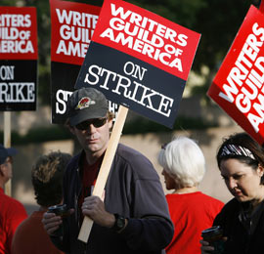
UNIONS AND COLLECTIVE BARGAINING
A strike will be organized if the union and the firm cannot reach an agreement.
A strike refers to when the union organizes a withdrawal of labor from the firm.

Slide 62
UNIONS AND COLLECTIVE BARGAINING
A successful strike makes some workers better off and other workers worse off.
Workers in unions (insiders) reap the benefits of collective bargaining, while workers not in the union (outsiders) bear some of the costs.

Slide 63
UNIONS AND COLLECTIVE BARGAINING
By acting as a cartel with ability to strike or otherwise impose high costs on employers, unions usually achieve above-equilibrium wages for their members.
Union workers earn 10 to 20 percent more than nonunion workers.
Their fringe benefits are typically worth two to four times as much.
The financial advantage is even greater for workers with little formal education and training and for women, blacks, and Hispanic workers.
More than 85 percent of union members have health insurance, compared with 57 percent of non-union workers.

Slide 64
Are Unions Good or Bad for the Economy?
Critics argue that unions cause the allocation of labor to be inefficient and inequitable.
Wages above the competitive level reduce the quantity of labor demanded and cause unemployment.
Some workers benefit at the expense of other workers.

Slide 65
Are Unions Good or Bad for the Economy?
Advocates of unions contend that unions are a necessary antidote to the market power of firms that hire workers.
They claim that unions are important for helping firms respond efficiently to workers’ concerns.

Slide 66
THE THEORY OF EFFICIENCY WAGES
Efficiency wages are above-equilibrium wages paid by firms in order to increase worker productivity.
The theory of efficiency wages states that firms operate more efficiently if wages are above the equilibrium level.

Slide 67
THE THEORY OF EFFICIENCY WAGES
A firm may prefer higher-than-equilibrium wages for the following reasons:
Worker Health: Better paid workers eat a better diet and thus are more productive.
Worker Turnover: A higher paid worker is less likely to look for another job.
Worker Effort: Higher wages motivate workers to put forward their best effort.
Worker Quality: Higher wages attract a better pool of workers to apply for jobs.

Slide 68
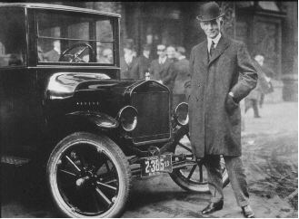
Henry Ford’s experiment
Henry Ford introduced the assembly line technique in automobile production, thereby ushering in a productivity revolution
In 1914, Ford began paying his workers $5 per day, which was far above the norm
It is $150 per day in 2023 money
See for yourself using the BLS’s inflation calculator: https://www.bls.gov/data/inflation_calculator.htm
And keep in mind that workers were far, far less productive back then

Slide 69
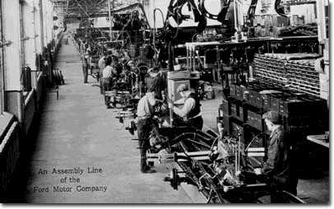
Henry Ford’s experiment
Turnover and absenteeism fell.
Productivity rose so much that Ford’s costs fell
Henry Ford himself called the $5-a-day wage “one of the finest cost-cutting moves we ever made”

Slide 70
Any questions?

Slide 71
Outline
Unemployment rate: definition and calculation
Labor Force Participation Rate: definition and calculation
unemployment = natural unemployment + cyclical unemployment;
natural unemployment = frictional unemployment + structural unemployment;
frictional unemployment depends on:
(a) stability of consumer preferences,
(b) stability of comparative advantage,
(c) geographical clustering of industries, and
(d) unemployment insurance.
Unemployment insurance:
can increase frictional unemployment
but it can have benefits too;
structural Unemployment depends on:
(a) min wage laws,
(b) unions,
(c) efficiency wages.
min wage laws: pro and con
unions: pro and con
Unions have shrunk in the US.
Efficiency wages paid by businesses to:
increase worker effort
increase worker productivity, and
attract talent.

Slide 72
Summary
The unemployment rate is the percentage of those who would like to work but don’t have jobs.
The Bureau of Labor Statistics calculates this statistic monthly.
The unemployment rate is an imperfect measure of joblessness.

Slide 73
Summary
In the U.S. economy, most people who become unemployed find work within a short period of time.
Most unemployment observed at any given time is attributable to a few people who are unemployed for long periods of time.

Slide 74
Summary
One reason for unemployment is the time it takes for workers to search for jobs that best suit their tastes and skills.
A second reason why our economy always has some unemployment is minimum-wage laws.
Minimum-wage laws raise the quantity of labor supplied and reduce the quantity demanded.

Slide 75
Summary
A third reason for unemployment is the market power of unions.
A fourth reason for unemployment is suggested by the theory of efficiency wages.
High wages can improve worker health, lower worker turnover, increase worker effort, and raise worker quality.

