Slide 1
Introduction to Economics
Udayan Roy
Notes:
This lecture is intended to introduce economics in ECO10, ECO11, ECO303, and ECO304.

Slide 2
Introduction to Economics
What is economics?
What is the use of economics?
What are economists expected to do?
How do economists do what they are expected to do?
Why does the economist’s method sometimes fail?
What is macroeconomics? What is microeconomics?

Slide 3
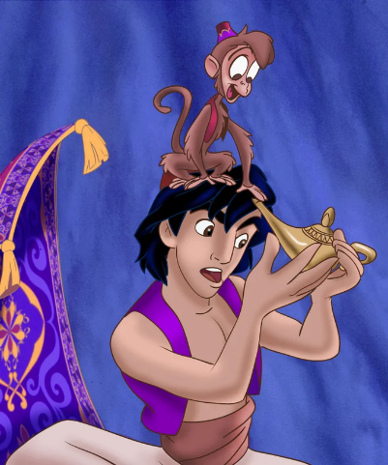
What is Economics?
Economics is the study of
our responses to scarcity, and
the consequences of those responses.
Scarcity – in economics – is the fact that we can’t always get what we want.
None of us has Aladdin’s magic lamp
Notes:
I usually mention Aladdin's magic lamp and say that “scarcity” means not having that lamp.

Slide 4
What is the Use of Economics?
Scarcity compels us to come up with less wasteful ways of running our societies.
We all want progress and we all want to reduce hunger, poverty and inequality.
But our resources are finite.
Therefore, we can’t afford to run our societies in wasteful and inefficient ways.
That’s where good economic policies have a crucial role to play.
That’s where the economist can make a contribution.

Slide 5
What is the Use of Economics?
The goals of a nation should not be coming from economists
It is usually the job of the representatives of the people to determine the nation’s goals
Once the goals have been determined, it is the job of the economist to outline the various policies by which the nation’s goals may be reached (assuming the goals are actually reachable)
The economist must also predict the likely benefits and costs associated with each of the various policies by which the nation’s goals may be achieved
The people’s representatives can then pick the policy they like best

Slide 6
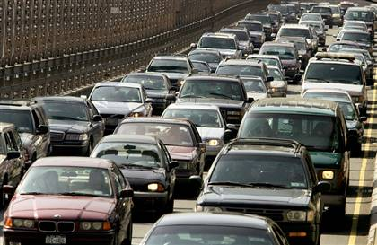
Wasted Resources: Stuck in Traffic
We waste a lot of time stuck in traffic
Economists would want to find a way to reduce this waste of time
Building more roads
may not always be possible,
may not solve the problem, and
would be costly in any case
Charging car owners for the use of a road may be the way to go
Investing in or subsidizing public transport is another option
It is the economist’s job to list the options available and to predict the likely costs and benefits of each option

Slide 7
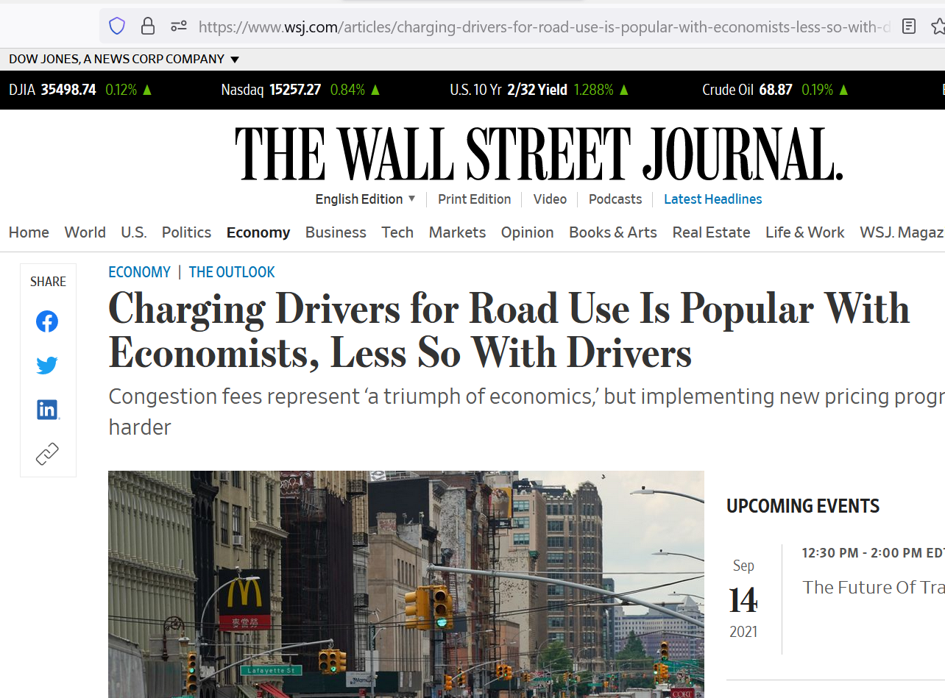
Wasted Resources: Stuck in Traffic
Source: https://www.wsj.com/articles/charging-drivers-for-road-use-is-popular-with-economists-less-so-with-drivers-11630245780
Charging Drivers for Road Use Is Popular With Economists, Less So With Drivers
By David Harrison, The Wall Street Journal, Aug. 29, 2021

Slide 8
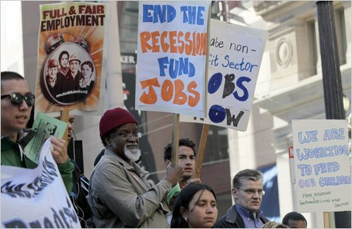
Wasted Resources: Unemployment
What can we do to reduce this waste of resources?
Cut taxes to encourage people to go shopping?
Have the government spend more roads and bridges?
Make overtime work illegal?
Limit imports?
It is the economist’s job to list the options available and to predict the likely costs and benefits of each option

Slide 9
Wasted Resources: Environment Destruction
Global warming may make life unsustainable. What do we do to conserve our natural resources and sustain life?
Carbon tax
Spending on research on renewable fuels, carbon sequestration, and other tech
Notes:
Photo Source: https://media.nationalgeographic.org/assets/photos/000/280/28044.jpg

Slide 10
Ethical Imperatives: Health Care
How can we help the 50 million people who have no health insurance?
Build government-run hospitals like the VA system for veterans? (Read this debate.)
Use taxpayers funds to help the uninsured buy private health insurance?
Allow the import of cheaper drugs?
It is the economist’s job to list the options available and to predict the likely costs and benefits of each option
Cut the length of drug patents?
Make it easier for foreign doctors to work here?
Notes:
Graph from “Income, Poverty, and Health Insurance Coverage in the United States: 2010,” U.S. Census Bureau, September 13, 2011.

Slide 11
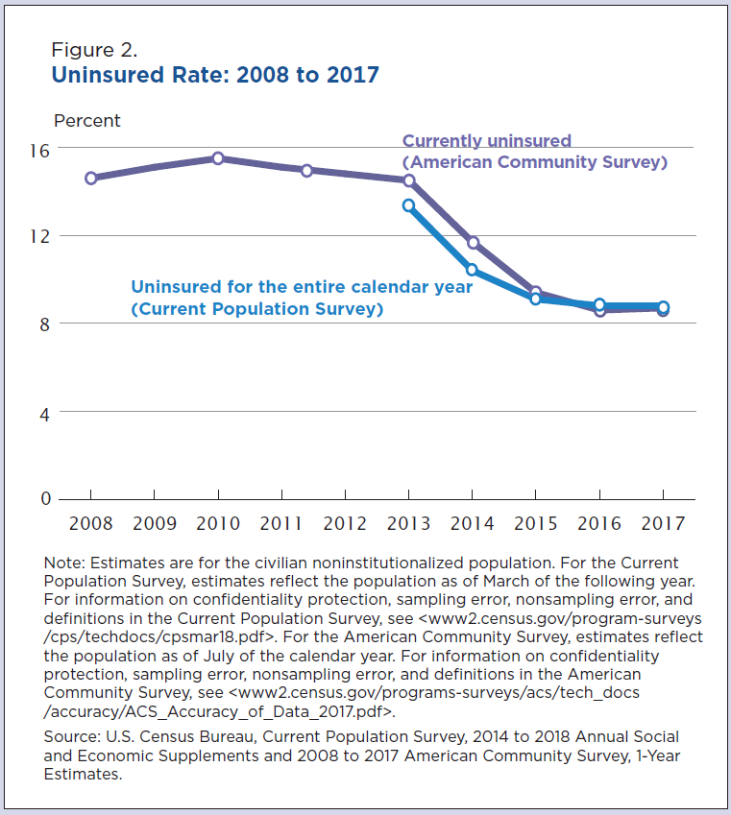
Government policy reform – in this case the Affordable Care Act (or, Obamacare, which was enacted in 2010 and took effect in 2014) – can sometimes make a real difference.
But every policy has both benefits and costs.
Notes:
Source: Health Insurance Coverage in the United States: 2017
Current Population Reports
By Edward R. Berchick, Emily Hood, and Jessica C. Barnett
Issued September 2018
https://www.census.gov/content/census/en/library/publications/2018/demo/p60-264.html?#

Slide 12
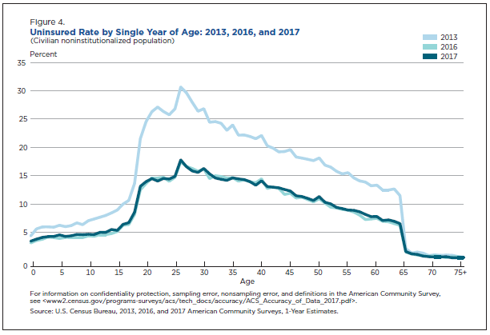
Government policy reform – in this case the Affordable Care Act (or, Obamacare , which was enacted in 2010 and took effect in 2014) – can sometimes make a real difference.
But every policy has both benefits and costs.
Notes:
Source: Health Insurance Coverage in the United States: 2017
Current Population Reports
By Edward R. Berchick, Emily Hood, and Jessica C. Barnett
Issued September 2018
https://www.census.gov/content/census/en/library/publications/2018/demo/p60-264.html?#

Slide 13
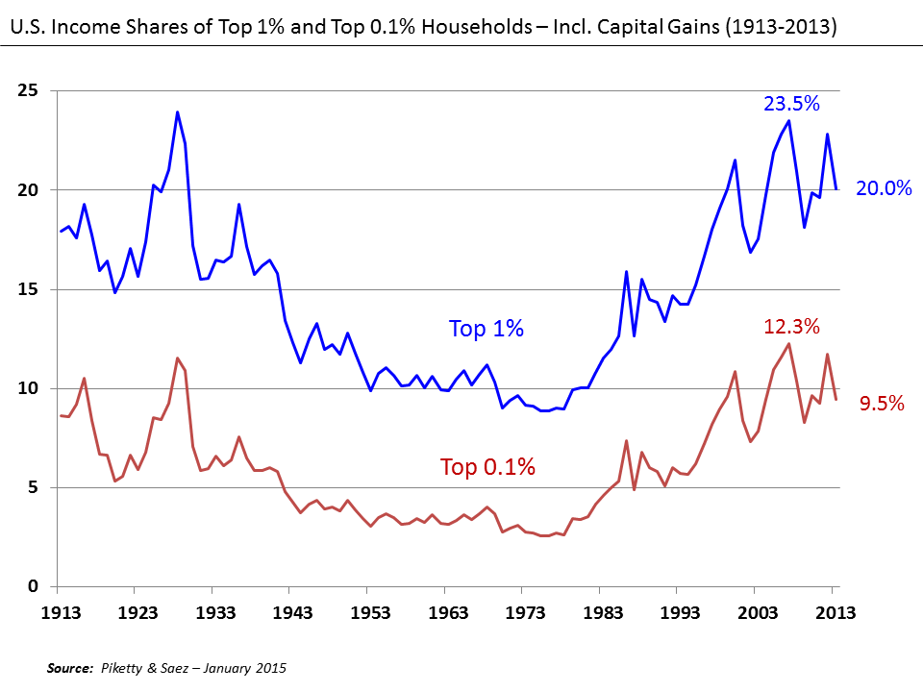
Ethical Imperatives: Inequality
How can we ensure that incomes are more equally shared?
Assuming a more equal nation is what the people want. (Remember that it is not the economist’s job to say what the nation should or should not want.)
Raise taxes on the rich?
Invest in and subsidize higher education?
Change existing laws to strengthen labor unions?
It is the economist’s job to list the options available and to predict the likely costs and benefits of each option
Notes:
Chart source: https://en.wikipedia.org/wiki/Income_inequality_in_the_United_States#/media/File:U.S._Income_Shares_of_Top_1%_and_0.1%_1913-2013.png

Slide 14
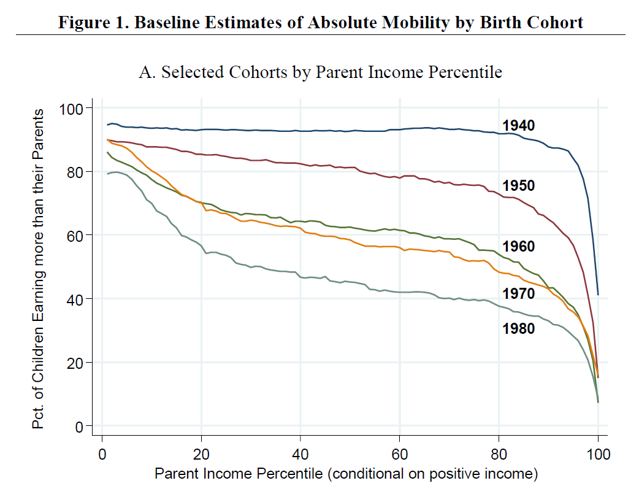
Ethical Imperatives: Intergenerational Mobility
Notes:
Source: Figure 1
The Fading American Dream: Trends in Absolute Income Mobility Since 1940
Raj Chetty, David Grusky, Maximilian Hell, Nathaniel Hendren, Robert Manduca, and Jimmy Narang
NBER Working Paper No. 22910
December 2016

Slide 15
Ethical Imperatives: Intergenerational Mobility
How can we keep the American Dream—the idea that each generation lives better than their parents—alive?
Universal Basic Income
Baby Bonds
Require politicians to raise election campaign money through small donations
Tuition-free college
Notes:
Source: Figure 1A
The Fading American Dream: Trends in Absolute Income Mobility Since 1940
Raj Chetty, David Grusky, Maximilian Hell, Nathaniel Hendren, Robert Manduca, and Jimmy Narang
NBER Working Paper No. 22910
December 2016

Slide 16
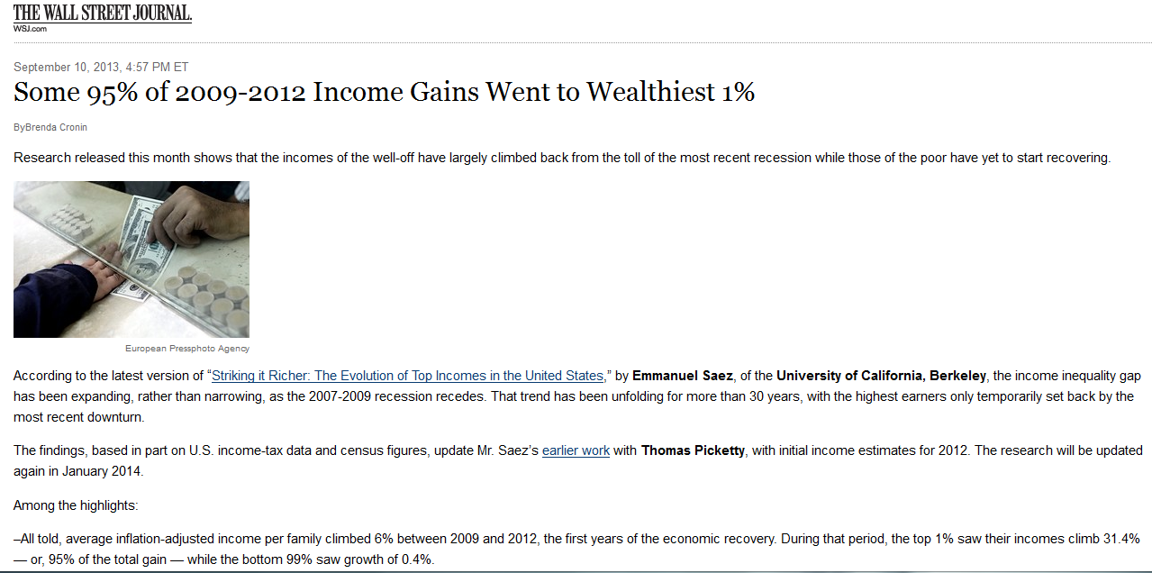

Slide 17
What Are Economists Expected to Do?
As we have just seen, when asked specific policy-related questions, the economist has to think hard and:
Identify the list of the options available to society, and
Make predictions of the consequences—costs and benefits—that would follow from each of those options.
The democratic process must then decide which option to pursue.
And government policies can make a difference:
Government’s Pandemic Response Turned a Would-Be Poverty Surge Into a Record Poverty Decline, By Danilo Trisi, Center for Budget and Policy Priorities, August 29, 2023

Slide 18
When Economic Policies Go Wrong
Joseph Stalin
Mao Zedong
Clearly, the stakes are very high in getting our economic policies right.

Slide 19
When Economic Policies Go Wrong—Stalin
The Soviet leader Stalin is believed to have caused about 40 million deaths during the 1930s in the then Soviet Union in an attempt to collectivize agriculture.

Slide 20
When Economic Policies Go Wrong—Stalin
For more on Stalin’s policies and their effects see
Harvest of Sorrow: Soviet Collectivization and the Terror-Famine by Robert Conquest, Oxford University Press, New York, NY, 1986, ISBN 0195051807.
Bloodlands: Europe Between Hitler and Stalin by Timothy Snyder, Basic Books, New York, NY, 2010, ISBN 978-0465002399.

Slide 21
When Economic Policies Go Wrong—Mao
During 1958-61 there was a famine in China that is estimated to have killed 30 million people.
Those deaths were largely due to the Chinese leader Mao Zedong’s failed economic policy—grandly called “the great leap forward”—of the forced industrialization of China’s agricultural economy.

Slide 22
When Economic Policies Go Wrong—Mao
For more on Mao’s policies and the famine that they caused please read:
Tombstone: The Great Chinese Famine, 1958-1962 by Yang Jisheng, Farrar, Straus and Giroux, New York, NY, 2012, ISBN 978-0374277932.
Hungry Ghosts: Mao’s Secret Famine by Jasper Becker, Free Press, New York, NY, 1996, ISBN: 068483457X.
Mao’s Great Famine: The History of China’s Most Devastating Catastrophe by Frank Dikotter, Walker & Co., New York, NY, 2010, ISBN: 978-0-8027-7768-3.

Slide 23
How Do Economists Do What They Are Expected to Do?
Economists make simplifying assumptions
This helps them make predictions about the likely consequences of different policy options
Economists usually disagree about their predictions
Because different economists make different simplifying assumptions
They try to use data to sort out their disagreements
If all goes well, economists may come up with unambiguous and useful advice for policy makers.

Slide 24
Simplifying Assumptions
An actual economy is extremely complex.
So, it is hard to think about how it would respond to, say, an increase in income tax rates.
Therefore, it would be hard to make even a theoretical prediction of a tax hike’s effect on, say, the unemployment rate
Remember, this is the sort of prediction that the nation might need.
So economists will have to make simplifying assumptions in their analyses. They will have to imagine a simpler economy because …
It might be easier to make a prediction for the simplified imaginary economy than the complex actual economy. (More)

Slide 25
Simplifying Assumptions
These simplifying assumptions must be very carefully chosen so that the hypothetical simplified economy
is not too dissimilar to the actual economy, and
is, at the same time, easier to analyze than the actual economy.
Notes:
I usually discuss the art of making simplifying assumptions in a judicious manner by pointing out that a good cartoon of a public personality must be a simplified but nonetheless easily identifiable likeness.

Slide 26
Predictions: Examples
If income tax rates are increased, the nation’s unemployment rate will increase.
If Florida has a severe winter, the price of orange juice will increase.
If the price of imported oil goes up, the nation’s gross domestic product will decrease.
If the tax per airline ticket is increased, the price of hotel rooms will decrease.

Slide 27
Disagreements Among Economists
There is no universally accepted way for economists to decide which simplifying assumptions are the most appropriate.
Different economists when asked the same question—say, How will an income tax hike affect unemployment?—may make different simplifying assumptions in their analyses.
Therefore, they may end up making different predictions.

Slide 28
Data Helps to Sort Out Disagreements
When economists disagree, the right kind of historical evidence may help them decide which economist’s prediction to trust.
A large part of the economist’s job is to
dig up evidence from the past, and
use the evidence to test the clashing theories that various economists may propose.

Slide 29
Why Does the Economist’s Method Sometimes Fail?
We have just seen that different economists may give different answers (predictions) for the same question.
Those disagreements can’t always be sorted out. (Why?)
This leaves the general public puzzled and annoyed.

Slide 30
Economists’ Disagreements Can’t Always Be Sorted Out
Often there isn’t enough data. When there isn't enough data, one may not be able to choose between clashing theories or predictions.
Economists generally can’t do experiments.
Even if there is a lot of historical data, there is no guarantee that a study of the past will help in identifying the best theory or prediction.
If you toss a coin ten thousand times, you would be no better at predicting the ten thousand and first toss as you were at predicting the first toss.

Slide 31
What Is Macroeconomics? What Is Microeconomics?
Macroeconomics deals with questions about variables that describe the economy of an entire nation. (More)
Microeconomics deals with questions related to individual economic agents, such as households and firms. (More)

Slide 32
Macroeconomics
Macroeconomics deals with issues related to data that give summary descriptions of the economy of an entire nation.
A macroeconomist would ponder questions such as,
what would happen to Uzbekistan’s unemployment rate if Japan suddenly stops trading with Uzbekistan and
what policy should the government of Uzbekistan then follow?
The focus would always be on Uzbekistan as a whole.

Slide 33
Microeconomics
Microeconomics deals with questions related to economic variables that describe a sub-national entity, typically individual economic agents, such as households and firms.

Slide 34
Macro and Micro Are Related
One cannot really do macroeconomics without simultaneously doing microeconomics.
One cannot analyze an economy without studying the behavior of the individual economic units that make up that economy.
However, in macroeconomics the microeconomic underpinnings are de-emphasized.

