Slide 1
Supply, Demand, and Government Policies
Introduction to Microeconomics
Udayan Roy

Slide 2
Sources: Principles of Microeconomics/Economics by N. Gregory Mankiw
Chapter 6: Supply, Demand, and Government Policies
Whole chapter

Slide 3
Sources: Principles of Microeconomics/Economics by Timothy Taylor
Chapter 4: Demand and Supply
Price Ceilings and Price Floors in Markets for Goods and Services

Slide 4
Sources: The Economy by The CORE Team
Unit 8: Supply and Demand
8.7: The effects of taxes

Slide 5
Supply, Demand, and Government Policies
In a free-market system, the prices of goods and the quantities traded are determined by market forces
While the market outcome may have desirable properties, not everyone may be happy with it
Consequently, governments may impose
Price control
Taxes and subsidies
Notes:
2
2

Slide 6
CONTROLS ON PRICES
Price control is usually enacted when policymakers believe the market price is unfair to buyers or sellers.
The government can enact
Price ceilings, and
Price floors.
Notes:
3
3

Slide 7
CONTROLS ON PRICES
Price Ceiling
A legal maximum on the price at which a good can be sold.
In extreme cases, the sale of a particular commodity for cash may be declared illegal; this is equivalent to a price ceiling of zero
Examples: prostitution, ticket scalping, sale of kidneys and other organs
Price Floor
A legal minimum on the price at which a good can be sold.
Notes:
4
4

Slide 8
Price ceilings
Rent control

Slide 9
How Price Ceilings Affect Market Outcomes
A price ceiling is:
not binding if set above the equilibrium price.
binding if set below the equilibrium price.
Key Idea: A binding price ceiling creates a shortage.
Notes:
5
5

Slide 10
A Market with a Price Ceiling
(a) A Price Ceiling That Is Not Binding
Price of
Ice-Cream
Cone
Supply
$4
Price
ceiling
3
Equilibrium
price
Demand
0
100
Quantity of
Equilibrium
Ice-Cream
quantity
Cones

Slide 11
A Market with a Price Ceiling
(b) A Price Ceiling That Is Binding
Price of
Ice-Cream
Cone
Supply
Equilibrium
price
$3
2
Price
Shortage
ceiling
Demand
0
75
125
Quantity of
Quantity
Quantity
Ice-Cream
supplied
demanded
Cones

Slide 12
How Price Ceilings Affect Market Outcomes
Effects of binding price ceilings
Shortages
because quantity demanded > quantity supplied.
Example: Gasoline shortage of the 1970s
Non-price rationing
Examples: Long lines, discrimination by sellers
Notes:
14
11

Slide 13
CASE STUDY: Lines at the Gas Pump
In 1973, OPEC raised the price of crude oil in world markets.
Crude oil is the major input in gasoline, so the higher oil prices reduced the supply of gasoline.
This was followed by long lines of cars at gas pumps. Why?
Economists blame government regulations that limited the price oil companies could charge for gasoline.

Slide 14
The Market for Gasoline with a Price Ceiling
(a) The Price Ceiling on Gasoline Is Not Binding
Price of
Gasoline
Supply,
S₁
1. Initially,
the price
ceiling
is not
binding . . .
Price ceiling
P₁
Demand
0
Q₁
Quantity of
Gasoline

Slide 15
The Market for Gasoline with a Price Ceiling
(b) The Price Ceiling on Gasoline Is Binding
Price of
S₂
Gasoline
2. . . . but when
supply falls . . .
S₁
P₂
Price ceiling
P₁
3. . . . the price
4. . . .
ceiling becomes
resulting
binding . . .
in a
shortage.
Demand
0
Q_{S}
Q_{D}
Q₁
Quantity of
Gasoline

Slide 16
CASE STUDY: Rent Control in the Short Run and Long Run
Rent controls are ceilings placed on the rents that landlords may charge their tenants.
The goal of rent control policy is to help the poor by making housing more affordable.
However, economists tend not to like rent control
One economist called rent control “the best way to destroy a city, other than bombing.”
Notes:
2

Slide 17
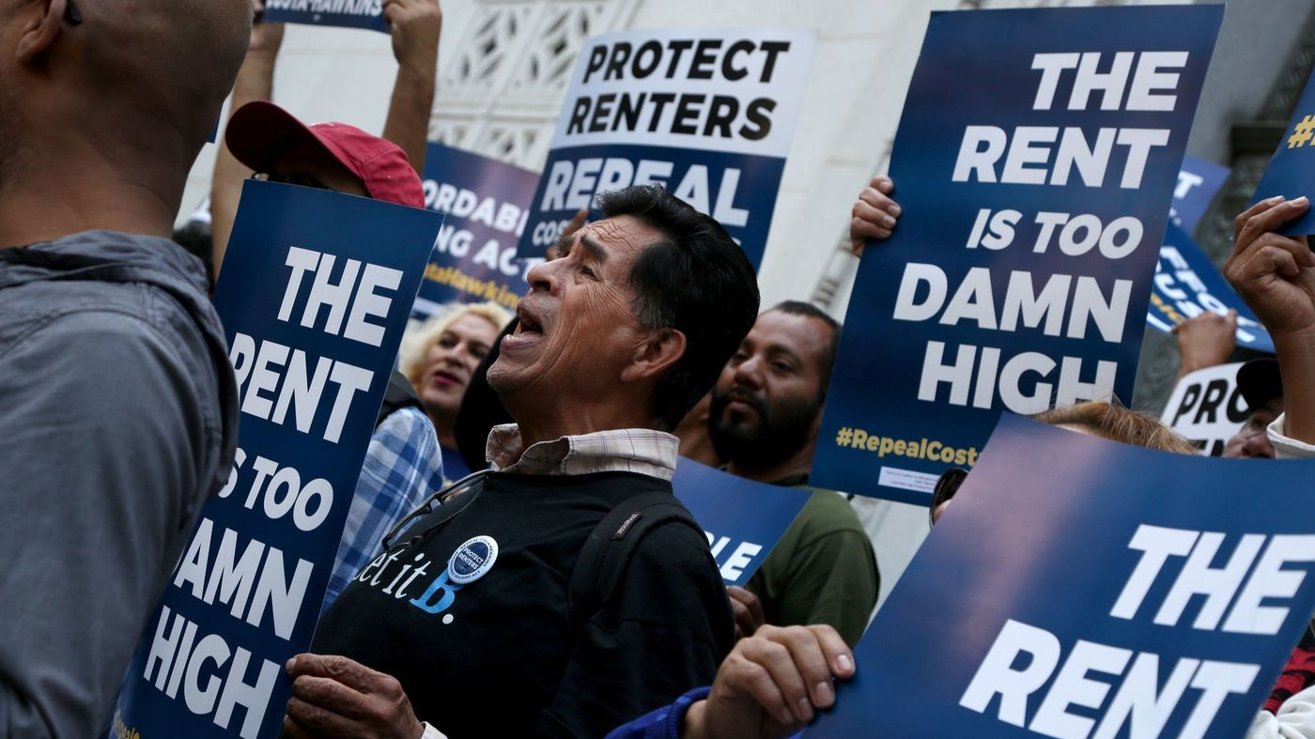
Notes:
Advocates chant on the steps of Los Angeles City Hall in April before the announcement that supporters had turned in signatures to qualify Proposition 10 for the November ballot. (Katie Falkenberg / Los Angeles Times) http://www.latimes.com/politics/la-pol-ca-rent-control-campaign-spending-20181031-story.html

Slide 18
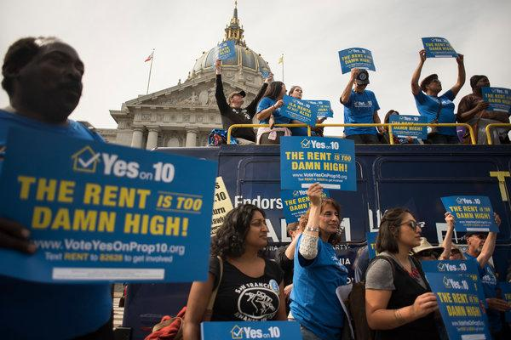
Notes:
A rally in San Francisco by supporters of Proposition 10, a ballot initiative that would loosen California’s restraints on local rent control laws. https://nyti.ms/2A73av7

Slide 19
Rent Control in the Short Run and in the Long Run
(a) Rent Control in the Short Run
(supply and demand are inelastic)
Rental
The consequences of rent control:
1. Some people pay lower rents. They gain; the landlords lose
2. The beneficiaries are often rich and well-connected, not the poor
3. Landlords can discriminate on the basis of race and socio-economic status
4. Bribery
5. Maintenance suffers
Price of
Apartment
Supply
Controlled rent
Shortage
Demand
0
Quantity of
Apartments

Slide 20
Rich Beneficiaries of Rent Control
“Don’t Hate the Influencer Who Loves Her Big, Cheap Apartment. Wouldn’t You?” by Victoria M. Walker, The New York Times, August 30, 2023

Slide 21
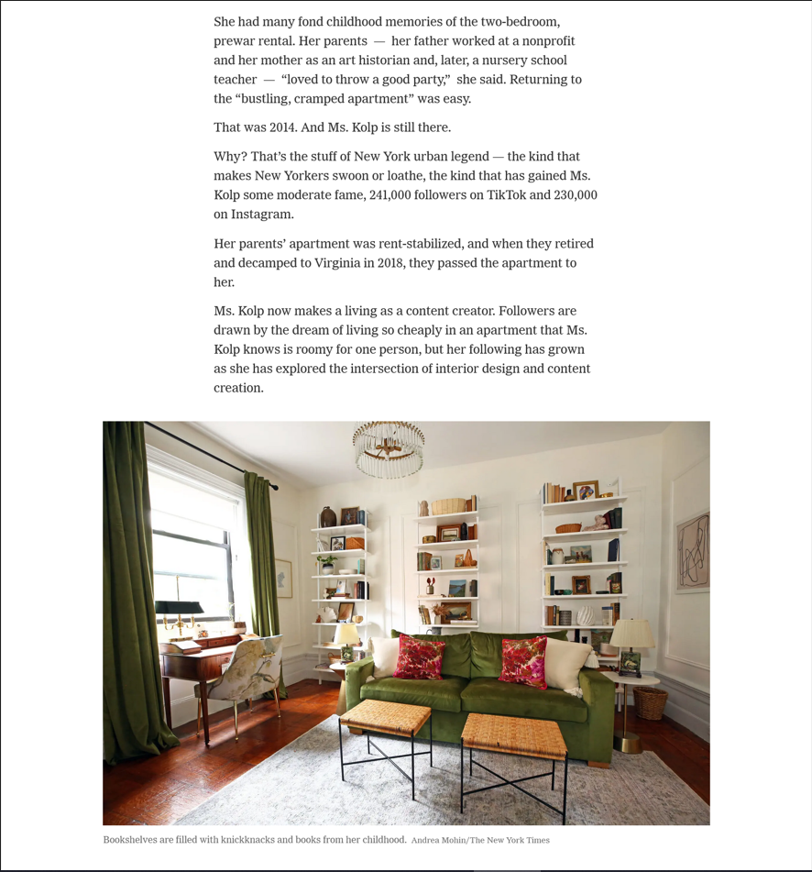
Rich Beneficiaries of Rent Control
“Don’t Hate the Influencer Who Loves Her Big, Cheap Apartment. Wouldn’t You?” by Victoria M. Walker, The New York Times, August 30, 2023

Slide 22
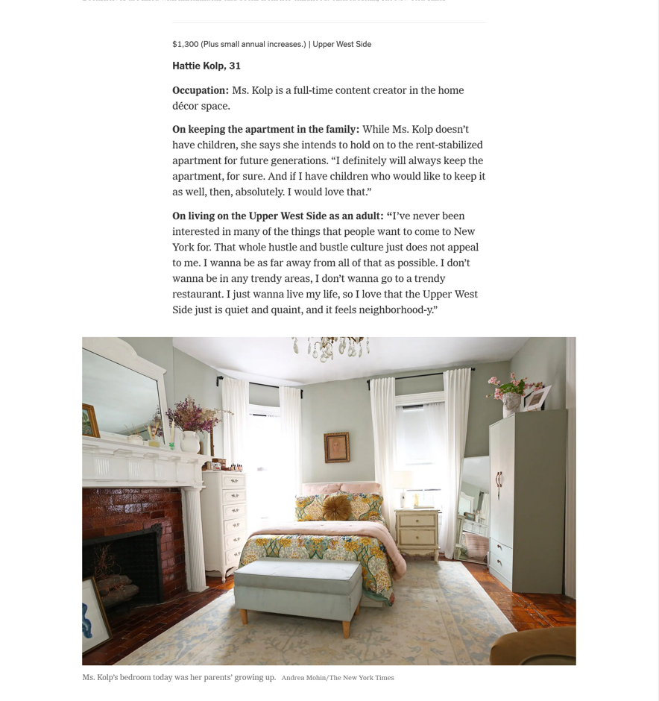
Rich Beneficiaries of Rent Control
“Don’t Hate the Influencer Who Loves Her Big, Cheap Apartment. Wouldn’t You?” by Victoria M. Walker, The New York Times, August 30, 2023

Slide 23
Rent Control in the Short Run and in the Long Run
(b) Rent Control in the Long Run
(supply and demand are elastic)
Rental
Price of
Apartment
Supply
Controlled rent
Shortage
Demand
0
Quantity of
Apartments

Slide 24
An Alternative to Rent Control
If the goal is to help the poor, taxpayer-funded housing subsidies would be better
There would be no shortage
In the sense that quantity supplied would equal quantity demanded
There would be none of the other problems associated with shortages
Specifically, the help would go to the poor and not to those who do not need the help
However, the tax imposed to pay for the housing subsidies would create problems too

Slide 25
Price floors
The minimum wage

Slide 26
How Price Floors Affect Market Outcomes
A price floor is
not binding, if set below the equilibrium price.
Binding, if set above the equilibrium price.
Key Idea: A binding price floor causes a surplus.
Notes:
15
12

Slide 27
A Market with a Price Floor
(a) A Price Floor That Is Not Binding
Price of
Ice-Cream
Cone
Supply
Equilibrium
price
$3
Price
floor
2
Demand
0
100
Quantity of
Equilibrium
Ice-Cream
quantity
Cones

Slide 28
A Market with a Price Floor
(b) A Price Floor That Is Binding
Price of
Ice-Cream
Cone
Supply
Surplus
$4
Price
floor
3
Equilibrium
price
Demand
0
80
120
Quantity of
Quantity
Quantity
Ice-Cream
demanded
supplied
Cones

Slide 29
How Price Floors Affect Market Outcomes
A binding price floor causes . . .
a surplus, because quantity supplied > quantity demanded.
non-price rationing, which is an alternative mechanism for rationing the good, using discrimination criteria.
Examples: The minimum wage, agricultural price supports
Notes:
25
15

Slide 30
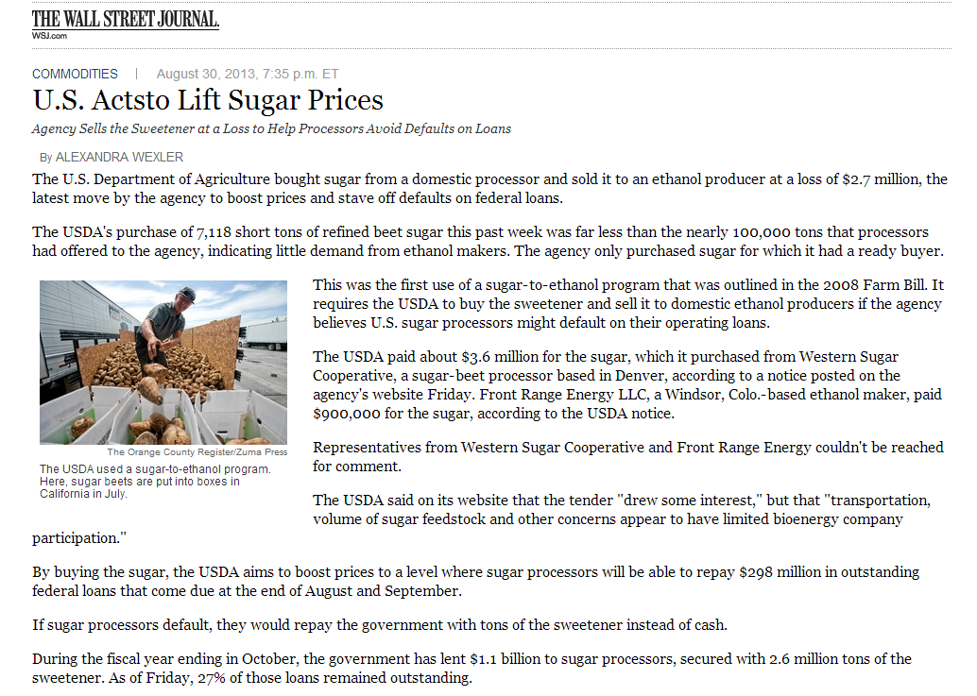
In this example, the U.S. government is controlling prices, not by decree, but by artificially boosting demand for the product. So, no surplus is created.
This is also an example of how one government intervention (cheap loans to farmers) leads to another (price support for farmers).
Technically, this is what’s called a “sweet deal.”

Slide 31
The Minimum Wage
An important example of a price floor is the minimum wage.
Minimum wage laws dictate the lowest wage any employer may pay.
For current US federal and state minimum wage rates, see http://www.dol.gov/whd/minwage/america.htm
For the historical data on minimum wage rates, see http://www.dol.gov/whd/state/stateMinWageHis.htm

Slide 32
How the Minimum Wage Affects the Labor Market
Wage
A labor market without government wage control
Labor
Supply
Equilibrium
wage
Labor
demand
0
Equilibrium
employment
Quantity of
Labor

Slide 33
How the Minimum Wage Affects the Labor Market
Wage
Consequences:
Teen employment falls between 1 and 3 percent for every 10% increase in the minimum wage
But the total income of minimum-wage workers rises
Some teenagers drop out of school
Opportunities for on-the-job training are reduced
Some beneficiaries are teens from middle-class families
Labor
Supply
Labor surplus
(unemployment)
Minimum
wage
Labor
demand
0
Quantity
demanded
Quantity
supplied
Quantity of
Labor

Slide 34
An alternative to the minimum wage
Wage subsidies
Example: the earned income tax credit
Though better, these subsidies are not perfect
They must be paid for by raising taxes, and taxes can have negative effects

Slide 35
Health Care—a price-control exception
In several advanced countries, such as Japan, the prices of pharmaceutical drugs and medical services are controlled by the government
These governments have decided that the market for health care is somehow different and that the theory of price control discussed in this chapter is not applicable
When a market is not perfectly competitive, price control may have desirable effects

Slide 36
Taxes and subsidies

Slide 37
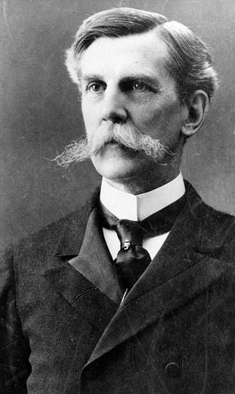
TAXES
Key Idea: Governments impose taxes
to raise revenue for public projects and
to discourage certain activities that society considers harmful
to make society less unfair
“Taxes are the price we pay for a civilized society.”
Oliver Wendell Holmes, Jr., associate justice of the US Supreme Court
Notes:
29
20

Slide 38
How Taxes Affect Market Outcomes
Key Idea: When a good is taxed,
the quantity bought and sold is reduced
buyers and sellers are both adversely affected
the government earns revenue
Notes:
30
22

Slide 39
Taxes and Prices
A tax could be imposed on
buyers, or
sellers, or
both
Key Idea: When there is a tax, the price that buyers pay is no longer the same as the price that sellers get

Slide 40
Taxes and Prices
Buyers pay tax $0.50 per ice cream cone
Sellers pay tax $0.50 per ice cream cone
Suppose sellers, who don’t pay the tax, charge $2.00 per cone
Then the buyers pay $2.50 per cone, after paying the tax
The price paid by the buyer = the price received by the seller + the tax
Suppose buyers, who don’t pay the tax, pay $2.50 per cone
Then the sellers get $2.00 per cone, after paying the tax
The price paid by the buyer = the price received by the seller + the tax

Slide 41
Taxes and Prices
A tax could be imposed on
buyers, or
sellers, or
both
Key Idea: When there is a tax, the price that buyers pay is no longer the same as the price that sellers get
Key Idea: The price paid by the buyer = the price received by the seller + the tax
Price paid by buyer
Tax
Price received by seller

Slide 42
Quantity Supplied = Quantity Demanded
We just saw that when there’s a tax, the price paid by buyers = the price received by sellers + the tax
Another condition that must also be satisfied is that:
Key Idea: In equilibrium, the quantity demanded at the price paid by buyers must be equal to the quantity supplied at the price received by sellers

Slide 43
Price
5.50
Can you show the price-quantity outcome?
5.00
4.50
Price = 3.00 Quantity = 80
Supply
4.00
3.50
A
3.00
2.50
2.00
1.50
Demand
1.00
0.50
0.00
0
10
20
30
40
50
60
70
80
90
100
110
120
Quantity

Slide 44
Price
5.50
Now suppose that buyers must pay a tax of $1.50 per ice cream cone.
5.00
4.50
Supply
4.00
3.50
A
3.00
Can you show the price-quantity outcome after this tax?
(Tax-included) Price buyers pay = ?? Price sellers get = ?? Quantity = ??
2.50
2.00
1.50
Demand
1.00
0.50
0.00
0
10
20
30
40
50
60
70
80
90
100
110
120
Quantity

Slide 45
Price
5.50
Suppose that buyers must pay a tax of $1.50 per ice cream cone.
The quantity demanded after the tax must equal the quantity supplied after the tax. What is this after-tax equilibrium quantity?
5.00
4.50
Supply
B
4.00
Tax = $1.50 per cup
3.50
A
3.00
2.50
C
Step 1: Find the quantity at which the height of Demand exceeds the height of Supply by the size of the tax ($1.50). This is 50, and this is the after-tax equilibrium quantity.
2.00
1.50
Demand
1.00
0.50
0.00
0
10
20
30
40
50
60
70
80
90
100
110
120
Quantity
Post-tax equilibrium quantity demanded and quantity supplied

Slide 46
Price
5.50
As before, suppose that buyers must pay a tax of $1.50 per ice cream cone.
Can you show the tax-included price that buyers will pay?
5.00
4.50
Supply
Buyers Price
B
4.00
Tax = $1.50 per cup
3.50
A
3.00
Step 2: At the after-tax quantity that we saw in the last slide, find the height of the demand curve.
This is $4.00.
And this is the tax-included price that buyers will pay.
2.50
C
2.00
1.50
Demand
1.00
0.50
0.00
0
10
20
30
40
50
60
70
80
90
100
110
120
Quantity
Post-tax equilibrium quantity demanded and quantity supplied

Slide 47
Price
5.50
As before, suppose that buyers must pay a tax of $1.50 per ice cream cone.
Can you show price that sellers will get?
5.00
4.50
Supply
Buyers Price
B
4.00
Tax = $1.50 per cup
3.50
A
3.00
Step 3: At the after-tax quantity that we saw earlier, find the height of the supply curve.
This is $2.50.
And this is the price that sellers will get.
Sellers Price
2.50
C
2.00
1.50
Demand
1.00
0.50
0.00
0
10
20
30
40
50
60
70
80
90
100
110
120
Quantity
Post-tax equilibrium quantity demanded and quantity supplied

Slide 48
Price
5.50
Suppose that buyers must pay a tax of $1.50 per ice cream cone.
Price buyers pay = $4.00 Price sellers get = $2.50
Quantity Demanded = 50
Quantity Supplied = 50
Check that the after-tax equilibrium outcome satisfies our two main requirements:
First, the price paid by the buyer = the price received by the seller + the tax Second, quantity demanded equals quantity supplied
5.00
4.50
Supply
Buyers Price
B
4.00
Tax = $1.50 per cup
3.50
A
3.00
Sellers Price
2.50
C
2.00
1.50
Demand
1.00
0.50
0.00
0
10
20
30
40
50
60
70
80
90
100
110
120
Quantity
Post-tax equilibrium quantity demanded and quantity supplied

Slide 49
When buyers pay a tax of $1.50 per ice cream cone:
Price buyers pay = $4.00 Price sellers get = $2.50
Quantity Demanded = 50
Quantity Supplied = 50
Before the tax, what was the outcome?
Price buyers pay = $3.00 Price sellers get = $3.00
Quantity Demanded = 80
Quantity Supplied = 80
So, the tax has these effects:
Quantity traded decreases
Buyers pay more, but not as much more as the tax
Sellers get less
So, sellers suffer even though it is the buyers who are taxed.
Price
5.50
5.00
4.50
Supply
Buyers Price
B
4.00
Tax = $1.50 per cup
3.50
A
3.00
Sellers Price
2.50
C
2.00
1.50
Demand
1.00
0.50
0.00
0
10
20
30
40
50
60
70
80
90
100
110
120
Quantity
Post-tax equilibrium quantity demanded and quantity supplied

Slide 50
Price
5.50
Now suppose that sellers must pay a tax of $1.50 per ice cream cone.
What will the equilibrium look like?
Price buyers pay = ?? (After-tax) Price sellers get = ??
Quantity Demanded = ??
Quantity Supplied = ??
5.00
4.50
Supply
4.00
3.50
A
3.00
2.50
2.00
1.50
Demand
1.00
0.50
0.00
0
10
20
30
40
50
60
70
80
90
100
110
120
Quantity

Slide 51
Price
5.50
Suppose that sellers must pay a tax of $1.50 per ice cream cone.
Price buyers pay = $4.00 Price sellers get = $2.50
Quantity Demanded = 50
Quantity Supplied = 50
Check that the after-tax equilibrium outcome satisfies our two main requirements:
First, the price paid by the buyer = the price received by the seller + the tax Second, quantity demanded equals quantity supplied
5.00
4.50
Supply
Buyers Price
B
4.00
Tax = $1.50 per cup
3.50
A
3.00
Sellers Price
2.50
C
2.00
1.50
Demand
1.00
0.50
0.00
0
10
20
30
40
50
60
70
80
90
100
110
120
Quantity
Post-tax equilibrium quantity demanded and quantity supplied

Slide 52
When sellers pay a tax of $1.50 per ice cream cone:
Price buyers pay = $4.00 Price sellers get = $2.50
Quantity Demanded = 50
Quantity Supplied = 50
Before the tax, what was the outcome?
Price buyers pay = $3.00 Price sellers get = $3.00
Quantity Demanded = 80
Quantity Supplied = 80
So, the tax has these effects:
Quantity traded decreases
Buyers pay more
Sellers get less, but not as much less as the tax
So, buyers suffer even though it is the sellers who are taxed.
Price
5.50
5.00
4.50
Supply
Buyers Price
B
4.00
Tax = $1.50 per cup
3.50
A
3.00
Sellers Price
2.50
C
2.00
1.50
Demand
1.00
0.50
0.00
0
10
20
30
40
50
60
70
80
90
100
110
120
Quantity
Post-tax equilibrium quantity demanded and quantity supplied

Slide 53
Legal and Economic Incidence
Key Idea: Whether the law puts the tax on buyers or on sellers is economically irrelevant
The economic effect of a tax is the same (in every way) in either case

Slide 54
The effect of a tax, on buyers or on sellers
1. Find the quantity at which the height of the demand curve exceeds the height of the supply curve by the amount of the tax. This will be the after-tax equilibrium quantity.
Buyers’ Price, Sellers’ price
Equilibrium after tax
Price buyers pay after tax
Supply
2. The height of the demand curve at the after-tax equilibrium quantity will tell you the after-tax equilibrium price paid by buyers.
$3.30
Equilibrium without tax
3.00
Tax ($0.50)
Price before tax
2.80
Price sellers get after tax
3. The height of the supply curve at the after-tax equilibrium quantity will tell you the after-tax equilibrium price received by sellers.
4. Buyer’s tax burden = buyer’s price after the tax – buyer’s price when there is no tax = $0.30
5. Seller’s tax burden = seller’s price after the tax – seller’s price when there is no tax = $0.20
Demand
6. Seller’s tax burden + Buyer’s tax burden = tax = $0.50
0
90
100
Quantity
Quantity after tax
Quantity before tax

Slide 55
A Payroll Tax
Wage
Labor supply
Wage firms pay
Tax wedge
Wage without tax
Wage workers
receive
Labor demand
0
Quantity
of Labor

Slide 56
Elasticity and Tax Incidence
Recap: What is the impact of a tax?
When a good is taxed, the quantity sold is smaller.
Buyers and sellers share the tax burden.
Buyers pay more
Sellers receive less
Notes:
30
22

Slide 57
Elasticity and Tax Incidence
We just saw that buyers and sellers share the tax burden.
Key Questions:
In what proportion is the burden of the tax divided between buyers and sellers?
Which side bears more of the burden? (Tax Incidence)
The answer depends on the price elasticity of demand and the price elasticity of supply.
Notes:
39
29

Slide 58
How the Burden of a Tax Is Divided
(a) Elastic Supply, Inelastic Demand
Price
1. When supply is more elastic
than demand . . .
Price buyers pay
Supply
Tax
2. . . . the
incidence of the
Price without tax
tax falls more
heavily on
Price sellers
consumers . . .
receive
3. . . . than
Demand
on producers.
0
Quantity

Slide 59
How the Burden of a Tax Is Divided
(b) Inelastic Supply, Elastic Demand
Price
1. When demand is more elastic
than supply . . .
Price buyers pay
Supply
Price without tax
3. . . . than on
consumers.
Tax
2. . . . the
Demand
Price sellers
incidence of
receive
the tax falls
more heavily
on producers . . .
0
Quantity

Slide 60
ELASTICITY AND TAX INCIDENCE
So, how is the economic burden of the tax divided?
Key Idea: The economic burden of a tax falls more heavily on the side of the market that is less elastic.
Notes:
41
30

Slide 61
Who pays the luxury tax?
In 1990, the US Congress adopted a new tax on luxury items, such as yachts
The goal was to raise revenue from the rich
The demand for yachts is elastic
Because the rich have lots of substitutes to sailing yachts when it comes to entertainment
The supply of yachts is inelastic, especially in the short run
Therefore, the burden of the tax on yachts fell on the workers who make yachts and not on the rich
The tax was repealed in 1993

Slide 62
SUBSIDIES
Key Definition: A subsidy is the opposite of a tax
Here the government is paying people to reward them for taking some action
Key Idea: An activity may be subsidized
To encourage an activity that society considers worthy
To help people who need help
A subsidy will have to be paid for with tax revenues

Slide 63
SUBSIDIES
A subsidy could be given to
Buyers,
Sellers, or
Both
Key Result: Whatever the case, the price received by sellers = the price paid by buyers + the subsidy
Price received by seller
Subsidy
Price paid by buyer
If ice cream sellers charge $2.00 per ice cream cone and buyers receive a $0.50 per cone subsidy, then buyers pay $1.50 per cone.
If ice cream buyers pay $2.50 per cone and sellers receive a $0.50 per cone subsidy, then the price received by sellers is $2.50 per cone.

Slide 64
Quantity Supplied = Quantity Demanded
We just saw that when there’s a subsidy, the price paid by buyers is not the same as the price received by sellers
But there’s another requirement:
Key Idea: In equilibrium, the quantity demanded at the price paid by buyers must be equal to the quantity supplied at the price received by sellers

Slide 65
The effect of a subsidy, for buyers or for sellers
Step 1: Find the quantity at which the height of the supply curve exceeds the height of the demand curve by the amount of the subsidy. This will be the after-subsidy equilibrium quantity.
Step 2: The height of the supply curve at the after-subsidy equilibrium quantity gives the price that sellers get after the subsidy.
Buyers’ Price, Sellers’ Price
Equilibrium after subsidy
Price sellers get after subsidy
Supply
$4.25
Equilibrium without subsidy
Price before subsidy
3.00
Subsidy ($2.50)
1.75
Price buyers pay after subsidy
Step 3: The height of the demand curve at the after-subsidy equilibrium quantity gives the price that buyers pay after the subsidy.
Demand
0
100
120
Quantity
Quantity before subsidy
Quantity after subsidy

Slide 66
Effects of a Subsidy
The equilibrium quantity increases
The price paid by buyers falls
So, buyers gain
The price received by sellers increases
So, sellers gain too
The buyers’ gain + sellers’ gain = the total subsidy
Which side gains how much depends on the price elasticities of demand and supply
The government must raise taxes to pay for the subsidy

Slide 67
Economic Incidence of a Subsidy
Key Result: As in the case of taxes, the effect of a subsidy is greater for whichever side—demand or supply—has the lower elasticity
For example, if demand is inelastic and supply is elastic, the bulk of the benefits of the subsidy will go to the buyers

Slide 68
Summary
Price controls include price ceilings and price floors.
A price ceiling is a legal maximum on the price of a good or service. An example is rent control.
A price floor is a legal minimum on the price of a good or a service. An example is the minimum wage.

Slide 69
Summary
Taxes are used to raise revenue for public purposes.
When the government levies a tax on a good, the equilibrium quantity of the good falls.
A tax on a good places a wedge between the price paid by buyers and the price received by sellers.

Slide 70
Summary
The incidence of a tax refers to who bears the burden of a tax.
The incidence of a tax does not depend on whether the tax is levied on buyers or sellers.
The incidence of the tax depends on the price elasticities of supply and demand.
The burden tends to fall on the side of the market that is less elastic.

