Slide 1
Welfare Analysis: Price Control, Taxes, and Subsidies
Introduction to Microeconomics
Udayan Roy

Slide 2
Sources: Principles of Microeconomics/Economics by N. Gregory Mankiw
Chapter 8: Application: The Costs of Taxation
8-1 The Deadweight Loss of Taxation

Slide 3
Sources: Principles of Microeconomics/Economics by Timothy Taylor
Chapter 4: Demand and Supply
Supply, Demand, and Efficiency
Inefficiency of Price Floors and Price Ceilings

Slide 4
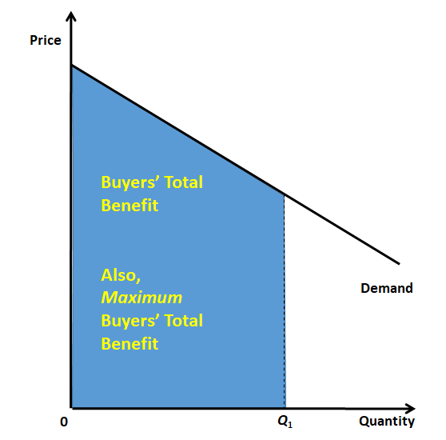
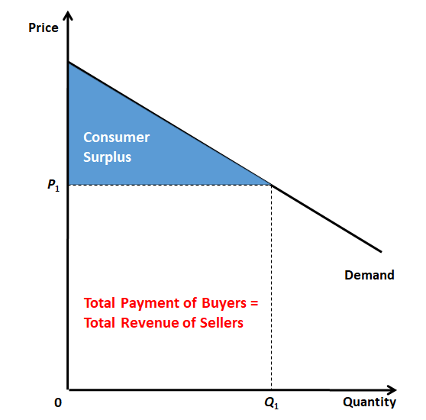
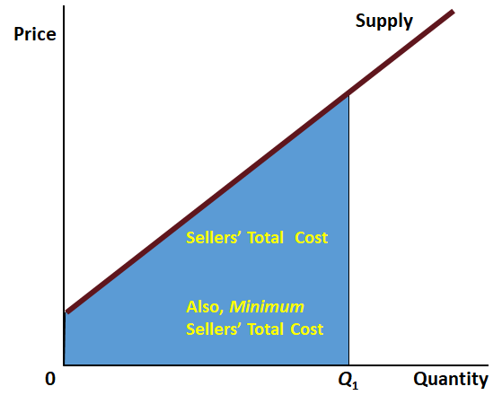
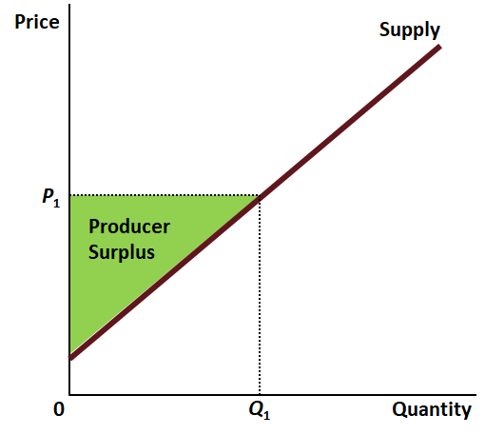
Recap: The Graphical Cornerstones of Welfare Analysis

Slide 5
Total Surplus = Benefit – Cost
 | Benefit | Cost | Total Surplus
Q_{eqm}
Q_{less}
Price
A
Supply
B
C
D
E
Demand
F
G
0
Q_{less}
Q_{eqm}
Quantity

Slide 6
Total Surplus = Benefit – Cost
 | Benefit | Cost | Total Surplus
Q_{eqm} | ABCDEFG | FG | ABCDE
Q_{less} | ABDF | F | ABD
Price
A
Supply
Conclusion: Producing less than the equilibrium output reduces Total Surplus.
B
C
D
E
The reduction of Total Surplus is called the Deadweight Loss. It is CE in the figure.
Demand
F
G
0
Q_{less}
Q_{eqm}
Quantity

Slide 7
Total Surplus = Benefit – Cost
 | Benefit | Cost | Total Surplus
Q_{eqm} | ABCDEFG | FG | ABCDE
Q_{less} | ABDF | F | ABD
Price
A
Supply
Conclusion: Producing less than the equilibrium output reduces Total Surplus.
B
C
D
E
Taxes, price ceilings, and price floors all push the quantity bought and sold below the equilibrium quantity. Consequently, they all reduce Total Surplus.
Demand
F
G
0
Q_{less}
Q_{eqm}
Quantity

Slide 8
Welfare Analysis of Government Interventions
When in an earlier chapter we analyzed the effects of price control and taxes we saw that they all made the quantity bought and sold less than the equilibrium quantity
We also saw that each policy intervention was bad for some and good for some
But we could not measure how much those who gained gained and how much those who lost lost
So, we could not say whether the economy as a whole benefited from these policy interventions or not

Slide 9
Welfare Analysis of Government Interventions
But now we can show that the benefits from price control and taxation are always smaller than the costs
Every one of these policy interventions ends up reducing the economy’s total surplus
Every one of these policy interventions ends up having a deadweight loss

Slide 10
Total Surplus = Benefit – Cost
 | Benefit | Cost | Total Surplus
Q_{eqm}
Q_{more}
Price
A
Supply
B
C
D
Demand
F
G
0
Q_{eqm}
Q_{more}
Quantity

Slide 11
Total Surplus = Benefit – Cost
 | Benefit | Cost | Total Surplus
Q_{eqm} | ABDF | F | ABD
Q_{more} | ABDFG | CG | ABD – C
Price
A
Supply
E
Conclusion: Producing more than the equilibrium output reduces Total Surplus.
B
C
The decrease in Total Surplus is called the Deadweight Loss. It is C in the figure.
D
Demand
F
G
0
Q_{eqm}
Q_{more}
Quantity

Slide 12
Total Surplus = Benefit – Cost
 | Benefit | Cost | Total Surplus
Q_{eqm} | ABDF | F | ABD
Q_{more} | ABDFG | CG | ABD – C
Price
A
Supply
E
Conclusion: Producing more than the equilibrium output reduces Total Surplus.
B
C
Subsidies push the quantity bought and sold above the equilibrium quantity. Consequently, subsidies reduce Total Surplus.
D
Demand
F
G
0
Q_{eqm}
Q_{more}
Quantity

Slide 13
Welfare Analysis of Government Interventions
Taxes, price ceilings, and price floors have one thing in common: they all make the quantity bought and sold less than the equilibrium quantity
Subsidies make the quantity bought and sold more than the equilibrium quantity
In the last chapter, we saw that under perfect competition the equilibrium quantity maximizes total surplus
Therefore, under perfect competition all four government interventions end up reducing total surplus

Slide 14
How taxation affects well-being
A lesson in how to apply the concepts of consumer surplus and producer surplus to evaluate a government policy

Slide 15
The Effects of Taxation
We have seen in an earlier chapter that taxes
reduce the equilibrium quantity,
increase the price paid by buyers, and
decrease the price received by sellers.
We have also seen that
It does not matter whether a tax is placed on the buyers or the sellers;
the outcome is the same in either case
But how do taxes affect the economic well-being of market participants?

Slide 16
Welfare Economics
Welfare economics is the study of how the allocation of resources affects economic well-being.
We have seen that
Buyers benefit from buying (consumer surplus), and
Sellers benefit from selling (producer surplus)
The equilibrium outcome in a perfectly competitive market maximizes the total surplus of society.

Slide 17
Applying welfare economics to study the effects of taxation
In this chapter we will combine what we learned in previous chapters to compare the costs and the benefits of a tax

Slide 18
The Effects of a Tax
Buyers’ Price Sellers’ price
Supply
Price buyers pay
Size of tax
Price
without tax
Price sellers
receive
Demand
0
Quantity
Quantity
Quantity
with tax
without tax

Slide 19
How a Tax Affects Market Participants
A tax places a wedge between the price buyers pay and the price sellers receive.
Because of this tax wedge, the quantity sold falls below the level that would be sold without a tax.
This fall in output leads to a reduction in Total Surplus

Slide 20
How a Tax Affects Market Participants
Governments earn revenue from taxes
This revenue is the benefit of the tax
Tax Revenue
T = the size of the tax
Q = the quantity of the good sold
T × Q = the government’s tax revenue

Slide 21
Tax Revenue
Price
Supply
Price buyers
Size of tax (T)
pay
Tax
revenue
(T × Q)
Price sellers
receive
Quantity
Demand
sold (Q)
0
Quantity
Quantity
Quantity
with tax
without tax

Slide 22
How a Tax Affects Welfare
Price
Price
A
Supply
buyers
=
PB
pay
B
Price
C
without tax
=
P1
D
E
Price
sellers
=
PS
receive
F
Demand
0
Q2
Q1
Quantity

Slide 23
Deadweight Losses and the Gains from Trade
The cost of a tax exceeds the benefit of a tax
The decrease in total surplus that is caused by a tax is the deadweight loss of the tax
Taxes cause deadweight losses because they prevent buyers and sellers from realizing some of the gains from trade.

Slide 24
The Deadweight Loss
Price
Lost gains
Supply
from trade
PB
Size of tax
Price
without tax
PS
Cost to
sellers
Demand
Value to
buyers
0
Q₂
Q₁
Quantity
Reduction in quantity due to the tax

Slide 25
DETERMINANTS OF THE DEADWEIGHT LOSS
What determines whether the deadweight loss from a tax is large or small?
The size of the deadweight loss depends on how much the quantity supplied and quantity demanded respond to changes in the price.
In other words, the size of a tax’s deadweight loss depends on the price elasticities of supply and demand.

Slide 26
Tax Distortions and Elasticities
(a) Inelastic Supply
Price
Supply
When supply is
relatively inelastic,
the deadweight loss
of a tax is small.
Size of tax
Demand
0
Quantity

Slide 27
Tax Distortions and Elasticities
(b) Elastic Supply
Price
When supply is relatively
elastic, the deadweight
loss of a tax is large.
Size
Supply
of
tax
Demand
0
Quantity

Slide 28
Tax Distortions and Elasticities
(c) Inelastic Demand
Price
Supply
Size of tax
When demand is
relatively inelastic,
the deadweight loss
of a tax is small.
Demand
0
Quantity

Slide 29
Tax Distortions and Elasticities
(d) Elastic Demand
Price
Supply
Size
of
tax
Demand
When demand is relatively
elastic, the deadweight
loss of a tax is large.
0
Quantity

Slide 30
DETERMINANTS OF THE DEADWEIGHT LOSS
Key Idea: The greater the elasticities of demand and supply:
the larger the decline in equilibrium quantity and,
the greater the deadweight loss of a tax.

Slide 31
The Deadweight Loss Debate
Some economists argue that taxes on labor income are highly distorting—that is, taxes on labor income have high deadweight losses—because they believe that labor supply is elastic.
Here are some examples of workers who may respond more to incentives:
Workers who can adjust the number of hours they work
Families with second earners
Elderly who can choose when to retire
Workers in the underground economy (i.e., those engaging in illegal activity)

Slide 32
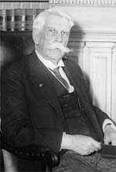
Why then do we have taxes?
This chapter has focused on the negative effects of taxes on buyers and sellers in a market
However, without taxes we would not have a functioning government
As Oliver Wendell Holmes, Jr., Supreme Court Justice, once said, “Taxes are the price we pay for a civilized society."

Slide 33
Why then do we have taxes?
We may wish to discourage certain activities, such as smoking
Government must be paid for
Tax revenues may increase fairness, even if it decreases efficiency

Slide 34
How a Price Ceiling Affects Welfare

Slide 35
How a Price Ceiling Affects Welfare
Price
Supply
Equilibrium Price
P₁
Equilibrium (No Price Ceiling)
Demand
0
Q₁
Quantity
Equilibrium Quantity

Slide 36
How a Price Ceiling Affects Welfare
Price
Supply
Equilibrium Price
P₁
Equilibrium (No Price Ceiling)
Price Ceiling
P_{C}
Demand
0
Q_{S}
Q₁
Quantity
Equilibrium Quantity

Slide 37
How a Price Ceiling Affects Welfare
Price
Supply
A
Total Surplus = Buyers’ Benefit – Sellers’ Cost
 | No Price Ceiling | Price Ceiling | Change
Buyers’ Benefit
Sellers’ Cost
Total Surplus
Equilibrium Price
B
P₁
Equilibrium (No Price Ceiling)
C
D
Price Ceiling
P_{C}
E
Demand
F
G
0
Q_{S}
Q₁
Quantity
Equilibrium Quantity

Slide 38
How a Price Ceiling Affects Welfare
Price
Supply
A
Total Surplus = Buyers’ Benefit – Sellers’ Cost
 | No Price Ceiling | Price Ceiling | Change
Buyers’ Benefit | ABCDEFG | ACEF | -(B+D+G)
Sellers’ Cost | FG | F | -G
Total Surplus | ABCDE | ACE | -(B+D)
Equilibrium Price
B
P₁
Equilibrium (No Price Ceiling)
C
D
Price Ceiling
P_{C}
E
Demand
F
G
0
Q_{S}
Q₁
Quantity
Equilibrium Quantity

Slide 39
How a Price Ceiling Affects Welfare
Price
Supply
A
Total Surplus = Buyers’ Benefit – Sellers’ Cost
 | No Price Ceiling | Price Ceiling | Change
Buyers’ Benefit | ABCDEFG | ACEF | -(B+D+G)
Sellers’ Cost | FG | F | -G
Total Surplus | ABCDE | ACE | -(B+D)
Equilibrium Price
B
P₁
Equilibrium (No Price Ceiling)
C
D
Price Ceiling
P_{C}
E
Key Definition: The deadweight loss of a government policy is the decrease in total surplus caused by the policy.
So, the deadweight loss of a price ceiling is B + D.
Demand
F
G
0
Q_{S}
Q₁
Quantity
Equilibrium Quantity

Slide 40
How a Price Ceiling Affects Welfare
Total Surplus = Buyers’ Benefit – Sellers’ Cost
 | No Price Ceiling | Price Ceiling | Change
Buyers’ Benefit | ABCDEFG | ACEF | -(B+D+G)
Sellers’ Cost | FG | F | -G
Total Surplus | ABCDE | ACE | -(B+D)
Price
The bad news is that the price ceiling makes the buyers’ benefit (or willingness to pay, or happiness) decrease.
Sellers’ costs also decrease, but not enough to make up for the drop in buyers’ benefit.
So, total surplus decreases. The deadweight loss of a price ceiling is B + D.
Supply
A
Equilibrium Price
B
P₁
Equilibrium (No Price Ceiling)
C
D
Price Ceiling
P_{C}
E
Demand
F
G
0
Q_{S}
Q₁
Quantity
Equilibrium Quantity

Slide 41
How a Price Ceiling Affects Welfare
Price
Supply
A
Total Surplus = Consumer Surplus + Producer Surplus
 | No Price Ceiling | Price Ceiling | Change
Consumer Surplus
Producer Surplus
Total Surplus
Equilibrium Price
B
P₁
Equilibrium (No Price Ceiling)
C
D
Price Ceiling
P_{C}
E
Demand
F
G
0
Q_{S}
Q₁
Quantity
Equilibrium Quantity

Slide 42
How a Price Ceiling Affects Welfare
Price
Supply
A
Total Surplus = Consumer Surplus + Producer Surplus
 | No Price Ceiling | Price Ceiling | Change
Consumer Surplus | AB | AC | C-B
Producer Surplus | CDE | E | -(C+D)
Total Surplus | ABCDE | ACE | -(B+D)
Equilibrium Price
B
P₁
Equilibrium (No Price Ceiling)
C
D
Price Ceiling
P_{C}
E
Key Definition: The deadweight loss of a government policy is the decrease in total surplus caused by the policy.
So, the deadweight loss of a price ceiling is B + D.
Demand
F
G
0
Q_{S}
Q₁
Quantity
Equilibrium Quantity

Slide 43
How a Price Ceiling Affects Welfare
Total Surplus = Consumer Surplus + Producer Surplus
 | No Price Ceiling | Price Ceiling | Change
Consumer Surplus | AB | AC | C-B
Producer Surplus | CDE | E | -(C+D)
Total Surplus | ABCDE | ACE | -(B+D)
Price
Producer surplus decreases when the government imposes a price ceiling.
Even though the consumers may have begged the government for a price ceiling, consumer surplus may increase (if C > B) or decrease (if C < B).
Even if consumer surplus increases, the increase will not make up for the decrease in producer surplus.
So, total surplus will decrease. The deadweight loss of a price ceiling is B + D.
Supply
A
Equilibrium Price
B
P₁
Equilibrium (No Price Ceiling)
C
D
Price Ceiling
P_{C}
E
Demand
F
G
0
Q_{S}
Q₁
Quantity
Equilibrium Quantity

Slide 44
How a Price Floor Affects Welfare

Slide 45
How a Price Floor Affects Welfare
Price
Supply
Equilibrium Price
P₁
Equilibrium (No Price Floor)
Demand
0
Q₁
Quantity
Equilibrium Quantity

Slide 46
How a Price Floor Affects Welfare
Price
Supply
Price Floor
P_{F}
Equilibrium Price
P₁
Equilibrium (No Price Floor)
Demand
0
Q_{D}
Q₁
Quantity
Equilibrium Quantity

Slide 47
How a Price Floor Affects Welfare
Price
A
Supply
Price Floor
P_{F}
Total Surplus = Buyers’ Benefit – Sellers’ Cost
 | No Price Floor | Price Floor | Change
Buyers’ Benefit
Sellers’ Cost
Total Surplus
B
Equilibrium Price
C
P₁
Equilibrium (No Price Floor)
E
D
Demand
F
G
0
Q_{D}
Q₁
Quantity
Equilibrium Quantity

Slide 48
How a Price Floor Affects Welfare
Price
A
Supply
Price Floor
P_{F}
Total Surplus = Buyers’ Benefit – Sellers’ Cost
 | No Price Floor | Price Floor | Change
Buyers’ Benefit | ABCDEFG | ABDF | -(CEG)
Sellers’ Cost | FG | F | -G
Total Surplus | ABCDE | ABD | -(CE)
B
Equilibrium Price
C
P₁
Equilibrium (No Price Floor)
E
D
Demand
F
G
0
Q_{D}
Q₁
Quantity
Equilibrium Quantity

Slide 49
How a Price Floor Affects Welfare
Price
A
Supply
Price Floor
P_{F}
Total Surplus = Buyers’ Benefit – Sellers’ Cost
 | No Price Floor | Price Floor | Change
Buyers’ Benefit | ABCDEFG | ABDF | -(CEG)
Sellers’ Cost | FG | F | -G
Total Surplus | ABCDE | ABD | -(CE)
B
Equilibrium Price
C
P₁
Equilibrium (No Price Floor)
E
D
Key Definition: The deadweight loss of a government policy is the decrease in total surplus caused by the policy.
So, the deadweight loss of a price ceiling is C + E.
Demand
F
G
0
Q_{D}
Q₁
Quantity
Equilibrium Quantity

Slide 50
How a Price Floor Affects Welfare
Total Surplus = Buyers’ Benefit – Sellers’ Cost
 | No Price Floor | Price Floor | Change
Buyers’ Benefit | ABCDEFG | ABDF | -(CEG)
Sellers’ Cost | FG | F | -G
Total Surplus | ABCDE | ABD | -(CE)
Price
The bad news about a price floor: buyers’ benefit decreases.
The good news about a price floor:
Sellers’ cost also decreases.
But buyers’ benefit decreases more than sellers’ cost decreases.
So, overall, total surplus decreases.
The deadweight loss of a price ceiling is C + E.
A
Supply
Price Floor
P_{F}
B
Equilibrium Price
C
P₁
Equilibrium (No Price Floor)
E
D
Demand
F
G
0
Q_{D}
Q₁
Quantity
Equilibrium Quantity

Slide 51
How a Price Floor Affects Welfare
Price
A
Supply
Price Floor
P_{F}
Total Surplus = Consumer Surplus + Producer Surplus
 | No Price Floor | Price Floor | Change
Consumer Surplus
Producer Surplus
Total Surplus
B
Equilibrium Price
C
P₁
Equilibrium (No Price Floor)
E
D
Demand
F
G
0
Q_{D}
Q₁
Quantity
Equilibrium Quantity

Slide 52
How a Price Floor Affects Welfare
Price
A
Supply
Price Floor
P_{F}
Total Surplus = Consumer Surplus + Producer Surplus
 | No Price Floor | Price Floor | Change
Consumer Surplus | ABC | A | -(BC)
Producer Surplus | DE | BD | B-E
Total Surplus | ABCDE | ABD | -(CE)
B
Equilibrium Price
C
P₁
Equilibrium (No Price Floor)
E
D
Demand
F
G
0
Q_{D}
Q₁
Quantity
Equilibrium Quantity

Slide 53
How a Price Floor Affects Welfare
Price
A
Supply
Price Floor
P_{F}
Total Surplus = Consumer Surplus + Producer Surplus
 | No Price Floor | Price Floor | Change
Consumer Surplus | ABC | A | -(BC)
Producer Surplus | DE | BD | B-E
Total Surplus | ABCDE | ABD | -(CE)
B
Equilibrium Price
C
P₁
Equilibrium (No Price Floor)
E
D
Key Definition: The deadweight loss of a government policy is the decrease in total surplus caused by the policy.
So, the deadweight loss of our price floor is C + E.
Demand
F
G
0
Q_{D}
Q₁
Quantity
Equilibrium Quantity

Slide 54
How a Price Floor Affects Welfare
Total Surplus = Consumer Surplus + Producer Surplus
 | No Price Floor | Price Floor | Change
Consumer Surplus | ABC | A | -(BC)
Producer Surplus | DE | BD | B-E
Total Surplus | ABCDE | ABD | -(CE)
Price
A price floor makes consumers surplus decrease (by B + C).
Although producers may have begged the government to set a price floor, producers surplus may increase (if B > E) or decrease (if B < E).
Even if producer surplus increases, it won’t make up for the decrease in consumer surplus.
So, total surplus decreases (by C + E). The deadweight loss of a price floor is C + E.
A
Supply
Price Floor
P_{F}
B
Equilibrium Price
C
P₁
Equilibrium (No Price Floor)
E
D
Demand
F
G
0
Q_{D}
Q₁
Quantity
Equilibrium Quantity

Slide 55
Summing Up

Slide 56
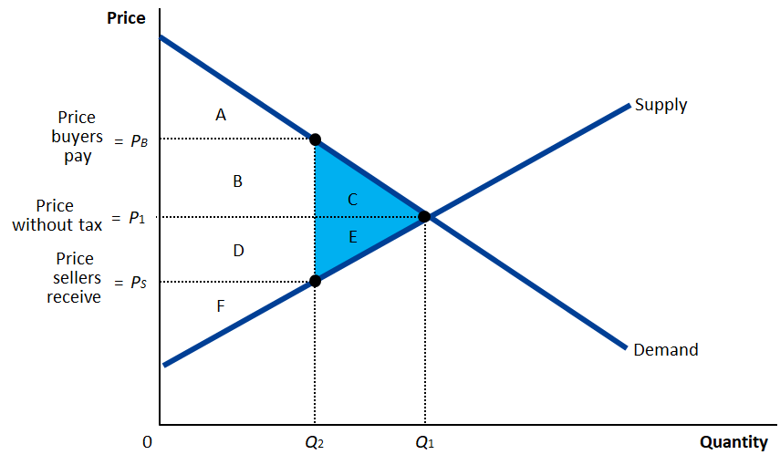
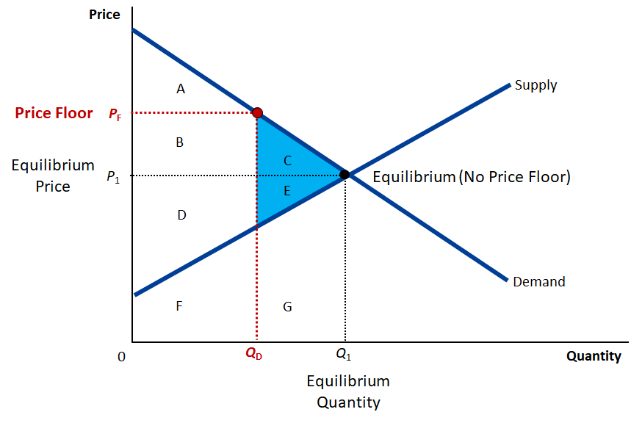
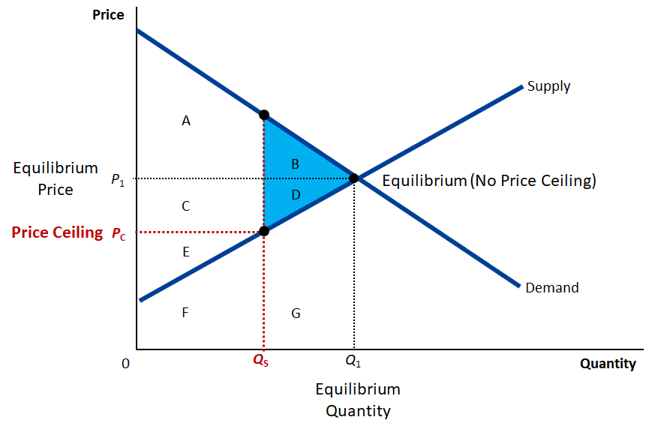
Here are our three key diagrams. What common feature do you see?
Welfare effects of a tax
Welfare effects of a price floor
Welfare effects of a price ceiling

Slide 57
What is the common feature?
1. In all three cases, government intervention reduces total surplus (by the area of the blue triangle).
Welfare effects of a tax
Welfare effects of a price floor
2. This is not a surprise, because we saw earlier that the equilibrium outcome under perfect competition maximizes total surplus. So, any intervention that changes that outcome has to reduce total surplus.
Welfare effects of a price ceiling

Slide 58
What is the common feature?
1. In all three cases, the quantity bought and sold decreases. And the deadweight loss is always the area between the demand and supply curves for the lost quantity.
Welfare effects of a tax
Welfare effects of a price floor
2. This should not be a surprise either.
Voluntary trade between buyers and sellers must benefit both sides without hurting anyone else. So, any reduction in voluntary trade must reduce total surplus.
3. We have seen that total surplus is the area between the demand and supply curves, for the quantity traded. So, the reduction in total surplus caused by a fall in the quantity traded must be the area between the demand and supply curves for the lost quantity.
Welfare effects of a price ceiling

Slide 59
Welfare Analysis: Subsidy

Slide 60
Recap from Supply, Demand, and Government Policies The effect of a subsidy, for buyers or for sellers
Step 1: Find the quantity at which the height of the supply curve exceeds the height of the demand curve by the amount of the subsidy. This will be the after-subsidy equilibrium quantity.
Step 2: The height of the supply curve at the after-subsidy equilibrium quantity gives the price that sellers get after the subsidy.
Buyers’ Price, Sellers’ Price
Equilibrium after subsidy
Price sellers get after subsidy
Supply
$4.25
Equilibrium without subsidy
Price before subsidy
3.00
Subsidy ($2.50)
1.75
Price buyers pay after subsidy
Step 3: The height of the demand curve at the after-subsidy equilibrium quantity gives the price that buyers pay after the subsidy.
Demand
0
100
120
Quantity
Quantity before subsidy
Quantity after subsidy

Slide 61
Welfare Analysis: Subsidy
Price
Supply
A
B
C
D
E
The equilibrium quantity is Q₁.
We have seen that a subsidy increases the quantity bought and sold.
Suppose a subsidy increases the quantity to Q₃.
F
G
H
I
J
K
Demand
Q₂
Q₁
Q₃
Quantity
Total Surplus = Buyers’ Benefit – Sellers’ Cost
 | No Subsidy (Q₁) | Subsidy (Q₃) | Change
Buyers’ Benefit
Sellers’ Cost
Total Surplus

Slide 62
Welfare Analysis: Subsidy
Price
Supply
A
B
C
D
E
The equilibrium quantity is Q₁.
We have seen that a subsidy increases the quantity bought and sold.
Suppose a subsidy increases the quantity to Q₃.
F
G
H
I
J
K
Demand
Q₂
Q₁
Q₃
Quantity
Total Surplus = Buyers’ Benefit – Sellers’ Cost
 | No Subsidy (Q₁) | Subsidy (Q₃) | Change
Buyers’ Benefit | ABCFGIJ
Sellers’ Cost | IJ
Total Surplus | ABCFG

Slide 63
Welfare Analysis: Subsidy
Price
Supply
A
B
C
D
E
The equilibrium quantity is Q₁.
We have seen that a subsidy increases the quantity bought and sold.
Suppose a subsidy increases the quantity to Q₃.
… but benefits are less than cost for the additional units produced
So, total surplus decreases
The deadweight loss of a subsidy is EH
F
G
H
I
J
K
Demand
Q₂
Q₁
Q₃
Quantity
Total Surplus = Buyers’ Benefit – Sellers’ Cost
 | No Subsidy (Q₁) | Subsidy (Q₃) | Change
Buyers’ Benefit | ABCFGIJ | ABCFGIJK | K
Sellers’ Cost | IJ | EHIJK | EHK
Total Surplus | ABCFG | ABCFG-EH | -EH

Slide 64
Welfare Analysis: Summary
We have seen how the tools of welfare analysis—such as consumer surplus, producer surplus, and total surplus—can be used to think carefully about economic policy.
When in previous chapters we used the tools of supply and demand, we could say that government interventions—such as price control, taxes and subsidies—help some people and hurt some people. But the overall effect on our well-being was never clear.
The tools of welfare analysis help us measure the pluses and minuses of each policy intervention and describe its overall effect.

Slide 65
Welfare Analysis: Summary
Price ceilings, price floors and taxes all lead to less buying and selling than would take place in their absence
By stopping economic activity that has more benefits than costs, such policy interventions decrease overall welfare
Subsidies lead to more buying and selling than would take place in their absence
By forcing economic activity that has less benefits than costs, subsidies also decrease overall welfare

