Slide 1
Public Goods and Common Resources
ECO 10 Introduction to Microeconomics
Udayan Roy

Slide 2
Sources: Principles of Microeconomics/Economics by N. Gregory Mankiw
Chapter 11: Public Goods and Common Resources

Slide 3
Sources: Principles of Microeconomics/Economics by Timothy Taylor
Chapter 14: Environmental Protection and Negative Externalities
Chapter 15: Technology, Positive Externalities, and Public Goods

Slide 4
Sources: The Economy by The CORE Team
Unit 12: Markets, efficiency, and public policy
  12.5: Public Goods

Slide 5
“The best things in life are free”
Free goods provide a special challenge for economic analysis.

Slide 6
“The best things in life are free”
When goods are available free of charge, the market forces that normally allocate resources in our economy are absent.

Slide 7
“The best things in life are free”
When a price cannot be charged for a good, private producers will not produce it.
In such cases, a government may have to step in and provide it.
When a price cannot be charged for a resource, private citizens will be unable to protect it or conserve it.
In such cases, a government may have to step in and protect the resource.

Slide 8
THE DIFFERENT
KINDS OF GOODS
When thinking about the various goods in the economy, it is useful to group them according to two characteristics:
  Is the good excludable?
  Is the good rival in consumption?

Slide 9
THE DIFFERENT KINDS OF GOODS
Excludability
  Consider something specific that you would like to have. Does anybody have the power or ability to stop you from having it without paying for it?
  If yes, the commodity is excludable,
    and you will have to pay to consume it
  If no, the commodity is not excludable,
    and nobody can make you pay to consume it

Slide 10
THE DIFFERENT KINDS OF GOODS
Rivalry in consumption
  If you decide to enjoy or use an object, can others enjoy it too at the same time?
  If no, it is a rival good
  If yes, the object is a non-rival good

Slide 11
Figure 1 Four Types of Goods
Rival?
Yes
No
Private Goods
Natural Monopolies
Yes
•
Ice-cream cones
•
Fire protection
•
Clothing
•
Cable TV
•
Congested toll roads
•
Uncongested toll roads
Excludable?
Common Resources
Public Goods
No
•
Fish in the ocean
•
Tornado siren
•
The environment
•
National defense
•
Congested nontoll roads
•
Uncongested nontoll roads

Slide 12
Public Goods: The Free-Rider Problem
Since people cannot be excluded from enjoying the benefits of a public good, they may refuse to pay, hoping that others will.
That is, people may behave like free riders
  A free-rider is a person who receives the benefit of a good but avoids paying for it
The free-rider problem prevents private businesses from supplying public goods.

Slide 13
Public Goods: The Free-Rider Problem
Solving the Free-Rider Problem
  The government can step forward to provide the public good
    Assuming its total benefits exceed its costs.
  The government can make everyone better off by providing the public good and paying for it with tax revenues.

Slide 14
Some Important Public Goods
National Defense
Fundamental Scientific Research
Fighting Poverty

Slide 15
CASE STUDY: Are Lighthouses Public Goods?
Notes:
“On the coast of England in the 19th century, for example, some lighthouses were privately owned and operated. … the owner of the lighthouse charged the owner of the nearby port. If the port owner did not pay, the lighthouse owner turned off the light, and ships avoided that port.”

Slide 16
Public Goods: Cost-Benefit Analysis
In order to decide whether to provide a public good or not, the total benefits of all those who use the good must be compared to the costs of providing and maintaining the public good.
  Cost-benefit analysis refers to the measurement of the costs and benefits to society of providing a public good.
Notes:
Discuss: Why is cost-benefit analysis not needed for private goods?

Slide 17
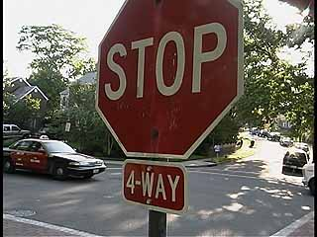

Yes or no?
A town intersection currently has only stop signs.
Should a traffic light be installed?

Slide 18
Yes or no?
In an ideal situation …
  We could ask each person who uses that intersection what’s his/her willingness-to-pay for the traffic light
  The traffic light should then be installed if and only if the total willingness-to-pay exceeds the cost
  The light could be paid for by charging a tax proportional to each person’s willingness-to-pay

Slide 19
Yes or no?
However, in the real world …
  Asking people won’t work
  People will not reveal their willingness-to-pay truthfully
    If the tax is independent of willingness-to-pay, those who would benefit/not benefit from the public good would have an incentive to exaggerate the benefits/costs
    If the tax is related to willingness-to-pay people will understate their willingness to pay
  So, some other kind of cost-benefit analysis will be needed

Slide 20
The Difficult Job of Cost-Benefit Analysis
A cost-benefit analysis is an estimate of the total costs and benefits of the project to society as a whole.
  It is difficult to do this because of the absence of prices needed to estimate social benefits and costs.
  The value of life, the consumer’s time, and aesthetics are difficult to measure.

Slide 21
How much is a life worth?
It may be necessary to know the dollar value of a human life in order to decide whether a new traffic light would be worth the cost
Studies say the dollar value of a human life is … about $10 million
Calculations:
  Value of lives lost without light = 0.016 × $10 m
  Value of lives lost with light = 0.011 × $10 m
  Benefit of light = 0.005 × $10 m = $50,000
  Yes to traffic light if and only if cost is less

Slide 22
How much is a life worth?
Isn’t it infinite?
  Not if you see the risks that people take to avoid paying extra
  By observing these choices economists can estimate the monetary value that people themselves place on their own lives
  One estimate is $10 million

Slide 23
Common Resources: non-excludable and rival
Rival?
Yes
No
Private Goods
Natural Monopolies
Yes
•
Ice-cream cones
•
Fire protection
•
Clothing
•
Cable TV
•
Congested toll roads
•
Uncongested toll roads
Excludable?
Common Resources
Public Goods
No
•
Fish in the ocean
•
Tornado siren
•
The environment
•
National defense
•
Congested non-toll roads
•
Uncongested nontoll roads
As common resources are not excludable, they are available free of charge to anyone who wishes to use them
Common resources are rival goods because one person’s use of the common resource reduces other people’s use

Slide 24
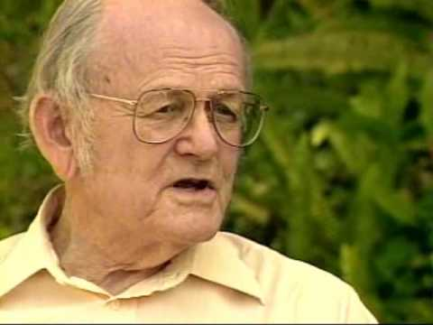
Tragedy of the Commons
The Tragedy of the Commons is a parable that illustrates why common resources are overused
  That is, they are used more than is desirable from the standpoint of society as a whole.
  The idea of tragedy of the commons was popularized by the biologist Garret Hardin

Slide 25
Tragedy of the Commons
Common resources tend to be overused because they are not excludable and so people do not have to pay to use them
Moreover, when a person uses a common resource, only that person benefits, nobody else does
  Common resources are rival in consumption.
  This is similar to a negative externality.
  We saw in the previous chapter that negative externalities lead to over-consumption

Slide 26
Tragedy of the Commons
Common resources need to be conserved for future use
However, as they are not excludable, nobody has the incentive to conserve them

Slide 27
Tragedy of the Commons: solutions
The government can assert ownership of a common resource
  The government can then control and restrict the use of a common resource
  The government can conserve and maintain the resource for use by the people in the future
The government can assign ownership rights to private citizens
  This will convert a common resource to a private resource

Slide 28
Some Important Common Resources
Clean air and water
Congested roads
Fish, whales, and other wildlife

Slide 29
A Solution to City Congestion
Motorists driving into central London on weekdays between 7:00 A.M. and 6:30 P.M. pay a daily tax of about $9.50.
Cameras record license plate numbers and nonpayers are charged stiff penalties.
Congestion in central London has decreased by 30%.
50,000 fewer cars enter the eight square mile “restricted area” each day.

Slide 30
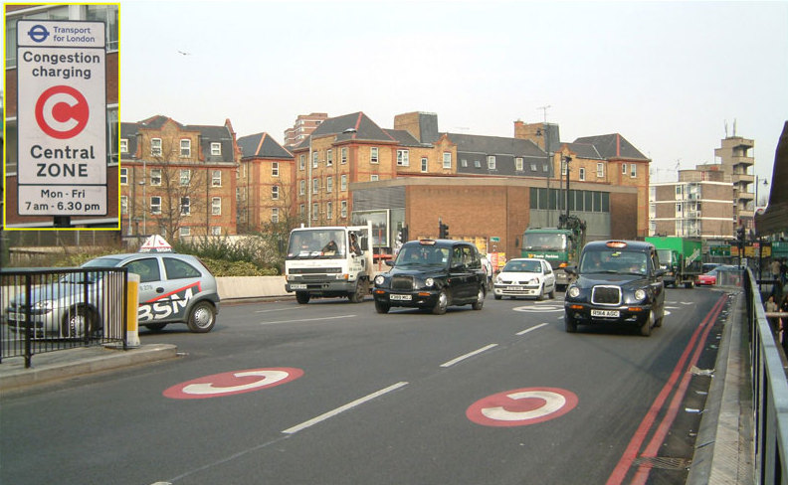
A Solution to City Congestion: London

Slide 31
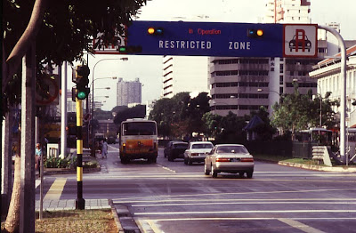
A Solution to City Congestion: Singapore

Slide 32
CASE STUDY: Why Isn’t the Cow Extinct?
Will the market protect me?

Slide 33
IN THE NEWS: Should Yellowstone Charge as Much as Disney World?
National parks can be viewed as either public goods or common resources.
If park congestion is light, visits are not rival in consumption.
As congestion increases, park entrance fees could be raised.
The likely increase in revenues…
  could be used to improve national parks, and
  would encourage others to develop new parks.

Slide 34
CASE STUDY: “You’ve Got Spam!”
Some firms use spam email to advertise their products.
Spam is not excludable: Firms cannot be prevented
from spamming.
Spam is rival: As more companies use spam, it becomes less effective.
Thus, spam is a common resource.
Like most common resources, spam is free – which is why we get so much of it!
If each person had complete ownership rights over his or her email inbox, then spammers would have to ask for permission to send spam email
You could then charge spammers a price for every spam email they send you
Notes:
This case study is not in the textbook.

Slide 35
CONCLUSION: THE IMPORTANCE OF PROPERTY RIGHTS
The market fails to allocate resources efficiently when property rights are not well-established
  That is, some item of value does not have an owner with the legal authority to control it

Slide 36
CONCLUSION: THE IMPORTANCE OF PROPERTY RIGHTS
When the absence of property rights causes a market failure, the government may be able to solve the problem.
  The government can assign property rights and lay the foundation for a market where none existed before
    Example: the pollution-rights market
  The government can also directly regulate the private use of a common resource
    Forests are protected in the US

Slide 37
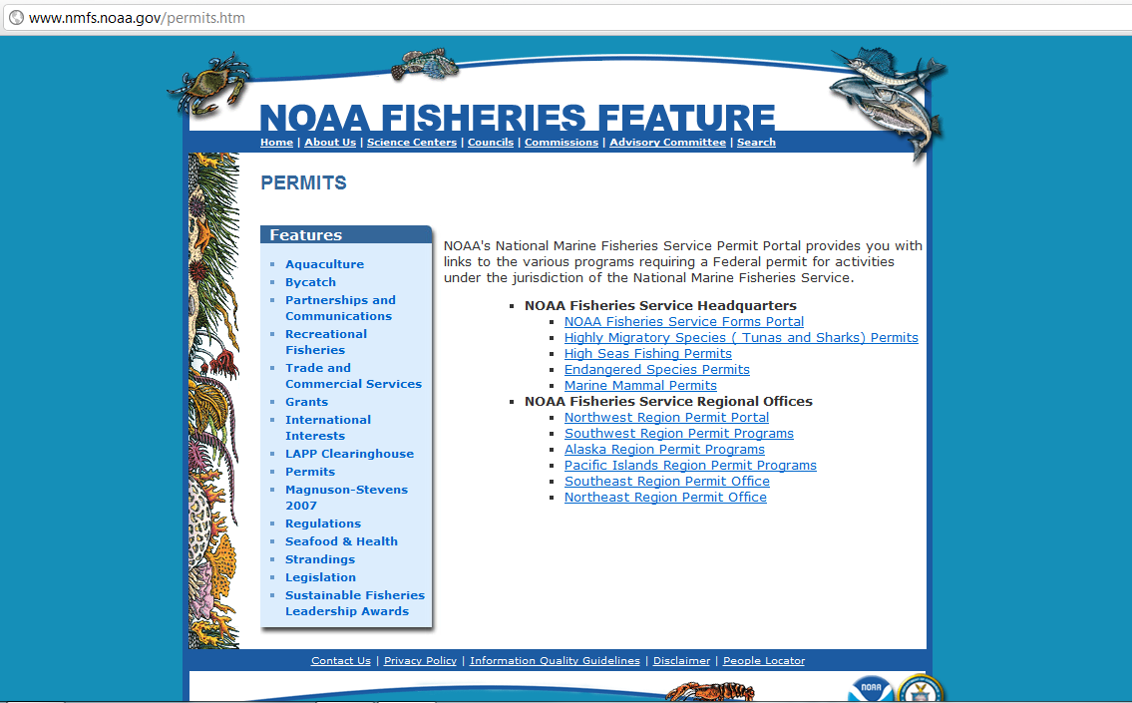
US Government Requires Fishing Permits

Slide 38

Elinor ostrom
Top-down government administration and total privatization are not the only ways to utilize and maintain a common resource. Communities of users of the resource may be able to do this more efficiently.

Slide 39

Elinor Ostrom: a different view
Elinor Ostrom shared the 2009 Nobel memorial prize in Economics "for her analysis of economic governance, especially the commons"
  See http://nobelprize.org/nobel_prizes/economics/laureates/2009/index.html

Slide 40
Ostrom: Tragedy of the Commons is not inevitable
Based on numerous empirical studies of user-managed fish stocks, pastures, woods, lakes, and groundwater basins, she concluded that common property is often well tended by user associations.

Slide 41
Ostrom’s seven keys to successful utilization of a common resource
Rules clearly define entitlements
Conflict resolution mechanisms are in place
Duties stand in reasonable proportion to benefits
Monitoring and sanctioning is carried out either by the users themselves or by someone who is accountable to the users
Sanctions are graduated, mild for a first violation and stricter as violations are repeated
Decision processes are democratic
The rights of users to self-organize are clearly recognized by outside authorities

Slide 42
Ostrom: centralized control of resources can fail
All too often, resource degradation is due to flawed intervention by central government.
Consider the satellite image—next slide—of grasslands spanning two different jurisdictions.
In the southern jurisdiction, grasslands are managed by groups of nomads according to traditional methods.
In the northern jurisdiction, grasslands have been collectivized and animal husbandry has been modernized.
Despite similar numbers of grazing animals per acre, only traditional group management has prevented the grasslands from degrading and also produced greatest yields.

Slide 43
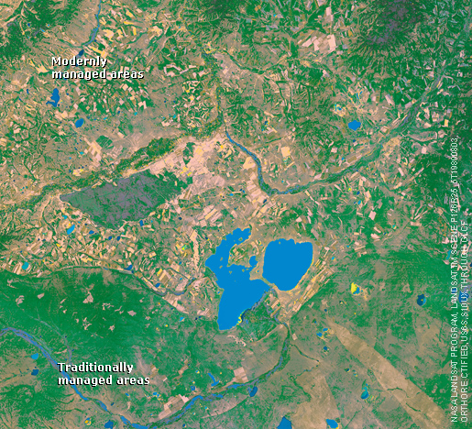
Ostrom: centralized control of resources can fail
The choice is not between individual control and control by a central government
Groups of individuals can self organize and successfully form a mini government to maintain a common resource that they all use
Users themselves can both create and enforce rules that mitigate overexploitation

Slide 44

Any Questions?

Slide 45
Summary
Goods differ in whether they are excludable and whether they are rival.
  A good is excludable if it is possible to prevent someone from using it.
  A good is rival if one person’s enjoyment of the good prevents other people from enjoying the same unit of the good.

Slide 46
Summary
Public goods are neither rival nor excludable.
Because people are not charged for their use of public goods, they have an incentive to free ride when the good is provided privately.
Governments provide public goods, making quantity decisions based upon cost-benefit analysis.

Slide 47
Summary
Common resources are rival but not excludable.
Because people are not charged for their use of common resources, they tend to use them excessively.
Governments tend to try to limit the use of common resources.

