Slide 1
15
Monopoly

Slide 2
Monopoly
A firm is a monopoly if . . .
it is the only seller of its product, and
its product does not have close substitutes.

Slide 3
WHY MONOPOLIES ARISE
The fundamental cause of monopoly is the existence of barriers to entry.

Slide 4
WHY MONOPOLIES ARISE
Barriers to entry have three sources:
Ownership of a key resource.
The government gives a firm the exclusive right to produce some good.
Costs of production make one producer more efficient than a large number of producers.

Slide 5
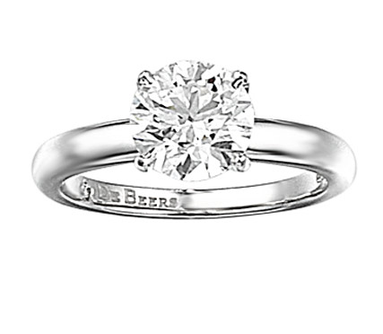
Monopoly Resources
Although exclusive ownership of a key resource is a potential source of monopoly, in practice monopolies rarely arise for this reason.
Example: The DeBeers Diamond Monopoly

Slide 6
Government-Created Monopolies
Governments may restrict entry by giving one firm the exclusive right to sell a particular good in certain markets.
Example: Patent and copyright laws are two important examples of how governments create monopoly to serve the public interest.

Slide 7
Natural Monopolies
An industry is a natural monopoly when one firm can supply a good or service to an entire market at a smaller cost than could two or more firms.
Example: delivery of electricity, phone service, tap water, etc.

Slide 8
Natural Monopolies
Cost
A natural monopoly arises when there are economies of scale over the relevant range of output.
Average
total
cost
0
Quantity of Output

Slide 9
HOW MONOPOLIES MAKE PRODUCTION AND PRICING DECISIONS
Monopoly versus Competition
Monopoly
Is the sole producer
Faces a downward-sloping demand curve
Is a price maker
Can reduce its sales to increase price
Competitive Firm
Is one of many producers
Faces a horizontal demand curve
Is a price taker
Sells as much or as little as it wants at market price

Slide 10
Figure 2 Demand Curves for Competitive and Monopoly Firms
’
A firm’s demand curve under perfect competition
A monopolist’s demand curve
Price
Price
Demand
Demand
0
Quantity of Output
0
Quantity of Output
See Ch. 14 for a review of perfect competition.

Slide 11
Recap from Ch 14: A Firm’s Revenue
Total Revenue
TR = P × Q
Average Revenue
AR = TR/Q = P
Marginal Revenue
MR = ΔTR/ΔQ

Slide 12
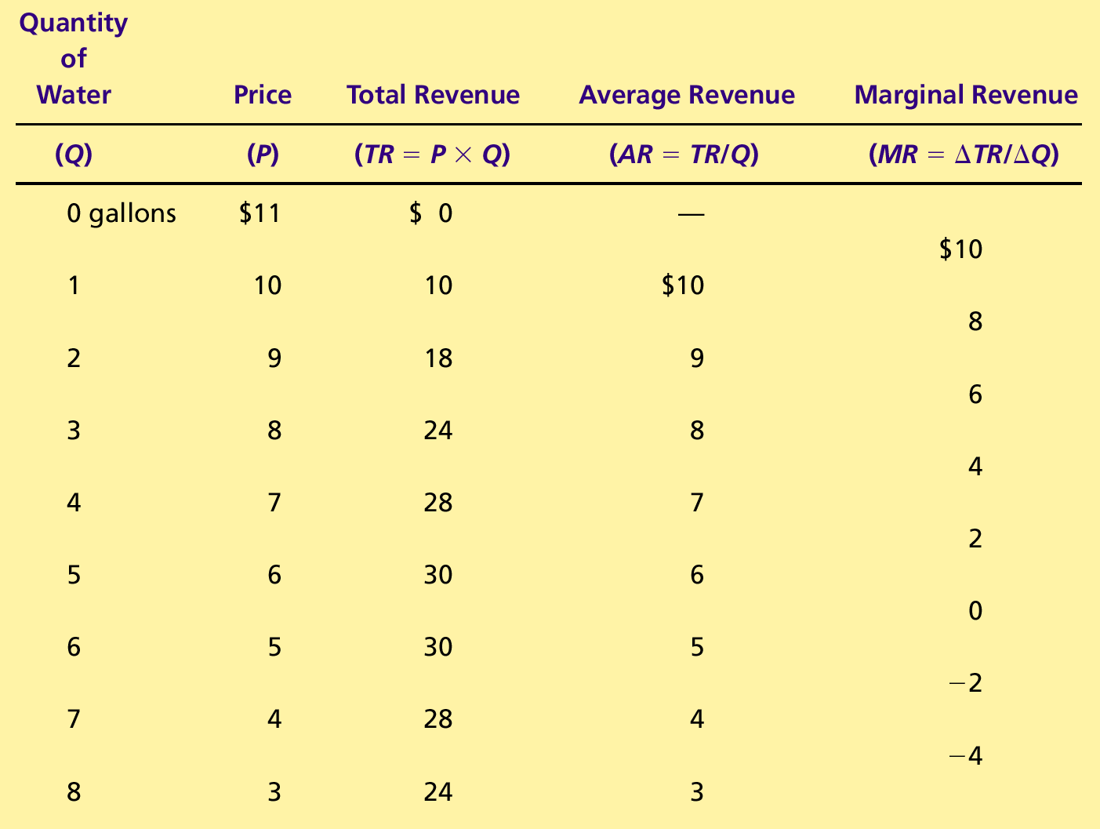
Table 1 A Monopoly’s Total, Average, and Marginal Revenue
Note that P = AR > MR.
Recall that, in perfect competition, P = AR = MR.

Slide 13
Why is MR < P?
When Q = 3, P = 8 but MR = 6. Why is MR < P?
Output Effect: When the 3rd unit is sold, the firm earns an additional $8 for it. So, TR increases by $8, which is P.
Price Effect: But to sell the 3rd unit, the price had to be reduced from $9 to $8. So, the total revenue from the first two units -- which would have been $18 if only 2 units were sold -- decreases to $16 when 3 units are sold. Thus, TR also decreases by $2 when the 3rd unit is sold.
Therefore, the increase in total revenue is $8 - $2 = $6, which is less than P. In other words, MR < P.

Slide 14
A Monopoly’s Total Revenue
When a monopoly increases the amount it sells by one unit, there are two effects on total revenue P × Q.
The output effect: when an additional unit of output is sold, the monopolist charges a price for it. Therefore, total revenue increases by P, the price.
The price effect: to sell the additional unit, the price must be reduced. Therefore, total revenue from the units that the monopolist would have decreases.
The overall effect will depend on the price elasticity of demand; see chapter 5
If demand is elastic—that is, PED > 1—an increase in output is accompanied by an increase in total revenue

Slide 15
Figure 3 Demand and Marginal-Revenue Curves for a Monopoly
Price
$11
Note that P = AR > MR at all quantities.
10
9
8
7
6
5
4
3
Demand
2
Marginal
(average
1
revenue
revenue)
0
–1
1
2
3
4
5
6
7
8
Quantity of Water
–2
–3
–4

Slide 16
Profit Maximization
For any firm, the profit-maximizing quantity supplied is that at which marginal revenue equals marginal cost: MR = MC.
We saw this in Chapter 14
In equilibrium, quantity supplied = quantity demanded
A monopoly firm then uses the demand curve to find the price that will induce consumers to buy the profit-maximizing quantity.

Slide 17
Figure 4 Profit Maximization for a Monopoly
Costs and
Revenue
2. . . . and then the demand
1. The intersection of the
curve shows the price
marginal-revenue curve
consistent with this quantity.
and the marginal-cost
curve determines the
B
profit-maximizing
3. Note that P > MR = MC in equilibrium (point B).
Monopoly
quantity . . .
price
4. Recall that in perfect competition P = MC and Q_{D} = Q_{S} (Ch. 14). Can you pinpoint the perfect competition outcome in this diagram? That is, can you find the price-and-quantity point in this diagram at which P = MC and Q_{D} = Q_{S}?
Average total cost
MC
A
Marginal
Demand
cost
Marginal revenue
0
Q
Q_{MAX}
Q
Quantity
Notes:
The average total cost and marginal cost curves were discussed in Chapter 13.

Slide 18
Comparing Monopoly and Competition
For a competitive firm, price equals marginal cost.
P = MR = MC
For a monopoly firm, price exceeds marginal cost.
P > MR = MC
Note that the monopolist does not have a supply curve
The monopolist is a price maker; it chooses what price to charge
A perfectly competitive firm is a price taker; it responds to whatever the market price happens to be and chooses what quantity to produce at that price
This is why there is a supply curve in perfect competition, but not in monopoly.
This is why the theory of supply and demand (chapter 4) works only under perfect competition

Slide 19
Recap from Ch 14: Profit
Profit equals total revenue minus total costs.
Profit = TR – TC
Profit/Q = TR/Q – TC/Q
Profit = (TR/Q – TC/Q) × Q
Profit = (P – ATC) × Q

Slide 20
Figure 5 The Monopolist’s Profit
Costs and
Revenue
Marginal cost
Monopoly
E
B
price
Monopoly
Average total cost
profit
Average
total
D
C
cost
Demand
Marginal revenue
0
Q_{MAX}
Quantity

Slide 21
A Monopolist’s Profit
Recall that profit = (P – ATC) × Q
Therefore, the monopolist will stay in business as long as price (P) is greater than average total cost (ATC).

Slide 22
A monopolist will exit when P < ATC at all Q
Costs and
Revenue
Average total cost
Demand
0
Quantity

Slide 23
Figure 6 The Market for Drugs (Pharmaceutical)
Costs and
Revenue
P > MC and Q_{D} = Q_{S}; monopoly
Price
during
P = MC and Q_{D} = Q_{S}; perfect competition
patent life
Price after
Marginal
patent
cost
expires
Marginal
Demand
revenue
0
Monopoly
Competitive
Quantity
quantity
quantity

Slide 24
Video: Generic Drugs
Pharmaceutical drugs that are no longer under patent are called generic drugs
It is often assumed that the market for generic drugs is perfectly competitive
But the reality is very different
Why generic drugs don’t necessarily mean lower prices by Megan Thompson, PBS Newshour, December 23, 2013
Notes:
Video: http://www.pbs.org/newshour/bb/health/july-dec13/generics_12-23.html . This video also, en passant, gives an example of price matching, which reduces the downside of monopoly pricing and encourages monopoly even when there are many firms.

Slide 25
THE WELFARE COST OF MONOPOLY
In contrast to a competitive firm, the monopoly charges a price above the marginal cost (P > MC).
For consumers, this high price makes monopoly undesirable.
For the monopolist, the high price makes monopoly profitable.

Slide 26
Figure 7 The Efficient Level of Output
The height of the Demand curve at any quantity shows the value of the commodity to whoever bought the last unit.
Price
Marginal cost
So, the height of the Demand curve at any quantity shows the social benefit of the last unit.
Value
Cost
to
to
When this is no less than the marginal cost of the last unit, the last unit is socially desirable.
buyers
monopolist
Demand
Cost
Value
(marginal value to buyers)
to
to
monopolist
buyers
0
Quantity
Value to buyers
Value to buyers
is greater than
is less than
cost to seller.
cost to seller.
Efficient
quantity

Slide 27
The Deadweight Loss
Because a monopoly sets its price above marginal cost, it places a wedge between the consumer’s willingness to pay and the producer’s cost.
This wedge causes the quantity sold to fall short of the social optimum.

Slide 28
Figure 8 The Inefficiency of Monopoly
P > MC and Q_{D} = Q_{S}; monopoly
Price
Deadweight
Marginal cost
loss
Monopoly
price
P = MC and Q_{D} = Q_{S}; perfect competition and optimum
Note that the monopolist produces less than the socially efficient/optimum quantity
Marginal
revenue
Demand
0
Monopoly
Efficient
Quantity
quantity
quantity

Slide 29
The Deadweight Loss
The deadweight loss caused by a monopoly is similar to the deadweight loss caused by a tax.
See chapter 8
The difference between the two cases is that the government gets the revenue from a tax, whereas a private firm gets the monopoly profit.

Slide 30
PUBLIC POLICY TOWARD MONOPOLIES
Governments may respond to the problem of monopoly in one of four ways.
Making monopolized industries more competitive.
Regulating the behavior of monopolies.
Turning some private monopolies into public enterprises.
Doing nothing at all.

Slide 31
Increasing Competition with Antitrust Laws
Antitrust laws are laws aimed at curbing monopoly power.
Antitrust laws give government various ways to promote competition.
They allow government to prevent mergers.
They allow government to break up companies.
They prevent companies from performing activities that make markets less competitive.

Slide 32
Increasing Competition with Antitrust Laws
Two Important Antitrust Laws
Sherman Antitrust Act (1890)
Reduced the market power of the large and powerful “trusts” of that time period.
Clayton Act (1914)
Strengthened the government’s powers and authorized private lawsuits.

Slide 33
Regulation
Government may regulate the prices that the monopoly charges.
Example: ConEd, LIPA, etc.
The regulator may force the monopolist to implement the efficient outcome
Recall that the allocation of resources is efficient when price is set to equal marginal cost (P = MC).
But it might be difficult for government regulators to force the monopolist to set P = MC

Slide 34
Figure 10 Marginal-Cost Pricing for a Natural Monopoly
Price
The ideal policy is to force the firm to produce Q_{optimal} and then subsidize it for its loss.
Compromise outcome
The compromise outcome is to produce where P = ATC and the monopolist breaks even
Average total
cost
Average total cost
Loss
Regulated
price
Marginal cost
Ideal outcome
Demand
0
Q_{optimal}
Quantity

Slide 35
Regulation
In practice, regulators will allow monopolists to keep some of the benefits from lower costs in the form of higher profit
This requires some departure from marginal-cost pricing.

Slide 36
Public Ownership
Rather than regulating a natural monopoly that is run by a private firm, the government may run the monopoly itself
e.g. in the United States, the government runs the U.S. Postal Service.

Slide 37
Doing Nothing
Government may do nothing at all if the market failure is deemed small compared to the imperfections of public policies.

Slide 38
Price discrimination

Slide 39
PRICE DISCRIMINATION
Price discrimination is the business practice of selling the same good at different prices to different customers, even though the cost of production is the same for all customers.
What do you think of this practice?

Slide 40
PRICE DISCRIMINATION
Price discrimination is not possible in a competitive market
as there are many firms all selling the same product at the market price.
In order to price discriminate, the firm must have some market power.
That is, it must have the ability to set its prices without being afraid that its customers will go to competing firms.
Price discrimination won’t work if resale is easy

Slide 41
Perfect Price Discrimination
Perfect price discrimination refers to the situation when
the monopolist knows each customer’s willingness to pay, and
can charge each customer exactly what he/she is willing to pay.
Example:
Suppose the Cable TV industry is a monopoly
Suppose you are willing to pay up to $200 per month for a cable connection
Suppose the cable company knows this and accordingly charges you $200 per month
All other customers are also being charged the maximum they are willing to pay
What do you think of this state of affairs?

Slide 42
PRICE DISCRIMINATION
Important effects of price discrimination:
It increases the monopolist’s profits.
It reduces the consumer surplus.
Under perfect price discrimination, consumer surplus is zero
It reduces the deadweight loss.
Under perfect price discrimination, deadweight loss is zero,
Exactly as under perfect competition.

Slide 43
Figure 9 Welfare with and without Price Discrimination
(a) Monopolist with Single Price
Price
Total Surplus = Consumer Surplus + Profit
Consumer
Monopoly outcome
surplus
Monopoly
Deadweight
loss
Efficient outcome
price
Profit
Marginal cost
Marginal
Demand
revenue
0
Quantity sold
Quantity

Slide 44
Figure 9 Welfare with and without Price Discrimination
(b) Monopolist with Perfect Price Discrimination
Price
Total Surplus = Profit. Consumer Surplus and Deadweight Loss are both ZERO!
Monopoly outcome under perfect price discrimination
(also the efficient outcome)
Profit
Marginal cost
Demand
0
Quantity sold
Quantity

Slide 45
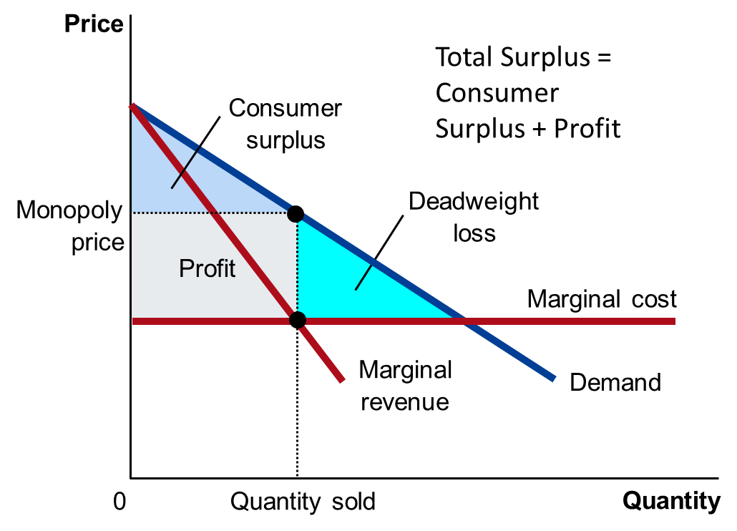
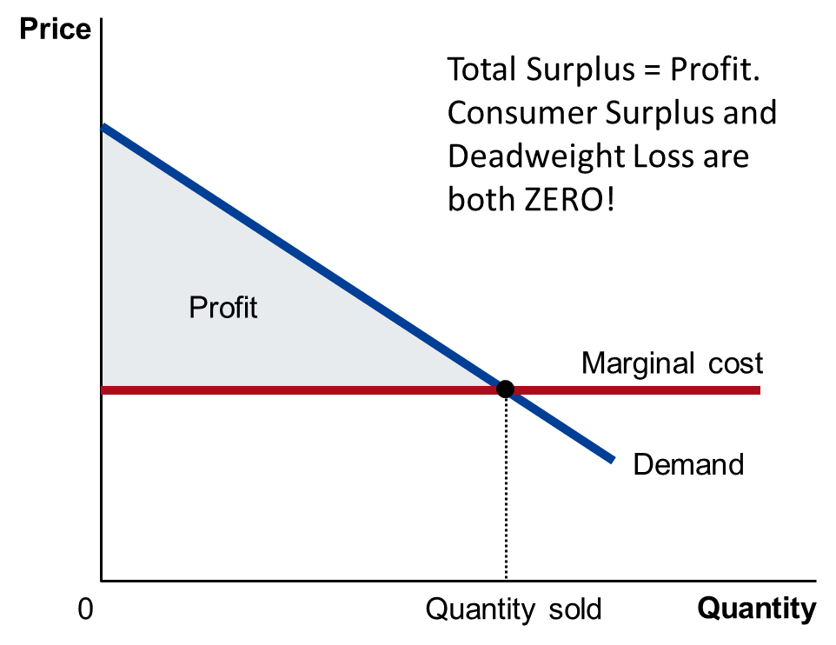
Which outcome is better?
One price for all
A different price for every buyer
P = AR is no longer true!

Slide 46
Examples of Price Discrimination
Movie tickets
Airline tickets
Discount coupons
Financial aid
Quantity discounts

Slide 47
CONCLUSION: THE PREVALENCE OF MONOPOLY
We have seen that monopoly is inefficient. But how widespread is monopoly? How worried should we be?
Monopolies are common.
Most firms have some control over their prices because of differentiated products. But
Firms with substantial monopoly power are rare.
Few goods are truly unique.

Slide 48
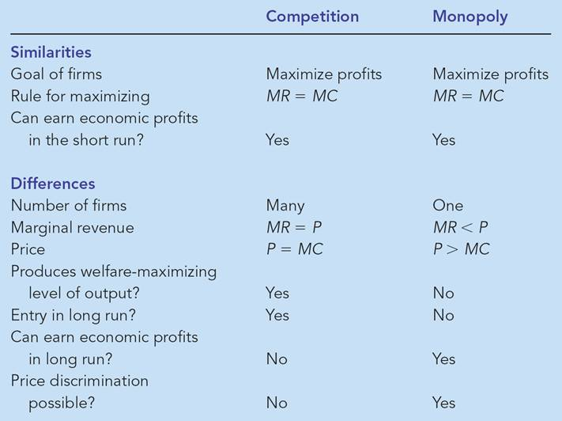
Competition v. Monopoly

Slide 49
Any Questions?

Slide 50
Summary
A monopoly is a firm that is the sole seller in its market.
It faces a downward-sloping demand curve for its product.
A monopoly’s marginal revenue is always below the price of its good.

Slide 51
Summary
Like a competitive firm, a monopoly maximizes profit by producing the quantity at which marginal cost and marginal revenue are equal.
Unlike a competitive firm, its price exceeds its marginal revenue, so its price exceeds marginal cost.

Slide 52
Summary
A monopolist’s profit-maximizing level of output is below the level that maximizes the sum of consumer and producer surplus.
A monopoly causes deadweight losses similar to the deadweight losses caused by taxes.

Slide 53
Summary
Policymakers can respond to the inefficiencies of monopoly behavior with antitrust laws, regulation of prices, or by turning the monopoly into a government-run enterprise.
If the market failure is deemed small, policymakers may decide to do nothing at all.

Slide 54
Summary
Monopolists can raise their profits by charging different prices to different buyers based on their willingness to pay.
Price discrimination can raise economic welfare and lessen deadweight losses.

Slide 55
Pricing Power
While a competitive firm is a price taker, a monopoly firm is a price maker.

Slide 56
Figure 1 Economies of Scale as a Cause of Monopoly
Cost
Average
total
cost
0
Quantity of Output

