Slide 1
Chapter 17 Oligopoly
Introduction to Microeconomics
Udayan Roy

Slide 2
BETWEEN MONOPOLY AND PERFECT COMPETITION
Imperfect competition refers to those market structures that fall between perfect competition and pure monopoly.

Slide 3
BETWEEN MONOPOLY AND PERFECT COMPETITION
Imperfect competition includes industries in which firms have competitors but do not face so much competition that they are forced to be price takers.

Slide 4
BETWEEN MONOPOLY AND PERFECT COMPETITION
Types of Imperfectly Competitive Markets
Oligopoly
Only a few sellers, each offering a similar or identical product to the others.
Monopolistic Competition
Many firms selling products that are similar but not identical.

Slide 5
The Four Types of Market Structure
Number of Firms?
Many
firms
Type of Products?
One
Few
Differentiated
Identical
firm
firms
products
products
Monopolistic
Perfect
Monopoly
Oligopoly
Competition
Competition
(Chapter 15)
(Chapter 17)
(Chapter 16)
(Chapter 14)
•
Tap water
•
Tennis balls
•
Novels
•
Wheat
•
Cable TV
•
Crude oil
•
Movies
•
Milk

Slide 6
MARKETS WITH ONLY A FEW SELLERS
Because of the few sellers, the key feature of oligopoly is the tension between cooperation and self-interest.

Slide 7
MARKETS WITH ONLY A FEW SELLERS
Characteristics of an Oligopoly Market
Few sellers offering similar or identical products
Interdependent firms
Best off cooperating and acting like a monopolist by producing a small quantity of output and charging a price above marginal cost

Slide 8
A Duopoly Example
A duopoly is an oligopoly with only two members.
It is the simplest type of oligopoly.

Slide 9
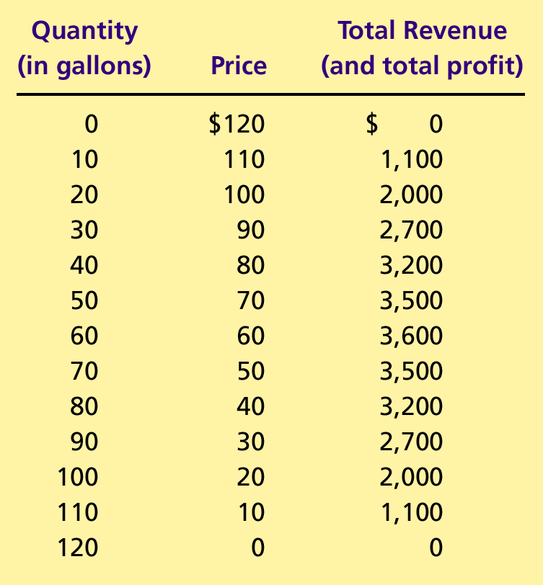
Table 1 The Demand Schedule for Water
Assumption: Marginal Cost of producing water is zero: MC = 0.
Monopoly
Duopoly
Perfect Competition

Slide 10
A Duopoly Example
Price and Quantity Supplied
In a perfectly competitive market:
P = MC = $0
Q = 120 gallons
In a monopoly price would be where total profit is maximized:
P = $60
Q = 60 gallons

Slide 11
A Duopoly Example
Price and Quantity Supplied
The socially efficient quantity of water is 120 gallons, but a monopolist would produce only 60 gallons of water.
So what outcome then could be expected from duopolists?

Slide 12
Competition, Monopolies, and Cartels
The duopolists may agree on a monopoly outcome.
Collusion
An agreement among firms in a market about quantities to produce or prices to charge.
Cartel
A group of firms acting in unison.

Slide 13
Competition, Monopolies, and Cartels
Although oligopolists would like to form cartels and earn monopoly profits, often that is not possible.
Antitrust laws prohibit explicit agreements among oligopolists.

Slide 14
The Equilibrium for an Oligopoly
A Nash equilibrium is a situation in which economic actors interacting with one another each choose their best strategy given the strategies that all the others have chosen.

Slide 15
The Equilibrium for an Oligopoly
When each firm in an oligopoly chooses its own production to maximize its own profit, taking the other firms’ outputs as given, they collectively produce
more than the level produced by a monopoly and
less than the level produced in perfect competition.

Slide 16
The Equilibrium for an Oligopoly
Therefore, the oligopoly price is
less than the monopoly price but
greater than the competitive price (which equals marginal cost).

Slide 17
Equilibrium for an Oligopoly: Summary
Joint output is greater than the monopoly quantity but less than the competitive industry quantity.
Market prices are lower than monopoly price but greater than competitive price.
Total profits are less than the monopoly profit.

Slide 18
Table 1 The Demand Schedule for Water

Slide 19
How the Size of an Oligopoly Affects the Market Outcome
Recall from Ch. 15: How an increase in production affects price and profit:
The output effect: Because price is above marginal cost, selling more at the going price raises profits. (+)
The price effect: Raising production will increase the amount sold, which will lower the price and the profit per unit on all units sold. (–)

Slide 20
How the Size of an Oligopoly Affects the Market Outcome
As the number of firms in the oligopoly increases, the price effect becomes weaker.
As a result, the output effect determines firms’ behavior: firms feel encouraged to boost production as long as P > MC.

Slide 21
How the Size of an Oligopoly Affects the Market Outcome
As the number of sellers in an oligopoly grows larger, an oligopolistic market looks more and more like a competitive market.
The price approaches marginal cost, and the quantity produced approaches the socially efficient level.

Slide 22
THE ECONOMICS OF COOPERATION
Game theory is the study of how people behave in strategic situations.
Strategic decisions are those in which each person, in deciding what actions to take, must consider how others might respond to that action.

Slide 23
THE ECONOMICS OF COOPERATION
Because the number of firms in an oligopolistic market is small, each firm must act strategically.
Each firm knows that its profit depends not only on how much it produces but also on how much the other firms produce.

Slide 24
The Prisoners’ Dilemma
The prisoners’ dilemma is a game that provides insight into the difficulty in maintaining cooperation.
Often people (firms) fail to cooperate with one another even when cooperation would make them better off.

Slide 25
The Prisoners’ Dilemma
The prisoners’ dilemma is a particular “game” between two captured prisoners that illustrates why cooperation is difficult to maintain even when it is mutually beneficial.

Slide 26
Figure 1 The Prisoners’ Dilemma
Bonnie’ s Decision
Confess
Remain Silent
Bonnie gets 8 years
Bonnie gets 20 years
Confess
Clyde’s
Clyde gets 8 years
Clyde goes free
Decision
Bonnie goes free
Bonnie
gets 1 year
Remain
Silent
Clyde gets 20 years
Clyde gets 1 year
Can you predict what these two perps will do?

Slide 27
The Prisoners’ Dilemma
The dominant strategy is the best strategy for a player to follow regardless of the strategies chosen by the other players.
In the Prisoners’ Dilemma game, each player’s dominant strategy is to confess.
And yet, they would both be better off if they remained silent
The pursuit of self interest leads to misery for all. (Sorry, Mr. Adam Smith.)

Slide 28
The Prisoners’ Dilemma
Cooperation is difficult to maintain, because cooperation is not in the best interest of the individual player.
The Prisoners’ Dilemma is an apt metaphor for many social situations in which we’d all be better off if we cooperated, but we don’t
This lesson applies to the duopoly analysis we saw earlier

Slide 29
Oligopolies as a Prisoners’ Dilemma
Self-interest makes it difficult for the oligopoly to maintain a cooperative outcome with low production, high prices, and monopoly profits.

Slide 30
Figure 2 Jack and Jill’s Oligopoly Game
Jack’s Decision
Sell 40 Gallons
Sell 30 Gallons
Jack gets
Jack gets
$1,600 profit
$1,500 profit
Sell 40
Gallons
Jill gets
Jill gets
Jill’s
$1,600 profit
$2,000 profit
Decision
Jack gets
Jack gets
$2,000 profit
$1,800 profit
Sell 30
Gallons
Jill gets
Jill gets
$1,500 profit
$1,800 profit

Slide 31
Figure 2 Jack and Jill’s Oligopoly Game
Jack’ s Decision
High production: 40 gallons
Low production: 30 gallons
Jack gets
$1,600 profit
Jack gets
$1,500 profit
High production:
40 gallons
Jill gets
$1,600 profit
Jill gets
$2,000 profit
Jill’s
Decision
Jack gets
$2,000 profit
Jack gets
$1,800 profit
Low production:
30 gallons
Jill gets
$1,500 profit
Jill gets
$1,800 profit
Can you predict what Jack and Jill will do?

Slide 32
Other examples of the prisoners’ dilemma
Arms races
Common resources

Slide 33
Figure 3 An Arms-Race Game
Decision of the United States (U.S.)
Arm
Disarm
U.S. at risk
U.S. at risk and weak
Arm
Decision
USSR at risk
USSR safe and powerful
of the
Soviet Union
U.S. safe and powerful
U.S. safe
(USSR)
Disarm
USSR at risk and weak
USSR safe

Slide 34
Figure 3 An Arms-Race Game
USA Decision
Arm
Disarm
USA at risk
USA at risk and weak
Arm
USSR at risk
USSR safe and powerful
USSR
Decision
USA safe and powerful
USA safe
Disarm
USSR at risk and weak
USSR safe
Can you predict what USA and USSR will do?

Slide 35
Figure 4 A Common-Resource Game
Exxon
’
s Decision
Drill Two Wells
Drill One Well
Exxon gets $4
Exxon gets $3
million profit
million profit
Drill Two
Wells
Texaco gets $4
Texaco gets $6
Texaco’s
million profit
million profit
Decision
Exxon gets $6
Exxon gets $5
million profit
million profit
Drill One
Well
Texaco gets $3
Texaco gets $5
million profit
million profit

Slide 36
Figure 4 A Common-Resources Game
Exxon’s Decision
Drill Two Wells
Drill One Well
Exxon gets $4 million profit
Exxon gets $3 million profit
Drill Two Wells
Texaco’s
Texaco gets $4 million profit
Texaco gets $6 million profit
Decision
Exxon gets $6 million profit
Exxon gets $5 million profit
Drill One Well
Texaco gets $3 million profit
Texaco gets $5 million profit
Can you predict what Exxon and Texaco will do?

Slide 37
Figure 5 An Advertising Game
Marlboro’ s Decision
Advertise
Don
’
t Advertise
Marlboro gets $3
Marlboro gets $2
billion profit
billion profit
Advertise
Camel gets $3
Camel gets $5
Camel’s
billion profit
billion profit
Decision
Marlboro gets $5
Marlboro gets $4
billion profit
billion profit
Don
’
t
Advertise
Camel gets $2
Camel gets $4
billion profit
billion profit

Slide 38
The prisoners’ dilemma and the welfare of society

Slide 39
Why People Sometimes Cooperate
Firms that care about future profits will cooperate in repeated games rather than cheating in a single game to achieve a one-time gain.

Slide 40
The prisoners’ dilemma tournament
Notes:
The fifth edition has a box on the Nobel for Aumann and Schelling. Maybe there should also be stuff on Nash, Selten, and Harsanyi.

Slide 41
PUBLIC POLICY TOWARD OLIGOPOLIES
Cooperation among oligopolists is undesirable from the standpoint of society as a whole because it leads to
production that is too low and
prices that are too high.

Slide 42
Restraint of Trade and the Antitrust Laws
Antitrust laws make it illegal to restrain trade or attempt to monopolize a market.
Sherman Antitrust Act of 1890
Clayton Act of 1914
Notes:
The fifth edition has a Case Study on price fixing by two airline heads.

Slide 43
Controversies over Antitrust Policy
Antitrust policies sometimes may not allow business practices that have potentially positive effects:
Resale price maintenance
Predatory pricing
Tying
Notes:
The fifth edition has an “In The News” item on a Supreme Court case on minimum retail prices. There is also a Case Study on the Microsoft case.

Slide 44
Controversies over Antitrust Policy
Resale Price Maintenance (or fair trade)
occurs when suppliers (like wholesalers) require retailers to charge a specific amount
Predatory Pricing
occurs when a large firm begins to cut the price of its product(s) with the intent of driving its competitor(s) out of the market
Tying
when a firm offers two (or more) of its products together at a single price, rather than separately

Slide 45
Any Questions?

Slide 46
Summary
Oligopolists maximize their total profits by forming a cartel and acting like a monopolist.
If oligopolists make decisions about production levels individually, the result is a greater quantity and a lower price than under the monopoly outcome.

Slide 47
Summary
The prisoners’ dilemma shows that self-interest can prevent people from maintaining cooperation, even when cooperation is in their mutual self-interest.
The logic of the prisoners’ dilemma applies in many situations, including oligopolies.

Slide 48
Summary
Policymakers use the antitrust laws to prevent oligopolies from engaging in behavior that reduces competition.

