Slide 1
6
THE ECONOMICS OF LABOR MARKETS

Slide 2
Chapter 18: The Markets for the Factors of Production
Introduction to Microeconomics
Udayan Roy

Slide 3
The Markets for the Factors of Production
Factors of production are the inputs used to produce goods and services
Examples: labor, land, and capital (machines, tools, factory buildings)

Slide 4
The Markets for the Factors of Production
The demand for a factor of production is a derived demand.
A firm’s demand for a factor of production is derived from its decision to supply the good that is produced with that factor.

Slide 5
THE DEMAND FOR LABOR
Labor markets, like other markets in the economy, are governed by the forces of
supply and
demand.

Slide 6
The competitive profit-maximizing firm
The supply-demand theory of factor markets is true under perfect competition
… exactly as was the case for goods markets

Slide 7
Figure 1 The Versatility of Supply and Demand
(a) The Market for Apples
(b) The Market for Apple Pickers
Price of
Wage of
Apples
Apple
Pickers
Supply
Supply
P
W
Demand
Demand
0
Q
Quantity of
0
L
Quantity of
Apples
Apple Pickers

Slide 8
THE DEMAND FOR LABOR
Most labor services, rather than being final goods ready to be enjoyed by consumers, are inputs into the production of other goods.

Slide 9
The Production Function and the Marginal Product of Labor
The production function describes the relationship between the quantity of inputs used and the quantity of output produced.
See Chapter 13 for a recap

Slide 10
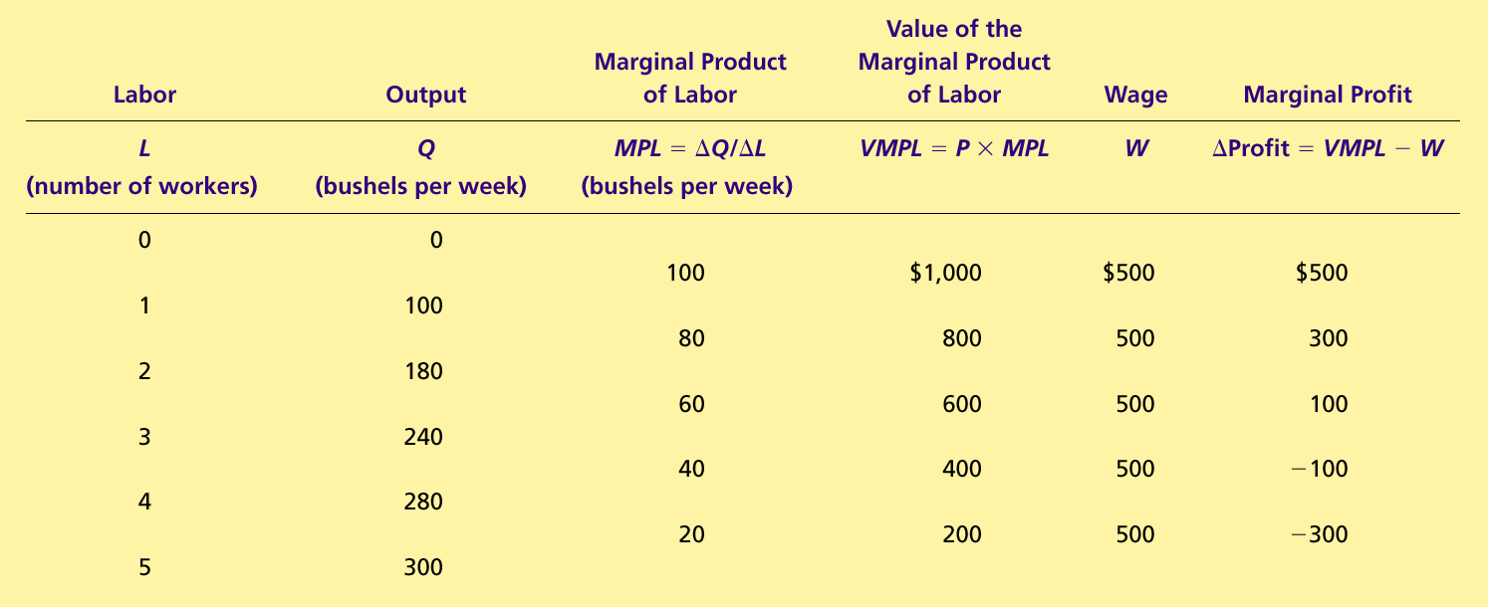
Table 1 How the Competitive Firm Decides How Much Labor to Hire
Note that the MPL decreases as more workers are hired. This reflects diminishing returns.
Note that the wage paid by the firm does not depend on the number of workers hired. This implies perfect competition in the labor market.

Slide 11
Figure 2 The Production Function
Quantity
of Apples
Production
300
function
280
240
180
100
0
1
2
3
4
5
Quantity of
Apple Pickers

Slide 12
The Production Function and the Marginal Product of Labor
The marginal product of labor is the increase in output from an additional unit of labor.
MPL = ΔQ/ΔL
MPL = (Q₂ – Q₁)/(L₂ – L₁)

Slide 13
Diminishing Marginal Product of Labor
As the number of workers increases, the marginal product of labor decreases.
Why?
The amount of some resources—called fixed resources—cannot be increased in the short run.
Therefore, any increase in the amount of labor implies that there is less of the fixed resources for each worker to work with.
This leads to diminishing marginal product of labor.

Slide 14
The Production Function and the Marginal Product of Labor
Diminishing marginal product refers to the property whereby
the marginal product of an input declines as the quantity of the input increases
… and all other factors that affect marginal product—such as the amounts of other resources in use and the technology—are unchanged

Slide 15
Figure 2 The Production Function
Quantity
of Apples
Production
300
function
280
240
180
100
0
1
2
3
4
5
Quantity of
Apple Pickers

Slide 16
The Value of the Marginal Product and the Demand for Labor
VMPL is the additional revenue from the output produced by an additional worker.
VMPL = MPL × P
Example: If a worker adds 20 cookies to a cookie producer’s hourly output, her MPL = 20 cookies per hour. If the sale price of each cookie is P = $0.50, the worker contributes 20 × 0.50 = $10 per hour to the firm’s revenues. So, her VMPL = $10 per hour.
Note that a worker’s VMPL is also the firm’s willingness-to-pay for the worker.

Slide 17
The Value of the Marginal Product and the Demand for Labor
VMPL = MPL × P
VMPL decreases as the number of workers increases because MPL, the marginal product, decreases and P, the market price of the good, stays constant.

Slide 18
The Value of the Marginal Product and the Demand for Labor
To maximize profit, the competitive, profit-maximizing firm hires workers up to the point where the value of the marginal product of labor equals the wage.
VMPL = Wage

Slide 19
Figure 3 The Value of the Marginal Product of Labor
wage
Note that the VMPL curve tells us how many workers the firm will hire at different wage rates. Therefore, the VMPL curve is actually the labor demand curve.
w₂
w₁
Value of Marginal Product of Labor or Firm’s willingness-to-pay for labor
0
L₂
L₁
Quantity of
0
Apple Pickers

Slide 20
The Value of the Marginal Product and the Demand for Labor
The value-of-marginal-product curve is the labor demand curve for a competitive, profit-maximizing firm.
VMPL is also the firm’s willingness-to-pay for labor.
Just as the demand curve for apples is the willingness-to-pay curve for apples, the demand curve for labor is the willingness-to-pay curve for labor

Slide 21
Figure 3 The Value of the Marginal Product of Labor
Value
of the
Marginal
Product
Market
wage
Value of marginal product
(demand curve for labor)
0
Number of
0
Profit-maximizing quantity
Apple Pickers

Slide 22
Figure 3 The Value of the Marginal Product of Labor
Value
of the
Marginal
Product
Market
wage
VMPL = MPL × P
(demand curve for labor)
0
Number of
0
Profit-maximizing quantity
Apple Pickers

Slide 23
What Causes the Labor Demand Curve to Shift?
Changes in P, the produced good’s price
Changes in MPL. This is caused by:
Technological Change
Changes in the amounts of the other factors being used alongside labor

Slide 24
FYI—Input Demand and Output Supply
When a competitive firm hires labor up to the point at which the value of the marginal product equals the wage, it also produces up to the point at which the price equals the marginal cost.
Notes:
This FYI shows that VMPL = W and P = MC are equivalent. The sixth edition has an additional FYI on “The Luddite Revolt”.

Slide 25
THE SUPPLY OF LABOR
The labor supply curve reflects how workers’ decisions about the labor-leisure tradeoff respond to changes in the wage.
An upward-sloping labor supply curve means that an increase in the wages induces workers to increase the quantity of labor they supply.

Slide 26
Figure 4 Equilibrium in a Labor Market
Wage
(price of
labor)
Supply
0
Quantity of
Labor

Slide 27
Supply Curve = Marginal Cost Curve
We saw in Ch. 14 that a firm’s supply curve (of a produced good) is essentially its marginal cost curve
The same idea applies in the case of labor supply as well
A worker’s labor supply curve is the worker’s marginal cost of working another hour

Slide 28
Figure 4 Equilibrium in a Labor Market
$
MC_{L} = Supply
The pain and suffering of having to work another hour is $8.00
8.00
Therefore, this worker will work 40 hours a week when the wage is $8.00 per hour
Therefore, the MCL curve shows the worker’s supply of labor
0
40 hours per week
Quantity of
Labor

Slide 29
A backward-bending labor supply?
At high wages, the quantity of labor supplied might decrease when the wage increases
Example: Suppose $1000 a week is enough for Jim. Also, Jim enjoys spending time with his family
When Jim’s wage rises from $20 per hour to $25 per hour, he, therefore, reduces his time at work from 50 hours a week to 40 hours a week

Slide 30
What Causes the Labor Supply Curve to Shift?
Changes in attitudes towards work
Changes in alternative work opportunities
Immigration

Slide 31
EQUILIBRIUM IN THE LABOR MARKET
The wage adjusts to balance the supply and demand for labor.
As the labor demand curve is also the VMPL curve, the wage equals the value of the marginal product of labor; w = VMPL.

Slide 32
Figure 4 Equilibrium in a Labor Market
Wage
(price of
labor)
Supply
Equilibrium
wage,
W
Demand
0
Equilibrium
Quantity of
employment,
L
Labor

Slide 33
EQUILIBRIUM IN THE LABOR MARKET
Shifts in the supply curve or shifts in the demand curve for labor cause the equilibrium wage to change.

Slide 34
Figure 5 A Shift in Labor Supply
Wage
(price of
1. An increase in
Supply,
S
labor supply . . .
labor)
S
W
W
2. . . . reduces
the wage . . .
Demand
0
L
L
Quantity of
Labor
3. . . . and raises employment.

Slide 35
Shifts in Labor Supply
An increase in the supply of labor :
Results in a surplus of labor.
Puts downward pressure on wages.
Makes it profitable for firms to hire more workers.
Results in diminishing marginal product.
Lowers the value of the marginal product.
Gives a new equilibrium.
Notes:
The sixth edition has an In The News interview with Pia Orrenius, who studies immigration.

Slide 36
Figure 6 A Shift in Labor Demand
Wage
(price of
Supply
labor)
W
1. An increase in
labor demand . . .
W
2. . . . increases
the wage . . .
D
Demand,
D
0
L
L
Quantity of
Labor
3. . . . and increases employment.

Slide 37
Shifts in Labor Demand
An increase in the demand for labor :
Makes it profitable for firms to hire more workers.
Puts upward pressure on wages.
Raises the value of the marginal product.
Gives a new equilibrium.

Slide 38
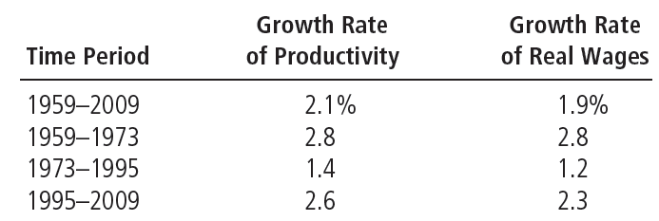
Table 2 Productivity and Wage Growth in the United States
Growth in productivity is measured here as the annualized rate of change in output per hour in the nonfarm business sector. Growth in real wages is measured as the annualized change in compensation per hour in the nonfarm business sector divided by the implicit price deflator for that sector. These productivity data measure average productivity—the quantity of output divided by the quantity of labor—rather than marginal productivity, but average and marginal productivity are thought to move closely together.
Notes:
The sixth edition has an FYI item on monopsony.

Slide 39
OTHER FACTORS OF PRODUCTION: LAND AND CAPITAL
Capital refers to the equipment and structures used to produce goods and services.
The economy’s capital represents the accumulation of goods produced in the past that are being used in the present to produce new goods and services.

Slide 40
OTHER FACTORS OF PRODUCTION: LAND AND CAPITAL
Prices of Land and Capital
The purchase price is what a person pays to own a factor of production indefinitely.
The rental price is what a person pays to use a factor of production for a limited period of time.

Slide 41
Equilibrium in the Markets for Land and Capital
The rental price of land and the rental price of capital are determined by supply and demand exactly as in the case of the wage of labor.
The firm increases the quantity hired until the value of the factor’s marginal product equals the factor’s price.
Rental price of land = VMP of land
Rental price of capital = VMP of capital

Slide 42
Figure 7 The Markets for Land and Capital
(a) The Market for Land
(b) The Market for Capital
Rental
Rental
Price of
Supply
Price of
Supply
Land
Capital
P
P
Demand
Demand
0
Q
Quantity of
0
Q
Quantity of
Land
Capital

Slide 43
Linkages among the Factors of Production
Factors of production are used together.
The marginal product of any one factor depends on the quantities of all factors that are available.

Slide 44
Linkages among the Factors of Production
A change in the supply of one factor alters the earnings of all the factors.

Slide 45
Linkages among the Factors of Production
A change in earnings of any factor can be found by analyzing the impact of the event on the value of the marginal product of that factor.
Notes:
The sixth edition has an FYI item on “What is capital income?”

Slide 46
The Black Death (1347-1350)
One-third of Europe’s population was wiped out by the bubonic plague.
Our theory implies:
A rise in wages for the surviving workers
A fall in the marginal product of land and, therefore, a fall in the value of the marginal product of land, which is also the rent of land
This is what actually happened:
Wages approximately doubled
Land rents were approximately halved

Slide 47
Any Questions?

Slide 48
Summary
The economy’s income is distributed in the markets for the factors of production.
The three most important factors of production are labor, land, and capital.
The demand for a factor, such as labor, is a derived demand that comes from firms that use the factors to produce goods and services.

Slide 49
Summary
Competitive, profit-maximizing firms hire each factor up to the point at which the value of the marginal product of the factor equals its price.
The supply of labor arises from individuals’ tradeoff between work and leisure.
An upward-sloping labor supply curve means that people respond to an increase in the wage by enjoying less leisure and working more hours.

Slide 50
Summary
The price paid to each factor adjusts to balance the supply and demand for that factor.
Because factor demand reflects the value of the marginal product of that factor, in equilibrium each factor is compensated according to its marginal contribution to the production of goods and services.

Slide 51
Summary
Because factors of production are used together, the marginal product of any one factor depends on the quantities of all factors that are available.
As a result, a change in the supply of one factor alters the equilibrium earnings of all the factors.

