Slide 1
Chapter 19: Earnings and Discrimination
Introduction to Microeconomics
Udayan Roy

Slide 2
Earnings Variations
Differences in Earnings in the United States Today
The typical physician earns about $200,000 a year.
The typical police officer earns about $50,000 a year.
The typical farmworker earns about $20,000 a year.

Slide 3
Earnings and Productivity
Wages are governed by labor supply and labor demand.
Labor demand reflects the marginal productivity of labor.
Labor supply reflects the marginal opportunity cost of work.

Slide 4
Earnings
In equilibrium, each worker is paid a wage equal to the value of his or her marginal product
MPL is the worker’s contribution to the economy’s production of goods and services.
VMPL = MPL × price of end product
This wage is also equal to the marginal cost of working.
We saw all this in Chapter 18.

Slide 5
Ch. 18 Figure 4 Equilibrium in a Labor Market
Wage
(price of
labor)
Supply
(Marginal Opportunity Cost of Labor)
Equilibrium
wage,
W
Demand
(Value of the Marginal Product of Labor)
0
Equilibrium
Quantity of
employment,
L
Labor

Slide 6
Earnings Variations
But all this still does not explain why earnings vary
from profession to profession and
from person to person.

Slide 7
SOME DETERMINANTS OF EQUILIBRIUM WAGES
Compensating differentials
Human capital
Ability, effort, and chance
Signaling
The superstar phenomenon

Slide 8
Compensating Differentials
Compensating differential refers to a difference in wages that offset the different non-monetary characteristics of different jobs.
Coal miners are paid more than others with similar levels of education.
Night-shift workers are paid more than day-shift workers.
Professors are paid less than lawyers and doctors.

Slide 9
Human Capital
Human capital is the accumulation of investments in people. It includes
education, and
on-the-job training.
Higher human capital leads to
higher productivity and, therefore,
a higher wage.

Slide 10
Human Capital
Education represents an expenditure of resources to raise future productivity.
For example, the returns to a college degree are huge, and increasing
See next slide

Slide 11
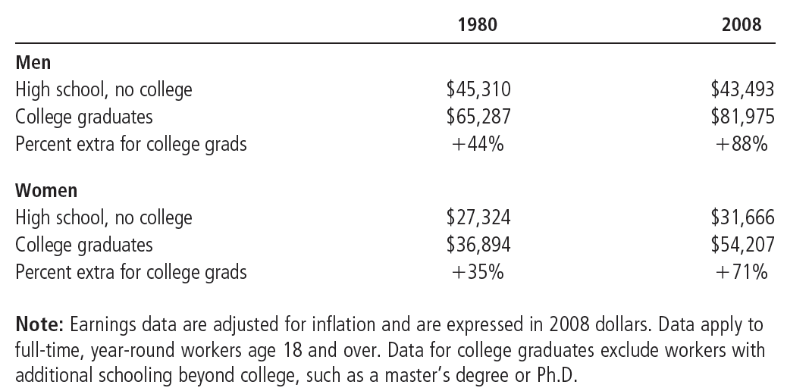
Table 1 Average Annual Earnings by Educational Attainment
College graduates have always earned more than workers without the benefit of college, but the salary gap has grown even larger over the past few decades.
Notes:
This table needs to be updated. It is part of a Case Study on “The increasing value of skills”.

Slide 12
The Increasing College Premium
Why has the gap in earnings between skilled and unskilled workers risen in recent years? Here are two hypotheses:
Globalization provides more opportunities for our skilled labor and reduces the need for our unskilled labor.
Technological progress has increased the need for skilled labor and reduced the need for unskilled labor.
Notes:
The fifth edition has an In The News item on the loss of manufacturing jobs in the US.

Slide 13
Ability, Effort, and Chance
High natural ability leads to high productivity and a high wage.
One’s love of leisure and one’s natural ability determine one’s effort. Effort determines productivity and the wage.
These characteristics of a worker are determined by chance.
Chance also determines whether one chooses the right career.

Slide 14
Case Study: The Benefits of Beauty
A 1994 poll was used to rank a set of pictures of people by beauty
After controlling for education, job experience, profession, and other standard determinants of wages, it was found that people considered more attractive than average earned 5 to 10 percent more than those considered less attractive than average.
Why does beauty make a difference?

Slide 15
Photo by Udayan Roy

Slide 16
An Alternative View of Education: Signaling
According to another theory, education does not improve productivity.
Firms use educational attainment as a way of sorting between high-ability and low-ability workers.
It is rational for firms to interpret a college degree as a signal of ability.
As a result, the college-educated earn more even though college is a waste of time.

Slide 17
An Alternative View of Education: Signaling
The human capital approach is probably true for those with professional degrees
The signaling approach may be true for liberal arts majors
Notes:
The sixth edition has an In The News item on “The human capital of terrorists”.

Slide 18
The Superstar Phenomenon
Superstars arise in markets that exhibit the following characteristics:
Every customer in the market wants to enjoy the good supplied by the best producer.
The good is produced with a technology that makes it possible for the best producer to supply every customer at a low cost.
In such a market wages vary a great deal more than ability does.

Slide 19
Above-Equilibrium Wages
The equilibrium theory of wages that you saw in chapter 18 does not always apply (Sorry!)
In some cases, the wage exceeds the equilibrium wage. Why?
Minimum-wage laws
Market power of labor unions
Efficiency wages

Slide 20
Above-Equilibrium Wages: Unions
A union is a worker association that bargains with employers over wages and working conditions.
A union’s final weapon is a strike. A strike refers to the organized withdrawal of labor from a firm by a union.
Union workers earn 10 to 20 percent more than similar non-union workers

Slide 21
Above-Equilibrium Wages: Efficiency Wages
The theory of efficiency wages holds that a firm can find it profitable to pay high wages because doing so increases the productivity of its workers. High wages may:
reduce worker turnover.
increase worker effort.
raise the quality of workers that apply for jobs at the firm.

Slide 22
THE ECONOMICS OF DISCRIMINATION
Wages are also affected by discrimination.
Discrimination occurs when the marketplace offers different opportunities to similar individuals who differ only by race, ethnic group, sex, age, or other personal characteristics.

Slide 23
THE ECONOMICS OF DISCRIMINATION
Although discrimination is an emotionally charged topic, economists try to study the topic objectively in order to separate myth from reality.

Slide 24
Measuring Labor-Market Discrimination
Discrimination is often measured by looking at the average wages of different groups.

Slide 25
Measuring Labor-Market Discrimination
Even in a labor market free of discrimination, different people have different wages.

Slide 26
Measuring Labor-Market Discrimination
People differ in the amount of human capital they have and in the kinds of work they are willing and able to do.

Slide 27
Measuring Labor-Market Discrimination
Simply observing differences in wages among broad groups—white and black, men and women—says little about the prevalence of discrimination.

Slide 28
Table 2 Median Annual Earnings by Race and Sex
Do these facts prove discrimination?

Slide 29
Case Study: Is Emily more employable than Lakisha?
Economists Marianne Bertrand & Sendhil Mullainathan
Answered more than 1,300 help-wanted ads run in Boston and Chicago newspapers
Send in nearly 5,000 fake résumés - similar
Half of the résumés had names that were common in the African American community
The other half had names that were more common among the white population

Slide 30
Case Study: Is Emily more employable than Lakisha?
Results
Job applicants with white names
Received about 50% more calls
Discrimination occurred for all types of employers
Conclusion
“Racial discrimination is still a prominent feature of the labor market”

Slide 31
Measuring Labor-Market Discrimination
Because the differences in average wages among groups in part reflect differences in human capital and job characteristics, they do not by themselves say anything about how much discrimination there is in the labor market.
Notes:
The sixth edition has a Case Study on discrimination against black-sounding names. It also has an In The News article on the career choices of men and women.

Slide 32
Discrimination by Employers
The fact that discrimination is hard to measure does not mean that it does not happen.
Firms may discriminate in their hiring. However,
Firms that do not discriminate will have lower labor costs when they hire the employees who have been discriminated against.

Slide 33
Discrimination by Employers
Nondiscriminatory firms will tend to out-compete and replace firms that discriminate.

Slide 34
Discrimination by Employers
Competitive markets tend to limit the impact of discrimination on wages.
Firms that do not discriminate will be more profitable than those firms that do discriminate.

Slide 35
Discrimination by Customers and Governments
Although the profit motive is a strong force acting to eliminate discriminatory wage differentials, there are limits to its corrective abilities.
Customer preferences
Government policies

Slide 36
Discrimination by Customers
If customers have discriminatory preferences, firms may discriminate for profitability reasons.
This will happen when customers are willing to pay to maintain the discriminatory practice.

Slide 37
Case Study: Discrimination in Sports
According to a 1988 study, black basketball players earned 20 percent less than white players of comparable ability.
A possible explanation is discrimination by fans.
Late 1960s data showed that black baseball players earned less than white players of similar ability
A 1990 study found that baseball cards for black hitters (pitchers) sold for 10 percent (13 percent) less than cards for comparable white hitters (pitchers)

Slide 38
Case Study: Segregated streetcars and the profit motive
Early 20th century
Streetcars in many southern cities were segregated by race
White passengers sat in the front of the streetcars
Black passengers sat in the back

Slide 39
Case Study: Segregated streetcars and the profit motive
Why?
Laws required such segregation
Before these laws were passed, racial discrimination in seating was rare
It was far more common to segregate smokers and nonsmokers

Slide 40
Case Study: Segregated streetcars and the profit motive
Firms that ran the streetcars
Often opposed the laws requiring racial segregation
Separate seating for different races
Raised firms’ costs
Reduced firms’ profit

Slide 41
Case Study: Segregated streetcars and the profit motive
General lesson
Business owners are more interested in making profit than in discriminating against a particular group
When firms engage in discriminatory practices
Ultimate source of the discrimination often lies not with the firms themselves but elsewhere

Slide 42
Discrimination by Customers and Governments
Competitive markets contain a natural remedy for employer discrimination
The entry into the market of firms that care only about profit tends to eliminate discriminatory wage differentials
These wage differentials persist in competitive markets only when customers are willing to pay to maintain the discriminatory practice or when the government mandates it

Slide 43
Any Questions?

Slide 44
Summary
Workers earn different wages for many reasons.
To some extent, wage differentials compensate workers for job attributes.
Workers with more human capital get paid more than workers with less human capital.

Slide 45
Summary
The return to accumulating human capital is high and has increased over the past decade.
There is much variation in earnings that cannot be explained by things economists can measure.

Slide 46
Summary
The unexplained variation in earnings is largely attributable to natural ability, effort, and chance.
Some economists have suggested that more-educated workers earn higher wages because workers with high natural ability use education as a way to signal their high ability to employers.

Slide 47
Summary
Wages are sometimes pushed above the equilibrium level because of minimum-wage laws, unions, and efficiency wages.
Some differences in earnings are attributable to discrimination on the basis of race, sex, or other factors.
When measuring the amount of discrimination, one must correct for differences in human capital and job characteristics.

Slide 48
Summary
Competitive markets tend to limit the impact of discrimination on wages.
Discrimination can persist in competitive markets if customers are
willing to pay more to discriminatory firms,
or if the government passes laws requiring firms to discriminate.

