Slide 1
Frontiers of Microeconomics
22

Slide 2
Asymmetric Information
Information asymmetry
“I know something you don’t know”
A difference in access to relevant knowledge
Hidden action
Hidden characteristic

Slide 3
Asymmetric Information
Hidden actions: principals, agents, moral hazard
Moral hazard
Person who is imperfectly monitored
Tendency to engage in dishonest or otherwise undesirable behavior
Agent
Person who is performing an act for another person (the principal)
Principal
Person for whom another person (the agent) is performing some act

Slide 4
Asymmetric Information
Hidden actions: principals, agents, moral hazard
Employment relationship
Moral hazard
Employer – the principal
Worker – the agent
Responses to moral hazard problem
Better monitoring
Higher wages
Delayed payment

Slide 5
Asymmetric Information
Hidden characteristics: adverse selection & the lemons problem
Adverse selection
Mix of unobserved attributes
Tendency to become undesirable from the standpoint of an uninformed party
Market for used cars
Sellers – know the defects of cars better
Than prospective buyers

Slide 6
Asymmetric Information
Hidden characteristics: adverse selection & the lemons problem
Labor market
Workers – know their abilities better
Than firms
Markets for insurance
People buying insurance – know more
Than insurance company

Slide 7
Asymmetric Information
Signaling to convey private information
Signaling
Action taken by an informed party
To reveal private information to an uninformed party
Firms – advertising
Students – college degree
Effective signaling
Costly
More beneficial - higher-quality product

Slide 8
Gifts as signals
Gift giving
Reflects asymmetric information and signaling
Choosing a good gift
Signal of love
Costly - it takes time
Cost depends on private information
Giving cash as gift
Signal: May offend

Slide 9
Asymmetric Information
Screening to induce information revelation
Screening
Action taken by an uninformed party
To induce an informed party to reveal information
Seller of car insurance
Low premium to safe drivers
High premium to risky drivers

Slide 10
Asymmetric Information
Asymmetric information and public policy
Asymmetric information
Market may fail to put resources to their best use
May call for government action in some cases
Complications for government intervention
Private market - deal with information asymmetries
Signaling and screening
Government - rarely has more information than the private parties
Government - imperfect institution

Slide 11
Political Economy
Political economy
Study of government
Using the analytic methods of economics
The Condorcet voting paradox
Failure of majority rule to produce transitive preferences for society

Slide 12
The Condorcet paradox
1
 | Voter type
 | Type 1 | Type 2 | Type 3
Percent of Electorate First choice Second choice Third choice | 35 A B C | 45 B C A | 20 C A B
If voters have these preferences over outcomes A, B, and C, then in pairwise majority voting, A beats B, B beats C, and C beats A.

Slide 13
Political Economy
Arrow’s impossibility theorem
Properties for voting system:
Unanimity
If everyone prefers A to B, then A should beat B
Transitivity
If A beats B, and B beats C, then A should beat C
Independence of irrelevant alternatives
Ranking between any two outcomes A & B
Should not depend on whether outcome C is also available
No dictators
There is no person who always gets his way
Regardless of everyone else’s preferences

Slide 14
Political Economy
Arrow’s impossibility theorem
Mathematical result
Under certain assumed conditions
There is no scheme for aggregating individual preferences
Into a valid set of social preferences

Slide 15
Political Economy
The median voter is king
Voting – by majority rule
Median voter theorem
Mathematical result
If voters are choosing a point along a line
And each voter wants the point closest to his most preferred point
Then majority rule will pick the most preferred point of the median voter

Slide 16
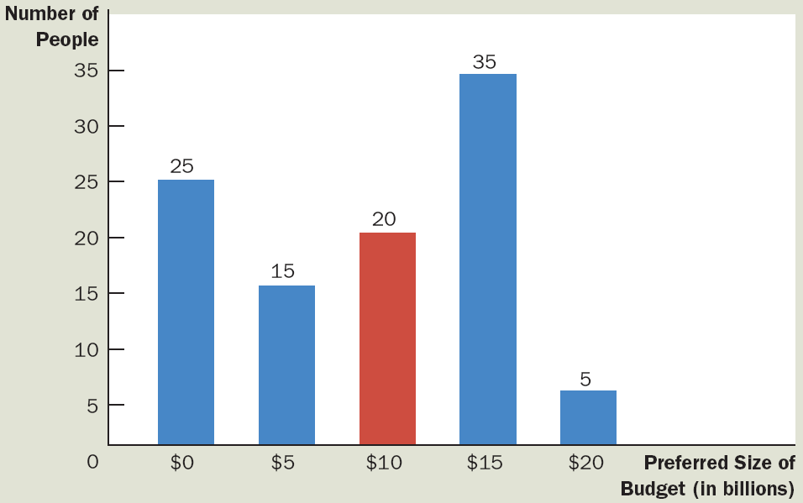
The median voter theorem: an example
1
This bar chart shows how 100 voters’ most preferred budgets are distributed over five options, ranging from zero to $20 billion. If society makes its choice by majority rule, the median voter (who here prefers $10 billion) determines the outcome.

Slide 17
Political Economy
Implications of the median voter theorem
Parties in a two-party system
Move toward the median voter
Minority views are not given much weight
Majority rule
Looks only to the person in the exact middle of the distribution

Slide 18
Political Economy
Politicians are people too
Have objectives
Nice to assume (not realistic)
Looking out for the well-being of society as a whole
Aiming for an optimal combination of efficiency and equality.
Self-interest – powerful motive
Desire for reelection
Greed

Slide 19
Behavioral Economics
Behavioral economics
Subfield of economics
Integrates the insights of psychology
People aren’t always rational
Imperfections of human reasoning
Forgetful, impulsive, confused, emotional, and shortsighted

Slide 20
Behavioral Economics
People aren’t always rational
Not rational maximizers
Always choosing the best course of action
Satisficers
Make decisions that are merely good enough
Systematic mistakes that people make
Overconfidence
Give too much weight to a small number of vivid observations
Reluctant to change their minds

Slide 21
Behavioral Economics
People aren’t always rational
Economics - built on the rationality assumption
Yields reasonably accurate models of behavior
Economists are themselves not rational maximizers

Slide 22
Behavioral Economics
People care about fairness
Game: split $100 between two players
Only one player decides the shares
99-1 – acceptable and rational
60-40 – fair
People are inconsistent over time
People make plans for themselves
But then they fail to follow through
People should try to find ways to commit their future selves to following through on their plans

