Slide 1
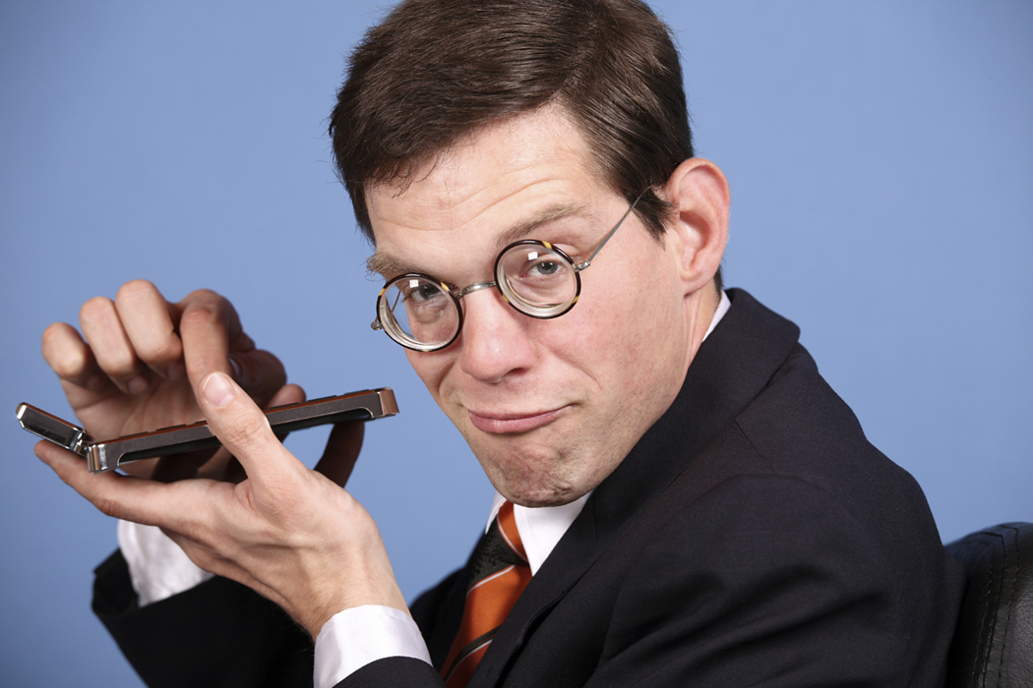
The standard economic model of economic behavior … and its weaknesses
Notes:
What does the subject matter of this presentation have to do with economics? How can people protect themselves from the weaknesses discussed here? How can or should rational actors and policy makers make use of the ideas discussed here?

Slide 2
Behavioral Economics
Standard Economics + Psychology = Behavioral Economics

Slide 3
What is the standard economic model?
The standard, or neo-classical, economic model is the way most economists think about consumer welfare and consumer choice.
It is what you will learn in any introductory microeconomics course.

Slide 4
Rationality in the Standard Economic Model
Standard economics relies heavily on the assumption that people are rational
Standard economics assumes that people
are fully aware of all the options they have
can -- always and consistently -- rank their options in accordance with their preferences, and
always choose the option they like best

Slide 5
Assumptions of the Standard Economic Model of Consumer Behavior
People act with full information.
Full External Knowledge

Slide 6
Assumptions of the Standard Economic Model of Consumer Behavior
People act with full information.
People have known preferences.
Full External Knowledge
Full Internal Knowledge

Slide 7
Assumptions of the Standard Economic Model of Consumer Behavior
People act with full information.
People have known preferences.
People choose the best option available.
Full External Knowledge
Full Internal Knowledge
Rational Choices

Slide 8
Assumptions of the Standard Economic Model of Consumer Behavior
People act with full information.
Full External Knowledge
No matter how complex the situation, a human being can always figure out which choices are available and which are unavailable

Slide 9
Assumptions of the Standard Economic Model of Consumer Behavior
People act with full information.
People have known preferences.
Full External Knowledge
Full Internal Knowledge
No matter what set of choices are put before a human being, he or she will know how to rank the choices, from best to worst

Slide 10
Assumptions of the Standard Economic Model of Consumer Behavior
People act with full information.
People have known preferences.
People choose the best option available.
Full External Knowledge
Full Internal Knowledge
Rational Choices
A human being will always pick the highest ranked choice that is available

Slide 11
Advantages of the standard model
From these three assumptions,
a logically consistent theory of economic behavior can be built,
that theory can be used to make predictions about economic behavior, and
those predictions can be compared with reality
These models often correspond to actual behavior

Slide 12
Advantages of the standard model
From these three assumptions,
a logically consistent theory of consumer behavior can be built,
that theory can be used to make predictions about consumer behavior, and
those predictions can be compared with reality
These models often correspond to actual behavior

Slide 13
Advantages of the standard model
From these three assumptions,
a logically consistent theory of consumer behavior can be built,
that theory can be used to make predictions about consumer behavior, and
those predictions can be compared with reality
These models often correspond to actual behavior
Pssst. Sometimes the basic assumptions are false!

Slide 14
Assumptions of the Standard Economic Model of Consumer Behavior
People act with full information.
People have known preferences.
People choose the best option available.
Full External Knowledge
Full Internal Knowledge
Rational Choices

Slide 15
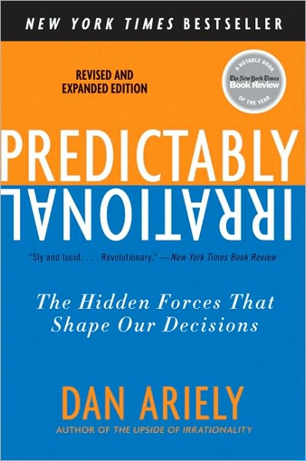
The Inconvenient Truth
Clear and voluminous evidence from psychology has shown that the rationality assumptions of standard economics are wrong!
Evidence from psychology has shown that
that we often are irrational, and also
that we are predictably irrational

Slide 16
Predictably Irrational
If irrational people were irrational in random ways, they would cancel each other out, leaving the overall outcome determined by the behavior of rational people
In that case, economic theories that ignored irrational behavior would work just fine
But psychology has shown that we are irrational in similar and predictable ways
Therefore, irrationality does not cancel out and therefore cannot be ignored

Slide 17
Predictably Irrational
Moreover, the fact that we are predictably irrational means that our predictably irrational behavior can be relatively easily inserted into economic theories to make economic predictions more accurate

Slide 18
Bounded Rationality
We will see evidence that people often are unable to figure out the best available option even when they know their available options and their preferences.

Slide 19
Bounded Willpower
And even when we can figure out what’s best for us, evidence shows that we often succumb to temptations and end up making bad choices anyway.

Slide 20
Bounded Self-Interest
Although economic theory does not always assume self-interested behavior, as a practical matter, most applications of economic theory assume that people act according to self-interest
Unfortunately for economics—and fortunately for the human race—there’s plenty of reliable evidence of predictably unselfish behavior

Slide 21
Neo-Classical Backlash
Die-hard believers in the standard economic model often accept the evidence from psychology and yet doubt the need to abandon the assumption of rational behavior
They make three arguments:
Competitive market trade (arbitrage)
Darwinian evolution
Learning

Slide 22
1. Market competition makes us rational (pro)
A competitive market in auto insurance will charge very high rates to someone who wishes to drive a fast but unsafe motorbike
This, one might argue, will protect people from taking stupid risks

Slide 23
1. Market competition makes us rational (con)
But it is also true that the free market does not punish all bad choices
Although financial markets are relatively sophisticated markets, there are abundant examples of sophisticated professionals who, instead of punishing foolish behavior by unsophisticated individuals, end up encouraging the bad behavior, at least for some time, because it is in their interest to do so
Notes:
See “Behavioral Economics” by Sendhil Mullainathan and Richard Thaler, NBER Working Paper 7948, http://www.nber.org/papers/w7948.

Slide 24
2. Darwinian evolution makes us rational (pro)
Those who make dumb mistakes will be unattractive to potential mates and will find it hard to reproduce and propagate their genes.
In this way, evolution will ensure that only rational people will survive ultimately

Slide 25
2. Darwinian evolution makes us rational (con)
The counterargument is that evolution tends to take forever
Besides, a behavioral trait that is an evolutionary disadvantage in one context may be an advantage in other contexts.
Example: overconfidence

Slide 26
3. Learning makes us rational (pro)
Even if people are predictably irrational, they can learn from their -- and other people’s -- mistakes
Therefore, over time, we will learn to be rational

Slide 27
3. Learning makes us rational (con)
Those who make stupid mistakes may also be too stupid to learn from their mistakes or too stupid to invest in education
Moreover, many of the most important decisions we make are made once or just a few times in a lifetime
As a result, there are few opportunities to learn from our mistakes
Finally, if there are many potential bad choices and one good choice, it might take a lot of costly experimentation to figure out the right choice

Slide 28
We are predictably irrational
Having considered several counter-arguments, it now seems safe to conclude that the standard economic model can be improved by behavioral economics

Slide 29
Video: What is behavioral economics?
http://www.youtube.com/watch?v=Fa-mIosWOK8

Slide 30
Summary
Standard economic theories assume that people are rational, strong-willed, and self-interested
Evidence from psychology shows that they are not
That evidence also shows that our irrationality has predictable features

Slide 31
Summary
Behavioral economics makes economic predictions more accurate by using the evidence on our predictable irrational behavior
Although market competition, Darwinian evolution, and learning may be expected to reduce irrational behavior over time, these processes may not work well and may take too long to work

