Slide 1
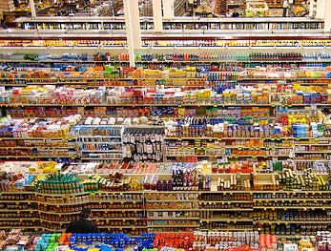
The paradox of choice: Too many good options?
Notes:
This discussion can be paired with an idea in mental accounting theory that says that in-kind gifts may be better than cash gifts. The argument is that people make up mental accounts and do not wish to buy luxury items that would put an account in the red, even though the item’s benefit may exceed its cost. In such a case, an in-kind gift gives people what they need but would never buy. (I wonder if the same idea can explain the paradox of choice.)

Slide 2
Standard Economics:
too few choices is bad

Slide 3
Standard economics:
lots of choice is good
Notes:
http://www.flickr.com/photos/unaesthetic/22725413/#comment72157600327196839

Slide 4
Experimental findings:
Simplicity can be good

Slide 5
Experimental findings:
Hyper-choice can be bad
Notes:
http://www.flickr.com/photos/unaesthetic/22725413/#comment72157600327196839

Slide 6
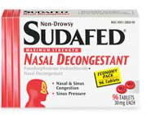
Choice variety in standard economics
Good

Slide 7
Choice variety in standard economics
Better

Slide 8
Best!

Slide 9
In standard economics, more choice is always better because I can simply ignore the less desirable choices
<
<

Slide 10
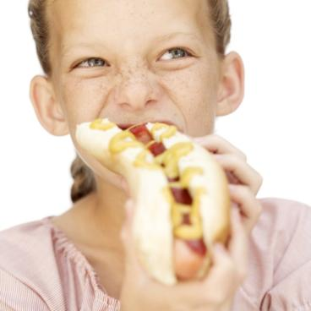
Diminishing marginal utility and choice variety in standard economics
We’ve just seen that the addition of choices is thought to be clearly superior when existing choices remain available.
Another reason why the availability of more choices is desirable is diminishing marginal utility.
Hot Dogs Consumed | Utility from Each Hot Dog
1 | +10
2 | +4
3 | 0
4 | -1
5 | -4
6 | -10

Slide 11
Greater availability of tempting options leads to greater consumption.
But otherwise, more options are always a good thing, right?

Slide 12
Hyperchoice and the choice paradox
We think more choice is better, but there can be problems with excessive choice:
Decisions become less likely (paralysis)
Choice satisfaction drops

Slide 13
Too many choices can lead to paralysis
http://www.youtube.com/watch?v=VO6XEQIsCoM
0:25-9:57

Slide 14
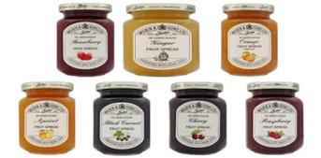
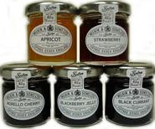
The Jam Experiment
Tasting booth for unusual jams in an upscale grocery story.
A: offered 6 jams
B: offered 24 jams
What percentage of tasters later purchased one of the jams?
A
B
Iyengar, S. (Columbia) & Lepper, M. (Stanford), 2000, When choice is demotivating: Can one desire too much of a good thing. Journal of Personality and Social Psychology, 79, 995-1006

Slide 15
The Jam Experiment
“On two consecutive Saturdays, neither of which fell on a long holiday weekend, a tasting booth was set up inside the grocery store.
Over the course of these two 5-hr experimental periods, the behavior of approximately 754 shoppers was observed.
Among the 386 customers present in the store during the hours when the extensive-choice booth was displayed, only 242 (63%) actually encountered the display.
Among the 368 customers present in the store during the hours when the limited-choice booth was displayed, only 260 (71%) actually encountered the display.”

Slide 16
The Jam Experiment
“Of the 242 customers who passed the extensive-selection display of jams, 60% (145) actually stopped at the booth.
In contrast, of the 260 customers who passed the limited-selection display of jams, only 40% (104) stopped.
Thus, consumers who encountered the extensive-choice condition were more attracted to the booth than consumers exposed to the limited-choice condition, suggesting that the variety provided in the extensive-choice condition was initially more attractive”

Slide 17
The Jam Experiment
“One might imagine that consumers who encountered 24 different jams would sample more flavors than would those who encountered 6 different varieties.
In fact, however, there were no significant differences.”

Slide 18
The Jam Experiment
“Nearly 30% (31) of the consumers in the limited-choice condition subsequently purchased a jar
In contrast, only 3% (4) of the consumers in the extensive-choice condition did so
Thus, consumers initially exposed to limited choices proved considerably more likely to purchase the product than consumers who had initially encountered a much larger set of options.”

Slide 19
Decision paralysis
30%
Tasting booth for unusual jams in an upscale grocery story.
A: offered 6 jams
B: offered 24 jams
What percentage of tasters later purchased one of the jams?
A
B
3%
Iyengar, S. (Columbia) & Lepper, M. (Stanford), 2000, When choice is demotivating: Can one desire too much of a good thing. Journal of Personality and Social Psychology, 79, 995-1006

Slide 20
Decision paralysis
40%
What percentage of shoppers stopped at the display?
Shoppers were more attracted to greater variety, but were less likely to actually make a decision.
A
B
60%
Iyengar, S. (Columbia) & Lepper, M. (Stanford), 2000, When choice is demotivating: Can one desire too much of a good thing. Journal of Personality and Social Psychology, 79, 995-1006

Slide 21
An extra credit writing assignment in a class at Stanford: some sections had 6 topic options. Others had 30 topic options.
Which sections were most likely to
complete the essay?
Iyengar, S. (Columbia) & Lepper, M. (Stanford), 2000, When choice is demotivating: Can one desire too much of a good thing. Journal of Personality and Social Psychology, 79, 995-1006

Slide 22
6 topics available 30 topics available
74% completed 60% completed
And grades—for both content and form—were significantly higher for the few-choices group.
Iyengar, S. (Columbia) & Lepper, M. (Stanford), 2000, When choice is demotivating: Can one desire too much of a good thing. Journal of Personality and Social Psychology, 79, 995-1006

Slide 23
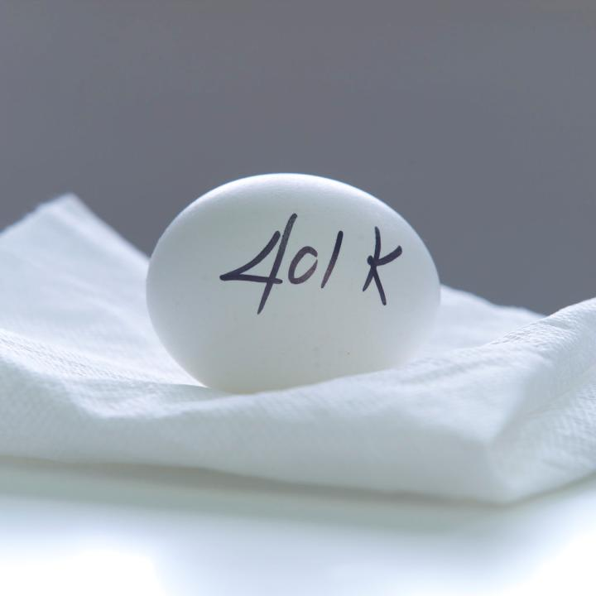
800,000 eligible employees at 657 companies
401(k) plans ranged from 2 to 60 investment options
As choices increased what happened to the likelihood of investing?
Decreased b) Increased c) Stayed the same

Slide 24
S. Botti (Cornell) & S. S. Iyengar (Columbia), 2006, The dark side of choice: When choice impairs social welfare. Journal of Public Policy and Marketing, 25(1), 24-38.

Slide 25
Choice paradox and satisfaction
http://www.youtube.com/watch?v=VO6XEQIsCoM
Barry Schwartz. 9:57-17:20

Slide 26
An experiment with two digital video player versions
Before use, which had higher rating of “How satisfied would you be if you subscribed to the digital player?”
Few features (7)
Many features (21)
No difference

Slide 27
An Experiment with Digital Video Players
D. Thompson (U. Maryland), R. Hamilton (U. Maryland), R. Rust (U. Maryland), 2005, Feature fatigue: When product capabilities become too much of a good thing. Journal of Marketing Research, 42, 432-442.

Slide 28
An experiment with two digital video player versions
After use, which had higher rating of “How satisfied were you with the digital player you used?”
Few features (7)
Many features (21)
No difference

Slide 29
An Experiment with Digital Video Players
D. Thompson (U. Maryland), R. Hamilton (U. Maryland), R. Rust (U. Maryland), 2005, Feature fatigue: When product capabilities become too much of a good thing. Journal of Marketing Research, 42, 432-442.

Slide 30
Do more television options make you better off?
72,012 respondents from 24 nations with varying numbers of available television stations
Comparing among those with similarly high or low levels of television watching compared with group norms

Slide 31
C. Benesch(U. of Zurich), B. Frey (U. Zurich), & A. Stutzer (U. Basel), 2006, TV Channels, Self Control and Happiness, Working Paper - Institute for Empirical Research in Economics, University of Zurich

Slide 32
Choice paradox and satisfaction
No choice can be bad.
Excessive choice can also be bad.
Limited choice may be best.
satisfaction
Number of choices

Slide 33
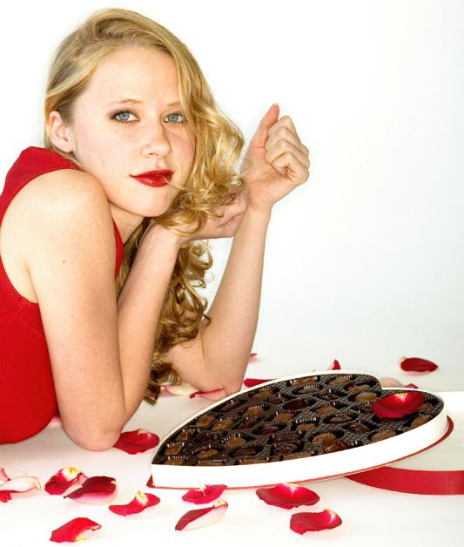
Participants choosing from a selection of 30 chocolates instead of 6 chocolates were “more dissatisfied and regretful of the choices they made.”
Iyengar, S. (Columbia) & Lepper, M. (Stanford), 2000, When choice is demotivating: Can one desire too much of a good thing? Journal of Personality and Social Psychology, 79, 995-1006

Slide 34
Participants were given a picture representing a set of gift boxes with a certain number of alternatives.
They were asked to choose the gift box they would buy to pack a present for a friend.

Slide 35
Different people were tested with different numbers of gift box options.
According to standard economic theory, which group should be the happiest with their selected option?
5 options
10 options
15 options
30 options

Slide 36
Different people were tested with different numbers of gift box options.
When asked afterwards, which group actually reported the highest satisfaction with their choice?
5 options
10 options
15 options
30 options

Slide 37
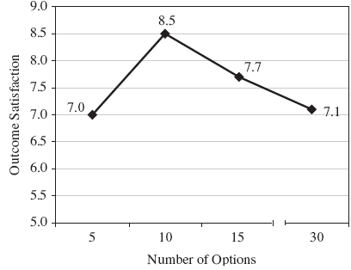
E. Reutskaja (IESE) & R. Hogarth (Universitat Pompeu Fabra-Barcelona), 2009, Satisfaction in Choice as a Function of the Number of Alternatives: When “Goods Satiate. Psychology and Marketing, 26(3), 197-203.

Slide 38
When asked afterwards, which group most enjoyed the process of selecting the box?
5 options
10 options
15 options
30 options

Slide 39
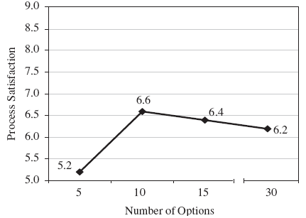
E. Reutskaja (IESE) & R. Hogarth (Universitat Pompeu Fabra-Barcelona), 2009, Satisfaction in Choice as a Function of the Number of Alternatives: When “Goods Satiate. Psychology and Marketing, 26(3), 197-203.

Slide 40
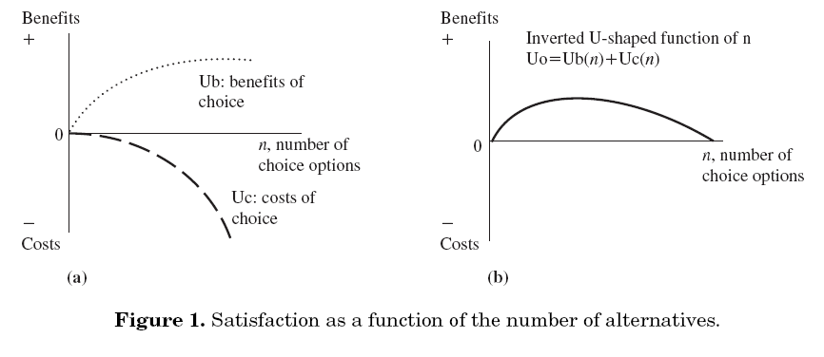
Breaking apart the choice paradox
E. Reutskaja (IESE) & R. Hogarth (Universitat Pompeu Fabra-Barcelona), 2009, Satisfaction in Choice as a Function of the Number of Alternatives: When “Goods Satiate. Psychology and Marketing, 26(3), 197-203.

Slide 41
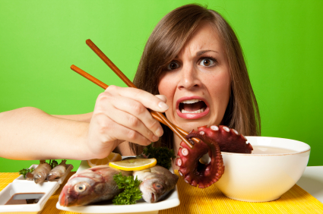
When all options are negative, even limited choice can be undesirable
Increases time spent contemplating negative results
Attaches personal responsibility to the negative outcome

Slide 42
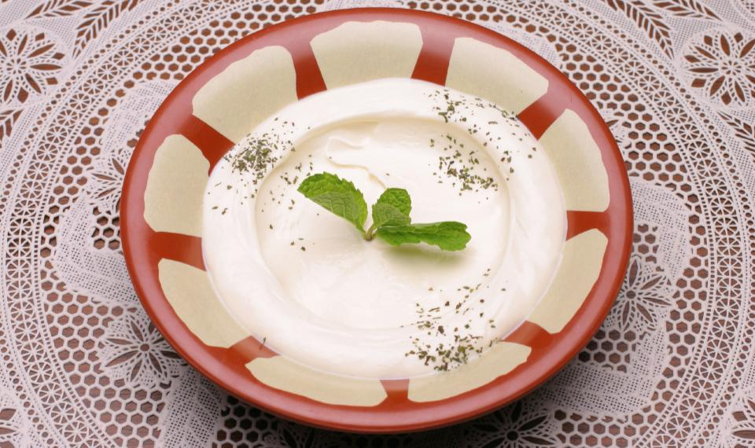
An experiment with unpleasant yogurt flavors:
sage, chili powder, tarragon, or celery seeds
Either asked to pick one or told they would be given one randomly.

Slide 43
Did you like the fact that you were given a choice?
5.50 agreement
Did you like the fact that you did not have to choose?
4.41 agreement
But, did choice result in greater satisfaction?
Yes
No
Made no difference
S. Botti (U. Chicago) & S. Iyengar (Columbia U.), 2004, The psychological pleasure and pain of choosing: When people prefer choosing at the cost of subsequent outcome satisfaction. Journal of Personality and Social Psychology, 87(3), 312-326.

Slide 44
Not too many options here (only 4), but all options were negative
S. Botti (U. Chicago) & S. Iyengar (Columbia U.), 2004, The psychological pleasure and pain of choosing: When people prefer choosing at the cost of subsequent outcome satisfaction. Journal of Personality and Social Psychology, 87(3), 312-326.

Slide 45
“Although increased choice is perceived as desirable, in some circumstances, the provision of choice either inhibits decision makers’ likelihood to make a choice or detrimentally affects their experienced well-being after the choice is made.”
S. Botti (Cornell) & S. Iyengar (Columbia), 2006, The dark side of choice: When choice impairs social welfare. Journal of Public Policy and Marketing, 25(1), 24-38.

Slide 46
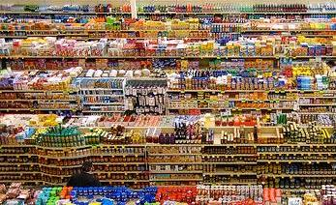
Simplicity v. Variety
Sometimes too many options…
can make decisions difficult.
may lead to doing nothing.
are more likely to cause regret.

Slide 47
Diversification Bias
We hate losing options, even when they are bad ones.
We love diversification, even when it is pointless and costly.
We avoid focusing, even when there is only one correct choice.
Paradox of Choice: Too many options
can make decisions difficult.
may lead to doing nothing.
are more likely to cause regret.

Slide 48
The struggle is important because…
Diversification Bias
We hate losing options, even when they are bad ones.
We love diversification, even when it is pointless and costly.
We avoid focusing, even when there is only one correct choice.
The Paradox of Choice
Too many options
can make decisions difficult.
may lead to doing nothing.
are more likely to cause regret.
Controlling your decision environment
often means eliminating options

Slide 49
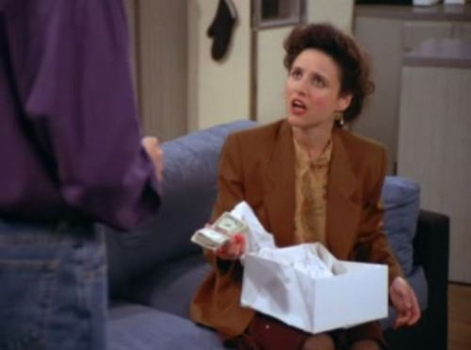
Cash as a birthday gift?
Seinfeld episode: Jerry gives Elaine $182 as a gift on her birthday!
It seems rational because it expands the recipient’s choices …
… but a cash gift replaces social norms by market norms and ruins the feelings usually evoked by a typical non-cash birthday gift
Moreover, the expansion of choice may not be helpful

Slide 50
Cash as a birthday gift?
The theory of mental accounting provides yet another reason why an in-kind gift may be superior to a cash gift

