Slide 1
Loss Aversion and the Endowment Effect
Notes:
Students should be given a preview of prospect theory and the role of loss aversion in it.
What does the subject matter of this presentation have to do with economics? How can people protect themselves from the weaknesses discussed here? How can or should rational actors and policy makers make use of the ideas discussed here?

Slide 2
Reading
Thinking, Fast and Slow by Daniel Kahneman
Chapter 26: Prospect Theory, “Loss Aversion”
Misbehaving by Richard Thaler
Chapter 4: Value Theory
Nudge by Richard Thaler and Cass Sunstein
Chapter 1: Biases and Blunders, “Gains and Losses”

Slide 3
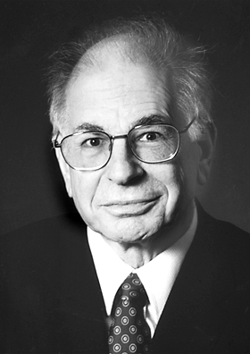
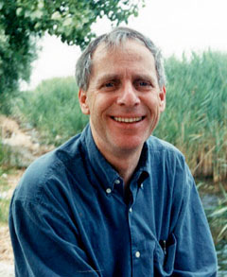
Prospect Theory
This is easily the most famous theoretical contribution to behavioral economics
Prospect Theory: An Analysis of Decision under Risk, by Daniel Kahneman and Amos Tversky, Econometrica, Vol. 47, No. 2 (March 1979), pp. 263-292
One of the key components of prospect theory is loss aversion

Slide 4
People are more motivated to avoid a loss than to acquire a similar gain.

Slide 5
Gains and Losses Relative to a Reference Point
In The Undoing Project by Michael Lewis, Daniel Kahneman is described as imagining the following scenario (p. 267):
Yesterday, Jack had $1 million and Jill had $9 million.
Today Jack and Jill each have $5 million.
Assuming they are otherwise identical, are they equally happy?
Standard economics would say they are equally happy
Kahneman concluded that Jill was obviously less happy than Jack

Slide 6
Gains and Losses Relative to a Reference Point
In The Undoing Project by Michael Lewis, Daniel Kahneman is described as imagining the following scenario (p. 267):
Yesterday, Jack had $1 million and Jill had $9 million.
Today Jack and Jill each have $5 million.
Assuming they are otherwise identical, are they equally happy?
What matters is whether an outcome is a gain or a loss relative to each person’s reference point (or, in this case, the status quo)

Slide 7
Loss Aversion, Measured
Daniel Kahneman on loss aversion: http://www.youtube.com/watch?v=VorB7X5L8ZY&feature=related
Experiment after experiment has shown that people will accept a gamble with equal odds of a loss and a gain, as long as the gain is roughly 2.5 times the loss

Slide 8
Gains, Losses and the Reference Outcome
People react differently to gains and losses.
It is important to people whether an outcome is a gain or a loss.
This means that people classify each outcome as either a gain or a loss.
This means that people compare each outcome to a reference outcome (or status quo or default).
If an outcome is better than the reference outcome it is a gain. Otherwise, it is a loss.

Slide 9
Gains, Losses and the Reference Outcome
We just saw that:
people react very differently to gains and losses and
whether an outcome is perceived as a gain or a loss depends on how the outcome compares to a reference outcome
But this also means that whether an outcome is perceived as a gain or a loss depends also on what outcome is considered to be the reference outcome
This opens the door to framing
Depending on how the reference outcome is framed, the same outcome could be seen as a gain or as a loss

Slide 10
Loss aversion and framing
If the same choice is framed as a loss, rather than as a gain, different decisions will be made.
Notes:
Here the term “reference point” should be introduced, and its role in prospect theory should be indicated.

Slide 11
Loss Aversion: Framing
Imagine that the US is preparing for the outbreak of an unusual disease, which is expected to kill 600 people.
Choose a program—either A or B—to address the problem.
A: 200 people will be saved
B: 1/3 chance that 600 people will be saved. 2/3 chance that no people will be saved.

Slide 12
Loss Aversion: Framing
Imagine that the US is preparing for the outbreak of an unusual disease, which is expected to kill 600 people.
Choose a program—either A or B—to address the problem.
A: 200 people will be saved
B: 1/3 chance that 600 people will be saved. 2/3 chance that no people will be saved.
72%
28%

Slide 13
Imagine that the US is preparing for the outbreak of an unusual disease which is expected to kill 600 people.
Choose a program to address the problem.
A: 400 people will die.
B: 1/3 chance that nobody will die. 2/3 chance that 600 people will die.

Slide 14
Imagine that the US is preparing for the outbreak of an unusual disease which is expected to kill 600 people.
Choose a program to address the problem.
A: 400 people will die.
B: 1/3 chance that nobody will die. 2/3 chance that 600 people will die.
22%
78%
Tversky, A. & Kahneman, D., 1981, The framing of decisions and the psychology of choice. Science, 211, 453-458.

Slide 15
Only the framing changed
600 people expected to die…
1/3 chance that nobody will die.
2/3 chance that 600 people will die.
600 people expected to die…
1/3 chance that 600 people will be saved. 2/3 chance that no people will be saved.
=
This experiment is discussed further in Chapter 34 (Frames and Reality) of Thinking, Fast and Slow by Daniel Kahneman. He says that the puzzle presented by this experiment has become known as the “Asian disease problem.”
78%
≠
28%
We will take great risks to avoid a loss. Reframing the same option as a loss changes the choices.
Tversky, A. & Kahneman, D., 1981, The framing of decisions and the psychology of choice. Science, 211, 453-458.
Notes:
So, this should be taught as a lesson in the interaction of loss aversion and framing?

Slide 16
In the Stock Market
When an investor sells a losing stock, she is committing to the loss.
Does loss aversion cause investors to hold losing stocks longer than winning stocks?
The predictable irrationality discussed here is known as the disposition effect. It is discussed in Chapter 32 (Keeping Score) of Thinking, Fast and Slow by Daniel Kahneman, in the section titled “Mental Accounts”.

Slide 17
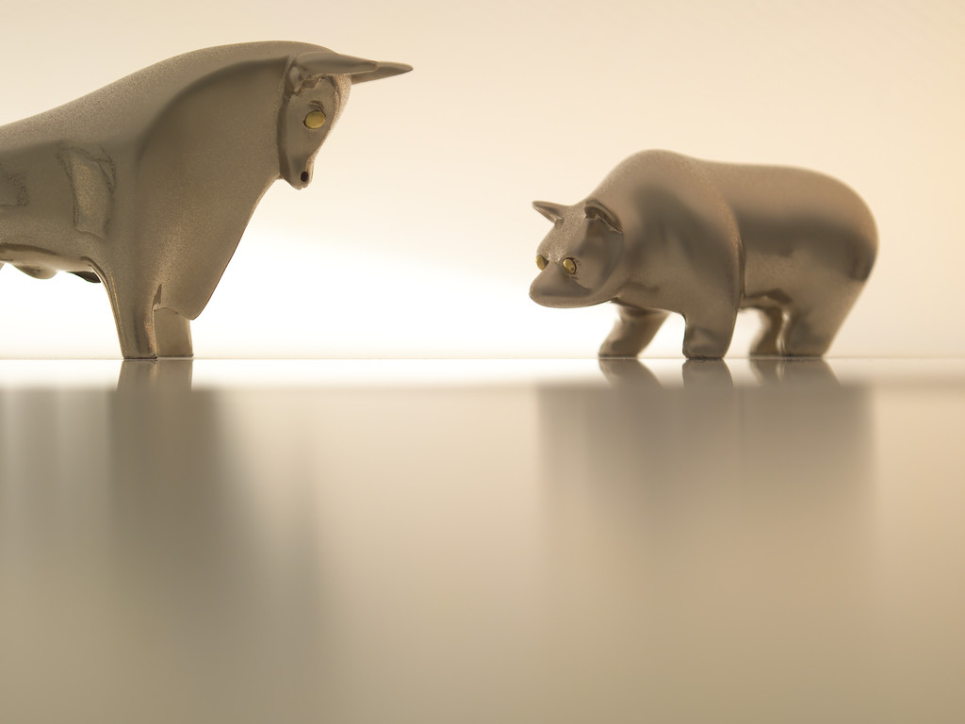
Study: Tracking 10,000 brokerage accounts from 1987-1993 including 162,948 trades.
In any one year…
What share of losing stocks were sold?
What share of gaining stocks were sold?

Slide 18
Study: Tracking 10,000 brokerage accounts from 1987-1993 including 162,948 trades.
In any one year…
What share of losing stocks were sold?
What share of gaining stocks were sold?
Note the strong opposing tax incentives
9.8%
14.8%
Odean, T. (UC-Davis), 1998, Are investors reluctant to realize their losses? Journal of Finance, 53, 1775-1798.

Slide 19
Would investors have been better off to hold the winners and sell the losers?
Average 252-day gain after winners sold
Average 252-day gain after other stocks sold, but losing stocks held

Slide 20
Would investors have been better off to hold the winners and sell the losers?
Average 252-day gain after winners sold
Average 252-day gain after other stocks sold, but losing stocks held
+2.35% (better than market)
-1.06% (worse than market)
Odean, T. (UC-Davis), 1998, Are investors reluctant to realize their losses? Journal of Finance, 53, 1775-1798.

Slide 21
Sunk cost fallacy
Once you have made an unrecoverable payment for something, the amount you paid is “sunk”
Your future behavior should not be influenced by sunk costs
But typically they do …
… because we suffer from the sunk cost fallacy

Slide 22
Sunk cost fallacy
Researchers have found that the price at which owners listed condominiums in Boston was highly correlated with the buying price.
Owners are less willing to sell a stock whose price has fallen than a stock whose price has risen, even though the former makes more sense for tax reasons
Professional investors in real estate and stocks have been found to be less likely to make these errors
Notes:
David Genesove and Christopher Mayer (2001), “Loss aversion and seller behavior: evidence from the housing market,” Quarterly Journal of Economics, 116, 4, pp. 1233-1260.

Slide 23
Loss aversion is everywhere
Loss aversion may explain various forms of predictable irrationality:
endowment effect, disposition effect, the sunk cost fallacy, status quo bias, paradox of choice, and diversification bias

Slide 24
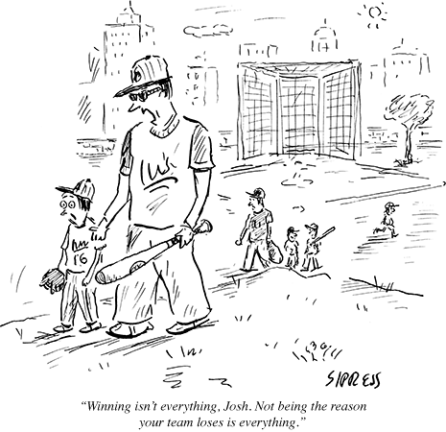
Notes:
The New Yorker, September 17, 2012.

