Slide 1
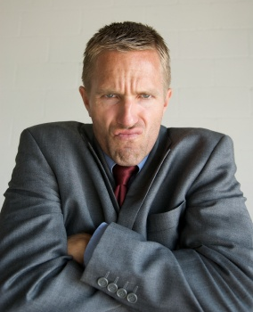
Status quo bias
Avoiding action
Avoiding change
Notes:
Is the status quo bias related to some of the other phenomena in my presentations, or is it something unique?
What does the subject matter of this presentation have to do with economics? How can people protect themselves from the weaknesses discussed here? How can or should rational actors and policy makers make use of the ideas discussed here? Here the role of nudges that rely on carefully selecting the default option need to be discussed.

Slide 2
Status Quo Bias: Readings
Thinking, Fast and Slow by Daniel Kahneman
  Chapter 28, “Defending the Status Quo”
Nudge by Richard Thaler and Cass Sunstein
  Chapter 1, “Status Quo Bias”
Misbehaving by Richard Thaler
  Chapter 16 (“Mugs”), page 154

Slide 3

Status quo bias:
Avoiding action and avoiding change
We are biased to keep things the way they are
  Even if we didn’t originally choose it!
We are biased to avoid risks generated by change
  Even when the risks are less than from making no change!
But change may be necessary

Slide 4
Loss Aversion → Change Aversion
A proposed reform may have lots of pluses and a few minuses
Loss aversion magnifies the impact of the minuses
As a result, we tend to instinctually resist change

Slide 5
Loss Aversion → Stalemate
In any negotiation, each side makes a demand and a concession
But, even if each side wants to be fair, loss aversion makes them make a big demand and a small concession
Naturally, the other side rejects the proposal and replies with a big demand and a small concession of its own
This is why negotiations are never easy

Slide 6
Loss Aversion → Stalemate
A proposal would have a better chance of success if the concessions each side has to make are required of future generations or cohorts while sparing the current generation or cohort
Also, negotiators often attempt to convince the other side that their side is making concessions that are huge losses

Slide 7
Lack of Attention
Apart from loss aversion, another reason for the status quo bias is simply our lack of attention to the choices we make
We often stick with the default option
  In retirement plans
  In organ donation
Marketing pros and policy makers pay a lot of attention to designing the default option

Slide 8
Inertia
“People … stick with what they have unless there is some good reason to switch, or perhaps despite there being a good reason to switch.”
  Misbehaving by Richard Thaler, page 154.
  Here, Thaler is discussing explanations for his experiment with mugs that we discussed under “endowment effect”

Slide 9
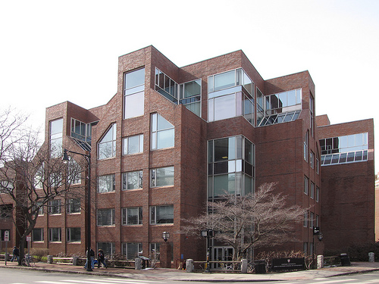
Students at Harvard’s Kennedy School of Government and Boston University School of Management were given different questions, some indicating a status quo, others not
Notes:
http://www.flickr.com/photos/euthman/3375515917/
Picture of Kennedy School of Government at Harvard

Slide 10
You recently inherited some money from your great uncle. Choose one of the following investments for the inheritance.
Invest in moderate-risk company A.
Invest in high-risk company B.
Which choice was the most popular?
Outcome probabilities
Samuelson, W. (Boston U.) & Zeckhauser, R. (Harvard), 1988, Status quo bias in decision making. Journal of Risk and Uncertainty, 1, 7-59.

Slide 11
You recently inherited some money from your great uncle. Choose one of the following investments for the inheritance.
Invest in moderate-risk company A.
Invest in high-risk company B.
60%
40%
Outcome probabilities
Samuelson, W. (Boston U.) & Zeckhauser, R. (Harvard), 1988, Status quo bias in decision making. Journal of Risk and Uncertainty, 1, 7-59.

Slide 12
You recently inherited some money and stocks from your great uncle. The stocks are in high-risk company B. (The tax and broker charges to change are inconsequential.)
Invest in moderate-risk company A.
Invest in high-risk company B.
Which choice was the most popular?
Outcome probabilities
Samuelson, W. (Boston U.) & Zeckhauser, R. (Harvard), 1988, Status quo bias in decision making. Journal of Risk and Uncertainty, 1, 7-59.
Notes:
Looks like the endowment effect, derived from loss aversion.

Slide 13
You recently inherited some money and stocks from your great uncle. The stocks are in high-risk company B. The tax and broker charges to change are inconsequential.
Invest in moderate-risk company A.
Invest in high-risk company B.
44%
56%
Outcome probabilities
Samuelson, W. (Boston U.) & Zeckhauser, R. (Harvard), 1988, Status quo bias in decision making. Journal of Risk and Uncertainty, 1, 7-59.

Slide 14
You recently inherited some money and stocks from your great uncle. The stocks are in moderate-risk company A. (The tax and broker charges to change are inconsequential.)
Invest in moderate-risk company A.
Invest in high-risk company B.
Which choice was the most popular?
Outcome probabilities
Samuelson, W. (Boston U.) & Zeckhauser, R. (Harvard), 1988, Status quo bias in decision making. Journal of Risk and Uncertainty, 1, 7-59.

Slide 15
You recently inherited some money and stocks from your great uncle. The stocks are in moderate-risk company A. The tax and broker charges to change are inconsequential.
Invest in moderate-risk company A.
Invest in high-risk company B.
63%
37%
Outcome probabilities
Samuelson, W. (Boston U.) & Zeckhauser, R. (Harvard), 1988, Status quo bias in decision making. Journal of Risk and Uncertainty, 1, 7-59.

Slide 16
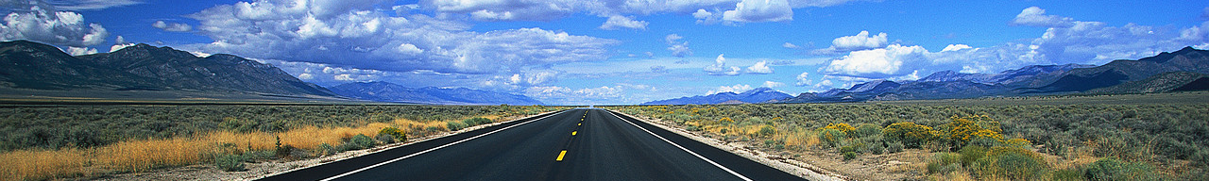
Choose how the Highway Safety Commission should divide its budget between improving auto safety (seatbelts, bumpers, etc.) and highway safety (guard rails, interchanges, etc.).
70% to auto safety and 30% to highway safety
30% to auto safety and 70% to highway safety
Which choice was the most popular?
Samuelson, W. (Boston U.) & Zeckhauser, R. (Harvard), 1988, Status quo bias in decision making. Journal of Risk and Uncertainty, 1, 7-59.

Slide 17
Choose how the Highway Safety Commission should divide its budget between improving auto safety (seatbelts, bumpers, etc.) and highway safety (guard rails, interchanges, etc.).
70% to auto safety and 30% to highway safety
30% to auto safety and 70% to highway safety
53%
About even
47%
Samuelson, W. (Boston U.) & Zeckhauser, R. (Harvard), 1988, Status quo bias in decision making. Journal of Risk and Uncertainty, 1, 7-59.

Slide 18
Choose how the Highway Safety Commission should divide its budget between improving auto safety (seatbelts, bumpers, etc.) and highway safety (guard rails, interchanges, etc.). Currently 70% goes to auto safety and 30% to highway safety.
70% to auto safety and 30% to highway safety
30% to auto safety and 70% to highway safety
Which choice was the most popular?
Samuelson, W. (Boston U.) & Zeckhauser, R. (Harvard), 1988, Status quo bias in decision making. Journal of Risk and Uncertainty, 1, 7-59.

Slide 19
Choose how the Highway Safety Commission should divide its budget between improving auto safety (seatbelts, bumpers, etc.) and highway safety (guard rails, interchanges, etc.). Currently 70% goes to auto safety and 30% to highway safety.
70% to auto safety and 30% to highway safety
30% to auto safety and 70% to highway safety
62%
Almost 2-1 for cars
38%
Samuelson, W. (Boston U.) & Zeckhauser, R. (Harvard), 1988, Status quo bias in decision making. Journal of Risk and Uncertainty, 1, 7-59.

Slide 20
Choose how the Highway Safety Commission should divide its budget between improving auto safety (seatbelts, bumpers, etc.) and highway safety (guard rails, interchanges, etc.). Currently 30% goes to auto safety and 70% to highway safety.
70% to auto safety and 30% to highway safety
30% to auto safety and 70% to highway safety
Which choice was the most popular?
Samuelson, W. (Boston U.) & Zeckhauser, R. (Harvard), 1988, Status quo bias in decision making. Journal of Risk and Uncertainty, 1, 7-59.

Slide 21
Choose how the Highway Safety Commission should divide its budget between improving auto safety (seatbelts, bumpers, etc.) and highway safety (guard rails, interchanges, etc.). Currently 30% goes to auto safety and 70% to highway safety.
70% to auto safety and 30% to highway safety
30% to auto safety and 70% to highway safety
38%
Almost 2-1 for roads
62%
Samuelson, W. (Boston U.) & Zeckhauser, R. (Harvard), 1988, Status quo bias in decision making. Journal of Risk and Uncertainty, 1, 7-59.

Slide 22

You are preparing a bid for your company to supply mattresses to the government. When bidding for large department store orders the company has often applied a 15% markup. Choose one:
Bid with a 15% markup (chances of winning the contract are 70%)
B) Bid with a 25% markup (chances of winning the contract are 50%)
95%
5%
Samuelson, W. (Boston U.) & Zeckhauser, R. (Harvard), 1988, Status quo bias in decision making. Journal of Risk and Uncertainty, 1, 7-59.

Slide 23
You are preparing a bid for your company to supply mattresses to the government. When bidding for large department store orders the company has often applied a 25% markup. Choose one:
Bid with a 15% markup (chances of winning the contract are 70%)
B) Bid with a 25% markup (chances of winning the contract are 50%)
72%
28%
Samuelson, W. (Boston U.) & Zeckhauser, R. (Harvard), 1988, Status quo bias in decision making. Journal of Risk and Uncertainty, 1, 7-59.

Slide 24
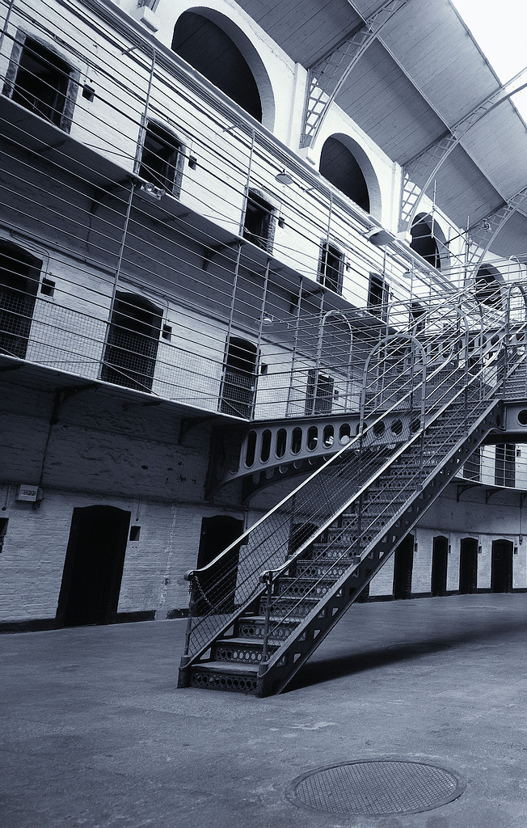
Building new v. expanding old
Which choice was the most popular?
As chief of the governor’s task force, you are considering options for increasing the capacity of the state’s prisons.
Expand the current prison in Town A (sparsely settled) to house 1500 prisoners at a cost of $140 million.
Build a new prison
in Town B (where the population is densely settled) to house 2000 prisoners at a cost of $150 million.
65%
35%
Samuelson, W. (Boston U.) & Zeckhauser, R. (Harvard), 1988, Status quo bias in decision making. Journal of Risk and Uncertainty, 1, 7-59.

Slide 25
Building new v. expanding old
Which choice was the most popular?
As chief of the governor’s task force, you are considering options for increasing the capacity of the state’s prisons.
Build a new prison
in Town A (sparsely settled) to house 1500 prisoners at a cost of $140 million.
B) Expand the current prison in Town B (where the population is densely settled) to house 2000 prisoners at a cost of $150 million.
32%
68%
Samuelson, W. (Boston U.) & Zeckhauser, R. (Harvard), 1988, Status quo bias in decision making. Journal of Risk and Uncertainty, 1, 7-59.

Slide 26
Two months ago you put yourself on a waiting list for a highly desired new car. To speed delivery, you agree to accept any color (red, blue, tan or white).
Color Red Selected
Two days ago, the dealer indicated that all four colors are now available.
22%
53%
15%
Yesterday the dealer called to say that a RED car had arrived.
Today when you call, you learn you can also choose from three other colors.
Yesterday the dealer called to say that a (blue, tan, or white) car had arrived. Today when you call, you learn you can also choose from three other colors.
Samuelson, W. (Boston U.) & Zeckhauser, R. (Harvard), 1988, Status quo bias in decision making. Journal of Risk and Uncertainty, 1, 7-59.
Notes:
This looks a lot like anchoring.

Slide 27
Two months ago you put yourself on a waiting list for a highly desired new car. To speed delivery, you agree to accept any color (red, blue, tan or white).
Color Blue Selected
Two days ago, the dealer indicated that all four colors are now available.
52%
76%
50%
Yesterday the dealer called to say that a BLUE car had arrived.
Today when you call, you learn you can also choose from three other colors.
Yesterday the dealer called to say that a (red, tan, or white) car had arrived. Today when you call, you learn you can also choose from three other colors.
Samuelson, W. (Boston U.) & Zeckhauser, R. (Harvard), 1988, Status quo bias in decision making. Journal of Risk and Uncertainty, 1, 7-59.

Slide 28
Two months ago you put yourself on a waiting list for a highly desired new car. To speed delivery, you agree to accept any color (red, blue, tan or white).
Color Tan Selected
Two days ago, the dealer indicated that all four colors are now available.
9%
13%
2%
Yesterday the dealer called to say that a TAN car had arrived.
Today when you call, you learn you can also choose from three other colors.
Yesterday the dealer called to say that a (blue, red , or white) car had arrived. Today when you call, you learn you can also choose from three other colors.
Samuelson, W. (Boston U.) & Zeckhauser, R. (Harvard), 1988, Status quo bias in decision making. Journal of Risk and Uncertainty, 1, 7-59.

Slide 29
Two months ago you put yourself on a waiting list for a highly desired new car. To speed delivery, you agree to accept any color (red, blue, tan or white).
Color Red Selected
Two days ago, the dealer indicated that all four colors are now available.
17%
28%
9%
Yesterday the dealer called to say that a WHITE car had arrived.
Today when you call, you learn you can also choose from three other colors.
Yesterday the dealer called to say that a (blue, tan, or white) car had arrived. Today when you call, you learn you can also choose from three other colors.
Samuelson, W. (Boston U.) & Zeckhauser, R. (Harvard), 1988, Status quo bias in decision making. Journal of Risk and Uncertainty, 1, 7-59.

Slide 30
Surveying college students in different locations where policies were and were not the status quo.
 | Support Level (1-6)
 | Policy currently in force | Policy not currently in force
No right turn on red | 4.6 | 3.1
Right turn on red allowed | 4.4 | 3.5
Voting in Polls only | 4.5 | 2.8
Absentee voting allowed | 4.7 | 2.4
No test of car emissions | 3.0 | 4.3
Mandatory test of car emissions | 4.9 | 2.1
90 min. lectures | 5.4 | 2.6
2 X 45 min. lectures | 4.0 | 3.7
A. Moshinsky & M Bar-Hillel, 2004, Working Paper, Loss Aversion and the Status-Quo Label Bias

Slide 31
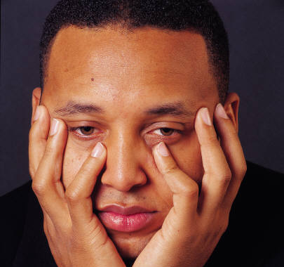
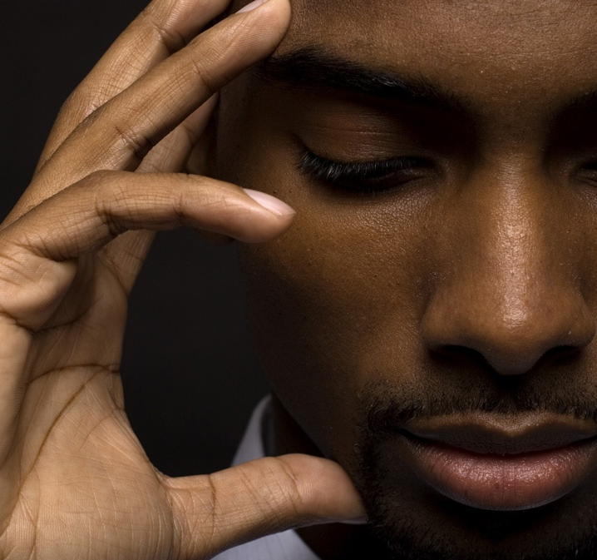
Inertia v. Action
Who feels worse?
A) Paul owns shares in Company A. During the past year he has considered switching to stock in company B, but he decided against it. He now finds he would have been better off by $1200 if he had switched to the stock of company B.
B) George owns shares in company B. During the past year he switched to stock in company A. He now finds that he would have been better off by $1200 if he had kept his stock in company B.

Slide 32
Inertia v. Action
Who feels worse?
A) Paul owns shares in Company A. During the past year he has considered switching to stock in company B, but he decided against it. He now finds he would have been better off by $1200 if he had switched to the stock of company B.
B) George owns shares in company B. During the past year he switched to stock in company A. He now finds that he would have been better off by $1200 if he had kept his stock in company B.
Most people think George would feel worse
Kahneman, D. & Tversky, A., 1982, The psychology of preferences. Scientific American, 246, 160-173.

Slide 33
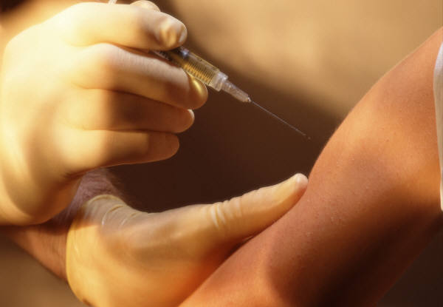
“Imagine that you are married and have one child, a one-year old. You wonder whether you should vaccinate your child. Your child will have a 10 in 10,000 chance of dying from the flu without the vaccination”
Would most people vaccinate if the vaccine had a 6 in 10,000 chance of causing death?
Ritov, I (U. Penn) & Baron, J. (U. Penn), 1990, Reluctance to vaccinate: Omission bias and ambiguity. Journal of Behavioral Decision Making, 3, 263-277.

Slide 34
“Imagine that you are married and have one child, a one-year old. You wonder whether you should vaccinate your child. Your child will have a 10 in 10,000 chance of dying from the flu without the vaccination”
Would most people vaccinate if the vaccine had a 6 in 10,000 chance of causing death?
NO.
Ritov, I (U. Penn) & Baron, J. (U. Penn), 1990, Reluctance to vaccinate: Omission bias and ambiguity. Journal of Behavioral Decision Making, 3, 263-277.

Slide 35
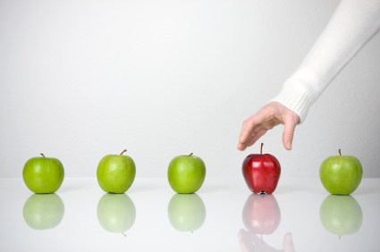
Harvard employees who started when there were few health insurance options tended to stay with initial choices, even when new options become available.
Employees who began later were much less likely to choose the older plans.
Samuelson, W. (Boston U.) & Zeckhauser, R. (Harvard), 1988, Status quo bias in decision making. Journal of Risk and Uncertainty, 1, 7-59.

Slide 36
Status quo bias:
Avoiding action and avoiding change
We are biased to keep things the way they are
  Even if we didn’t originally choose it!
We are biased to avoid risks generated by change
  Even when the risks are less than from making no change!
But, changing outcomes requires pursuing action and change
Notes:
O.K., so what can we do to deal with the status-quo bias? What are the policy implications?

Slide 37
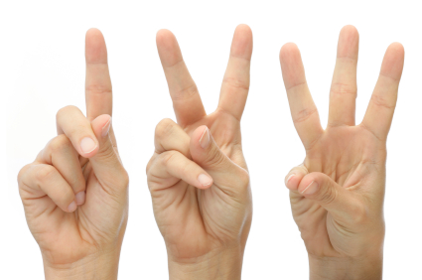
Using prospect theory to pursue your goals
Make it a habit (status quo bias)
Own it (endowment effect)
Fear its loss (loss aversion)
Notes:
Wait a minute! What is prospect theory? Has it been discussed in the previous lectures?

Slide 38
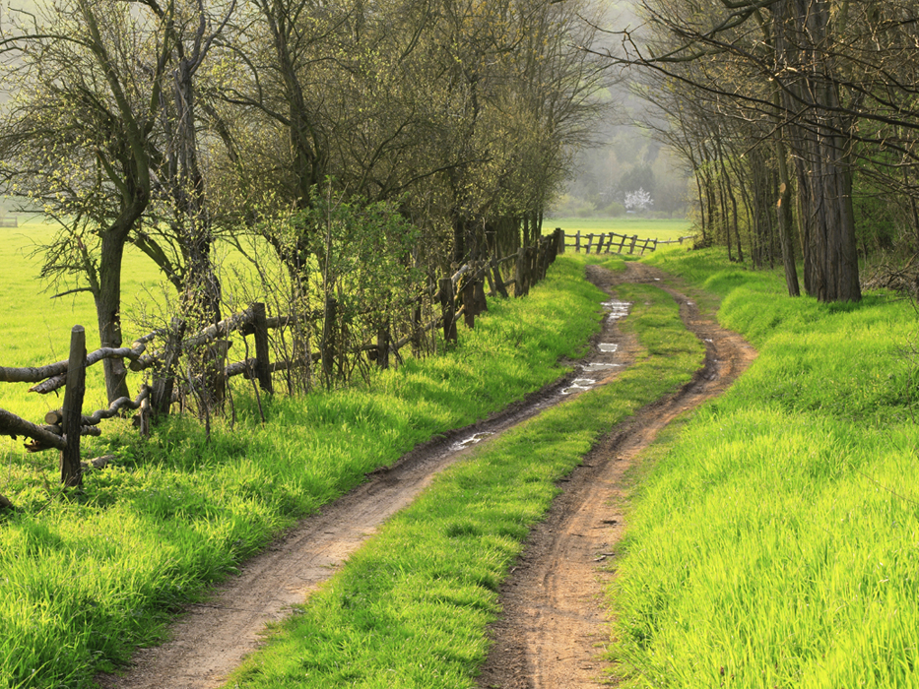
1. Make it a habit
(Goal pursuit becomes the status quo)
“Creating a good habit requires much conscious effort, but once the groove has been produced the acts which make up a habitual pattern are not consciously willed.”
H. Keane (Australian National University), 2000, Setting yourself free: Techniques of recovery. Health, 4, 324-346.

Slide 39

2. Own it
Ownership creates satisfaction (endowment effect). By completely identifying yourself with a future goal, you become more attached to it
I claim my future

Slide 40
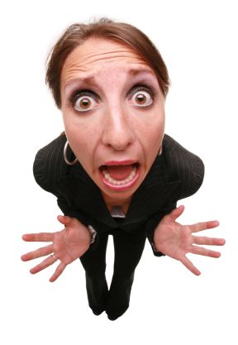
3. Fear its loss
By “owning” a future goal, immediate temptations which put that future at risk can be framed as a potential loss.

Slide 41
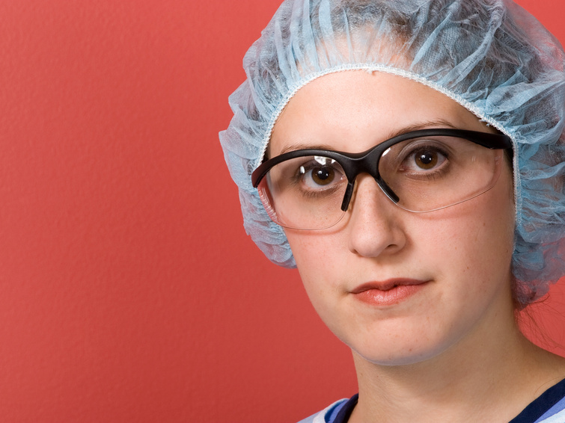
Application question
Suppose you are advising a friend who wants to become a surgeon. What practical suggestions can you give to help her “own” her identity as a future surgeon?

