Slide 1
Self-Control
Behavioral Economics
Udayan Roy

Slide 2
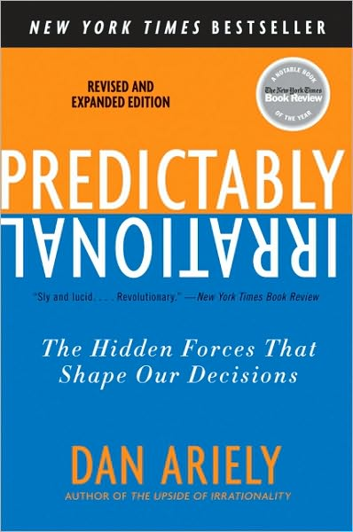
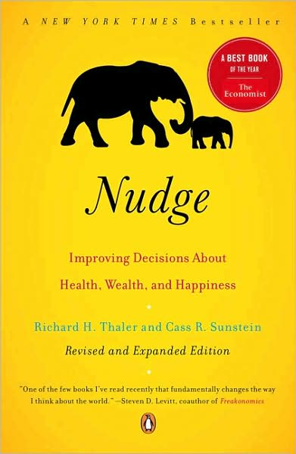
Reading
Predictably Irrational, Chapter 7, The Problem of Procrastination and Self-Control
Nudge, Chapter 2, Resisting Temptation

Slide 3
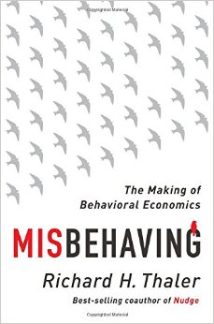
Reading
Misbehaving, Chapter 11, Willpower? No Problem
Misbehaving, Chapter 12, The Planner and the Doer

Slide 4
Why do we lack self-control?
Hyperbolic discounting
Availability bias
Stress, projection bias, peer pressure, …

Slide 5
What can we do?
To deal with hyperbolic discounting
Pre-commitment
Mental accounts
Technology
Government policies
Combining pleasant activities with unpleasant ones
Calming down
To deal with availability bias
Changing life environment
Calming down

