Slide 1
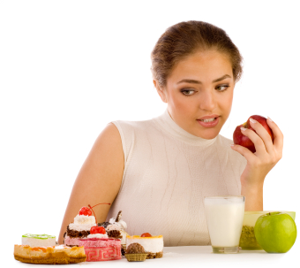
(appealing) Availability
(eventually) Beats
(rational) Cognition

Slide 2
Reading
See the “Mindless Choosing” section in Chapter 2 of Nudge

Slide 3
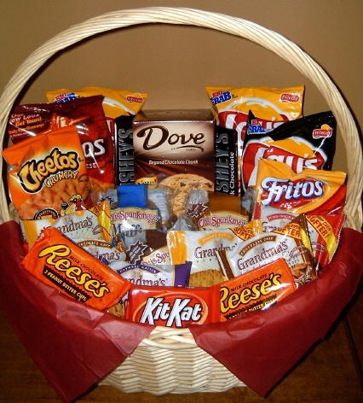
appealing Availability
eventually Beats
rational Cognition
“Availability of … energy dense foods, is also a major risk factor for other consumption related pathology, such as certain forms of obesity and type-2 diabetes.”
Ahmed, S. (2005) Imbalance between drug and non-drug reward availability: A major risk factor for addiction. European Journal of Pharmacology, 526, p. 11.

Slide 4
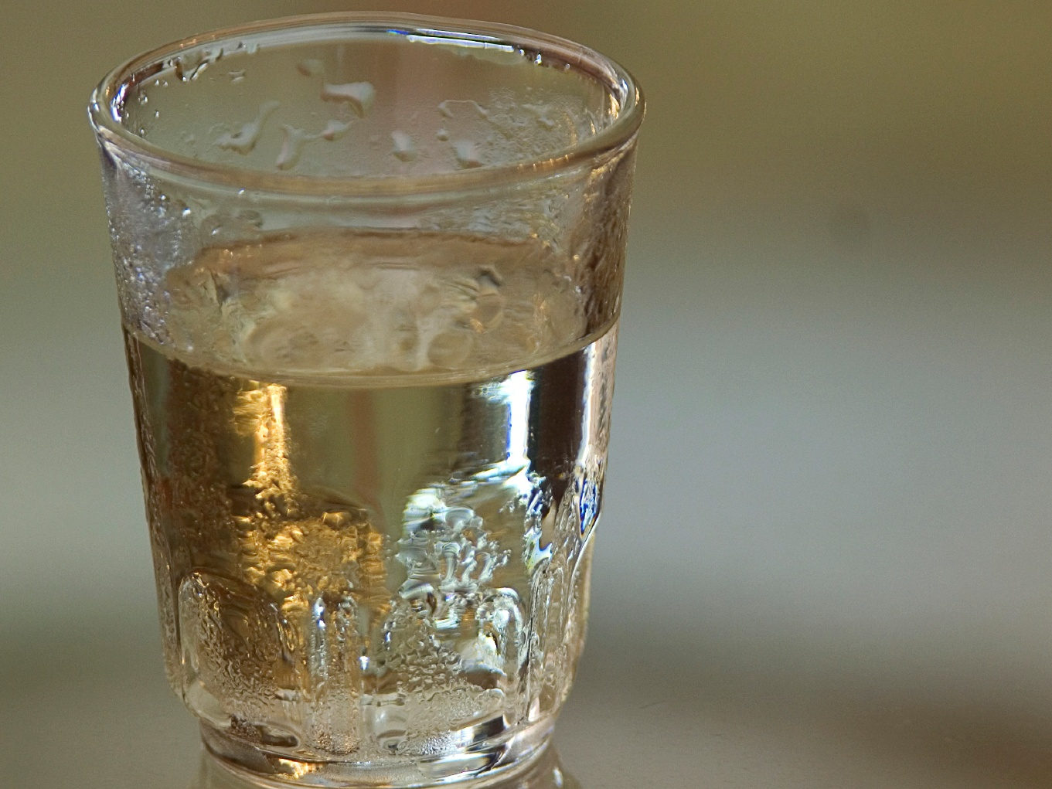
“alcohol problems vary with alcohol availability; this body of evidence is among the strongest bodies of evidence in existence linking health problems to determinants.”
Mann, 2005, Availability as a law of addiction. Addiction, 100, p. 924.
appealing Availability
eventually Beats
rational Cognition

Slide 5
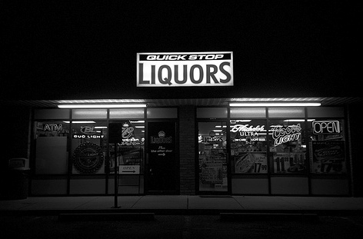
appealing Availability
eventually Beats
rational Cognition
“Drinking and alcohol related problems can be affected by restriction of the hours and days of alcohol purchasing and of the numbers and types of alcohol outlets.”
Room, Babor, & Rehm, 2005, Alcohol and public health. The Lancet, 365, p. 526.
Notes:
http://www.flickr.com/photos/bcostin/325307589/
Restricted hours would require advance planning to get alcohol. This increases the chances that alcohol buying decisions would be made in a “cold” and rational frame of mind.

Slide 6
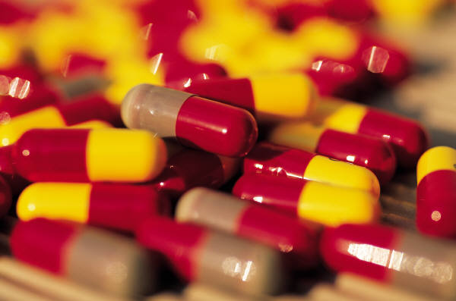
appealing Availability eventually Beats
rational Cognition
“Among environmental factors, drug availability represents a major risk factor. Increased drug availability can precipitate the transition to addiction”
Ahmed, S. (2005) Imbalance between drug and non-drug reward availability: A major risk factor for addiction. European Journal of Pharmacology, 526, p. 11.

Slide 7

Does physicians’ greater drug knowledge protect them against greater availability?

Slide 8
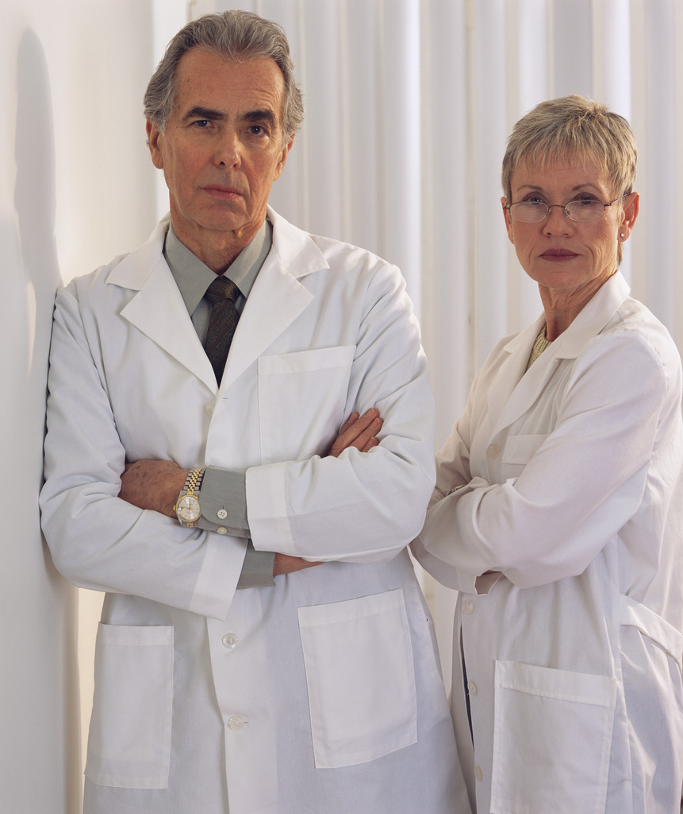
    Physicians in the U.S. use more opiates and benzodiazepine than others of the same age
    Male physicians in Sweden were more than twice as likely to be using tranquilizers as non-physicians
    “A higher percentage of drug users among physicians can be due to the fact that self-treatment is widespread”
Rosvold, E. (U. of Oslo), Vaglum, P. (U. of Oslo), Moum, T. (U. of Oslo), 1998, Use of minor tranquilizers among Norwegian physicians. A nation-wide comparative study. Social Science & Medicine, 46, 581-590.

Slide 9
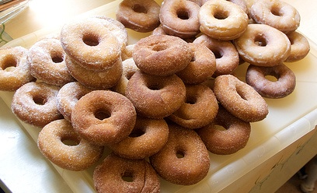
Excessive availability increases consumption
I’ll have just a few…It’s not like I’m eating all 40!
Notes:
http://www.flickr.com/photos/foonus/2791079659/

Slide 10
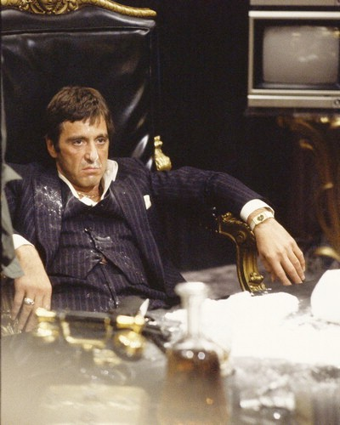
Excessive availability increases consumption
For any Scarface fans, you may recall that this environment did not produce a happy ending…

Slide 11
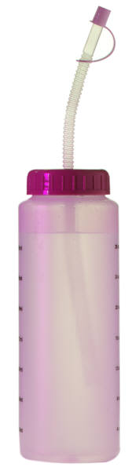
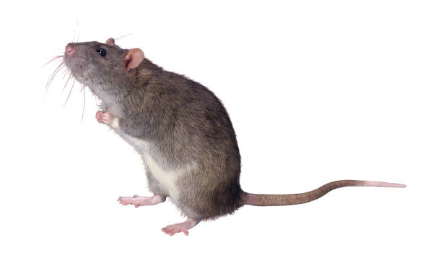
A lab experiment
Group A
5 unlimited bottles of water and
1 unlimited bottle of sugar water
Group B
1 unlimited bottle of water and
5 unlimited bottles of sugar water
a) Group A consumed more sugar?
b) Group B consumed more sugar?
c) No difference?

Slide 12
Excessive availability increases consumption
Tordoff, M. G. (2002) Obesity by choice: The powerful influence of nutrient availability on nutrient intake. American Journal of Physiology – Regulatory, Integrative and Comparative Physiology, 282, 1536-1539.

Slide 13

Excessive availability increases consumption
Group A
Average fat content of rats after 36 days: 57 grams
Group B
Average fat content of rats after 36 days: 76 grams
Both groups had unlimited access to Purina rodent chow during the test.

Slide 14
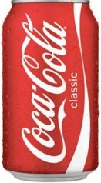
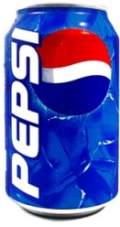
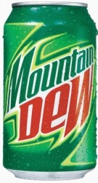
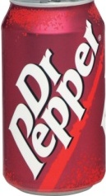
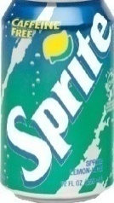
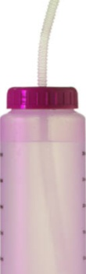


Excessive availability increases consumption
Any relevance for humans?

Slide 15
What about alcohol?
Group A
5 unlimited bottles of water and
1 unlimited bottle of 10% alcohol
Group B
1 unlimited bottle of water and
5 unlimited bottles of 10% alcohol
Did it make any difference?

Slide 16
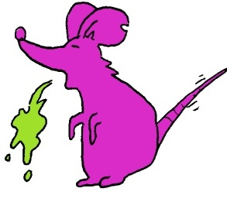
Excessive availability increases consumption
Group A
Alcohol intake grams per kilogram of mouse body weight: 9.4
Group B
Alcohol intake grams per kilogram of mouse body weight: 23.4
What about with different ratios?
What about a different breed?
What about a rat instead of mouse?

Slide 17
Excessive availability increases consumption
Alcohol as a % of total liquid intake
Unlimited bottles | Mice (129x1/Svj) | Rats
1 alcohol vs. 5 water | 9% | 3%
2 alcohol vs. 4 water | 16% | 7%
3 alcohol vs. 3 water | 24% | 15%
4 alcohol vs. 2 water | 32% | 16%
5 alcohol vs. 1 water | 42% | 31%
Tordoff, M. G., & Bachmanov, A. A. (2003) Influence of the number of alcohol and water bottles on murine alcohol intake. Alcoholism: Clinical and Experimental Research, 27(4), 600-606.

Slide 18

Availability beats cognition even when…
You know about the effects of environment on your decisions
You don’t believe the environment is changing your decisions
Notes:
Image purchased from istockphoto

Slide 19

Your KNOWLEDGE of the impact of environment on your behavior
    and your BELIEF about the impact of environment on your behavior
        doesn’t CHANGE the impact of the environment on your behavior.
Notes:
Photo purchased from istockphoto

Slide 20

So, what can we do?
Whether we admit it or not, more knowledge won’t change the impact of environment on our behaviors.
But, changing our environment can change our behaviors.
We can focus more on choosing our environment!

Slide 21

So why don’t we choose our environment to match our goals?
Hyperbolic discounting [We will make better choices in the future]
Projection bias [The “rider” will always be in control]
Diversification bias [We want maximum options]

Slide 22


I would like to reduce the amount of sugar I eat, but I have problems with self-control because I really like sweets.
For health reasons, I would like to increase the amount of raw vegetables, like carrots and celery, I eat. They don’t taste bad, but they aren’t that exciting, either.
What practical suggestions can you think of to help each person by employing the principal of “availability beats cognition”?

