Slide 1
Choices Involving Risk
Behavioral Economics
Udayan Roy
Notes:
Here, I need to bring the various threads of prospect theory – loss aversion, hedonic adaptation, reference points -- together. I need to get through the importance of probability weighting in PT and the paradoxes that justify it. But can I give examples of how to utilize PT to do something useful? That would be a tall order.
What does the subject matter of this presentation have to do with economics? How can people protect themselves from the weaknesses discussed here? How can or should rational actors and policy makers make use of the ideas discussed here?

Slide 2
Misconceptions over probabilities

Slide 3
Trouble Assessing Probabilities
People tend to make specific errors in assessing probabilities
Hot-hand fallacy is the belief that once an event has occurred several times in a row it is more likely to repeat
Arises when people can easily invent explanations for streaks, e.g., basketball
Gambler’s fallacy is the belief that once an event has occurred it is less likely to repeat
Arises when people can’t easily invent explanations for streaks, e.g., state lotteries
Both fallacies have important implications for economic behavior, e.g., clearly relevant in context of investing
Overconfidence causes people to:
Overstate the likelihood of favorable events
Understate the uncertainty involved
13-3

Slide 4
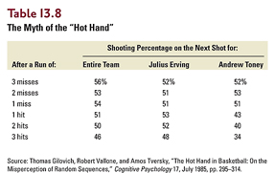
Hot-hand fallacy
Philadelphia 76ers, 48 home games, 1980-81 season

Slide 5
The Representativeness Heuristic
The hot-hand fallacy is an example of the representativeness heuristic
The more that A fits our mental image or stereotype of category B, the more we tend to think that A belongs to category B.
When a basketball player’s streak of successes looks like our stereotype of a random sequence of successes, we conclude that he/she has a “hot hand”
(heuristic means rule of thumb)

Slide 6
Gambler’s fallacy
A study of nearly 1800 daily drawings between 1988 and 1992 in a New Jersey lottery showed that after a number came up a winner, bettors tended to avoid it
This is irrational because it assumes lottery drawings to be dependent events when they clearly are independent events

Slide 7
The Hot-Hand and Gambler’s Fallacies
We don’t understand randomness very well and resort to stereotypes of randomness
People tend to believe that the sequence (Heads, Heads, Heads, Heads, Heads) of five tosses of a fair coin is obviously less likely than (Tails, Heads, Heads, Tails, Tails) even though, according to the rational analysis of the probability of a particular sequence of independent coin tosses, both sequences have the same probability: (½)⁵

Slide 8
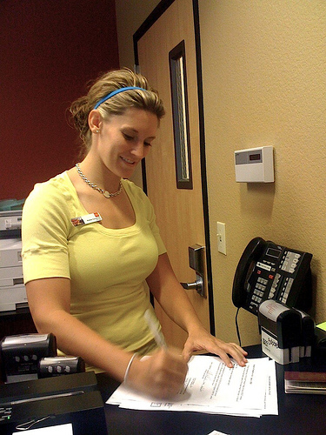
The Representativeness Heuristic: Who is Linda?
Experimental subjects were told the following:
Linda is thirty-one years old, single, outspoken, and very bright. She majored in philosophy. As a students, she was deeply concerned with issues of discrimination and social justice and also participated in anti-nuclear demonstrations.”
Then people were asked to rank, in order of likelihood, eight possible futures for Linda
Of those eight futures were
“bank teller” and
“bank teller and active in the feminist movement.”

Slide 9
The Representativeness Heuristic: Who is Linda?
Most people said that Linda was less likely to be a bank teller than to be a bank teller and active in the feminist movement
This is not surprising
But it is a logical mistake
See Thinking, Fast and Slow, Ch. 15 “Linda: Less Is More”

Slide 10
Overconfidence
In one study of US students with an average age of 22, 82% ranked their driving ability among the top 30% of their age group
Video: Your Mind and Your Money - Investor Overconfidence, Monday, February 08, 2010, Nightly Business Report, PBS
Notes:
O. Svenson, “Are we less risky and more skillful than our fellow drivers?” Acta Psychologica 47, February 1981, pp. 143-148.

Slide 11
Overconfidence in the stock market
Brad Barber and Terrance Odean studied the investment performance of 66,465 households with discount brokerage accounts
During the period studied, households that trade infrequently received an 18% return on their money, and
households that trade most actively got an 11.3% return

Slide 12
Overconfidence and gender
The extent of trading was found to be influenced by gender: the men traded a lot more than the women
Psychologists commonly find that men tend to have excessive confidence in their own abilities, while women tend to be more realistic.
Psychologists tend to refer to this aspect of men’s behavior as self-serving attribution bias

Slide 13
Overconfidence and gender
Men tend to think their successes are a result of their own skill, rather than dumb luck, and so become overconfident
This overconfidence can have financial repercussions.
In the study by Barber and Odean, men traded 45% more than women
The average return on investment to men was a full percentage point lower than the return to women

Slide 14
Overconfidence
In the manufacturing sector,
more than 60% of new entrants exit within five years;
nearly 80% exit within ten years
The high failure rate may be partly due to overconfidence
In a survey of nearly 3000 new business owners,
81% said they had more than 70% chance of success
though only 39% said that a business like theirs would be that likely to succeed
One-third said they were 100% certain to succeed
Notes:
A. Cooper, C. Woo, and W. Dunkelberg, “Entrepreneurs’ perceived chances for success,” J. of Business Venturing 3, Spring 1988, pp. 97-108.

Slide 15
Law of small numbers
People tend to read too much significance into small samples, especially when the samples represent personal experience
See Thinking, Fast and Slow by Daniel Kahneman, Ch. 10: “The Law of Small Numbers”
Notes:
A. Tversky and D. Kahneman (1971), “Belief in the law of small numbers,” Psychological Bulletin, 76, 2, pp. 105-110.

Slide 16
Larger hospital, smaller hospital
A certain town has two hospitals. In the larger hospital about 45 babies are born each day, and in the smaller hospital about 15 babies are born each day.
As you know, about 50 percent of all babies are boys. However, the exact percentage varies from day to day. Sometimes it may be higher than 50 percent, sometimes lower.
For a period of one year, each hospital recorded the days on which more than 60% of the babies born were boys.
Which hospital do you think recorded more such days?

Slide 17
Larger hospital, smaller hospital
In a survey of college students,
22 percent said “larger hospital”
56 percent said “equal for both”
22 percent said “smaller hospital” (correct)
People underestimate how different samples can be from the population

Slide 18
Ellsberg Paradox
There are two jars, each with 100 marbles, colored either red or black
Jar 1 is known to have 50 red marbles and 50 black marbles
The composition of red and black marbles in Jar 2 is unknown
Therefore the objective probability of drawing a red marble from Jar 1 is equal to the subjective probability of drawing a red marble from Jar 2
And yet, most experimental subjects say that a red marble is more likely from Jar 1!

Slide 19
Preferences Toward Risk

Slide 20
Preferences Toward Risk
Here are two puzzles involving observed behavior and risk preferences
Overemphasis on low-probability events:
People show aversion to risk in gambles with moderate odds
However, some of these same people take gambles with very high payoffs with very low probabilities (lotto), which indicates a love of risk!
Aversion to very small risks:
Many people also appear reluctant to take even very tiny shares of certain gambles that have positive expected payoffs
This implies a level of risk aversion so high that it is impossible to explain the typical person’s willingness to take larger financial risks

Slide 21
Low-probability events grab all the attention
Gamble 1
A: Win $2,500
B: Win $5,000 with 1/2 probability
Gamble 2
C: Win $5
D: Win $5,000 with 1/1000 probability
Most people choose A over B, suggesting risk-averse preferences
A sizable majority picks D over C, suggesting risk-loving preferences
In both gambles, the second option takes the first option and reduces the probability and increases the prize by the same factor

Slide 22
Prospect Theory

Slide 23
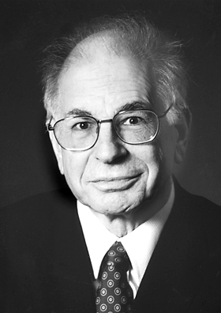
Prospect Theory: A Potential Solution
Proposed in late 1970s by two psychologists, Daniel Kahneman and Amos Tversky
Kahneman later won Nobel Memorial Prize in economics in 2002; Tversky died in 1996
An alternative to expected utility theory
May resolve a number of puzzles related to risky decisions, including the two on previous slide
Remains controversial among economists

Slide 24
Expected Utility Theory
To this day, economists primarily use expected utility theory in analyzing consumer behavior
In expected utility theory, people assess an option available to them—say, Option X—according to:
The utility they would derive from the various possible end results of choosing Option X, and
The probability of each possible end result of Option X.
The utility and the probability of each end result are multiplied and these results are added for all possible end results. This is the expected utility of Option X.
A rational person is assumed to choose the option that has the highest expected utility

Slide 25
Prospect Theory
In prospect theory, people assess Choice X according to:
The difference in utility that they would experience from each of the various possible end results of Choice X. This difference in utility from an end result is the utility of the end result compared to expected utility (also called a reference point).
The difference in utility obtained at an end result depends on whether the end result is classified as a gain or a loss relative to the reference point
Here, loss aversion is crucial
Also important is the idea of diminishing sensitivity
And a subjective notion of the probability of each possible end result of Choice X.
This is a probability weighting function that overweights low probabilities and underweights higher probabilities

Slide 26
Prospect Theory v. Expected Utility Theory
Consumer starts out with $R
A gamble pays $X₁ with probability P and $X₂ with probability 1 – P
Will the consumer take this gamble?
Expected utility theory: yes if
U(R) < [P × U(R + X₁)] + [(1 – P) × U(R + X₂)]
Prospect theory: yes if
V(0) < [W(P) × V(X₁)] + [W(1 – P) × V(X₂)]

Slide 27
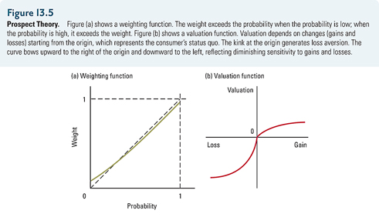
Prospect Theory
Prospect theory has two key features: (a) the probability weighting function and (b) the outcome valuation function.

Slide 28
Prospect Theory
W(P) is the weight (or, importance) a consumer assigns to the probability P. It is called the weighting function
Note that people tend to assign disproportionate weight to low-probability outcomes
Notes:
Bernheim and Whinston have an application on the equity premium puzzle.

Slide 29
Prospect Theory
V(X) is the value of $X to the consumer.
It is called the valuation function.
This is the same as the utility function in expected utility theory, except that it is asymmetric.
Loss aversion and diminishing sensitivity are built in.
Notes:
Bernheim and Whinston have an application on the equity premium puzzle.

Slide 30
Prospect theory: Probabilities and probability weights

Slide 31
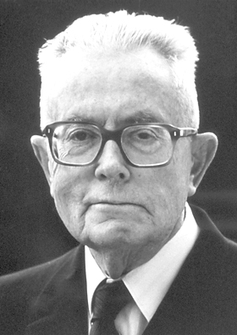
Maurice Allais
Maurice Allais (31 May 1911 – 9 October 2010) pointed out some predictable irrationalities in preferences over risk in the 1950s
Winner of the Nobel Memorial Prize in Economics in 1988
Daniel Kahneman and Amos Tversky used these anomalies in their prospect theory

Slide 32
Allais Paradox: Common Ratio Effect
Choice 1:
A: 80% chance of getting $4,000
B: 100% chance of getting $3,000
Choice 2:
C: 20% chance of getting $4,000
D: 25% chance of getting $3,000
This is not rational
For big probabilities, the bigger of two probabilities gets more weight in our minds
For small probabilities, the smaller of two probabilities gets more weight
The vast majority, 80%, chose B over A.
Now 65% prefer C over D!

Slide 33
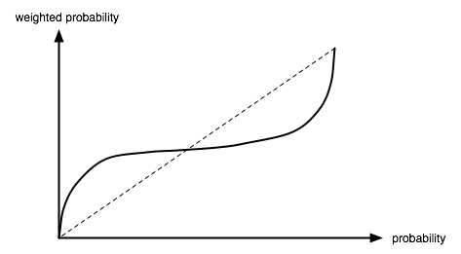
Allais Paradox: Common Ratio Effect
As the importance of a 20% chance relative to a 25% chance, exceeds the importance of a 80% chance relative to a 100% chance, Kahneman and Tversky concluded that the decision weights used by people overweight low probabilities and underweight higher probabilities
20
25
50
80
100%

Slide 34
Allais Paradox: Common Consequence Effect
Gamble 1
A: $1 million
B: 89% chance of $1 million and 10% chance of $5 million
Most people choose A
Gamble 2
C: 11% chance of $1 million
D: 10% chance of $5 million
Most people choose D
Note that Gamble 2 is obtained from Gamble 1 by eliminating a 89% chance of winning $1 million from options A and B.

Slide 35
Prospect theory: loss aversion

Slide 36
Extreme Risk Aversion
Gamble A:
Win $1,010 with 50% probability and lose $1,000 with 50% probability
Most people refuse this gamble
Gamble B:
Win $10.10 with 50% probability and lose $10.00 with 50% probability
Most people refuse this gamble too, suggesting extreme risk aversion
Such risk aversion indicates loss aversion

Slide 37
Extreme risk aversion: implications
Excessive risk aversion shows up in insurance markets where
People tend to over-insure themselves against various small risks.
People buy insurance against losing their cell phone, even thought they can often replace it at quite a low cost
People also buy auto insurance with deductibles that are much too low to make economic sense

Slide 38
Risk aversion and loss aversion
The excessive risk aversion may actually be a form of loss aversion (which we have discussed before)
The aversion to any kind of loss makes people put seemingly excessive weight on the status quo—their starting point—as opposed to where they will end up
This in turn leads to an unwillingness to trade away something one owns

Slide 39
Gains and Losses, the Asymmetry
In experiments by Kahneman and Tversky, people chose a sure loss over a 50-50 risk of losing $1,000 only when the sure loss was less than $370
This led K&T to make their valuation function a lot steeper for small losses than for small gains

Slide 40
Framing, again
A disease will kill 600 people if nothing is done
Doctors make four proposals: A, B, C, and D.
Under Proposal A, exactly 200 people will be saved
Under Proposal B, there is 1/3 chance that 600 people will be saved
72% of college students picked A over B
A second group of students were shown proposals C and D
Under Proposal C, exactly 400 people will die
Under Proposal D, there is 2/3 chance that 600 people will die
Now 78% chose D over C!
Note that A and C are equivalent, as are B and D
Our decisions are influenced by how our options are presented to us (framed for us)
Notes:
Amos Tversky and Daniel Kahneman, “The Framing of Decisions and the Psychology of Choice,” Science, 211(4481), January 1981, 453-458.

Slide 41
Prospect theory: losses, gains, and the reference outcome

Slide 42
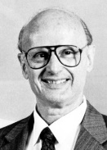
Changes in One’s Situation Matter, Not the Situation Itself
“The economist Harry Markowitz, who would later earn the Nobel Prize for his work in finance, had proposed a theory in which utilities were attached to changes of wealth rather than to states of wealth. Markowitz’s idea had been around for a quarter of a century an had not attracted much attention, but we concluded that this was he way to go, and that the theory we were planning to develop would define outcomes as gains and losses, not as states of wealth.”
Thinking, Fast and Slow by Daniel Kahneman, pages 278-279

Slide 43
Gains and Losses Relative to a Reference Point
In The Undoing Project by Michael Lewis, Daniel Kahneman is described as imagining the following scenario (p. 267):
Yesterday, Jack had $1 million and Jill had $9 million.
Today Jack and Jill each have $5 million.
Assuming they are otherwise identical, are they equally happy?
Standard economics would say they are equally happy
Kahneman concluded that Jill was obviously less happy than Jack

Slide 44
Gains and Losses Relative to a Reference Point
In The Undoing Project by Michael Lewis, Daniel Kahneman is described as imagining the following scenario (p. 267):
Yesterday, Jack had $1 million and Jill had $9 million.
Today Jack and Jill each have $5 million.
Assuming they are otherwise identical, are they equally happy?
What matters is whether an outcome is a gain or a loss relative to each person’s reference point (or, in this case, the status quo)

Slide 45
Gains and Losses Relative to a Reference Point
The reference point can be subjective, situation dependent, and heavily influenced by the way choices are framed.
This makes it difficult, occasionally, to apply prospect theory in the analysis of behavior.

Slide 46
Prospect theory: diminishing sensitivity to gains and losses

Slide 47
Gains and Losses, the Asymmetry
“When you gave a person a choice between a gift of $500 and a 50-50 shot at winning $1,000, he picked the sure thing. Give that same person a choice between losing $500 for sure and a 50-50 risk of losing $1,000, and he took the bet.”
The Undoing Project by Michael Lewis, page 269
This is a justification for diminishing sensitivity

Slide 48
Diminishing Sensitivity: The Reason Behind the Strange Shape of the Valuation Function/Curve
Valuation (+)
-900
-500
-100
Loss
C
D
B
A
Gain
100
500
900
Valuation (-)
When choosing between (A) a fifty-fifty gamble over $100 and $900 and (B) $500 for sure, people choose B, the sure thing.
When choosing between (C) a fifty-fifty gamble over losing $100 and losing $900 and (D) losing $500 for sure, people choose C, the gamble (because at least there is a chance of avoiding a big loss).

Slide 49
Gains and Losses Relative to a Reference Point
Problem A
Problem B
In addition to whatever you own, you have been given $1,000. You are now required to choose between the following options:
A 50% chance to win $1,000
A gift of $500
Most picked #2, the sure thing
In addition to whatever you own, you have been given $2,000. You are now required to choose between the following options:
A 50% chance to lose $1,000
A sure loss of $500
Most picked #3, the gamble
See The Undoing Project by Michael Lewis, pages 275-6. This preference for the sure outcome over the gamble when choosing among gains and the preference for the gamble over the sure outcome when choosing among losses requires the outcomes valuation function to have diminishing sensitivity to gains and losses. And this diminishing sensitivity gives the valuation function its unique shape.

Slide 50
Gains and Losses Relative to a Reference Point
Problem A
Problem B
In addition to whatever you own, you have been given $1,000. You are now required to choose between the following options:
A 50% chance to win $1,000
A gift of $500
Most picked #2, the sure thing
In addition to whatever you own, you have been given $2,000. You are now required to choose between the following options:
A 50% chance to lose $1,000
A sure loss of $500
Most picked #3, the gamble
Note that the end results are the same for options 1 and 3.
Similarly, options 2 and 4 are identical.
And yet the choices are different for Problems A and B.
This makes the point that the end results are not important; whether an outcome is classified as a gain or a loss relative to a reference point is important.

Slide 51
Gains and Losses Relative to a Reference Point
Problem A
Problem B
In addition to whatever you own, you have been given $1,000. You are now required to choose between the following options:
A 50% chance to win $1,000
A gift of $500
Most picked #2, the sure thing
In addition to whatever you own, you have been given $2,000. You are now required to choose between the following options:
A 50% chance to lose $1,000
A sure loss of $500
Most picked #3, the gamble
Note that the end results are the same for options 1 and 3.
Similarly, options 2 and 4 are identical.
And yet the choices are different for Problems A and B.
The preference for the sure thing in the gains framing and for the gamble in the losses framing also suggests diminishing sensitivity to gains and losses and determines the unique shape of the valuation function.

Slide 52
Choose
A sure gain of $250
25% chance to gain $1000, and 75% chance to gain nothing
We are less likely to risk to get an extra gain
We are more likely to risk to avoid a sure loss
84%
16%
This preference for the sure outcome over the gamble when choosing among gains and the preference for the gamble over the sure outcome when choosing among losses requires the outcomes valuation function to have diminishing sensitivity to gains and losses. And this diminishing sensitivity gives the valuation function its unique shape.
Take $1000. Choose
A sure loss of $750 (of $1000)
75% chance to lose $1000, and 25% chance to lose nothing
13%
87%
Tversky, A. & Kahneman, D., 1981, The framing of decisions and the psychology of choice. Science, 211, 453-458.
Notes:
This slide and the next may be more appropriate when the discussion is focusing on uncertainty

Slide 53
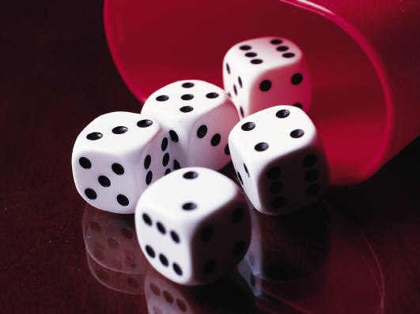
Framing a gamble as a loss or a gain
http://www.youtube.com/watch?v=Ng9V2JneJ68 start – 5:54
Notes:
Conjuror in London demonstrates that people gamble to avoid a perceived loss but avoid a gamble when the alternative is a sure perceived gain.

Slide 54
Explaining the equity premium puzzle

Slide 55
The Equity Premium Puzzle
US corporate stocks are riskier than US Treasury bonds
As compensation, stock returns exceed bon returns. This is the equity premium
For most of the 20th century, the equity premium averaged 8 percentage points
Puzzle: the 8 percentage points premium implies an absurdly high degree of risk aversion

Slide 56
The Equity Premium Puzzle
Given the actual difference in riskiness between stocks and bonds, people who would demand an 8 percentage points premium would be indifferent between
a fifty-fifty chance of getting either $50,000 or $100,000, and
$51,209 for sure
This absurd degree of risk aversion is the only way standard economics can explain the EPP

Slide 57
The Equity Premium Puzzle
However, loss aversion can explain the EPP if investors focus on short-term returns
Unlike bond returns, annual stock returns are frequently negative
Losses reduce our happiness a lot more than equal gains increases it
This makes us prefer stocks only for a very high equity premium
Over longer time horizons, equity returns are less likely to be negative and, consequently, loss aversion cannot explain the EPP

Slide 58
conclusion

Slide 59
Prospect Theory: Summary
The common ratio effect form of the Allais Paradox justifies the probability weighting function
The fact that people refuse even small but fair bets justifies the loss aversion in the valuation function
The fact that people favor sure gains (risk aversion) but avoid sure losses (risk love) justifies concavity for gains and convexity for losses

Slide 60
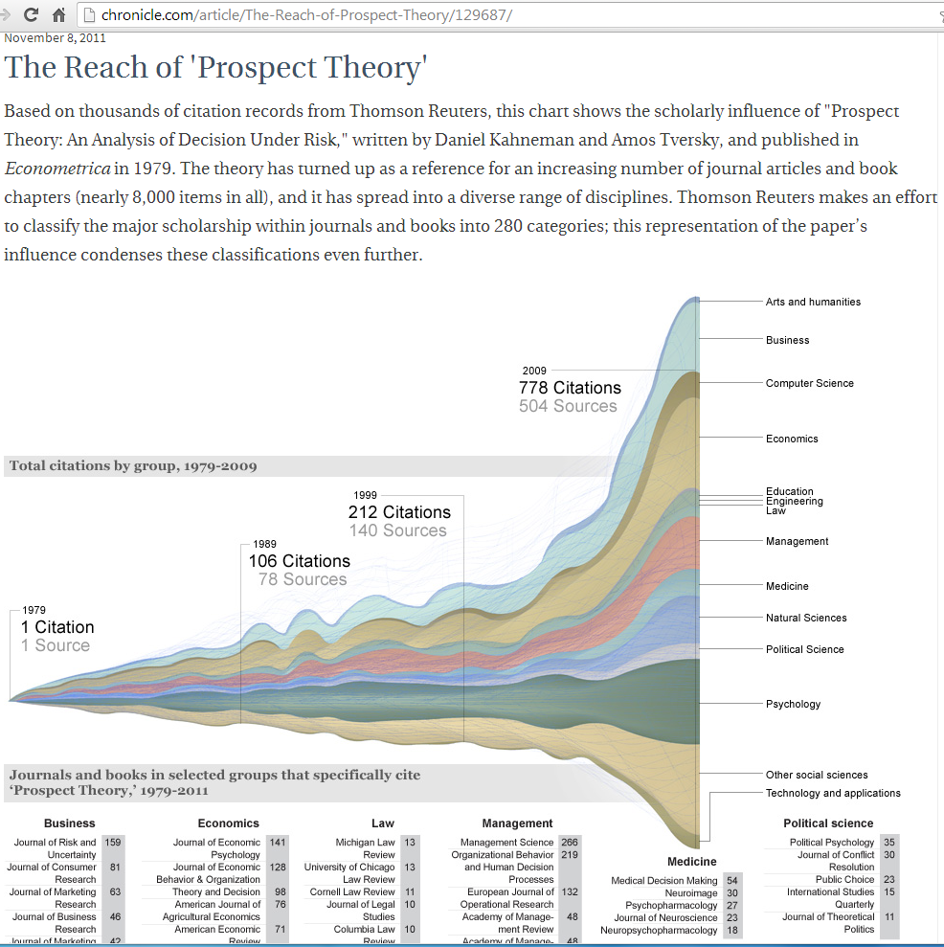

Slide 61
Video
Risk, a short documentary film by Nisha Ligon, is available at http://vimeo.com/11113009

