Slide 1

    Diversification Bias:
    The fear of focus
Non-standard decision making (Menu effects) and non-standard beliefs
Notes:
Might be a good idea to teach this with paradox of choice. That presentation refers to experimental results that suggest that people want more choices (even though more choice leads to choice paralysis and ex post regret). Also, what economic significance does all this have?

Slide 2
Reading
Predictably Irrational, Chapter 9, Keeping Doors Open
Nudge, sections “Rules of Thumb” and “Company Stock” of Chapter 7, Naïve Investing

Slide 3
Focus
Benefits
  Avoiding negative addictions
  Pursuing positive addictions
  Achieving competitive mastery
Barriers to planned focus
  Hyperbolic discounting
  Projection bias
  Diversification bias

Slide 4
Nonstandard decision making and the diversification bias

Slide 5
Diversification bias: The fear of focus
We hate losing options, even if they are bad ones.
We love diversification, even when it is pointless and costly.
We avoid focusing on an activity, even if we know that it is the only correct choice.
But, controlling your decision environment means focusing your choices and sometimes eliminating future options.

Slide 6
Diversification bias: We hate losing options
Experimental finding
“options that threaten to disappear cause decision makers to invest more effort and money in keeping these options open, even when the options themselves seem to be of little interest”
Shin (MIT) & Ariely (MIT), 2004, Keeping doors open:
The effect of unavailability on incentives to keep
options viable. Management Science, 50, 575-586.

Slide 7
An experiment on diversification bias
First, pick a door.
Shin, J. (MIT) & Ariely, D. (MIT), 2004, Keeping doors open: The effect of unavailability on incentives to keep options viable. Management Science, 50, 575-586.

Slide 8
An experiment on diversification bias
Then click on the payoff box for some unknown amount (avg. 3¢ per click).
$

Slide 9
An experiment on diversification bias
Then click on the payoff box for some unknown amount (avg. 3¢ per click). 50 clicks total. Earn as much money as possible.
1¢
2¢
4¢
5¢
$

Slide 10
An experiment on diversification bias
Can continue to click on the payoff button.
Or can click to switch doors.
But, switching uses up one of your 50 clicks.
1¢
2¢
4¢
5¢
$

Slide 11
An experiment on diversification bias
All doors have the same average value (3¢).
What is the best strategy?
1¢
2¢
4¢
5¢
$

Slide 12
If all doors have the same average value (3¢), the best strategy is…
Never switch doors because switching uses a click
Use ⅓ of clicks on red door, ⅓ on blue, ⅓ on green
Use ½ of clicks on one door and ½ on another door
Switch doors on every other click
Switch doors randomly
$

Slide 13
An experiment on diversification bias
Best strategy: Pick one door and keep clicking. Never switch!
1¢
2¢
4¢
5¢
$

Slide 14
An experiment on diversification bias
Participants explicitly told: These doors all have the same average payoff.
Did they switch doors during the game?
1¢
2¢
4¢
5¢
$

Slide 15
An experiment on diversification bias
Participants explicitly told: These doors all have the same average payoff.
The average number of switches: about 1.
1¢
2¢
4¢
5¢
$

Slide 16
An experiment on diversification bias
New twist. Each time a door is clicked, the others shrink 1/15th. At the 15th time without being clicked they disappear.
1¢
2¢
4¢
5¢
$

Slide 17
An experiment on diversification bias
All doors still have same average payout. Does the best strategy change?
1¢
2¢
4¢
5¢
$

Slide 18
If all doors have the same average value, but unclicked doors eventually disappear, the best strategy is…
Never switch doors because switching uses a click
Use ⅓ of clicks on red door, ⅓ on blue, ⅓ on green
Use ½ of clicks on one door and ½ on another door
Switch doors on every other click
Switch doors randomly
$

Slide 19
An experiment on diversification bias
Participants explicitly told: These doors all have the same average payoff.
Did they switch doors during the game with disappearing doors?
1¢
2¢
4¢
5¢
$

Slide 20
An experiment on diversification bias
With the risk of door disappearance the average number of door switches changes from 1 to almost 7!
1¢
2¢
4¢
5¢
$

Slide 21
An experiment on diversification bias
People can’t stand to let the option disappear, even if it they know there is no advantage!
1¢
2¢
4¢
5¢
$

Slide 22
An experiment on diversification bias
Similar results…
if switching costs a click and 3¢.
if you could make the door come back.
if the disappearing doors have a lower payoff.
1¢
2¢
4¢
5¢
$

Slide 23

Diversification bias in dating?
Prof. Dan Ariely’s comments
http://www.youtube.com/watch?v=RpvpCLI5wxE

Slide 24
Take a little of everything!
Our loss aversion is a reason for our need to keep options open. We are averse to the loss of options.
When we face a complicated choice from a multi-item menu, we often rely on a rule-of-thumb called the diversification heuristic: When in doubt, diversify.
An extreme form of this is the 1/n heuristic: When faced with n options, choose equal amounts of each option

Slide 25
Diversification
Diversification, if done to reduce risk in one’s wealth portfolio, can be a great idea
  Good financial planning requires each individual to use his/her wealth to buy a sensible mix of different assets, such as stocks, bonds, real estate, etc.
But naïve diversification that is done simply because one is overwhelmed by a complex choice can cause serious problems

Slide 26
Diversification experiment
University employees were asked how they would invest their money if they had only two mutual funds to choose from
  A mutual fund takes money from (willing) people, buys financial assets, and returns the gains to the investors in proportion to each investor’s contribution (after deducting some fees)
  Some mutual funds invest in stocks, some in bonds, some in real estate, etc.
Notes:
Benartzi, Shlomo, and Richard H. Thaler. 2001. “Naïve Diversification Strategies in Defined Contribution Saving Plans.” American Economic Review, 91(1): 79–98.

Slide 27
Diversification experiment
Group 1 could invest in:
  A mutual fund that invested only in stocks, and/or
  A mutual fund that invested only in bonds
Group 2 could invest in:
  A mutual fund that invested only in stocks, and/or
  A “balanced” mutual fund that invested half in stocks and half in bonds, and/or
The results confirmed the 1/n heuristic
50% 50%
50% 50%
Group 2 is dangerously reliant on stocks

Slide 28
Diversification experiment
Group 3 could invest in:
  A mutual fund that invested only in bonds, and/or
  A “balanced” mutual fund that invested half in stocks and half in bonds, and/or
Guess what these geniuses did!
50% 50%

Slide 29
Diversification experiment
One study examined employee behavior in the retirement saving plans of 170 companies
It found that the more stock mutual funds a plan offered, the greater was the percentage of employees’ money that was invested in stocks
Notes:
Benartzi, Shlomo, and Richard H. Thaler. 2001. “Naïve Diversification Strategies in Defined Contribution Saving Plans.” American Economic Review, 91(1): 79–98.

Slide 30
Nudges
When choices are complex, people rely on rules-of-thumb or heuristics
This leads to bad decisions
In these cases, libertarian paternalism may be necessary
Governments can help by nudging people toward sensible choices

Slide 31

Discussion
Working in groups of 2-5, answer this: When can an irrational desire to keep options open be detrimental to a person’s future?
  Careers? College major? Athletics? Relationships?
  Addiction? Other examples?
Sometimes focus (eliminating other options) leads to a better set of new options.

Slide 32

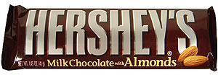
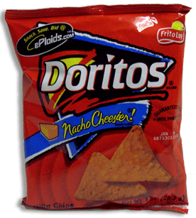
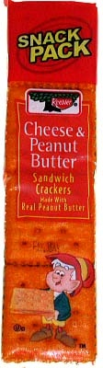
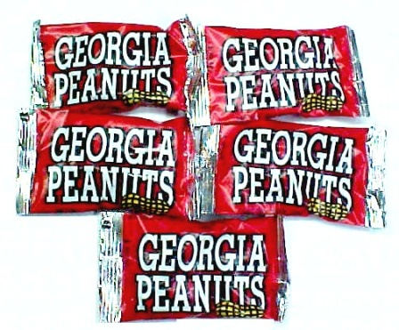
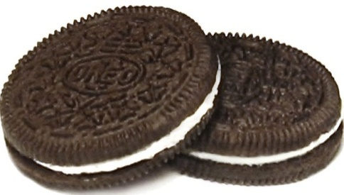
Another Experiment
Students in class given the option of snacks at the end of class each week: Snickers, Oreos, chocolate with almonds, tortilla chips, peanuts, and cheese-peanut butter crackers.
Group 1: What would you like right now? (Asked each week for three weeks.)
Group 2: Asked to select choices for the following three weeks in advance.
Read, D. (Carnegie Mellon) & Loewenstein, G. (Carnegie Mellon), 1995, Diversification bias: Explaining the discrepancy in variety seeking between combined and separated choices. Journal of Experimental Psychology: Applied, 1, 1, 34-49.

Slide 33
What do you think?
Group 1: Asked what would you like right now? (Asked each week for three weeks.)
Group 2: Asked to select choices for the following three weeks in advance
Who was more likely to select three different snacks for the three different weeks?
a) Group 1
b) Group 2
c) They were about the same
Read, D. (Carnegie Mellon) & Loewenstein, G. (Carnegie Mellon), 1995, Diversification bias: Explaining the discrepancy in variety seeking between combined and separated choices. Journal of Experimental Psychology: Applied, 1, 1, 34-49.

Slide 34
People plan more future variety than they will want
 | % choosing three different snacks
Group 1: What would you like right now? (Asked each week for three weeks.) | 8%
Group 2: Asked to select all choices for the following weeks in advance | 45%
 | % always choosing same snack
Group 1: What would you like right now? (Asked each week for three weeks.) | 46%
Group 2: Asked to select all choices for the following weeks in advance | 18%
Notes:
In Ch. 30 of Intermediate Microeconomics, 8th edition, by Hal Varian, this experiment is discussed in a section titled “Bracketing.”

Slide 35
Complexity
Making a choice for the next three weeks is too complex
So, we resort to the diversification heuristic
But this will not turn out to be a good decision

Slide 36
We don’t know our future selves
The snacks experiment shows that when planning for the future we believe that a varied life is good for us, but when the future arrives we reject variety!
This is somewhat similar to dynamic inconsistency: when planning for the future we have clear ideas of what is virtuous and sensible, but when the future arrives our impulses take over!

Slide 37
Just pick something!
We need to make choices
Being careful when making choices is good
But time is money; we need to make a choice and move on with life
When it is hard to decide, it is because all options are equally good
So, when it seems hard to choose, it should actually be easy to decide!

