Slide 1
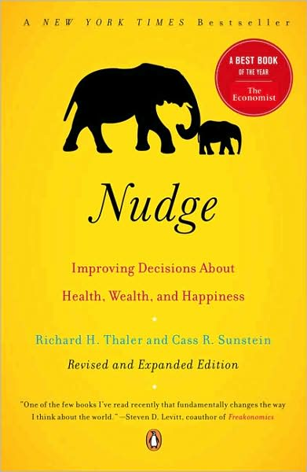
Choice Architecture
Nudge, Chapter 5
Behavioral Economics
Udayan Roy

Slide 2
Choice Architecture 101
We have an automatic system and a reflective system that guide our choices
There’s no need to worry about the reflective system
But the automatic system can make mistakes when it is confused
A good choice architect tries extra hard to ensure fewer mistakes by the automatic system in every one of us

Slide 3
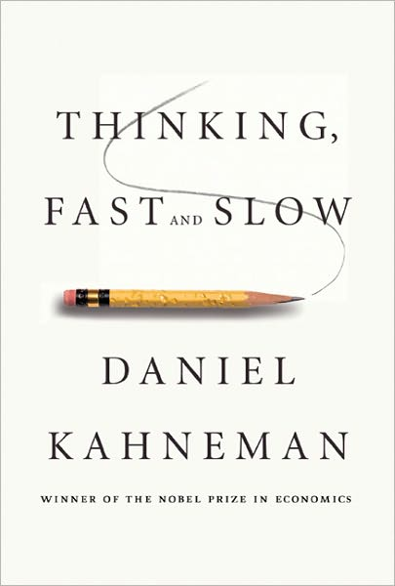
Side Note: Automatic and Reflective
What Nudge calls the automatic system, Thinking, Fast and Slow calls System 1
What Nudge calls the reflective system, Thinking, Fast and Slow calls System 2
Please see Chapter 1 (“The Characters of the Story”) of Thinking, Fast and Slow for further details
The entire Part I (Chapters 1 – 9) of Thinking, Fast and Slow explores these two aspects of our minds, and is called “Two Systems”.

Slide 4
Defaults
Every choice situation has a default choice, whether it is made explicit or not
The default is what a chooser gets when she chooses nothing
When people are required to choose one item from a list, it is often helpful if the choice architect specifies a default choice that would be a good choice for most people, especially those who need help in choosing

Slide 5
Defaults
“Dead man switches” in dangerous machines, computers that switch off when unattended, auto headlights (that turn off when the engine is off)
As most people will keep the factory-set default value of the length of time an unattended computer waits before it switches off, it is important that this default be chosen carefully to help most computer users, especially the least savvy

Slide 6
Defaults
Software downloads often come with a choice between a “recommended” download and a “custom” download.
It is a good idea to help non-expert downloaders by designing the recommended download so that it is a good choice for most non-experts
This recommended option should be pre-selected, not just offered
However, the custom option should be available for those confident enough to use it

Slide 7
Defaults can be abused
Our willingness to stick with the default option chosen for us can be abused by the organizations that make us choose
If you are not careful, you may end up ‘choosing’ a default that gives your ‘permission’ to a company to send you unwanted mail or phone solicitations

Slide 8
The US Defense Department
A provision in the No Child Left Behind Act requires that school districts supply the names, addresses, and telephone numbers of students to recruiters in the armed forces
However, the law also says that parents have the right to have their children’s information not given to the recruiters

Slide 9
The US Defense Department
The Fairport, NY school district interpreted the law as an ‘opt-in’ policy: information is given to recruiters only for those students whose parents give explicit permission
The Defense Department on the other hand insisted that the law was an ‘opt-out’ policy: information will have to be given to recruiters for all students except the students whose parents explicitly refuse permission
Both sides understood the power of the default option

Slide 10
Default Choice or Mandated Choice?
Instead of specifying a default choice—a choice that will be applied to those who make no choice—the choice architect could force every individual to make a choice

Slide 11
Default Choice or Mandated Choice?
Forcing a choice is a good idea when it is important to get the chooser to think hard about the choice and come to a conclusion, instead of relying on the default
This is likely to be true especially when
there is no default that is likely to be the right choice for a large number of people, and
many people will likely end up hating the default

Slide 12
Default Choice or Mandated Choice?
However, mandated choice is not helpful when the choice requires expert knowledge.
In such cases, most people would be happier accepting the suggestion of an expert
Moreover, the choice may not be a simple yes or no choice. It may require choices about innumerable little details.
In such cases, it may be easier to simply rely on the default

Slide 13
Expect Error
A well-designed system anticipates the errors that its users are likely to make and helps them avoid such errors
Card readers that read data no matter how the card is inserted
Cars that warn you if you are not wearing seat belts, are running out of gas, should have the engine checked, etc.
Different nozzles for different fuels (at a gas station), so that a car does not get the wrong fuel

Slide 14
Expect Error
The hose and the delivery port should be unique to each important injected drug so that chances of confusion are minimized
The use of placebo pills to regularize dosage
The “look right” signs at London crosswalks

Slide 15
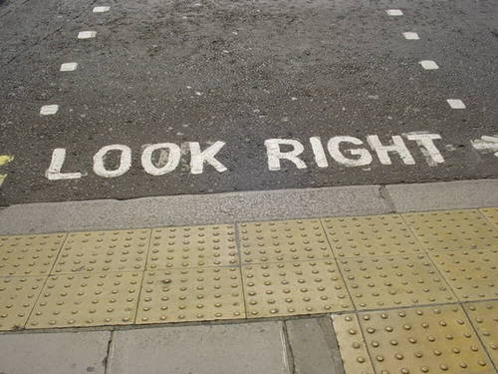

Slide 16
Give Feedback
You are much likelier to take better pictures if you use cameras (digital or polaroid) that give instant feedback, than if you use film cameras that require a lot of time and effort to develop film into photographs
Warnings from computers and cars
Ceiling paint that is pink when wet and white when dry
Choice architects should warn users when they are probably making mistakes

Slide 17
Understand how choices correspond to happiness
People make better choices when they have help in understanding what the various choices means in terms of their personal happiness
Instead of telling customers the number of megapixels in a typical photo taken by a camera, tell them what is the largest recommended print size

Slide 18
Understand how choices correspond to happiness: RECAP
For complex products (especially financial products such as credit cards, insurance, mortgage) one usually has to consider many features of the product and also to anticipate how one would utilize the product and its various features
Here a type of libertarian paternalism (nudge) called RECAP can help

Slide 19
Understand how choices correspond to happiness: RECAP
Record, Evaluate, and Compare Alternative Prices (RECAP):
Require the seller of any financial product to provide
a downloadable spreadsheet that shows all fees
Require the seller of a financial product purchased by an individual to provide
a downloadable spreadsheet that shows how the consumer used the product in a typical period in the past

Slide 20
Understand how choices correspond to happiness: RECAP
These documents would enable the consumer to generate, in a spreadsheet, an accurate measurement of the full costs that he/she actually paid for the product he/she is using …
… and simulations of what the costs would be under alternative patterns of use of the product or similar products
This would make it a lot easier to compare alternative complex products

Slide 21
Structure Complex Choices
When people need to choose one item from a long list and evaluate each item by another long list of criteria, people use rules-of-thumb
For example, an apartment hunter may restrict his choice to only those apartments with a commute less than 30 minutes
Such strategies are imperfect; one may miss out on an outstanding apartment with a 32-minute commute
Naturally, nudges are needed

Slide 22
Structure Complex Choices
Online stores have vast collections. But they also offer
sophisticated search capabilities by various categories, and
users’ recommendations and comments
correlation-based recommendations
Such structuring of choices make choosing easier

Slide 23
Incentives
While human beings respond to nudges, they also respond to incentives
Make sure users have the right incentives
Make the incentives salient (or prominent) so that people don’t miss them
People tend to overweight the costs of a cab ride and underweight the full costs of having a car
A tax on energy use will have a bigger effect if the thermostat tells the user the savings from turning the temperature down by a degree

Slide 24
NUDGES
iNcentives
Understand how choices correspond to happiness
Defaults
Give feedback
Expect error
Structure complex choices

