Slide 1
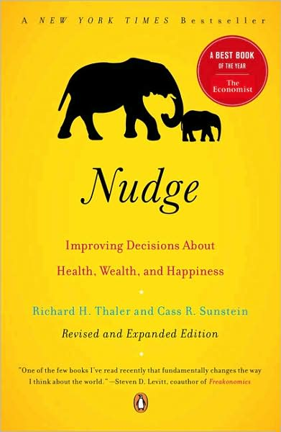
Save More Tomorrow
Nudge, Chapter 6
Behavioral Economics
Udayan Roy

Slide 2
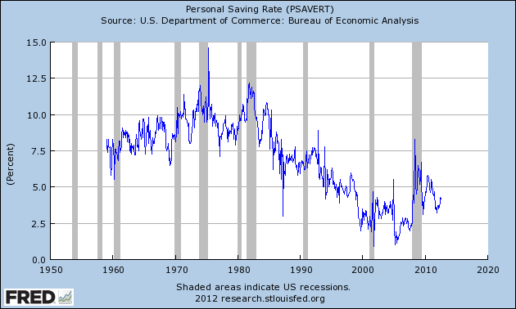
The US Personal Saving Rate

Slide 3
We need to save more
We live longer and retire earlier
We have fewer kids to take care of us when we are old
Families are geographically dispersed
Our pension system has changed from defined benefit to defined contribution.
So, saving for retirement has become a personal responsibility
Here, our predictable irrationalities are a problem

Slide 4
Not saving enough
Some of us are clearly not saving enough
Those not enrolled in a retirement plan
Those saving a small percentage of income even after reaching their forties

Slide 5
Not saving enough
In one survey of 401(k) participants,
68% said their saving rate was “too low”
38% said their saving rate was “about right”
1% said their saving rate was “too high”

Slide 6
Two nudges
Make opt-out—rather than opt-in—the default in the defined contribution plans of US employees
The Save More Tomorrow program

Slide 7
Automatic enrollment

Slide 8
Not even enrolled in a retirement plan
The government gives strong incentives for people to join a retirement plan at work
Contributions are tax deductible
Accumulations are tax deferred
Employers have incentives to match employee contributions
At LIU, the university contributes 10% of an employee’s salary if the employee joins the retirement plan and saves at least 5% of his/her income in the retirement fund
And yet …

Slide 9
Not even enrolled in a retirement plan
Roughly 30% of employees eligible to join a retirement plan fail to enroll
In many cases, workers take years to join
This indicates procrastination

Slide 10
Automatic Enrollment is the Answer
Under automatic enrollment, as soon as an employee is eligible to join his/her employer’s retirement plan,
He/she is automatically enrolled
A specified percent of the paycheck is taken and put into the retirement fund
He/she is informed of this and notified of his/her right to opt out

Slide 11
Automatic Enrollment is the Answer
Automatic enrollment has been a success when tried
In one plan, studied by Madrian and Shea (2001),
Under the initial opt-in system, enrollment rates were 20% after three months of employment, and rose to 65% after three years
When the opt-out system was adopted, enrollment rates rose to 90% after three months of employment, and to 98% after three years
People join sooner; more people join eventually!
Notes:
Brigitte C. Madrian and Dennis F. Shea. “The Power of Suggestion: Inertia in 401(k) Participation and Savings Behavior.” Quarterly Journal of Economics 116 (2001): 1149 – 1225.

Slide 12
Does automatic enrollment lead to too much saving?
Very few employees drop out once they are automatically enrolled
In one study, the fraction of employees who drop out in the first year rose only between 0.3% and 0.6% after automatic enrollment was introduced
Although inertia may explain some of this, it does suggest that most automatically enrolled people do not conclude that they are saving too much

Slide 13
Is it better to require a decision?
An alternative to automatic enrollment is to tell employees that to get paid they must explicitly state whether or not they wanted to join the retirement plan
This forces employees to choose and reduces the role of the choice architect
This strategy works too!
In one study, participation rates increased by 25 percentage points

Slide 14
Simplicity also helps
When employees are forced to state their choice, results are better when employees are given some help
In one study, employees could check
no, or
yes, to a 2% savings contribution with a pre-selected asset allocation, or
yes, with self-chosen savings contribution and asset allocation
Participation rates jumped from 9% to 34%

Slide 15
Simplicity also helps
Conversely, when required to state a choice, people will say no if the choice is too complex
One study found that the more options in a plan, the lower the participation rates
Recall the paradox of choice

Slide 16
Why not try education?
Instead of messing around with choice architecture and nudges, why not try to educate the employees about retirement plans?

Slide 17
Why not try education?
Well, it does not seem to work
One employer offered an education program and used before-and-after quizzes on financial literacy to test the program’s effectiveness
The average score went up … from 54 to 55!
Also, people often leave such education seminars saying they want to join, but fail to follow through

Slide 18
Save more tomorrow

Slide 19
The Save More Tomorrow Program
Developed by Richard Thaler and Shlomo Benartzi, this plan is based on five psychological principles
People plan to save more, but never follow through
Costly choice removal is easier to accept if it is to happen not now but in the future
Loss aversion: people hate to see shrinking paychecks
Money illusion: any inflation-unadjusted shrinkage in paychecks is hard for us to take
Inertia is a powerful influence

Slide 20
The Save More Tomorrow Program
The main feature of the SMT program is that your contributions to your pension fund automatically go up when your pay goes up

Slide 21
The Save More Tomorrow Program
We have seen that automatic enrollment solves the enrollment problem
But it doesn’t solve the problem of low saving rates
The SMT program has turned out to be hugely effective in raising saving rates
Why?

Slide 22
The Save More Tomorrow Program
As retirement contributions are raised in sync with salary increases, people do not feel the automatic diversion of their pay into the retirement fund as a loss
Moreover, they do not have to do anything to raise their saving rates; it keeps going up automatically every time they get a pay raise

Slide 23
SMT is effective
In a 1998 study, employees were given the opportunity to get free financial advice on saving for retirement
Group A chose not to meet with the financial advisor: saved 6% of income; no change over 3-year period
Group B met with the advisor and agreed to immediately increase their saving rate by 5 percentage points: saving rate rose from 4% to 9%; then remained stable
Group C said they could not afford any increase in their (3.5%) saving rate and were offered SMT

Slide 24
SMT is effective
Group C started with a 3.5% saving rate
These employees were offered SMT
Their saving rate would go up every time their salary went up; they would never see any decline in take-home pay on account of joining SMT
78% signed up
Their saving rate increased steadily to 13.6% after three years—a quadrupling!

Slide 25
SMT is effective
Most people who enrolled in Save More Tomorrow stuck with it until they reached the maximum they were allowed to contribute to the plan!
The few people who left the program did not reduce their saving rate, they only put a stop to further automatic increases in their saving rates
SMT is spreading across the corporate world

Slide 26
The US Government has helped
The IRS has defined, approved, and promoted the use of SMT plans
In 2006, Congress passed the Pension Protection Act that offers employers incentives to
Match employee contributions
Automatically enroll them in the plan
Automatically increase their contribution rates over time
Hooray for behavioral economics!

Slide 27
News Items
More Workers Get Help in Building Rainy Day Savings By Ann Carrns, The New York Times, Nov. 6, 2020
I Made One Simple Financial Change and It Lowered My Spending By JOE PINSKER, The Atlantic, SEPTEMBER 7, 2018

Slide 28
Tailpiece: You save more when you feel empathy for your future self
Virtual Reality Study Encourages Subjects to Save for the Future: Morphed Photographs Show What You'll Look Like 'When You're 64‘
By JOHN BERMAN and JENNIFER METZ ABC World News with Diane Sawyer, December 9, 2010

