Slide 1
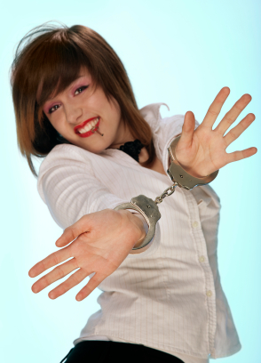
Pre-commitment Strategies
in behavioral economics
Part I: Changing Rewards and Penalties

Slide 2
Many self-inflicted harmful decisions are the result of exchanging instant gratification for risk of future negative consequences.
Long-term
Patient
Planner
Impartial spectator
Deliberative
Cold state
Short-term
Impulsive
Doer
Passions
Affective/Visceral
Hot state

Slide 3
The temptation of instant gratification can thwart our long-term dreams and goals.
Long-term
Patient
Planner
Impartial spectator
Deliberative
Cold state
Short-term
Impulsive
Doer
Passions
Affective/Visceral
Hot state

Slide 4

How am I going to live today in order to create the tomorrow I'm committed to?
-Anthony Robbins

Slide 5

How can we change?

Slide 6
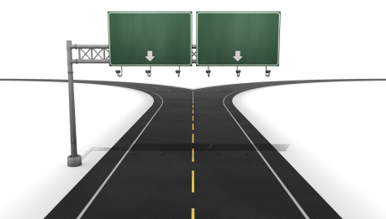
Pre-commitment gives the rider control over the elephant’s future environment.
Many Temptations
Few Temptations

Slide 7

Pre-commitment allows calm decision-making and reduces problems of hyperbolic discounting and projection bias

Slide 8
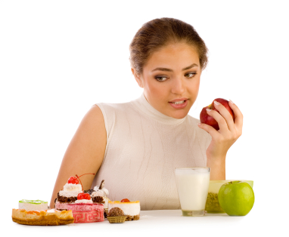
Pre-commitment changes decisions from now v. later to later v. later.
This avoids the “instant gratification” bias of hyperbolic discounting

Slide 9

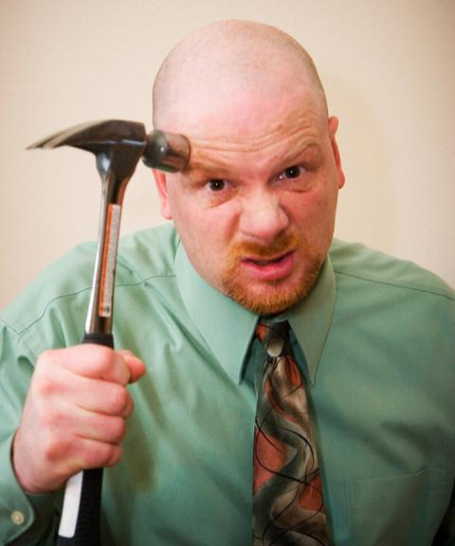
Pre-commitment allows us to make decisions while in a cold state and creates barriers to change while in a hot state
Cold v. Hot
Projection Bias

Slide 10
Pre-commitment Strategies
1.
Change the rewards and penalties
2.
Change the number of decision points

Slide 11
1. Change the rewards and penalties
The goal is to change the environment as perceived by the elephant.
The elephant is
  Emotional
  Focused on now
  Fears loss
Long-term
Patient
Planner
Impartial spectator
Deliberative
Cold state
Short-term
Impulsive
Doer
Passions
Affective/Visceral
Hot state

Slide 12
Elephant characteristic
  Emotional
  Focused on now
  Hates loss
Approach
Change social rewards to alter emotional payoffs of future choices
Change immediate rewards of future choices
Reframe the felt losses of future choices

Slide 13
  Emotional
Change social rewards to alter emotional payoffs of future choices
“Social relations are prime instigators of emotions”
“when respondents are asked for instances in which they experienced certain emotions, invariably and with very high frequency they report contexts involving social relations”
T. Kemper (St. John's U.), 1991, Predicting emotions from social relations. Social Psychology Quarterly, 54, 330-342

Slide 14
  Emotional
Change social rewards to alter emotional payoffs of future choices
Negative Choices
Positive Choices
Add social stigma
  Peer group selection
  Competition
  Promises
Add social status
  Peer group selection
  Competition
  Promises

Slide 15
Peer Group Selection
We examined studies showing peer effects in
Weight
Drug use
Tobacco use
GPA
Athletic fitness
Academic cheating
Retirement saving
Mutual fund selection
College selection
Competitive excellence

Slide 16

Peer groups for specific self-control
Weight Watchers
Alcoholics Anonymous
Gamblers Anonymous
Narcotics Anonymous

Slide 17
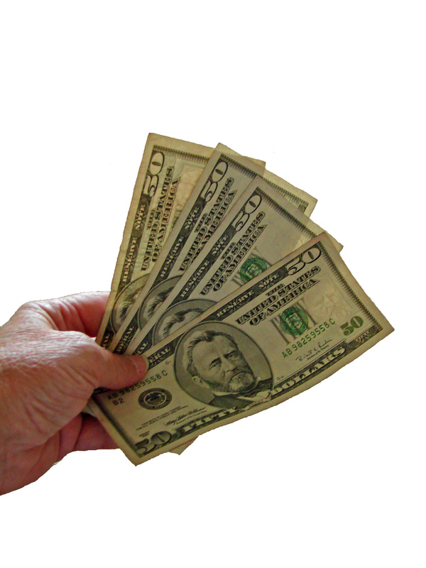
Financial peer groups - ROSCAS
ROSCAS (Rotating Savings and Credit Association) a group of individuals who agree to meet for a defined period of time in order to save and borrow together.
http://www.youtube.com/watch?v=PyFmlXlsbhQ
http://www.youtube.com/watch?v=rC7_OQou6MI&NR=1

Slide 18

Financial peer groups – Microfinance
http://www.youtube.com/watch?v=nMg_Lc6akos (0:00-1:45)
Notes:
Here’s a market solution to mental waywardness.

Slide 19
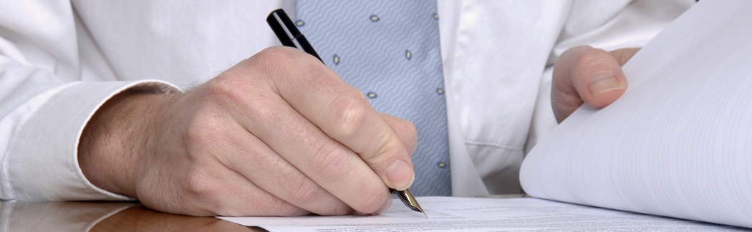
Reducing privacy to add social costs
“In a cocaine addiction center…[patients] may write a self-incriminating letter, preferably a letter confessing their drug addiction, deposit the letter with the clinic and submit to a randomized schedule of laboratory tests. If the laboratory finds evidence of cocaine use, the clinic sends the letter to the addressee.”
T. Schelling (Harvard), 1992, “Self-Control” in G. Loewenstein and J. Elster (eds.), Choice over Time, New York: Russell Sage, p. 167

Slide 20
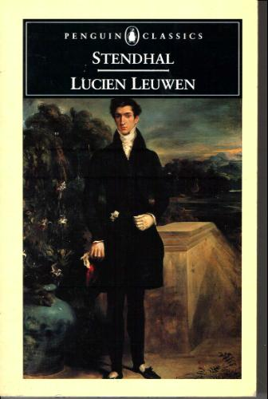
Reducing privacy to add social costs
“In Lucien Leuwen, Mademoiselle de Chasteller takes care to see Lucien only in the company of a chaperone, to make it prohibitively costly to give in to her love for him.”
J. Elster (Columbia U.), 2000, Ulysses unbound. Cambridge University Press, Cambridge, UK
Notes:
Also mention the obvious example of Ulysses and the sirens after drawing attention to the title of Elster’s book.

Slide 21

Competition
Competition creates a social group with standards, goals, and the opportunity to gain or lose social status
Competition can motivate goal-oriented self-control.

Slide 22

Promises can add social stigma to negative behavior
Notes:
A promise to one’s peers will have a stronger effect on one’s own discipline the more one’s peers trust one. In other words, there’s increasing returns here. The better you get, the easier it gets to get even better.

Slide 23
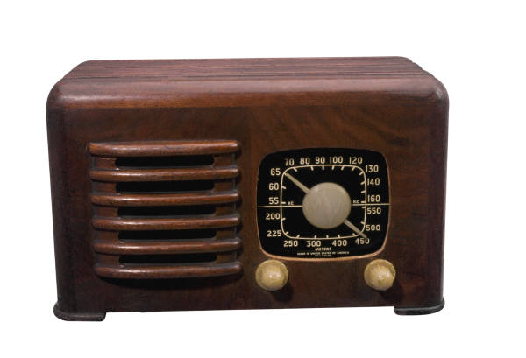
Charitable pledges as promises
“an example of impulsive pre-commitment is given in [a study of radio appeals for WWII war bonds]… ‘in some instances, listeners telephoned at once precisely because they wished to commit themselves to a bond before inhibiting factors intervened’”
T. Cowen (George Mason U.), 1991, Self-constraint versus self-liberation. Ethics, 101, p. 363, citing R. Merton (Columbia U.), 1946, Mass Persuasion, Westport, Conn: Greenwood, pp. 68-69

Slide 24
Elephant characteristic
  Emotional
  Focused on now
  Hates loss
Approach
Change social rewards to alter emotional payoffs of future choices
Change immediate rewards of future choices
Reframe the felt losses of future choices

Slide 25
  2. Focused on now
Change immediate rewards of future choices
Negative Choices
Positive Choices
Reducing the immediate payoff
Increasing the immediate payoff

Slide 26
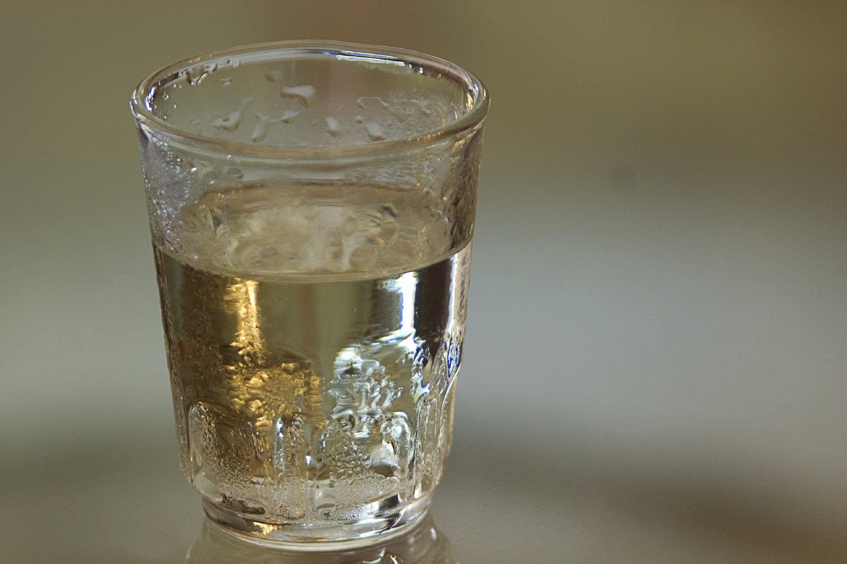
Reduce the immediate payoff from negative choices
Disulfiram accelerates the “hangover” effect of alcohol, so that you feel it about 5 minutes after drinking alcohol.
“Approximately 200,000 alcoholics take disulfiram, or Antabuse, regularly in the United States.”
S. Soghoian (NYU) & S. Wiener (SUNY), J Díaz-Alcalá, (Aug. 20, 2008) Disulfiram- Toxicity. Downloaded from http://emedicine.medscape.com/article/814525-overview

Slide 27

Reduce immediate
payoff from negative
choices
“One study shows tentatively that treatment with naltrexone, a drug that blocks the operation of opiate receptors in the brain, reduces the urge to gamble. The same drug has been used to successfully treat “compulsive shopping”.”
C. Camerer (Cal Tech), G. Loewenstein (Carnegie Mellon) & D. Prelec (MIT), 2005, Neuroeconomics: How neuroscience can inform economics. Journal of Economic Literature, 43, p. 45

Slide 28
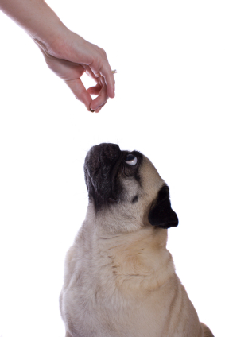
Increase the
immediate payoff
from positive choices
  Adding visceral rewards to small goal achievements motivates the (short-term focused) elephant
  Incentivize the immediate behavior you want, not just the long-term outcome

Slide 29

Increase the immediate
payoff from positive choices
  How did adding an immediate payoff allow Dr. Ariely to be the only patient who consistently took the Interleukin injections?
http://www.youtube.com/watch?v=e7q-3aGJ7hQ 37:40-40:40
Notes:
A city can provide beautifully landscaped walking trails for its citizens. The unpleasantness of exercise will be accompanied by the aesthetic appeal of the trail. This may encourage more exercise.

Slide 30

Increase the
immediate payoff
from positive choices
  Monitoring itself can create a positive reward
  “Research on self-regulation shows that it isn’t enough to set a goal and make it a priority: People must monitor their progress toward the goal.”
P. Silvia (U. North Carolina – Greensboro), 2007, How to write a lot. American Psychological Association: Washington, D.C., p. 39 citing T. Duval (U. Southern California) & P. Silvia (U. North Carolina – Greensboro), 2001, Self-awareness and causal attribution: A dual systems theory. Boston: Kluwer Academic

Slide 31

Increase the
immediate payoff
from positive choices
“Writing’s rewards are delayed – it takes months to hear from journal editors and grant panels – so immediate self rewards will sustain your motivation.”
“Only a fool, however, rewards productive writing with skipping a scheduled writing period.”
P. Silvia (U. North Carolina – Greensboro), 2007, How to write a lot. American Psychological Association: Washington, D.C., p. 44

Slide 32

Application question
    Suppose you don’t like to write, but you need to finish a 20 page term project.
    What would be the best factor to monitor? Hours? Words? Pages?
    What would be a good immediate reward?
    What would not be a good immediate reward?

Slide 33
Elephant characteristic
  Emotional
  Focused on now
  Hates loss
Approach
Change social rewards to alter emotional payoffs of future choices
Change immediate rewards of future choices
Reframe the felt losses of future choices

Slide 34
  3. Hates loss
Reframe the felt losses of future choices
Negative Choices
Positive Choices
Adding Felt
Losses
Removing Felt Losses

Slide 35
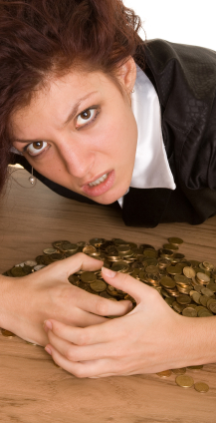
Adding felt losses
Illiquidity (increasing loss from withdraws)
Contingent return of money (increasing loss from undesired behavior)
Adding preliminary deadlines (making losses felt earlier and more frequently)
Paying with cash (physically giving up something valuable)

Slide 36
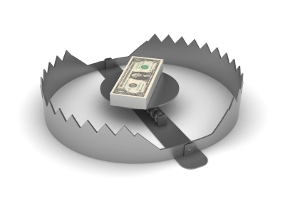
Illiquidity may encourage wealth accumulation by reducing the temptation to consume.
“All Illiquid assets provide a form of pre-commitment”
D. Laibson (Harvard), 1997, Golden eggs and hyperbolic discounting. Quarterly Journal of Economics, 112, p.444.

Slide 37

Unavailable
Pension, Christmas Club Account,
Excess tax withholding
Penalty for withdraw
CDs, IRAs, 401(k)s
Completely Unavailable
Current income + High transaction costs
Housing, farm, family business, Consumer durable
Very High Penalty
High Penalty
Modest
Penalty
Minor
Penalty

Slide 38

Contingent return of initial pledges
“[Agreements where] a designated amount of weight loss is rewarded by return to the client of portions of a refundable money deposit … produced significantly greater losses (approximately 20 pounds) over a ten-week period than did a [comparable] treatment.”
G. Wilson (Rutgers U.) ,1980, “Behavior therapy and the treatment of obesity,” in W. R. Miller (ed.), The Addictive Behaviors, Oxford: Pergamon Press, p. 218

Slide 39

Contingent return of initial pledges
“The [contract] offered individuals a savings account in which they deposit funds for six months, after which they take a urine test for nicotine and cotinine. If they pass, their money is returned; otherwise, their money is forfeited to a charity of the bank’s choosing… [contract] usage increased the likelihood of smoking cessation by 30 percentage points or more.”
X. Giné (World Bank), D Karlan, J Zinman, 2008, Put your money where your butt is: A commitment savings account for smoking cessation, MIMEO, Yale University

Slide 40
Financial motivation: finishing research
Richard Thaler once motivated a newly hired colleague, “David,” to finish his PhD dissertation within a year after this colleague was hired
Thaler offered the following deal:
  David would write Thaler a check for each chapter that needed to be finished.
  If the chapter was not finished by the agreed deadline, Thaler would cash the check.
“David” finished every chapter on time!

Slide 41
Financial motivation: losing weight
Economists John Romalis and Dean Karlan made a pact:
  Each would pay the other $10,000 if they could not lose 30 pounds over a nine-month period
  Both met their target
  They then utilized the basic idea to keep their weight off for the next four years

Slide 42
Governments can help
Governments may help gambling addicts by requiring
  casinos to turn away gamblers who put themselves on a “don’t let me gamble” list
  cigarette sellers to check IDs and turn away or heavily tax those who put themselves on a “don’t help me smoke” list

Slide 43

Adding preliminary deadlines:
Making losses felt earlier and more frequently

Slide 44

“‘The problem sets should have been graded. I had no incentive to do them, and as a result did poorly on the exams.’
                comment from anonymous teacher evaluation, undergraduate game theory course.”
Is this an issue of lack of penalty or timing of penalty?
T. O’Donoghue (Cornell) & M. Rabin (UC-Berkeley), “Incentives and self-control”, in Advances in Economics and Econometrics, Theory and Application 9th World Congress, Volume II, R. Blundell, W. Newey, & T. Persson (eds.), Cambridge, UK: Cambridge University Press.

Slide 45
College students paid to proofread 3 papers. Lost $1 for each day late
Group A:
#1 due in 7 days,
#2 due in 14 days
#3 due in 21 days
Group B:
Pick your own due dates (with penalties) between now and 21 days.
Group C:
3 papers due anytime in 21 days

Slide 46
College students paid to proofread 3 papers. Lost $1 for each day late
Group A:
#1 due in 7 days,
#2 due in 14 days
#3 due in 21 days
Group B:
Pick your own due dates (with penalties) between now and 21 days.
Group C:
3 papers due anytime in 21 days
Which group paid the fewest late penalties?

Slide 47
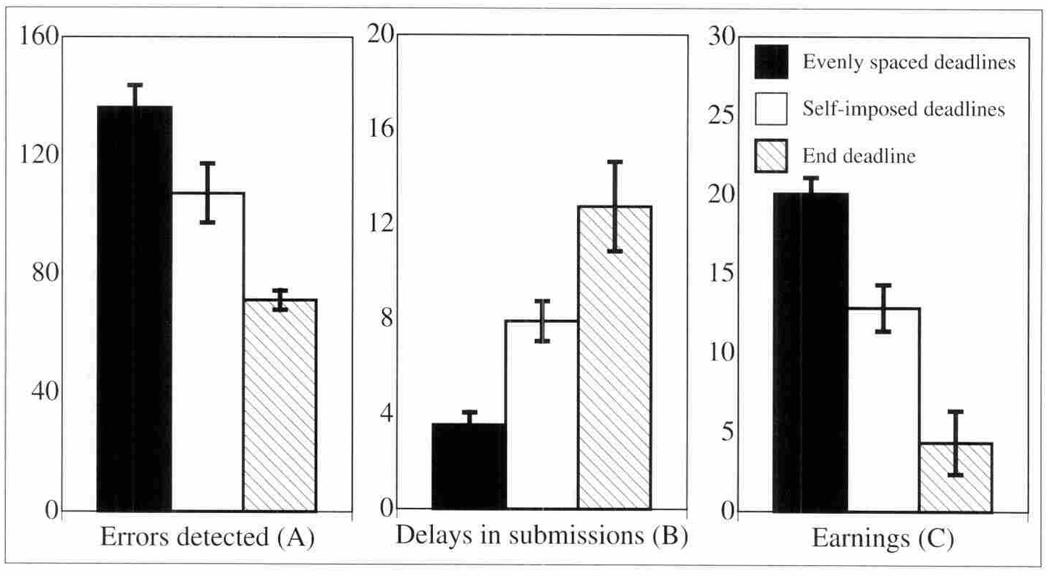
Better results when potential losses occur earlier and more frequently
Airely, D. (MIT) & Wertenbroch, K (INSEAD), 2002, Procrastination, deadlines, and performance: Self-control by precommitment. Psychological Science, 13(3), 219-224.

Slide 48
College students paid to proofread 3 papers. Lost $1 for each day late
Group A:
#1 due in 7 days,
#2 due in 14 days
#3 due in 21 days
Group B:
Pick your own due dates (with penalties) between now and 21 days.
Group C:
3 papers due anytime in 21 days
Which group found the most errors?

Slide 49
Better results when potential losses occur earlier and more frequently
Ariely, D. (MIT) & Wertenbroch, K (INSEAD), 2002, Procrastination, deadlines, and performance: Self-control by precommitment. Psychological Science, 13(3), 219-224.

Slide 50
Adding felt losses – paying with cash
“In studies involving genuine transactions of potentially high value we show that willingness-to-pay can be increased when customers are instructed to use a credit card rather than cash. The effect may be large (up to 100%).”
D. Prelec (MIT) & D. Simester (MIT), 2001, Always leave home without it: A further investigation of the credit-card effect on willingness to pay. Marketing Letters ,12, 5-12,

Slide 51
D. Soman (U. of Toronto), 2003, The effect of payment transparency on consumption: Quasi-experiments from the field. Marketing Letters, 14, 173-183.

Slide 52
Experimental purchase following series of check writing v. series of credit card slip signing
D. Soman (U. of Toronto), 2001, Effects of payment mechanism on spending behavior: The role of rehearsal and immediacy of payments. Journal of Consumer Research, 27, 460-474

Slide 53

Removing felt losses
Pre-paying for the gym
Keep the change
Save more tomorrow
Tax refund splitting
Invest and ignore
The automatic millionaire

Slide 54

Removing felt losses
In a study of gym memberships, “Eighty percent of the monthly members would have been better off had they paid per visit for the same number of visits.”
But, if the goal was to increase the attendance, could this still be a good strategy?
S. Dellavigna (UC-Berkeley) & U. Malmendier (Stanford), 2006, Paying not to go to the gym. American Economic Review, 96, 694-719
Notes:
Again, one could use the idea of taking money from members and gradually refunding it based on attendance.

Slide 55


Removing felt losses
The Automatic Millionaire: #1 selling business book of 2004
Make savings automatic so that you don’t notice it (payroll deductions, automatic withdraws from checking, mortgage payment, etc.)

Slide 56
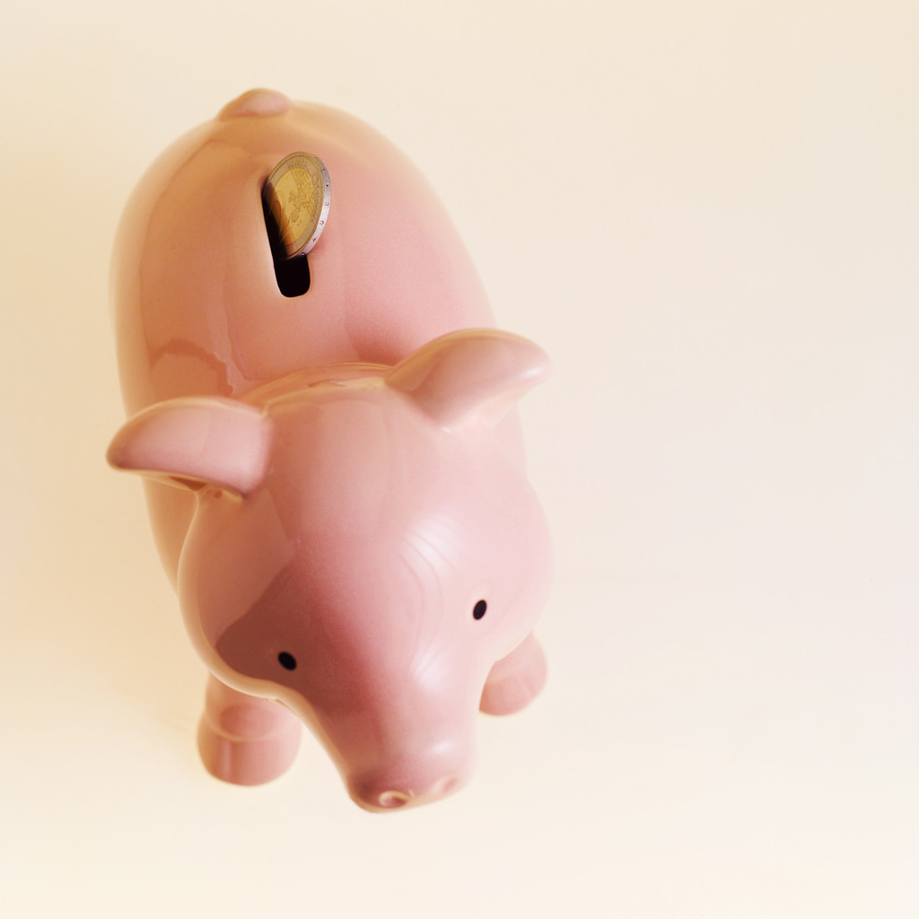
Removing felt losses:
Save more tomorrow
People commit in advance to allocating a portion of their future salary increases toward retirement savings.
“the average saving rates for [Save More Tomorrow] program participants increased from 3.5 percent to 13.6 percent over the course of 40 months.”
R. Thaler (University of Chicago), S. Benartzi (UCLA), 2004, Save more tomorrow: Using behavioral economics to increase employee saving. Journal of Political Economy, 112, S164-S186

Slide 57


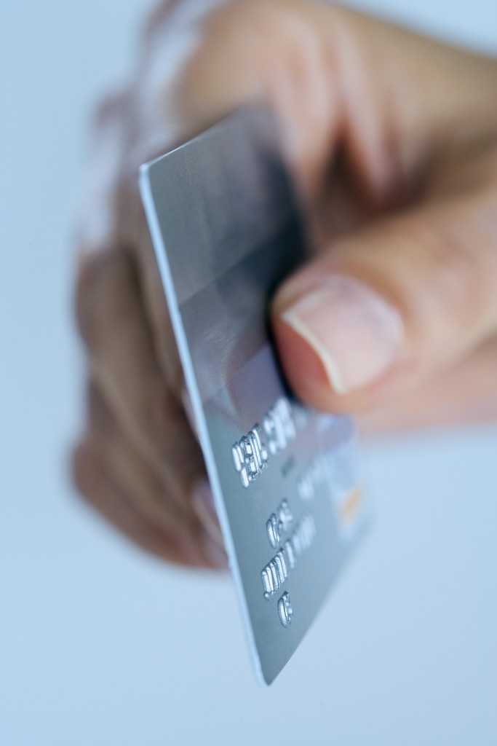
Removing felt losses:
Bank of America’s
Keep the Change
“each time you buy something with your Bank of America Check Card, we’ll round up your purchase to the nearest dollar amount and transfer the difference from your checking account to your savings account.”
http://www.bankofamerica.com/promos/jump/ktc/ downloaded 7 Nov. 2009

Slide 58
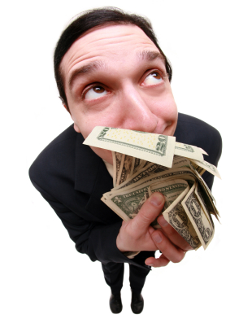
Removing felt losses: Tax refund splitting
Tax refund splitting is a pre-commitment to put a portion of the tax refund into a savings account
In a pilot program “those that did participate saved 236% more than they said they would before hearing about the program”
A. Chiou, S. Roe, E. Wozniak, advisor E. Luttmer (Harvard), 2005, An evaluation of tax-refund splitting as an asset-building tool for low-to-middle income individuals. http://www.d2dfund.org/system/files/publications/PAE+R2A2+FINAL.pdf

Slide 59

Removing felt losses: Invest and ignore
Investors prefer to realize gains (sell winners) but not losses (hold losers). This lowers returns as compared to “buy and hold” strategies.
Among active traders, “Men underperformed their buy-and-hold portfolios by 2.652 percentage points annually; women underperformed their buy-and-hold portfolios by 1.716 percentage points annually.”
B. Barber (UC-Davis) and T. Odean (UC-Davis), Nov/Dec. 1999, The courage of misguided convictions. Financial Analysts Journal, 41-55

Slide 60
Elephant characteristic
  Emotional
  Focused on now
  Hates loss
Approach
Change social rewards to alter emotional payoffs of future choices
Change immediate rewards of future choices
Reframe the felt losses of future choices

Slide 61
Pre-commitment Strategies
NEXT
2.
Change the number of decision points
Notes:
www.stickk.com, betting on your own grade

