Slide 1

Relative consumption and
satisfaction
Notes:
This presentation may be grouped with those on “Spirit Level,” “Help,” “Altruism and Fairness,” and “Cheating.”

Slide 2
Our choices and our satisfaction are driven by the comparisons we make
Nearby additional
Alternative
Past
Expected
Current
Future
Multiple Alternative
Relevant Observed

Slide 3
Behavioral Economics Concepts
Loss Aversion; Endowment Effect; Status Quo Bias
Availability Effects
Endogenous Determination of Time Preference
Nearby additional
Alternative
Past
Expected
Current
Future
Hedonic Adaptation
Placebo Effect; Stereotypes
Multiple Alternative
Anchoring; Paradox of Choice
Peer Effects;
Relevant Observed
Relative Standing

Slide 4

A fundamental idea of standard economics:
Higher income means greater consumption and therefore greater utility and satisfaction

Slide 5

But, some pieces of the puzzle don’t seem to fit!

Slide 6
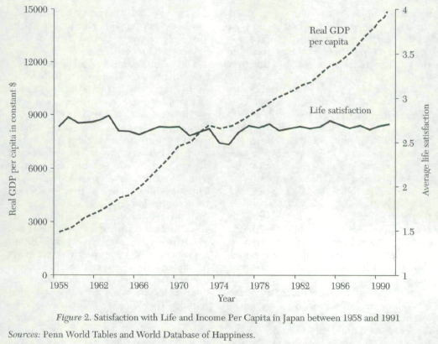

B. Frey (U. Zurich), A. Stutzer, 2002, What can economists learn from happiness research? Journal of Economic Literature, 40, 402-435.

Slide 7
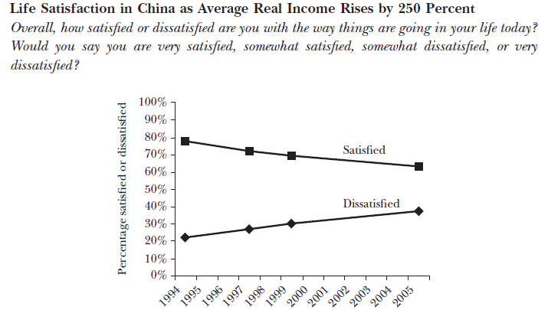

Daniel Kahneman (Princeton) and Alan B. Krueger (Princeton), 2006, Developments in the Measurement of Subjective Well-Being, Journal of Economic Perspectives, 20(1), 3-24.

Slide 8
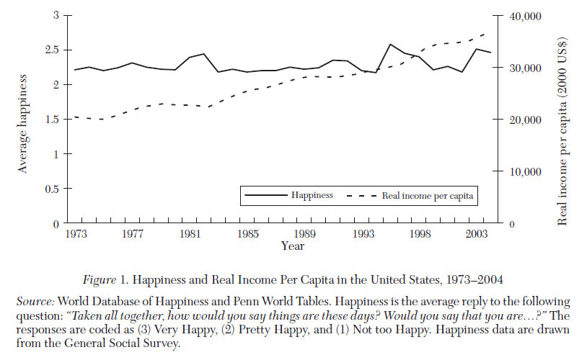

A. Clark, P. Frijters, and M. Shield, 2008, Relative Income, Happiness, and Utility: An Explanation for the Easterlin Paradox and Other Puzzles, Journal of Economic Literature, 46(1), 95–144

Slide 9
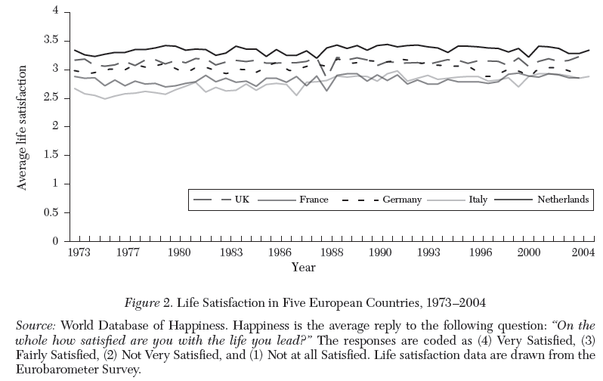
A. Clark, P. Frijters, and M. Shield, 2008, Relative Income, Happiness, and Utility: An Explanation for the Easterlin Paradox and Other Puzzles, Journal of Economic Literature, 46(1), 95–144

Slide 10
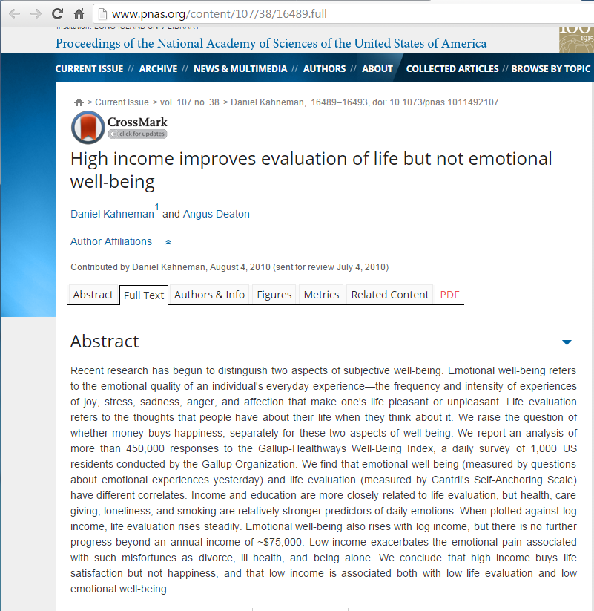
Both authors—Daniel Kahneman (a psychologist) and Angus Deaton (an economist)—have separately won the Nobel Memorial Prize in Economics.
Their research inspired the event described in the next slide

Slide 11

In The News
At about the 1:20 point in this CBS News video report, Dan Price explains that his decision was influenced by the research by Kahneman and Deaton: see https://youtu.be/KJxVRNNdgl4

Slide 12

Why don’t we see national subjective well-being rising with national income?

Slide 13

Standard economics
More money means greater consumption and therefore greater utility and satisfaction
Behavioral economics
My level of satisfaction depends upon my relative consumption v. those in my comparison group

Slide 14
Some goods are more “positional”
Goods where relative level is key
Cars
Houses
Fashion
Professional attire
Income
Goods where absolute level is key
Health
Safety
Relationships
Vacation time
S. J. Solnick (U. Vermont) & D. Hemenway (Harvard), 2005. Are positional concerns stronger in some domains than in others? American Economic Review, 95, 147-151

Slide 15
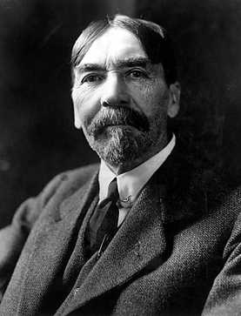
“Conspicuous Consumption”
Thorstein Veblen
Theory of the Leisure Class (1899)
“Conspicuous Consumption” when people prefer a good because it is more expensive. The display of the item projects relative standing.
Notes:
http://en.wikipedia.org/wiki/File:Veblen3a.jpg

Slide 16
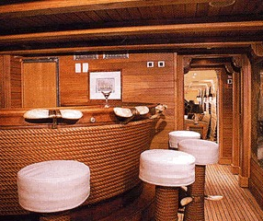

Conspicuous consumption
Shipping magnate Aristotle Onassis wanted a special yacht
Christina – 325 ft.
Barstools with whale ivory footrests and leather made from whale penis.
Mosaic tile floor of swimming pool rose to become a dance floor.
Notes:
Images from http://www.christina-o.com/images.pdf & http://www.robert-h-frank.com/

Slide 17


Relative standing in conspicuous consumption
Shipping competitor, Stavros Niarchos built the Atlantis II with the instruction of making it 50-ft longer than the Christina.
1990 Turama, 3-ft longer than the Atlantis II
Etc., Etc.

Slide 18

You graduate from college and your income changes from $0 to $29,000. Your friends all get jobs making $50,000. How do you feel?

Slide 19
Standard economics
More money means greater consumption and therefore greater utility and satisfaction
$0 v. $29,000
Behavioral economics
My level of satisfaction depends upon my relative consumption v. those in my comparison group
$29,000 v. $50,000

Slide 20

Which world
would you choose?
World A: You and your family live in a neighborhood with 3,000 sq. ft. houses, the rest of the town lives in neighborhoods with 2,000 sq. ft. houses.
World B: You and your family live in a neighborhood with 4,000 sq. ft. houses, the rest of the town lives in neighborhoods with 6,000 sq. ft. houses.

Slide 21
Relative income and hedonic adaptation
Dan Ariely’s “The truth about relativity”
http://www.youtube.com/watch?v=mAc2VdnK78c

Slide 22
Relative income and life satisfaction
Study: A panel study of about 10,000 people in 965 different neighborhoods
Question: Comparing individuals with the same income, do they feel worse when others around them have more income?
What do you think?
People feel less happy when the income of those around them goes up.
People feel more happy when the income of those around them goes up.
People are unaffected by what those around them earn.
Luttmer, E. (Harvard), 2005, Neighbors as negatives: Relative earnings and well-being. Quarterly Journal of Economics, 120(3), 963-1002.

Slide 23
Relative income and life satisfaction
Finding: “higher earnings of neighbors are associated with lower levels of self-reported happiness.”
It appears that people have “utility functions that depend on relative consumption in addition to absolute consumption.”
Luttmer, E. (Harvard), 2005, Neighbors as negatives: Relative earnings and well-being. Quarterly Journal of Economics, 120(3), 963-1002.

Slide 24
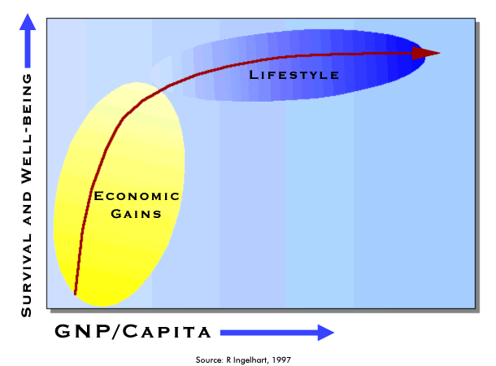
Global results from World Values Survey
R. Inglehart, Modernization and Postmodernization (Princeton, 1997).

Slide 25

Overall income may still be important for life satisfaction in relatively poor nations.

Slide 26
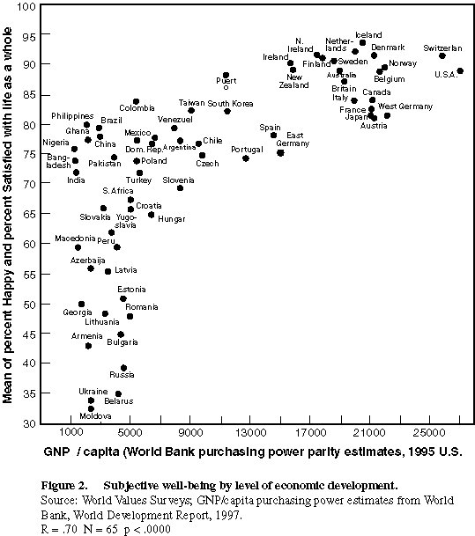
R.Inglehart and H-D. Klingemann, "Genes, Culture and Happiness," MIT Press, 2000.

Slide 27
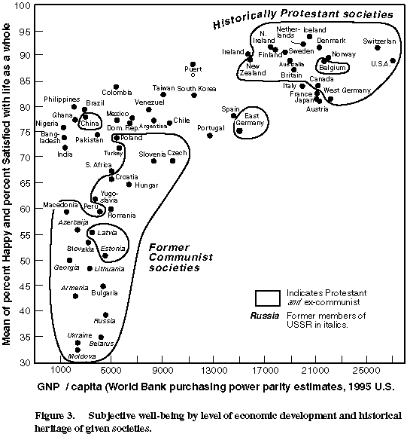
R.Inglehart and H-D. Klingemann, "Genes, Culture and Happiness," MIT Press, 2000.

Slide 28
Income effect weakens for the top half
50th percentile of income
Original chart from B. Frey (U. Zurich), A. Stutzer, 2002, What can economists learn from happiness research? Journal of Economic Literature, 40, 402-435.

Slide 29
Similar results from 35 years ago
50th percentile of income
Original chart from B. Frey (U. Zurich), A. Stutzer, 2002, What can economists learn from happiness research? Journal of Economic Literature, 40, 402-435.

Slide 30

Relative standing and peer effects

Slide 31
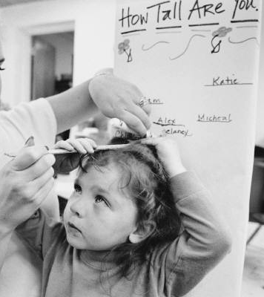
If we are doing well compared to those around us we tend to be satisfied and complacent.
If we are doing poorly compared to those around us, we tend to be dissatisfied and driven to action.

Slide 32

If you want to work on acquiring MORE of something, focus on those who have MORE of it than you do.
If you want to be satisfied with your current level of something, focus on those who have LESS of it than you do.
I am the BEST
I
I need to work harder
I am almost there

Slide 33

Sisters and relative income
Suppose two married women’s husbands make identical salaries. If one woman’s husband makes less money than her sister’s husband, does this make her
Less likely to be employed outside the home?
More likely to be employed outside the home?
No impact
Neumark, D. (Michigan State) & Postlewaite, A. (U. Penn), 1998, Relative income concerns and the rise in married women’s employment. Journal of Public Economics, 70, 157-183.
Notes:
Ariely’s Chapter 1 has a discussion of how relative comparisons and anchoring affect our choices. That material was also discussed in the presentation on “diversification bias.” A lot of the material here also intersects with the presentation on “altruism and fairness.”

Slide 34
Sisters and relative income
Among married women with a sister who was not employed, the probability of the woman’s own employment rises 16-25% if her sister’s husband makes more than her husband.
Neumark, D. (Michigan State) & Postlewaite, A. (U. Penn), 1998, Relative income concerns and the rise in married women’s employment. Journal of Public Economics, 70, 157-183.

Slide 35

Problem: Relative standing drives satisfaction. Increasing one person’s relative standing has a negative impact on another person’s relative standing.
Question: Is there any way to increase your perceived relative standing without reducing someone else’s?

Slide 36

By focusing on those in need through volunteering, philanthropy, or compassion, we reshape our personal environment of relative standing.
Does this increase life satisfaction?

Slide 37

“Volunteers report higher well-being scores than non-volunteers; they are less depressed, and their mortality rate is lower than average”
Meier, S. (Harvard), 2006, The economics of non-selfish behavior. Edward Elgar Publishing: Northampton, MA. p. 43

Slide 38

Volunteering, happiness, & causation
When people lost volunteer opportunities, subsequent happiness ratings declined, suggesting that volunteering was causing happiness (not only vice-versa).
Meier, S. (Harvard) & Stutzer (U. Zurich), 2008, Is Volunteering Rewarding in Itself? Economica, 75, 39-39.

Slide 39

Giving and Happiness
In a study of charitable giving decisions made while in an fMRI machine, charitable giving was “associated with neural activation similar to that which comes from receiving money for oneself.”
Harbaugh, W. T. (Oregon), Mayr, U. (NBER), & Burghart, D. R. (Oregon), 2006, Neural responses to taxation and voluntary giving reveal motives for charitable donations. Science, 316, 1622-1625

Slide 40

It’s not just about the charity receiving money, it is about us voluntarily making the gift
“neural activity … as well as subjective satisfaction, is larger in the voluntary than in the mandatory situation.”
Harbaugh, W. T. (Oregon), Mayr, U. (NBER), & Burghart, D. R. (Oregon), 2006, Neural responses to taxation and voluntary giving reveal motives for charitable donations. Science, 316, 1622-1625

Slide 41
Standard economics
More money means greater consumption and therefore greater utility and satisfaction
Behavioral economics
My level of satisfaction depends upon my relative consumption v. those in my comparison group

Slide 42
If you want to work on acquiring MORE of something, focus on those who have MORE of it than you do.
If you want to be satisfied with your current level of something, focus on those who have LESS of it than you do.
I am the BEST
I
I need to work harder
I am almost there

Slide 43
Spirit Level
Many more examples in the book
Notes:
What does the subject matter of this presentation have to do with economics? How can people protect themselves from the weaknesses discussed here? How can or should rational actors and policy makers make use of the ideas discussed here?

