Slide 1
Stress and Decisions
Behavioral Economics
Udayan Roy
Notes:
This presentation has not been well developed. Also, it tries to connect stress to our self-control problems, and not to bad decisions in general. The slides about the Israeli judges is a bit out of place because its is not clear what stress has to do with food intake. Maybe the point is that judging is a stressful job and food helps us cope with stress. Bad judging with an empty stomach proves that stress drives us to bad decisions. So, other than the Israeli judges example, this presentation limits itself to self-control problems.

Slide 2
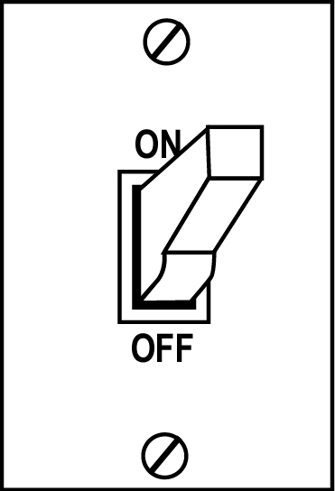
Stress can change you
Stress can push a person from the reflective state to the automatic state
Conversely, de-stressing can save you from the automatic state

Slide 3
Affective and Deliberative Conflict
If “self-control” in decision making is the outcome of a conflict between the deliberative and the affective systems, what happens if the deliberative system is busy with another task?
An experiment to test this was conducted by Dr. Baba Shiv (University of Iowa) and Dr. Alexander Fedorikhin (Washington State University).
Shiv, B. & Fedorikhin, A. (1999). Heart and mind in conflict: The interplay of affect and cognition in consumer decision making. Journal of Consumer Research, 26(2), 278-292.

Slide 4
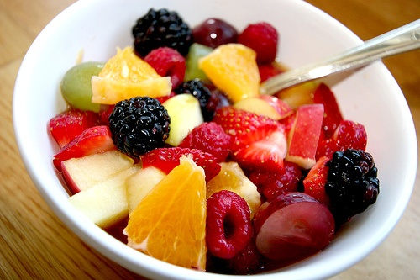
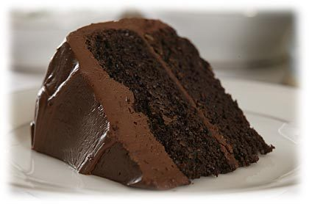
An experiment with numbers and cake Shiv & Fedorikhin (1999)
Memorize a two-digit number (Group A) or seven-digit number (Group B).
Walk to a table and choose between two desserts, chocolate cake and fruit salad.
Walk to another room and repeat the memorized number.
OR

Slide 5
What do you think?
Which group was more likely to choose the chocolate cake?
Group memorizing 2-digit number
Group memorizing 7-digit number chose chocolate cake
Both were equally likely
OR
Notes:
Shiv, B. & Fedorikhin, A. (1999). Heart and mind in conflict: The interplay of affect and cognition in consumer decision making. Journal of Consumer Research, 26(2), 278-292.

Slide 6
When the deliberative “self” is busy…
Group memorizing 2-digit number chose chocolate cake
41% of the time
Group memorizing 7-digit number chose chocolate cake
63% of the time
OR
Notes:
Shiv, B. & Fedorikhin, A. (1999). Heart and mind in conflict: The interplay of affect and cognition in consumer decision making. Journal of Consumer Research, 26(2), 278-292.

Slide 7

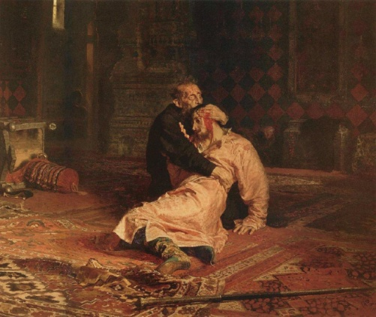
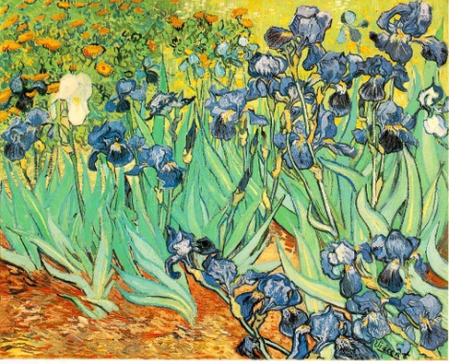
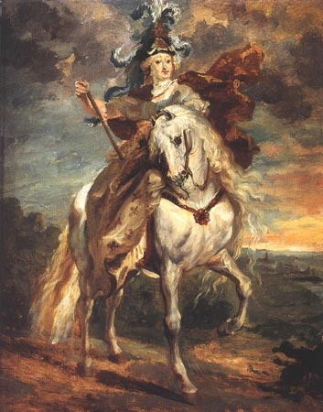
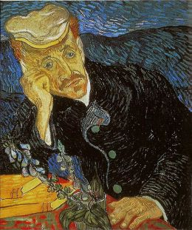
An experiment with art and cookies
Experiment with undergraduate female participants who were dieting.
  Group A asked to memorize 60 art slides in preparation for a recognition test.
  Group B had no memory task.
Conducted by Dr. Andrew Ward (Swarthmore College) and Dr. Traci Mann (UCLA). Ward, A., & Mann, T. (2000). Don’t mind if I do: Disinhibited eating under cognitive load. Journal of Personality and Social Psychology, 78(4), 753-763.
Notes:
Ward, A., & Mann, T. (2000). Don’t mind if I do: Disinhibited eating under cognitive load. Journal of Personality and Social Psychology, 78(4), 753-763.

Slide 8
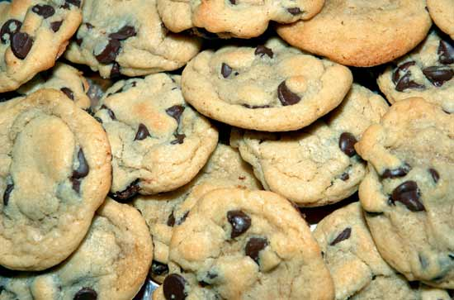
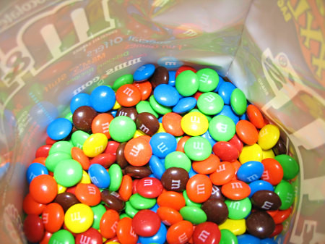
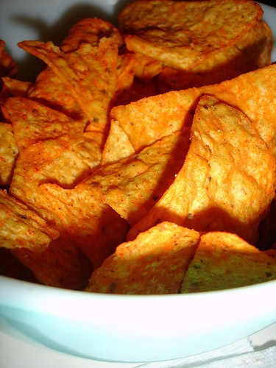
An experiment with art and cookies
Participants in both conditions were requested to have a snack as part of the experiment.
Left with large bowls of Doritos, M&M's, and chocolate chip cookies during the 10-minute task.

Slide 9
An experiment with art and cookies
Which group ate more of the snacks?
  Group A (asked to memorize 60 art slides)
  Group B (no memory task)
  Both group about the same
Dr. Andrew Ward (Swarthmore College) and Dr. Traci Mann (UCLA). Ward, A., & Mann, T. (2000). Don’t mind if I do: Disinhibited eating under cognitive load. Journal of Personality and Social Psychology, 78(4), 753-763.
Notes:
Ward, A., & Mann, T. (2000). Don’t mind if I do: Disinhibited eating under cognitive load. Journal of Personality and Social Psychology, 78(4), 753-763.

Slide 10
An experiment with art and cookies

Slide 11

De-Stressing
Take a deep breath!
Count backwards: 100, 99, 98, …
Meditate
This might bring you back to your reflective state

Slide 12
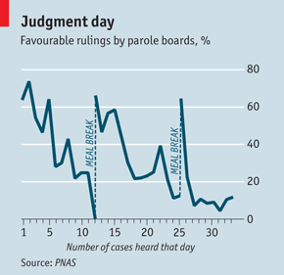
Judges are kinder after a meal!
Researchers followed eight Israeli judges for ten months as they ruled on over 1,000 applications made by prisoners to parole boards.
The plaintiffs were asking either to be allowed out on parole or to have the conditions of their incarceration changed.
Notes:
“I think it's time we broke for lunch…” The Economist, April 14, 2011.

Slide 13
Judges are kinder after a meal!
Decision making is mentally taxing and that, if forced to keep deciding things, people get tired and start looking for easy answers.
In this case, the easy answer is to maintain the status quo by denying the prisoner’s request.
Notes:
“Extraneous factors in judicial decisions” by Shai Danziger, Jonathan Levav, and Liora Avnaim-Pesso, Published online before print April 11, 2011, doi: 10.1073/pnas.1018033108, PNAS April 11, 2011. www.pnas.org/content/early/2011/03/29/1018033108.full.pdf

Slide 14
Sleep on it!
Don’t make an important, life-changing decisions when you are tired, stressed out, or hungry!

