Slide 1
Behavioral Economics and the Poor
ECO23/PSY284 Behavioral Economics
Udayan Roy

Slide 2
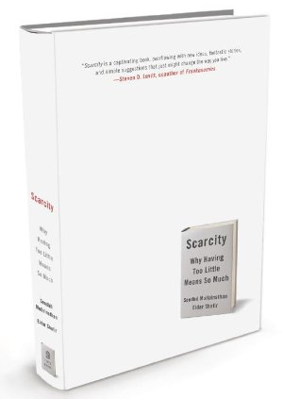
A Behavioral Economics Approach to the Poor
Scarcity: Why Having Too Little Means So Much
By Sendhil Mullainathan and Eldar Shafir, Times Books, 2013

Slide 3
Two Dominant Views of Behavior Under Poverty
The poor behave rationally
They are poor because they have few productive resources or bad luck, but their choices are rational
The poor behave pathologically
They are impatient, don’t plan, and are confused
The poor are different
They are poor because they make bad choices

Slide 4
Behavioral Economics and the Poor
Behavioral economics says:
Yes, people become poor because they have few productive resources or bad luck
But scarcity then reduces their cognitive bandwidth—that is, their attention, cognitive ability, and self-control—and thereby leads them into bad choices
This makes them fall deeper into poverty

Slide 5
The WWII Starvation Experiments
After WWII, the victorious Allies found lots of people who had been starving for a long time
What was the safest way to feed them?
Let them eat as much as they wanted from the get-go?
Or, increase their food intake gradually?
An experiment was conducted in which volunteers were starved

Slide 6
The WWII Starvation Experiments
The men became impatient waiting in line if the service was slow. They were possessive about their food. Some hunched over their trays using their arms to protect their meal. … Dislikes for certain foods, such as rutabagas, disappeared.
Hunger by Sharman Apt Russell
None of this was surprising

Slide 7
The WWII Starvation Experiments
But some observed changes were unexpected
Obsessions developed around cookbooks and menus from local restaurants. Some men could spend hours comparing the prices of fruits and vegetables from one newspaper to the next. Some planned now to go into agriculture. They dreamed of new careers as restaurant owners. …

Slide 8
The WWII Starvation Experiments
… They lost their will for academic problems and became far more interested in cookbooks. … When they went to the movies, only the scenes with food held their interest.
Hunger by Sharman Apt Russell
Scarcity (in this case, of food) captured the attention of people and made it impossible for them to think about anything else

Slide 9
Scarcity Captures Attention
Scarcity captures our attention and makes it difficult for us to think about anything other than the source of the scarcity
And this capture of our attention is involuntary
We have no choice in the matter

Slide 10
Poverty and Its Puzzles
The poor tend to care less for their health
Use less preventive healthcare
Comply less with treatment regimes (Case et al AER 2004)
The poor are less attentive parents
Better off parents read more to their kids, engage them in more conversations, take them to cultural/educational events more often, regulate the amount of TV that their kids watch more…
The poor pass up on productive investment opportunities…
…despite having resources and knowledge to do so (Duflo et al 2010)
Poverty is correlated with “bad” behavior. WHY ??

Slide 11
Possible Explanations
Good things cost money
Example: medicines cost money
Factors associated with poverty
Poor are less knowledgeable
The poor are just different people
Care less about the future, less intelligent

Slide 12
Possible Explanations
Good things cost money
Example: medicines cost money
Costs do not matter for many behaviors
Factors associated with poverty
Poor are less knowledgeable
Doesn’t quite explain many behaviors of the poor
The poor are different people
Care less about the future, less intelligent

Slide 13
Poor are Worse Decision Makers
One explanation for poverty:
(Bad) Decision-Making ➔ Poverty
Alternative Explanation:
Poverty ➔ (Bad) Decision-Making

Slide 14
There’s Something About Scarcity
The poor must manage sporadic income, juggle expenses, and make difficult financial tradeoffs.
Mental bandwidth is limited
Concerns about (financial) scarcity are taxing…
They capture our attention (mental bandwidth) and trigger intrusive thoughts…
… leaving less for other important, but less urgent tasks
Why should the mind be structured like this?
Capture is involuntary
Notes:
Baddeley & Hitch(1974) : The Psychology of Learning & Motivation; Luck & Vogel (Nature, 1997)

Slide 15
Scarcity Focuses Our Minds
In one study, the participants came to the lab around lunchtime, not having eaten for three to four hours
Half of them were fed lunch (full), the other half wasn’t (hungry)
They were all then given word recognition tests

Slide 16
Scarcity Focuses Our Minds
The full and the hungry did equally well for neutral (not food-related) words
The hungry did much better on food-related words
Scarcity captures our minds and focuses on the scarcity
This capture is involuntary (automatic)

Slide 17
Scarcity Focuses Our Minds
Thirst made experiment participants focus on thirst-related words, such as water
When asked to estimate the sizes of various coins, poorer children consistently gave bigger estimates

Slide 18
Focus Dividend
Scarcity captures our minds and makes us focus on the scarcity
This helps us make better choices regarding the source of the scarcity
Scarcity makes us more efficient users of the thing that is scarce
This is the focus dividend, the good side of the psychological effects of scarcity

Slide 19
Tunneling
Unfortunately, we cannot control the effect of scarcity on our minds
We cannot turn the focus dividend on or off as we wish
We may stay focused on the scarcity when we desperately need to focus on something else
This is the tunneling tax of scarcity
We look at the world as though through a tunnel

Slide 20
The Bandwidth Tax
Scarcity reduces our cognitive bandwidth
Our IQ scores go down
Our self-control decreases
This is the bandwidth tax

Slide 21
Evidence on the Bandwidth Tax
Picture identification experiment
Push a button when you see a red dot on the computer screen
Sometimes, just before the dot appeared, another picture would flash on the screen
Do people see the red dot and press the button?

Slide 22
Evidence on the Bandwidth Tax
For non-dieters, the picture had no effect on whether people saw the dot
Dieters were less likely to see the dot if they had just seen a picture of food
For people facing scarcity, the source of the scarcity captures their attention and makes it difficult for them to focus on other things

Slide 23
More on the Focus Dividend
Work meetings become more productive towards the end
Fixed deadlines work better than flexible ones
Coupons are less likely to be used if they have no expiration dates
Sales people work hardest in the last weeks of the sales cycle

Slide 24
More on Tunneling
Between 1984 and 2000, vehicle collisions accounted for between 20 and 25 percent of firefighter deaths
In 79 percent of these cases, the firefighters were not wearing seat belts
Firefighters know very well the need for seat belts
But in the rush to a fire scene, they tunnel

Slide 25
Tunneling leads to bad choices
Tunneling makes us ignore tasks that are crucial but do not appear urgent

Slide 26
Tunneling leads to bad choices
A family suffers a misfortune and falls into poverty. It needs to reduce its regular cash outflow. It switches its car insurance to a plan with a higher deductible and lower premium. It focuses on reducing premiums and tunnels out the bigger future expenses it would face in case of an auto accident
In general, the poor ignore insurance of various kinds, and end up tunneling

Slide 27
The Bandwidth Tax
The experimental subjects were given a grid of letters and asked to find a particular word (such as “street”)
Then another
And another, etc.

Slide 28
Search for a neutral word

Slide 29
The Bandwidth Tax
A second group was given a list in which
the odd-numbered words were the same as before, but
the even-numbered words were food-related

Slide 30
Search for a food-related word
Notes:
Page 46

Slide 31
The Bandwidth Tax
Dieters took 30 percent longer (than non-dieters) to find CLOUD after they had just searched for DONUT
DONUT captured the attention of the dieters and would not let go
They were still thinking about DONUT when they were supposed to be searching for CLOUD

Slide 32
Evidence for the Hypothesis
EXPERIMENTAL STUDY:
Trigger thoughts about Financial concerns by presenting hypothetical scenarios to mall shoppers …
Give them IQ tests as they’re thinking about how they would deal with the scenario
FIELD STUDY:
Farmers financially stretched before harvest, richer after they’re paid.
Compare IQ test performance of the same farmer before harvest versus after harvest (when he is richer)

Slide 33
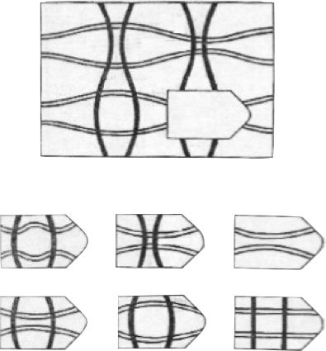
Cognitive Tests
Raven’s Tests
Number Stroop Tests
Respondents shown a string of (identical) numbers; Task is to count the number of digits, not the number itself
333
666666
22
11
4
1
2
3
4
5
6

Slide 34
Study in a NJ Mall
Scenario: Your car breaks down and requires $300 to be fixed. You can pay in full, take a loan, or take a chance and forego the service at the moment... How would you go about making this decision? Financially, would it be an easy or a difficult decision for you to make?
This was followed by Raven’s Matrices tests for IQ
The rich and the poor did equally well

Slide 35
Study in a NJ Mall
The experiment was then repeated, but the repair cost was given as $3,000
The rich subjects now did as well as before
The poor did significantly worse
Preoccupied with scarcity, their IQ went down!!
Notes:
Page 51

Slide 36
Findings
Financial Stress results in a drop of 10-13 IQ points…which is the equivalent of IQ lost
From loss of a full night’s sleep
From becoming a normal drinker to an alcoholic
Going from 45 to 60 years of age

Slide 37
Conclusions and Policy Implications
Poverty is not just about material resources, but also about lower mental resources
Policies should be created in a way to reduce the cognitive demand in the poor
Set up the right default in retirement plans, health insurance, bank accounts
Simplify forms, application procedures
Set up commitment devices and timely reminders

Slide 38
Loss of Executive Control
We have discussed Walter Mischel’s 1960s marshmallow experiment
That experiment showed how important self-control is as a determinant of success in life
Unfortunately, scarcity reduces self-control

Slide 39
Loss of Executive Control
Self-control relies heavily on executive control
Executive control is essential when we need to
Direct attention
Initiate an action
Inhibit an intuitive response
Resist an impulse
These abilities are tested by psychologists using a simple test

Slide 40
Loss of Executive Control
Another experiment in the NJ Mall
You got a problem with that?
As before, the subjects were presented with hypothetical financial problems, either easy ($300 car trouble) or hard ($3,000 car trouble)
Then they were shown in quick succession and at random either a heart  or a flower 
The task was to click the same side as the heart and the opposite side of the flower

Slide 41
Cognitive Control Task

Slide 42
Loss of Executive Control
The natural instinct is to click on the flower when it appears
But this urge has to be resisted because the subjects are required on the opposite side when a flower appears
This requires executive control

Slide 43
Loss of Executive Control
After the easy scenario, the rich and the poor did equally well
After the hard scenario, a dramatic difference appeared:
The rich did just as well as they did after the easy scenario
The poor did significantly worse. They clicked more impulsively on the flower rather than on the opposite side

Slide 44
Scarcity Taxes our Bandwidth
The New Jersey Mall experiments show that scarcity appears to make us
Dumber, and
More impulsive
Keep in mind that after the easy financial scenario the rich and the poor did equally well in both the IQ tests and in the executive control tests

Slide 45
Sugarcane Farmers in India
Each sugarcane farmer harvests one crop per year
The farmer tends to be really poor immediately before the harvest and a lot more financially comfortable after the harvest
The farmers were given the Raven’s matrices test for IQ and the heart-flower test or the Stroop test for executive control, some before harvest and some after the harvest

Slide 46
Sugarcane Farmers in India
On both intelligence and self-control, farmers did much worse before the harvest than after
Here the same people become dumber and have less self-control when they are poorer
Only their circumstances make poorer people do stupid things and show a lack of self-control

Slide 47
Executive Control
Psychologists have found that self-control is finite
The poor spend most of their lives being tempted by things that cannot afford
This exhausts their self-control
As a result, when a really big temptation comes along, they may not have any self-control left to resist it
The rich are less likely to face this problem

Slide 48
Packing a Suitcase and Slack
For the rich, deciding what to do with their resources is not a mentally taxing job that requires a lot of careful trade-offs
They first buy the things they really need
With the leftover money, they buy things that are less essential
In other words, they have a lot of slack in their lives

Slide 49
Packing a Suitcase and Slack
For the poor, deciding how to use their meager resources is like packing a very small suitcase
Even with all the money spent on essentials, there may still be other essentials that need to be bought
This requires very tough trade-offs
The difficulty of the problem can tax the bandwidth of the poor and lead to mistakes

Slide 50
Packing a Suitcase and Slack
And mistakes—say, an impulsive, extravagant purchase—can be easily taken in stride by the rich but very costly for the poor

Slide 51
Summary
The poor exhibited diminished cognitive abilities when financial problems were challenging, but were comparable to the rich when problems were benign
Field and lab evidence suggests that financial scarcity presents challenges that consume cognitive resources, leaving less for other tasks, hence impeding other basic cognitive functions

Slide 52
Conclusions and Policy Implications
A new explanation for why the poor appear less capable: The state of poverty hurts mental capacity
Policies should be created in a way to reduce the cognitive demand in the poor
Set up the right default in retirement plans, health insurance, bank accounts
Simplify forms, application procedures
Set up commitment devices
Reminders

Slide 53
More Than Poverty
Scarcity more broadly
Studies on the lonely
Studies on dieters
Experimentally constructed scarcity

Slide 54
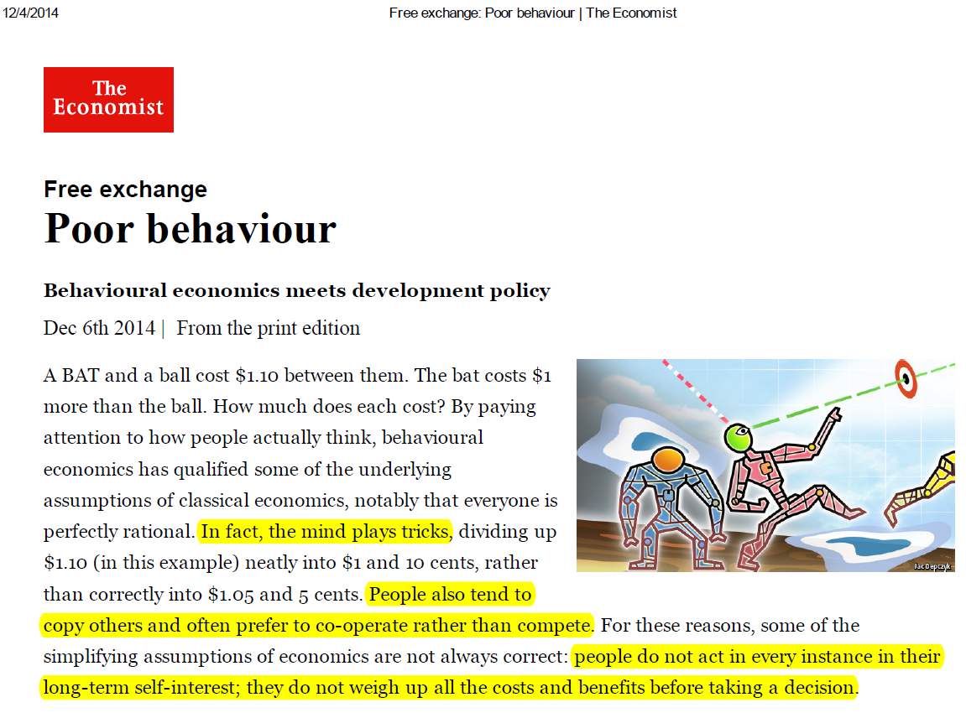

Slide 56
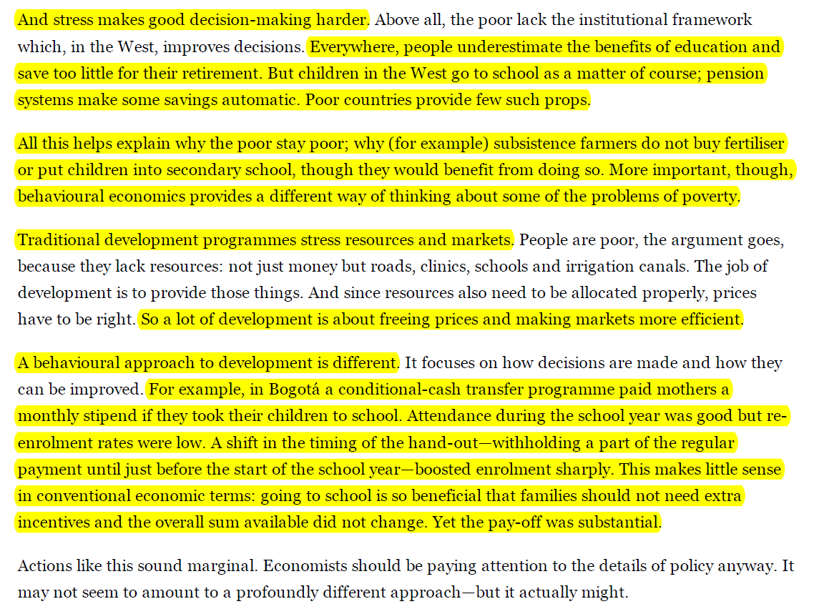

Slide 57
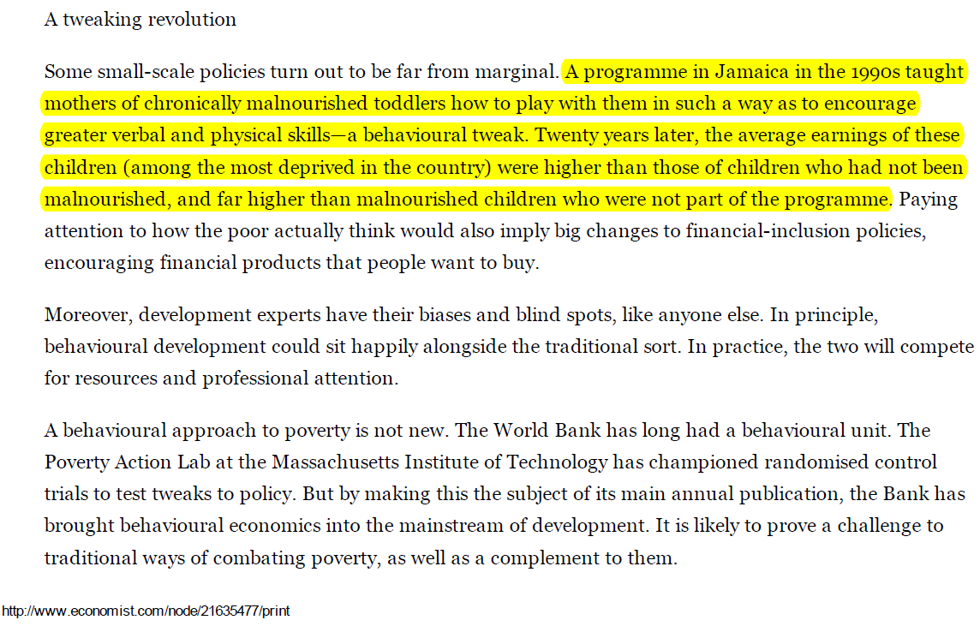

Slide 58
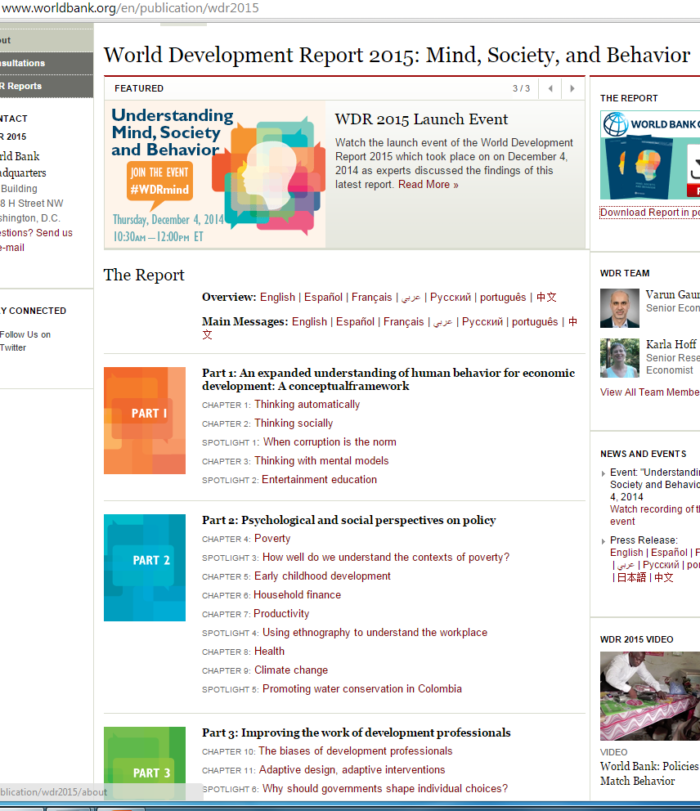

Slide 59
From WDR 2015
In Malawi, a small performance incentive to encourage farmers to work with their peers increased the take-up of productivity-enhancing agricultural technologies.
This intervention used social networks to amplify the effects of information programs
Notes:
(Ben Yishay and Mobarak 2014)

Slide 60
From WDR 2015
In the Philippines, when savings accounts were offered without the option of withdrawal for six months, nearly 30 percent of those offered the accounts accepted them.
After one year, individuals who had been offered and had used the accounts increased savings by 82 percent more than a control group.
Notes:
(Ashraf, Karlan, and Yin 2006)

Slide 62
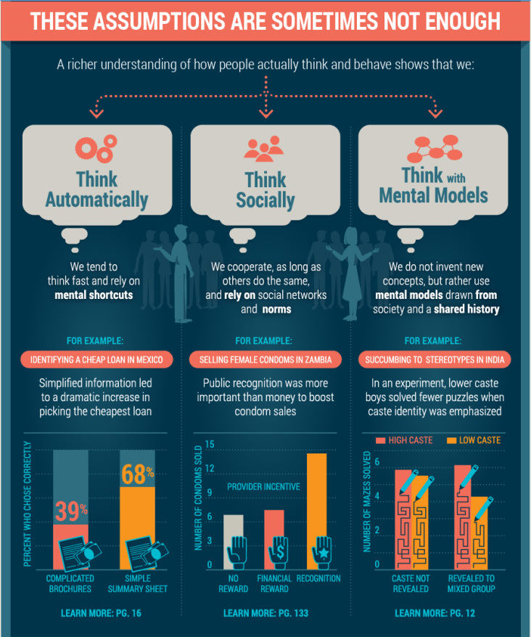

Slide 63
