Slide 1
Behavioral Economics
Udayan Roy
ECO54 History of Economic Thought

Slide 2
Main Innovators
Thorstein Veblen
John Kenneth Galbraith
Maurice Allais
Harry Markowitz
Daniel Kahneman
Amos Tversky
Richard Thaler

Slide 4
Motivations
The two main motivations for behavioral economics concern apparent weaknesses in standard economic theory:
People tend to make choices that are difficult to explain with standard economic theory
Standard economic theory can lead to seemingly unreasonable conclusions about consumer welfare

Slide 5
Objectives
Behavioral economics grew out of research in psychology
The objective is to modify, supplement, and enrich economic theory by adding insights from psychology
Suggesting that people care about things standard theory typically ignores, like fairness or status
Allowing for the possibility of predictable mistakes

Slide 6
Methods
Behavioral economics uses many of the same tools and frameworks as standard economics
Assumes individuals have well-defined objectives, that objectives and actions are connected, and actions affect well-being
Relies on mathematical models
Subjects theories to careful empirical testing
An important difference is that BE often relies on experiments on human subjects
Behavioral economists tend to use experimental data to test their theories rather than historical data from the real world

Slide 7
Anchoring: example
Experimental subjects’ willingness to pay for various goods was influenced by the last two digits of their social security numbers, when they were primed by suggestion to think about those numbers
Skeptics note that subjects had little experience purchasing the goods in the experiment, and that
They might have been less sensitive to suggestion if more familiar products were used
Significance of anchoring effects for many economic choices remains unclear
13-7

Slide 8
Anchoring: experiment
55 subjects were shown a series of six common products with average retail price of $70
For each product, the experiment had three steps: Each participant was asked
his/her SSN
whether he/she would buy the product at a price equal to the last 2 digits of SSN
The maximum he/she would be willing to pay

Slide 9
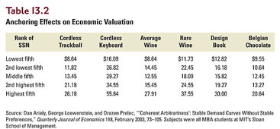
Anchoring: experiment
Those with higher numbers for the last two digits of their SSNs bid more

Slide 10
Bias Toward the Status Quo: Endowment Effect
The endowment effect is people’s tendency to value something more highly when they own it than when they don’t
Example: experiment in which median owner value for mugs was roughly twice the median non-owner valuation
Some economists think this reflects something fundamental about the nature of preferences
Incorporating the endowment effect into standard theory implies an indifference curve kinked at the consumer’s initial consumption bundle
Smooth changes in price yield abrupt changes in consumption
For extreme cases of the endowment effect, see the A&E TV series, Hoarders.
13-10
Notes:
In Ch 29, page 725, of Microeconomics, 2011, Thomas Nechyba argues that “reference dependence” and “loss aversion” combine to create the endowment effect. From this perspective, he argues that taxes on wealth may face stiffer resistance than taxes on income. And, withholding taxes at the source of income would face less resistance than collecting taxes at year end, after people have already felt ownership of their income.

Slide 11
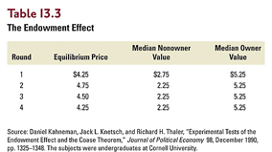
Experiment: Endowment Effect
Half the participants were given mugs (available at the campus bookstore for $6)
The other half were allowed to only examine the mugs
Each student who had a mug was asked to name the lowest sale price
Each student who did not have a mug was asked to name the highest purchase price
Supply and demand curves were constructed and the equilibrium price was obtained
Trade followed
There were four rounds of this

Slide 12
Bias Toward the Status Quo: Default Effect
When confronted with many alternatives, people sometimes avoid making a choice and end up with the option that is assigned as a default
Example: Experiment showing that more subjects kept $1.50 participation fee rather than trading it for a more valuable prize when the list of prizes to choose from was lengthened
Possible explanation is that psychological costs of decision-making rise as number of alternatives rises, increasing number of people who accept the default
Retirement saving example illustrates the default effect when the stakes are high
13-12

Slide 13
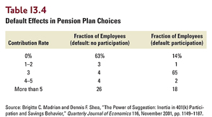
Default effect: retirement
Prior to April 1, 1998, the default option was nonparticipation in the retirement plan (“opt in”)
After April 1, 1998, all employees were by default enrolled in a plan that invested 3% of salary in money market mutual funds (“opt out”)
Only the default option changed

Slide 14
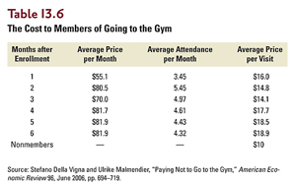
The Problem of Dynamic Inconsistency
People often waste expensive gym memberships
The LIU gym plan for faculty

Slide 15
Choosing Movies
Subjects given opportunity to choose a movie video from a set of 24 titles
Four Weddings and a Funeral
Schindler’s List
When choosing for today: 56% choose low-brow
When choosing for next Monday, 37% choose low-brow
When choosing for second Monday, 29% choose low-brow

