Slide 1
Bentham, Mill and Dupuit: The Rise of Demand in Classical Theories of Value
ECO54 History of Economic Thought
Udayan Roy

Slide 2
Sources
New Ideas from Dead Economists by Todd G. Buchholz, Chapter V (The Stormy Mind of John Stuart Mill)
The Worldly Philosophers by Robert L. Heilbroner, Chapter V (The Dreams of the Utopian Socialists, pages 126-135)
The Ordinary Business of Life by Roger Backhouse, Chapter 7 (Classical Political Economy, pages 136-7, 145-6, 153-6)

Slide 3
Contents
To look at the Rise of Demand in Classical Theories of Value …
Jeremy Bentham
John Stuart Mill
Jules Dupuit
… and to finish our discussion of the Classical School …
Jean Baptiste Say

Slide 4
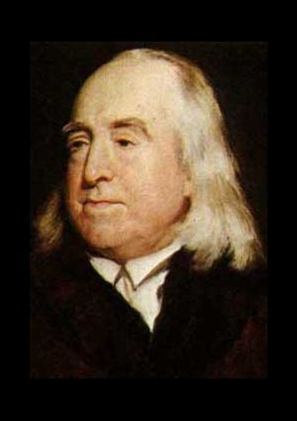
Jeremy Bentham (1748-1832)
Utility and Utilitarianism

Slide 5
The idea of utility maximization
Bentham argued that our choices are based on utility maximization.
Bentham provided the first statement of what has since become a commonplace idea:
economic analysis would be enriched if it makes use of and explores the implications of the assumption that human beings do what they do in order to maximize utility, which is the excess of pleasure over pain

Slide 6
Utilitarianism
Bentham argued that our ethical choices must be based on maximization of the sum of utilities.
Bentham went on to propose a theory of ethics called utilitarianism.
According to Bentham’s utilitarianism, the right thing to do in any situation—personal or political—is to make the choice that maximizes “the greatest happiness of the greatest number.”
Notes:
The phrase “the greatest happiness of the greatest number” was first used by Francis Hutcheson. See A History of Economic Theory: Classic Contributions 1720 – 1980 by Jurg Niehans, Johns Hopkins University Press, Baltimore, MD, 1990, page 60.

Slide 7
Utilitarianism
Let us assume
that each individual's happiness can be represented by a numerical measure—called utility—in any given situation. Let us also assume
that the sum of the utilities of a group of people is a meaningful measure of the well being of this group.
In such case, it follows that the right thing to do is to make the choice that maximizes the sum of the utilities of all people.

Slide 8
Utilitarianism
The assumptions (i) and (ii) on which Betham's utilitarianism is based are highly suspect in the eyes of many economists.
Besides, in cases in which Jack's well being is linked in some (perhaps malign) way to Jill's well-being, utilitarianism can generate ethical prescriptions that offend our natural sense of the inviolability of individual rights.
(Cardinal utility—formalized by Daniel Bernoulli and William Forster Lloyd—and interpersonal comparability of utilities makes total utility a meaningful concept.)

Slide 9
Egalitarianism
Interpersonal comparability and Diminishing Marginal Utility—formalized by Daniel Bernoulli—gave an egalitarian flavor to utilitarian ethics.
If, in addition to assumptions 1 and 2, we also accept the assumption that the link between one's happiness (or, utility) and one's wealth is
the same for all people and
characterized by diminishing marginal utility (that is, the twenty-first dollar you earn contributes more to your utility than the five hundredth dollar you earn), …
… we are led to the conclusion that the most ethical distribution of wealth is also the most equal distribution of wealth in which every person has the same amount of money.

Slide 10
Egalitarianism
Bentham, however, rejected this extreme implication of his own theory and argued that such egalitarian policies of wealth redistribution would reduce our incentive to work and, thereby, leave society impoverished.

Slide 11
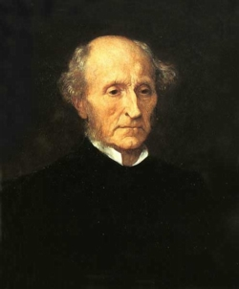
John Stuart Mill (1806-1873)

Slide 12
Theory of International Values
Mill solved a problem left open by Ricardo.
Ricardo had used only production costs.
Mill used demand as well.
The stronger is a country’s demand for its imported good, the closer the free trade price would be to the country’s pre-trade price and, therefore, the smaller would be the country’s gains from trade.

Slide 13
Terms-of-trade justification for a tariff
Mill and Robert Torrens showed that, for a country that is large enough to unilaterally affect worldwide prices, a tariff, by reducing the demand for imports, can move the free trade price away from the country’s pre-trade price and thereby reduces the damage done by the tariff.

Slide 14
Terms-of-trade justification for a tariff
Mill and Torrens speculated that in some cases this positive effect of the tariff—called the terms-of-trade effect—might outweigh the negative effect and the tariff may end up being beneficial.
However, the gain to the tariff-imposing country would be outweighed by the damage done to its trading partners and, therefore, the tariff would end up being worse for the world.

Slide 15
Technological Progress
Mill showed that export-biased technological progress might have adverse effects on terms of trade.

Slide 16
Utilitarianism, pro and con
Philosopher, political scientist, and economist who exemplified classical social liberalism
Mill began as a utilitarian and was one of its most famous exponents
Later in life he began to point out utilitarianism’s weaknesses:
It is better to be a human being dissatisfied than a pig satisfied; better to be Socrates dissatisfied than a fool satisfied. And if the fool, or the pig, is of a different opinion, it is because they only know their own side of the question. The other party to the comparison knows both sides.
John Stuart Mill, Utilitarianism.

Slide 17
Main Works
A System of Logic (1843)
Principles Of Political Economy (1848)
On Liberty (1859) Mill’s most famous work
Considerations on Representative Government (1861)
Utilitarianism (1863)
The Subjection of Women (1869)
Mill was one of the earliest supporters of the right of women to vote
Socialism (1879, posthumous)

Slide 18
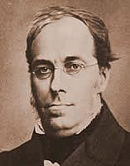
Jules Dupuit (1804-1866)

Slide 19
Willingness-to-pay and utility
Dupuit argued that utility (or, happiness) can be measured by willingness to pay.
Marginal utility of money implicitly assumed to be constant.

Slide 20
Willingness-to-pay and demand
Dupuit derived the downward-sloping demand curve from willingness to pay
The height of Dupuit’s demand curve equals marginal utility
So, his demand curve is the marginal utility curve
Leon Walras criticized Dupuit later for not clarifying the difference between the demand curve and the marginal utility curve
Dupuit implicitly assumed the existence of a product with constant marginal utility

Slide 21
Willingness-to-pay and demand
The area under Dupuit’s demand curve is a measure of total utility.
In this way the link between marginal utility (height) and total utility (area) was clarified

Slide 22
Consumer Surplus
Dupuit defined consumer surplus as the excess of the total utility from a purchase over the consumer’s payment for the purchase
Dupuit showed that increases in price reduce the consumer surplus

Slide 23
Deadweight Loss
Dupuit defined the deadweight loss of an outcome as the extent to which total utility in the outcome is less than the maximum attainable total utility
The deadweight loss of a tax was graphically described

Slide 24
Tax Policy
Dupuit showed that, to reach a tax target, it is better to have low taxes on many goods rather than high taxes on a few goods.
This is because the deadweight loss of a tax increases very rapidly as the size of the tax increases.
Dupuit explained the logic underlying what today is called the “Laffer Curve”

Slide 25
Price Discrimination Boosts Welfare
For a natural monopoly, price discrimination can reduce deadweight losses
Dupuit was an engineer, working for the government and building public works, such as the water supply, roads, and bridges
Naturally, he wondered what price should be charged for the public services and how the benefit to the public could be measured

Slide 26
Cost-Benefit Analysis
Dupuit pioneered cost-benefit approach to the optimum provision of public goods
He used no formal optimization; his results were usually established through numerical examples
Dupuit’s implicit assumption of constant marginal utility of money obscures the trade-offs consumers deal with in making choices.

Slide 27
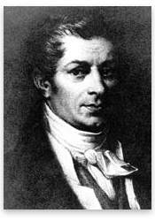
Jean Baptiste Say (1767-1832)
Say’s Law

Slide 28
Jean Baptiste Say (1767-1832)
Say’s Law
Supply creates its own demand
Therefore, market gluts (such as those discussed by Malthus) are unlikely
Provided the cornerstone of non-interventionist macroeconomic policy until the advent of the Keynesian revolution
Widely considered correct in the long run, but not in the short run

Slide 29
What next?
We are done discussing the Classical School of economic thought
Next, we will discuss the rise of socialism

