Slide 1
Game Theory
ECO 54 History of Economic Thought
Udayan Roy

Slide 2
What is Game Theory?
Game theory looks at rational behavior when each decision maker’s well-being depends on the decisions of others as well as her own.

Slide 3
What is Game Theory?
Game theory consists of cooperative and non-cooperative game theory.
In cooperative game theory, it is assumed that the decision makers (or, “players”) are able to sign legally enforceable contracts with each other.
Non-cooperative game theory does not make this assumption.
This lecture will concentrate on non-cooperative game theory and its impact on economics.

Slide 4
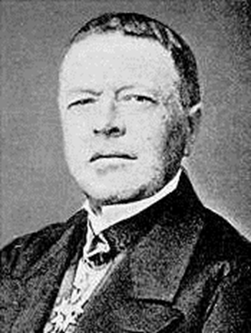
Cournot’s analysis of duopoly

Slide 5
Cournot’s Analysis of Duopoly
In 1838, Antoine Augustin Cournot showed how two firms that make up a duopoly could decide, independently and rationally, how much they should each produce.
Here, the price a firm would get for its product would depend on the total amount produced by the two firms. So, each firm’s profit depends on the production decisions of both firms.
This makes duopoly a game theory problem

Slide 6
Cournot’s Analysis of Duopoly
First, Cournot developed the crucial marginalist result that a profit-maximizing firm should produce the output at which its marginal revenue (or MR, the additional revenue it would earn from the production and sale of an additional unit of output) is equal to its marginal cost (or MC, the additional cost of an additional unit of output).

Slide 7
Cournot’s Analysis of Duopoly
Cournot then showed that each firm’s MR depends on the quantity produced by the other firm.
For example, if Firm B floods the market (of, say, milk) by producing a large amount (of milk), the market price (of milk) will be low and, therefore, Firm A’s MR will be low.

Slide 8
Cournot’s Analysis of Duopoly
As a result, Firm A will typically produce a small amount if it expects Firm B to produce a large amount, and vice versa.
This dependence of Firm A’s output on Firm B’s output is known as Firm A’s reaction curve
see Figure 1.
Similarly, Firm B’s output will depend on what Firm A produces and this dependence gives us Firm B’s reaction curve.

Slide 9
Cournot’s Analysis of Duopoly: Figure 1
Firm B’s production
Firm A’s reaction curve
Firm B’s monopoly output
Cournot’s solution
Firm B’s duopoly output
Firm B’s reaction curve
Firm A’s production
Firm A’s duopoly output
Firm A’s monopoly output

Slide 10
Cournot’s Analysis of Duopoly
The interdependence creates a problem: As Firm A’s decision (about what amount to produce) depends on Firm B’s decision, which depends on Firm A’s decision, which depends on Firm B’s decision, and so on and on, how can we deduce the rational decisions for the two firms?

Slide 11
Cournot’s Analysis of Duopoly
This puzzle, rooted in interdependence, lies at the heart of game theory and distinguishes it from the theory of rational consumer or firm behavior constructed by marginalists such as Gossen, Jevons, and Thunen.

Slide 12
Cournot’s Analysis of Duopoly
Gossen and Jevons considered a consumer who has to decide how to spend her income on the various goods that are available for purchase.
The consumer takes the prices of goods as given—as something beyond her control, like the weather—and does not need to think about the decisions of others.

Slide 13
Cournot’s Analysis of Duopoly
In game theory, on the other hand, each player must try to predict the actions of the other players because what she should do depends on what others do.

Slide 14
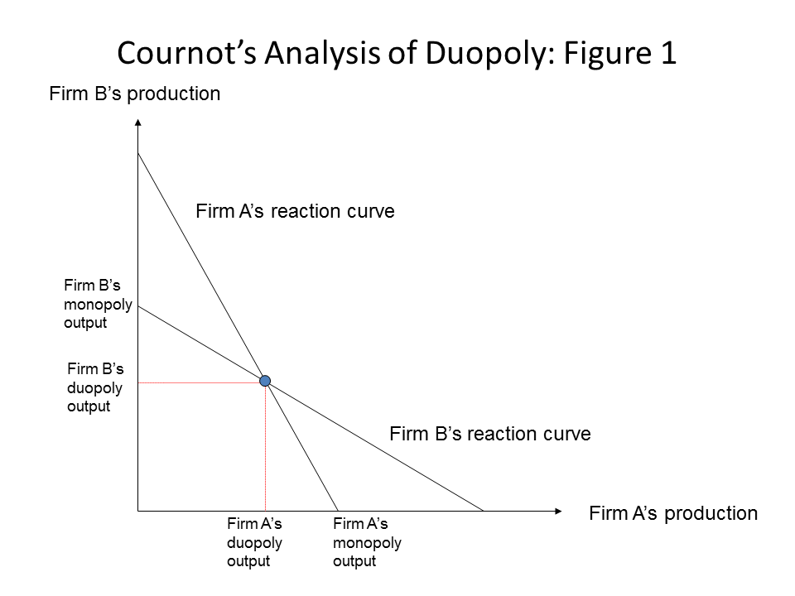
Cournot’s Analysis of Duopoly
Cournot argued that the rational outcome of the duopoly problem is at the intersection of the two reaction curves

Slide 15
Cournot’s Analysis of Duopoly
Although Cournot’s 1838 solution was, in the light of John Nash’s invention of Nash Equilibrium more than a century later in 1950, the correct solution to Cournot’s duopoly problem, it did not lead to a general theory of rational behavior by interdependent actors.
There were at least three reasons for this

Slide 16
Cournot’s Analysis of Duopoly
Cournot’s writings were not read widely.
He saw himself as solving the narrow problem of duopoly and was unable to see that there was a large class of problems that could be addressed using his technique.
Cournot’s justification for his solution had some unattractive underlying assumptions that ended up convincing economists that although Cournot had the right answer, he did not have the right logic to justify his answer.

Slide 17
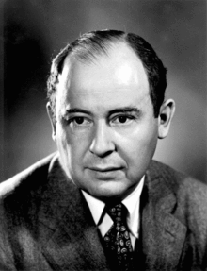
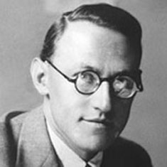
Von Neumann and Morgenstern: two-player zero-sum games

Slide 18
Two-Player Zero-Sum Games
Mathematicians such as James Waldegrave (in 1713), Ernest Zermelo (in 1913), Emile Borel (in 1921-27), and John von Neumann (in 1928) had begun to look at decision-making in parlor games—such as poker, tic-tac-toe, and chess—as the subject of serious mathematical analysis.

Slide 19
Two-Player Zero-Sum Games
However, it was not until Oskar Morgenstern, an economist, collaborated with von Neumann—a mathematician, physicist, and computer scientist—to write The Theory of Games and Economic Behavior in 1944 that the problem of rational behavior by interdependent players began to be seen as central to economics.

Slide 20
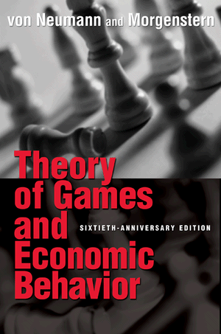
Two-Player Zero-Sum Games
This book marks the beginning of modern game theory

Slide 21
Two-Player Zero-Sum Games
Von Neumann and Morgenstern analyzed rational behavior in two-player zero-sum games, such as the one in Figure 2 below.
Figure 2 |  | Betty
 |  | Left | Right
Al | Top | -10, 10 | -4, 4
 | Middle | 4, -4 | 1, -1
 | Bottom | 6, -6 | -3, 3

Slide 22
Two-Player Zero-Sum Games
Note that the payoffs in each cell add up to zero.
This is why these games are called zero-sum games; one player’s gain is inevitably the other player’s loss.
Figure 2 |  | Betty
 |  | Left | Right
Al | Top | -10, 10 | -4, 4
 | Middle | 4, -4 | 1, -1
 | Bottom | 6, -6 | -3, 3

Slide 23
Two-Player Zero-Sum Games
The question now is, “What will Al and Betty do?”
Figure 2 |  | Betty
 |  | Left | Right | Min
Al | Top | -10, 10 | -4, 4 | -10
 | Middle | 4, -4 | 1, -1 | 1
 | Bottom | 6, -6 | -3, 3 | -3
 | Min | -6 | -1

Slide 24
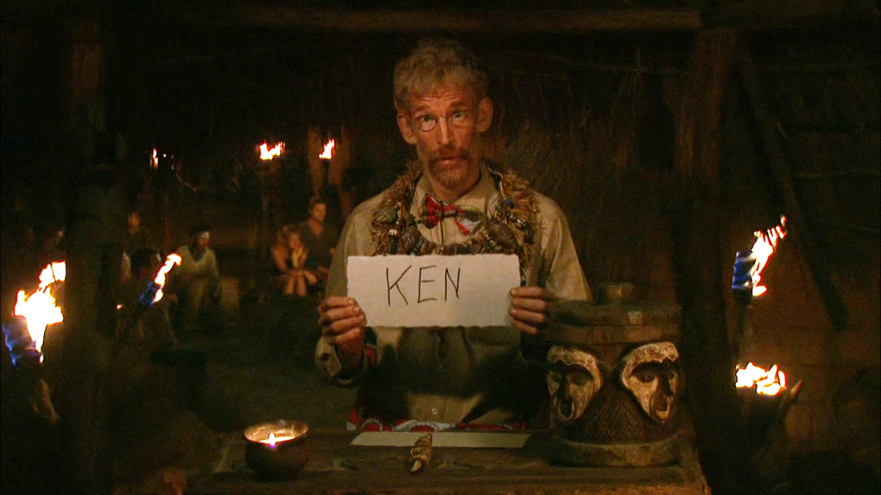
Two-Player Zero-Sum Games
Assume that each player writes down his or her strategy and puts it in a box, just like people voting in an election or Survivor contestants voting in Tribal Council.

Slide 25
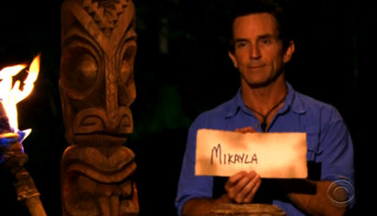
Two-Player Zero-Sum Games
A referee—think Jeff Probst in Survivor—then reveals all the choices and gives everybody the resulting payoffs.
Figure 2 |  | Betty
 |  | Left | Right
Al | Top | -10, 10 | -4, 4
 | Middle | 4, -4 | 1, -1
 | Bottom | 6, -6 | -3, 3

Slide 26
The Maxmin Solution
Waldegrave, Borel and von Neumann had all discussed a specific rational way to play these games called the maxmin solution.
Figure 2 |  | Betty
 |  | Left | Right | Min
Al | Top | -10, 10 | -4, 4 | -10
 | Middle | 4, -4 | 1, -1 | 1
 | Bottom | 6, -6 | -3, 3 | -3
 | Min | -6 | -1

Slide 27
The Maxmin Solution
This approach argues that each player should look at each of his available options and ask, what is the worst that could happen to me if I choose this option?
Figure 2 |  | Betty
 |  | Left | Right | Min
Al | Top | -10, 10 | -4, 4 | -10
 | Middle | 4, -4 | 1, -1 | 1
 | Bottom | 6, -6 | -3, 3 | -3
 | Min | -6 | -1

Slide 28
The Maxmin Solution
Then he should pick the option that has the best what’s-the-worst-that-could-happen outcome.
Figure 2 |  | Betty
 |  | Left | Right | Min
Al | Top | -10, 10 | -4, 4 | -10
 | Middle | 4, -4 | 1, -1 | 1
 | Bottom | 6, -6 | -3, 3 | -3
 | Min | -6 | -1

Slide 29
The Maxmin Solution
Note that each player had feared that whatever move he or she makes the other player would inflict the maximum damage possible on him or her and that these fears are confirmed in the end.
Figure 2 |  | Betty
 |  | Left | Right | Min
Al | Top | -10, 10 | -4, 4 | -10
 | Middle | 4, -4 | 1, -1 | 1
 | Bottom | 6, -6 | -3, 3 | -3
 | Min | -6 | -1

Slide 30
The Maxmin Solution
The players’ pessimism is revealed, after the fact, to have been right on the money.
Each player does the best for himself. But in a zero-sum game, this also means doing the worst to one’s opponent.
Figure 2 |  | Betty
 |  | Left | Right | Min
Al | Top | -10, 10 | -4, 4 | -10
 | Middle | 4, -4 | 1, -1 | 1
 | Bottom | 6, -6 | -3, 3 | -3
 | Min | -6 | -1

Slide 31
The Maxmin Solution
Von Neumann and Morgenstern showed that every two-player zero-sum game has a unique maxmin (or, saddle-point) solution.
Von Neumann and Morgenstern allowed the use of randomized strategies to get their proof.
Waldegrave had not only introduced the idea of maximin strategies (in 1713) as a rational way to play zero-sum games, he had also shown that allowing the use of randomized strategies could yield a solution when it is impossible to find non-randomized strategies that solve a game.

Slide 32
The Maxmin Solution
Although von Neumann and Morgenstern showed economists how players could make rational choices in two-player zero-sum games, their achievement did not lead to any significant use of game theory in economics.

Slide 33
The Maxmin Solution
In zero-sum games, one player’s gain is always another player’s loss.
In other words, these are games of pure conflict and no cooperation.

Slide 34
The Maxmin Solution
Therefore, these games are excellent metaphors for the analysis of sports or military conflicts, where one side’s triumph is necessarily the other side’s defeat, but not for the analysis of economic activity where people—employees and employers, buyers and sellers—come together for mutual gain.

Slide 35
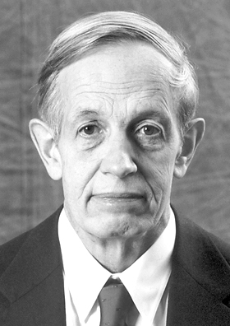
John Forbes Nash

Slide 36
Nash Equilibrium
It was John Nash (in 1950) who provided the crucial breakthrough idea, called Nash Equilibrium, that enabled the analysis of rational behavior in games that are not necessarily zero-sum and may have any number of players.

Slide 37
A Beautiful Mind
John Forbes Nash shared the 1994 Nobel Memorial Prize in Economics with Reinhard Selten and John Harasanyi
The story of his extraordinary academic discoveries, his descent into madness, and his miraculous recovery is told in A Beautiful Mind by Sylvia Nasar.

Slide 38
A Beautiful Mind
The movie based on the biography won the 2002 Academy Award for Best Film, three other Oscars, and four other nominations

Slide 39
Nash Equilibrium
The Nash equilibrium is a set of strategies, one per player, such that each player’s strategy is that player’s best strategy against the strategies chosen by the other players.

Slide 40
Nash Equilibrium
Consider the following game.
What is its Nash Equilibrium?
Figure 3 |  | Betty
 |  | Left | Center | Right
Al | Top | 3, 1 | 2, 3 | 10, 2
 | High | 4, 5 | 3, 0 | 6, 4
 | Low | 2, 2 | 5, 4 | 12, 3
 | Bottom | 5, 6 | 4, 5 | 9, 7

Slide 41
Nash Equilibrium
Note first that this is not a zero-sum game.
For example, if Al plays Top and Betty plays Center, Al gets $2 and Betty gets $3.
These gains are mutual gains and are not obtained at each other’s expense.
Figure 3 |  | Betty
 |  | Left | Center | Right
Al | Top | 3, 1 | 2, 3 | 10, 2
 | High | 4, 5 | 3, 0 | 6, 4
 | Low | 2, 2 | 5, 4 | 12, 3
 | Bottom | 5, 6 | 4, 5 | 9, 7

Slide 42
Nash Equilibrium
Check that the only Nash equilibrium is “Al plays Low and Betty plays Center”.
Figure 3 |  | Betty
 |  | Left | Center | Right
Al | Top | 3, 1 | 2, 3 | 10, 2
 | High | 4, 5 | 3, 0 | 6, 4
 | Low | 2, 2 | 5, 4 | 12, 3
 | Bottom | 5, 6 | 4, 5 | 9, 7

Slide 43
Nash Equilibrium
This is a Nash equilibrium because, given that Al plays Low, Betty’s best move is Center and, given that Betty plays Center, Al’s best move is Low.
Figure 3 |  | Betty
 |  | Left | Center | Right
Al | Top | 3, 1 | 2, 3 | 10, 2
 | High | 4, 5 | 3, 0 | 6, 4
 | Low | 2, 2 | 5, 4 | 12, 3
 | Bottom | 5, 6 | 4, 5 | 9, 7

Slide 44
Nash Equilibrium
None of the other possible choices fit the definition of Nash equilibrium.
Take, for example, the strategy-pair “Al plays High and Betty plays Left”.
Figure 3 |  | Betty
 |  | Left | Center | Right
Al | Top | 3, 1 | 2, 3 | 10, 2
 | High | 4, 5 | 3, 0 | 6, 4
 | Low | 2, 2 | 5, 4 | 12, 3
 | Bottom | 5, 6 | 4, 5 | 9, 7

Slide 45
Nash Equilibrium
This is not a Nash equilibrium because, although Left is indeed Betty’s best move when Al plays High, Al’s best move when Betty plays Left is Bottom, not High.
Figure 3 |  | Betty
 |  | Left | Center | Right
Al | Top | 3, 1 | 2, 3 | 10, 2
 | High | 4, 5 | 3, 0 | 6, 4
 | Low | 2, 2 | 5, 4 | 12, 3
 | Bottom | 5, 6 | 4, 5 | 9, 7

Slide 46
Nash Equilibrium
Nash was able to show that virtually any game-like situation that one could think of is guaranteed to have at least one Nash equilibrium.
Like von Neumann and Morgenstern, Nash assumed that players could use randomized strategies.

Slide 47
Nash Equilibrium
In other words, for virtually any problem in the social sciences, the Nash equilibrium concept makes it possible to say something definite about the likely outcome; one does not have to throw up one’s hands in despair.
For this reason, it is not an exaggeration to say that Nash equilibrium is the fundamental unifying concept for all social sciences.

Slide 48
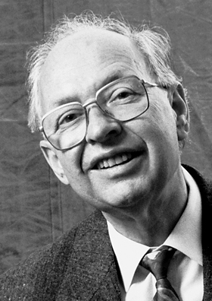
Reinhard Selten and equilibrium selection

Slide 49
Reinhard Selten and Equilibrium Selection
For some game-like situations, there may be multiple Nash equilibria.
In such cases, it is not possible to use the Nash equilibrium concept to say something definite about the likely outcome.
We need other criteria to select the equilibria that are more “reasonable” than other equilibria

Slide 50
Reinhard Selten and Equilibrium Selection
Reinhard Selten showed a way out of these difficult situations by demonstrating that some Nash equilibria have unattractive properties.
Consequently, where there are multiple Nash equilibria, we may be able to reduce the number of equilibria by throwing out the ones with the unattractive properties.

Slide 51
Reinhard Selten and Equilibrium Selection
Consider the following game expressed in tree form (or, extensive form)
Al’s move
l
r
Betty’s move
(8, 10)
L
R
(5, 1)
(11, 5)
Figure 4

Slide 52
Two Nash Equilibria
It can be checked that this game has two Nash equilibria:
(NE1) Al chooses r and Betty chooses R, and
(NE2) Al chooses l and Betty chooses L.
Al’s move
The problem with having two Nash equilibria is that one cannot say anything definite about the likely outcome of this game.
l
r
Betty’s move
(8, 10)
L
R
(5, 1)
(11, 5)
Figure 4
Notes:
Before you object that there is something weird about NE2 because, if Al chooses l, Betty does not get the chance to make a move and, therefore, Betty’s choice of L is irrelevant, remind yourself that this is like Tribal Council in Survivor; everybody must write down their choices without knowing the choices of others.

Slide 53
Two Nash Equilibria
Selten, however, showed that there is something illogical about NE2: although “Al chooses l and Betty chooses L” is indeed a Nash equilibrium, Betty’s choice of L is not credible.
Al’s move
l
r
Betty’s move
(8, 10)
Nash Equilibrium, but not Subgame Perfect
L
R
(5, 1)
(11, 5)
Subgame Perfect Nash Equilibrium
Figure 4

Slide 54
Subgame Perfect Equilibria
After all, if called upon to make a move, Betty will surely choose R because $5 is better than $1.
In Selten’s terminology, only NE1 is subgame perfect.
Al’s move
l
r
Betty’s move
(8, 10)
Nash Equilibrium, but not Subgame Perfect
L
R
(5, 1)
(11, 5)
Subgame Perfect Nash Equilibrium
Figure 4

Slide 55
Subgame Perfect Equilibria
In this way, Selten was able to show how the problem of multiple equilibria can be made managable, at least in some cases, by eliminating those Nash equilibria that are not subgame perfect.
Al’s move
l
r
Betty’s move
(8, 10)
Nash Equilibrium, but not Subgame Perfect
L
R
(5, 1)
(11, 5)
Subgame Perfect Nash Equilibrium
Figure 4

Slide 56
Two Nash Equilibria
It can be checked that there are two Nash equilibria:
(NE1) Al plays T and Betty plays L, and
(NE2) Al plays B and Betty plays R.
Figure 5 |  | Betty
 |  | L | R
Al | T | 6, 10 | 8, 10
 | B | 5, 1 | 11, 5

Slide 57
Two Nash Equilibria
However, Selten argued that NE1 is unlikely to occur.
To see why, note that if Al plays T, L and R are equally good for Betty.
Nevertheless, we cannot realistically expect Betty to play L.
She will instead play R because, if Al plays T, R is no worse for Betty than L, and if by chance Al plays B then R is definitely better for Betty.
Figure 5 |  | Betty
 |  | L | R
Al | T | 6, 10 | 8, 10
 | B | 5, 1 | 11, 5

Slide 58
Trembling-Hand Perfect Equilibria
In Selten’s terminology, L is a weakly dominated strategy
Nash equilibria with weakly dominated strategies should be ignored because they are unlikely to be played
Only NE2 makes sense and Selten called it the trembling-hand perfect equilibrium.
Figure 5 |  | Betty
 |  | L | R
Al | T | 6, 10 | 8, 10
 | B | 5, 1 | 11, 5
Trembling-Hand Perfect Equilibrium

Slide 59
Equilibrium Selection
Once again, Reinhard Selten showed how to turn an ambiguous situation with two Nash equilibria into a definite solution with one equilibrium.
He shared the 1994 Nobel Memorial Prize in Economics with John Nash and John Harasanyi

Slide 60
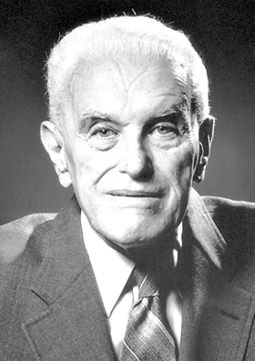
John Harsanyi and Incomplete Information

Slide 61
John Harsanyi and Incomplete Information
Both Nash and Selten received the Nobel Memorial Prize in Economics in 1994.
The third game theorist who got the Nobel that year was John Harsanyi.
Harsanyi showed how to solve games under incomplete information.

Slide 62
Complete and Incomplete Information
In the games discussed so far there is nothing uncertain about the preferences of Al and Betty.
The payoffs to Al and Betty in the various outcomes reflect their preferences over those outcomes.
Therefore, Al knows what sort of person Betty is—what Betty likes or dislikes about the various possible outcomes—and Betty knows what sort of person Al is.

Slide 63
Complete and Incomplete Information
However, it is not a realistic to assume such mutual knowledge if you want to analyze rational behavior in, say, a sealed-bid auction where none of the bidders knows how badly the other bidders want the object.

Slide 64
Complete and Incomplete Information
Harsanyi figured out how games in which Al does not know Betty’s payoffs—and vice versa—could be solved.
This achievement led, in turn, to the widespread use of game theory in the analysis of auctions and other economic phenomena.

Slide 65
Conclusion
Game theory has become an important analytical tool in economics, sociology, political science, and even biology.

Slide 66
Sources
Game Theory by Avinash Dixit and Barry Nalebuff
Prisoners' Dilemma by Avinash Dixit and Barry Nalebuff
Game theory, from Wikipedia
Game Theory, from THE HISTORY OF ECONOMIC THOUGHT WEBSITE
Strategy and Conflict: An Introductory Sketch of Game Theory by Roger A. McCain
AN OUTLINE OF THE HISTORY OF GAME THEORY by Paul Walker
Game Theory by Don Ross, Stanford Encyclopedia of Philosophy
Prisoner's Dilemma by Steven Kuhn, Stanford Encyclopedia of Philosophy
Evolutionary Game Theory by J. McKenzie Alexander, Stanford Encyclopedia of Philosophy
Gametheory.net
Al Roth's game theory and experimental economics page
Economic and Game Theory by David K. Levine
Gambit: Software Tools for Game Theory
http://www.econlib.org/library/Enc/bios/Neumann.html
http://www.econlib.org/library/Enc/bios/Morgenstern.html
The Ordinary Business of Life by Roger Backhouse, Chapter 11, pages 262-265

Slide 67
Topics I need to add
Repeated games and cooperation
Robert Aumann and correlated equilibria
Lloyd Shapley and the Shapley Value
Thomas Schelling, William Vickrey, Roger Myerson, Eric Maskin, and Al Roth
Example of a solved game with incomplete information

