Slide 1
John Maynard Keynes
ECO 54 History of Economic Thought
Udayan Roy

Slide 2
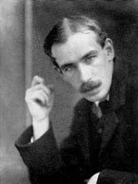
John Maynard Keynes (1883-1946)
The General Theory of Employment, Interest and Money (1936)
A Treatise on Money (1930)

Slide 3
The Great Depression
The classical or neoclassical theories implied full-employment.
After all, if there are any unemployed people they would offer to work for less and, therefore, get hired.
The wage would keep decreasing till all willing workers are hired.
If the wage occasionally gets stuck at too high a level, unemployment would result.
However, such episodes would be brief because the presence of the unemployed would push wages down.

Slide 4
The Great Depression
But the Great Depression (1929-39) was a period of prolonged high unemployment that the classical theory could not explain.
Therefore, it was the Great Depression that exposed a major weakness in the classical theory.

Slide 5
Downward Wage Rigidity
Keynes argued that wages might not be driven down by the unemployed.
Wages in some cases are fixed by long-term contracts.
Moreover, workers suffer ‘wage illusion’.
That is, they would refuse to accept wage cuts but happily accept price increases even though both these changes reduce the purchasing power of the wage (or, the real wage).
Notes:
In his ideas on wage illusion, Keynes may have put his finger on the idea of loss aversion in behavioral economics.

Slide 6
Futility of Wage Reductions
Moreover, Keynes made an informal argument that even if the wage fell, there was no guarantee that the unemployed would be hired.
If wages fell, the workers would be poorer and would cut back on their shopping.
This would lead to a fall in the prices of goods.
As a result, businesses would not find it viable to hire more workers;
although wages have fallen, the lower prices of manufactured goods would still make it hard to hire workers.

Slide 7
Effective Demand
As wage reductions could not be relied upon to encourage more hiring by businesses, some other strategy was needed.
Keynes suggested expansionary fiscal policy—also called ‘pump priming’—as the cure.

Slide 8
Expansionary Fiscal Policy
If the government starts spending more—on, say, new roads and bridges—this would directly create more jobs and reduce unemployment.
If the government cuts taxes, people would have more spending money and would go shopping.
This would raise the prices of goods and induce businesses to hire the unemployed.

Slide 9
The Multiplier
Key to the persuasiveness of Keynes’s argument was the concept of the multiplier
Keynes borrowed this idea from his contemporaries, Richard Kahn and Ralph Hawtrey.
Apart from the direct effects of expansionary fiscal policy on employment, Keynes argued that there would also be a chain of indirect effects.
If one set of unemployed workers get hired, they would have some extra money in their pockets.
Therefore, they would go shopping.
This would induce businesses to hire some more of the unemployed.

Slide 10
The Multiplier
These workers would, therefore, have some extra shopping money and their shopping would similarly create more jobs.
And so on and on the process would go, creating more and more jobs.
As a result of this chain effect—called the multiplier—a $10 million increase in government spending would end up adding to GDP by not $10 million but by a multiple of $10 million.

Slide 11
Thrift makes the multiplier smaller
The indirect multiplier effect of fiscal policy was shown to depend on the attitudes of consumers.
The less thrifty they were, the bigger would be the number of additional jobs created by expansionary fiscal policy.
If workers are free spenders by nature, then any group of newly hired workers would go on a spending binge and this would create a large number of additional jobs for the unemployed.

Slide 12
Thrift makes the multiplier smaller
Conversely, if workers are thrifty by nature, their shopping would be pretty tame and only a small number of additional jobs would be created.
This is an important theme in Keynes’s writings: thrift may be rational for an individual, but it may be counterproductive for the community

Slide 13
Expansionary Monetary Policy
Keynes also proposed expansionary monetary policy as a cure for unemployment.
This idea was based on a new theory of the demand for money called liquidity preference.

Slide 14
Speculative Demand for Money
The classical theory of the demand for money had said that people carry liquid assets, such as the cash in their wallets, only because cash is needed for shopping
that is, only for transactions purposes
After all, the classical economists argued, as cash does not earn interest, you would be better off using your money to buy stocks and bonds if you wanted your wealth to grow.

Slide 15
Speculative Demand for Money
Keynes argued that people carry cash for the sensible management of their wealth as well as for transactions purposes.
Suppose you are convinced that the interest rate on long-term bonds would soon go up.
It would not be a good idea to use all of your savings to buy bonds now. You should hold on to some cash.
That way, when the interest rates do go up, you would have some ready cash with which to buy those high interest bonds.

Slide 16
Speculative Demand for Money
Therefore, Keynes argued, sensible wealth management required that people hang on to some cash even if they don’t need it for shopping.
In other words, people have liquidity preference

Slide 17
The Demand for Money
Keynes’s liquidity preference idea implied that the demand for money would be inversely related to the interest rate.
If interest rates are currently very high, then it is likely that they will soon fall.
Therefore, it would not make sense to carry cash; it would better to spend all your savings to buy the bonds and lock in the current high interest rates.
On the other hand, if interest rates are currently low, then they would be likely to rise soon.
This gives people a good reason to hang on to cash and be ready to snap up the bonds when interest rates rise.

Slide 18
The Demand for Money
Therefore, the demand for money would be high when interest rates are low.
And vice versa

Slide 19
Monetary Expansion
The equality of the supply and demand for money then implied that a country’s central bank could reduce interest rates by increasing the money supply.
This ability of the monetary authorities to reduce interest rates can help drag an economy out of a recession

Slide 20
Monetary Policy
The neoclassical theory of investment had argued that investment increases when interest rates fall and vice versa.
Therefore, if the central bank reduces interest rates, it would increase investment spending by businesses.
This would increase the production of capital equipment for businesses and, thereby, reduce unemployment.

Slide 21
Stabilization Policy
Thus, we see that Keynes had proposed two cures for unemployment:
expansionary fiscal policy, and
expansionary monetary policy.
However, of these two cures, Keynes preferred expansionary fiscal policy and had doubts about the effectiveness of monetary policy.

Slide 22
Doubts about monetary policy
First, Keynes argued that at especially low interest rates a liquidity trap may appear.
That is, the demand for money may become infinitely elastic and, therefore, it may no longer be possible to reduce interest rates by printing more money.

Slide 23
Doubts about monetary policy
Second, even if interest rates are reduced, investment spending by businesses may not increase.
Business investment is influenced mainly by expectations—optimistic or pessimistic “animal spirits”—and only slightly by the interest rate.
Therefore, when the economy is in trouble, even if the central bank succeeds in reducing interest rates, the businesses may be so pessimistic that they may not boost investment spending.
And if that happens, no new jobs would get created.

Slide 24
Founder of Macroeconomics
Keynes is regarded as the pioneer of macroeconomic theory and policy

Slide 25
Sources
New Ideas from Dead Economists by Todd Buchholz, Chapters IX and XI (pages 263-274)
The Worldly Philosophers by Robert Heilbroner, Chapter IX
The Ordinary Business of Life by Roger Backhouse, Chapter 10, pages 219-236
http://www.econlib.org/library/Enc/bios/Keynes.html
http://www.econlib.org/library/Enc/KeynesianEconomics.html
http://www.econlib.org/library/Enc/NewKeynesianEconomics.html

Slide 26
Sources
John Maynard Keynes, by Robert Reich, Time, March 29, 1999
John Maynard Keynes, The Concise Encyclopedia of Economics
Introduction to Keynes’s General Theory, by Paul Krugman, 2006
http://www.hetwebsite.net/het/profiles/keynes.htm

Slide 27
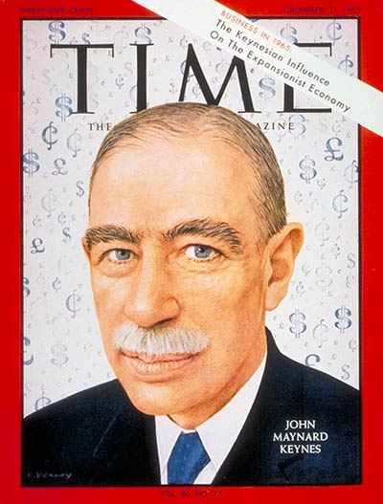
On the cover of Time, December 31, 1965, nearly two decades after his death!

