Slide 1
Early Socialist Thought
Udayan Roy
http://myweb.liu.edu/~uroy/eco54/

Slide 2
Utopian Socialists
Henri Comte de Saint-Simon (1760-1825)
Charles Fourier (1772-1837)
Simonde de Sismondi (1773-1842)
Robert Owen (1771-1858)

Slide 3
Historical Background
With the advent of large factories, the industrial revolution shattered the security of the old agricultural-rural-handicraft economy.
Around these factories sprang up crowded slums, where vice, crime, disease, hunger, and misery were a way of life.
The poverty of the masses stood in contrast to the massive fortunes of the few.

Slide 4
Historical Background
This situation led to calls for reform
The capitalists—often citing classical economists such as Adam Smith—opposed any intervention by governments
Proponents of a moderate form of socialism were shouted down
A fiercer form of socialism emerged later under the leadership of Karl Marx

Slide 5
Utopian Socialists
First of the moderate reformers were the utopian socialists
They regarded the competition-based market economy to be unfair and irrational
They imagined—and described in detail—various social arrangements that they considered ideal and appealed to the whole world to adopt them

Slide 6
Utopian Socialists
The workers were politically weak in the early stages of the industrial revolution
The utopian socialists preached universal togetherness rather than class conflict
They expected capitalists to lead the implementation of their utopian plans
Some model cooperative communities were actually tried
But without much success

Slide 7
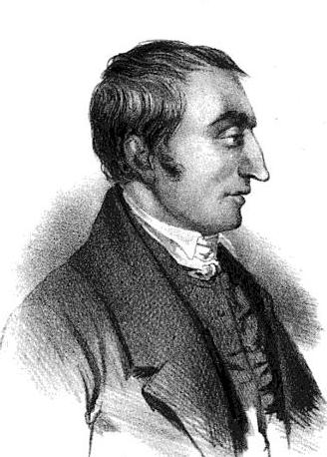
Claude Henri de Rouvroy, comte de Saint-Simon (1760-1825)

Slide 8
Henri Comte de Saint-Simon (1760-1825)
Ruined French aristocrat, an officer in the American Revolutionary War on the American side, a real estate speculator and journalist, Saint-Simon was the founder of the “Saint-Simonian” movement, a type of semi-mystical “Christian-Scientific” socialism
The working class had not yet become a powerful political force
So Saint-Simon made no appeal to the workers to rise up against their bosses

Slide 9
Henri Comte de Saint-Simon (1760-1825)
Nevertheless, he alarmed the rich by making production, not property, the basis of his ideal society
His followers opposed the laws of inheritance and urged the collective ownership of property
Saint-Simon believed that the antisocial egotism of the rich would make the poor rise up in revolt
Unless the rich adopted a new, cooperative ethic

Slide 10
Henri Comte de Saint-Simon (1760-1825)
Saint-Simon envisaged the reorganization of society with an elite of philosophers, engineers and scientists leading a peaceful process of industrialization
This was one of the earliest proposals for central planning by educated elites
Note that he rejected the classical economists’ faith in the free market
His advocacy of a “New Christianity” -- a secular humanist religion to replace the defunct traditional religions -- was to have scientists as priests.

Slide 11
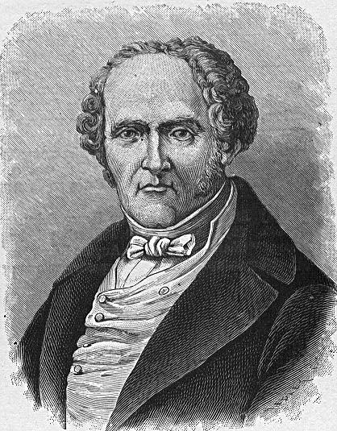
Francois Marie Charles Fourier (1772-1837)

Slide 12
Francois Marie Charles Fourier (1772-1837)
Unlike his contemporary, Saint-Simon, the half-mad Charles Fourier was an outright utopian.
He was anti-state, anti-industry, anti-competition and anti-urban.
Yet, he distanced himself from the socialists who wanted the abolition of private property.
He envisaged a utopian society in “natural harmony” with the cosmos that could be achieved by non-violent means.

Slide 13
Francois Marie Charles Fourier (1772-1837)
Fourier was by no means a revolutionary, and his appeals were usually addressed to the wealthy or to the king
However, he was a critic of capitalism, seeing in it waste, price gouging, and moral bankruptcy (especially in the financial sector)
He advocated the setting up of phalanxes, a type of production and consumption co-operative enterprise or society that emphasized agriculture and handicrafts.

Slide 14
Francois Marie Charles Fourier (1772-1837)
Through his main publication, Réforme industrielle, Fourier collected numerous followers, many of whom attempted (and failed) at setting up Fourierist phalanxes or mini-societies.
Cooperative living was central to his thinking
It was a way to change the environment in order to generate an entirely new and noble type of person

Slide 15
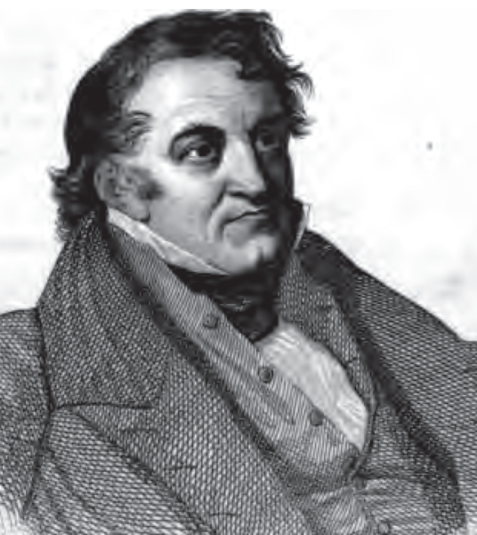
Jean Charles Léonard Simonde de Sismondi (1773-1842)

Slide 16
Simonde de Sismondi (1773-1842)
French historian, early socialist and great rival of Jean-Baptiste Say and the French Liberal School.
Simonde de Sismondi was no friend of the rising capitalist industrial system, which he viewed as detrimental to the interests of the poor and particularly prone to crisis brought about by an insufficient general demand for goods.
His under-consumption thesis was shared by Malthus, and sparked off the General Glut Controversy of the 1820s where their theories were pitted against those of Say, Ricardo and the Classicals.

Slide 17
Simonde de Sismondi (1773-1842)
Gluts lead to widespread unemployment
The poor go bankrupt and more wealth gets concentrated in the hands of the wealthy
This narrows the domestic market for industry
Hence industry needs to open up foreign markets
This necessarily leads to nationalistic wars
Economic imperialism is inherent in capitalism

Slide 18
Simonde de Sismondi (1773-1842)
According to Sismondi, only government intervention can ensure a living wage and a minimal level of social security for workers
Sismondi shifted the focus from aggregate output to distribution, arguing that a smaller output would be preferable, if more fairly shared
For this reason, he favored small-scale agriculture and manufacturing

Slide 19
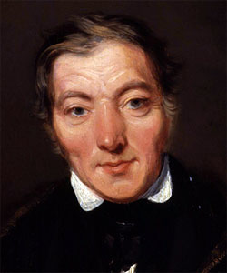
Robert Owen (1771-1858)

Slide 20
Robert Owen (1771-1858)
Utopian socialist
A “doer” more than a “talker”
Owen founded the famous model community of New Lanark Mills in Scotland to demonstrate the viability of co-operative factory communities.
Owen paid his employees high wages, and still made good profits, because his grateful employees worked hard
This could be seen as an early use of efficiency wages: the purposeful payment of above-market wages to increase productivity and reduce labor turnover
Nevertheless, the enterprise failed because of unrelated conflicts between Owen and his partners.

Slide 21
Robert Owen (1771-1858)
Many industrialists actually visited these “model factories” and some even adopted parts of Owen’s system.
Owen attempted to extend these into agriculture - advocating collective farming, as in New Harmony, Indiana.
Owen believed that his type of cooperative system would sweep away capitalism and the competition-based system.
Although most of these efforts failed, he continued with his social work and became the head of one of the largest trade union federations in Britain in 1843.

Slide 22
Sources
Chapter V, The Dreams of the Utopian Socialists, in The Worldly Philosophers by Robert Heilbroner

