Slide 1
The Science of Macroeconomics
Chapter 1 of Macroeconomics, 10th edition, by N. Gregory Mankiw
ECO62 Udayan Roy

Slide 2
What Macroeconomists Study
Why are some countries rich and others poor?
Why have some countries’ incomes grown rapidly over the past decade while others have stagnated?
Why do some countries have high rates of inflation while others maintain stable prices?
Why do all countries experience periods of economic stagnation or even crisis?

Slide 3
What Macroeconomists Study
What can government policy do to help an economy recover from a slump?
How do we know whether the amount of money that has been printed is too much, too little, or just enough?
Should China keep the value of the yuan fixed with respect to the US dollar?
Why has the US been running huge trade deficits? Does it matter?

Slide 4
Macroeconomics
Macroeconomics is the study of the economy as a whole
Macroeconomists collect data on incomes, price levels, interest rates, unemployment, and many other macroeconomic variables from different time periods and different countries
They then try to build general theories to explain the data that history gives them

Slide 5
Macroeconomics
My goal is to emphasize two aspects of macroeconomics that make it unique in the undergraduate curriculum:
The interconnections among the different parts of the economy are important
The dynamics that propel an economy forward over time are important

Slide 6
Macroeconomics: interconnections
First, macroeconomics is where students learn how to think about the economy as a collection of multiple markets that affect, and are affected by, each other.
It is not enough to analyze the goods market, and then the asset market, and then the labor market, and so on; all markets must be analyzed together, as interacting arenas of economic activity.

Slide 7
Macroeconomics: dynamics
Second, macroeconomics is where students learn to think dynamically about the economy.
It is important to understand how today leads to tomorrow, how tomorrow leads to the day after, and so on.
This emphasis on the dynamic laws of motion of an economy also makes macroeconomics different.

Slide 8
Macroeconomics
Macroeconomics is a young and imperfect science
Macroeconomists were not generally successful in predicting the global economic crisis of 2008
Even after the crisis, they were unable to agree on what should be done to deal with the crisis
Nevertheless, the importance of the subject is clearer than ever

Slide 9
Macroeconomic data
What sort of economic variables does macroeconomics try to explain?

Slide 10
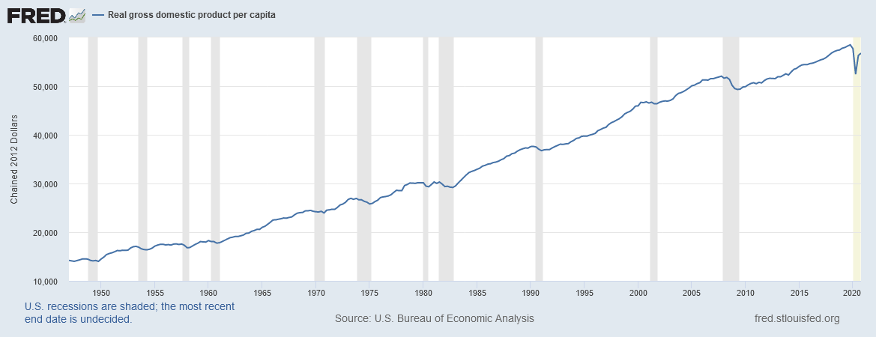
The Historical Performance of the U.S. Economy: Figure 1.1
Source: https://fred.stlouisfed.org/series/A939RX0Q048SBEA
Notes:
Downloaded from https://fred.stlouisfed.org/series/A939RX0Q048SBEA on February 7, 2021.

Slide 11
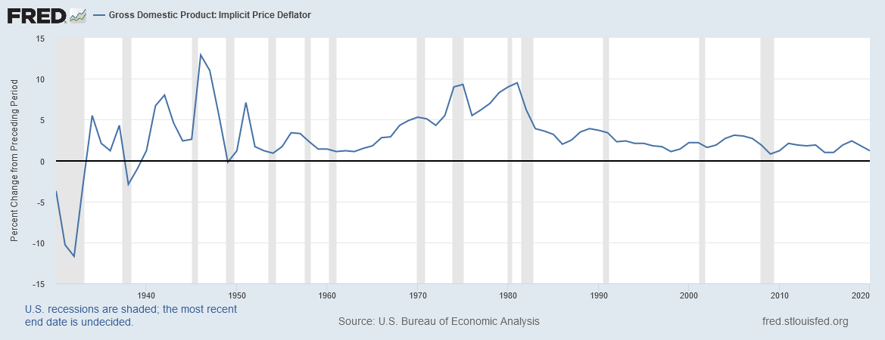
The Historical Performance of the U.S. Economy: Figure 1.2
Source: https://fred.stlouisfed.org/series/A191RI1A225NBEA
Notes:
Downloaded from https://fred.stlouisfed.org/series/A191RI1A225NBEA on February 7, 2021.

Slide 12
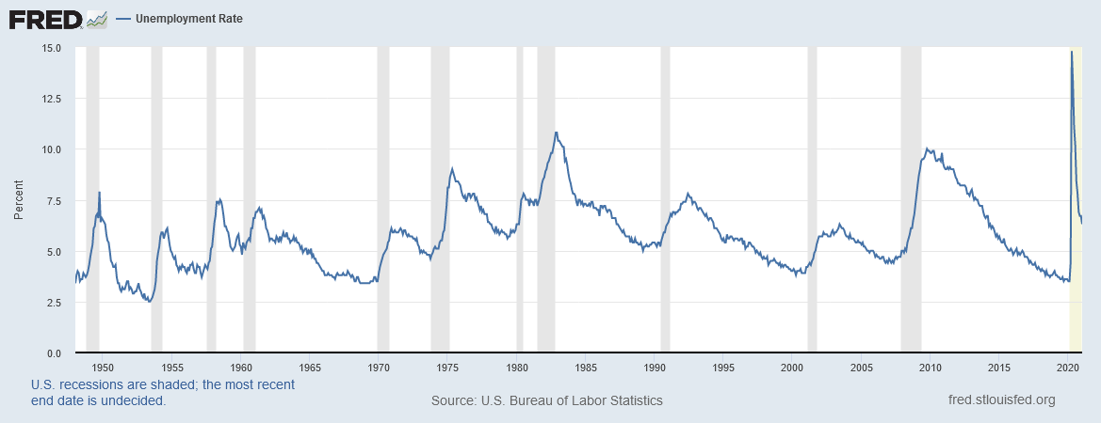
The Historical Performance of the U.S. Economy: Figure 1.3
Source: https://fred.stlouisfed.org/series/UNRATE
Notes:
Downloaded from https://fred.stlouisfed.org/series/UNRATE on February 7, 2021.

Slide 13
How Economists Think: graphs

Slide 14
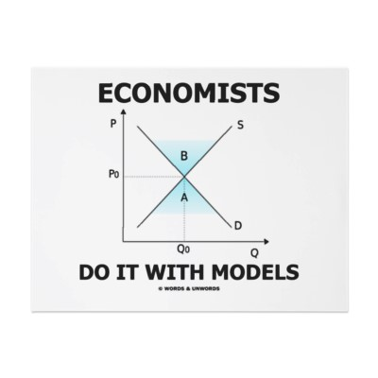
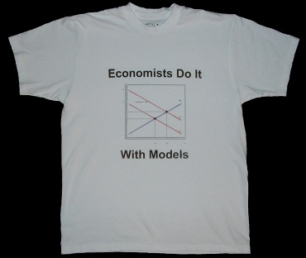
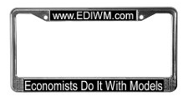
How Economists Think

Slide 15
How Economists Think: graphs
Every economic theory consists of
Endogenous variables
Graphs that show how the endogenous variables are linked to each other (model)
Exogenous variables (shift variables)
The theory predicts how changes in the exogenous variables affect the endogenous variables

Slide 16
Endogenous and exogenous variables
The endogenous variables of a theory are those variables whose fluctuations the theory is trying to explain
The exogenous variables of a theory are those variables that the theory assumes are crucial to understanding the endogenous variables, but are themselves not a concern of the theory

Slide 17
Graphs
Graphs are used to represent the various ways in which the endogenous variables are linked to each other
The graphs together determine the predicted values of the endogenous variables
Changes in exogenous variables cause the graphs to shift
The shifts of the graphs then tell us how the endogenous variables are likely to be affected

Slide 18
Example: the pizza market
Endogenous variables: price and quantity
The theory also needs
Graphs that show how the endogenous variables are linked to each other (model)
Exogenous variables (shift variables)

Slide 19
Graphs: Supply

Slide 20
Graphs: Demand

Slide 21
Graphs: Supply and Demand

Slide 22
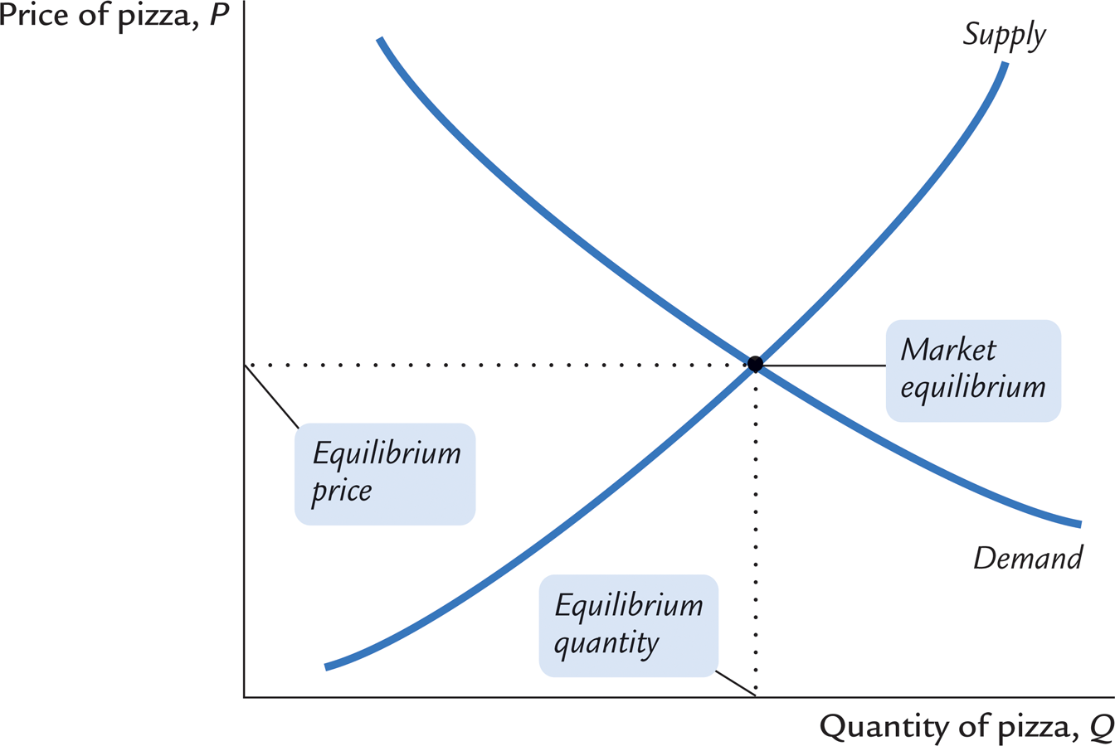
Graphs: equilibrium

Slide 23
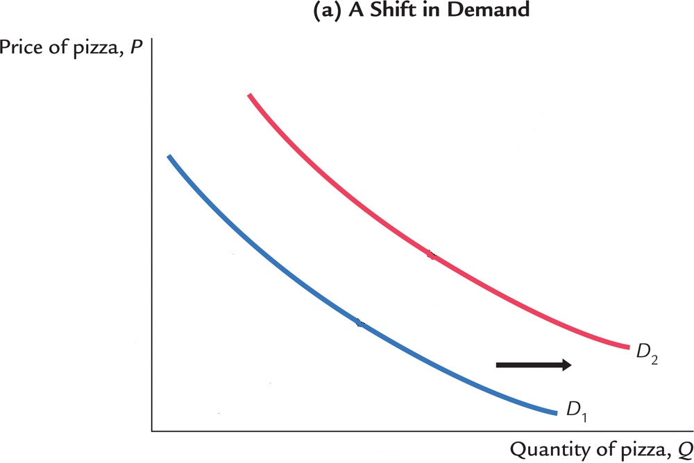
Shift variables for demand
Income ↑
prices of competing goods ↑
prices of complementary goods ↓
population ↑
Preference for pizza ↑
Notes:
The slide assumes that pizza is a normal good.

Slide 24
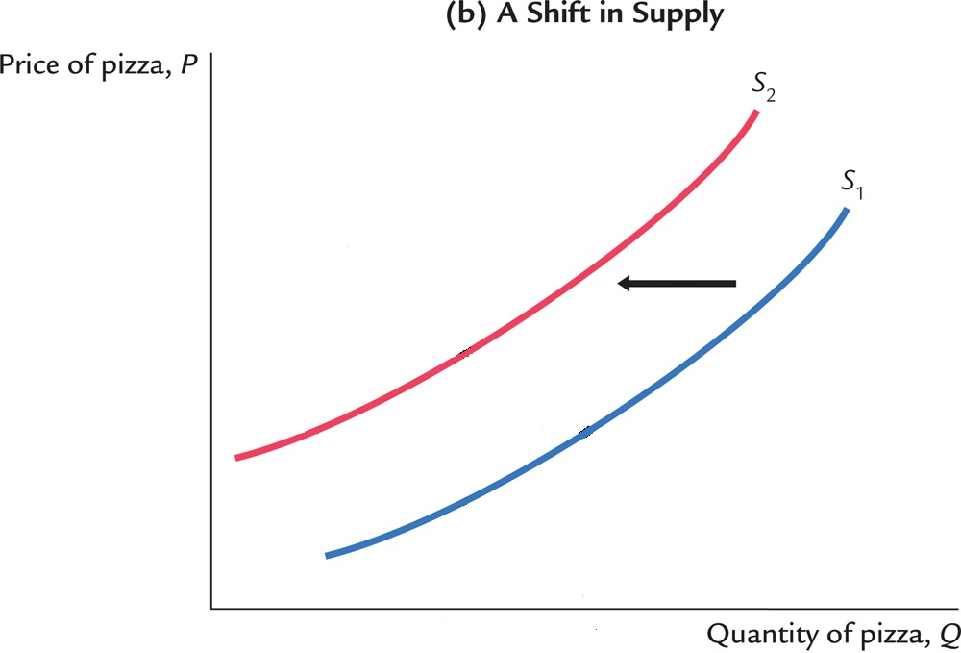
Shift variables for supply
Technology ↓
prices of raw materials ↑
Wages ↑

Slide 25
Predictions
Now all our ducks are in a row!
We can use our theory to predict how changes in the exogenous (shift) variables will affect the endogenous variables

Slide 26
Predictions: demand shifters
Income ↑
prices of competing goods ↑
prices of complementary goods ↓
population ↑
Predictions Grid | P | Q
Income | + | +
prices of competing goods | + | +
prices of complementary goods | - | -
population | + | +
ad spending by pizzerias
Sales tax rate

Slide 27
Predictions: demand shifters
Income ↑
prices of competing goods ↑
prices of complementary goods ↓
population ↑
Predictions Grid | P | Q
Income | + | +
prices of competing goods | + | +
prices of complementary goods | - | -
population | + | +
ad spending by pizzerias | + | +
Sales tax rate | - | -
At this point, you should do problem 3 on page 15 of the textbook.

Slide 28
Predictions: supply shifters
Technology ↓
prices of raw materials ↑
Wages ↑
Predictions Grid | P | Q
Technology | - | +
Prices of raw materials | + | -
Wages | + | -

Slide 29
How Economists Think: algebra

Slide 30
How Economists Think: algebra
Every economic theory consists of
Endogenous variables
Exogenous variables and parameters (shift variables)
Equations that show how the variables and parameters are linked to each other (model)
The theory predicts how changes in the exogenous variables and parameters affect the endogenous variables

Slide 31
Equations
Each equation algebraically represents one idea/assumption about how the (endogenous and exogenous) variables and parameters are linked to each other

Slide 32
Solving the equations
If we have a set of equations such that the number of equations is equal to the number of endogenous variables in the equations, then we can usually solve the equations and express each endogenous variable in the equations in terms of the exogenous variables and parameters
These solutions predict the likely effects of the exogenous variables and parameters on the endogenous variables

Slide 33
Example: the pizza market
Endogenous variables: price (P), quantity demanded (Q^{d}), and quantity supplied (Q^{s})
We still need
Exogenous variables and parameters
Equations linking all variables and parameters

Slide 34
Algebra: demand
Assume that the quantity of pizza demanded (Q^{d}) depends inversely on the price (P) and directly on the country’s total income (Y)
This assumption can be represented algebraically as
Q^{d} = D(P, Y)
Note that Q^{d} and P are endogenous, whereas Y is exogenous
We can have additional exogenous variables, such as the prices of competing goods

Slide 35
Algebra: demand
Q^{d} = D(P, Y) is a very general equation
We can have a more specific demand equation
Q^{d} = a + bY – cP
Here, a, b, and c are any trio of non-negative numbers
They are called parameters
Note that this equation faithfully represents the assumption that the quantity of pizza demanded (Q^{d}) depends inversely on the price (P) and directly on the country’s total income (Y)
Q: How would the equation change if we assume that the demand for pizza depends on the price of burgers (P_{b}) and the price of soda (P_{s})?

Slide 36
Equations: demand
Q^{d} = a + bY – cP
Suppose a = 10, b = 3, and c = 5
Note: The red numbers give Q^{d} for various values of P and Y.
Note: Equations can be turned into graphs! Y is a shift variable in graphical analysis
 |  | Income (Y)
 |  | 10
Price (P) | 0 | 40
 | 1 | 35
 | 2 | 30
 | 3 | 25
 | 4 | 20
 | 5 | 15
 | 6 | 10
 | 7 | 5
 | 8 | 0

Slide 37
Equations: demand
Q^{d} = a + bY – cP
Suppose a = 10, b = 3, and c = 5
Note: The red numbers give Q^{d} for various values of P and Y.
Note: Equations can be turned into graphs! Y is a shift variable in graphical analysis
 |  | Income (Y)
 |  | 10 | 20 | 30 | 40
Price (P) | 0 | 40 | 70 | 100 | 130
 | 1 | 35 | 65 | 95 | 125
 | 2 | 30 | 60 | 90 | 120
 | 3 | 25 | 55 | 85 | 115
 | 4 | 20 | 50 | 80 | 110
 | 5 | 15 | 45 | 75 | 105
 | 6 | 10 | 40 | 70 | 100
 | 7 | 5 | 35 | 65 | 95
 | 8 | 0 | 30 | 60 | 90

Slide 38
Algebra: supply
Assume that the quantity of pizza supplied (Q^{s}) depends directly on the price (P) and inversely on the price of raw materials (P_{m})
This assumption can be represented algebraically as
Q^{s} = S(P, P_{m})
Note that Q^{s} and P are endogenous, whereas P_{m} is exogenous
We can have additional exogenous variables, such as wages and technology

Slide 39
Algebra: supply
Q^{s} = S(P, P_{m}) is a very general equation
We can have a more specific supply equation
Q^{s} = e – fP_{m} + gP
Here, e, f, and g are any trio of non-negative numbers
They are called parameters
Note that this equation faithfully represents the assumption that the quantity of pizza supplied (Q^{s}) depends directly on the price (P) and inversely on the price of raw materials (P_{m})
Q: How would the equation change if we assume that the supply of pizza depends on workers’ wages (w) and the technology (T)?

Slide 40
Algebra: supply
Q^{s} = e – fP_{m} + gP
Suppose e = 10, f = 3, and g = 5
The red numbers give Q^{s} for various values of P and P_{m}.
Note: Equations can be turned into graphs! P_{m} is a shift variable in graphical analysis
 |  | Price of raw materials (P_{m})
 |  | 1 | 2 | 3
Price (P) | 0 | 7 | 4 | 1
 | 1 | 12 | 9 | 6
 | 2 | 17 | 14 | 11
 | 3 | 22 | 19 | 16
 | 4 | 27 | 24 | 21
 | 5 | 32 | 29 | 26
 | 6 | 37 | 34 | 31
 | 7 | 42 | 39 | 36
 | 8 | 47 | 44 | 41

Slide 41
Algebra: equilibrium
So far we have two equations:
Q^{d} = a + bY – cP
Q^{s} = e – fP_{m} + gP
And these two equations have three endogenous variables: price (P), quantity demanded (Q^{d}), and quantity supplied (Q^{s})
We need one more equation
Equilibrium: Q^{d} = Q^{s}

Slide 42
A complete model, in equations
We have three equations:
Q^{d} = a + bY – cP
Q^{s} = e – fP_{m} + gP
Q^{d} = Q^{s}
These three equations have three endogenous variables in them
We can solve the equations
We can express our endogenous variables entirely in terms of our exogenous variables and parameters

Slide 43
Models make predictions
Predictions Grid
 | P
Y | +
a | +
b | +
c | –
P_{m} | +
e | –
f | +
g | –
Q^{d} = a + bY – cP
Q^{s} = e – fP_{m} + gP
Q^{d} = Q^{s}
Demand shifts
a + bY – cP = e – fP_{m} + gP
(a + bY) – (e – fP_{m}) = cP + gP
(c + g)P = (a + bY) – (e – fP_{m})
Supply shifts

Slide 44
Models make predictions
Predictions Grid
 | P
Y | +
a | +
b | +
c | –
P_{m} | +
e | –
f | +
g | –
P_{b}
P_{s}
w
T
Q^{d} = a + bY – cP
Q^{s} = e – fP_{m} + gP
Q^{d} = Q^{s}
Demand shifts
a + bY – cP = e – fP_{m} + gP
(a + bY) – (e – fP_{m}) = cP + gP
(c + g)P = (a + bY) – (e – fP_{m})
Supply shifts
Guess
Notes:
Pb price of burgers, Ps price of soda, w wage of workers, T productivity of technology

Slide 45
Models make predictions
Predictions Grid
 | P
Y | +
a | +
b | +
c | –
P_{m} | +
e | –
f | +
g | –
P_{b} | +
P_{s} | -
w | +
T | -
Q^{d} = a + bY – cP
Q^{s} = e – fP_{m} + gP
Q^{d} = Q^{s}
Demand shifts
a + bY – cP = e – fP_{m} + gP
(a + bY) – (e – fP_{m}) = cP + gP
(c + g)P = (a + bY) – (e – fP_{m})
Supply shifts
Guess

Slide 46
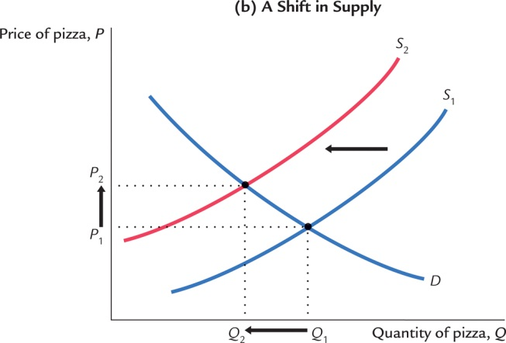
Models make predictions
Q^{d} = a + bY – cP
Q^{s} = e – fP_{m} + gP
Q^{d} = Q^{s}
Predictions Grid
 | P | Q^{d}, Q^{s}
Y | + | +
a | + | +
b | + | +
c | – | –
P_{m} | + | –
e | – | +
f | + | –
g | – | +
Demand shifts
Supply shifts

Slide 47
Models make predictions
Q^{d} = a + bY – cP
Q^{s} = e – fP_{m} + gP
Q^{d} = Q^{s}
Predictions Grid
 | P | Q^{d}, Q^{s}
Y | + | +
a | + | +
b | + | +
c | – | –
P_{m} | + | –
e | – | +
f | + | –
g | – | +
P_{b} | +
P_{s} | -
w | +
T | -
Demand shifts
Supply shifts
Guess

Slide 48
Models make predictions
Q^{d} = a + bY – cP
Q^{s} = e – fP_{m} + gP
Q^{d} = Q^{s}
Predictions Grid
 | P | Q^{d}, Q^{s}
Y | + | +
a | + | +
b | + | +
c | – | –
P_{m} | + | –
e | – | +
f | + | –
g | – | +
P_{b} | + | +
P_{s} | - | -
w | + | -
T | - | +
Demand shifts
Supply shifts
Guess

Slide 49
Models make predictions
Q^{d} = a + bY – cP
Q^{s} = e – fP_{m} + gP
Q^{d} = Q^{s}
Predictions Grid
 | P | Q^{d}, Q^{s}
Y | + | +
a | + | +
b | + | +
c | – | –
P_{m} | + | –
e | – | +
f | + | –
g | – | +
Demand shifts
Supply shifts
Notes:
The equilibrium quantity is a weighted average of the non-price effects on demand and supply.

Slide 50
The end of the line
Exogenous variables and parameters are, by definition, not the concern of the theory
Therefore, once all endogenous variables have been expressed entirely in terms of exogenous variables and parameters, our job is done
We can’t say anything more
All that remains is to use data to test whether the predictions are true in the real world

Slide 51
Onward
In the rest of this course we will use the graphical and algebraic techniques of this chapter to analyze all sorts of macroeconomic problems

