Slide 1
The Data of Macroeconomics
Chapter 2 of Macroeconomics, 10th edition, by N. Gregory Mankiw
ECO62 Udayan Roy

Slide 2
Chapter Overview
What do the following macroeconomic variables represent? How are they measured?
  Gross Domestic Product (GDP)
  The Consumer Price Index (CPI)
  The Unemployment Rate
You’ve seen this before in Introductory Macroeconomics. So, I will try to be brief.
Notes:
2

Slide 3
Gross domestic product and its components

Slide 4
Gross Domestic Product
An economy’s Gross Domestic Product (GDP) is the market value of all final goods and services produced within an economy in a given period of time.

Slide 5
GDP is both …
Total expenditure on domestically-produced final goods and services.
Total income earned by domestically-located productive resources.
Expenditure equals income because
every dollar spent by a buyer
becomes income to the seller.
Notes:
Most students, having taken principles of economics, will have seen this definition and be familiar with it. It’s not worth spending a lot of time on.
It might be worthwhile, however, to briefly review the factors of production.

Slide 6
Final and Intermediate Goods
GDP counts the value of only final goods, not intermediate goods
  Intermediate goods are those goods that disappear inside other goods that are produced for sale
  Final goods are goods that are not intermediate goods
This way, the value of intermediate goods is counted only once, not multiple times.

Slide 7
The Circular Flow of Income and Expenditure
Income ($)
Labor
Households
Firms
Goods
Expenditure ($)

Slide 8
A Firm’s Value Added is …
The value of its output
minus
the value of the intermediate goods that were used to produce that output
Notes:
It might be useful here to remind students what “intermediate goods” are.

Slide 9
NOW YOU TRY:
Identifying value-added
Activity | Value Added
A farmer grows a bushel of wheat and sells it to a miller for $1.00. | $1.00
The miller turns the wheat into flour and sells it to a baker for $3.00. | $2.00
The baker uses the flour to make a loaf of bread and sells it to an engineer for $6.00. | $3.00
The engineer eats the bread. | $0.00
Total Value Added | $6.00
Value of Final Good (bread) | $6.00
Contribution of above activity to GDP | $6.00
GDP is the market value of all final goods produced. This is also total expenditure on final goods. GDP is also the total value added by all producers. The value added is also income. Thus, GDP is total expenditure and total income.
Notes:
This is end-of-chapter problem 2 on p.41.
When students compute GDP, they should assume that these are the only transactions in the economy.
Lessons of this problem:
GDP = value of final goods = sum of value at all stages of production
We don’t include the value of intermediate goods in GDP because their value is already embodied in the value of the final goods.
Answer:
Each person’s value-added (VA) equals the value of what he/she produced minus the value of the intermediate inputs he/she started with.
Farmer’s VA = $1
Miller’s VA = $3
Baker’s VA = $3
GDP = $6
Note that GDP = value of final good = sum of value-added at all stages of production.
Even though this problem is highly simplified, its main lesson holds in the real world: the value of all final goods produced equals the sum of value-added in all stages of production of all goods.

Slide 10
Final goods, value added, and GDP
GDP = market value of final goods produced
= sum of value added at all stages of production.
The market value of the final goods already includes the market value of the intermediate goods.
So, including intermediate and final goods in GDP would be double-counting.

Slide 11
The expenditure components of GDP
consumption, C
investment, I
government spending, G
net exports, NX
The national income identity:
Y = C + I + G + NX
total expenditure (GDP)
Sum of all components of expenditure
Notes:
This slide lists the expenditure components; the following slides will define and discuss each of them.
We can define GDP not just as total expenditure on final goods & services, but also as (the value of) aggregate output of final goods & services.
An identity is an equation that always holds because of the way the variables are defined.

Slide 12

Consumption (C)
Consumption is the value of all goods and services bought by households. It includes:
  durable goods
  last a long time
  e.g., cars, home appliances
  nondurable goods
  last a short time
  e.g., food, clothing
  services
  work done for consumers
  e.g., dry cleaning,
  air travel
Notes:
A consumer’s spending on a new house counts under investment, not consumption. More on this in a few moments, when we get to Investment.
A tenant’s spending on rent counts under services -- rent is considered spending on “housing services.”
So what happens if a renter buys the house she had been renting? Conceptually, consumption should remain unchanged: just because she is no longer paying rent, she is still consuming the same housing services as before.
In national income accounting, (the services category of) consumption includes the imputed rental value of owner-occupied housing.
To help students keep all this straight, you might suggest that they think of a house as a piece of capital which is used to produce a consumer service, which we might call “housing services.” Thus, spending on the house counts in “investment,” and the value of the housing services that the house provides counts under “consumption” (regardless of whether the housing services are being consumed by the owner of the house or a tenant).

Slide 13
U.S. Consumption, 2017
Gross Domestic Product and its components, 2017
Source: Bureau of Economic Analysis, U.S. Department of Commerce, bea.gov
Last Revised on: March 28, 2018 - Next Release Date April 27, 2018
 | Total | Percent of GDP | Per Person
 | $ millions | % | $
Gross domestic product | 19,390,605 | 100 | 59,483.49
Personal consumption expenditures | 13,395,505 | 69.1 | 41,092.65
Goods | 4,295,313 | 22.2 | 13,176.49
Durable goods | 1,473,802 | 7.6 | 4,521.10
Nondurable goods | 2,821,511 | 14.6 | 8,655.39
Services | 9,100,192 | 46.9 | 27,916.16
Population (midperiod, thousands) | 325,983
Notes:
Downloaded on April 5, 2018
Sources: BEA.GOV Tables
Nominal GDP and its components: Table 1.1.5
Real GDP and its components: Table 1.1.6
Percentage Shares of Gross Domestic Product: Table 1.1.10
Population: Table 7.1

Slide 14
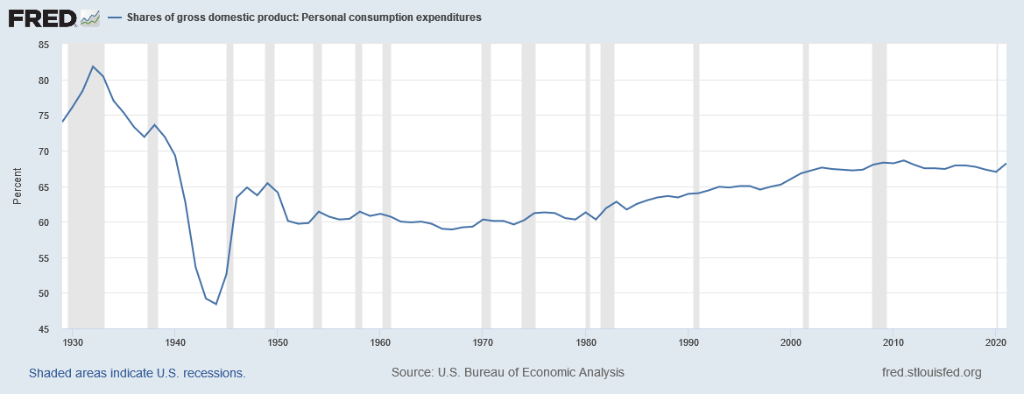
Consumption, as a share of GDP
1929 – 2021
Notes:
Source: https://fred.stlouisfed.org/series/DPCERE1Q156NBEA

Slide 15
Investment (I)
This is spending on goods bought for future use (i.e., capital goods)
It includes:
  Business fixed investment
  Spending on plant and equipment
  Residential fixed investment
  Spending by consumers and landlords on housing units
  Inventory investment
  The change in the value of all firms’ inventories
Notes:
Note that aggregate investment equals total spending on newly produced capital goods. If I pay $1000 for a used computer for my business, then I’m doing $1000 of investment, but the person who sold it to me is doing $1000 of disinvestment, so there is no net impact on aggregate investment.
The housing issue
A consumer’s spending on a new house counts under investment, not consumption.
A tenant’s spending on rent counts under services -- rent is considered spending on “housing services.”
So what happens if a renter buys the house she had been renting? Conceptually, consumption should remain unchanged: just because she is no longer paying rent, she is still consuming the same housing services as before.
In national income accounting, (the services category of) consumption includes the imputed rental value of owner-occupied housing.
To help students keep all this straight, you might suggest that they think of a house as a piece of capital which is used to produce a consumer service, which we might call “housing services”. Thus, spending on the house counts in “investment”, and the value of the housing services that the house provides counts under “consumption” (regardless of whether the housing services are being consumed by the owner of the house or a tenant).
Inventories
If total inventories are $10 billion at the beginning of the year, and $12 billion at the end, then inventory investment equals $2 billion for the year.
Note that inventory investment can be negative (which means inventories fell over the year).

Slide 16
U.S. Investment, 2017
Gross Domestic Product and its components, 2017
Source: Bureau of Economic Analysis, U.S. Department of Commerce, bea.gov
Last Revised on: March 28, 2018 - Next Release Date April 27, 2018
 | Total | Percent of GDP | Per Person
 | $ millions | % | $
Gross domestic product | 19,390,605 | 100 | 59,483.49
Gross private domestic investment | 3,212,828 | 16.6 | 9,855.81
Fixed investment | 3,197,164 | 16.5 | 9,807.76
Nonresidential | 2,449,581 | 12.6 | 7,514.44
Structures | 560,180 | 2.9 | 1,718.43
Equipment | 1,098,360 | 5.7 | 3,369.38
Intellectual property products | 791,040 | 4.1 | 2,426.63
Residential | 747,583 | 3.9 | 2,293.32
Change in private inventories | 15,664 | 0.1 | 48.05
Population (midperiod, thousands) | 325,983
Notes:
Downloaded on April 5, 2018
Sources: BEA.GOV Tables
Nominal GDP and its components: Table 1.1.5
Real GDP and its components: Table 1.1.6
Percentage Shares of Gross Domestic Product: Table 1.1.10
Population: Table 7.1

Slide 17
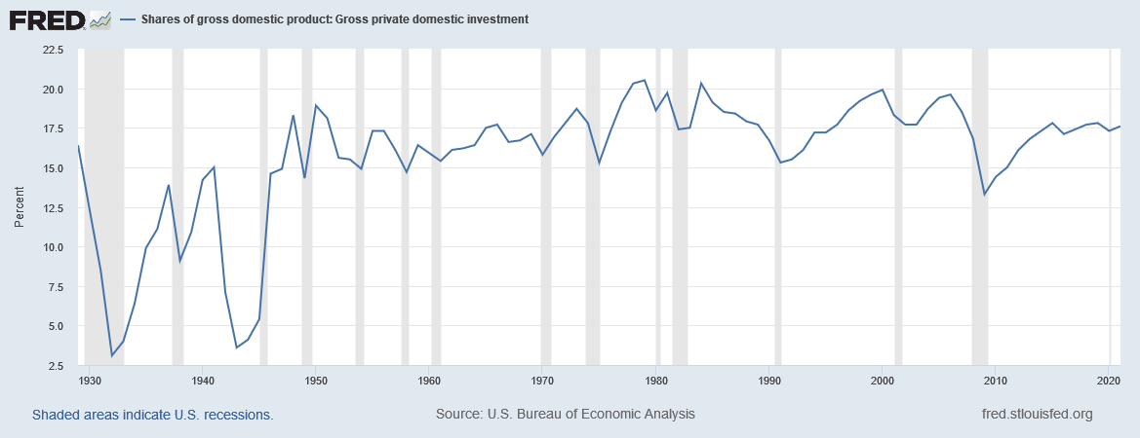
Investment, as a share of GDP
1929 – 2021
Notes:
Source: https://fred.stlouisfed.org/series/A006RE1Q156NBEA

Slide 18
Investment vs. Capital
Note: Investment is spending on new capital.
Example:
  1/1/2018: economy has $500b worth of capital
  during 2018: investment = $60b
  1/1/2019: economy will have $560b worth of capital
    assumes no depreciation
Notes:
If you teach the stocks vs. flows concepts, this is a good example of the difference.

Slide 19
Stocks vs. Flows
Flow
Stock
A stock is a
quantity measured
at a point in time.
E.g.,
“The U.S. capital stock was $26 trillion on January 1, 2009.”
A flow is a quantity measured per unit of time.
E.g., “U.S. investment was $2.5 trillion during 2009.”
Notes:
The bathtub example is the classic means of explaining stocks and flows, and appears in Chapter 2.

Slide 20
Stocks vs. Flows - examples
stock
flow
a person’s wealth
a person’s
annual saving
# of people with college degrees
# of new college graduates this year
the govt debt
the govt budget deficit
Notes:
Point out that a specific quantity of a flow variable only makes sense if you know the size of the time unit.
If someone tells you her salary is $5000 but does not say whether it is “per month” or “per year” or otherwise, then you’d have no idea what her salary really is.
A pitfall with flow variables is that many of them have a very standard time unit (e.g., per year). Therefore, people often omit the time unit: “John’s salary is $50,000.” And omitting the time unit makes it easy to forget that John’s salary is a flow variable, not a stock.
Another point: It is often the case that a flow variable measures the rate of change in a corresponding stock variable, as the examples on this slide (and the investment/capital example) make clear.

Slide 21
NOW YOU TRY:
Stock or Flow?
the balance on your credit card statement
how much you study economics outside of class
the size of your compact disc collection
the inflation rate
the unemployment rate
Notes:
You can use this slide to get some class participation. I suggest you display the entire slide, give students a few moments to formulate their answers, and then ask for volunteers. Doing so results in wider participation than if you ask for someone to volunteer the answer immediately after displaying each item on the list.
Here are the answers, and explanations:
The balance on your credit card statement is a stock. (A corresponding flow would be the amount of new purchases on your credit card statement.)
How much you study is a flow. The statement “I study 10 hours” is only meaningful if we know the time period – whether 10 years per day, per week, per month, etc.
The size of your compact disc collection is a stock. (A corresponding flow would be how many CDs you buy per month.)
The inflation rate is a flow: we say “prices are increasing by 3.2% per year” or “by 0.4% per month.”
The unemployment rate is a stock: It’s the number of unemployed people divided by the number of people in the workforce. In contrast, the number of newly unemployed people per month would be a flow.
Note: Students have not yet seen official definitions of the inflation and unemployment rates. However, it is likely they are familiar with these terms, either from their introductory economics course or from reading the newspaper.
Note: The stocks vs. flows concept is not mentioned very much in the subsequent chapters. If you do not want your students to forget it, then a good idea would be to do the following: As subsequent chapters introduce new variables, ask students whether each new variable is a stock or a flow.

Slide 22
Government Purchases (G)
G includes all government spending on goods and services.
It excludes transfer payments (e.g., unemployment insurance payments), because they do not represent spending on goods and services.
Notes:
Transfer payments are included in “government outlays,” but not in government spending. People who receive transfer payments use these funds to pay for their consumption. Thus, we avoid double-counting by excluding transfer payments from G.

Slide 23
U.S. Government Spending, 2017
Gross Domestic Product and its components, 2017
Source: Bureau of Economic Analysis, U.S. Department of Commerce, bea.gov
Last Revised on: March 28, 2018 - Next Release Date April 27, 2018
 | Total | Percent of GDP | Per Person
 | $ millions | % | $
Gross domestic product | 19,390,605 | 100 | 59,483.49
Government consumption expenditures and gross investment | 3,353,834 | 17.3 | 10,288.37
Federal | 1,260,656 | 6.5 | 3,867.24
National defense | 744,421 | 3.8 | 2,283.62
Nondefense | 516,235 | 2.7 | 1,583.63
State and local | 2,093,178 | 10.8 | 6,421.13
Population (midperiod, thousands) | 325,983
Notes:
Downloaded on April 5, 2018
Sources: BEA.GOV Tables
Nominal GDP and its components: Table 1.1.5
Real GDP and its components: Table 1.1.6
Percentage Shares of Gross Domestic Product: Table 1.1.10
Population: Table 7.1

Slide 24
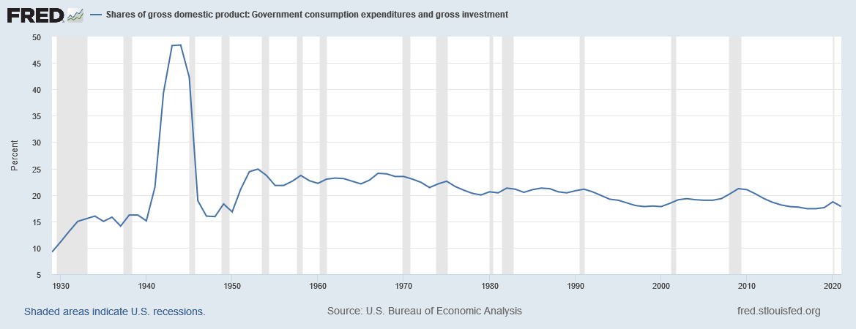
Government Purchases, as a share of GDP
1929 - 2021
Notes:
Source: https://fred.stlouisfed.org/series/A822RE1A156NBEA

Slide 25
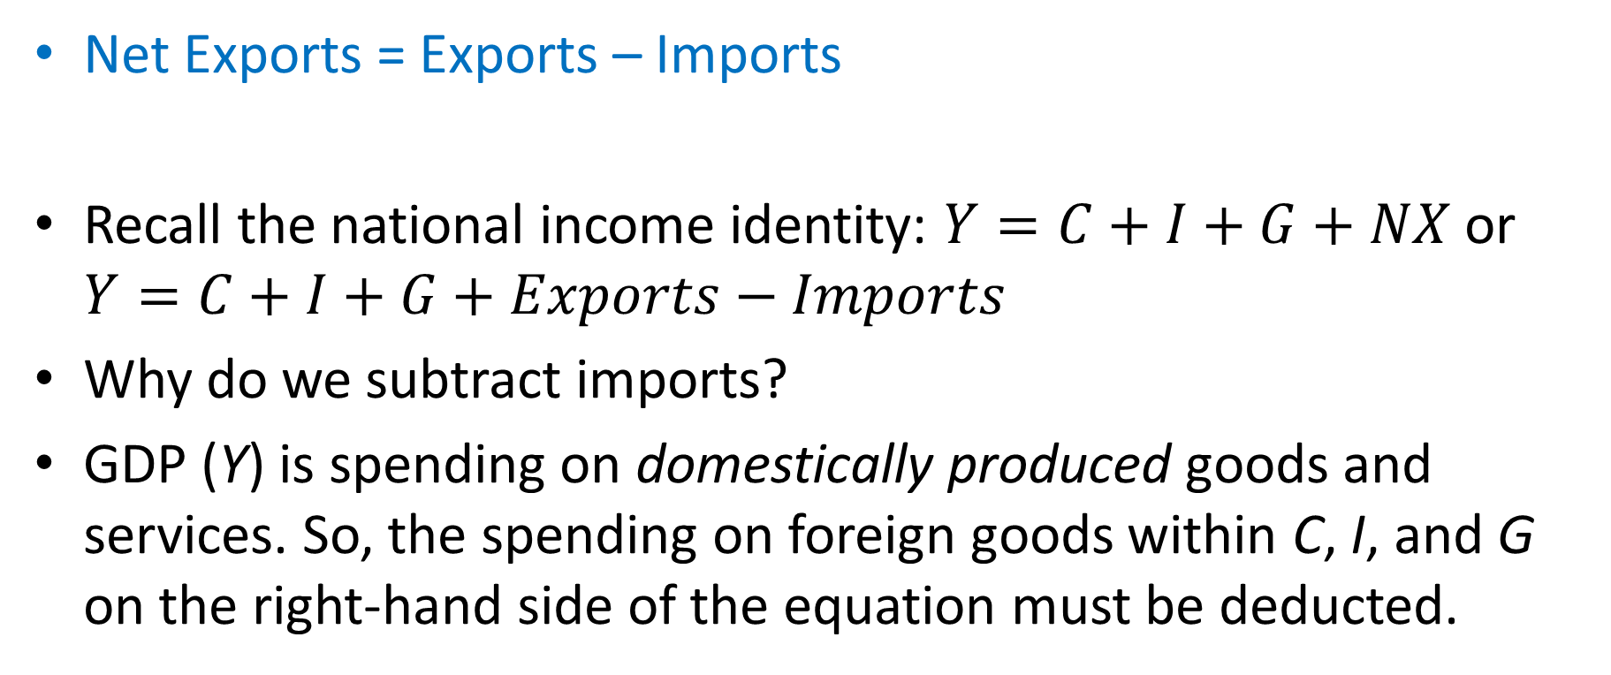
Net Exports (NX)
Net Exports = Exports – Imports
Recall the national income identity: $Y=C+I+G+NX$ or $Y=C+I+G+Exports−Imports$
Why do we subtract imports?
GDP (Y) is spending on domestically produced goods and services. So, the spending on foreign goods within C, I, and G on the right-hand side of the equation must be deducted.

Slide 26
U.S. Net Exports, 2017
Gross Domestic Product and its components, 2017
Source: Bureau of Economic Analysis, U.S. Department of Commerce, bea.gov
Last Revised on: March 28, 2018 - Next Release Date April 27, 2018
 | Total | Percent of GDP | Per Person
 | $ millions | % | $
Gross domestic product | 19,390,605 | 100 | 59,483.49
Net exports of goods and services | -571,563 | -2.9 | -1,753.35
Exports | 2,343,988 | 12.1 | 7,190.52
Goods | 1,546,843 | 8 | 4,745.16
Services | 797,146 | 4.1 | 2,445.36
Imports | 2,915,551 | 15 | 8,943.87
Goods | 2,381,754 | 12.3 | 7,306.37
Services | 533,797 | 2.8 | 1,637.50
Population (midperiod, thousands) | 325,983
Notes:
Downloaded on April 5, 2018
Sources: BEA.GOV Tables
Nominal GDP and its components: Table 1.1.5
Real GDP and its components: Table 1.1.6
Percentage Shares of Gross Domestic Product: Table 1.1.10
Population: Table 7.1

Slide 27
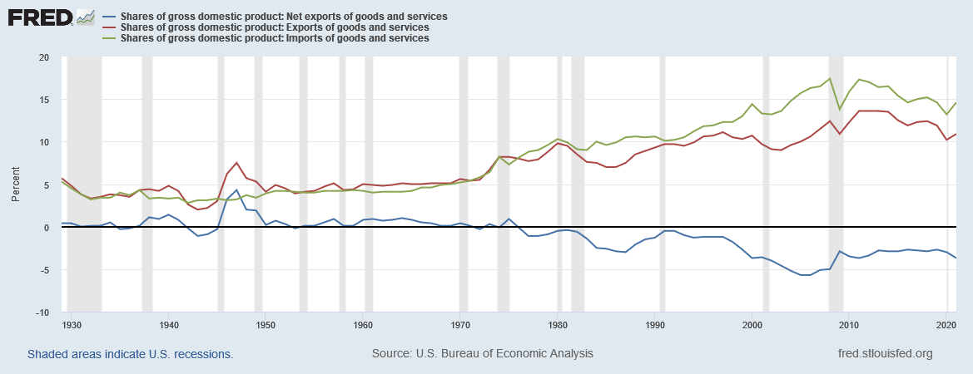
Exports, Imports, Net Exports, as a share of GDP
1929 - 2021
Notes:
Source: https://fred.stlouisfed.org/series/B020RE1A156NBEA (exports), https://fred.stlouisfed.org/series/B021RE1A156NBEA (imports), and https://fred.stlouisfed.org/series/A019RE1A156NBEA (net exports).

Slide 28
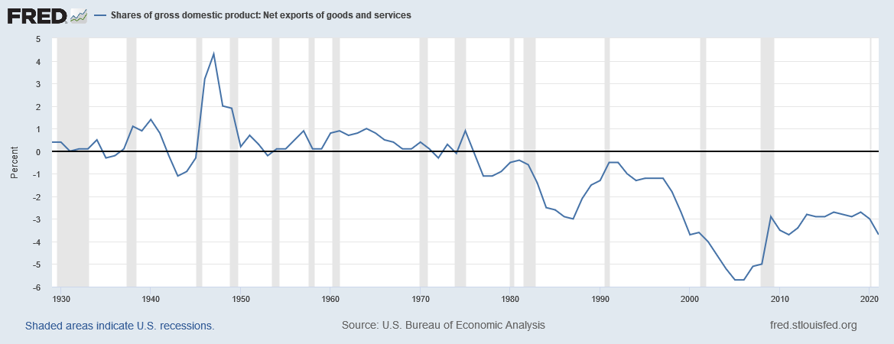
Net Exports, as a share of GDP
1929 - 2021
Notes:
Source: https://fred.stlouisfed.org/series/A019RE1A156NBEA

Slide 29
Gross Domestic Product and its components, 2017
Source: Bureau of Economic Analysis, U.S. Department of Commerce, bea.gov
Last Revised on: March 28, 2018 - Next Release Date April 27, 2018
 |  | Total | Percent of GDP | Per Person
 |  | $ millions | % | $
1 | Gross domestic product | 19,390,605 | 100 | 59,483.49
2 | Personal consumption expenditures | 13,395,505 | 69.1 | 41,092.65
3 | Goods | 4,295,313 | 22.2 | 13,176.49
4 | Durable goods | 1,473,802 | 7.6 | 4,521.10
5 | Nondurable goods | 2,821,511 | 14.6 | 8,655.39
6 | Services | 9,100,192 | 46.9 | 27,916.16
7 | Gross private domestic investment | 3,212,828 | 16.6 | 9,855.81
8 | Fixed investment | 3,197,164 | 16.5 | 9,807.76
9 | Nonresidential | 2,449,581 | 12.6 | 7,514.44
10 | Structures | 560,180 | 2.9 | 1,718.43
11 | Equipment | 1,098,360 | 5.7 | 3,369.38
12 | Intellectual property products | 791,040 | 4.1 | 2,426.63
13 | Residential | 747,583 | 3.9 | 2,293.32
14 | Change in private inventories | 15,664 | 0.1 | 48.05
15 | Net exports of goods and services | -571,563 | -2.9 | -1,753.35
16 | Exports | 2,343,988 | 12.1 | 7,190.52
17 | Goods | 1,546,843 | 8 | 4,745.16
18 | Services | 797,146 | 4.1 | 2,445.36
19 | Imports | 2,915,551 | 15 | 8,943.87
20 | Goods | 2,381,754 | 12.3 | 7,306.37
21 | Services | 533,797 | 2.8 | 1,637.50
22 | Government consumption expenditures and gross investment | 3,353,834 | 17.3 | 10,288.37
23 | Federal | 1,260,656 | 6.5 | 3,867.24
24 | National defense | 744,421 | 3.8 | 2,283.62
25 | Nondefense | 516,235 | 2.7 | 1,583.63
26 | State and local | 2,093,178 | 10.8 | 6,421.13
 | Population (midperiod, thousands) | 325,983
Notes:
Downloaded on April 5, 2018
Sources: BEA.GOV Tables
Nominal GDP and its components: Table 1.1.5
Real GDP and its components: Table 1.1.6
Percentage Shares of Gross Domestic Product: Table 1.1.10
Population: Table 7.1

Slide 30
GDP:
An important and versatile concept
We have now seen that GDP measures:
  total income
  total output
  total expenditure
  the sum of value-added at all stages in the production of final goods
Notes:
This is why economists often use the terms income, output, expenditure, and GDP interchangeably.

Slide 31
Real and Nominal GDP
GDP is the market value of all final goods and services produced.
Nominal GDP measures these values using current prices.
  Current prices are the prices that prevailed at the time of production
Real GDP measure these values using constant prices (the prices during the base year).

Slide 32
NOW YOU TRY:
Real and Nominal GDP
 | 2016 |  | 2017 |  | 2018
 | P | Q | P | Q | P | Q
good A | $30 | 900 | $31 | 1,000 | $36 | 1,050
good B | $100 | 192 | $102 | 200 | $100 | 205
Nominal GDP
Real GDP
Compute nominal GDP in each year.
Compute real GDP in each year using 2016 as the base year.
Notes:
This slide (and a few of the following ones) contain exercises that you can have your students do in class for immediate reinforcement of the material.
This problem requires calculators. If most of your students do not have calculators, you might “hide” this slide and instead pass out a printout of it for a homework exercise. Or: just have them write down the expressions that they would enter into a calculator if they had calculators, i.e. Nominal GDP in 2016 = $30 x 900 + $100 x 192.

Slide 33
NOW YOU TRY:
Real and Nominal GDP
 | 2016 |  | 2017 |  | 2018
 | P | Q | P | Q | P | Q
good A | $30 | 900 | $31 | 1,000 | $36 | 1,050
good B | $100 | 192 | $102 | 200 | $100 | 205
Nominal GDP | (30 × 900) + (100 × 192) = $46,200 |  | (31 × 1000) + (102 × 200) = $51,400 |  | (36 × 1,050) + (100 × 205) = $58,300
Real GDP | (30 × 900) + (100 × 192) = $46,200 |  | (30 × 1000) + (100 × 200) = $50,000 |  | (30 × 1,050) + (100 × 205) = $52,000

Slide 34
GDP Deflator: overall price level
 | 2016 |  | 2017 |  | 2018
 | P | Q | P | Q | P | Q
good A | $30 | 900 | $31 | 1,000 | $36 | 1,050
good B | $100 | 192 | $102 | 200 | $100 | 205
Nominal GDP | (30 × 900) + (100 × 192) = $46,200 |  | (31 × 1000) + (102 × 200) = $51,400 |  | (36 × 1,500) + (100 × 205) = $58,300
Real GDP | (30 × 900) + (100 × 192) = $46,200 |  | (30 × 1000) + (100 × 200) = $50,000 |  | (30 × 1,500) + (100 × 205) = $52,000
GDP Deflator | 100 | 100 × 51,400/50,000 = 102.8 | 100 × 58,300/52,000 = 112.1
Average prices compared to base year | Same | 2.8% higher | 12.1% higher

Slide 35
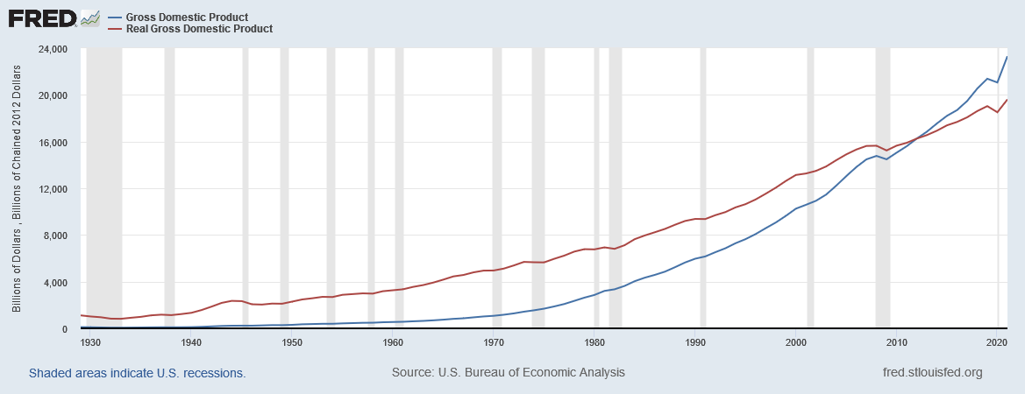
U.S. Nominal and Real GDP, 1929-2021
Real GDP: https://fred.stlouisfed.org/series/GDPCA
Nominal GDP: https://fred.stlouisfed.org/series/GDPA
Notes:
Downloaded from http://research.stlouisfed.org/fred2/ on January 19, 2023.
Notice that the red line (nominal GDP) is steeper than the blue line (real GDP). That’s because prices generally rise over time. So, nominal GDP grows at a faster rate than real GDP.
Question: What is the significance of the two lines crossing in 2012?
Answer: 2012 is the base year for this real GDP data, so RGDP = NGDP in 2012. Before 2012, RGDP > NGDP. After 2012, RGDP < NGDP. This is intuitive if you think about it for a minute: Take 1970. When the economy’s output of 1970 is measured in the (then) current prices, GDP is about $1 trillion. Between 1970 and 2000, most prices have risen. Hence, if you value the country’s 1970 using the higher year-2000 prices (to get real GDP), you get a bigger value than if you measure 1970’s output using the low 1970 prices (nominal GDP). This explains why real GDP is larger than nominal GDP in 1970 (as in most or all years before the base year).

Slide 36
Growth Rate: Computation

Slide 37
NOW YOU TRY:
Real and Nominal GDP
 | 2016 | 2017 | 2018
Nominal GDP | $46,200 | $51,400 | $58,300
Growth Rate %
Real GDP | $46,200 | $50,000 | $52,000
Growth Rate %

Slide 38
NOW YOU TRY:
Real and Nominal GDP
 | 2016 | 2017 | 2018
Nominal GDP | $46,200 | $51,400 | $58,300
Growth Rate % |  | 11.26 | 13.42
Real GDP | $46,200 | $50,000 | $52,000
Growth Rate % |  | 8.23 | 4.00
[(51,400 – 46,200) / 46,200] × 100 = 11.26

Slide 39
NOW YOU TRY:
Real and Nominal GDP
 | 2016 | 2017 | 2018
Nominal GDP | $46,200 | $51,400 | $58,300
Growth Rate % |  | 11.26 | 13.42
Real GDP | $46,200 | $50,000 | $52,000
Growth Rate % |  | 8.23 | 4.00
GDP Deflator | 1.00 | 1.028 | 1.121
Growth Rate % |  | 2.80 | 9.06
GDP Deflator = Nominal GDP / Real GDP
It is a measure of the overall price level
Its growth rate is a measure of the rate of inflation
As an approximation, the GDP Deflator’s growth rate = growth rate of Nominal GDP – growth rate of Real GDP

Slide 40
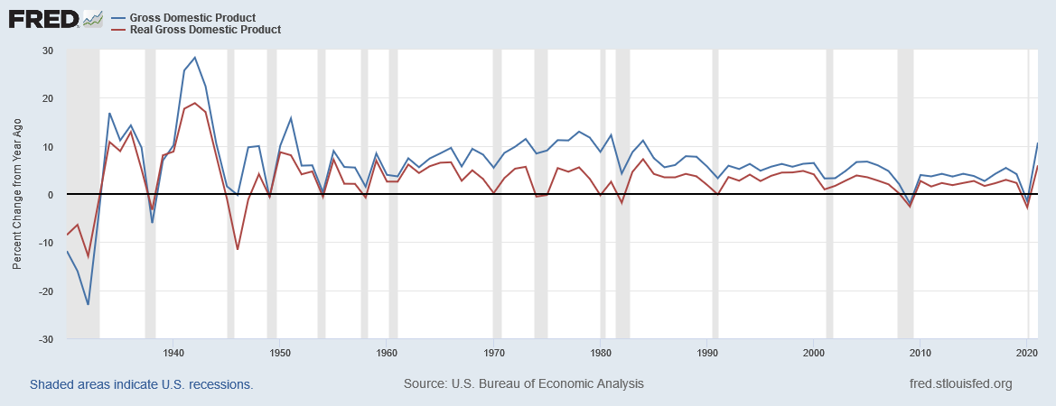
Growth Rate of Nominal and Real GDP, USA
Notes:
Downloaded from FRED on Janruary 19, 2023.
Real Gross Domestic Product Growth Rate (A191RL1A225NBEA)
https://fred.stlouisfed.org/series/A191RL1A225NBEA
Gross Domestic Product Growth Rate (A191RP1A027NBEA)
https://fred.stlouisfed.org/series/A191RP1A027NBEA

Slide 41
Where to find US data
Bureau of Economic Analysis, U.S. Department of Commerce: http://bea.gov
Federal Reserve Bank of St. Louis: http://research.stlouisfed.org/fred2/categories/18

Slide 42
International GDP comparisons
How can we measure national productive activity so that the numbers can be compared across nations?

Slide 43
International Comparisons
When the GDP numbers for various countries’ are compared, the same currency units must be used
There are two ways of converting from national currencies to a common currency, such as the US dollar
  Use market exchange rates
  Use a common set of prices (PPP)

Slide 44
Market Exchange Rate Method
Step 1: Look up Mexico’s GDP in Mexico’s currency, the peso
Step 2: Look up how many US dollars one Mexican peso is worth
Step 3: Multiply the numbers in Steps 1 and 2
  This gives you Mexico’s GDP in US dollars
  If the GDPs of two countries are both expressed in US dollars, they can be compared head to head
There’s another way to calculate Mexico’s GDP in US dollars …

Slide 45
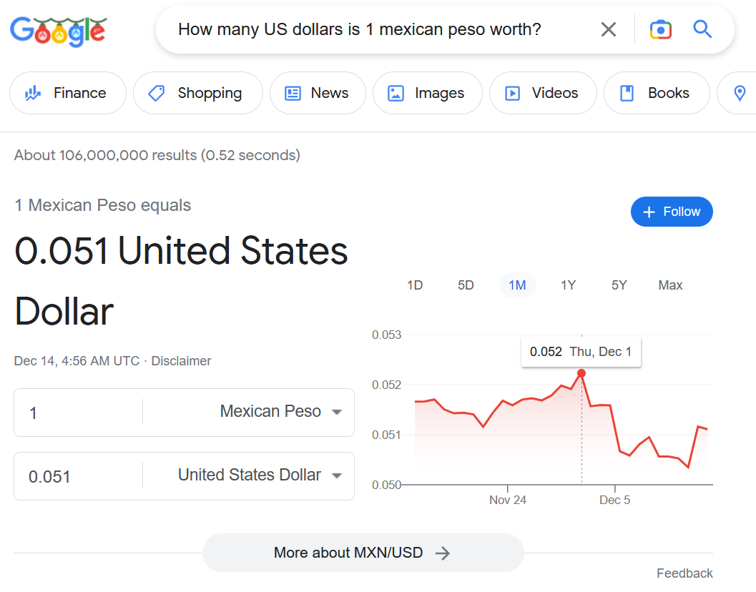
Market Exchange Rate Method
As on December 13, 2022
Notes:
Information accessed on December 3, 2019

Slide 46
Purchasing Power Parity Method
Step 1: Find out the quantities of all the final goods that were produced in Mexico during 2016
Step 2: Find out the prices of those goods in the United States—not Mexico—in 2016.
  These prices are in US dollars
Step 3: Calculate Mexico’s GDP in US dollars, by
  Step 3a: multiplying the quantities in Step 1 by the corresponding prices in Step 2 and
  Step 3b: then adding the results obtained in Step 3a

Slide 47
Let’s Compare GDP!
country | GDP 2021 (2021 US$ billions) |  | country | GDP.PPP 2021 (2021 international $ billions)
United States | 22,996 |  | China | 27,313
China | 17,734 |  | United States | 22,996
Japan | 4,937 |  | India | 10,219
Germany | 4,223 |  | Japan | 5,397
United Kingdom | 3,187 |  | Germany | 4,815
India | 3,173 |  | Russian Federation | 4,785
France | 2,937 |  | Indonesia | 3,566
Italy | 2,100 |  | Brazil | 3,436
Canada | 1,991 |  | France | 3,424
Korea, Rep. | 1,799 |  | United Kingdom | 3,344
Russian Federation | 1,776 |  | Italy | 2,713
Brazil | 1,609 |  | Mexico | 2,610
Australia | 1,543 |  | Turkiye | 2,591
Spain | 1,425 |  | Korea, Rep. | 2,428
Mexico | 1,293 |  | Canada | 1,992
Indonesia | 1,186 |  | Spain | 1,930
Netherlands | 1,018 |  | Saudi Arabia | 1,751
Saudi Arabia | 834 |  | Australia | 1,436
Turkiye | 815 |  | Poland | 1,417
Switzerland | 813 |  | Egypt, Arab Rep. | 1,388

Slide 48
Let’s Compare GDP per capita!
country | GDP.per.cap 2021 (2021 US$) |  | country | GDP.per.cap.PPP 2021 (2021 international $) |  | country | GDP.per.cap 2021 (2021 US$) |  | country | GDP.per.cap.PPP 2021 (2021 international $)
Luxembourg | 135,683 |  | Luxembourg | 134,754 |  | Burkina Faso | 918 |  | Ethiopia | 2600
Bermuda | 110,869 |  | Singapore | 116,486 |  | Mali | 918 |  | Rwanda | 2494
Ireland | 99,152 |  | Ireland | 106,456 |  | Tajikistan | 897 |  | Burkina Faso | 2462
Switzerland | 93,457 |  | Qatar | 93,521 |  | Uganda | 858 |  | Mali | 2447
Norway | 89,203 |  | Bermuda | 85,192 |  | Gambia, The | 836 |  | Zimbabwe | 2444
Singapore | 72,794 |  | Norway | 79,201 |  | Rwanda | 834 |  | Gambia, The | 2434
United States | 69,288 |  | Switzerland | 77,324 |  | Guinea-Bissau | 813 |  | Uganda | 2398
Iceland | 68,384 |  | Macao SAR, China | 73,802 |  | Sudan | 764 |  | Togo | 2380
Denmark | 67,803 |  | United States | 69,288 |  | Chad | 696 |  | Guinea-Bissau | 2057
Qatar | 61,276 |  | Brunei Darussalam | 66,620 |  | Yemen, Rep. | 691 |  | Sierra Leone | 1816
Sweden | 60,239 |  | Hong Kong SAR, China | 65,973 |  | Liberia | 673 |  | Malawi | 1658
Australia | 59,934 |  | Denmark | 64,651 |  | Malawi | 643 |  | Madagascar | 1635
Netherlands | 58,061 |  | Netherlands | 63,767 |  | Niger | 595 |  | Chad | 1591
Finland | 53,983 |  | Sweden | 59,324 |  | Congo, Dem. Rep. | 584 |  | Liberia | 1553
Austria | 53,268 |  | Belgium | 58,931 |  | Sierra Leone | 516 |  | Mozambique | 1342
Canada | 52,051 |  | Austria | 58,427 |  | Madagascar | 515 |  | Niger | 1310
Belgium | 51,768 |  | Germany | 57,928 |  | Central African Republic | 511 |  | Somalia | 1302
Israel | 51,430 |  | Iceland | 57,646 |  | Mozambique | 500 |  | Congo, Dem. Rep. | 1219
Germany | 50,802 |  | Australia | 55,807 |  | Somalia | 446 |  | Central African Republic | 1021
Hong Kong SAR, China | 49,661 |  | Finland | 55,007 |  | Burundi | 237 |  | Burundi | 793
Comparing by market exchange rates, the average resident of Luxembourg earns 572 times what the average resident of Burundi earns.
Comparing by purchasing power parity, the average resident of Luxembourg earns 170 times what the average resident of Burundi earns.

Slide 49
Growth Matters a Lot
There are huge differences in growth rates too
And differences in growth rates can matter a lot over time
country | year.beg | year.end | GDP.per.cap.PPP.beg | GDP.per.cap.PPP.end | GDP.per.cap.PPP.growth
Bosnia and Herzegovina | 1994 | 2021 | 901.39 | 16,846.46 | 11.45
Equatorial Guinea | 1990 | 2021 | 653.21 | 18,127.19 | 11.32
China | 1990 | 2021 | 981.42 | 19,338.23 | 10.09
Myanmar | 1990 | 2021 | 400.09 | 4,344.94 | 8.00
Lithuania | 1995 | 2021 | 5,927.33 | 42,665.32 | 7.89
Vietnam | 1990 | 2021 | 1,165.42 | 11,553.07 | 7.68
Nauru | 2004 | 2021 | 4,389.81 | 15,102.66 | 7.54
Estonia | 1995 | 2021 | 6,476.33 | 42,191.51 | 7.47
Latvia | 1995 | 2021 | 5,514.67 | 34,468.60 | 7.30
Lao PDR | 1990 | 2021 | 1,024.63 | 8,674.03 | 7.13
Gabon | 1990 | 2021 | 12,381.91 | 15,597.52 | 0.75
Oman | 1990 | 2020 | 26,185.95 | 31,117.76 | 0.58
Brunei Darussalam | 1990 | 2021 | 55,853.61 | 66,619.87 | 0.57
Congo, Rep. | 1990 | 2021 | 3,471.17 | 3,616.86 | 0.13
Cayman Islands | 2006 | 2020 | 71,482.57 | 72,481.01 | 0.10
Qatar | 2000 | 2021 | 96,713.11 | 93,521.44 | -0.16
Curacao | 2000 | 2020 | 21,888.35 | 20,681.24 | -0.28
United Arab Emirates | 1990 | 2020 | 87,131.68 | 66,766.05 | -0.88
Kuwait | 1995 | 2020 | 59,865.10 | 47,303.13 | -0.94
South Sudan | 2008 | 2015 | 2,913.32 | 1,234.73 | -11.54
 |  | Years From Today
Annual Growth % | Today | 20 | 100 | 200
1 | 100 | 122.02 | 270.48 | 731.60
2 | 100 | 148.59 | 724.46 | 5248.49
So, even small increases in annual growth rates can make a big difference if sustained over a long time.

Slide 50
Data Sources
GDP (current US$): https://data.worldbank.org/indicator/NY.GDP.MKTP.CD
GDP, PPP (current international $): https://data.worldbank.org/indicator/NY.GDP.MKTP.PP.CD
GDP per capita (current US$): https://data.worldbank.org/indicator/NY.GDP.PCAP.CD
GDP per capita, PPP (current international $): https://data.worldbank.org/indicator/NY.GDP.PCAP.PP.CD
GDP growth (annual %): https://data.worldbank.org/indicator/NY.GDP.MKTP.KD.ZG
GDP per capita growth (annual %): https://data.worldbank.org/indicator/NY.GDP.PCAP.KD.ZG

Slide 51
Basic Facts of Wealth
Video: https://youtu.be/PzAr_mL0Qd8

Slide 52
Growth rate math

Slide 53
Two arithmetic tricks for working with percentage changes
1. For any variables X and Y,
percentage change in (X × Y )
≈ percentage change in X
+ percentage change in Y
Example: If your hourly wage rises 5%
and you work 7% more hours,
then your wage income rises
approximately 12%.
Notes:
These handy arithmetic tricks will be useful in many different contexts later in this book. For example, in the Quantity Theory of Money in chapter 4, they help us understand how the Quantity Equation, MV = PY, gives us a relation between the rates of inflation, money growth, and GDP growth.
The example on this slide uses
wage income = (hourly wage) x (number of hours worked)
Another example would be
revenue = price x quantity
Students will see many more examples later in the textbook.

Slide 54
Two arithmetic tricks for working with percentage changes
2. percentage change in (X/Y )
≈ percentage change in X
− percentage change in Y
Example: GDP deflator = 100 × NGDP/RGDP.
If NGDP rises 9% and RGDP rises 4%,
then the inflation rate is approximately 5%.
Notes:
Again, we will see uses for this in many different contexts later in the textbook. For example, if your wage rises 10% while prices rise 6%, then your real wage – the purchasing power of your wage – rises by about 4%, because
real wage = (nominal wage)/(price level)

Slide 55
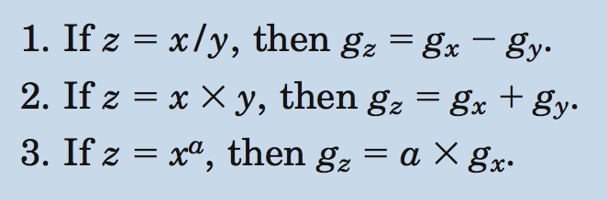
The growth rate of the ratio of two variables equals the difference of their growth rates.
The growth rate of the product of two variables equals the sum of their growth rates.
The growth rate of a variable raised to an exponent, is the growth rate of the variable times the exponent.

Slide 56
If Z = X × Y then g_{z} = g_{x} + g_{y}
The growth rates here are in decimal form: for example, if X grows at the rate of 5%, then g_{x} = 0.05. The product of two decimals is small enough to be ignored: for example, 0.05 × 0.04 = 0.0020.

Slide 57
If Z = X ÷ Y then g_{z} = g_{x} – g_{y}

Slide 58

If Z = Xª then g_{z} = a × g_{x}
$z=x^{a}=x×x×⋯×x$, or x multiplied by itself a times
Therefore, $g_{z}=g_{x}+g_{x}+⋯+g_{x}=a×g_{x}$, or the growth rate of x added to itself a times

Slide 59
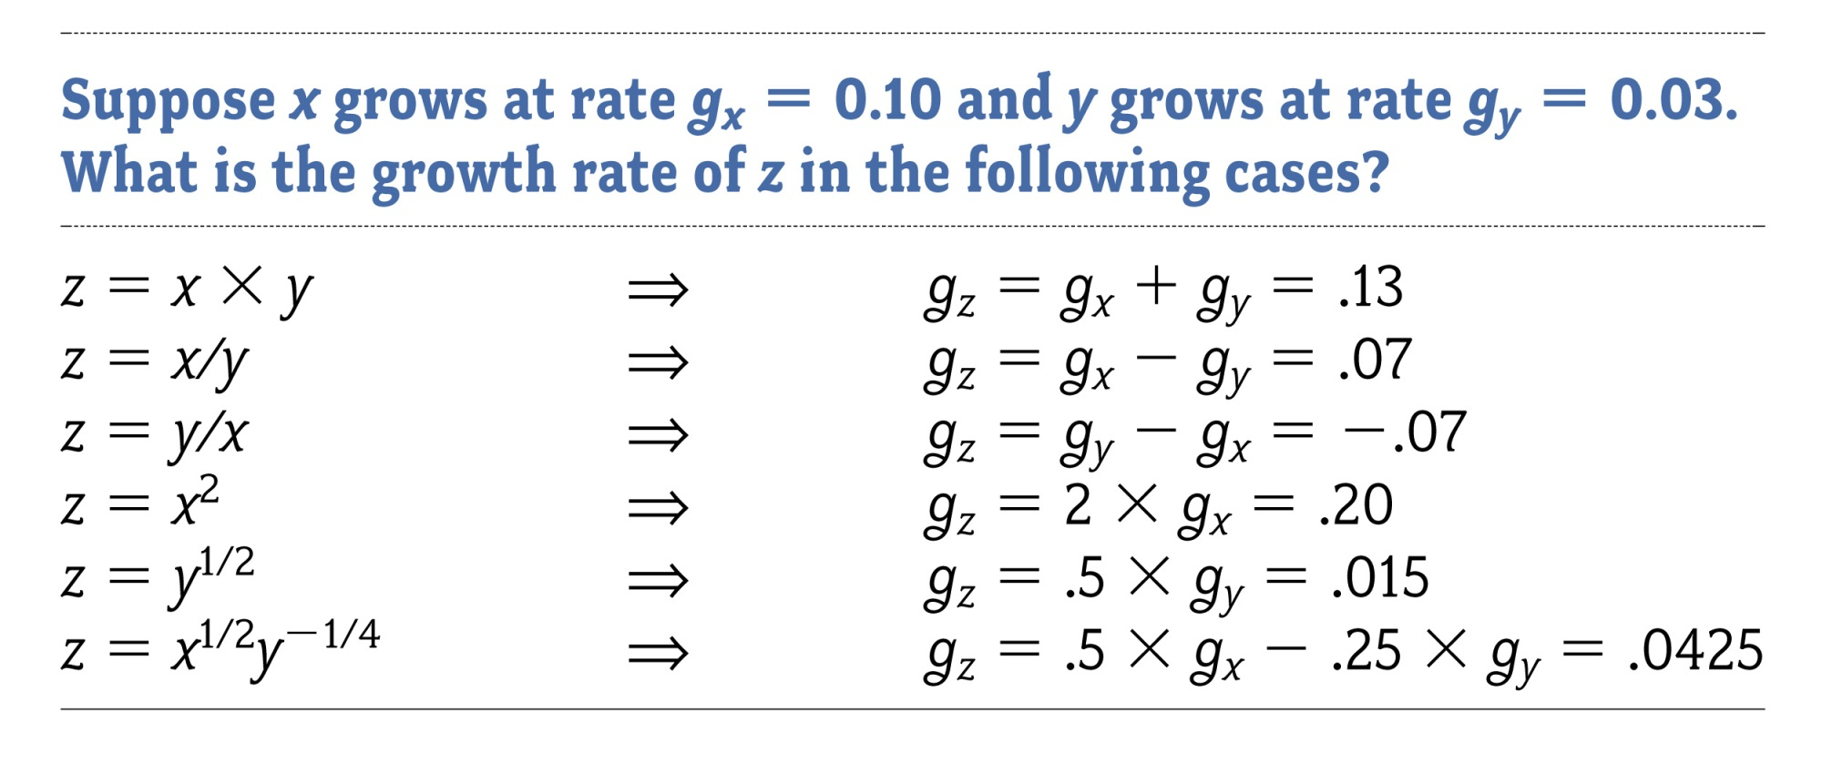

Slide 60
Consumer price index (CPI)

Slide 61
Consumer Price Index (CPI)
The CPI is a measure of the overall level of prices
  Recall that the GDP deflator is also a measure of the overall level of prices
The CPI is published by the Bureau of Labor Statistics (BLS)
The CPI is used to:
  track changes in the typical household’s
  cost of living
  adjust many contracts for inflation (“COLAs”)
  allow comparisons of dollar amounts over time
Notes:
Regarding the comparison of dollar figures from different years:
If we want to know whether the average college graduate today is better off than the average college graduate of 1975, we can’t simply compare the nominal salaries, because the cost of living is so much higher now than in 1975. We can use the CPI to express the 1975 in “current dollars”, i.e. see what it would be worth at today’s prices.
Also: when the price of oil (and hence gasoline) shot up in 2000, some in the news reported that oil prices were even higher than in the 1970s. This was true, but only in nominal terms. If you use the CPI to adjust for inflation, the highest oil price in 2000 is still substantially less than the highest oil prices of the 1970s.

Slide 62
How the BLS constructs the CPI
1. Survey consumers to determine composition of the typical consumer’s “basket” of goods
2. Every month, collect data on prices of all items in the basket, and compute cost of basket
3. CPI in any month equals

Slide 63
The composition of the CPI’s “basket”
Notes:
Each number is the percent of the “typical” household’s total expenditure.
source: Bureau of Labor Statistics, http://www.bls.gov/cpi/
Ask students for examples of how the breakdown of their own expenditure differs from that of the typical household shown here. Then, ask students how the typical elderly person’s expenditure might differ from that shown here. (This is relevant because the CPI is used to give Social Security COLAs to the elderly; however, the elderly spend a much larger fraction of their income on medical care, a category in which prices grow much faster than the CPI.)
The website listed above also gives a very fine disaggregation of each category, which enables students to compare their own spending on compact discs, beer, or cell phones to that of the “typical” household.

Slide 64
NOW YOU TRY:
Compute the CPI
Typical consumer’s basket: 20 pizzas, 10 compact discs
prices:
pizza CDs
2002 $10 $15
2003 $11 $15
2004 $12 $16
2005 $13 $15
For each year, compute
the cost of the basket
the CPI (use 2002 as the base year)
the inflation rate from the preceding year
Notes:
From 2002 to 2003, it’s not obvious that the inflation rate will be positive (that the basket’s cost will increase): the price of pizza rises by $1, the price of CDs falls by $1.
However, since the basket contains twice as many pizzas as CDs, a given change in the price of pizza will have a bigger impact on the basket’s cost (and CPI) than the same sized price change in CDs.

Slide 65
NOW YOU TRY:
Compute the CPI and Inflation Rate
Typical consumer’s basket: 20 pizzas, 10 compact discs
 | pizza | CDs | cost | CPI | inflation
2002 | $10 | $15
2003 | $11 | $15
2004 | $12 | $16
2005 | $13 | $15

Slide 66
NOW YOU TRY:
Compute the CPI and Inflation Rate
Typical consumer’s basket: 20 pizzas, 10 compact discs
 | pizza | CDs | cost | CPI | inflation
2002 | $10 | $15 | $350
2003 | $11 | $15 | $370
2004 | $12 | $16 | $400
2005 | $13 | $15 | $410

Slide 67
NOW YOU TRY:
Compute the CPI and Inflation Rate
Typical consumer’s basket: 20 pizzas, 10 compact discs
 | pizza | CDs | cost | CPI | inflation
2002 | $10 | $15 | $350 | 100
2003 | $11 | $15 | $370 | 105.71
2004 | $12 | $16 | $400 | 114.29
2005 | $13 | $15 | $410 | 117.14

Slide 68
NOW YOU TRY:
Compute the CPI and Inflation Rate
Typical consumer’s basket: 20 pizzas, 10 compact discs
 | pizza | CDs | cost | CPI | inflation
2002 | $10 | $15 | $350 | 100
2003 | $11 | $15 | $370 | 105.71 | 5.71
2004 | $12 | $16 | $400 | 114.29 | 8.11
2005 | $13 | $15 | $410 | 117.14 | 2.50

Slide 69
Why the CPI may overstate inflation
Substitution bias:
The CPI uses fixed weights, so it cannot reflect consumers’ ability to substitute toward goods whose relative prices have fallen.
Introduction of new goods:
The introduction of new goods makes consumers better off and, in effect, increases the real value of the dollar. But it does not reduce the CPI, because the CPI uses fixed weights.
Unmeasured changes in quality:
Quality improvements increase the value of the dollar, but are often not fully measured.

Slide 70
The size of the CPI’s bias
In 1995, a Senate-appointed panel of experts estimated that the CPI overstates inflation by about 1.1 percentage points per year.
So the BLS made adjustments to reduce the bias.
Now, the CPI’s bias is probably under 1 percentage points per year.

Slide 71
NOW YOU TRY:
Discussion Questions
1. If your grandmother receives Social Security,
how is she affected by the CPI’s bias?
2. Where does the government get the money to pay COLAs to Social Security recipients?
3. If you pay income and Social Security taxes,
how does the CPI’s bias affect you?
4. Is the government giving your grandmother
too much of a COLA?
5. How does your grandmother’s “basket” differ from the CPI’s? Does this affect your answer to Q4?
Notes:
If you can afford a few minutes of class time, you can use these questions to illustrate one reason why the CPI’s bias is important, and also to get students to think about the implications of applying a measure of the “typical household’s cost of living” to groups (like the elderly) that are not typical.

Slide 72
CPI vs. GDP Deflator
Prices of non-consumer goods:
  included in GDP deflator (if produced domestically)
  excluded from CPI
Prices of imported consumer goods:
  included in CPI
  excluded from GDP deflator
The basket of goods:
  CPI: fixed
  GDP deflator: changes every year

Slide 73
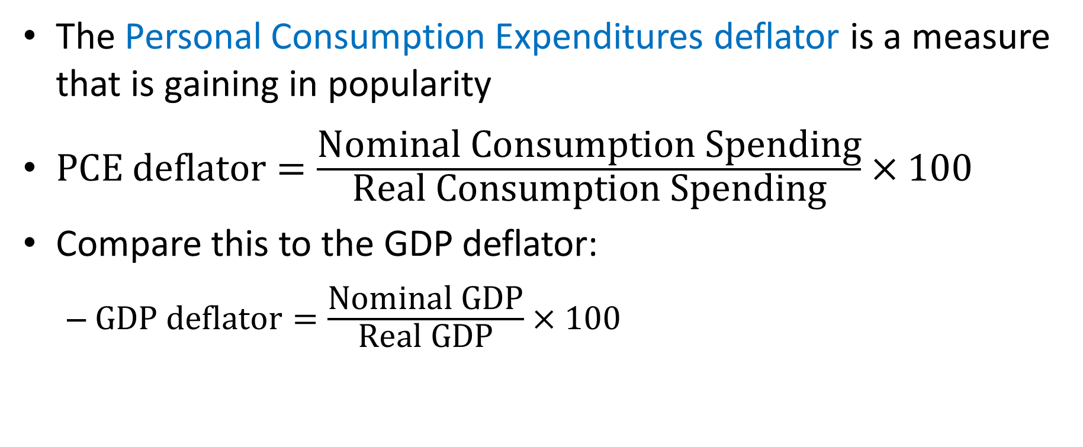
A Third Measure of the Overall Price Level!
The Personal Consumption Expenditures deflator is a measure that is gaining in popularity
$\text{PCE} \text{deflator}=\frac{\text{Nominal} \text{Consumption} \text{Spending}}{\text{Real} \text{Consumption} \text{Spending}}×100$
Compare this to the GDP deflator:
  $\text{GDP} \text{deflator}=\frac{\text{Nominal} \text{GDP}}{\text{Real} \text{GDP}}×100$

Slide 74
A Third Measure of the Overall Price Level!
The GDP deflator considers the prices of all domestically produced final goods and services whereas the PCE deflator considers the prices of only consumer goods and services, wherever produced.

Slide 75
CPI vs. GDP Deflator vs. PCE Deflator
Prices of non-consumer goods:
  included in GDP deflator (if produced domestically)
  excluded from CPI and PCE deflator
Prices of imported consumer goods:
  included in CPI and PCE deflator
  excluded from GDP deflator
The basket of goods:
  CPI: fixed
  GDP deflator and PCE deflator: changes every year
The PCE deflator is a compromise between the CPI and the GDP deflator. For this reason, the Federal Reserve, which conducts monetary policy in the US, considers the PCE deflator its preferred measure of the price level.
More precisely, the Fed uses a version of the PCE deflator that ignores the prices of food and energy. This is the Core PCE deflator. It is less volatile (because it leaves food and energy out) and is considered more useful as a guide to future prices.

Slide 76
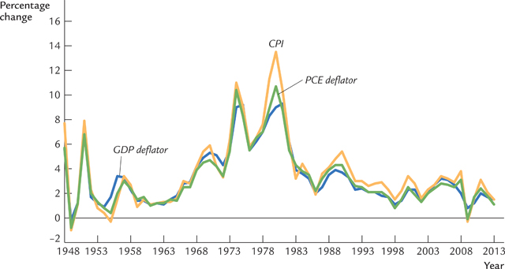
CPI vs. GDP Deflator vs. PCE Deflator

Slide 77
unemployment

Slide 78
The Current Population Survey
The Bureau of Labor Statistics (BLS) of the U.S. Department of Labor computes the unemployment rate every month
The data comes from a monthly survey of U.S. households called the Current Population Survey
  See http://bls.gov/cps/
This survey classifies each adult into one of three categories: employed, unemployed, and not in the labor force

Slide 79
Three Population Categories
This survey classifies each adult into one of three categories:
  employed (working at a paid job)
  unemployed (not employed but looking for a job), and
  not in the labor force (not employed, not looking for work)
Labor force = employed + unemployed

Slide 80
Two important labor market stats
unemployment rate
percentage of the labor force that is unemployed
labor force participation rate
percentage of the adult population that is in the labor force

Slide 81
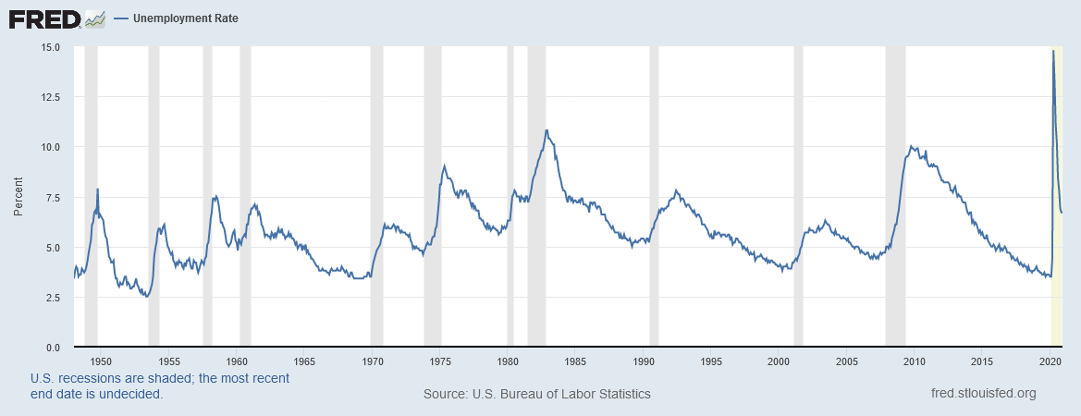
U.S. Unemployment Rate, 1948 Jan-2020 Dec
Source: https://fred.stlouisfed.org/series/UNRATE
Notes:
Downloaded on February 4, 2021.

Slide 82
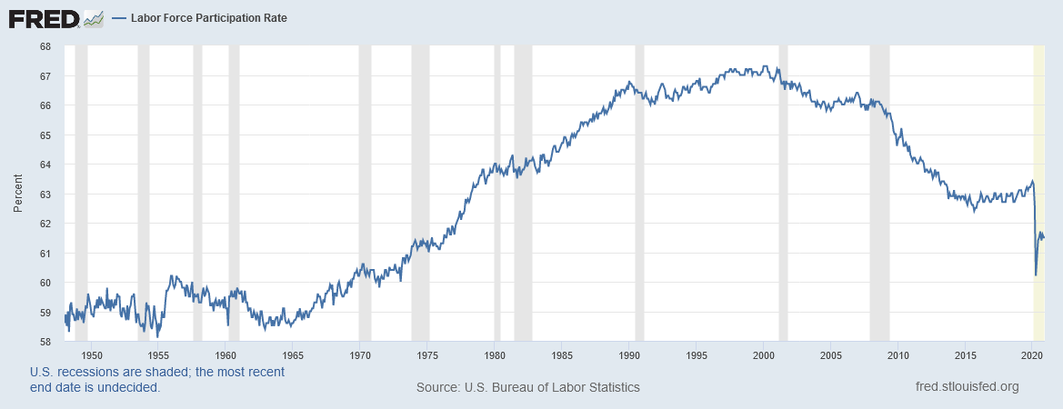
U.S. Labor Force Participation Rate
1948 Jan-2020 Dec
Source: https://fred.stlouisfed.org/series/CIVPART
Notes:
Downloaded on February 4, 2021

Slide 83
NOW YOU TRY:
Computing labor statistics
U.S. adult population by group, May 2009
Number employed = 140.57 million
Number unemployed = 14.51 million
Adult population = 235.45 million
Use the above data to calculate
  the labor force
  the number of people not in the labor force
  the labor force participation rate
  the unemployment rate
Notes:
source: Bureau of Labor Statistics, U.S. Department of Labor. http://www.bls.gov

Slide 84
NOW YOU TRY:
Answers
data: E = 140.57, U = 14.51, POP = 235.45
labor force
L = E +U = 140.57 + 14.51 = 155.08
not in labor force
NILF = POP – L = 235.45 – 155.08 = 80.37
unemployment rate
U/L x 100% = (14.51/155.08) x 100% = 9.4%
labor force participation rate
L/POP x 100% = (155.08/ 235.45) x 100% = 65.9%

Slide 85
Unemployment and Labor Force Participation
 | Population | Labor Force | Unemployed | Unemployment Rate | Labor Force Participation Rate
Situation A | 10 | 10 | 1 | 10% | 100%
Situation B | 10 | 9 | 0 | 0% | 90%
Suppose the one unemployed person in Situation A gets discouraged and drops out of the labor force
The result is Situation B
The unemployment rate is lower in Situation B. But that does not mean it is an improvement over Situation A.
Lesson: We need to watch both the unemployment rate and the labor force participation rate. A fall in the former is good news only when it is not accompanied by a fall in the latter.

Slide 86
NOW YOU TRY:
Compute percentage changes in labor statistics
Suppose
  population increases by 1%
  labor force increases by 3%
  number of unemployed persons increases by 2%
Compute the percentage changes in the labor force participation and unemployment rates.
Notes:
Allow two minutes of class time for your students to work this exercise. This will give them immediate reinforcement of the definitions of the labor force participation rate, the unemployment rate, and the “arithmetic tricks for working with percentage changes” introduced earlier.

Slide 87
NOW YOU TRY:
Answers
LFPR = L/POP
  L increases 3%, POP increases 1%, so
  LFPR increases 3% – 1% = 2%
U rate = U/L
  U increases 2%, L increases 3%, so
  U-rate increases 2% – 3% = –1%
Note: the changes in LFPR and U-rate are shown as percent of their initial values, not in percentage points! E.g., if initial value of LFPR is 60.0%, a 2% increase would bring it to 61.2%, because 2% of 60 equals 1.2.
Notes:
Feel free to delete the red italicized text if you think it will only confuse your students.

Slide 88
The Current Establishment Survey
The BLS obtains a second measure of employment by surveying businesses, asking how many workers are on their payrolls.
  See http://bls.gov/ces/
Neither measure is perfect, and they occasionally diverge due to:
  treatment of self-employed persons
  new firms not counted in establishment survey
  technical issues involving population inferences from sample data

Slide 89
Two measures of employment growth
Percentage change
from 12 months earlier
Notes:
Source: http://research.stlouisfed.org/fred2/
This graph shows the percentage change in total U.S. non-farm employment from 12 months earlier (based on monthly, seasonally-adjusted data from the Bureau of Labor Statistics), from two surveys: The household survey, which is used to generate the widely-known unemployment rate data, and the establishment survey.
The textbook (pp.39-40) discusses the establishment survey in detail and contrasts it with the household survey to help explain the divergences.

Slide 90
U.S. Labor Data
  Current Population Survey: http://bls.gov/cps/
    ftp://ftp.bls.gov/pub/special.requests/lf/aat1.txt
Current Establishment Survey: http://bls.gov/ces/
    ftp://ftp.bls.gov/pub/suppl/empsit.ceseeb1.txt
    ftp://ftp.bls.gov/pub/suppl/empsit.ceseeb2.txt

Slide 91
International Labor Comparisons
The BLS presents internationally comparable labor data for many countries at http://bls.gov/fls/home.htm

Slide 92
Chapter Summary
Gross Domestic Product (GDP) measures both total income and total expenditure on the economy’s output of goods & services.
Nominal GDP values output at current prices;
real GDP values output at constant prices. Changes in output affect both measures,
but changes in prices only affect nominal GDP.
GDP is the sum of consumption, investment, government purchases, and net exports.
Notes:
92

Slide 93
Chapter Summary
The overall level of prices can be measured
by either:
  the Consumer Price Index (CPI),
  the price of a fixed basket of goods purchased by the typical consumer, or
  the GDP deflator,
  the ratio of nominal to real GDP
The unemployment rate is the fraction of the labor force that is not employed.
Notes:
93

