Slide 1
The Monetary System: What It Is and How It Works
Chapter 4, Macroeconomics, by N. Gregory Mankiw, 11th Edition
ECO 62, Udayan Roy

Slide 2
Three Main Questions
What is money?
What is the role of a nation’s banking system in determining the quantity of money in the economy?
How does a nation’s central bank influence the banking system and the quantity of money?

Slide 3
What is money?

Slide 4
What is money?
Money is any asset that can be readily used to pay for purchases
Therefore, money is a medium of exchange …
… and a store of value
Moreover, money also functions as a unit of account

Slide 5
Two Types of Money
Fiat money
People accept fiat money either because a government decree (or, fiat) requires them to do so or simply because others would also accept it as payment
Commodity money
This money is valuable in itself (e.g., gold coins) or can by law be converted into something valuable (as in a gold standard system)

Slide 6
The Quantity of Money
The quantity of money, amount of money, and supply of money all refer to the same thing:
The total value of all assets in the economy that can be used as money
It is denoted M

Slide 7
Money: Definition
Money is the stock of assets that can be readily used to make transactions.
Two common measures of the quantity of money in an economy are M1 and M2

Slide 8
What Counts as Money?
The dollar value of the currency we carry, C, should clearly be counted as money
In the previous chapter, C represented consumption spending
Take care to not get confused about the usage in this chapter
Moreover, when we do our shopping, we use checks and debit cards exactly the way we use currency. Therefore, the dollars that we can spend this way should also be counted as money.
Credit cards are ignored. Why?

Slide 9
The Quantity of Money
There are several prominent measures of the quantity of money (M)

Slide 10
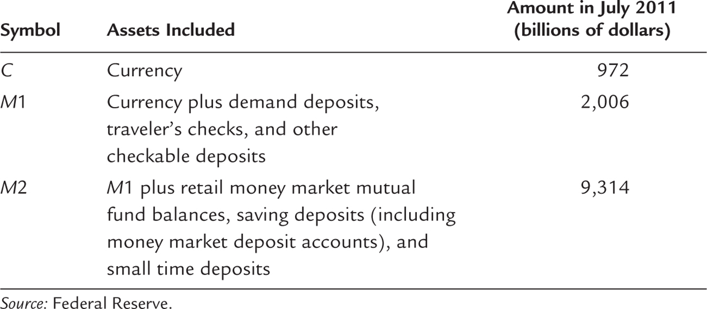
Table 4.1 The Measures of Money
Simplified version: Money Supply (M) = Currency (C) + Demand Deposits (D)

Slide 11
Data Sources
M1: http://research.stlouisfed.org/fred2/series/M1SL?cid=25
M1 and its components: http://research.stlouisfed.org/fred2/categories/25
Currency (C): http://research.stlouisfed.org/fred2/series/CURRSL?cid=25
Demand Deposits: http://research.stlouisfed.org/fred2/series/DEMDEPSL?cid=25
Traveler’s Checks: http://research.stlouisfed.org/fred2/series/TVCKSSL?cid=25
Other Checkable Deposits: http://research.stlouisfed.org/fred2/series/OCDSL?cid=25

Slide 12
Data Sources
M2: http://research.stlouisfed.org/fred2/series/M2SL?cid=29
M2 and its components: http://research.stlouisfed.org/fred2/categories/29
Retail money market mutual fund balances: http://research.stlouisfed.org/fred2/series/RMFNS?cid=29
Saving deposits: http://research.stlouisfed.org/fred2/series/SAVINGSL?cid=29
Small time deposits: http://research.stlouisfed.org/fred2/series/STDSL?cid=29

Slide 13
Role of Banks in the Monetary System

Slide 14
Banks’ Liabilities: how do banks get money?
Banks take deposits (D) from depositors
Banks also borrow money
This is called their debt
The owners of a bank must also invest their own money in their bank. This is called the bank’s capital (or, equity)
Total bank liabilities = deposits + debt
Total bank funds = liabilities + capital

Slide 15
Banks’ Assets: what do banks do with their funds?
Some of the banks’ funds are kept as reserves (R)
Why?
The banks’ depositors may need some of their money back
But not all deposits have to be kept as reserves all the time
If the arrival rate of new deposits is roughly equal to the departure rate of the money withdrawn by depositors, then some of the banks’ funds could be put to other uses

Slide 16
Banks’ Assets: what do banks do with their funds?
Some of the banks’ funds are kept as reserves (R)
The rest of the banks’ funds are used to make loans
The interest charged on loans is a source of income for banks
… and to make securities purchases
Banks earn income from the securities they own
Total bank assets = reserves + loans + securities purchases

Slide 17
The Role of Banks in the Monetary System: Bank’s Balance Sheet
The bank’s funds—its liabilities plus capital—are used to buy assets
Assets = liabilities + capital
Assets |  | Liabilities and Owners’ Equity
Reserves | $200 | Deposits | $750
Loans | 500 | Debt | 200
Securities | 300 | Capital (owners’ equity) | 50

Slide 18
The Role of Banks in the Monetary System: Leverage
Leverage is the use of borrowed money (deposits + debt) to supplement owners’ funds for purposes of investment
Leverage ratio = assets/capital = $(200 + 500 + 300)/$50 = 20
Assets |  | Liabilities and Owners’ Equity
Reserves | $200 | Deposits | $750
Loans | 500 | Debt | 200
Securities | 300 | Capital (owners’ equity) | 50

Slide 19
The Role of Banks in the Monetary System: Leverage
Being highly leveraged makes banks vulnerable.
Example: Suppose the value of our bank’s assets falls by 5%, to $950.
Then, capital = assets – liabilities = 950 – 950 = 0 (the end!)
Assets |  | Liabilities and Owners’ Equity
Reserves | $200 | Deposits | $750
Loans | 500 | Debt | 200
Securities | 300 | Capital (owners’ equity) | 50

Slide 20
Capital Requirements
To reduce the risk of a bank going bust—as in the previous slide’s example—bank regulators impose capital requirements on banks
The goal is to ensure that a bank’s capital would exceed its liabilities, so that the bank’s owners could return the money of its depositors and repay its debts
Banks with riskier assets face higher capital requirements

Slide 21
Capital Requirements
In the 2008-2009 financial crisis, losses on mortgages shrank bank capital, slowed lending, exacerbated the recession
The government injected capital into banks to ease the crisis and encourage more lending

Slide 22
central banks’ influence

Slide 23
The Central Bank’s Influence
A bank that prints currency is called a central bank
Besides printing currency, central banks have other responsibilities such as regulating the behavior of financial institutions and keeping the economy stable
We will now build an algebraic model of the central bank’s influence on the monetary system of a country
We will mainly discuss the central bank of the United States, which is called the Federal Reserve or simply the Fed

Slide 24
The Central Bank’s Influence
Our first equation is one we have seen already: M = C + D
That is, money supply equals currency held by the public plus bank deposits
All three variables will be considered endogenous

Slide 25
Monetary Base
The monetary base (B) is the total number of dollars held
by the public as currency (C) or
by banks as reserves (R)
So, our second equation is B = C + R
A country’s monetary base is directly determined by its central bank
B is exogenous; C and R are endogenous

Slide 26
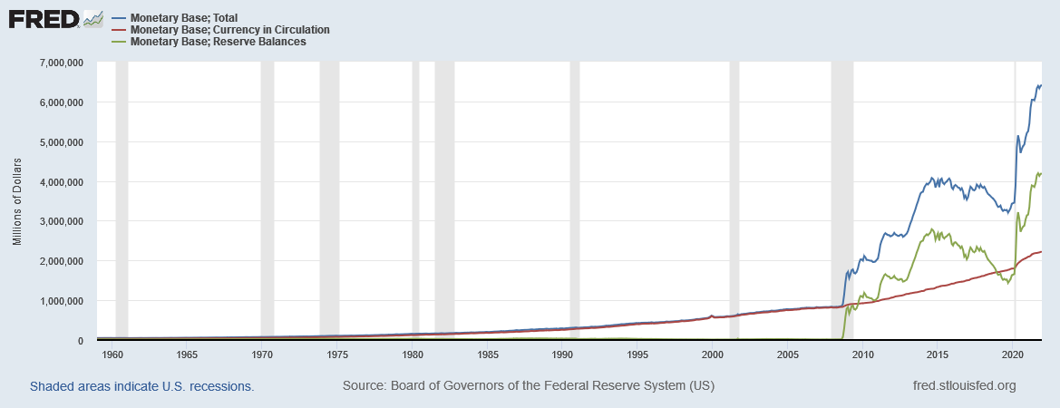
Monetary Base = Currency + Reserves
For December 2021, Monetary Base (B) = $ 6,413,300 million, Currency (C) = $2,225,300 million, and Reserves (R) = $6,413,300 million. Note that until the financial crisis of 2008, monetary base consisted almost entirely of currency. Since then, much of the increase in the monetary base has been in reserves.
Notes:
Currency: https://fred.stlouisfed.org/series/MBCURRCIR Reserves: https://fred.stlouisfed.org/series/BOGMBBM
Base: https://fred.stlouisfed.org/series/BOGMBASE Downloaded on February 9, 2022
Graphic: https://fred.stlouisfed.org/graph/?g=LUsG

Slide 27
The Currency-Deposit Ratio
cd = C/D is the currency-deposit ratio
This is a matter of households’ preferences
When people feel distrust of banks they may reduce their bank deposits (D↓) and increase their currency holdings (C↑)
This increases the currency-deposit ratio (cd↑)
cd is assumed exogenous

Slide 28
The Reserve-Deposit Ratio
rd = R/D is the reserve-deposit ratio
Note that 0 < rd < 1
This is a matter of banks’ preferences
When banks are afraid to make loans or buy securities, they increase their idle reserves (R↑)
This increases the reserve-deposit ratio (rd↑)
rd is assumed exogenous

Slide 29
Demand Deposits
$cd=C/D$ implies $C=cd∙D$
$rd=R/D$ implies $R=rd∙D$
$B=C+R=cd∙D+rd∙D=(cd+rd)∙D$
Therefore, $D=\frac{1}{cd+rd}∙B$
We have expressed an endogenous variable, D, entirely in terms of our exogenous variables (cd, rd, and B)

Slide 30
Currency held by the public
We just saw that $D=\frac{1}{cd+rd}∙B$
$C=cd×D=\frac{cd}{cd+rd}∙B$
Again, we have expressed an endogenous variable, C, entirely in terms of our exogenous variables (cd, rd, and B)

Slide 31
Reserves held by banks
We just saw that $D=\frac{1}{cd+rd}∙B$
$R=rd×D=\frac{rd}{cd+rd}∙B$
Again, we have expressed an endogenous variable, R, entirely in terms of our exogenous variables (cd, rd, and B)

Slide 32
Money Supply
We know that M = C + D. Therefore,
$M=\frac{cd}{cd+rd}∙B+\frac{1}{cd+rd}∙B=\frac{cd+1}{cd+rd}∙B$
Again, we have expressed an endogenous variable, M, entirely in terms of our exogenous variables (cd, rd, and B)

Slide 33
The Money Multiplier
$M=\frac{cd+1}{cd+rd}∙B$
The factor of proportionality is called the money multiplier:
$m=\frac{cd+1}{cd+rd}$
Therefore, $M=m×B$
Note that, as 0 < rd < 1, it must be that m > 1
That is, for every dollar of monetary base created by the central bank, the money supply increases by more than a dollar

Slide 34
The Model Is Solved!
$D=\frac{1}{cd+rd}∙B$
$C=\frac{cd}{cd+rd}∙B$
$R=\frac{rd}{cd+rd}∙B$
$M=\frac{cd+1}{cd+rd}∙B$
$m=\frac{cd+1}{cd+rd}$

Slide 35
Numerical Example
Q: Suppose the monetary base is B = $800 billion, the reserve-deposit ratio is rd = 0.1, and the currency-deposit ratio is cd = 0.8. Calculate C, R, M, D, and m.
A:
R = $88.89 billion
C = $711.11 billion
D = $888.89 billion
M = $1,600 billion, and
m = 2

Slide 36
The Central Bank
$M=\frac{cd+1}{cd+rd}∙B$
When the central bank increases the monetary base, the money supply increases
When the reserve-deposit ratio decreases, the money supply increases
When the currency-deposit ratio decreases, the money supply increases (Why?)

Slide 37
The Central Bank
$M=\frac{cd+1}{cd+rd}∙B$
A country’s central bank
directly controls the monetary base, B, and
indirectly controls the reserve-deposit ratio, rd.
Therefore, the central bank can change a country’s monetary supply
And do so by directly controlling the monetary base or by indirectly controlling the reserve-deposit ratio

Slide 38
How does the Fed change the monetary base?
Open-market operations:
The Fed could print dollars and use them to buy securities (usually short-term Treasury bonds) from banks or from the public
This reduces “securities” and increases “reserves” (R↑) in the assets column of the banks’ balance sheets, and
Increases cash held by the public (C↑)
Therefore, the monetary base increases (B = C + R↑) whenever the central bank prints money and buys securities with it

Slide 39
How does the Fed change the monetary base?
It does open-market operations:
The Fed prints dollars and uses those dollars to buy securities (usually short-term Treasury bonds):
from banks, or
from the public
When the Fed buys securities from banks (with the freshly printed cash), the banks’ stock of securities decreases and the banks’ reserves increases (R↑)

Slide 40
How does the Fed change the monetary base?
It does open-market operations:
The Fed prints dollars and uses those dollars to buy securities (usually short-term Treasury bonds):
from banks, or
from the public
When the Fed buys securities from households (with freshly printed cash), the households’ stock of securities decreases and their currency holdings increases (C↑)
As R↑ and C↑, B = C + R↑.

Slide 41
How does the Fed change the monetary base?
When the Fed buys securities from a bank it is basically lending money to the bank
These loans to banks increases banks’ reserves (R↑)
This typically happens when banks lose the trust of depositors and private lenders and are unable to borrow from them
The Fed is then the “lender of last resort”
The Fed’s lending can take two forms:
Discount Window
Term Auction Facility

Slide 42
How does the Fed change the monetary base? Discount Window
The Fed lends to banks directly and charges them an interest rate called the discount rate
When the Fed reduces the discount rate, banks borrow more, their reserves rise by a bigger amount, and so the monetary base rises by a bigger amount

Slide 43
How does the Fed change the monetary base? Term Auction Facility
The TAF was a response to the financial crisis of 2008-9
The Fed decides how much it wants to lend to banks via TAF.
Eligible banks then bid to borrow those funds, with the loans going to the banks that offer to pay the highest interest
In this way, both banks’ reserves and the monetary base increase
The TAF was last used in 2010.
So, we may ignore it

Slide 44
How does the Fed indirectly control the reserve-deposit ratio?
We have seen that a decrease in the reserve-deposit ratio (rd↓) causes the money multiplier and the money supply to increase
The Fed influences banks’ reserve-deposit ratio by adjusting the interest it pays banks for the reserves the banks hold
When the Fed reduces the interest rate it pays banks for the reserves they hold, banks keep fewer reserves and the reserve-deposit ratio decreases

Slide 45
How does the Fed indirectly control rd? By paying banks interest on the reserves they hold.
This new monetary policy tool was a response to the financial crisis of 2008-9
US banks keep their reserves with the Fed
The Fed now pays banks interest on the reserves they keep at the Fed
A reduction in this interest, induces banks to keep fewer reserves
This reduces rd, and increases m, M, and B

Slide 46
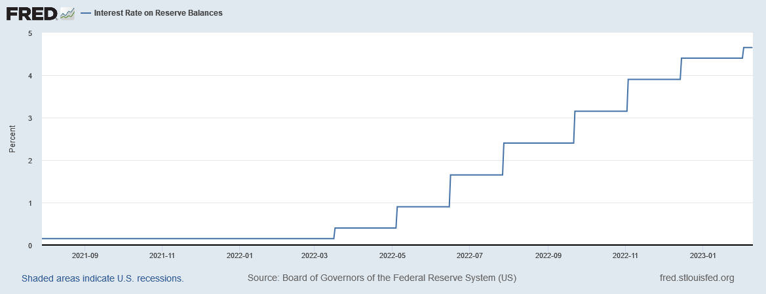
Interest Rate on Reserve Balances
See https://fred.stlouisfed.org/series/IORB. “The interest rate on reserve balances (IORB rate) is the rate of interest that the Federal Reserve pays on balances maintained by or on behalf of eligible institutions in master accounts at Federal Reserve Banks. The interest rate is set by the Board of Governors, and it is an important tool of monetary policy.”
Notes:
Downloaded from https://fred.stlouisfed.org/series/IORB on Feb 9, 2023

Slide 47
How does the Fed indirectly control rd? Reserve Requirements
Reserve requirements are Fed regulations that impose a minimum reserve-deposit ratio on banks
This is to ensure that there will always be enough money in banks for depositors who may need to withdraw cash
The required minimum rd is only a minimum
Still, when reserve requirements decrease, rd tends to fall.
This causes m, M and B to increase
The Fed ended reserve requirements in March 2020
So, we may ignore it

Slide 48
Case Study: Quantitative Easing
Prior to the financial crisis of 2008, the US monetary base rose gradually
Between 2007 and 2011, it tripled, mainly through open-market operations
The Fed printed money and used it to buy riskier securities than the Treasury bonds it buys during normal times

Slide 49
Case Study: Quantitative Easing
Although the monetary base increased 400% during 2007-14, the money supply rose a lot less:
M1 increased 100% and M2 increased 55%
Why?
Recall that $M=\frac{cd+1}{cd+rd}∙B$ and $m=\frac{cd+1}{cd+rd}$
Banks had suffered huge losses on their loans. As a result, they stopped lending.
The reserve-deposit ratio rose, thereby reducing m
This is why M did not rise as fast as B

Slide 50
Case Study: Quantitative Easing
But what if the rd returns to the pre-crisis level?
Then the huge increase in B would translate into an equally huge increase in M
This, as we shall see in Chapter 5, could cause massive inflation
Should we be worried?

Slide 51
Case Study: Quantitative Easing
No, there’s nothing to worry, says the Fed
They could simply sell the securities that they had earlier bought, thereby reducing the monetary base to pre-crisis levels
Moreover, if there are signs that banks are beginning to lend the reserves they have accumulated, the Fed could raise the interest it pays on reserves, thereby reversing any decline in rd

Slide 52
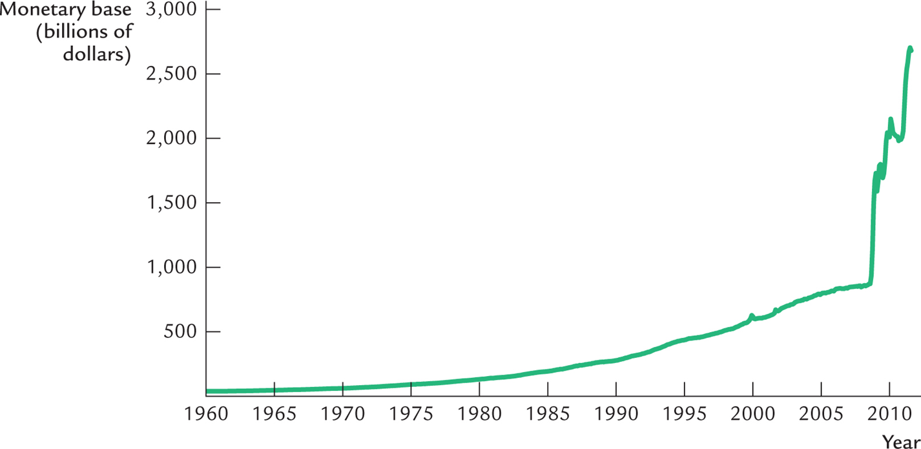
Figure 4.1 The Monetary Base

Slide 53
The Fed’s Monetary Control is Imperfect
Recall that $M=\frac{cd+1}{cd+rd}∙B$ and $m=\frac{cd+1}{cd+rd}$
The Fed can control the required minimum rd but not the actual rd. Banks may decide to keep reserves in excess of what is required.
The currency-deposit ratio is not under the Fed’s control. For example, when people are scared of keeping money in banks, cd increases.

Slide 54
Case Study: The 1930s
During the Great Depression of the 1930s, the monetary base increased but the money supply didn’t
Why?
Recall that $M=\frac{cd+1}{cd+rd}∙B$ and $m=\frac{cd+1}{cd+rd}$
Both cd and rd increased, which reduced m, making M grow slower than B

Slide 55
Case Study: The 1930s
Businesses were losing money and defaulting on their loans
This caused lots of bank failures
Ordinary depositors lost faith in banks and chose to keep their savings in cash
As a result, the cash-deposit ratio increased
This reduced the money multiplier
So, M rose slower than B
There was no FDIC then!

Slide 56
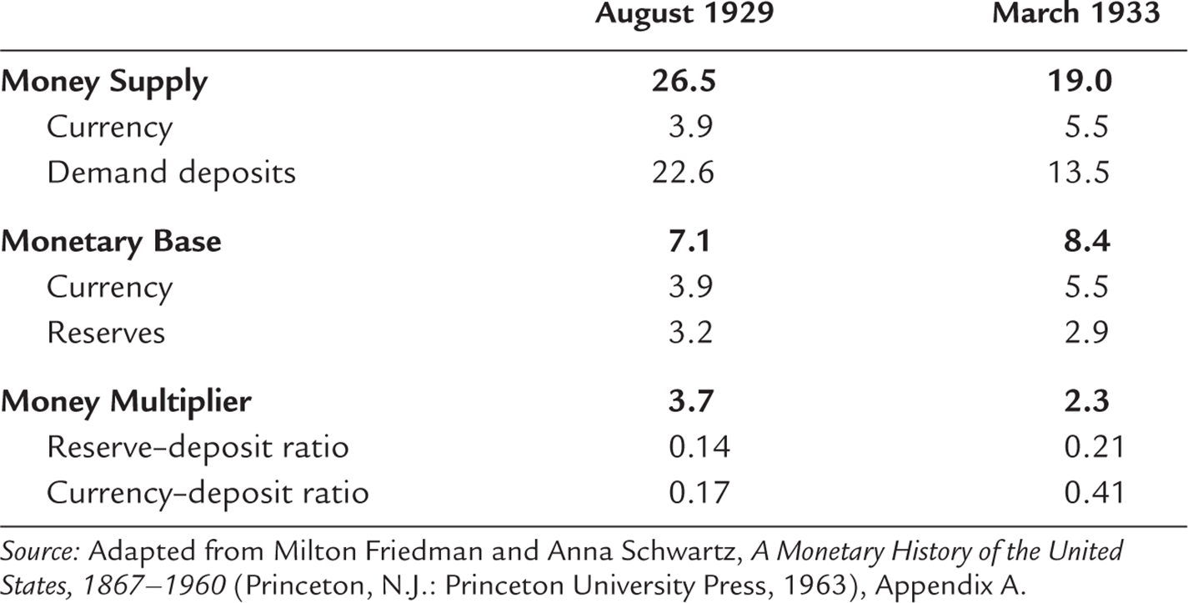
Table 4.2 The Money Supply and Its Determinants: 1929 and 1933

Slide 57
What’s Next?
In this chapter, we have studied what determines M
In the next chapter, we will see how M affects the economy in the long run

