Slide 1
Inflation: Its Causes, Effects, and Social Costs
Chapter 5 of Macroeconomics, 11th edition, by N. Gregory Mankiw
ECO 62 Udayan Roy

Slide 2
Nominal Variables
In Ch. 3 we saw a long-run theory of several real variables (Y, C, S, I, and r)
Real variables are inflation-adjusted variables
In this chapter we will see a long-run theory of three nominal variables:
The overall price level, P
The rate of inflation, π
The nominal interest rate, i
I will be discussing only sections 5-1 (only Case Study: Inflation and Money Growth), 5-3 and 5-4.

Slide 3
Nominal Variables and the Quantity of Money
We’ll see that all of our three nominal variables are, in the long run, driven primarily by the quantity of money in the economy
Recall that in Chapter 4 we discussed
money,
the quantity of money, and
the control of the quantity of money by a country’s central bank

Slide 4
The money supply and monetary policy definitions
The quantity of money available in the economy (M) is also called the money supply
Monetary policy is the control of the money supply.
The growth rate of the money supply is denoted M_{g}.
Both M and M_{g} are assumed exogenous
Notes:
Again, this is mostly review.

Slide 5
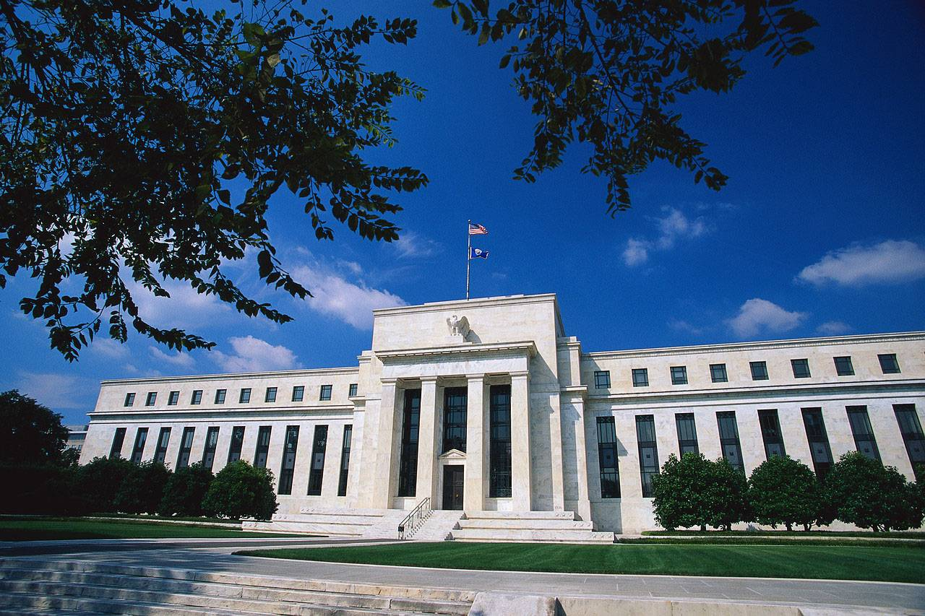
The Central Bank
Monetary policy is conducted by a country’s central bank.
In the U.S., the central bank is called the Federal Reserve (“the Fed”).
The Federal Reserve Building Washington, DC
Notes:
Again, this is mostly review.

Slide 6
Money Demand = Money Supply
Although a country’s central bank can control the money supply, ultimately the people must want to hold the money that the central bank wants them to hold
That is, the desired money demand of the people must be equal to the desired money supply of the central bank
How—by what mechanism—does the desired money demand of the people become equal to the desired money supply of the central bank?
We need to discuss money demand

Slide 7
Recap: interest rates
We studied this in Chapter 3

Slide 8
The Real Interest Rate
Imagine that lending and borrowing take place in our economy, but in commodities, not cash
That is, you may borrow some amount of the final good, as long as you pay back the quantity you borrowed plus a little bit extra as interest
The real interest rate (r) is the fraction of every unit of the final good borrowed that the borrower will have to pay to the lender as interest

Slide 9
The Nominal Interest Rate
On the other hand, the interest paid for cash loans is called the nominal interest rate (i)
It is the fraction of every dollar borrowed that the lender must pay in interest
The nominal interest rate is not adjusted for inflation

Slide 10
The Nominal Interest Rate: Example
Suppose you borrow $100 today and promise to pay back $110 a year from today
Here i = 0.10 or 10 percent
If prices are low a year from today, the purchasing power of the $10 you pay in interest will be high. So, you will regret the loss.
If prices are high a year from today, the purchasing power of the $10 you pay in interest will be low. You will not regret the loss as much.

Slide 11
The Real Interest Rate
In the case of cash loans, the real interest rate is the inflation-adjusted interest rate
To adjust the nominal interest rate for inflation, you simply subtract the inflation rate from the nominal interest rate
If the bank charges you 5% interest rate on a cash loan, that’s the nominal interest rate (i = 0.05).
If the inflation rate turns out to be 3% during the loan period (π = 0.03), then you paid the real interest rate of just 2% (r = i − π = 0.02)

Slide 12
The Real Interest Rate
The problem is that when you are taking out a loan you don’t quite know what the inflation rate will be over the loan period
So, economists distinguish between
the ex post real interest rate: r = i − π
and the ex ante real interest rate: r = i − Eπ, where Eπ is the expected inflation rate over the loan period

Slide 13
The Real Interest Rate
S = Y – C(Y-T) – G
r
S = F(K, L) – C(F(K, L) -T) – G
In Chapter 3, we also worked out the long-run theory of the (ex ante) real interest rate
The theory yielded several predictions
I(r) = I_{o} − I_{r}r
I
Predictions Grid
 | Y | C | S, I | r
K, L, A | + | + | + | −
Taxes, T | 0 | − | + | −
C-shock, C_{o} | 0 | + | − | +
Govt purchases, G | 0 | 0 | − | +
I-shock, I_{o} | 0 | 0 | 0 | +

Slide 14
Money demand

Slide 15
Money demand and the interest rate
We can keep our wealth (our assets) in two forms:
Liquid (money = currency + demand deposits)
Illiquid (stocks, bonds, real estate, a wine collection, etc.)
Our demand for money depends on whether money is as good a store of value as the illiquid assets

Slide 16
Money demand and the interest rate
Liquid assets are assumed to earn no interest
Illiquid assets are assumed to earn the nominal interest rate i
Therefore, an increase in i is assumed to reduce the demand for money
Assumption: the quantity of money demanded (M^{d}) is inversely related to the nominal interest rate (i)

Slide 17
Money demand and economic activity
We also hold some of our wealth in the form of money—instead of some illiquid asset—because money is an excellent medium of exchange, excellent for shopping
Therefore, the greater the need for shopping, the stronger will be the demand for money … and the need for shopping can be measured by nominal GDP
Assumption: the quantity of money demanded is directly related to nominal GDP

Slide 18
Money demand and economic activity
Let P represent the overall level of prices, as measured by the GDP Deflator (Ch. 2)
Recall that $\text{GDP} \text{Deflator}=\frac{\text{Nominal} \text{GDP}}{\text{Real} \text{GDP}}$
So, $\text{GDP} \text{Deflator}×\text{Real} \text{GDP}=\text{Nominal} \text{GDP}$
So, $P∙Y=\text{Nominal} \text{GDP}$
Assumption: the quantity of money demanded (M^{d}) is directly related to nominal GDP (P∙Y)

Slide 19
Money Demand
So, M^{d} is
inversely related to i, and
directly related to P∙Y
$M^{d}=L(i)∙P∙Y$
Here, L, is the desire for liquidity.
It is inversely related to i, the nominal interest rate.

Slide 20
Money Demand = Money Supply
For equilibrium in the money market we need the demand for money to be equal to the supply of money
$M^{d}=L\left(i\right)∙P∙Y=M$

Slide 21
Money Demand = Money Supply
$L\left(i\right)∙P∙Y=M$
We saw in Chapter 2 that the growth rate of a product of several variables is the sum of the growth rates of those variables.
Therefore, denoting growth rates by the g subscript, we get $L_{g}+P_{g}+Y_{g}=M_{g}$

Slide 22
Inflation
$L_{g}+P_{g}+Y_{g}=M_{g}$
Recall that the rate of inflation (π) is simply the growth rate of the overall level of prices (P_{g}): that is, π = P_{g}
Therefore, the equation above becomes $L_{g}+π+Y_{g}=M_{g}$
Therefore, π = M_{g} – L_{g} – Y_{g}

Slide 23
Growth Rates of Money and Output
Assumption: The growth rates of the quantity of money (M_{g}) and real GDP (Y_{g}) are both exogenous

Slide 24
Nominal Interest Rate: Simplifying assumption
I’ll make the following assumption to simplify our analysis
Assumption: In the long run, the nominal interest rate (i) stays constant over time
As a result, L(i) also stays constant over time
Therefore, its growth rate must be zero: L_{g} = 0

Slide 25
Nominal Interest Rate: Simplifying assumption
As L_{g} = 0, the equation π = M_{g} – L_{g} – Y_{g} we saw a few slides back becomes π = M_{g} – Y_{g}.
As both M_{g} and Y_{g} are assumed exogenous, we now have a solution for inflation (π)!
Our long-run theory of inflation is complete

Slide 26
Inflation in the Long Run
π = M_{g} – Y_{g}
In the long run, the inflation rate is equal to the rate at which the money supply grows minus the rate at which real GDP grows
Example: if real GDP grows at the annual rate of 3.5% and if the quantity of money grows at the annual rate of 4%, then the rate of inflation will be 0.5%
Inflation occurs when too much money chases too few goods

Slide 27
Inflation in the Long Run
Long-Run Predictions Grid (Ch. 3)
 | Y | C | S, I | r
K, L, Technology (A) | + | + | + | −
Taxes, T | 0 | − | + | −
C-shock, C_{o} | 0 | + | − | +
Govt, G | 0 | 0 | − | +
I-shock, I_{o} | 0 | 0 | 0 | +
Recall that one exogenous variable cannot, by definition, affect another exogenous variable
So, changes in K, L, A, T, C_{o}, G, and I_{o} cannot affect inflation π = M_{g} – Y_{g}.
And M_{g} – Y_{g} obviously has a direct effect on inflation because π = M_{g} – Y_{g}.
Long-Run Predictions Grid
 | Y | C | S, I | r | π
K, L, A | + | + | + | − | 0
T | 0 | − | + | − | 0
C_{o} | 0 | + | − | + | 0
G | 0 | 0 | − | + | 0
I_{o} | 0 | 0 | 0 | + | 0
M_{g} − Y_{g} | 0 | 0 | 0 | 0 | +

Slide 28
Expected Inflation: Simplifying Assumption
Assumption: In the long run, expected inflation equals actual inflation (Eπ = π)
Recall that $r=i−Eπ$
Therefore, $i=r+Eπ=r+π=r+M_{g}−Y_{g}$

Slide 29
Nominal Interest Rate in the Long Run
We just saw that $i=r+M_{g}−Y_{g}$
As we already have a theory of r from Chapter 3, and as both M_{g} and Y_{g} are exogenous, we now have a theory of the nominal interest rate (i) as well

Slide 30
Nominal Interest Rate in the Long Run
$i=r+M_{g}−Y_{g}$
Recall that changes in K, L, A, T, C_{o}, G, and I_{o} cannot affect inflation π = M_{g} – Y_{g}.
So their effect on i must be the same as their effect on r.
And, as M_{g} – Y_{g} has zero effect on r, any change in π = M_{g} – Y_{g} must cause an identical change in i.
This is called the Fisher Effect
Long-Run Predictions Grid
 | Y | C | S, I | r | π, Eπ | i
K, L, A | + | + | + | − | 0 | −
T | 0 | − | + | − | 0 | −
C-shock, C_{o} | 0 | + | − | + | 0 | +
G | 0 | 0 | − | + | 0 | +
I-shock, I_{o} | 0 | 0 | 0 | + | 0 | +
M_{g} − Y_{g} | 0 | 0 | 0 | 0 | + | +

Slide 31
Nominal Interest Rate in the Long Run
$i=r+M_{g}−Y_{g}$
Q: Can you see why the equation above yields the predictions in the i-column?
Next, the price level, P
Long-Run Predictions Grid
 | Y | C | S, I | r | π, Eπ | i
K, L, A | + | + | + | − | 0 | −
T | 0 | − | + | − | 0 | −
C-shock, C_{o} | 0 | + | − | + | 0 | +
G | 0 | 0 | − | + | 0 | +
I-shock, I_{o} | 0 | 0 | 0 | + | 0 | +
M_{g} − Y_{g} | 0 | 0 | 0 | 0 | + | +

Slide 32
The Overall Price Level in the Long Run
Recall that $L\left(i\right)∙P∙Y=M$ which implies $\frac{M}{L(i)∙Y}=P$
As we have already developed theories of the nominal interest rate (i) and real GDP (Y), and as the quantity of money (M) is exogenous, the above equation gives our theory of the overall price level (P)
We now have long-run theories for all three of our nominal variables (π, i, and P)!

Slide 33
The Overall Price Level in the Long Run
Let’s be more specific about L(i), which is the desire for liquidity
We have seen that the desire for liquidity is inversely related to the nominal interest rate
So, let $L\left(i\right)=\frac{L_{0}}{i}$
Here, L₀ is the liquidity shock. It represents all factors other than P, Y, and i that affect people’s demand for money.
L₀ represents wealth and the distrust of non-cash assets.

Slide 34
The Overall Price Level in the Long Run
Then $P=\frac{M}{L(i)∙Y}=\frac{M}{{(L}_{0}/i)∙Y}=\frac{M∙i}{L_{0}∙Y}$
Long-Run Predictions Grid (so far)
 | Y | C | S, I | r | π, Eπ | i
K, L, A | + | + | + | − | 0 | −
T | 0 | − | + | − | 0 | −
C-shock, C_{o} | 0 | + | − | + | 0 | +
G | 0 | 0 | − | + | 0 | +
I-shock, I_{o} | 0 | 0 | 0 | + | 0 | +
M_{g} − Y_{g} | 0 | 0 | 0 | 0 | + | +
Long-Run Predictions Grid
 | Y | C | S, I | r | π, Eπ | i | P
K, L, A | + | + | + | − | 0 | − | −
T | 0 | − | + | − | 0 | − | −
C-shock, C_{o} | 0 | + | − | + | 0 | + | +
G | 0 | 0 | − | + | 0 | + | +
I-shock, I_{o} | 0 | 0 | 0 | + | 0 | + | +
M_{g} − Y_{g} | 0 | 0 | 0 | 0 | + | + | +
M | 0 | 0 | 0 | 0 | 0 | 0 | +
L-shock, L₀ | 0 | 0 | 0 | 0 | 0 | 0 | −

Slide 35
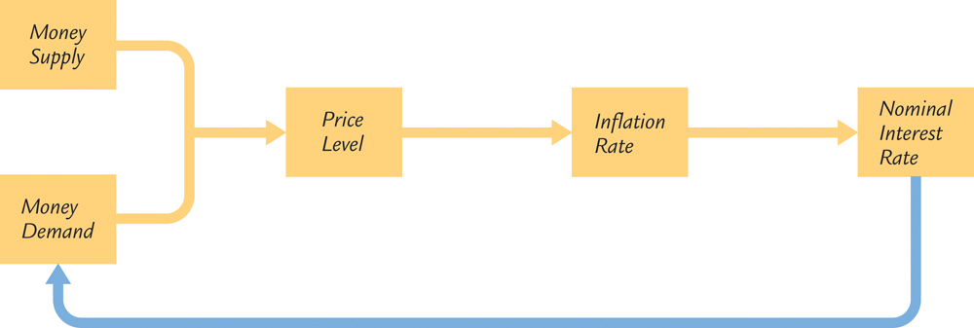
Figure 5-5: Simultaneous links

Slide 36
Solving it all, step by step!
M, L(i)
P = M/L(i)Y
i = r + π
I(r)
G
r
π
K, L, F(K, L)
Y
S = I = Y – C – G
C
C(Y – T), T
M_{g},Y_{g}, π = M_{g} – Y_{g}

Slide 37
The Overall Price Level in the Long Run: Exercise
We just saw that $P=\frac{M∙i}{L_{0}∙Y}$ is the long-run equation for the price level.
Q: Can you see why the above equation algebraically implies the predictions in the last column (P)?
Long-Run Predictions Grid
 | Y | C | S, I | r | π, Eπ | i | P
K, L, A | + | + | + | − | 0 | − | −
T | 0 | − | + | − | 0 | − | −
C-shock, C_{o} | 0 | + | − | + | 0 | + | +
G | 0 | 0 | − | + | 0 | + | +
I-shock, I_{o} | 0 | 0 | 0 | + | 0 | + | +
M_{g} − Y_{g} | 0 | 0 | 0 | 0 | + | + | +
M | 0 | 0 | 0 | 0 | 0 | 0 | +
L-shock, L₀ | 0 | 0 | 0 | 0 | 0 | 0 | −

Slide 38
Static Long-Run Macroeconomics in one slide!
$Y=A∙K^{0.3}L^{0.7}$
$C=C_{0}+C_{y}∙(Y−T)$
$I=S=Y−C−G$
$I=I_{0}−I_{r}∙r$ which gives $r=\frac{I_{0}−I}{I_{r}}$
$π=M_{g}−Y_{g}$
$i=r+π$
$M=\frac{L_{0}}{i}∙P∙Y$ which gives $P=\frac{M∙i}{L_{0}∙Y}$
Long-Run Predictions Grid
 | Y | C | S, I | r | π, Eπ | i | P
K, L, A | + | + | + | − | 0 | − | −
T | 0 | − | + | − | 0 | − | −
C-shock, C_{o} | 0 | + | − | + | 0 | + | +
G | 0 | 0 | − | + | 0 | + | +
I-shock, I_{o} | 0 | 0 | 0 | + | 0 | + | +
M_{g} − Y_{g} | 0 | 0 | 0 | 0 | + | + | +
M | 0 | 0 | 0 | 0 | 0 | 0 | +
L-shock, L₀ | 0 | 0 | 0 | 0 | 0 | 0 | −
Variables in red font are endogenous. Variables in black font are exogenous.

Slide 39
Long-Run Macroeconomics (Static)
Note that the money supply and its growth rate have no effect on the real endogenous variables
This result is called monetary neutrality
It holds in long-run theory, but not in short-run theory
Long-Run Predictions Grid
 | Y | C | S, I | r | π, Eπ | i | P
K, L, A | + | + | + | − | 0 | − | −
T | 0 | − | + | − | 0 | − | −
C-shock, C_{o} | 0 | + | − | + | 0 | + | +
G | 0 | 0 | − | + | 0 | + | +
I-shock, I_{o} | 0 | 0 | 0 | + | 0 | + | +
M_{g} − Y_{g} | 0 | 0 | 0 | 0 | + | + | +
M | 0 | 0 | 0 | 0 | 0 | 0 | +
L-shock, L₀ | 0 | 0 | 0 | 0 | 0 | 0 | −

Slide 40
Long-Run Macroeconomics (Static)
Recall that i = r + Eπ = r + π, assuming expected inflation = actual inflation
This yields the Fisher Effect: whatever affects inflation also has an identical effect on the nominal interest rate
Long-Run Predictions Grid
 | Y | C | S, I | r | π, Eπ | i | P
K, L, A | + | + | + | − | 0 | − | −
T | 0 | − | + | − | 0 | − | −
C-shock, C_{o} | 0 | + | − | + | 0 | + | +
G | 0 | 0 | − | + | 0 | + | +
I-shock, I_{o} | 0 | 0 | 0 | + | 0 | + | +
M_{g} − Y_{g} | 0 | 0 | 0 | 0 | + | + | +
M | 0 | 0 | 0 | 0 | 0 | 0 | +
L-shock, L₀ | 0 | 0 | 0 | 0 | 0 | 0 | −

Slide 41
Long-Run Macroeconomics (Static)
Exercise: Fill the blanks with + (same direction effect), – (opposite direction effect), 0 (no effect), or ? (uncertain effect).
Long-Run Predictions Grid
 | Y | C | S, I | r | π, Eπ | i | P
K, L, A
T
C-shock, C_{o}
G
I-shock, I_{o}
M_{g} − Y_{g}
M
L-shock, L₀

Slide 42
evidence

Slide 43
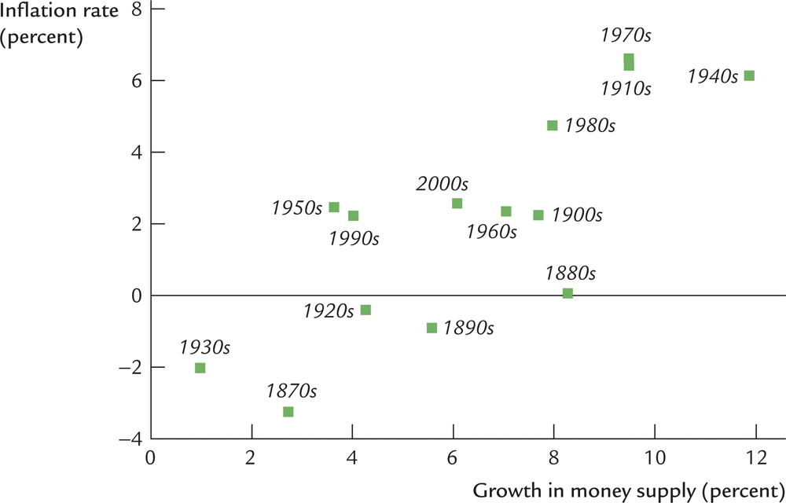
Figure 5 – 1: US Inflation and Money Growth

Slide 44
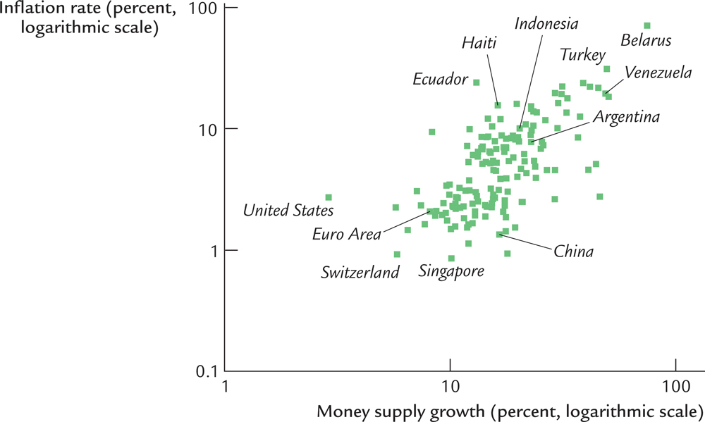
Figure 5 – 2: International Data on Inflation and Money Growth

Slide 45
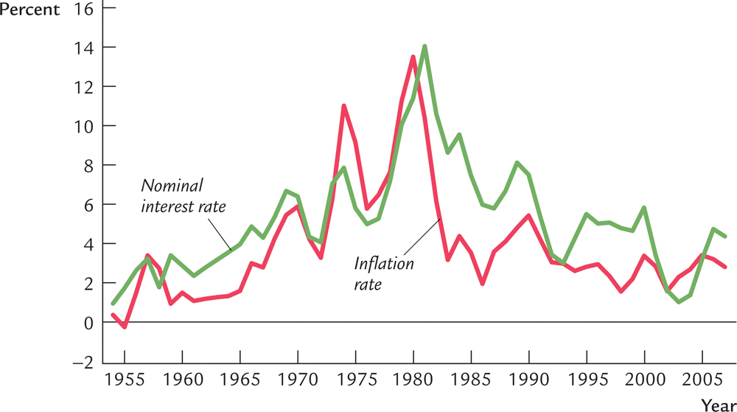
Figure 5 – 3: Fisher Effect in US Data

Slide 46
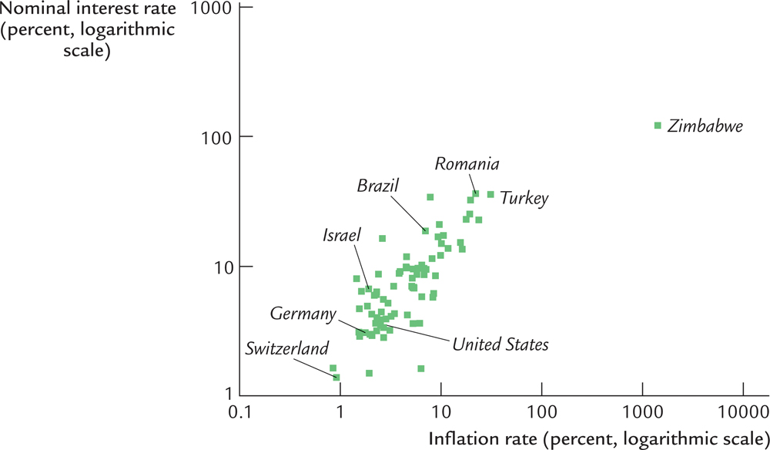
Figure 5 – 4: Fisher Effect in International Data

Slide 47
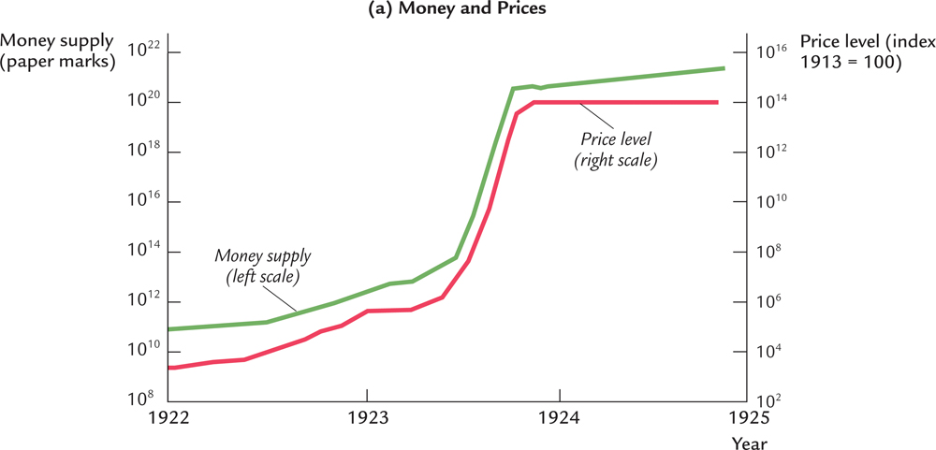
Figure 5 – 6: Money and Prices in Interwar Germany

