Slide 1
Introduction to Economic Fluctuations
PART IV Business Cycle Theory: The Economy in the Short Run
Chapter 10 of Macroeconomics, 10th edition, by N. Gregory Mankiw
ECO62 Udayan Roy

Slide 2
Short-Run Fluctuations
We have discussed the behavior of an economy in the long run
In the short run, the economy fluctuates around its long-run path
We need to understand why these fluctuations happen …
… and what can be done to stabilize the economy—as far as possible—when fluctuations occur

Slide 3
Business-cycle facts

Slide 4
Some facts about the business cycle
GDP growth averages 3 to 3.5 percent per year in the US over the long run
But there are large fluctuations in the short run.
Consumption and investment fluctuate with GDP, but consumption tends to be less volatile and investment more volatile than GDP.
Unemployment rises during recessions and falls during expansions.
Okun’s Law: there is a reliable negative relationship between the GDP growth rate and changes in the unemployment rate.
Notes:
The four slides that follow provide data on each of these points. If you wish, you can “hide” (omit) this slide from your presentation, and instead give students this information verbally as you display the following slides.

Slide 5
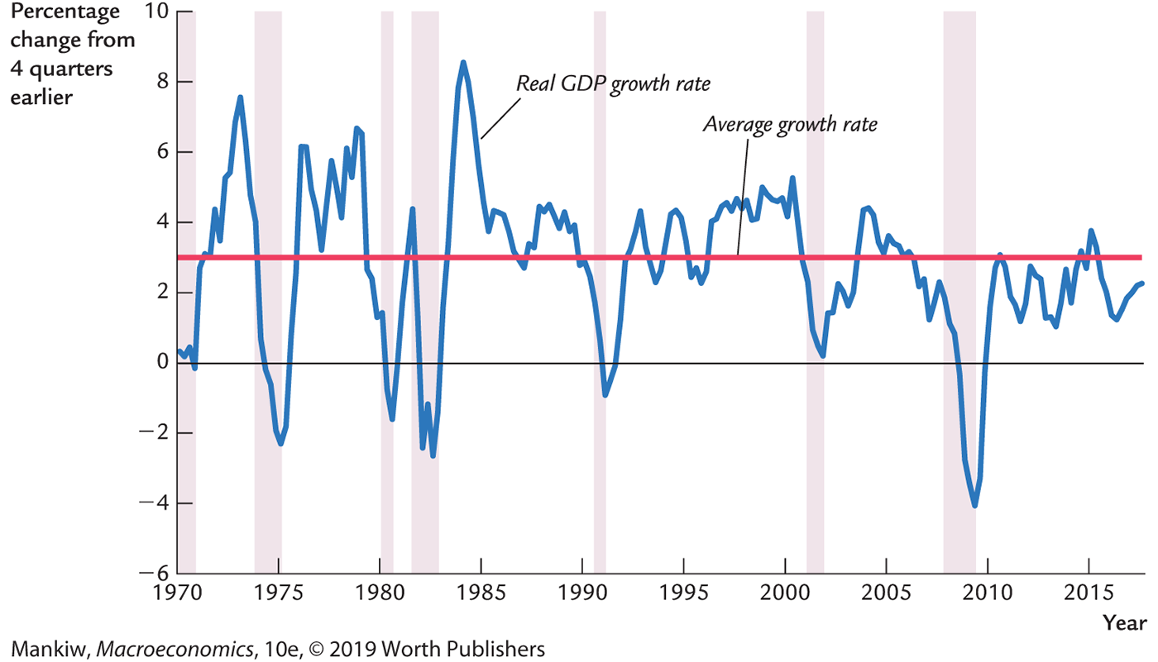
Real GDP Growth in the United States

Slide 6
Growth rates of real GDP, consumption
Percent change from 4 quarters earlier
Real GDP growth rate
Consumption growth rate
Average growth rate
Notes:
The shaded vertical bars denote recessions.
Over the long run, real GDP grows about 3 percent per year. Over the short run, though, there are substantial fluctuations in GDP, as this graph clearly shows.
This graph also shows the growth rate of consumption. It’s easy to see that consumption is usually less volatile than income. Consumers prefer smooth consumption, so they use saving as a buffer against income shocks.
(An exception occurs in the late 1990s, when consumption growth exceeded income growth – probably due to the stock market boom.)
Source of data: FRED

Slide 7
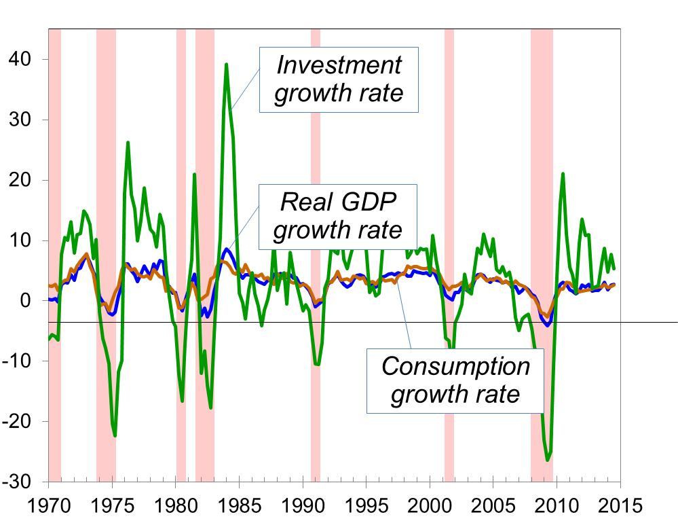
Growth of GDP and Its Components in the US
Percent change from 4 quarters earlier

Slide 8
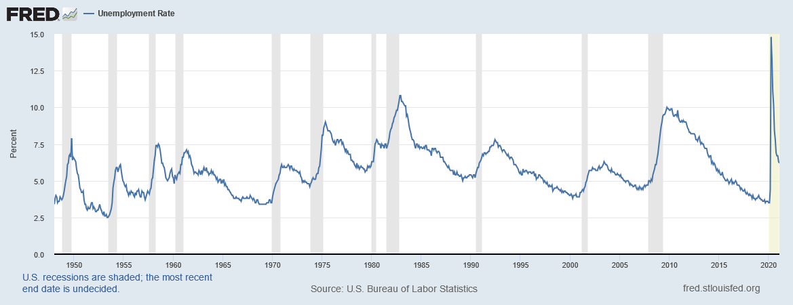
Unemployment in the United States
Notes:
Downloaded on 3/24/2021 from https://fred.stlouisfed.org/series/UNRATE

Slide 9
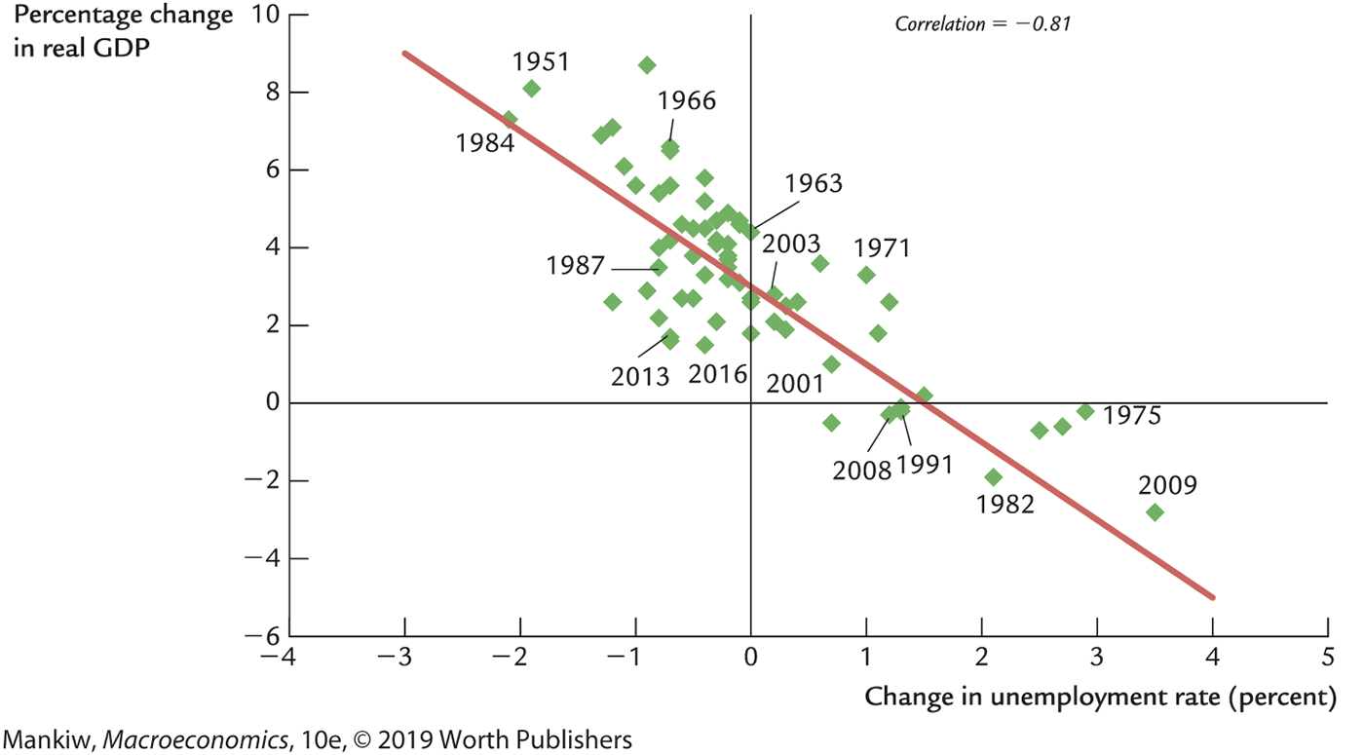
Okun’s Law
Percentage increase in real GDP | Percentage point increase in unemployment rate
7 | -2
5 | -1
3 | 0
1 | 1
-1 | 2

Slide 10
Index of Leading Economic Indicators
Published monthly by the Conference Board.
Aims to forecast changes in economic activity 6-9 months into the future.
Used in planning by businesses and government, even though ILEI is not a perfect predictor.

Slide 11
Index of Leading Economic Indicators, 1970-2012
2004 = 100
Source: Conference Board
Notes:
The index turns downward a few months to a year before almost every recession. It also turns upward just prior to the end of almost every recession.
Source: Conference Board. http://www.conference-board.org

Slide 12
Components of the ILEI
Average workweek in manufacturing
Initial weekly claims for unemployment insurance (–)
Manufacturers’ new orders for consumer goods and materials
Manufacturers’ new orders for nondefense capital goods, excluding aircraft
Institute for Supply Management new orders index
Building permits issued for new private housing units
Index of stock prices
Leading Credit Index
Interest rate spread (yield on 10-year Treasury bonds minus the federal funds rate)
Consumer expectations for business and economic conditions
Notes:
I’ve abbreviated some of the names to fit more neatly on this slide.
Pp. 281–283 provides a full list of complete names and a discussion of the role of each component in helping forecast economic activity.

Slide 13
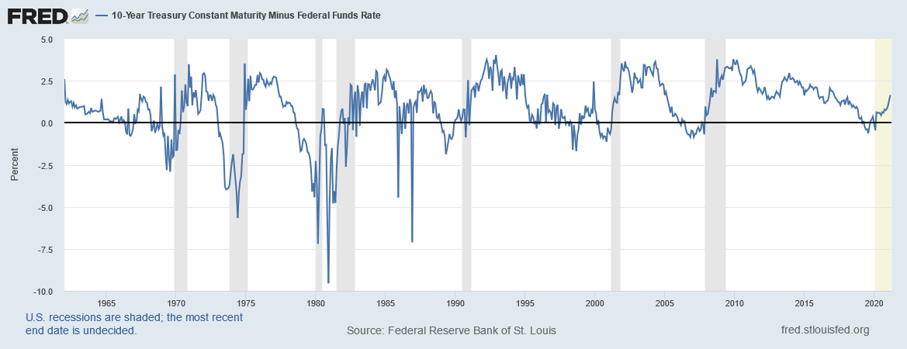
Components of the ILEI: Interest Rate Spread
Average workweek in manufacturing
Initial weekly claims for unemployment insurance (–)
Manufacturers’ new orders for consumer goods and materials
Manufacturers’ new orders for nondefense capital goods, excluding aircraft
Institute for Supply Management new orders index
Building permits issued for new private housing units
Index of stock prices
Leading Credit Index
Interest rate spread (yield on 10-year Treasury bonds minus the federal funds rate)
Consumer expectations for business and economic conditions
Source: https://fred.stlouisfed.org/series/T10YFF. Note that the Interest Rate Spread turns negative (gets “inverted”) before recessions.
Notes:
https://fred.stlouisfed.org/series/T10YFF
Also called the slope of the yield curve. Higher value means that interest rates are expected to rise, which typically occurs when economic activity increases.
Downloaded on March 31, 2021.

Slide 14
Components of the ILEI: Yield Curve
Closely related to the Interest Rate Spread is the Yield Curve
The Yield Curve shows the interest rates on US Treasury Bonds for bonds with increasing maturity
For example, the Yield Curve shows the interest rates on 3-month US Treasury Bonds as well as 10-year US Treasury Bonds
Higher values of 10-year interest rate minus 3-month interest rate signals improving prospects
Conversely, 10-year interest rate minus 3-month interest rate < 0 – also called an inverted yield curve – signals an approaching recession
See this video: https://youtu.be/DCQwiF0J7hw

Slide 15
Components of the ILEI: Yield Curve
Source: https://fred.stlouisfed.org/series/T10Y3M
Notes:
Downloaded on March 31, 2021

Slide 16
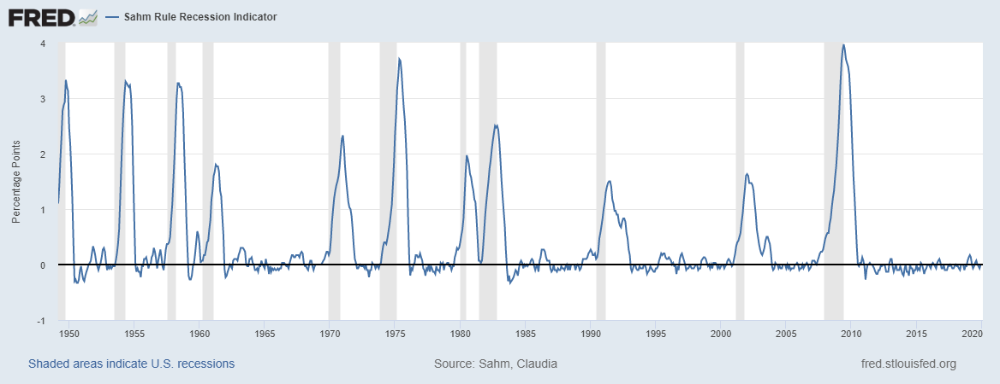
Sahm Rule Recession Indicator
Sahm Recession Indicator signals the start of a recession when the three-month moving average of the national unemployment rate (U3) rises by 0.50 percentage points or more relative to its low during the previous 12 months.
Notes:
Sahm Recession Indicator signals the start of a recession when the three-month moving average of the national unemployment rate (U3) rises by 0.50 percentage points or more relative to its low during the previous 12 months.
Sahm, Claudia, Sahm Rule Recession Indicator [SAHMCURRENT], retrieved from FRED, Federal Reserve Bank of St. Louis; https://fred.stlouisfed.org/series/SAHMCURRENT, March 16, 2020.
See https://www.reuters.com/article/us-usa-fed-sahm/sahm-rule-enters-fed-lexicon-as-fast-real-time-recession-flag-idUSKBN1WJ12J
See https://www.wsj.com/articles/are-we-in-a-recession-experts-agree-ask-claudia-sahm-11572789602

Slide 17
Short-run Price stickiness is the root cause of fluctuations

Slide 18
Time horizons in macroeconomics
Long run Prices are flexible, respond to changes in supply or demand.
Short run Many prices are “sticky” at a predetermined level.
The economy behaves very differently when prices are sticky.
Notes:
The material on this slide was introduced in Chapter 1. Since it’s been a while since your students read that chapter, it’s probably worth repeating at this point, especially since the behavior of prices is so critical for understanding short-run fluctuations.
It might also be worth reminding them that they (and most adults) are already aware of the concept of sticky prices. If they have a favorite beverage at Starbucks, ask if they can remember when its price was last increased. If they work, ask how long they go between wage changes. Sticky prices are a fact of everyday life, even if most adults have not heard the term “sticky prices” or studied the implications of sticky prices for short-run economic fluctuations.

Slide 19
Frequency of Price Adjustment
Firms’ answers to the question: How often do the prices of your most important products change in a typical year?
Frequency | Percentage of Firms
Less than once | 10.2
Once | 39.3
1.01 to 2 | 15.6
2.01 to 4 | 12.9
4.01 to 12 | 7.5
12.01 to 52 | 4.3
52.01 to 365 | 8.6
More than 365 | 1.6
Source: Alan S. Blinder, “On Sticky Prices: Academic Theories Meet the Real World,” in N. G. Mankiw, ed., Monetary Policy (Chicago: University of Chicago Press, 1994), 117—154, Table 4.1.

Slide 20
Reasons for Price Stickiness
Firms hold back on price changes waiting for others to go first
Price increases are delayed until costs rise
Firms prefer to vary product and service quality
Firms don’t want to look opportunistic
Prices are fixed by long-term contracts
Firms incur costs (“menu costs”)
When demand decreases, price changes have less effect
Certain prices (e.g., $9.99) have psychological significance
Firms adjust warehouse stocks (inventories) when demand changes
Production costs do not vary much with output
Bureaucratic delays within firms can delay price changes
Firms fear that people will interpret price cuts as reductions in quality

Slide 21
Recap of classical macro theory (Chaps. 3-9)
Output is determined by the supply side:
supplies of capital, labor
Technology
Y = F(K, L)
Changes in demand for goods and services (C, I, G) only affect interest rates (r) and prices (P), not output.
Assumes complete flexibility of overall price level (P).
Applies to the long run.
Notes:
Classical macroeconomic theory is what students learned in chapters 3-9. This slide recaps an important lesson from classical theory, which stands in sharp contrast to what we are about to cover now.

Slide 22
Recap of Ch. 5: Static Long-Run Macroeconomics in one slide!
$Y=A∙K^{0.3}L^{0.7}$
$C=C_{0}+C_{y}∙(Y−T)$
$I=S=Y−C−G$
$I=I_{0}−I_{r}∙r$ which gives $r=\frac{I_{0}−I}{I_{r}}$
$π=M_{g}−Y_{g}$
$i=r+π$
$M=\frac{L_{0}}{i}∙P∙Y$ which gives $P=\frac{M∙i}{L_{0}∙Y}$
Not used in short-run macroeconomic theory
P and π are exogenous in short-run macroeconomic theory
Long-Run Predictions Grid
 | Y | C | S, I | r | π, Eπ | i | P
K, L, A | + | + | + | − | 0 | − | −
T | 0 | − | + | − | 0 | − | −
C_{o} | 0 | + | − | + | 0 | + | +
G | 0 | 0 | − | + | 0 | + | +
I_{o} | 0 | 0 | 0 | + | 0 | + | +
M_{g} − Y_{g} | 0 | 0 | 0 | 0 | + | + | +
M | 0 | 0 | 0 | 0 | 0 | 0 | +
L₀ | 0 | 0 | 0 | 0 | 0 | 0 | −
Not used in short-run macroeconomic theory
Variables in red font are endogenous. Variables in black font are exogenous.

Slide 23
When prices are sticky…
… output and employment also depend on demand,
And demand is affected by:
fiscal policy: government purchases (G) and taxes (T)
monetary policy: the quantity of money (M)
other factors, like exogenous changes in C or I or NX.
Notes:
Chapters 10-12 focus on the closed economy case. In an open economy, the list of things that affect aggregate demand is a bit larger. (See Chapter 13.)

Slide 24
The role of price stickiness
If P is flexible, major recessions, in theory, could not occur
Under price and wage flexibility, if any recession did occur it would quickly be over …
… because unemployed workers would accept lower and lower wages, prices would drop, and people would flock to the malls, thereby ending the recession
To explain why recessions do in fact occur, we therefore need to assume that prices are sticky or rigid

Slide 25
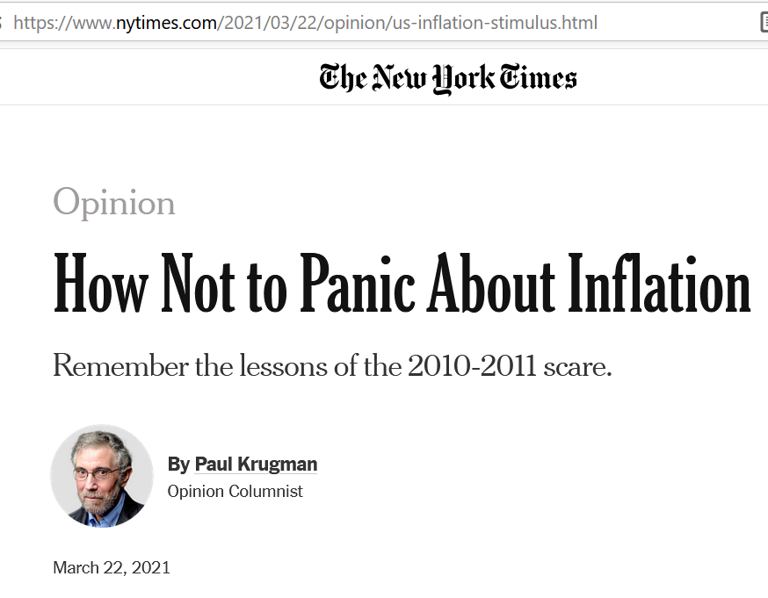
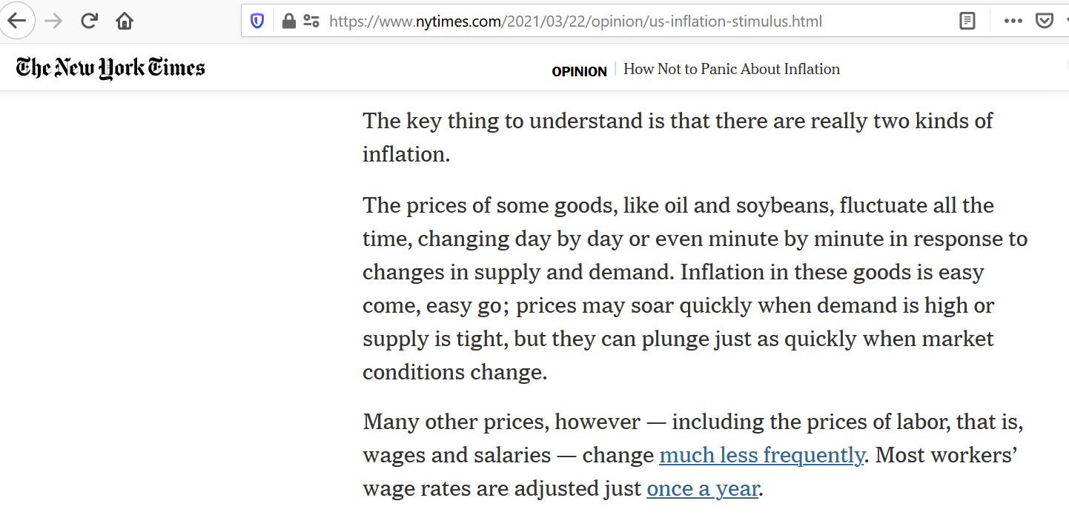

Slide 26
“Price Stickiness”
Price stickiness does not necessarily mean that the overall level of prices (P) is constant or unchanging
All that price stickiness means is that P no longer responds to the economic factors that you would expect to affect P
P may increase or decrease in the short run, but in that case it would be doing so purely on momentum or some exogenous reason, and not because of some economic cause

Slide 27
The role of shocks
Price stickiness helps us explain why an economy that has fallen into a recession may continue in a recession
But price stickiness does not explain why the economy got into trouble in the first place
For that we need shocks that can explain why businesses may suddenly see there customers stop buying

Slide 28
The role of shocks
Consumption function: C = C_{o} + C_{y}(Y – T)
Investment function: I = I_{o} − I_{r}r
Net exports function: NX = NX_{o} − NX_{ε}ε
Fiscal policy: government purchases (G) and taxes (T)
Monetary policy: the quantity of money (M)
Business and production costs
These shocks can throw an economy off its long-run path
Price stickiness then impedes a quick bounce back to the long-run path

Slide 29
The role of shocks
Consumption function: C = C_{o} + C_{y}(Y – T)
Investment function: I = I_{o} − I_{r}r
Net exports function: NX = NX_{o} − NX_{ε}ε
Fiscal policy: government purchases (G) and taxes (T)
Monetary policy: the quantity of money (M)
Business and production costs
These shocks can throw an economy off its long-run path
Price stickiness then impedes a quick bounce back to the long-run path
C₀ could represent shocks to consumption spending such as the coronavirus pandemic and massive decreases in asset prices.

Slide 30
The role of shocks
Consumption function: C = C_{o} + C_{y}(Y – T)
Investment function: I = I_{o} − I_{r}r
Net exports function: NX = NX_{o} − NX_{ε}ε
Fiscal policy: government purchases (G) and taxes (T)
Monetary policy: the quantity of money (M)
Business and production costs
These shocks can throw an economy off its long-run path
Price stickiness then impedes a quick bounce back to the long-run path
I₀ could represent shocks to investment spending such as the coronavirus pandemic and erratic behavior by a nation’s leaders.

Slide 31
The role of shocks
Consumption function: C = C_{o} + C_{y}(Y – T)
Investment function: I = I_{o} − I_{r}r
Net exports function: NX = NX_{o} − NX_{ε}ε
Fiscal policy: government purchases (G) and taxes (T)
Monetary policy: the quantity of money (M)
Business and production costs
These shocks can throw an economy off its long-run path
Price stickiness then impedes a quick bounce back to the long-run path
NX₀ could represent shocks to net exports such as steep declines in foreign GDP and steep increases in their tariff rates.

Slide 32
The role of shocks
Consumption function: C = C_{o} + C_{y}(Y – T)
Investment function: I = I_{o} − I_{r}r
Net exports function: NX = NX_{o} − NX_{ε}ε
Fiscal policy: government purchases (G) and taxes (T)
Monetary policy: the quantity of money (M)
Business and production costs
These shocks can throw an economy off its long-run path
Price stickiness then impedes a quick bounce back to the long-run path
A common and significant example of shocks to business and production costs is the price of imported oil.

Slide 33
Stabilization policy

Slide 34
Fiscal Policy
We saw in Ch. 3 that, in the long run, changes in government purchases (G) and taxes (T) have no effect on output (Y)
But, in the short run, G and T can affect Y
Therefore, G and T can be used to stabilize Y and other economic variables when shocks are causing fluctuations

Slide 35
Monetary Policy
We saw in Chs. 4 and 5 that, in the long run, changes in the quantity of money determined by the central bank (M) affect only the overall price level (P) and have no effect on output (Y)
Recall “classical dichotomy” and “monetary neutrality”
But, in the short run, M cannot affect P, which is sticky, but it can affect Y
Therefore, M can be used to stabilize Y and other economic variables

Slide 36
Case study: shocks to business costs

Slide 37
Supply shocks
A supply shock alters production costs, affects the prices that firms charge. (also called price shocks)
Examples of adverse supply shocks:
Bad weather reduces crop yields, pushing up food prices.
Workers unionize, negotiate wage increases.
New environmental regulations require firms to reduce emissions. Firms charge higher prices to help cover the costs of compliance.
A virus pandemic forces workers to stay home
Favorable supply shocks lower costs and prices.

Slide 38
CASE STUDY: The 1970s oil shocks
Early 1970s: The organization of petroleum exporting countries (OPEC) coordinated a reduction in the supply of oil.
Oil prices rose 11% in 1973 68% in 1974 16% in 1975
Such sharp oil price increases are supply shocks because they significantly impact production costs and prices.
Notes:
Oil is required to heat the factories in which goods are produced, and to fuel the trucks that transport the goods from the factories to the warehouses to Walmart stores. A sharp increase in the price of oil, therefore, has a substantial effect on production costs.

Slide 39
CASE STUDY: The 1970s oil shocks
Predicted effects of the oil shock:
inflation ↑
output ↓
unemployment ↑
… and then a gradual recovery.
Notes:
This slide first summarizes the model’s predictions from the preceding slide, and then presents data (from the text, p.282) that supports the model’s predictions.

Slide 40
CASE STUDY: The 1970s oil shocks
Late 1970s:
As the economy began recovering, oil prices shot up again, causing another huge supply shock!!!
Notes:
Data source: See p.282 of the textbook.
This second shock was associated with the revolution in Iran. The Shah, who maintained cordial relations with the West, was deposed. The new leader, Ayatollah Khomeini, was considerably less friendly toward the West. (He even forbade his citizens from listening to Western music.)

Slide 41
CASE STUDY: The 1980s oil shocks
1980s:
A favorable supply shock! A significant fall in oil prices.
As theory would predict, inflation and unemployment fell.
Notes:
A few slides back, we analyzed the effects of an adverse supply shock. It might be worth noting that the predicted effects of a favorable supply shock are just the opposite: in the short run, the price level (or inflation rate) falls, output rises, and unemployment falls.
Looking at the graph: at first glance, it may seem that the fall in oil prices doesn’t occur until 1986. But remind students to look at the left-hand scale, on which 0 is in the middle, not at the bottom. Oil prices fell about 10% in 1982, and generally fell during most years between 1982 and 1986.

Slide 42
Next: Static Short-Run Theory
In our discussion of long-run macroeconomics, we did static theory first and dynamic theory later.
We’ll follow the same pattern in our discussion of short-run macroeconomics
Chs. 11 and 12: a static theory called IS-LM theory
Ch. 15: a dynamic theory called DAD-DAS theory
We’ll end the course with Ch. 20 on the financial system

