Slide 1
A Dynamic Model of Aggregate Demand and Aggregate Supply
PART V Topics in Macroeconomic Theory
Chapter 15 of Macroeconomics, 8th edition, by N. Gregory Mankiw
ECO62 Udayan Roy

Slide 2
Inflation and dynamics in the short run
So far, to analyze the short run we have used
  the Keynesian Cross theory, and
  the IS-LM theory
Both theories are silent about
  Inflation, and
  Dynamics
This chapter presents a dynamic short-run theory of output, inflation, and interest rates.
This is the model of dynamic aggregate demand and dynamic aggregate supply (DAD-DAS)

Slide 3
Introduction
The dynamic model of aggregate demand and aggregate supply (DAD-DAS) determines both
  real GDP (Y), and
  the inflation rate (π)
This theory is dynamic in the sense that the outcome in one period affects the outcome in the next period
  like the Solow-Swan model, but for the short run

Slide 4
Introduction
Instead of representing monetary policy by an exogenous money supply, the central bank will now be seen as following a monetary policy rule
  The central bank’s monetary policy rule adjusts interest rates automatically when output or inflation are not where they should be.

Slide 5
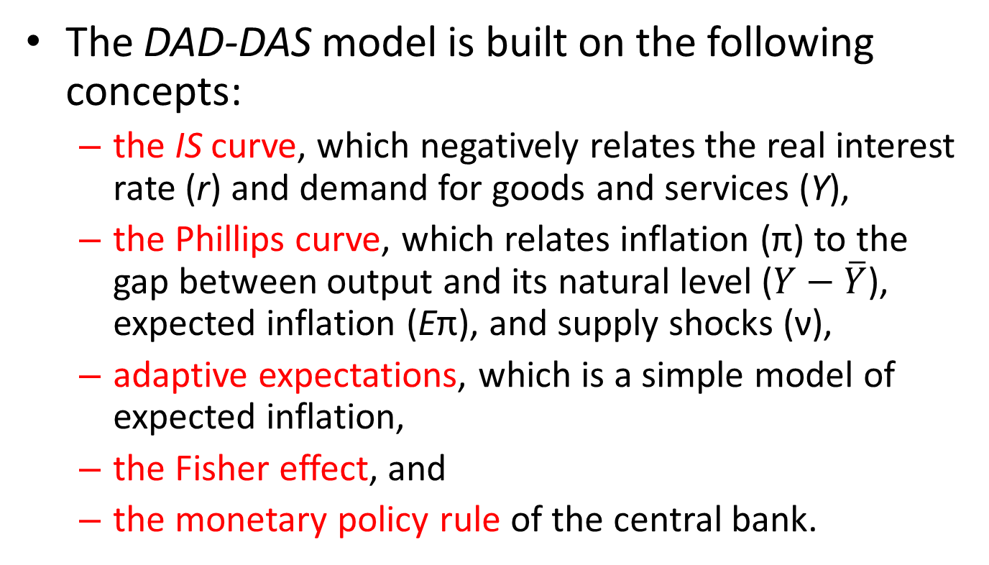
Introduction
The DAD-DAS model is built on the following concepts:
  the IS curve, which negatively relates the real interest rate (r) and demand for goods and services (Y),
  the Phillips curve, which relates inflation (π) to the gap between output and its natural level ($Y−\overline{Y}$), expected inflation (Eπ), and supply shocks (ν),
  adaptive expectations, which is a simple model of expected inflation,
  the Fisher effect, and
  the monetary policy rule of the central bank.

Slide 6
Keeping track of time
The subscript “t ” denotes a time period, e.g.
  Y_{t} = real GDP in period t
  Y_{t − 1} = real GDP in period t – 1
  Y_{t + 1} = real GDP in period t + 1
We can think of time periods as years.
E.g., if t = 2008, then
  Y_{t} = Y₂₀₀₈ = real GDP in 2008
  Y_{t − 1} = Y₂₀₀₇ = real GDP in 2007
  Y_{t + 1} = Y₂₀₀₉ = real GDP in 2009

Slide 7
The model’s elements
The model has five equations and five endogenous variables:
  output, inflation, the real interest rate, the nominal interest rate, and expected inflation.
The first equation is for output…

Slide 8
DAD-DAS: 5 Equations
Demand Equation
Fisher Equation
Phillips Curve
Adaptive Expectations
Monetary Policy Rule

Slide 9
The Demand Equation
Natural (or long-run or potential) Real GDP
Real interest rate
Natural (or long-run) Real interest rate
Real GDP
Parameter representing the response of demand to the real interest rates
Demand shock, represents changes in G, T, C₀, and I₀

Slide 10
The Demand Equation
Assumption: ρ > 0; although the real interest rate can be negative, in the long run people will not lend their resources to others without a positive return. This is the long-run real interest rate we had calculated in Ch. 3
α > 0
Positive when C₀, I₀, or G is higher than usual or T is lower than usual.
Assumption: There is a negative relation between output (Y_{t}) and interest rate (r_{t}). The justification is the same as for the IS curve of Ch. 11

Slide 11




IS Curve = Demand Equation
This graph is from Ch. 11
Assume the IS curve is a straight line
Then, for any pair of points—A and B, or C and B—the slope must be the same
r
A
r_{t}
B
$$\overline{r}$$
IS
Y_{t}
$$\overline{Y}$$
Y
r
C
r_{t}
B
$$\overline{r}$$
IS
Y_{t}
$$\overline{Y}$$
Y

Slide 12
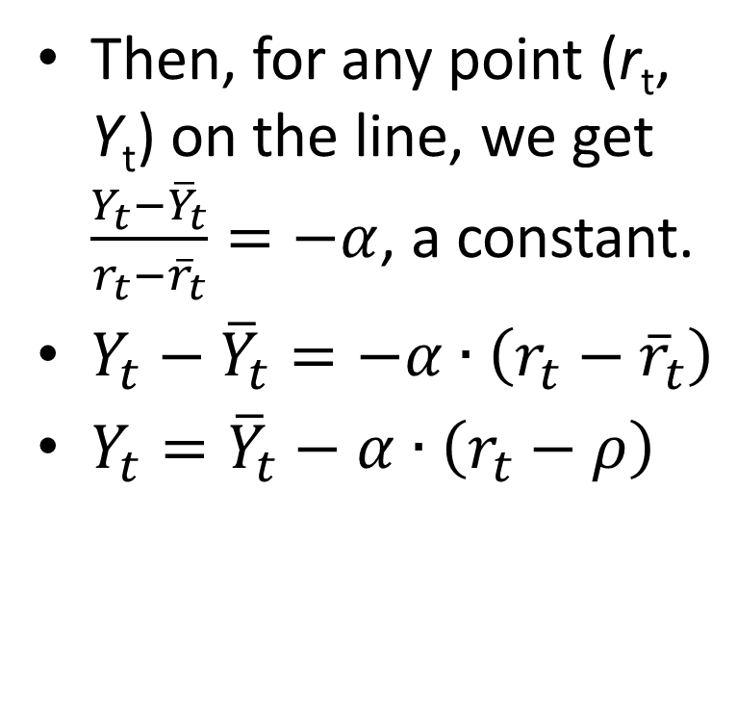
IS Curve = Demand Equation
Then, for any point (r_{t}, Y_{t}) on the line, we get $\frac{Y_{t}−{\overline{Y}}_{t}}{r_{t}−{\overline{r}}_{t}}=−α$, a constant.
$Y_{t}−{\overline{Y}}_{t}=−α∙\left(r_{t}−{\overline{r}}_{t}\right)$
$Y_{t}={\overline{Y}}_{t}−α∙\left(r_{t}−ρ\right)$
r
r_{t}
$$\overline{r}$$
IS
Y_{t}
$$\overline{Y}$$
Y
r
r_{t}
$$\overline{r}$$
The long-run real equilibrium interest rate of Figure 3-8 in Ch. 3 is now denoted by the lower-case Greek letter ρ.
IS
Y_{t}
$$\overline{Y}$$
Y

Slide 13
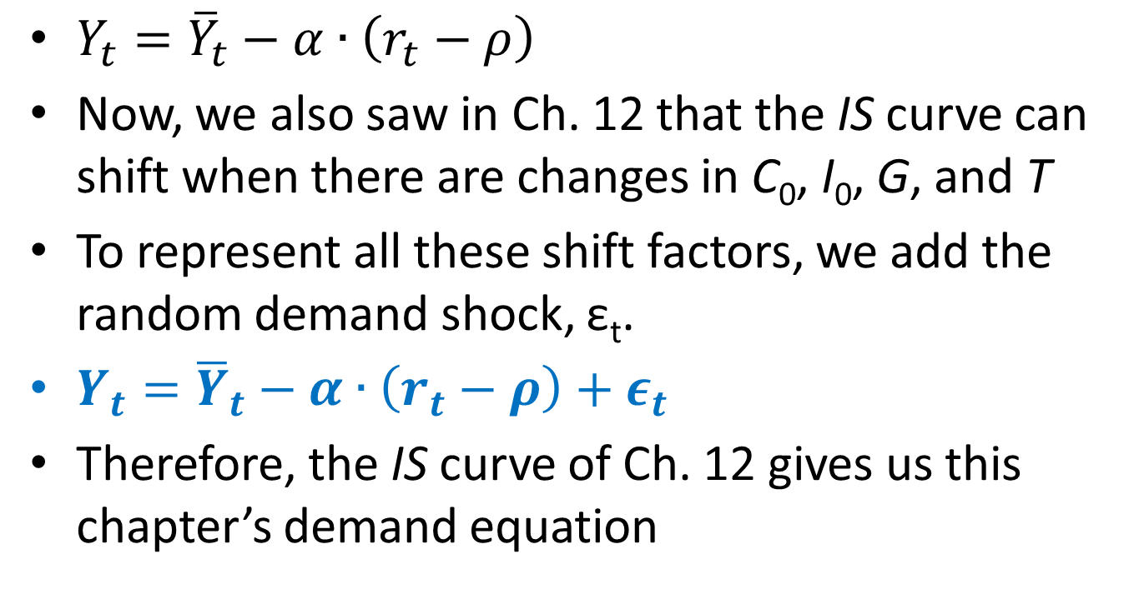
IS Curve = Demand Equation
$Y_{t}={\overline{Y}}_{t}−α∙\left(r_{t}−ρ\right)$
Now, we also saw in Ch. 12 that the IS curve can shift when there are changes in C₀, I₀, G, and T
To represent all these shift factors, we add the random demand shock, ε_{t}.
$Y_{t}={\overline{Y}}_{t}−α∙\left(r_{t}−ρ\right)+ε_{t}$
Therefore, the IS curve of Ch. 12 gives us this chapter’s demand equation

Slide 14



IS Curve = Demand Equation
r_{t}
r_{t}
$$ρ$$
$$ρ$$
IS
Demand
$$\overline{Y}t$$
Y_{t}
$$\overline{Y}$$
Y_{t}
The IS curve can simply be renamed the Demand Equation curve

Slide 15

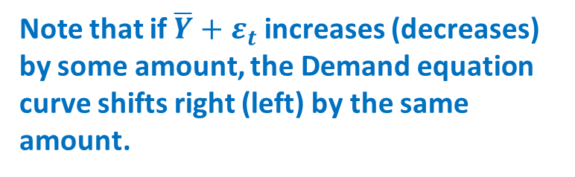

Demand Equation Curve
r_{t}
Note that if $\overline{Y}+ε_{t}$ increases (decreases) by some amount, the Demand equation curve shifts right (left) by the same amount.
$$ρ$$
Demand
Note also that if ρ increases (decreases) by some amount, the Demand equation curve shifts up (down) by the same amount.
$$\overline{Y}+ε_{t}$$
Y_{t}

Slide 16
DAD-DAS: 5 Equations
Demand Equation
Fisher Equation
Phillips Curve
Adaptive Expectations
Monetary Policy Rule

Slide 17
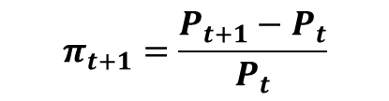
The Real Interest Rate: The Fisher Equation
ex ante
(i.e. expected) real interest rate
nominal interest rate
expected inflation rate
Assumption: The real interest rate is the inflation-adjusted interest rate. To adjust the nominal interest rate for inflation, one must simply subtract the expected inflation rate during the duration of the loan.
$$π_{t+1}=\frac{P_{t+1}−P_{t}}{P_{t}}$$
Notes:
The Fisher equation, familiar from Chapter 5, states that the nominal interest rate equals the real interest rate plus the inflation rate.
The equation on this slide is obtained by solving the Fisher equation for the real interest rate, and using the expected (rather than actual/realized) inflation rate to determine the ex ante (rather than ex post) real interest rate.
Thus, the real return savers expect to earn on their loans, and the real cost borrowers expect to pay on their debts, is the nominal interest rate minus the inflation rate people expect.

Slide 18
The Real Interest Rate: The Fisher Equation
ex ante
(i.e. expected) real interest rate
nominal interest rate
expected inflation rate
increase in price level from period t to t +1,
not known in period t
expectation, formed in period t,
of inflation from t to t +1
We saw this before in Ch. 5

Slide 19
DAD-DAS: 5 Equations
Demand Equation
Fisher Equation
Phillips Curve
Adaptive Expectations
Monetary Policy Rule

Slide 20
Inflation: The Phillips Curve
current inflation
previously expected inflation
supply shock, random and zero on average
indicates how much inflation responds when output fluctuates around its natural level
Notes:
Current inflation is affected by three things:
1) the rate of inflation people expected in the previous period, because it figured into their previous wage and price-setting decisions
2) the output gap: when output is above its natural level, firms experience rising marginal costs, so they raise prices faster. When output is below its natural level, marginal costs fall, so firms slow the rate of their price increases.
3) a supply shock (e.g. sharp changes in the price of oil), as discussed in Chapter 13

Slide 21
Phillips Curve
Assumption: At any particular time, inflation would be high if
  people in the past were expecting it to be high
  current demand is high (relative to natural GDP)
  there is a high inflation shock. That is, if prices are rising rapidly for some exogenous reason such as scarcity of imported oil or drought-caused scarcity of food

Slide 22
Phillips Curve
Momentum inflation
Demand-pull inflation
Cost-push inflation
This Phillips Curve can be seen as summarizing three reasons for inflation

Slide 23
DAD-DAS: 5 Equations
Demand Equation
Fisher Equation
Phillips Curve
Adaptive Expectations
Monetary Policy Rule

Slide 24
Expected Inflation: Adaptive Expectations
Assumption: people expect prices to continue rising at the current inflation rate.
Examples: E₂₀₀₀π₂₀₀₁ = π₂₀₀₀; E₂₀₁₃π₂₀₁₄ = π₂₀₁₃; etc.
Notes:
As the textbook mentions at this point and in Chapter 15, adaptive expectations is a crude simplification. Most people form their expectations rationally (at least when making important financial decisions, such as when a firm chooses prices for its catalog), taking into account all currently available relevant information.
Suppose inflation has been 3% for a number of years, when an “unemployment hawk” is appointed Fed chairperson. Surely, most people would expect inflation to rise, yet adaptive expectations assumes that people would continue to expect 3% inflation until actual inflation started rising.
We use adaptive expectations not because it’s perfect, but because it keeps the model from getting terribly complicated, yet doesn’t compromise the integrity of the results.

Slide 25
DAD-DAS: 5 Equations
Demand Equation
Fisher Equation
Phillips Curve
Adaptive Expectations
Monetary Policy Rule

Slide 26
Monetary Policy Rule
The fifth and final main assumption of the DAD-DAS theory is that
  The central bank sets the nominal interest rate
  and, in setting the nominal interest rate, the central bank is guided by a very specific formula called the monetary policy rule

Slide 27
Monetary Policy Rule
Current inflation rate
Parameter that measures how strongly the central bank responds to the inflation gap
Parameter that measures how strongly the central bank responds to the GDP gap
Nominal interest rate, set each period by the central bank
Natural real interest rate
Inflation Gap: The excess of current inflation over the central bank’s inflation target
GDP Gap: The excess of current GDP over natural GDP

Slide 28
The Nominal Interest Rate:
The Monetary-Policy Rule
nominal interest rate, set each period by the central bank
central bank’s inflation target
natural real interest rate
Notes:
The preceding four equations are all conceptually similar to equations students have learned in previous chapters. This one is not. It is new. Some additional explanation, therefore, is appropriate.
First, the interest rate explicitly becomes the central bank’s policy variable, not the money supply. In the real world, the Federal Reserve and many other central banks conduct monetary policy in terms of interest rates. The money supply is still present, behind the scenes: the central bank adjusts the money supply (or its growth rate) to achieve whatever nominal interest rate it desires. Students should recall that doing so is quite consistent with the IS-LM model from preceding chapters.
Second, the central bank sets a target for the inflation rate and adjusts the interest rate accordingly: if inflation is above the target, the central bank raises the nominal interest rate. For a given value of inflation, a higher nominal interest rate becomes a higher real interest rate, which will depress demand and bring inflation down.
Third, the central bank adjusts the interest rate when output deviates from its full-employment level. In a recession, output is below its potential level and the actual unemployment rate exceeds the natural rate of unemployment. In that case, the central bank would reduce the nominal interest rate. For a given level of inflation, the real interest rate falls, which stimulates aggregate demand and boosts output and employment.
(The following slide discusses the central bank’s policy parameters, the two thetas.)

Slide 29
The Nominal Interest Rate:
The Monetary-Policy Rule
measures how much the central bank adjusts the interest rate when inflation deviates from its target
measures how much the central bank adjusts the interest rate when output deviates from
its natural rate
Notes:
Two notes on this equation:
(1) The two theta parameters reflect the central bank’s policy priorities.
Theta_pi will be high relative to theta_Y if the central bank considers fighting inflation more important than fighting unemployment.
Theta_pi will be low relative to theta_Y if the central bank considers unemployment the bigger problem.
If you or your students are detail-oriented, note that it is not quite correct to say “theta_pi > theta_Y if fighting inflation is more important than fighting unemployment,” because the units of inflation and output are vastly different. Instead, we would say “as theta_pi/theta_Y rises, the central bank puts more weight on fighting inflation relative to fighting unemployment.”
(2) An increase in inflation will cause the central bank to not only increase the nominal interest rate, but the real interest rate, as well. To see this, note that inflation appears in two places on the right-hand-side of the equation, so the coefficient on inflation is really (1+theta_pi). Since theta_pi is positive, (1+theta_pi) is greater than 1. Therefore, each percentage point increase in inflation will induce the central bank to increase the nominal interest rate by more than a percentage point, so the real interest rate rises.
This should be intuitive. After all, the reason the central bank increases the interest rate is to help the economy “cool down” by reducing demand for goods and services, which depend on the real interest rate, not the nominal interest rate.

Slide 30
Example: The Taylor Rule
Economist John Taylor proposed a monetary policy rule very similar to ours:
i_{ff} = π + 2 + 0.5 (π – 2) – 0.5 (GDP gap)
where
  i_{ff} = nominal federal funds rate target
  GDP gap = 100 x
  = percent by which real GDP is below its natural rate
The Taylor Rule matches Fed policy fairly well.…

Slide 31
CASE STUDY
The Taylor Rule
actual Federal Funds rate
Taylor’s rule

Slide 32
Summary of the DAD-DAS model

Slide 33
The model’s variables and parameters
Endogenous variables:
Output
Inflation
Real interest rate
Nominal interest rate
Expected inflation
Notes:
This slide and the two that follow simply take stock of the model’s variables and parameters. If you wish, make these slides into handouts, so your students can refer to them throughout, and then you can safely omit the slides from your presentation.
In addition to the endogenous variables on this slide, we also care about the unemployment rate, which does not explicitly appear in the model. Remind your students about Okun’s law, which states a very strong negative relationship between output and unemployment over the business cycle.
Thus, if our model shows output falling below its natural rate, then we can infer that unemployment is rising above the natural rate of unemployment.

Slide 34
The model’s variables and parameters
Exogenous variables:
Predetermined variable:
Natural level of output
Central bank’s target inflation rate
Demand shock
Supply shock
Previous period’s inflation
Notes:
We want to solve the model for period t. Inflation in period (t-1) is no longer variable in period t, so it becomes exogenous, in a sense, in period t.
Previous period inflation was used in period (t-1) to form expectations of current period inflation, so it enters into the model in the Phillips curve equation for period t.

Slide 35
The model’s variables and parameters
Parameters:
Responsiveness of demand to
the real interest rate
Natural rate of interest
Responsiveness of inflation to output in the Phillips Curve
Responsiveness of i to inflation
in the monetary-policy rule
Responsiveness of i to output
in the monetary-policy rule
Notes:
Students sometimes confuse parameters and exogenous variables.
Loosely speaking, an exogenous variable is something that we might change. Loosely speaking, a parameter is a structural feature of the model that is unlikely to change.
For example, in the Solow model, we might change the saving rate to see its effects on endogenous variables, such as the steady-state level of income per capita. However, it’s very unlikely that we would change the Cobb-Douglas exponent that measure’s capital’s share in income, or the depreciation rate. In the IS-LM model, we might see how endogenous variables respond to a change in government purchases, but not to a change in the marginal propensity to consume.
I said “loosely speaking” above because these are guidelines only. For example, in the present model, we consider the two thetas to be parameters. However, it would not be unreasonable to consider the impact of a change in the thetas corresponding to a switch in central bank priorities.

Slide 36
The DAD-DAS Equations
Demand Equation
Fisher Equation
Phillips Curve
Adaptive Expectations
Monetary Policy Rule

Slide 37
Dynamic aggregate supply

Slide 38
Recap: Dynamic Aggregate Supply
Phillips Curve
Adaptive Expectations
DAS Curve

Slide 39
The Dynamic Aggregate Supply Curve
π_{t}
DAS slopes upward: high levels of output are associated with high inflation. This is because of demand-pull inflation
DAS_{t}
Y_{t}
Notes:
The intuition for the positive slope of DAS comes from the Phillips Curve:
If output is above its natural rate, unemployment is below the natural rate of unemployment. The labor market is very “tight” and the economy is “overheating,” leading to an increase in inflation.
(Of course, the unemployment rate is not explicitly included in this model, but students know from Okun’s Law that it is very tightly linked to output.)
Students may find it odd to say “DAS shifts in response to changes in previous inflation,” thinking that previous inflation is fixed because the past is unchangeable. However, a change in current period inflation will become a change in next period’s previous inflation, and thus will shift next period’s DAS curve.

Slide 40
The Dynamic Aggregate Supply Curve
π
If you know
the natural GDP at a particular date,
the inflation shock at that date, and
the previous period’s inflation,
you can figure out the location of the DAS curve at that date.
DAS₂₀₁₁
Y

Slide 41
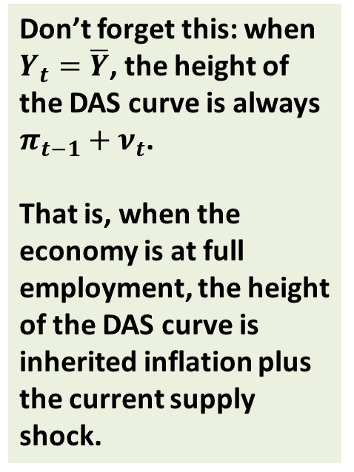
The Dynamic Aggregate Supply Curve
π
Don’t forget this: when $Y_{t}=\overline{Y}$, the height of the DAS curve is always $π_{t−1}+ν_{t}$.
That is, when the economy is at full employment, the height of the DAS curve is inherited inflation plus the current supply shock.
DAS₂₀₁₅
Y

Slide 42
Shifts of the DAS Curve
π
Any increase (decrease) in the previous period’s inflation or in the current period’s inflation shock shifts the DAS curve up (down) by the same amount
DAS_{t}
Y

Slide 43
Shifts of the DAS Curve
π
Any increase (decrease) in the previous period’s inflation or in the current period’s inflation shock shifts the DAS curve up (down) by the same amount
DAS_{t}
Any increase (decrease) in natural GDP shifts the DAS curve right (left) by the exact amount of the change.
Y

Slide 44
The DAS Curve: Summary
The DAS curve is upward sloping
When the economy is at full employment, the height of the DAS curve equals inherited inflation plus the current supply shock
When either the previous period’s inflation or the current period’s inflation shock increases (decreases), the DAS curve shifts up (down) by the same amount
When natural GDP increases (decreases), the DAS curve shifts right (left) by the same amount

Slide 45
Dynamic aggregate demand
Buckle up for some tedious algebra!

Slide 46
The Dynamic Aggregate Demand Curve
The Demand Equation
Fisher equation
adaptive expectations
Notes:
The derivation of the DAS curve was almost trivial. Not so for DAD. The next few slides walk students through (most of) the steps. See p. 440 for more details.

Slide 47
The Dynamic Aggregate Demand Curve
monetary policy rule
We’re almost there!

Slide 48
Dynamic Aggregate Demand
This is the equation of the DAD curve!

Slide 49

The Dynamic Aggregate Demand Curve
$$Y_{t}={\overline{Y}}_{t}−A∙\left(π_{t}−{π^{∗}}_{t}\right)+B∙ε_{t}$$
π
DAD slopes downward:
When inflation rises, the central bank raises the real interest rate, reducing the demand for goods and services.
Note that the DAD equation has no dynamics in it: it only shows how simultaneously measured variables are related to each other
DAD_{t}
Y

Slide 50
The Dynamic Aggregate Demand Curve
$$Y_{t}={\overline{Y}}_{t}−A∙\left(π_{t}−{π^{∗}}_{t}\right)+B∙ε_{t}$$
π
DAD_{tB}
Y

Slide 51
The Dynamic Aggregate Demand Curve
$$Y_{t}={\overline{Y}}_{t}−A∙\left(π_{t}−{π^{∗}}_{t}\right)+B∙ε_{t}$$
π
When the central bank’s target inflation rate increases (decreases) the DAD curve moves up (down) by the exact same amount.
Note how monetary policy is described in terms of the target inflation rate in the DAD-DAS model
DAD_{t2}
DAD_{t1}
Y

Slide 52
Monetary Policy
In the IS-LM model, monetary policy was described by the money supply or the interest rate
  Expansionary monetary policy meant M↑ or i↓
  Contractionary monetary policy meant M↓ or i↑
In the DAD-DAS model,
  Expansionary monetary policy is π*↑
  Contractionary monetary policy is π*↓

Slide 53
The Dynamic Aggregate Demand Curve
$$Y_{t}={\overline{Y}}_{t}−A∙\left(π_{t}−{π^{∗}}_{t}\right)+B∙ε_{t}$$
π
When the natural rate of output increases (decreases) the DAD curve moves right (left) by the exact same amount.
When there is a positive (negative) demand shock the DAD curve moves right (left) .
DAD_{t2}
DAD_{t1}
A positive demand shock could be an increase in C₀, I₀, or G, or a decrease in T.
Y

Slide 54
The Dynamic Aggregate Demand Curve
$$Y_{t}={\overline{Y}}_{t}−A∙\left(π_{t}−{π^{∗}}_{t}\right)+B∙ε_{t}$$
π
The DAD curve shifts right or up if:
the central bank’s target inflation rate goes up,
there is a positive demand shock, or
the natural rate of output increases.
DAD_{t2}
DAD_{t1}
Y

Slide 55
The DAD Curve: Summary
The DAD curve is downward sloping
When the central bank’s target inflation rate increases (decreases), the DAD curve shifts up (down) by the same amount
When natural GDP increases (decreases), the DAD curve shifts right (left) by the same amount
When the demand shock increases (decreases), the DAD curve shifts right (left)

Slide 56
Summary: DAS and DAD Equations

Slide 57
Summary: DAS and DAD Equations
DAS
DAD
Note that there are two endogenous variables—Y_{t} and π_{t}—in these two equations
Therefore, we can solve for the equilibrium values of Y_{t} and π_{t}

Slide 58


The Solution!
Using the equations in the previous slide—and a lot of very tedious algebra—one can express output and inflation entirely in terms of exogenous variables, parameters, shocks and pre-determined inflation. This is the algebraic solution of the DAD-DAS model.

Slide 59
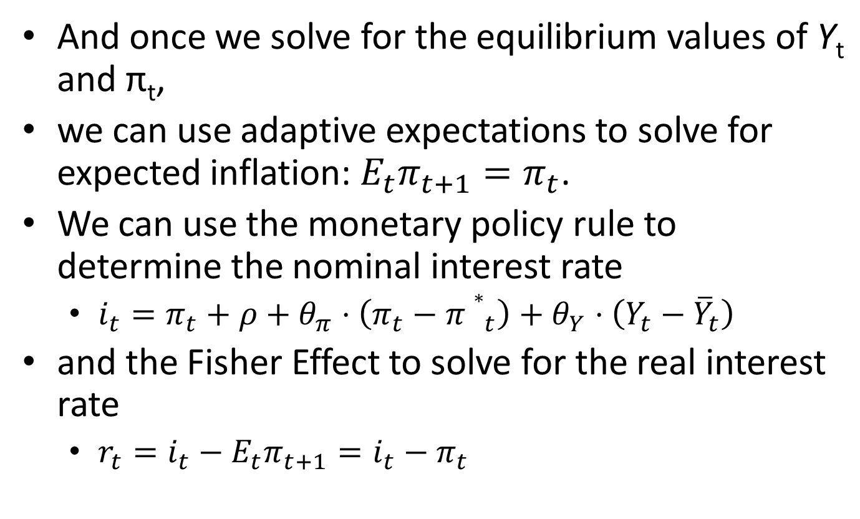
The Solution!
And once we solve for the equilibrium values of Y_{t} and π_{t},
we can use adaptive expectations to solve for expected inflation: $E_{t}π_{t+1}=π_{t}$.
We can use the monetary policy rule to determine the nominal interest rate
  $i_{t}=π_{t}+ρ+θ_{π}⋅\left(π_{t}−{π∗}_{t}\right)+θ_{Y}⋅\left(Y_{t}−{\overline{Y}}_{t}\right)$
and the Fisher Effect to solve for the real interest rate
  $r_{t}=i_{t}−E_{t}π_{t+1}=i_{t}−π_{t}$

Slide 60
The Solution!
By substituting the previous slide’s solutions for output and inflation into the monetary policy rule, we can then get the above solution for the nominal interest rate. The Fisher equation can be used to solve for the real interest rate.
Please do not worry about the solution and its derivation. However, if you are interested, please see http://myweb.liu.edu/~uroy/eco62/ppt/zlb-educ130328.pdf , especially sections 4.1 , 8.1 (appendix) and 8.2 (appendix).

Slide 61
Summary: DAD-DAS Slopes and Shifts
DAS
DAD
Upward sloping
If natural output increases, DAS shifts right by same amount
If previous-period inflation increases, DAS shifts up by same amount
If inflation shock increases, DAS shifts up by same amount
Downward sloping
If natural output increases, DAD shifts right by same amount
If target inflation increases, DAD shifts up by same amount
If demand shock increases, DAD shifts right

Slide 62
Equilibrium: short-run and long-run

Slide 63
Short-Run Equilibria
The economy is in short-run equilibrium at time t if output and inflation are at the intersection of the DAD and DAS curves for time t.
π
DAS₂₀₀₄
D
π₂₀₀₄
DAD₂₀₀₄
Y
Y₂₀₀₄

Slide 64
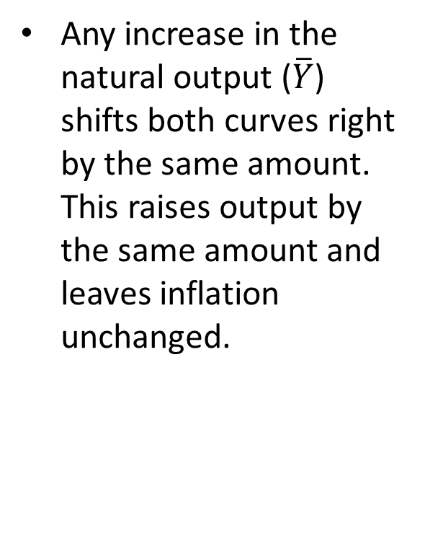
Short-Run Equilibria
Any increase in the natural output ($\overline{Y}$) shifts both curves right by the same amount. This raises output by the same amount and leaves inflation unchanged.
π
DAS₂₀₀₄
DAS_{2004*}
D
π₂₀₀₄
D*
DAD_{2004*}
DAD₂₀₀₄
Y
Y₂₀₀₄

Slide 65
Short-Run Equilibria
Any increase in the previous period’s inflation (π_{t-1}) or the current inflation shock (ν_{t}) will reduce output and raise inflation right away (stagflation).
π
DAS_{2004*}
D*
DAS₂₀₀₄
D
π₂₀₀₄
DAD₂₀₀₄
Y
Y₂₀₀₄

Slide 66
Short-Run Equilibria
Any increase in the central bank’s inflation target (π*) or the demand shock (ε_{t}) will raise both output and inflation right away.
π
DAS₂₀₀₄
D*
D
π₂₀₀₄
DAD_{2004*}
DAD₂₀₀₄
Y
Y₂₀₀₄

Slide 67
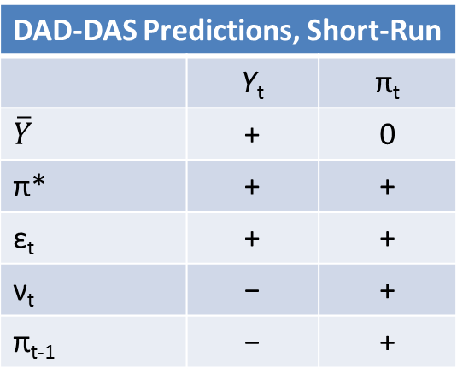
Short-Run Equilibria
DAD-DAS Predictions, Short-Run
 | Y_{t} | π_{t}
$$\overline{Y}$$ | + | 0
π* | + | +
ε_{t} | + | +
ν_{t} | − | +
π_{t-1} | − | +
Current inflation in one year becomes past inflation in the next year.
Therefore, any exogenous factors that affect inflation in 2016 will affect both output and inflation in 2017. This in turn, will affect both output and inflation in 2018. And so on and on.
In this way, output and inflation can change from one period to the next in the DAD-DAS model even if there are no changes in the economy’s shocks and parameters.
The question then is: Does this dynamic process of change eventually come to an end?

Slide 68
Long-Run Equilibria
The short-run equilibrium at period t is also a long-run equilibrium if, in the absence of shocks, parameter changes, and policy changes, it continues to be the short-run equilibrium in subsequent periods t + 1, t + 2, etc.

Slide 69
Short-Run Equilibria that are not Long-Run Equilibria
π
Y
DAS₂₀₀₂
DAS₂₀₀₃
B
DAS₂₀₀₄
π₂₀₀₂
C
Lesson: An economy that is in short-run equilibrium but not in long-run equilibrium will change—even though there are no shocks. The economy will move along DAD towards full employment.
π₂₀₀₃
D
π₂₀₀₄
Recall: The height of the DAS at the full-employment output equals the previous period’s inflation plus the current period’s inflation shock.
DAD_{all years}
Y₀₄
Y
Y₀₂
Y₀₃
In this example, there is no inflation shock in 2003 and 2004.

Slide 70
A Short-Run Equilibrium that is also a Long-Run Equilibrium
π
Y
DAS₂₀₁₄
π₂₀₁₃ = π₂₀₁₄
A
DAD_{all years}
Y
Y₂₀₁₄
If there are no shocks and all parameters are constant, the outcome at A will continue indefinitely

Slide 71
Short-Run Equilibria Converge to Long-Run Equilibrium
π
Y
DAS₂₀₀₂
DAS₂₀₀₃
B
DAS₂₀₀₄
π₂₀₀₂
π₂₀₀₃
C
D
π₂₀₀₄
DAS₂₀₁₄
π₂₀₁₃ = π₂₀₁₄
A
DAD_{all years}
Y
Y₂₀₁₄
If the economy is at B, it will not stay there. It will move along the DAD curve towards A, the long-run equilibrium. Once the economy reaches A, it will stay there.

Slide 72
Short-Run Equilibria Converge to Long-Run Equilibrium
π
Y
DAS₂₀₁₄
π₂₀₁₃ = π₂₀₁₄
Z
DAS₂₀₀₄
C
DAS₂₀₀₃
π₂₀₀₄
π₂₀₀₃
B
DAS₂₀₀₂
π₂₀₀₂
A
DAD_{all years}
Y
Y₂₀₁₄
If there are no shocks and all parameters are constant, an economy initially at A will move along the DAD curve towards Z, the long-run equilibrium. Once at Z, it will stay there.

Slide 73
The Long-Run Equilibrium is Stable
The last two slides show that:
  The economy will not stay put if it is at a short-run equilibrium that is not a long-run equilibrium
  One such equilibrium leads to another, even if there are no shocks, no parameter changes, and no policy changes
  The economy invariably ends up in a long-run equilibrium

Slide 74
DAD-DAS long-run equilibrium
A description of an economy in long-run equilibrium

Slide 75
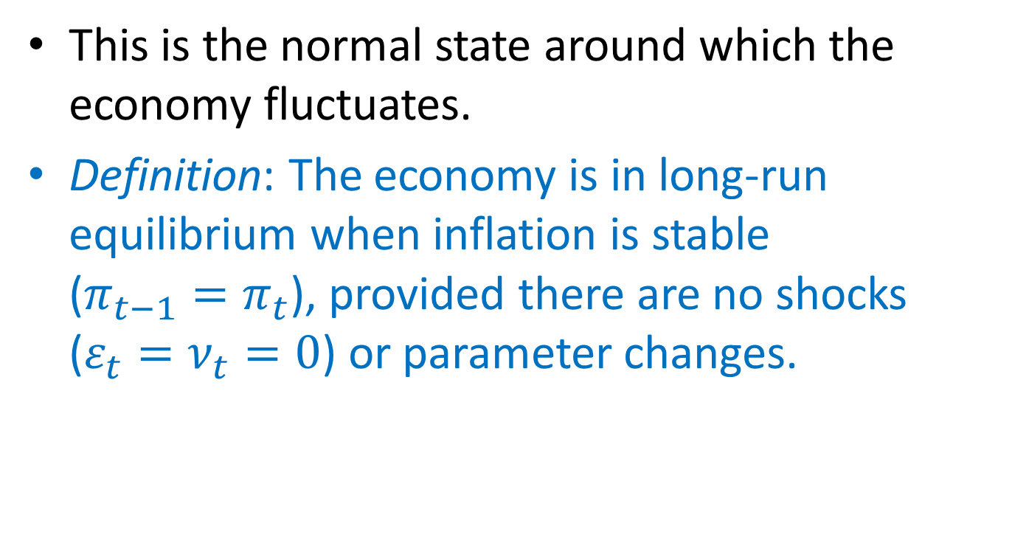
The DAD-DAS model’s long-run equilibrium
This is the normal state around which the economy fluctuates.
Definition: The economy is in long-run equilibrium when inflation is stable ($π_{t−1}=π_{t}$), provided there are no shocks ($ε_{t}=ν_{t}=0$) or parameter changes.
Notes:
Plugging these two conditions into the model’s 5 equations yields the solution on the next slide…

Slide 76
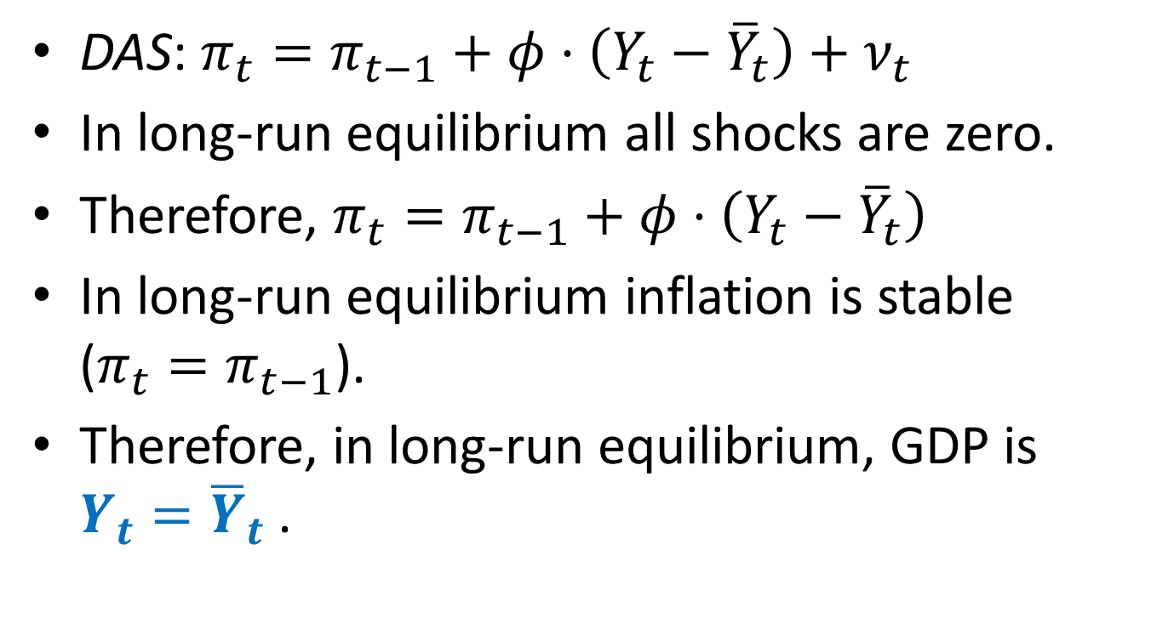
Long-Run Equilibrium
DAS: $π_{t}=π_{t−1}+φ⋅\left(Y_{t}−{\overline{Y}}_{t}\right)+ν_{t}$
In long-run equilibrium all shocks are zero.
Therefore, $π_{t}=π_{t−1}+φ⋅\left(Y_{t}−{\overline{Y}}_{t}\right)$
In long-run equilibrium inflation is stable ($π_{t}=π_{t−1}$).
Therefore, in long-run equilibrium, GDP is $Y_{t}={\overline{Y}}_{t}$ .

Slide 77
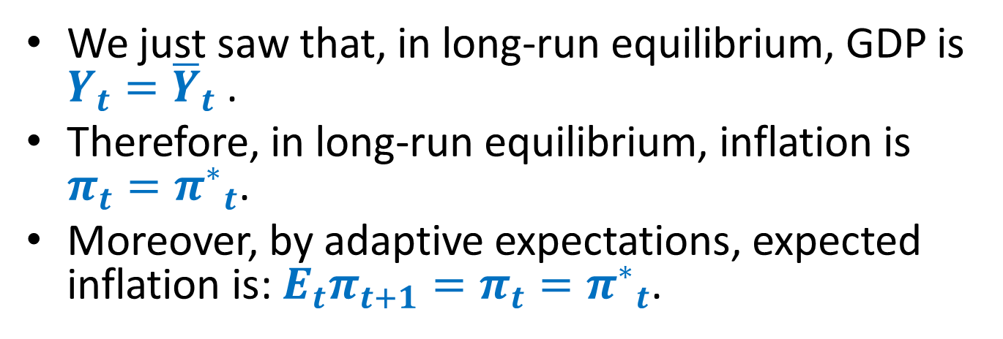
Long-Run Equilibrium
DAD
In long-run equilibrium all shocks are zero
We just saw that, in long-run equilibrium, GDP is $Y_{t}={\overline{Y}}_{t}$ .
Therefore, in long-run equilibrium, inflation is $π_{t}={π^{∗}}_{t}$.
Moreover, by adaptive expectations, expected inflation is: $E_{t}π_{t+1}=π_{t}={π^{∗}}_{t}$.

Slide 78
Long-Run Equilibrium
π
Y
DAS
π*
A
DAD
Y

Slide 79
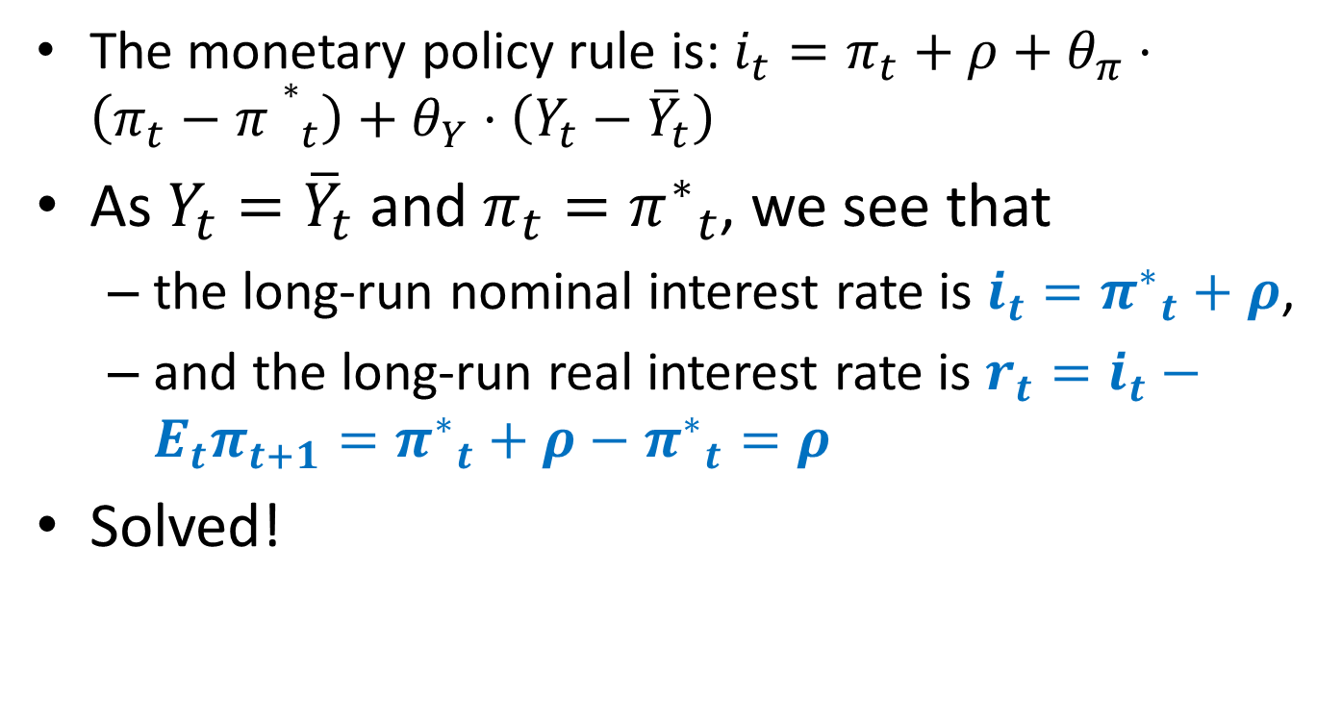
Long-Run Equilibrium
  The monetary policy rule is: $i_{t}=π_{t}+ρ+θ_{π}⋅\left(π_{t}−{π∗}_{t}\right)+θ_{Y}⋅\left(Y_{t}−{\overline{Y}}_{t}\right)$
As $Y_{t}={\overline{Y}}_{t}$ and $π_{t}={π^{∗}}_{t}$, we see that
  the long-run nominal interest rate is $i_{t}={π^{∗}}_{t}+ρ$,
  and the long-run real interest rate is $r_{t}=i_{t}−E_{t}π_{t+1}={π^{∗}}_{t}+ρ−{π^{∗}}_{t}=ρ$
Solved!

Slide 80
The DAD-DAS model’s long-run equilibrium
To summarize, the long-run equilibrium values in the DAD-DAS theory are essentially the same as the long run theory we saw earlier in this course:
In the short-run, the values of the various variables fluctuate around the long-run equilibrium values.
Notes:
The model’s long-run solution expresses each of the five endogenous variables in terms of exogenous variables and parameters.
In the long-run equilibrium,
output equals the natural rate of output (which means the unemployment rate equals the natural rate of unemployment)
the real interest rate equals the so-called “natural rate of interest” defined earlier in this chapter
the inflation rate equals the central bank’s target
inflation expectations are accurate (inflation is the same every period and equals the central bank’s target, so using this period’s inflation to forecast
next period’s inflation will yield an accurate forecast)
the nominal interest rate equals the natural real interest rate plus the (constant) central bank target inflation rate

Slide 81
DAD-DAS short-run equilibrium

Slide 82
Recall: The short-run equilibrium
π
In any period t, the intersection of DAD_{t} and DAS_{t} determines the short-run equilibrium values of inflation and output at t.
Y_{t}
DAS_{t}
A
π_{t}
In the equilibrium shown here at A, output is below its natural level. In other words, the DAD-DAS theory is fully capable of explaining recessions and booms.
DAD_{t}
Y
Y_{t}
Notes:
The vertical line drawn at Ybar is shown for reference: it allows us to see the gap between current output and its natural level, which, in turn, influences how the economy will evolve over subsequent periods.

Slide 83
DAD-DAS predictions
How does the economy respond—in the short run and in the long run—to (i) an increase in potential output, (ii) a temporary inflation shock, (iii) a temporary demand shock, and (iv) stricter monetary policy?

Slide 84
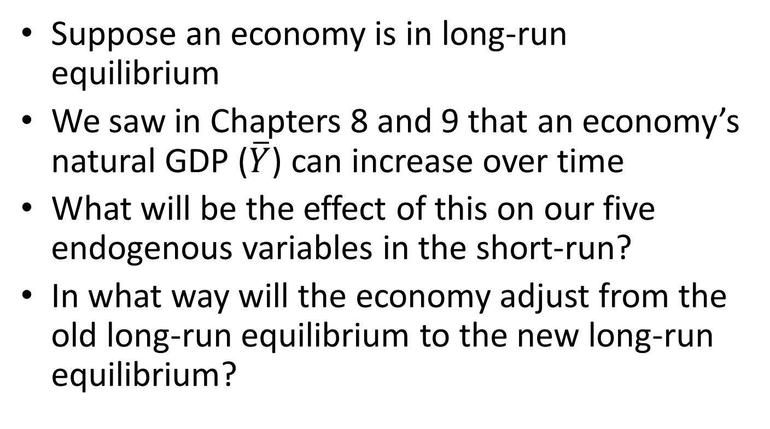
1. Long-Run Growth
Suppose an economy is in long-run equilibrium
We saw in Chapters 8 and 9 that an economy’s natural GDP ($\overline{Y}$) can increase over time
What will be the effect of this on our five endogenous variables in the short-run?
In what way will the economy adjust from the old long-run equilibrium to the new long-run equilibrium?

Slide 85
Recap: DAD-DAS Slopes and Shifts
DAS
DAD
Upward sloping
If natural output increases, shifts right by same amount
If previous-period inflation increases, shifts up by same amount
If there is a positive inflation shock (ν_{t} > 0), shifts up by same amount
Downward sloping
If natural output increases, shifts right by same amount
If target inflation increases, shifts up by same amount
If there is a positive demand shock (ε_{t} > 0), shifts right

Slide 86
1. Long-run growth
Period t: initial equilibrium at A
Period t + 1: Long-run growth increases the natural rate of output.
π
Y_{t}
Y_{t +1}
DAS_{t}
DAS_{t +1}
DAS shifts right by the exact amount of the increase in natural GDP.
π_{t}
=
A
B
π_{t + 1}
DAD shifts right too by the exact amount of the increase in natural GDP.
DAD_{t}
DAD_{t +1}
Y
Y_{t}
Y_{t +1}
New equilibrium at B. Income grows but inflation remains stable.
Notes:
This slide presents the experiment described on p. 444 of the text.
Since this experiment concerns the long run, it is best to think of periods t and t+1 as representing decades rather than years.
See the DAD and DAS equations to verify that the horizontal distance of the shifts in both curves are equal. To see that inflation remains unchanged in the new long-run equilibrium, refer to the model’s long-run solution values, which show that inflation in the long run does not depend on Ybar.

Slide 87
1. Long-run growth
π
Y_{t}
Y_{t +1}
Note that the economy goes directly from one long-run equilibrium, A, to another long-run equilibrium, B, as soon at the natural GDP increases. There is no transition period.
DAS_{t}
DAS_{t +1}
π_{t}
=
A
B
π_{t + 1}
DAD_{t}
DAD_{t +1}
Y
Y_{t}
Y_{t +1}
Notes:
This slide presents the experiment described on p. 444 of the text.
Since this experiment concerns the long run, it is best to think of periods t and t+1 as representing decades rather than years.
See the DAD and DAS equations to verify that the horizontal distance of the shifts in both curves are equal. To see that inflation remains unchanged in the new long-run equilibrium, refer to the model’s long-run solution values, which show that inflation in the long run does not depend on Ybar.

Slide 88
1. Long-Run Growth
Therefore, starting from long-run equilibrium, if there is an increase in the natural GDP,
  actual GDP will immediately increase to the new natural GDP, and
  none of the other endogenous variables will be affected

Slide 89
2. Inflation Shock
Suppose the economy is in long-run equilibrium
Then the inflation shock hits for one period (ν_{t} > 0) and then goes away (ν_{t+1} = 0)
How will the economy be affected, both in the short run and in the long run?

Slide 90
Recap: DAD-DAS Slopes and Shifts
DAS
DAD
Upward sloping
If natural output increases, shifts right by same amount
If previous-period inflation increases, shifts up by same amount
If there is a positive inflation shock (ν_{t} > 0), shifts up by same amount
Downward sloping
If natural output increases, shifts right by same amount
If target inflation increases, shifts up by same amount
If there is a positive demand shock (ε_{t} > 0), shifts right

Slide 91
A shock to aggregate supply
Period t + 2: As inflation falls, inflation expectations fall, DAS moves downward, output rises.
π
Y
Period t + 1: Supply shock is over (ν_{t+1} = 0)
but DAS does not return to its initial position due to higher inflation expectations.
DAS_{t}
DAS_{t +1}
DAS_{t +2}
π_{t}
B
C
π_{t + 2}
ν_{t}
D
DAS_{t -1}
Period t: Supply shock (ν_{t} > 0) shifts DAS upward; inflation rises, central bank responds by raising real interest rate, output falls.
π_{t – 1}
A
DAD
Y
This process continues until output returns to its natural rate. The long run equilibrium is at A.
Y_{t}
Y_{t + 2}
Y_{t –1}
Period t – 1: initial equilibrium at A
Notes:
For this and the remaining experiments, we focus on the short run and should think of periods as representing a year rather than a decade.
This slide presents the experiment described on pp.424-425 of the text. One difference: This slide shows the DAS curve for period t+2 (Figure 14-6 in the text stops at t+1), to give students a sense of the process that continues after the shock to bring the economy back toward full employment.

Slide 92
A shock to aggregate supply: one more time
π
Y
DAS₂₀₀₂
π₂₀₀₁ + ν₂₀₀₂
DAS₂₀₀₃
B
DAS₂₀₀₄
π₂₀₀₂
π₂₀₀₃
C
D
ν₂₀₀₂
π₂₀₀₄
DAS₂₀₀₁
π₂₀₀₀ = π₂₀₀₁
A
DAD
Y₀₄
Y
Y₀₂
Y₀₃
Y₀₁

Slide 93
2. Inflation Shock
So, we see that if a one-period inflation shock hits the economy,
  inflation rises at the date the shock hits, but eventually returns to the unchanged long-run level, and
  GDP falls at the date the shock hits, but eventually returns to the unchanged long-run level
What happens to the interest rates i and r?

Slide 94
2. Inflation Shock
According to the monetary policy rule, the temporary spike in inflation dictates an increase in the real interest rate, whereas the temporary fall in GDP indicates a decrease in the real interest rate
The overall effect is ambiguous, for both interest rates
We can do simulations for specific values of the parameters and exogenous variables

Slide 95
Recall: The Solution!
As we saw before, it is possible to express output and inflation entirely in terms of exogenous variables, parameters, shocks and pre-determined inflation. The monetary policy rule can then be used to solve for the nominal interest rate. The Fisher equation can be used to solve for the real interest rate. These solutions can be used to simulate the future outcomes for given values of the exogenous terms in the equations.

Slide 96
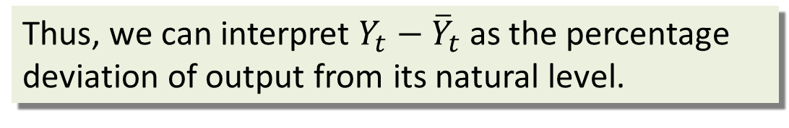
Parameter values for simulations
Thus, we can interpret $Y_{t}−{\overline{Y}}_{t}$ as the percentage deviation of output from its natural level.
The central bank’s inflation target is 2 percent.
A 1-percentage-point increase in the real interest rate reduces output demand by 1 percent of its natural level.
The natural rate of interest is 2 percent.
When output is 1 percent above its natural level, inflation rises by 0.25 percentage point.
These values are from the Taylor Rule, which approximates the actual behavior of the Federal Reserve.
Notes:
We have specific equations for DAD and DAS. If we plug in particular values for the parameters and exogenous variables, we can solve for output and inflation (and then use these solutions in the other equations to find the real and nominal interest rates).
Then, we can trace see how our endogenous variables (output, inflation, etc) respond over time to shocks such as the supply shock we analyzed on the preceding slide. In effect, we are simulating the economy’s response to a shock. This is very useful, and a reason why it’s worth the trouble to develop the dynamic model.
This slide shows the particular values used in the simulation. (These values will be used in other simulations in this chapter.) The box on p.425 contains more explanation and interpretation.

Slide 97
Impulse Response Functions
The following graphs are called impulse response functions.
They show the “response” of the endogenous variables to the “impulse,” i.e. the shock.
The graphs are calculated using our assumed values for the exogenous variables and parameters

Slide 98
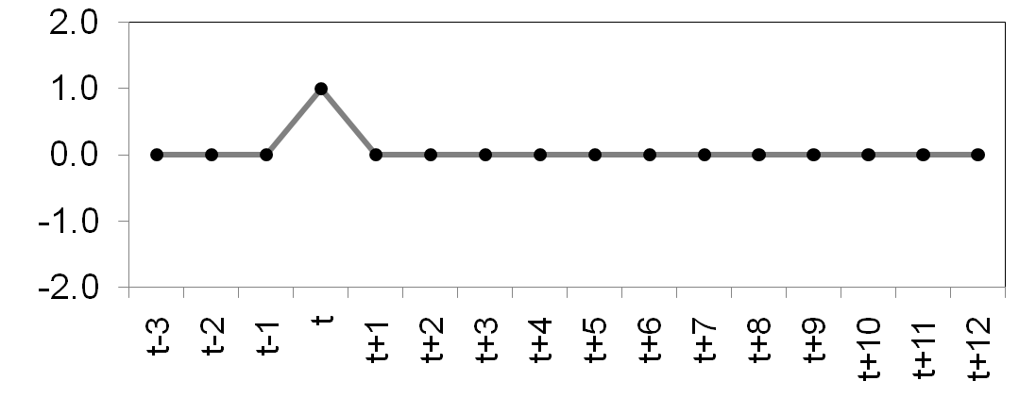
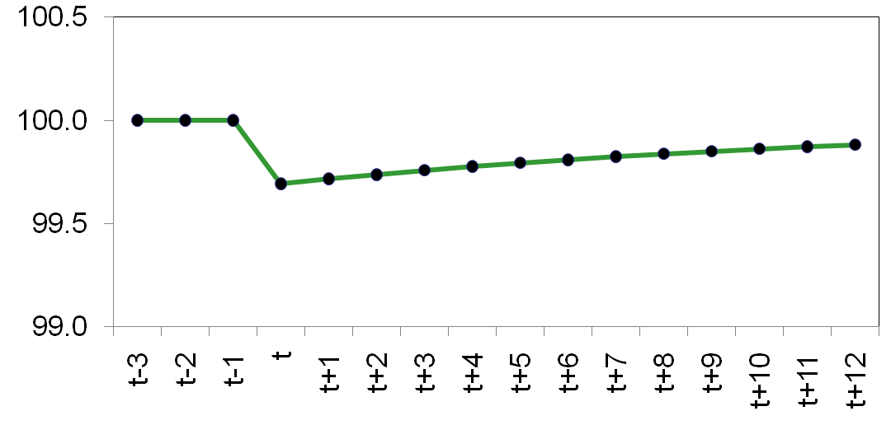
The dynamic response to a supply shock
A one-period supply shock affects output for many periods.
Notes:
The behavior of output shown on this slide mirrors the behavior of output on the DAD-DAS graph a few slides back.

Slide 99
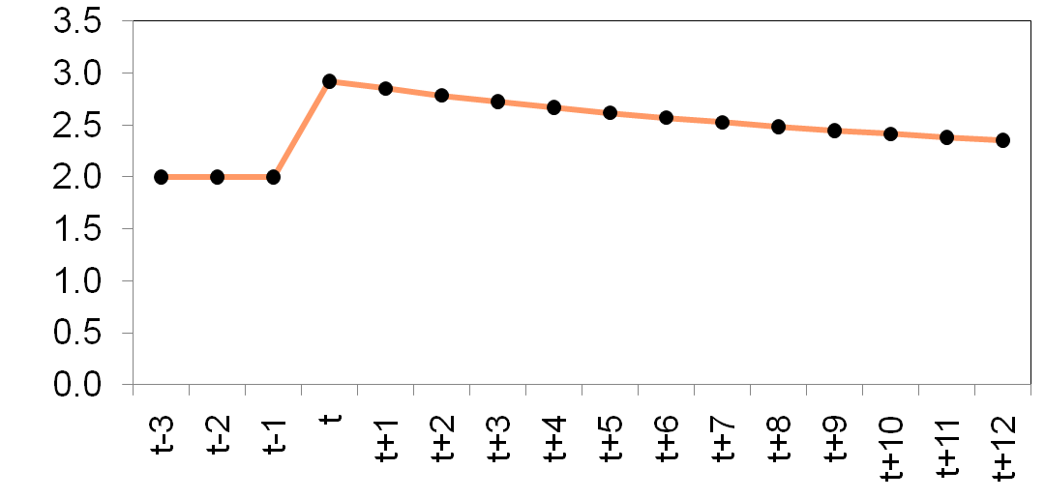
The dynamic response to a supply shock
Because inflation expectations adjust slowly, actual inflation remains high for many periods.
Notes:
Similarly, the behavior of inflation shown here mirrors that depicted on the DAD-DAS graph a few slides back.

Slide 100
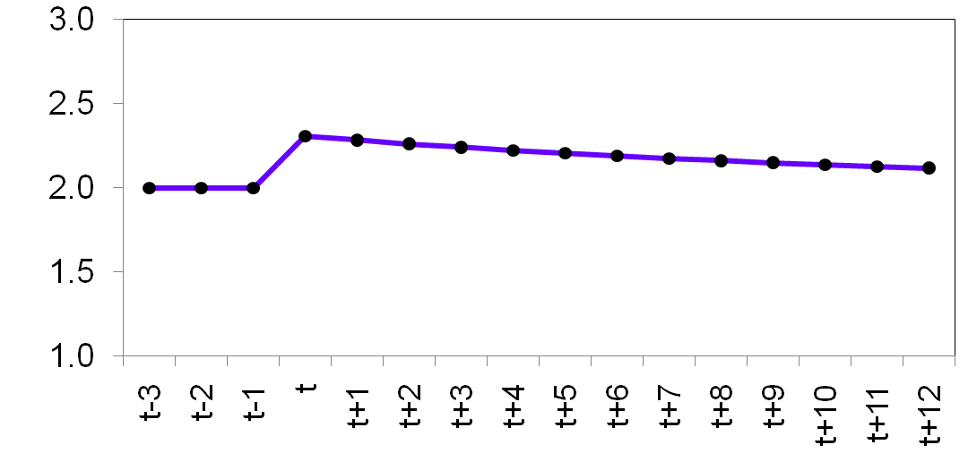
The dynamic response to a supply shock
The real interest rate takes many periods to return to its natural rate.
Notes:
When the shock causes inflation to rise, the central bank responds by raising the real and nominal interest rates. We see the real rate here. The nominal rate is shown on the following slide.
Over time, both move back toward their initial values.

Slide 101
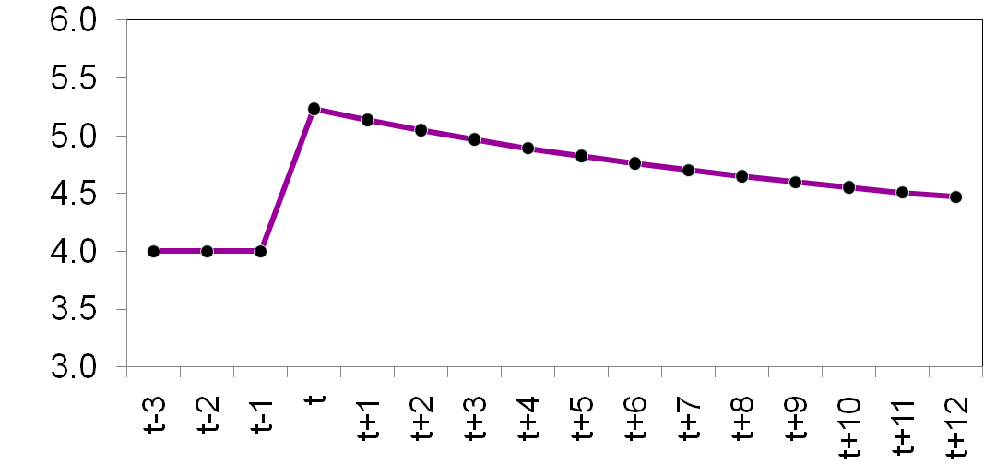
The dynamic response to a supply shock
The behavior
of the nominal interest
rate depends
on that
of inflation and real interest rates.

Slide 102
3. A Series of Aggregate Demand Shocks
Suppose the economy is at the long-run equilibrium
Then a positive aggregated demand shock hits the economy for five successive periods (ε_{t}= ε_{t+1}= ε_{t+2}= ε_{t+3}= ε_{t+4} > 0), and then goes away (ε_{t+5} = 0)
How will the economy be affected in the short run?
That is, how will the economy adjust over time?

Slide 103
Recap: DAD-DAS Slopes and Shifts
DAS
DAD
Upward sloping
If natural output increases, shifts right by same amount
If previous-period inflation increases, shifts up by same amount
If there is a positive inflation shock (ν_{t} > 0), shifts up by same amount
Downward sloping
If natural output increases, shifts right by same amount
If target inflation increases, shifts up by same amount
If there is a positive demand shock (ε_{t} > 0), shifts right

Slide 104
A shock to aggregate demand
Period t – 1: initial equilibrium at A
Period t: Positive demand shock (ε > 0) shifts AD to the right; output and inflation rise.
DAS_{t +5}
Period t + 1: Higher inflation in t raised inflation expectations for t + 1, shifting DAS up. Inflation rises more, output falls.
π
Y
DAS_{t +4}
Periods t + 2 to t + 4:
Higher inflation in previous period raises inflation expectations, shifts DAS up. Inflation rises, output falls.
DAS_{t +3}
F
G
DAS_{t +2}
π_{t + 5}
E
DAS_{t + 1}
Period t + 5: DAS is higher due to higher inflation in preceding period, but demand shock ends and DAD returns to its initial position. Equilibrium at G.
D
C
DAS_{t -1,t}
π_{t}
B
Periods t + 6 and higher:
DAS gradually shifts down as inflation and inflation expectations fall. The economy gradually recovers and reaches the long run equilibrium at A.
π_{t – 1}
A
DAD_{t ,t+1,…,t+4}
DAD_{t -1, t+5}
Y
Y_{t + 5}
Y_{t –1}
Y_{t}
Notes:
This slide presents the experiment described on pp. 448-449 of the text.

Slide 105
A 3-period shock to aggregate demand
π
Y
DAS₀₄
DAS₀₃
π₀₃
D
DAS₀₂
π₀₂
C
DAS_{00,01}
π₀₁
B
π₁₉₉₉ = π₀₀
A
DAD_{01,02,03}
DAD_{00,04}
Y
Y₀₀
Y₀₃
Y₀₂
Y₀₁
When the demand shock first hits, output and inflation both increase. In the two following periods, despite the continuing presence of the demand shock, output starts to fall. Inflation continues to rise.
Notes:
This slide presents the experiment described on pp. 448-449 of the text.

Slide 106
3. A shock to aggregate demand
π
Y
DAS₀₄
DAS₀₅
DAS₀₆
π₀₃
π₀₄
E
π₀₅
F
DAS_{00,01}
π₁₉₉₉ = π₀₀
A
DAD_{00,04,05,06}
Y
Y₀₄
Y₀₅
Y₀₀
On the date the demand shock ends, output falls below the long-run level and inflation finally begins to fall. After that, output rises and inflation falls towards the initial long-run equilibrium.
Notes:
This slide presents the experiment described on pp. 448-449 of the text.

Slide 107
3. A 3-period shock to aggregate demand
π
Y
π
Counter-clockwise cycle
π₀₃
E
D
π₀₄
π₀₂
F
π₀₅
C
Clockwise cycle
π₀₁
B
unemployment
π₁₉₉₉ = π₀₀
A
Y
Y₀₄
Y₀₅
Y₀₀
Y₀₃
Y₀₂
Y₀₁
In short, after a positive demand shock we get a counter-clockwise cycle in the output-inflation graph. But this is also a clockwise cycle in the unemployment-inflation graph.
Notes:
See http://krugman.blogs.nytimes.com/2012/04/08/unemployment-and-inflation/ and http://krugman.blogs.nytimes.com/2010/07/31/clockwise-spirals/ and http://krugman.blogs.nytimes.com/2011/11/17/subsiding-inflation/.

Slide 108
Inflation-Unemployment Cycles
Please see:
  http://krugman.blogs.nytimes.com/2010/07/31/clockwise-spirals/
  http://krugman.blogs.nytimes.com/2011/11/17/subsiding-inflation/
  http://krugman.blogs.nytimes.com/2012/04/08/unemployment-and-inflation/

Slide 109
A Series of Aggregate Demand Shocks: 4 Phases
On the date the multi-period demand shock first hits, both output and inflation rise above their long-run values
After that, while the demand shock is still present, output falls and inflation continues to rise
On the date the demand shock ends, output falls below its long-run value and inflation falls
After that, output recovers and inflation falls, gradually returning to their original long-run values
What happens to the interest rates i and r?

Slide 110
3. Aggregate Demand Shock
According to the monetary policy rule, an increase (decrease) in either inflation or output dictates an increase (decrease) in the real interest rate
We can do simulations for specific values of the parameters and exogenous variables

Slide 111
A Series of Aggregate Demand Shocks: 4 Phases, interest rates
On the date the multi-period demand shock first hits, both output and inflation rise above their long-run values. So, interest rate rises
After that, while the demand shock is still present, output falls and inflation continues to rise. Now, the effect on the interest rate is ambiguous
On the date the demand shock ends, output falls below its long-run value and inflation falls. So, the interest rate falls
After that, output recovers and inflation falls, gradually returning to their original long-run values. Again, the effect on the interest rate is ambiguous, but it does return to its original long run value (ρ)

Slide 112
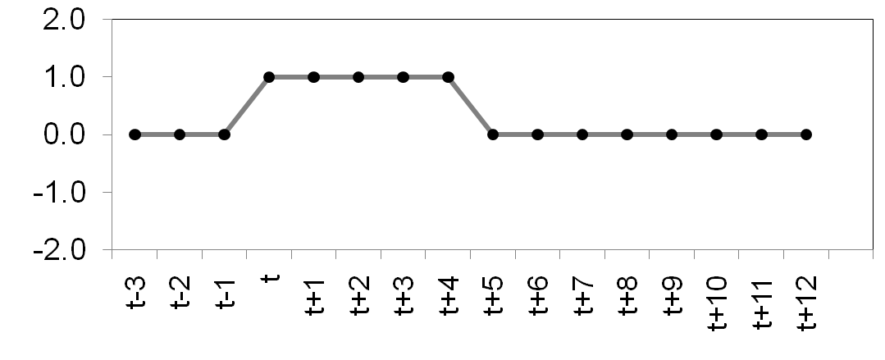
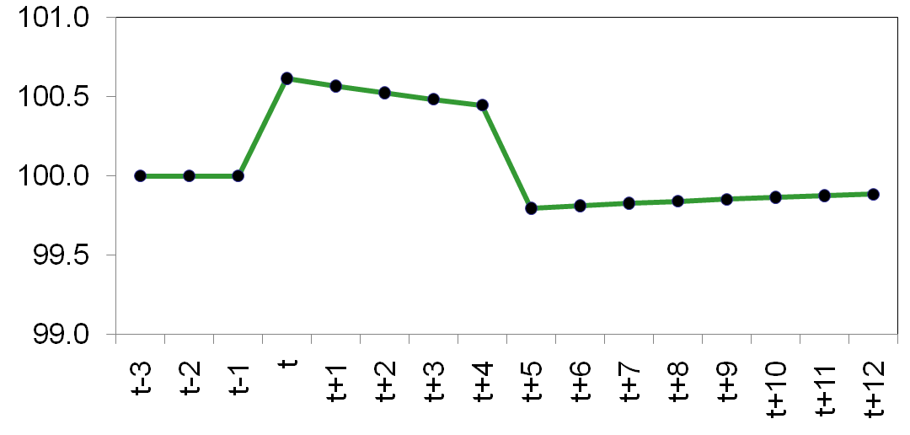
The dynamic response to a demand shock
The demand shock raises output for five periods. When the shock ends, output falls below its natural level, and recovers gradually.

Slide 113
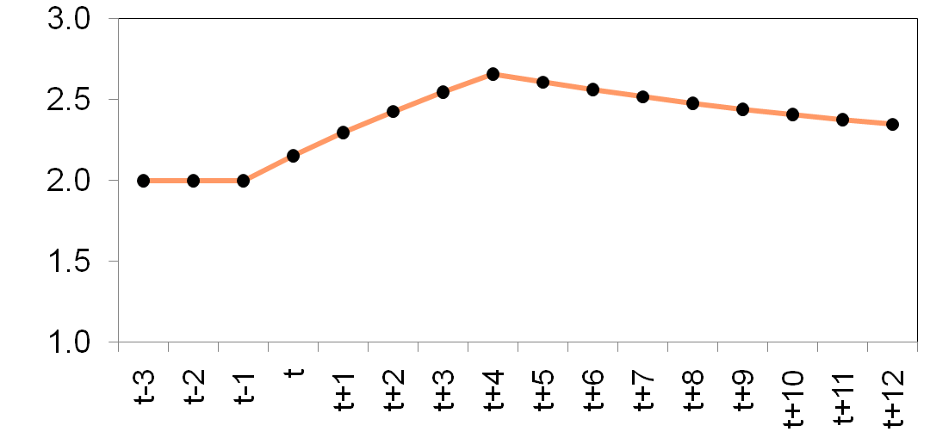
The dynamic response to a demand shock
The
demand shock causes inflation
to rise.
When the shock ends, inflation gradually falls toward its initial level.

Slide 114
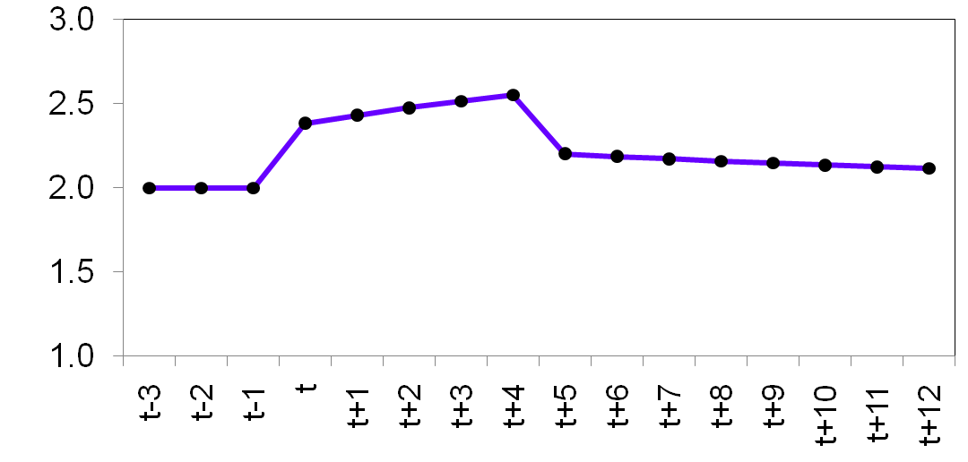
The dynamic response to a demand shock
The demand shock raises the real interest rate.
After the shock ends, the real interest
rate falls and approaches its initial level.

Slide 115
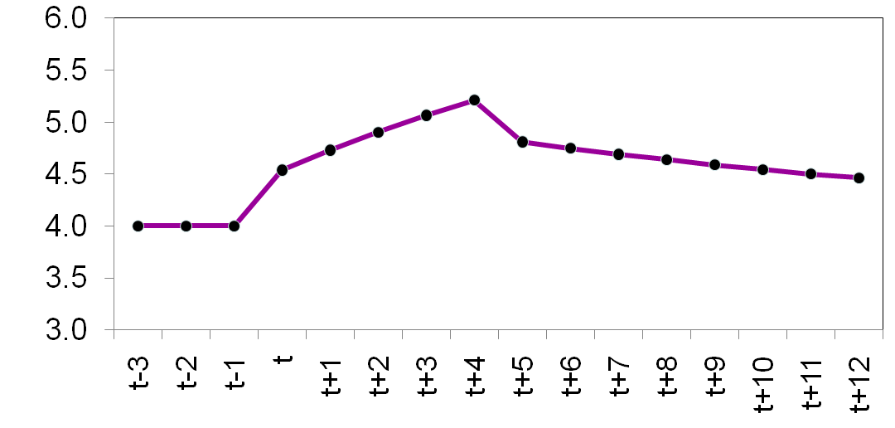
The dynamic response to a demand shock
The behavior
of the nominal interest rate depends on that
of the inflation and real interest rates.

Slide 116
4. Stricter Monetary Policy
Suppose an economy is initially at its long-run equilibrium
Then its central bank becomes less tolerant of inflation and reduces its target inflation rate (π*) from 2% to 1%
What will be the short-run effect?
How will the economy adjust to its new long-run equilibrium?

Slide 117
Recap: DAD-DAS Slopes and Shifts
DAS
DAD
Upward sloping
If natural output increases, shifts right by same amount
If previous-period inflation increases, shifts up by same amount
If there is a positive inflation shock (ν_{t} > 0), shifts up by same amount
Downward sloping
If natural output increases, shifts right by same amount
If target inflation increases, shifts up by same amount
If there is a positive demand shock (ε_{t} > 0), shifts right

Slide 118
A shift in monetary policy
Period t – 1: target inflation rate π* = 2%, initial equilibrium at A
Y
Period t: Central bank lowers target to π* = 1%, raises real interest rate, shifts DAD leftward. Output and inflation fall.
π
DAS_{t -1, t}
A
DAS_{t +1}
π_{t – 1} = 2%
π_{t}
B
C
Period t + 1: The fall in π_{t} reduced inflation expectations for t + 1, shifting DAS downward. Output rises, inflation falls.
DAS_{final}
π_{final} = 1%
Z
DAD_{t – 1}
DAD_{t, t + 1,…}
Subsequent periods:
This process continues until output returns to its natural rate and inflation reaches its new target.
Y
Y_{t}
,
Y_{final}
Y_{t –1}
Notes:
This slide presents the experiment described on pp.449-453 of the text.

Slide 119
4. Stricter Monetary Policy
At the date the target inflation is reduced, output falls below its natural level, and inflation falls too towards its new target level
  The real interest rate rises above its natural level (ρ)
  The effect on the nominal interest rate (i = r + π) is ambiguous
On the following dates, output recovers and gradually returns to its natural level. Inflation continues to fall and gradually approaches the new target level.
  The real interest rate falls, gradually returning to its natural level (ρ)
  The nominal interest rate falls to its new and lower long-run level (i = ρ + π*)

Slide 120
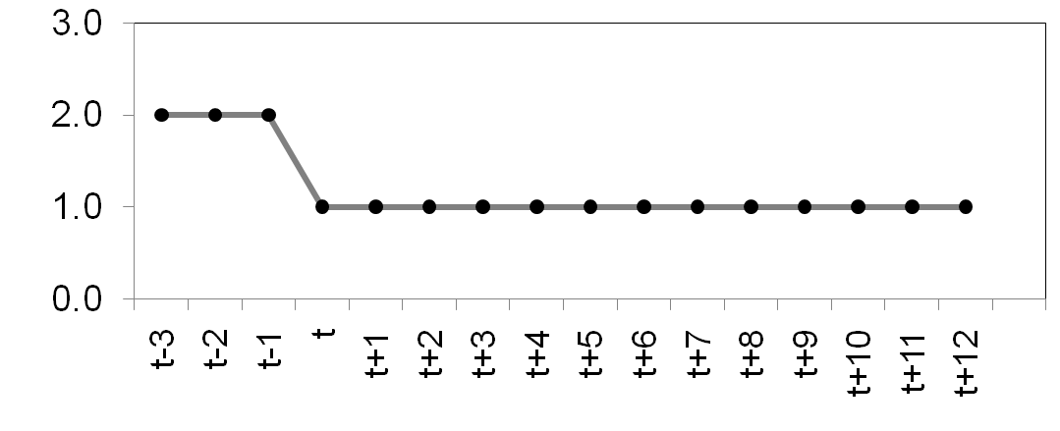
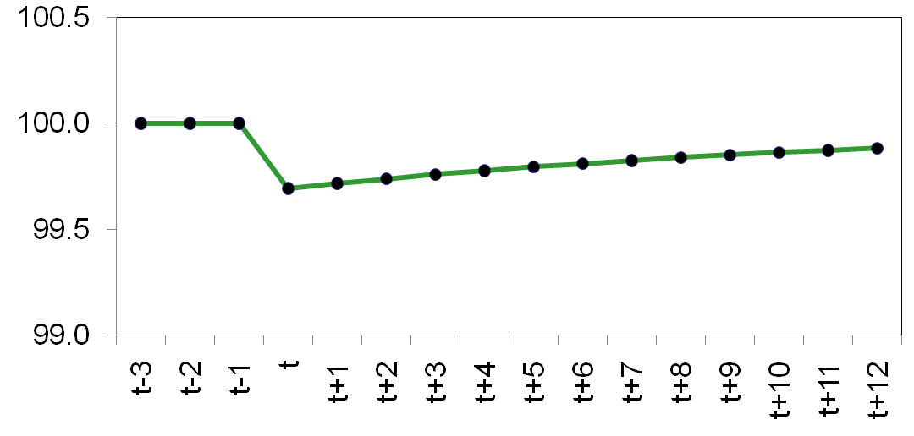
The dynamic response to a reduction in target inflation
Reducing the target inflation rate causes output to fall below its natural level for a while.
Output recovers gradually.
Notes:
The lower graph illustrates an important concept in macroeconomics: a central bank can permanently lower inflation by inducing a recession.

Slide 121
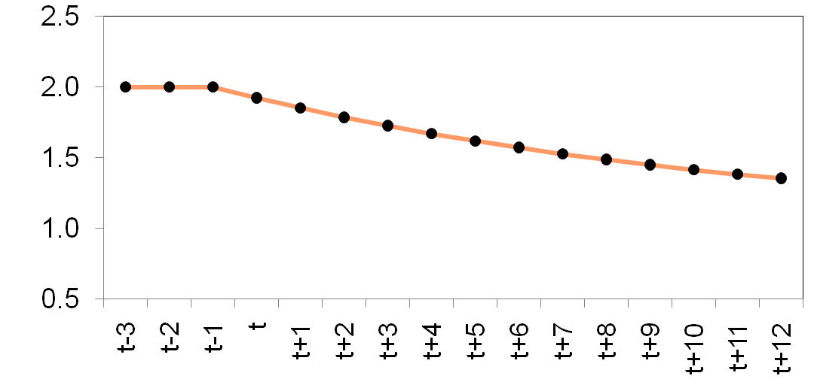
The dynamic response to a reduction in target inflation
Because expectations adjust slowly,
it takes many periods for inflation to reach the new target.
Notes:
The sluggish behavior of inflation results from our assumption that expectations are adaptive.

Slide 122
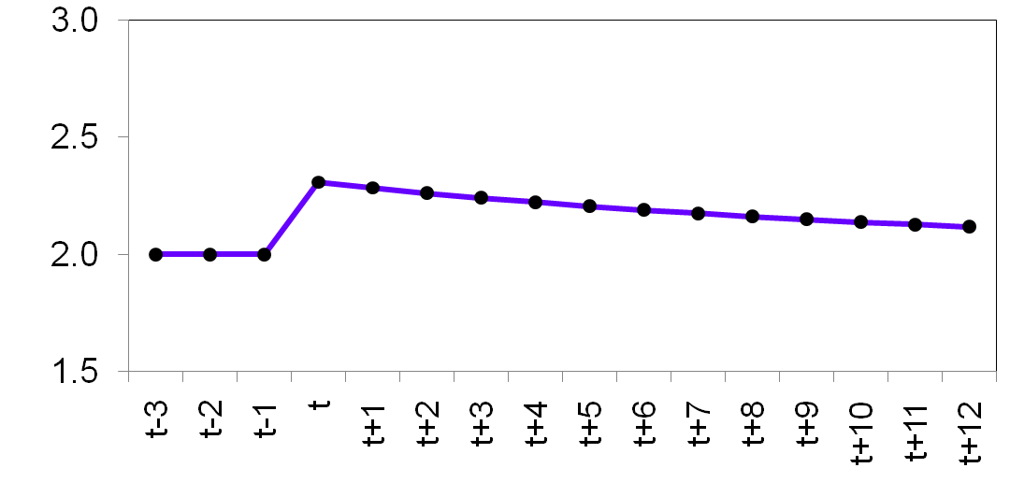
The dynamic response to a reduction in target inflation
To reduce inflation,
the central bank raises the real interest rate to reduce aggregate demand.
The real interest rate gradually returns to its natural rate.

Slide 123
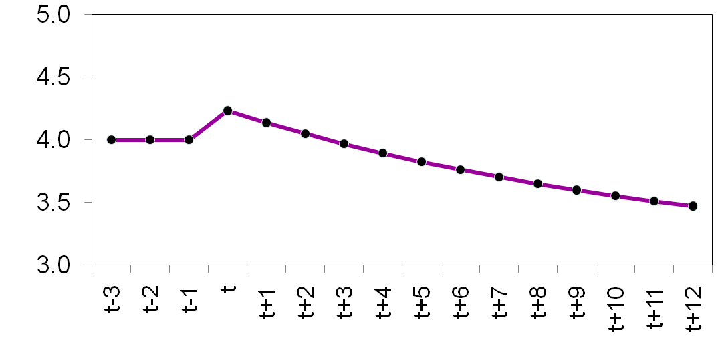
The dynamic response to a reduction in target inflation
The initial increase in the real interest rate raises the nominal interest rate.
As the inflation and real interest rates fall, the nominal rate falls.

Slide 124
APPLICATION:
Output variability vs. inflation variability
A supply shock reduces output (bad)
and raises inflation (also bad).
The central bank faces a tradeoff between these “bads” – it can reduce the effect on output,
but only by tolerating an increase in the effect
on inflation….
Notes:
This and the following two slides correspond to the first half of Section 15-4, pp. 453-456.

Slide 125
The DAD Equation
CASE 1: θ_{π} is large, θ_{Y} is small
Therefore, a small increase in inflation is accompanied by a large decrease in output
That is, the DAD curve is flat
  See the next slide

Slide 126
APPLICATION:
Output variability vs. inflation variability
CASE 1: θ_{π} is large, θ_{Y} is small
π
A supply shock shifts DAS up.
In this case, a small change in inflation has a large effect on output, so DAD
is relatively flat.
DAS_{t}
π_{t}
DAS_{t – 1}
π_{t –1}
The shock has a large effect on output, but a small effect on inflation.
DAD_{t – 1, t}
Y
Y_{t}
Y_{t –1}
Notes:
Most students can readily see that the slope of the DAD curve determines the relative magnitudes of the effects on output vs. inflation.
What is less obvious is the relation between the theta parameters and DAD’s slope. You can convince students of the relationship using intuition and using math:
Intuition: Large θ_{π} and small θ_{Y} means the central bank is more concerned with keeping inflation close to its target than with keeping output (and hence employment) close to their natural rates. Thus, a small change in inflation will induce the central bank to more sharply raise the real interest rate, causing a significant drop in the quantity of goods demanded.
Math: Look at the equation for the DAD curve, either on p.433 or on an earlier slide. Output appears on the left-hand side, while inflation is on the right. The coefficient on inflation is a ratio that contains θ_{π} in the numerator and θ_{Y} in the denominator. Other things equal, an increase in θ_{π} or a decrease in θ_{Y} will increase this coefficient. Of course, the coefficient is NOT the slope of the DAD curve (because output, not inflation, is on the left-hand side); it is the inverse of the slope of the DAD. Hence, if this coefficient is large, the slope of DAD is small, and the DAD curve is relatively flat, as depicted here.

Slide 127
The DAD Equation
CASE 2: θ_{π} is small, θ_{Y} is large
Therefore, even a large increase in inflation is accompanied by only a small decrease in output
That is, the DAD curve is steep
  See the next slide

Slide 128
APPLICATION:
Output variability vs. inflation variability
CASE 2: θ_{π} is small, θ_{Y} is large
π
In this case, a large change in inflation has only a small effect on output, so DAD is relatively steep.
DAS_{t}
π_{t}
DAS_{t – 1}
π_{t –1}
Now, the shock has only a small effect on output, but a big effect on inflation.
DAD_{t – 1, t}
Y
Y_{t}
Y_{t –1}
Notes:
In this case, the DAD curve is steep.
Intuition: Small θ_{π} and large θ_{Y} mean the central bank is more concerned with maintaining full employment output than with keeping inflation close to
its target. Thus, even if inflation rises a lot, the central bank won’t raise the real interest rate very much, so demand for goods and services won’t fall very much.
Math: see explanation in “notes” section of preceding slide.
The textbook (p.435) includes a nice case study comparing the priorities of the U.S.’ Federal Reserve with those of the European Central Bank. CASE 1 better fits the recent behavior of the ECB, while CASE 2 better fits the Fed’s recent behavior.

Slide 129
APPLICATION:
Output variability vs. inflation variability
The central bank must decide whether it wants
  Less variability in inflation, or
  Less variability in output
It can’t have less variability in both inflation and output

Slide 130
APPLICATION:
The Taylor Principle
The Taylor Principle (named after economist John Taylor): The proposition that a central bank should respond to an increase in inflation with an even greater increase in the nominal interest rate (so that the real interest rate rises). I.e., central bank should set θ_{π} > 0.
Otherwise, DAD will slope upward, economy may be unstable, and inflation may spiral out of control.
Notes:
This and the next few slides summarize the second half of Section 15-4, pp.456-459.
Looking at the equation for DAD, the sign of the coefficient on inflation is the opposite of the sign of θ_{π}.

Slide 131
APPLICATION:
The Taylor Principle
(DAD)
(MP rule)
If θ_{π} > 0:
When inflation rises, the central bank increases the nominal interest rate even more, which increases the real interest rate and reduces the demand for goods and services.
DAD has a negative slope.

Slide 132
APPLICATION:
The Taylor Principle
(DAD)
(MP rule)
If θ_{π} < 0:
When inflation rises, the central bank increases
the nominal interest rate by a smaller amount.
The real interest rate falls, which increases the demand for goods and services.
DAD has a positive slope.

Slide 133
APPLICATION:
The Taylor Principle
If DAD is upward-sloping and steeper than DAS, then the economy is unstable: output will not return to its natural level, and inflation will spiral upward (for positive demand shocks) or downward (for negative ones).
Estimates of θ_{π} from published research:
  θ_{π} = – 0.14 from 1960-78, before Paul Volcker became Fed chairman. Inflation was high during this time, especially during the 1970s.
  θ_{π} = 0.72 during the Volcker and Greenspan years. Inflation was much lower during these years.
Notes:
These estimates of θ_{π} help explain why inflation was out of control during the 1970s but came back under control with Paul Volcker and the change in monetary policy.
See the Case Study on pp.437-438 for more information about the estimates of θ_{π} and their implications.

Slide 134
DAD-DAS + ZLB!
See “A Simple Treatment of the Liquidity Trap for Intermediate Macroeconomics Courses,” The Journal of Economic Education, 45(1), 36-55, 2014. PDF copy available at http://myweb.liu.edu/~uroy/resume/myPDF/JEE-2014.pdf.

Slide 135
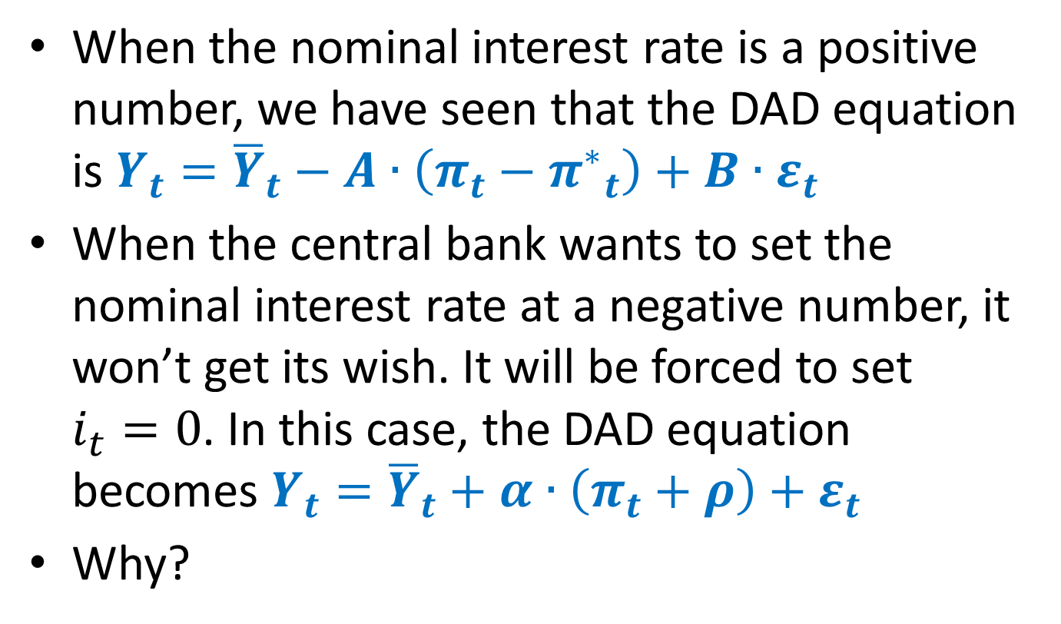
DAD-DAS + ZLB!
When the nominal interest rate is a positive number, we have seen that the DAD equation is $Y_{t}={\overline{Y}}_{t}−A∙\left(π_{t}−{π^{∗}}_{t}\right)+B∙ε_{t}$
When the central bank wants to set the nominal interest rate at a negative number, it won’t get its wish. It will be forced to set $i_{t}=0$. In this case, the DAD equation becomes $Y_{t}={\overline{Y}}_{t}+α∙\left(π_{t}+ρ\right)+ε_{t}$
Why?

Slide 136

The Dynamic Aggregate Demand Curve (ZLB)
The Demand Equation
Fisher equation
adaptive expectations
$$Y_{t}={\overline{Y}}_{t}−α∙\left(−π_{t}−ρ\right)+ε_{t}$$
$$i_{t}=0$$
$$Y_{t}={\overline{Y}}_{t}+α∙\left(π_{t}+ρ\right)+ε_{t}$$
Zero Lower Bound
Surprise, the DAD curve is now positively sloped!
Notes:
The derivation of the DAS curve was almost trivial. Not so for DAD. The next few slides walk students through (most of) the steps. See p. 440 for more details.

Slide 137
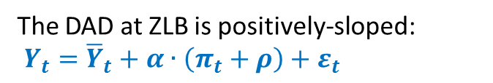
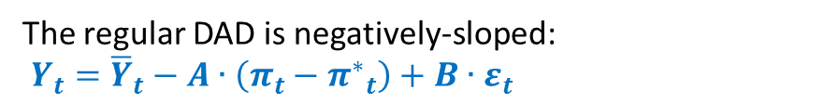
π_{t}
π*
O
The regular DAD is negatively-sloped:
$Y_{t}={\overline{Y}}_{t}−A∙\left(π_{t}−{π^{∗}}_{t}\right)+B∙ε_{t}$
$${\overline{Y}}_{}$$
Y_{t}
The DAD at ZLB is positively-sloped:
$Y_{t}={\overline{Y}}_{t}+α∙\left(π_{t}+ρ\right)+ε_{t}$
–ρ
D
There are two long-run equilibria: O and D! The long-run equilibrium that the textbook discusses is O, the orthodox long-run equilibrium. The new one is D, the deflationary long-run equilibrium, for the ZLB world.
Notes:
Figure 5

Slide 138
π_{t}
DAS_{O} (π_{t – 1} = π*; ν_{t} = 0)
If inflation is higher than –ρ, the negative of the natural real interest rate, at any date, there is nothing to worry: the economy will converge gradually to the long-run equilibrium at O.
π*
O
π_{r}
R
DAS_{R} (π_{t – 1} = π_{R} < π_{r}; ν_{t} = 0)
π_{R}
R’
R’’
$${\overline{Y}}_{}$$
Y_{t}
DAS_{D} (π_{t – 1} = – ρ; ν_{t} = 0)
–ρ
D
D’
There are two long-run equilibria: O and D! The long-run equilibrium that the textbook discusses is O, the orthodox long-run equilibrium. The new one is D, the deflationary long-run equilibrium, for the ZLB world.
Notes:
Figure 5

Slide 139
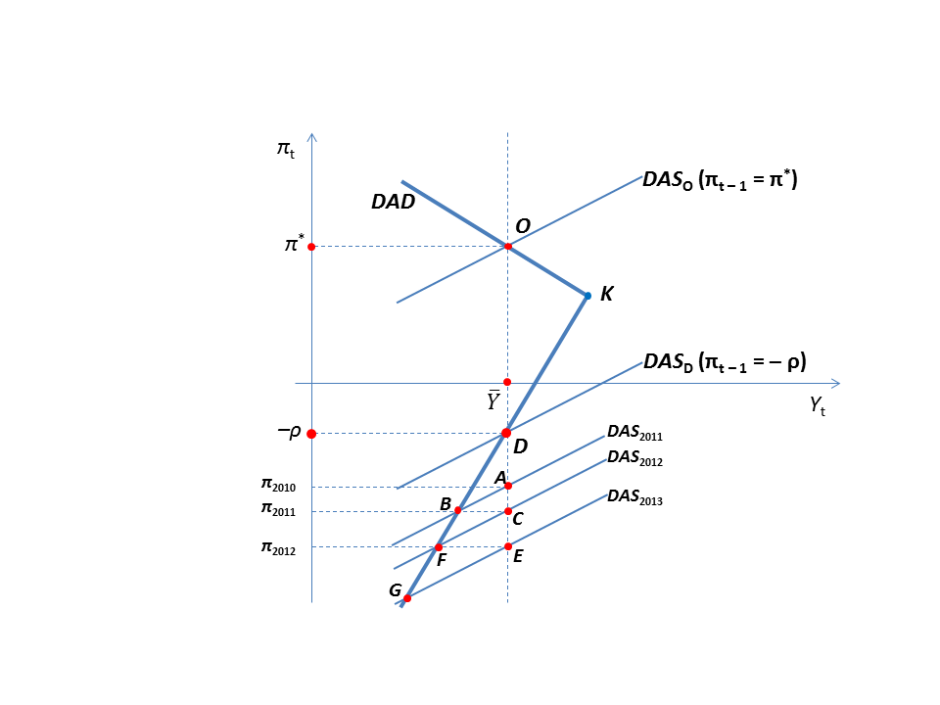
The new long-run equilibrium at D is unstable! For example, if the economy is at B, it will move to F and then to G, etc. In other words, the economy will move away from the long-run equilibrium at D and enter a deflationary spiral. Output and inflation will both keep falling and falling. Very scary!

Slide 140
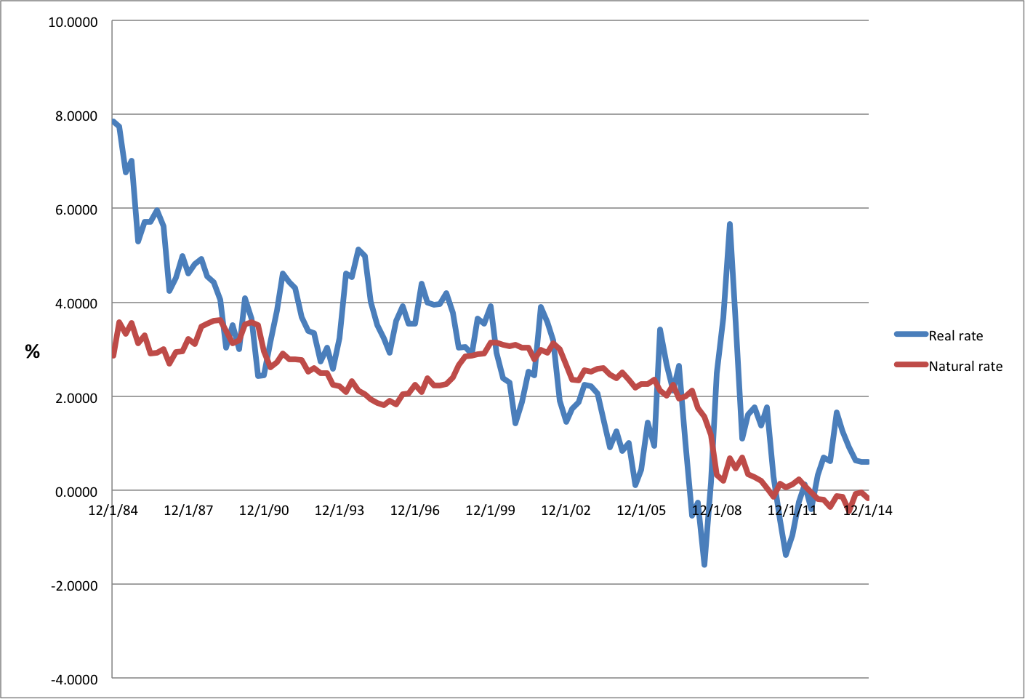
The natural real interest rate (ρ) has been falling since the 1980s and has become negative lately.
Notes:
Figure 2

Slide 141
The natural real interest rate (ρ) has been falling since the 1980s and has become negative lately. This brings the deflationary long-run equilibrium, D, closer to the stable long-run equilibrium, O. This increases the chance that a shock could throw a perfectly fine economy into the dreaded deflationary spiral. Very scary!

Slide 142
DAD-DAS + ZLB!

