Slide 1
Chapter 18: Six Debates over
Macroeconomic Policy

Slide 2
Debate #1
1. Should monetary and fiscal policymakers try to stabilize the economy?
Changes in aggregate demand and aggregate supply
Short-run fluctuations in production and employment
Monetary and fiscal policy
Can shift aggregate demand
Influence these fluctuations

Slide 3
Debate #1
Pro: policymakers should try to stabilize the economy
When aggregate demand is too small
High unemployment
Policymakers
Boost government spending
Cut taxes
Expand the money supply

Slide 4
Debate #1
Pro: policymakers should try to stabilize the economy
When aggregate demand is excessive
High inflation
Policymakers
Cut government spending
Raise taxes
Reduce the money supply
More stable economy, benefits everyone

Slide 5
Debate #1
Con: policymakers should not try to stabilize the economy
Monetary and fiscal policy
Do not affect the economy immediately
Work with a long lag
Monetary policy – about 6 months
Fiscal policy – long political process, it can take years
Economic forecasting is highly imprecise

Slide 6
Debate #1
Con: policymakers should not try to stabilize the economy
Policymakers trying to stabilize the economy
Can do just the opposite
Economic conditions can easily change

Slide 7
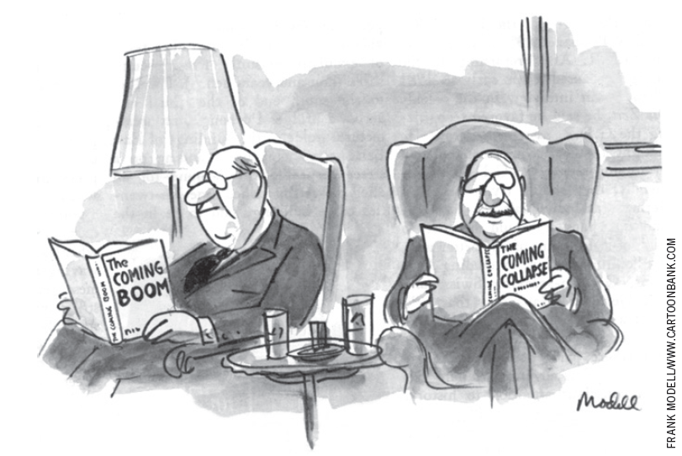
Debate #1

Slide 8
Debate #2
2. Should the government fight recessions with spending hikes rather than tax cuts?
President George W. Bush, 2001
Economy was slipping into a recession
Cutting tax rates
President Barack Obama, 2009
Economy –worst recession in many decades
Stimulus package – tax reductions and substantial increases in government spending

Slide 9
Debate #2
Pro: the government should fight recessions with spending hikes
Fundamental problem during recessions
Inadequate aggregate demand
Key to ending recessions
Restore aggregate demand to a level consistent with full employment

Slide 10
Debate #2
Pro: the government should fight recessions with spending hikes
Monetary policy
First line of defense - economic downturns
Increasing the money supply
Reduces interest rates
Reduce the cost of borrowing
Increased spending on investment
Increased aggregate demand

Slide 11
Debate #2
Pro: the government should fight recessions with spending hikes
Fiscal policy
Cutting taxes
Increased household disposable income
Increase spending on consumption
Increased government spending
Adds directly to aggregate demand

Slide 12
Debate #2
Pro: the government should fight recessions with spending hikes
Fiscal policy
Multiplier effects
Higher aggregate demand - Higher incomes
Induces additional consumer spending
Further increases in aggregate demand
Particularly useful when the tools of monetary policy lose their effectiveness

Slide 13
Debate #2
Pro: the government should fight recessions with spending hikes
Economic downturn of 2008 and 2009
The Fed cut its target interest rate to almost zero
Cannot reduce interest rates below zero
Once interest rates are at zero, the Fed has lost its most powerful tool
Turn to fiscal policy

Slide 14
Debate #2
Pro: the government should fight recessions with spending hikes
Traditional Keynesian analysis
Increases in government purchases are a more potent tool than decreases in taxes
$1 tax cut – part of it may be saved
Only part adds to AD
$1 government spending – fully adds to AD

Slide 15
Debate #2
Pro: the government should fight recessions with spending hikes
2009, Obama administration estimations
$1of tax cuts increases GDP by $0.99
$1of government purchases increases GDP by $1.59
The $800 billion stimulus package
Create or save more than 3 million jobs by the end of the president’s second year in office

Slide 16
Debate #2
Pro: the government should fight recessions with spending hikes
3 kinds of government spending
“Shovel-ready” projects
Federal aid to state and local governments
Constitutionally required to run balanced budgets
Increased payments to the jobless - unemployment insurance system
President Barack Obama delivers remarks at the groundbreaking of a road project funded by the American Recovery and Reinvestment Act, Friday, June 18, 2010, in Columbus, Ohio.

Slide 17
Debate #2
Con: the government should fight recessions with tax cuts
Tax cuts
Increase AD
Increase households’ disposable income
By altering incentives - stimulate investment
Increase AS
Unemployed - incentive to search for jobs
Employed - incentive to work longer hours

Slide 18
Debate #2
Con: the government should fight recessions with tax cuts
Problems with increasing government spending during recessions
Government-spending multipliers – smaller
Consumers - higher taxes in the future
Cut back spending today
Firms - reduced expectations of future profits
Reduce investment spending today

Slide 19
Debate #2
Con: the government should fight recessions with tax cuts
Problems with increasing government spending during recessions
Fast increase in spending
Buy things of little public value
“Bridges to nowhere”
Careful and deliberate planning
Long lags

Slide 20
Debate #3
3. Should monetary policy be made by rule rather than by discretion?
Federal Open Market Committee
Sets monetary policy – complete discretion
Meets about every six weeks
Evaluate the state of the economy
Short-term interest rates
Raise, lower, or leave unchanged
The Fed - adjusts the money supply

Slide 21
Debate #3
Pro: monetary policy should be made by rule
Problems with discretionary monetary policy
Does not limit incompetence and abuse of power
Political business cycle
If central bankers ally with politicians
Discretionary policy - can lead to economic fluctuations that reflect the electoral calendar

Slide 22
Debate #3
Pro: monetary policy should be made by rule
Problems with discretionary monetary policy
It might lead to more inflation than is desirable
Time inconsistency of policy
Central bankers – know there is no long-run trade-off between inflation and unemployment
Announce goal - zero inflation
Short-run trade-off between inflation and unemployment

Slide 23
Debate #3
Con: monetary policy should not be made by rule
Discretionary monetary policy – flexible
The Fed – various circumstances
Better to appoint good people to conduct monetary policy
And then give them the freedom to do the best they can
The alleged problems with discretion
Are largely hypothetical

Slide 24
Debate #4
4. Should the central bank aim for zero inflation?
Inflation
Prices rise when the government prints too much money
Society faces a short-run trade-off between inflation and unemployment

Slide 25
Debate #4
Pro: the central bank should aim for zero inflation
Six costs of inflation:
Shoeleather costs associated with reduced money holdings
Menu costs associated with more frequent adjustment of prices
Increased variability of relative prices

Slide 26
Debate #4
Pro: the central bank should aim for zero inflation
Six costs of inflation:
Unintended changes in tax liabilities due to non-indexation of the tax code
Confusion and inconvenience resulting from a changing unit of account
Arbitrary redistributions of wealth associated with dollar-denominated debts

Slide 27
Debate #4
Pro: the central bank should aim for zero inflation
Reducing inflation
Temporary: high unemployment & low output
Long-run: no trade-off
Temporary costs
Permanent benefits

Slide 28
Debate #4
Con: the central bank should not aim for zero inflation
Benefits of zero inflation – are small
Compared to moderate inflation
Costs of reaching zero inflation are large
Sacrifice ratio
Social costs
Small inflation - may be a good thing

Slide 29
Debate #5
5. Should the government balance its budget?
When the government spends more than it collects in tax revenue
It covers this budget deficit by issuing government debt
Affect saving, investment, and interest rates

Slide 30
Debate #5
Pro: government should balance its budget
Federal debt
$712 billion in 1980
$11.3 trillion in 2012
$36,000 - each person’s share of the government debt
“What?!? My share of the government debt is $36,000?”

Slide 31
Debate #5
Pro: government should balance its budget
Government debt
Direct effect: place a burden on future generations
Macroeconomic effects
Lower national saving
Future generations: lower incomes and higher taxes

Slide 32
Debate #5
Pro: government should balance its budget
Justifiable to run a budget deficit
War
Temporary downturn in economic activity
Not all budget deficits can be justified by war or recession

Slide 33
Debate #5
Pro: government should balance its budget
1980 – 1995, government debt as percentage of GDP
Increased from 26 to 50% of GDP
No major military conflict
No major economic downturn
Causes
Easier to increase government spending
Than to increase taxes

Slide 34
Debate #5
Pro: government should balance its budget
Budget deficit in recent years
Wars in Iraq and Afghanistan
Effects of the recessions in 2001 and 2008–2009
Imperative that this deficit not signal a return to the unsustainable fiscal policy of an earlier era

Slide 35
Debate #5
Pro: government should balance its budget
Aim for a balanced budget
Greater national saving
Greater investment
Economic growth

Slide 36
Debate #5
Con: government should not balance its budget
The problem of government debt
Often exaggerated
Government debt - tax burden on younger generations
Not large compared to lifetime income
Lifetime income = $2 million
Debt = $36,000 per person
2% of lifetime income

Slide 37
Debate #5
Con: government should not balance its budget
Budget deficit
Just one piece of a large picture
Of how the government chooses to raise and spend money
Fiscal policy
Affect different generations of taxpayers

Slide 38
Debate #5
Con: government should not balance its budget
Government debt - can continue to rise forever
Burden of the government debt relative to the size of the nation’s income
Economy – grows over time
Nation’s ability to pay the interest on the government debt grows over time as well

Slide 39
Debate #5
Con: government should not balance its budget
Government debt - can continue to rise forever
As long as the government debt grows more slowly than the nation’s income
There is nothing to prevent the government debt from growing forever
Real output of the U.S. economy
Grows on average about 3% per year

Slide 40
Debate #5
Con: government should not balance its budget
Government debt - can continue to rise forever
If the inflation rate is 2% per year
Nominal income grows: 5% per year
Real output grows: 3% per year
Government debt can rise by 5% per year without increasing the ratio of debt to income

Slide 41
Debate #5
Con: government should not balance its budget
Government debt - can continue to rise forever
2012, federal government debt: $11.3 trillion
$565 billion is 5%
As long as the federal budget deficit is smaller than $565 billion, the policy is sustainable

Slide 42
Debate #5
Con: government should not balance its budget
Very large budget deficits cannot persist forever
2009-2012, federal budget deficit: over $1 trillion very year
Driven by extraordinary circumstances
Major financial crisis
Deep economic downturn
Policy responses to these events

Slide 43
Debate #5
Con: government should not balance its budget
2009-2012, federal budget deficit
No one suggests that a deficit of this magnitude can continue
But zero is the wrong target for fiscal policymakers

Slide 44
Debate #6
6. Should the tax laws be reformed to encourage saving?
Nation’s standard of living
Depends on its ability to produce goods and services
Determined by how much it saves and invests for the future

Slide 45
Debate #6
Pro: the tax laws should be reformed to encourage saving
Nation’s saving rate
Determinant of long-run economic prosperity
U.S. tax system - discourages saving
Tax the return to saving quite heavily
Tax some forms of capital income twice
Inheritance tax rate - as high as 55%

Slide 46
Debate #6
Pro: the tax laws should be reformed to encourage saving
Other policies and institutions
Discourage saving
Tax code – improved to encourage saving
Preferential treatment to some types of retirement saving
Consumption tax

Slide 47
Debate #6
Con: the tax laws should not be reformed to encourage saving
Fairly distribution of the tax burden
Tax policies – to encourage saving
Increase the tax burden on people who cannot afford to save
May not be effective
Substitution effect
Income effect

Slide 48
Debate #6
Con: the tax laws should not be reformed to encourage saving
Other ways to increase national saving
No tax breaks to the rich
National saving = private + public saving
Raise public saving
By reducing the budget deficit
Raise taxes on the wealthy

