Slide 1
PART II
HOW MARKETS WORK

Slide 2
The Market Forces of Demand and Supply
Udayan Roy
http://myweb.liu.edu/~uroy/

Slide 3
We need a theory of prices and quantities
Recall that …
In economics we need to be able to predict the economic consequences of
alternative policies, and
events that are outside our control but we need to be prepared for
The mental tool we use to make such predictions is called a theory
A theory is of no use if its predictions are inaccurate

Slide 4
We need a theory of prices and quantities
The theory of demand and supply is a simple example of an economic theory
It can be used to make predictions about
the price and
the quantity traded of some commodity
Example: The theory of supply and demand can help you make a prediction about the effect of unusually cold weather on the price and the quantity traded of home heating oil in New York

Slide 5
We need a theory of prices and quantities
The theory of demand and supply is a simple example of an economic theory
It can be used to make predictions about
the price and
the quantity traded of some commodity
In a market-based economy, it is crucial to be able to predict the price because the price is the most important economic incentive

Slide 6
Assume a market-based economy
The theory of supply and demand assumes that commodities are traded by buyers and sellers dealing directly with each other in markets
Example: When I refer to the “market for coffee”, I simply mean the buyers and sellers of coffee and the rules they obey when they trade

Slide 7
Let’s get to the punch line
In a market-based economy, the price of a commodity will be high if the commodity is:
Highly desired
Costly to produce
Sold under little or no competition
Can you guess the circumstances in which the price of a commodity will be low?

Slide 8
Let’s get to the punch line
In a market-based economy, the price of a commodity will be high if the commodity is:
Highly desired
Costly to produce
Sold under little or no competition
The theory of supply and demand makes a very specific assumption about the intensity of competition

Slide 9
Perfect competition

Slide 10
Assume perfect competition
The theory of supply and demand assumes that commodities are traded in perfectly competitive markets
A perfectly competitive market is a market in which
there are many buyers
many sellers
and all sellers sell the exact same product
As a result, each buyer and seller has a negligible impact on the market price

Slide 11
Are the markets for these commodities perfectly competitive?
Wheat
White cotton T-shirts
Automobiles
Cable TV in your locality
Electricity for home use in your locality

Slide 12
What’s the opposite of perfect competition?
Imperfect competition (duh!)
Monopoly (Chapter 15, one seller)
Monopolistic Competition (Chapter 16, many sellers, differentiated products)
Oligopoly (Chapter 17, few sellers)
We will probably do only monopoly

Slide 13
demand
How should we describe the behavior of buyers?

Slide 14
Demand
Quantity demanded is the amount of a commodity that buyers are willing and able to purchase
Demand is a full description of how the quantity demanded changes as the price of the commodity changes.

Slide 15
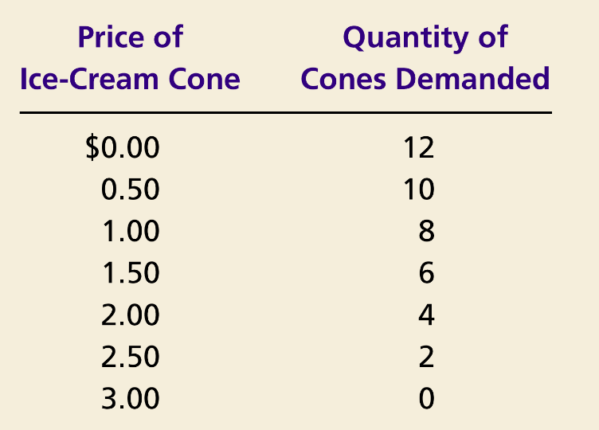
Catherine’s Demand Schedule and Demand Curve
Price of Ice-Cream Cones
$3.00
2.50
1. A decrease
2.00
in price
...
1.50
1.00
0.50
0
1
2
3
4
5
6
7
8
9
10
11
12
Quantity
of Ice-Cream Cones
2.
...
increases quantity
of cones demanded.
Copyright © 2004 South-Western

Slide 16
Market Demand is the Sum of Individual Demands

Slide 17
Law of Demand
The law of demand states that
the quantity demanded of a good falls when the price of the good rises, and vice versa, provided all other factors that affect buyers’ decisions are unchanged

Slide 18
Law of Demand
The law of demand states that
the quantity demanded of a good falls when the price of the good rises, and vice versa, provided all other factors that affect buyers’ decisions are unchanged

Slide 19
Law of Demand
The law of demand states that
the quantity demanded of a good falls when the price of the good rises, and vice versa, provided all other factors that affect buyers’ decisions are unchanged
This a crucial phrase. It suggests that the quantity of ice cream demanded may rise when the price of ice cream rises, provided there is a simultaneous change in some other factor. Can you think of examples where the price of ice cream rises, and yet the quantity of ice cream demanded in your locality increases?

Slide 20
“provided all other factors … are unchanged”
The quantity demanded of a good/service depends on
The price of the good/service
The prices of related goods/services
Buyers’ incomes
Buyers’ tastes
Buyers’ expectations about future prices and incomes
Number of buyers, etc.
The Law of Demand says that the quantity demanded of a good is inversely related to its price, provided all other factors are unchanged

Slide 21
“provided all other factors … are unchanged”
Price
The quantity demanded of a good/service depends on
The price of the good/service
The prices of related goods/services
Buyers’ incomes
Buyers’ tastes
Buyers’ expectations about future prices and incomes
Number of buyers, etc.
The Law of Demand says that the quantity demanded of a good is inversely related to its price, provided all other factors are unchanged
A
B
Inversely related
Quantity Demanded

Slide 22
Why Might Demand Increase?
 | Quantity Demanded
Price | Situation A | Situation B
0.00 | 12 | 20
0.50 | 10 | 16
1.00 | 8 | 12
1.50 | 6 | 8
2.00 | 4 | 6
2.50 | 2 | 4
3.00 | 0 | 2
How can we explain the difference in Catherine’s behavior in situations A and B?
Why does she consume more in situation B at every possible price?
Price
Quantity Demanded

Slide 23
“provided all other factors … are unchanged”
The quantity demanded of a good/service depends on
The price of the good/service
The prices of related goods/services
Buyers’ incomes
Buyers’ tastes
Buyers’ expectations about future prices and incomes
Number of buyers, etc.
The Law of Demand says that the quantity demanded of a good is inversely related to its price, provided all other factors are unchanged

Slide 24
“provided all other factors … are unchanged”
Price
The quantity demanded of a good/service depends on
The price of the good/service
The prices of related goods/services
Buyers’ incomes
Buyers’ tastes
Buyers’ expectations about future prices and incomes
Number of buyers, etc.
The Law of Demand says that the quantity demanded of a good is inversely related to its price, provided all other factors are unchanged
A
B
Causes demand to shift
Quantity Demanded

Slide 25
Shifts in the Demand Curve
Price
of Ice-Cream Cones
Increase
in demand
Decrease
in demand
Demand curve D²
Demand curve D¹
Demand curve D³
0
Quantity of Ice-Cream Cones

Slide 26
Shifts in the Demand Curve
Consumer Income
As income increases the demand for a normal good will increase
As income increases the demand for an inferior good will decrease
Example:
Restaurant food is a normal good
Demand shifts right when incomes rise
Fast food is an inferior good
Demand shifts left when incomes rise
Price
Quantity Demanded

Slide 27
Shifts in the Demand Curve
Prices of Related Goods
When a fall in the price of one good reduces the demand for another good, the two goods are called substitutes
When a fall in the price of one good increases the demand for another good, the two goods are called complements
Example:
Pepsi and Coke are substitutes
Pepsi’s demand shifts left when Coke’s price falls
Cars and gasoline are complements
The demand for cars shifts right when the price of gas falls
Price
Quantity Demanded

Slide 28
The Law of Demand—Explanations
There are two ways to explain the Law of Demand
Substitution effect
Income effect

Slide 29
Substitution Effect
When the price of a good decreases, consumers substitute that good instead of other competing (substitute) goods
1. When the price of Coke decreases…
2. Consumption of Pepsi decreases…
3. Consumption of Coke increases
Clothes
Coke
Books
Movies
Pepsi

Slide 30
Income Effect
A decrease in the price of a commodity is essentially equivalent to an increase in consumers’ income

Slide 31
Lower Prices = Higher Income
Situation A
Price of an Apple | $1.00
Price of an Orange | $2.00
Income | $10.00
If income rises, Situation A becomes Situation B.
Situation B
Price of an Apple | $1.00
Price of an Orange | $2.00
Income | $20.00
If prices fall, Situation A becomes Situation C.
Situation C
Price of an Apple | $0.50
Price of an Orange | $1.00
Income | $10.00
Q: Which change is better?
A: They are both equally desirable. A fall in prices is equivalent to an increase in income.

Slide 32
Income Effect
Consumers respond to a decrease in the price of a commodity as they would to an increase in income
They increase their consumption of a wide range of goods, including the good that had a price decrease
1. When the price of Coke decreases…
2. Consumers feel richer…
3. Consumption of Coke and other normal goods increases
4. Consumption of inferior goods decreases
Clothes
Coke
Books
Movies
Pepsi

Slide 33
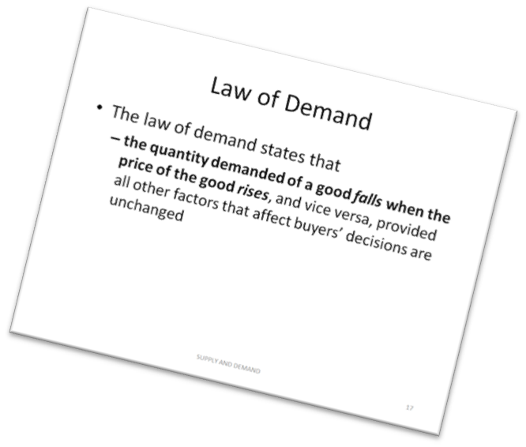
The Law of Demand—Explanations
We have used the substitution effect and the income effect to show that the Law of Demand is true for normal goods
Can you imagine an example where the Law of Demand is not true?

Slide 34
supply
How can we describe the behavior of sellers?

Slide 35
SUPPLY
Quantity supplied is the amount of a good that sellers are willing and able to sell
Supply is a full description of how the quantity supplied of a commodity responds to changes in its price
Notes:
25

Slide 36
Ben’s supply schedule and supply curve
Price of
Ice-Cream
Cones
Supply curve
$3.00
Price of Ice-cream cone | Quantity of Cones supplied
$0.00 0.50 1.00 1.50 2.00 2.50 3.00 | 0 cones 0 1 2 3 4 5
2.50
1. An increase
in price . . .
2.00
1.50
2. . . . increases quantity
of cones supplied.
1.00
0.50
0
1
2
3
4
5
6
7
8
9
10
11
12
Quantity of Ice-Cream Cones

Slide 37
Market supply and individual supplies
 | Quantity Supplied
Price of ice-cream cone | Ben |  | Jerry |  | Market
$0.00 0.50 1.00 1.50 2.00 2.50 3.00 | 0 0 1 2 3 4 5 | + | 0 0 0 2 4 6 8 | = | 0 0 1 4 7 10 13

Slide 38
Market supply and individual supplies
Ben’s
supply
+
Jerry’s
supply
=
Market
supply
Price of
Ice
Cream
Cones
Price of
Ice
Cream
Cones
Price of
Ice
Cream
Cones
S_{Ben}
$3.00
$3.00
$3.00
S_{Market}
S_{Jerry}
2.50
2.50
2.50
2.00
2.00
2.00
1.50
1.50
1.50
1.00
1.00
1.00
0.50
0.50
0.50
0
1
2
3
4
5
6
7
8
9
10
11
12
0
1
2
3
4
5
6
7
0
2
4
6
8
10
12
14
16
18
Quantity of Ice-Cream Cones
Quantity of
Ice-Cream Cones
Quantity of Ice-Cream Cones

Slide 39
Law of Supply
The law of supply states that, the quantity supplied of a good rises when the price of the good rises, and vice versa, provided all other factors that affect suppliers’ decisions are unchanged

Slide 40
Law of Supply
The law of supply states that, the quantity supplied of a good rises when the price of the good rises, and vice versa, provided all other factors that affect suppliers’ decisions are unchanged

Slide 41
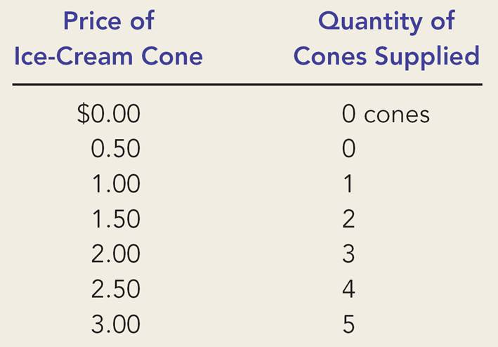
Law of Supply—Explanation
How can we make sense of the numbers in Ben’s supply schedule?
The best guess is that his costs must be something like the cost schedule below.
A specific ice-cream cone | It’s cost ($)
1st | 0.75
2nd | 1.35
3rd | 1.75
4th | 2.30
5th | 2.85
6th | 3.10
In this way, the Law of Supply follows from the assumption of Increasing Costs (or, Diminishing Returns)
Notes:
Note: Students will see later that the cost of a specific ice-cream cone is called its marginal cost.

Slide 42
Law of Supply
The law of supply states that, the quantity supplied of a good rises when the price of the good rises, and vice versa, provided all other factors that affect suppliers’ decisions are unchanged
This a crucial phrase. It suggests that the quantity of ice cream supplied may fall when the price of ice cream rises, provided there is a simultaneous change in some other factor. Can you think of examples where the price of ice cream rises, and yet the quantity of ice cream sold in your locality decreases?

Slide 43
“provided all other factors … are unchanged”
The quantity supplied of a good/service depends on
The price of the good/service
The prices of raw materials and labor
Technology
Number of sellers, etc.
The Law of Supply says that the quantity supplied of a good is positively related to its price, provided all other factors are unchanged

Slide 44
“provided all other factors … are unchanged”
The quantity supplied of a good/service depends on
The price of the good/service
The prices of raw materials and labor
Technology
Number of sellers, etc.
The Law of Supply says that the quantity supplied of a good is positively related to its price, provided all other factors are unchanged
Positively related

Slide 45
“provided all other factors … are unchanged”
The quantity supplied of a good/service depends on
The price of the good/service
The prices of raw materials and labor
Technology
Number of sellers, etc.
The Law of Supply says that the quantity supplied of a good is positively related to its price, provided all other factors are unchanged
Causes supply to shift

Slide 46
Shifts in the Supply Curve: What causes them?
Price of Ice-Cream Cones
Supply curve, S₃
Supply curve, S₁
Supply curve, S₂
Decrease
in supply
Increase
in supply
0
Quantity of Ice-Cream Cones

Slide 47
Supply Shift
Ben’s Supply Schedule
Price ($) | Quantity Supplied
 | Before | After
0.00 | 0 | 0
0.50 | 0 | 1
1.00 | 1 | 2
1.50 | 2 | 3
2.00 | 3 | 4
2.50 | 4 | 5
3.00 | 5 | 6
How could Ben’s supply have increased?
Ice-cream cone | It’s cost ($)
 | Before | After
1st | 0.75 | 0.45
2nd | 1.35 | 0.85
3rd | 1.75 | 1.45
4th | 2.30 | 1.95
5th | 2.85 | 2.45
6th | 3.10 | 2.90
Anything that reduces production costs, shifts supply to the right.

Slide 48
equilibrium
Are we there yet?

Slide 49
Interaction of demand and supply
We have seen what demand and supply are
We have seen why demand and supply may shift
Now it is time to say something about how buyers and sellers collectively determine the market outcome
To do this, we assume equilibrium

Slide 50
Equilibrium
The theory of supply and demand assumes that the price automatically reaches a level at which the quantity demanded equals the quantity supplied

Slide 51
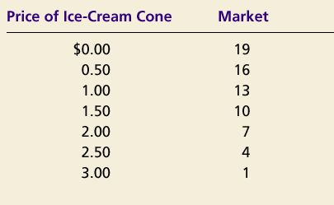
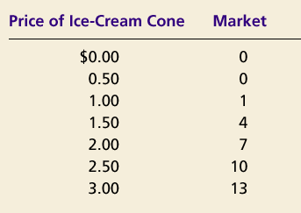
SUPPLY AND DEMAND TOGETHER
Demand Schedule
Supply Schedule
At $2.00, the quantity demanded is equal to the quantity supplied!
Notes:
36

Slide 52
Equilibrium of supply and demand
Price of
Ice-Cream
Cones
Supply
$3.00
2.50
Equilibrium
price
Equilibrium
2.00
1.50
1.00
Equilibrium
quantity
Demand
0.50
0
1
2
3
4
5
6
7
8
9
10
11
12
Quantity of Ice-Cream Cones

Slide 53
Equilibrium
Can we justify the assumption of equilibrium?

Slide 54
When Markets are Not in Equilibrium
(a) Excess Supply
Price of Ice-Cream Cones
Supply
Surplus
$2.50
2.00
Demand
0
4
7
10
Quantity of Ice-Cream Cones
Quantity
Quantity
demanded
supplied

Slide 55
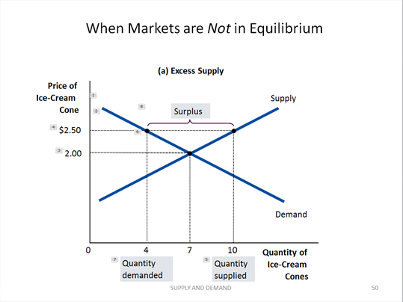
Justifying Equilibrium
Surplus
When the price exceeds equilibrium price, the quantity supplied exceeds the quantity demanded
This is called excess supply or a surplus
Suppliers will be forced to cut their prices, thereby moving closer to equilibrium

Slide 56
When Markets are Not in Equilibrium
(b) Excess Demand
Price of Ice-Cream Cones
Supply
$2.00
1.50
Shortage
Demand
0
4
7
10
Quantity of Ice-Cream Cones
Quantity
Quantity
supplied
demanded

Slide 57
When Markets are Not in Equilibrium
Shortage
When the price is less than the equilibrium price, the quantity demanded exceeds the quantity supplied
This is called excess demand or a shortage
Suppliers will raise the price, because too many buyers are chasing too few goods, thereby moving closer to equilibrium

Slide 58
Equilibrium
Law of supply and demand
The price of a good adjusts to bring the quantity supplied and the quantity demanded for that good into balance

Slide 59
Equilibrium: skepticism required
Although the Law of Supply and Demand is a good place to start the discussion of prices, it should not be taken to be the gospel truth.
In some cases the price might get stuck at some other level and quantity supplied and quantity demanded may not be equal.
Example: unemployment

Slide 60
Unemployment: a failure of equilibrium when the wage is too high and stuck there
Wage
Labor
Supply
Labor surplus
(unemployment)
Too-high
wage
Labor
demand
0
Quantity
demanded
Quantity
supplied
Quantity of
Labor

Slide 61
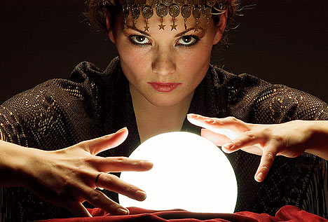
Making predictions
Are we there yet?? Is the theory of supply and demand of any use?

Slide 62
Let’s make some predictions
We have seen some of the factors that shift the demand and supply curves
Such shifts change the equilibrium outcome
Using the supply-demand theory we can try to predict the consequences of
alternative policy proposals, and
events outside our control that we need to be ready for

Slide 63
How an Increase in Demand Affects the Equilibrium
1. Hot weather increases
the demand for ice cream . . .
Price of Ice-Cream Cones
Supply
Can you now predict the consequences of unusually cold weather?
$2.50
New equilibrium
2.00
Can you use this graph to predict the effect on the market for rice if there is an increase in the price of wheat?
2. . . . resulting
Initial
in a higher
equilibrium
price . . .
D
D
0
7
10
Quantity of Ice-Cream Cones
3.
. . .
and a higher
quantity sold.

Slide 64
How a Decrease in Supply Affects the Equilibrium
1. An increase in the
price of sugar reduces
Price of Ice-Cream Cones
the supply of ice cream. . .
S₂
S₁
Can you now predict the consequences of a decrease in the price of sugar?
New
$2.50
equilibrium
2.00
Initial equilibrium
Can you use this graph to predict the effect on the market for rice if there is drought in our rice-growing areas?
2. . . . resulting
in a higher
price of ice
cream . . .
Demand
0
4
7
Quantity of Ice-Cream Cones
3.
. . .
and a lower
quantity sold.

Slide 65
Eggflation! Supply Decrease in the News
What's causing the price of eggs to skyrocket nationwide, PBS Newshour, YouTube, January 30, 2023

Slide 66
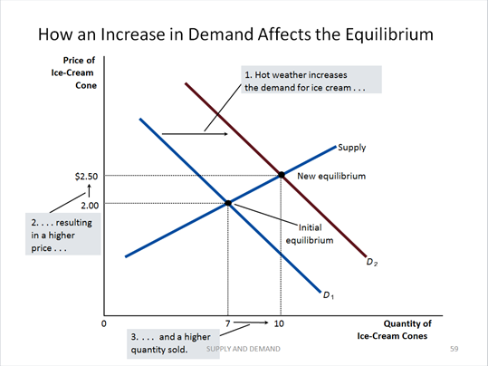
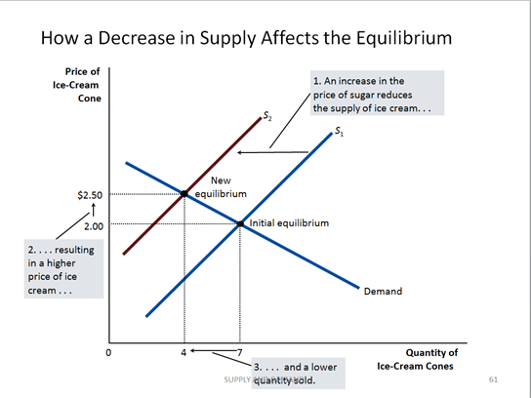
A Shift in Both Supply and Demand
Event | Effect on Price | Effect on Quantity
Demand increases | Up | Up
Supply decreases | Up | Down
Both | Up | Ambiguous

Slide 67
A Shift in Both Supply and Demand

Slide 68
Can you predict …
The effect of the Covid-19 pandemic
… on the price of gasoline?
… on the price of Manhattan real estate?

Slide 69
Can you predict …
The effect of a rise in the price of oil on the market for
Hybrid cars
Real estate
Staple foods (corn, wheat, rice)
The effect of the development of cheaper and better batteries for electric cars on the market for
traditional cars
gas

Slide 70
Other kinds of markets
Factor/resource markets
Assets markets
Prediction markets
Polymarket: https://polymarket.com/
Iowa electronic markets: https://iemweb.biz.uiowa.edu/, watch this video
Intrade prediction markets: http://www.intrade.com/, watch this video
Notes:
Watch these two videos on Intrade: http://youtu.be/e_U-7CTAJcw and http://youtu.be/QW46V4XNxwY. On IEM, watch http://youtu.be/h5G8wp4J_es and http://youtu.be/R1NhV_KhgoE.

Slide 71
Sources: Principles of Microeconomics/Economics by N. Gregory Mankiw
Chapter 4 The Market Forces of Supply and Demand
Whole chapter

Slide 72
Sources: Principles of Microeconomics/Economics by Timothy Taylor
Chapter 4: Demand and Supply
Demand, Supply, and Equilibrium in Markets for Goods and Services
Shifts in Demand and Supply for Goods and Services
Shifts in Equilibrium Price and Quantity: The Four-Step Process

Slide 73
Sources: The Economy by The CORE Team
Unit 8: Supply and Demand: Price-Taking and Competitive Markets
For now, ignore:
8.7: The effects of taxes
8.10: Price-setting and price-taking firms

