Slide 1
Elasticity
Introduction to Microeconomics
Udayan Roy

Slide 2
Sources: Principles of Microeconomics/Economics by N. Gregory Mankiw
Chapter 5 Elasticity and Its Application
Whole chapter

Slide 3
Sources: Principles of Microeconomics/Economics by Timothy Taylor
Chapter 7: Elasticity
Whole chapter

Slide 4
Sources: The Economy by The CORE Team
Unit 7: The Firm and Its Customers
7.8: The elasticity of demand

Slide 5
Elasticity
We have seen that
The quantity demanded of a consumer good is affected by
its price, the prices of other goods, buyers’ incomes, etc.
The quantity supplied of a good is affected by
its price, the prices of raw materials, technology, etc.
Elasticity is a measure of the strengths of these various effects

Slide 6
Elasticity = Responsiveness
Suppose there are two variables, x and y
Let x be the cause and y be the consequence
Key definition: The “x elasticity of y” is a measure of the effect on y of changes in x
when all other factors that affect y are unchanged
In other words, the “x elasticity of y” is a measure of the responsiveness of y to changes in x

Slide 7
Elasticity: definition
More specifically …
Key definition: The “x elasticity of y” is the percent increase in y when there is a one percent increase in x
and all other factors that affect y are unchanged

Slide 8
Elasticity: examples
Let x, the cause, be the price of a commodity
Let y, the consequence, be the quantity demanded of the commodity
The price elasticity of demand is the percent increase in the quantity demanded of a commodity when there is a one percent increase in the price of the commodity
and all other factors that affect quantity demanded are unchanged
Note: A decrease is expressed as a negative increase.

Slide 9
Elasticity: examples
Let x, the cause, be the income of the buyers
Let y, the consequence, be the quantity demanded of a commodity
The income elasticity of demand is the percent increase in the quantity demanded of a commodity when there is a one percent increase in the buyers’ income
and all other factors that affect quantity demanded are unchanged

Slide 10
Elasticity: examples
Let x, the cause, be the price of a commodity
Let y, the consequence, be the quantity demanded of a different commodity
The cross-price elasticity of demand is the percent increase in the quantity demanded of a commodity when there is a one percent increase in the price of another commodity
and all other factors that affect quantity demanded are unchanged

Slide 11
Elasticity: examples
Let x, the cause, be the price of a commodity
Let y, the consequence, be the quantity supplied of the commodity
The price elasticity of supply is the percent increase in the quantity supplied of a commodity when there is a one percent increase in the price of the commodity
and all other factors that affect quantity supplied are unchanged

Slide 12
Elasticity
For each of the elasticities we have just seen, we need to know
how to measure it, and
what makes it high in some situations and low in other situations, and
why it is useful

Slide 13
Price elasticity of demand (P.E.D.)

Slide 14
THE ELASTICITY OF DEMAND
Price elasticity of demand is a measure of how strongly the quantity demanded of a good responds to a change in the price of that good.
See http://www.ers.usda.gov/data-products/commodity-and-food-elasticities.aspx for various measures of elasticity of demand for various food products.

Slide 15
P.E.D. Computation
Key Definition: The price elasticity of demand is the percent increase in the quantity demanded of a commodity when there is a one percent increase in the price of the commodity
and all other factors that affect quantity demanded are unchanged
So, an initial formula would be: $\text{Price} \text{Elasticity} \text{of} \text{Demand}=\frac{\text{\% }\text{increase} \text{in} \text{quantity} \text{demanded}}{\text{\% }\text{increase} \text{in} \text{price}}$
But we are going to make a small change to this formula …

Slide 16
Price Elasticity of Demand: The Negative Sign
Recall that the Law of Demand says that price and quantity demanded move in opposite directions (provided all the other factors that affect buyers’ decisions are unchanged)
Therefore, the percent increase in price and the percent increase in quantity demanded will always be of opposite signs
Therefore, the PED formula in the previous slide will always be negative
For this reason, it is quite common to ignore the sign
And, for the rest of this course, I will ignore the negative sign of the PED

Slide 17
P.E.D. Computation
Suppose
the price of ice-cream increases by 10%, and
the quantity demanded decreases by 20%.
This is an increase of −20%
P.E.D. = − (− 20)/10 = 2.
That is, a 1% change in the price will change the quantity demanded by 2%.

Slide 18
What does the P.E.D. depend on?
Which commodity will have the lower price elasticity of demand:
gasoline or movies?
insulin injections (for diabetes patients) or music downloads (on iTunes)?
alcoholic beverages in general or Miller beer?
A 10 percent increase in gasoline prices reduces gasoline consumption by about 2.5 percent after a year and about 6 percent after five years. Why?

Slide 19
Determinants of Price Elasticity of Demand
Key Idea: P.E.D. of a consumer good tends to be higher…
if it has many close substitutes
if it is a luxury commodity
That is, if the good’s income elasticity of demand is high
if spending on the good is a large portion of total spending
if it is narrowly (rather than broadly) defined
if buyers are given more time to adjust to a price change

Slide 20
Income Elasticity of Demand
Key Definition: The income elasticity of demand is the percent increase in the quantity demanded of a commodity when there is a one percent increase in the buyers’ income
and all other factors that affect quantity demanded are unchanged

Slide 21
Computing Income Elasticity of Demand
Suppose:
income increases 10%, and
quantity demanded decreases 20%. Then
income elasticity of demand is -20/+10 = -2.
Note that I.E.D. can be positive, negative, or zero.

Slide 22
Normal Goods and Inferior Goods
Key Definition: Normal Goods: I.E.D. > 0
Key Definition: Inferior Goods: I.E.D. < 0
Higher income raises the quantity demanded for normal goods, but lowers the quantity demanded for inferior goods.
Examples

Slide 23
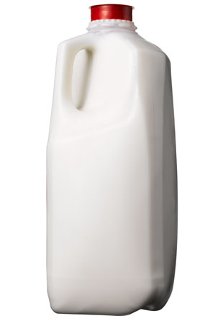
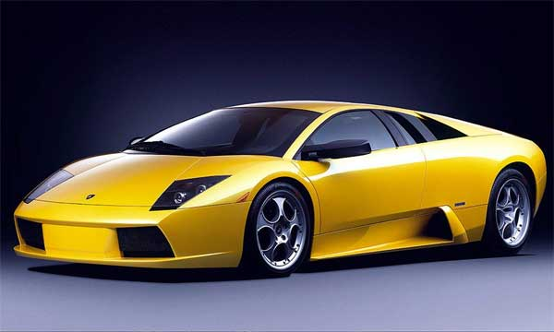
Necessities and Luxuries
Key Definition: When I.E.D. < 1, the good is called income inelastic or a necessity
Examples include food, fuel, clothing, utilities, and medical services.
Key Definition: When I.E.D. > 1, the good is called income elastic or a luxury
Examples include sports cars, furs, and expensive foods.

Slide 24
High Income Elasticity Implies High Price Elasticity
The effect of a change in the price of a good on its quantity demanded is the sum of:
The substitution effect, and
The income effect
See the chapter on Demand and Supply
The higher the I.E.D., the bigger the income effect. Therefore,
Key Idea: The higher the I.E.D., the higher the P.E.D..

Slide 25
Low I.E.D. implies low P.E.D.
Suppose the income elasticity of demand for Coke is positive, but low
2. Consumers feel richer…
3. Consumption of Coke increases, but only a little, because Coke’s I.E.D. is low
1. When the price of Coke decreases…
4. So, a decrease in the price of Coke leads to a small increase in the consumption of Coke, meaning that Coke’s P.E.D. is low
Clothes
Coke
Books
Movies
Pepsi

Slide 26
High I.E.D. implies high P.E.D.
Suppose the income elasticity of demand for Coke is positive and high
2. Consumers feel richer…
3. Consumption of Coke increases by a big amount, because Coke’s I.E.D. is high
1. When the price of Coke decreases…
4. So, a decrease in the price of Coke leads to a big increase in the consumption of Coke, meaning that Coke’s P.E.D. is high
Clothes
Coke
Books
Movies
Pepsi

Slide 27
Computing percentages

Slide 28
Price Elasticity of Demand: Calculation
The price elasticity of demand is easy to calculate in this case
$\text{PED}=−\frac{\text{\% }\text{increase} \text{in} \text{Quantity} \text{Demanded}}{\text{\% }\text{increase} \text{in} \text{Price}}$
-(-20/+10) = 2
But how do we calculate the PED in this case?
Now, we’ll need to calculate the percent increases from the data
And then plug them into the PED formula
Percent Increase
Price | Quantity Demanded
10 | -20
Price | Quantity Demanded
2 | 10
4 | 8

Slide 29
Price Elasticity of Demand: Calculation
Step 1: We arbitrarily call one of the rows Row A and the other row Row B.
Step 2: The percentage increase in price is:
$\frac{\text{Increase}}{\text{Average}}×100$
$\frac{P_{B}−P_{A}}{\frac{P_{B}+P_{A}}{2}}×100$
$\frac{4−2}{\frac{4+2}{2}}×100=\frac{2}{3}×100=66.7$
Price | Quantity Demanded
P_{A} = 2 | QD_{A} = 10
P_{B} = 4 | QD_{B} = 8

Slide 30
Price Elasticity of Demand: Calculation
Step 1: We arbitrarily call one of the rows Row A and the other row Row B.
Step 3: The percentage increase in quantity demanded is:
$\frac{\text{Increase}}{\text{Average}}×100$
$\frac{{QD}_{B}−{QD}_{A}}{\frac{{QD}_{B}+{QD}_{A}}{2}}×100$
$\frac{8−10}{\frac{8+10}{2}}×100=\frac{−2}{9}×100=−22.2$
Price | Quantity Demanded
P_{A} = 2 | QD_{A} = 10
P_{B} = 4 | QD_{B} = 8

Slide 31
Price Elasticity of Demand: Calculation
The price elasticity of demand is now easy to calculate
$\text{PED}=−\frac{\text{\% }\text{increase} \text{in} \text{Quantity} \text{Demanded}}{\text{\% }\text{increase} \text{in} \text{Price}}=−\frac{−22.2}{66.7}=0.33$
So, a 66.6 percent increase in price caused a 22.2 percent decrease in the quantity demanded
Therefore, a 1 percent increase in price caused a 0.33 percent decrease in the quantity demanded
That’s the PED
Price | Quantity Demanded
P_{A} = 2 | QD_{A} = 10
P_{B} = 4 | QD_{B} = 8

Slide 32
Price Elasticity of Demand: Midpoint Formula
The formula used here is called the midpoint formula
Note that you’ll get the same result if you switched the row names
Try it!
Price | Quantity Demanded
P_{B} = 2 | QD_{B} = 10
P_{A} = 4 | QD_{A} = 8

Slide 33
Price Elasticity of Demand: Example
Price
$5
Calculate the PED using the two points highlighted on this demand curve
Step 1: Turn the prices and quantities for the two highlighted points into a demand schedule
Step 2: Then calculate PED as in the previous example
4
Demand
0
50
100
Quantity

Slide 34
Price Elasticity of Demand: Example
Price
$5
A
The percentage increase in price is:
$\frac{P_{B}−P_{A}}{\frac{P_{B}+P_{A}}{2}}×100=\frac{4−5}{\frac{4+5}{2}}×100=−22.2$
The percentage increase in quantity demanded is:
$\frac{{QD}_{B}−{QD}_{A}}{\frac{{QD}_{B}+{QD}_{A}}{2}}×100=\frac{100−50}{\frac{100+50}{2}}×100=66.7$
$\text{PED}=−\frac{\text{\% }\text{increase} \text{in} \text{Quantity} \text{Demanded}}{\text{\% }\text{increase} \text{in} \text{Price}}=−\frac{66.7}{−22.2}=3$
B
4
Demand
0
50
100
Quantity
Price | Quantity Demanded
P_{A} = 5 | QD_{A} = 50
P_{B} = 4 | QD_{B} = 100

Slide 35
Recap: Price Elasticity of Demand: The Negative Sign
Recall that the Law of Demand says that price and quantity demanded move in opposite directions (provided all the other factors that affect buyers’ decisions are unchanged)
Therefore, the percent increase in price and the percent increase in quantity demanded will always be of opposite signs
Therefore, the PED will always be negative
For this reason, it is quite common to ignore the sign
And, for the rest of this course, I will ignore the negative sign of the PED

Slide 36
P.E.D. and the shape of the demand curve

Slide 37
Elastic, Unit-Elastic and Inelastic Demand
Demand can be
Inelastic
Unit-elastic
Elastic
… depending on the magnitude of the P.E.D.

Slide 38
Inelastic Demand: P.E.D. < 1
Suppose:
Price increases by 10%
Quantity demanded decreases by 5%.
% change in quantity is smaller than the % change in price
Here P.E.D. = -(-5/10) = 0.5 < 1
Recall that I am ignoring the negative sign of the P.E.D.
In this case, we say demand is inelastic

Slide 39
Unit-Elastic Demand: P.E.D. = 1
Suppose:
Price increases by 10%
Quantity demanded decreases by 10%.
% change in quantity is equal to the % change in price
Here P.E.D. = -(-10/10) = 1
Recall that I am ignoring the negative sign of the P.E.D.
In this case, we say demand is unit-inelastic

Slide 40
Elastic Demand: P.E.D. > 1
Suppose:
Price increases by 10%
Quantity demanded decreases by 30%.
% change in quantity is greater than the % change in price
Here P.E.D. = -(-30/10) = 3 > 1
Recall that I am ignoring the negative sign of the P.E.D.
In this case, we say demand is elastic

Slide 41
Perfectly Inelastic and Perfectly Elastic Demand
Key Definition: Perfectly Inelastic Demand
Quantity demanded does not respond at all to price changes.
P.E.D. = 0.
Key Definition: Perfectly Elastic Demand
Quantity demanded changes infinitely with any change in price.
P.E.D. = infinity.

Slide 42
The Variety of Demand Curves
Because P.E.D. measures how strongly quantity demanded responds to the price, it is closely related to the slope of the demand curve.
Key Idea: The higher the price elasticity of demand, the flatter the demand curve.

Slide 43
Figure 1 The Price Elasticity of Demand
(a) Perfectly Inelastic Demand: Elasticity Equals 0
Price
Demand
$5
4
1. An
increase
in price . . .
0
100
Quantity
2. . . . leaves the quantity demanded unchanged.

Slide 44
Figure 1 The Price Elasticity of Demand
(b) Inelastic Demand: Elasticity Is Less Than 1
Price
$5
4
1. A 22%
Demand
increase
in price . . .
0
90
100
Quantity
2. . . . leads to an 11% decrease in quantity demanded.

Slide 45
Figure 1 The Price Elasticity of Demand
(c) Unit Elastic Demand: Elasticity Equals 1
Price
$5
4
1. A 22%
Demand
increase
in price . . .
0
80
100
Quantity
2. . . . leads to a 22% decrease in quantity demanded.
Copyright©2003 Southwestern/Thomson Learning

Slide 46
Figure 1 The Price Elasticity of Demand
(d) Elastic Demand: Elasticity Is Greater Than 1
Price
$5
4
Demand
1. A 22%
increase
in price . . .
0
50
100
Quantity
2. . . . leads to a 67% decrease in quantity demanded.

Slide 47
Figure 1 The Price Elasticity of Demand
(e) Perfectly Elastic Demand: Elasticity Equals Infinity
Price
1. At any price
above $4, quantity
demanded is zero.
$4
Demand
2. At exactly $4,
consumers will
buy any quantity.
0
Quantity
3. At a price below $4,
quantity demanded is infinite.

Slide 48
P.E.D. affects the link between price and sales revenue

Slide 49
Total Revenue and the Price Elasticity of Demand
Key Definition: Total revenue (TR) is the amount received by sellers from the sale of a good.
It is usually computed as the price of the good (P) times the quantity sold (Q): $\text{TR}=P×Q$

Slide 50
Total Revenue, Graphically
Key Idea: For any given point on the demand curve, total revenue is the area of the rectangle that has corners at the given point and at the zero point (or, origin) of the graph.
Price
$4
P × Q = $400
P
(revenue)
Demand
0
100
Quantity
Q

Slide 51
Elasticity and Total Revenue: Inelastic Demand
Suppose demand is inelastic
Specifically, suppose
Price increases by 10%, and
Quantity demanded decreases by 4%.
TR = P × Q
+6%
+10%
- 4%
Key Idea: When demand is inelastic, price and total revenue move in the same direction.

Slide 52
Elasticity and Total Revenue: Elastic Demand
Suppose demand is elastic
Specifically, suppose
Price increases by 10%, and
Quantity demanded decreases by 25%.
TR = P × Q
- 15%
+10%
- 25%
Key Idea: When demand is elastic, price and total revenue move in opposite directions.

Slide 53
Elasticity and Total Revenue: Unit-elastic Demand
Suppose demand is unit-elastic
Specifically, suppose
Price increases by 10%, and
Quantity demanded decreases by 10%.
TR = P × Q
No Change
+10%
- 10%
Key Idea: When demand is unit-elastic, price has no effect on total revenue.

Slide 54
Elasticity of a Linear Demand Curve
Note that demand can change from elastic to unit-elastic to inelastic as the price changes
That is, in addition to the other factors discussed before, P.E.D. also depends on the price

Slide 55
Other important elasticities

Slide 56
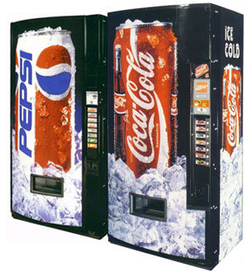
Cross Price Elasticity of Demand
Key Definition: The cross price elasticity of demand (C.P.E.D.) measures the responsiveness of the quantity demanded of one good to changes in the price of some other good.
$\text{CPED}=\frac{\text{\% }\text{increase} \text{in} \text{the} \text{quantity} \text{demanded} \text{of} \text{Good} \text{X}}{\text{\% }\text{increase} \text{in} \text{the} \text{price} \text{of} \text{Good} \text{Y}}$
Suppose:
The price of Coke increases 2%, and
The consumption of Pepsi increases 20%.
The C.P.E.D. for Coke with respect to Pepsi is +20/+2 = +10.

Slide 57
Substitutes: C.P.E.D. > 0
Key Definition: When the C.P.E.D. for one good with respect to another is positive, the two goods are called substitutes.
In the last slide’s example, the C.P.E.D. for Coke with respect to Pepsi was +10, which is positive.
This confirms our common-sense intuition that Coke and Pepsi are substitutes.

Slide 58
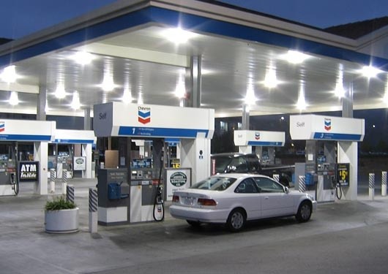
Complements: C.P.E.D. < 0
Key Definition: When the C.P.E.D. for one good with respect to another is negative, the two goods are called complements.
Suppose:
the price of gasoline increases 50%
the sale of cars decreases 10%
The C.P.E.D. is -10/+50 = -0.2, which is negative.
This is what one would expect, given our common-sense notion that gas and cars are complements.

Slide 59
THE ELASTICITY OF SUPPLY
Key Definition: Price elasticity of supply is a measure of how strongly the quantity supplied of a good responds to a change in the price of that good.

Slide 60
Elasticity: examples
Key Definition: The price elasticity of supply is the percent increase in the quantity supplied of a commodity when there is a one percent increase in the price of the commodity
and all other factors that affect quantity supplied are unchanged

Slide 61
The Price Elasticity of Supply
(a) Perfectly Inelastic Supply: Elasticity Equals 0
Price
Supply
$5
4
1. An
increase
in price . . .
0
100
Quantity
2. . . . leaves the quantity supplied unchanged.

Slide 62
The Price Elasticity of Supply
(b) Inelastic Supply: Elasticity Is Less Than 1
Price
Supply
$5
4
1. A 22%
increase
in price . . .
0
100
110
Quantity
2. . . . leads to a 10% increase in quantity supplied.

Slide 63
The Price Elasticity of Supply
(c) Unit Elastic Supply: Elasticity Equals 1
Price
Supply
$5
4
1. A 22%
increase
in price . . .
0
100
125
Quantity
2. . . . leads to a 22% increase in quantity supplied.

Slide 64
The Price Elasticity of Supply
(d) Elastic Supply: Elasticity Is Greater Than 1
Price
Supply
$5
4
1. A 22%
increase
in price . . .
0
100
200
Quantity
2. . . . leads to a 67% increase in quantity supplied.

Slide 65
The Price Elasticity of Supply
(e) Perfectly Elastic Supply: Elasticity Equals Infinity
Price
1. At any price
above $4, quantity
supplied is infinite.
$4
Supply
2. At exactly $4,
producers will
supply any quantity.
0
Quantity
3. At a price below $4,
quantity supplied is zero.

Slide 66
Determinants of Elasticity of Supply
Key Question: What makes the price elasticity of supply high in some cases and low in others?
Key Idea: The price elasticity of supply is high
if the technology enables sellers to change production easily.
Beach-front land has inelastic supply.
Books, cars, or manufactured goods have elastic supply.
if suppliers have time to respond to a price change
So, supply is more elastic in the long run.

Slide 67
Applications

Slide 68
THREE APPLICATIONS OF SUPPLY, DEMAND, AND ELASTICITY
Can good news for farming be bad news for farmers?
What happens to wheat farmers and the market for wheat when university agronomists discover a new wheat hybrid that is more productive than existing varieties?

Slide 70
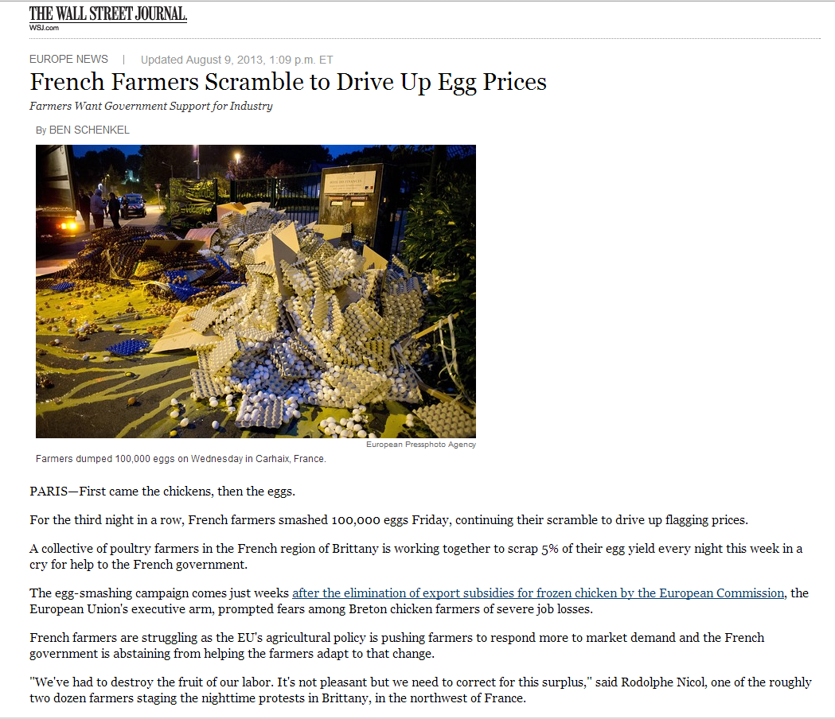

Slide 71
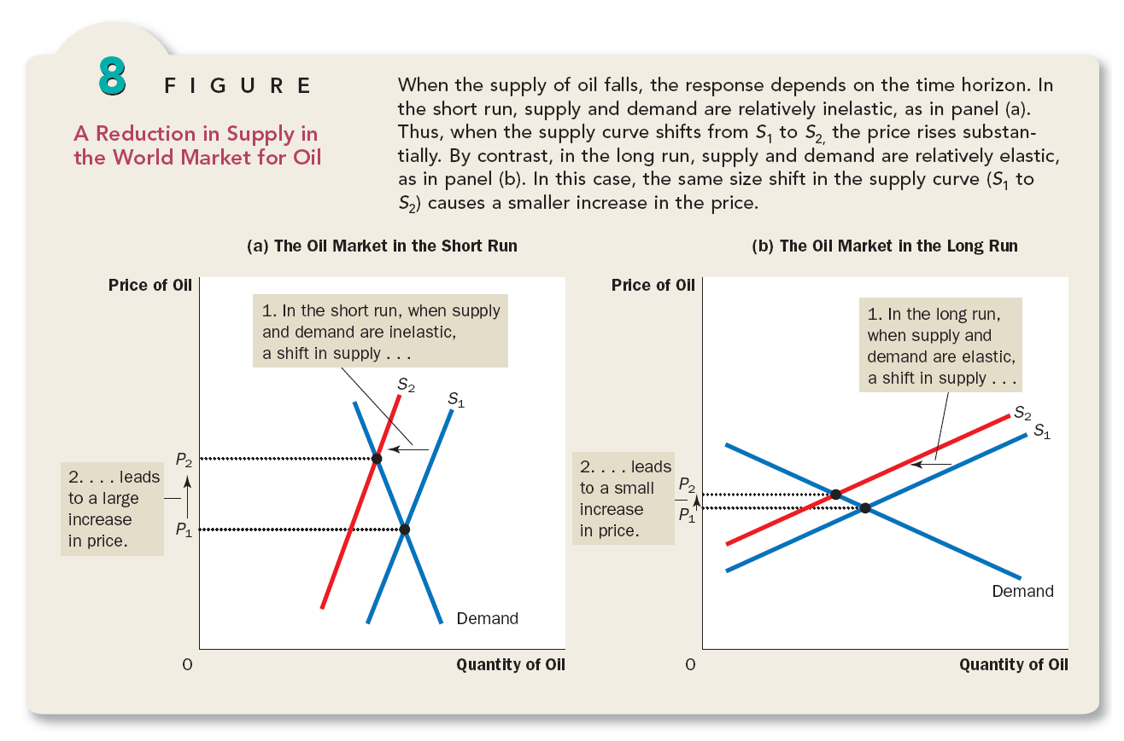

Slide 73
Screen shot from nytimes.com

Slide 74
Housing in the Bay Area
Video
https://youtu.be/0Flsg_mzG-M
https://youtu.be/AcVaTIW-DGQ

Slide 75
Any Questions?

