Slide 1
Chapter 12: The Design of the Tax System
Introduction to Microeconomics
Udayan Roy

Slide 2
What’s in this chapter?
How does the US government raise money and what does it do with it?
Is our tax system efficient? That is, does it raise money for the government in a way that minimizes ‘collateral damage’?
Is our tax system fair?

Slide 3
“In this world nothing is certain but death and taxes.” . . . Benjamin Franklin
100
80
Taxes paid in Ben Franklin’s time accounted for 5 percent of the average American’s income.
60
40
20
0
1789

Slide 4
“In this world nothing is certain but death and taxes.” . . . Benjamin Franklin
100
Today, taxes account for up to a third of the average American’s income.
80
60
40
20
0
1789
Today

Slide 5
Figure 1 Government Revenue as a Percentage of GDP
Percent of
Revenue as
GDP
35
Total government
30
25
State and local
20
15
Federal
10
5
0
1902
1913
1922
1927
1932
1940
1950
1960
1970
1980
1990
2000

Slide 6
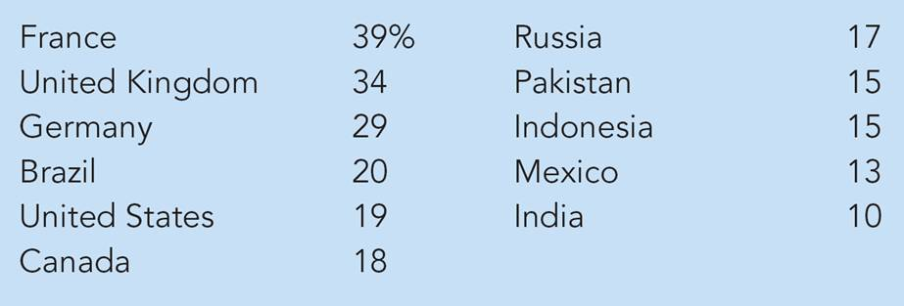
Table 1: Central Government Tax Revenue as a Percentage of GDP
Source: World Development Report 1998/99

Slide 7
The Federal Government
The U.S. federal government collects about two-thirds of the taxes in our economy.

Slide 8
The Federal Government
The largest source of revenue for the federal government is the individual income tax.

Slide 9
The Federal Government
Individual Income Taxes
The marginal tax rate is the tax rate applied to each additional dollar of income.
Higher-income families pay a larger percentage of their income in taxes.

Slide 10
The Federal Government
The Federal Government and Taxes
Payroll Taxes: tax on the wages that a firm pays its workers.
Social Insurance Taxes: taxes on wages that is earmarked to pay for Social Security and Medicare.
Excise Taxes: taxes on specific goods like gasoline, cigarettes, and alcoholic beverages.

Slide 11
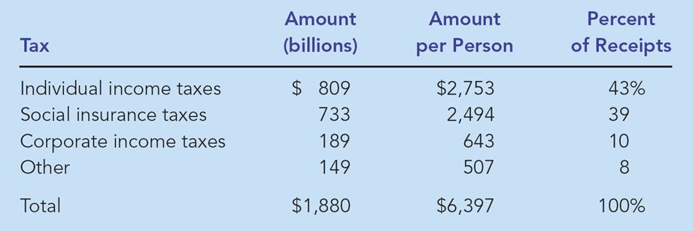
Table 2 Receipts of the Federal Government: 2004
Source: Economic Report of the President, 2005, Table B-81.
Social Insurance Taxes are taxes on wages that are earmarked to pay for Social Security and Medicare.

Slide 12
Receipts of the Federal Government 2004
Individual Income Tax, 43%
Social Insurance
Tax, 39%
Corporate Tax,
10%
Other, 8%

Slide 13
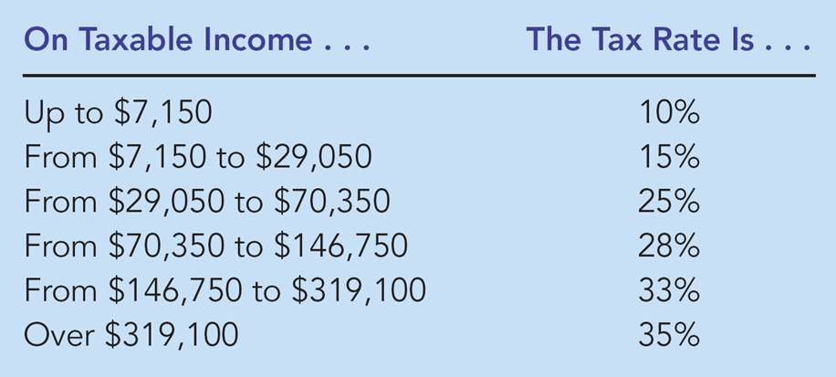
Table 3 Federal Income Tax Rates: 2004

Slide 14
Federal Government Spending
Government spending includes:
Transfer payments and
Spending on public goods and services.
Transfer payments are government payments not made in exchange for a good or a service.
Transfer payments are the largest of the government’s expenditures.

Slide 15
The Federal Government Spending
Expense Categories:
Social Security
National Defense
Income Security
Net Interest
Medicare
Health
Other

Slide 16
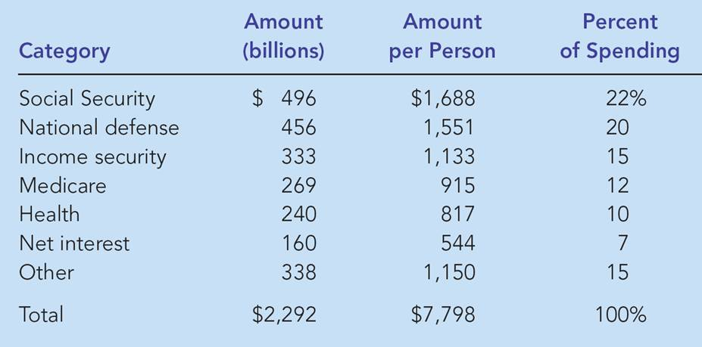
Table 4 Spending of the Federal Government: 2004
Source: Economic Report of the President, 2005, Table B-81.

Slide 17
Federal Government Spending: 2004
Net Interest, 7%
Other, 15%
Social Security, 22%
Defense, 20%
Medicare, 12%
Income Security, 15%
Health, 10%

Slide 18
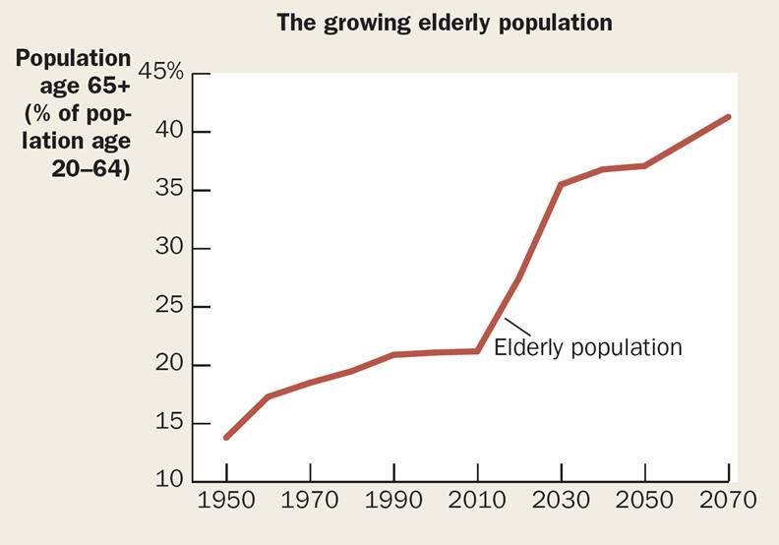
The Demographic and Fiscal Challenge

Slide 19
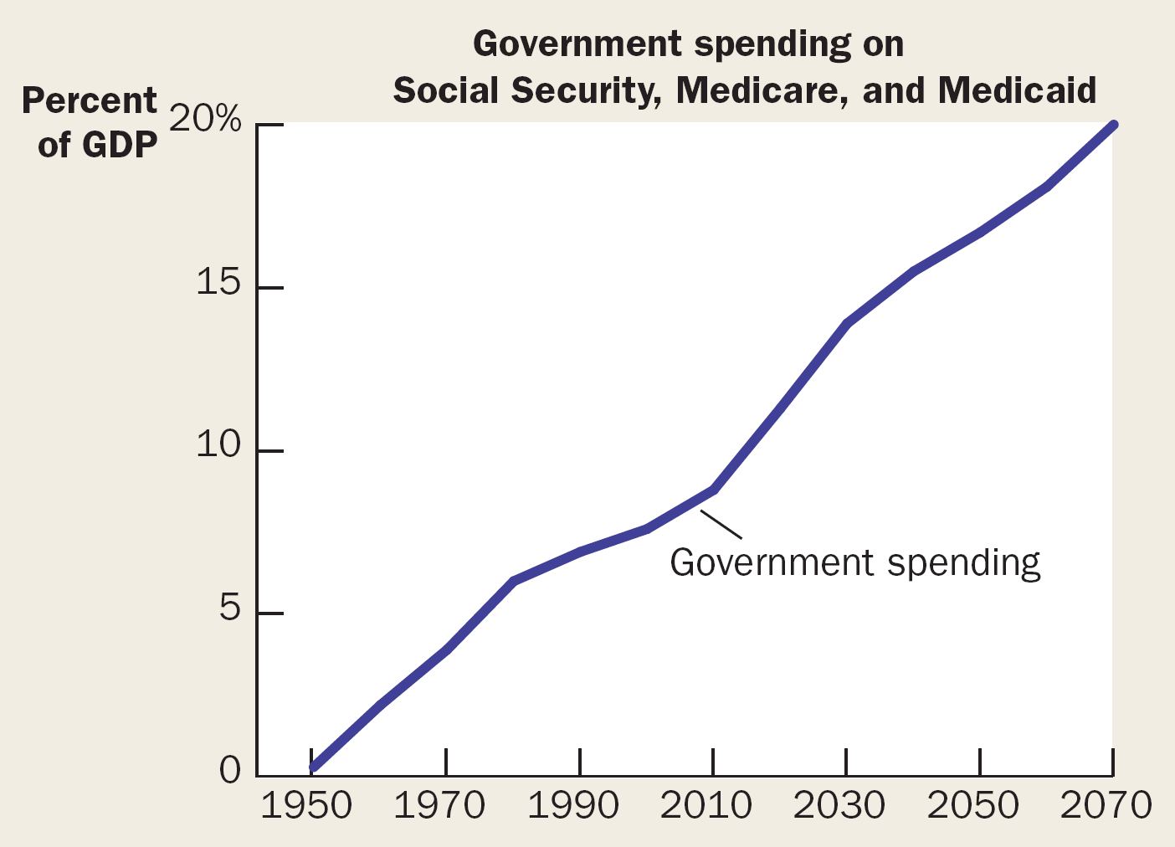
The Demographic and Fiscal Challenge

Slide 20
The Federal Government
Budget Surplus
A budget surplus is an excess of government receipts over government spending.
Budget Deficit
A budget deficit is an excess of government spending over government receipts.

Slide 21
The Federal Government
Financial Conditions of the Federal Budget
A budget deficit occurs when there is an excess of government spending over government receipts.
Government pays for the deficit by borrowing from the public.
A budget surplus occurs when government receipts are greater than government spending.
A budget surplus may be used to reduce the government’s debt.

Slide 22
State and Local Governments
State and local governments collect about 40 percent of taxes paid.

Slide 23
State and Local Governments
Receipts
Sales Taxes
Property Taxes
Individual Income Taxes
Corporate Income Taxes
Federal government
Other

Slide 24
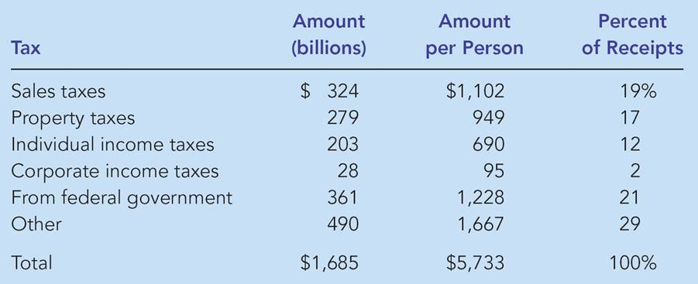
Table 5 Receipts of State and Local Governments: 2002
Source: Economic Report of the President, 2005, Table B-86.

Slide 25
State and Local Government
Spending
Education
Public Welfare
Highways
Other

Slide 26
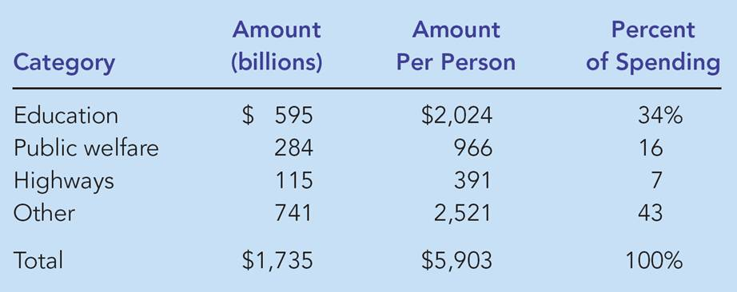
Table 6 Spending of State and Local Governments: 2002
Source: Economic Report of the President, 2005, Table B-86.

Slide 27
TAXES AND EFFICIENCY
Policymakers have two objectives in designing a tax system:
Efficiency
Equity (or, fairness)

Slide 28
TAXES AND EFFICIENCY
One tax system is more efficient than another if it raises the same amount of revenue at a smaller cost to taxpayers.

Slide 29
TAXES AND EFFICIENCY
The Cost of Taxes to Taxpayers consist of:
The tax payment itself
Deadweight losses
Administrative burdens

Slide 30
Deadweight Losses
Because taxes distort incentives, they entail deadweight losses. (See chapter 8.)
The deadweight loss of a tax is the reduction of the economic well-being caused by the tax minus the revenue raised by the government.

Slide 31
Deadweight Loss of Taxes
Jane stops buying this commodity to avoid having to pay the tax.
As a result she loses her consumer surplus.
This is also the deadweight loss of the tax.
Note that the deadweight loss is suffered by those who are not paying the tax!
Cost | Willingness to Pay
 | Joe | Jane
$5 | $8 | $6
 | No Tax | Tax = $2
Price = cost + tax | $5 | $5 + $2 = $7
Joe’s consumer surplus | 3 | 1
Jane’s consumer surplus | 1 | 0 (does not buy)
Total consumer surplus | 4 | 1
Producer surplus | 0 | 0
Tax revenue | 0 | 2
Total surplus | 4 | 3
Deadweight loss of tax | 0 | 1

Slide 32
Deadweight Loss of Taxes
When a tax changes someone’s behavior, it always has a deadweight loss.
An efficient tax does not affect anybody’s behavior and, therefore, has no deadweight losses
Example: lump-sum taxes

Slide 33
Should income or consumption be taxed?
Income tax reduces take-home interest income (as well as other income) and thereby changes our saving behavior
Consumption tax does not have this effect on saving behavior
This is why the US tax laws provide many ways of protecting interest income from taxes

Slide 34
Lump-Sum Taxes
A lump-sum tax is a tax that cannot be avoided by changing one’s behavior.
Example: a $10 tax on everyone
Example: a $10 tax on those born on a Tuesday
These taxes cannot be avoided and do not induce any behavior change
These taxes have no deadweight losses and are efficient ways of raising revenue for the government
Unfortunately, they are not fair.

Slide 35
Administrative Burdens
Complying with tax laws creates additional deadweight losses.
Taxpayers lose additional time and money documenting, computing, and avoiding taxes over and above the actual taxes they pay.
The administrative burden of any tax system is part of the inefficiency it creates.

Slide 36
Administrative Burdens
Administrative burdens can be reduced by making our tax laws simpler.
Unfortunately, greater simplicity may lead to less fairness.
Example: asking for the taxpayer’s marital status, number of dependents, health expenditures, etc. may be necessary to figure out a fair tax for the taxpayer, but this would increase the administrative burden.

Slide 37
Marginal Tax Rates versus Average Tax Rates
The average tax rate is total taxes paid divided by total income.
The marginal tax rate is the extra taxes paid on an additional dollar of income.

Slide 38
TAXES AND EQUITY
How should the burden of taxes be divided among the population?
How do we evaluate whether a tax system is fair?

Slide 39
TAXES AND EQUITY
Principles of Taxation
Benefits principle
Ability-to-pay principle

Slide 40
Benefits Principle
The benefits principle is the idea that people should pay taxes based on the benefits they receive from government services.
Examples:
Tax revenues from the gasoline tax are used to finance our highway system. As a result, people who drive the most also pay the most toward maintaining roads.
Rich people benefit more from police protection and should, therefore, pay more in taxes

Slide 41
Ability-to-Pay Principle
The ability-to-pay principle is the idea that taxes should be levied on a person according to how well that person can shoulder the burden.
The ability-to-pay principle leads to two corollary notions of equity.
Vertical equity
Horizontal equity

Slide 42
Ability-to-Pay Principle
Vertical equity is the idea that taxpayers with a greater ability to pay taxes should pay larger amounts.
For example, people with higher incomes should pay more than people with lower incomes.

Slide 43
Ability-to-Pay Principle
Horizontal Equity
Horizontal equity is the idea that taxpayers with similar abilities to pay taxes should pay the same amounts.
For example, two families with the same number of dependents and the same income living in different parts of the country should pay the same federal taxes.

Slide 44
Ability-to-Pay Principle
Vertical Equity and Alternative Tax Systems
A proportional tax is one for which high-income and low-income taxpayers pay the same fraction of income.
A regressive tax is one for which high-income taxpayers pay a smaller fraction of their income than do low-income taxpayers.
A progressive tax is one for which high-income taxpayers pay a larger fraction of their income than do low-income taxpayers.

Slide 45
Table 7: Three Tax Systems
All three tax systems can have vertical equity

Slide 46
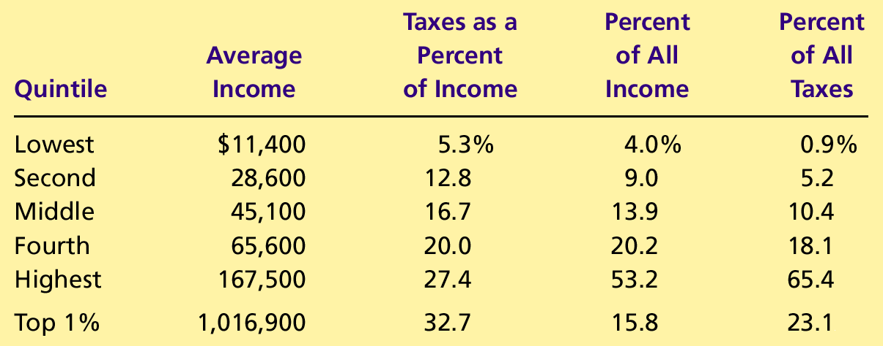
Table 8 The Burden of Federal Taxes
The last two columns show that our Federal taxes are progressive.

Slide 47
CASE STUDY: Horizontal Equity and the Marriage Tax
Marriage affects the tax liability of a couple in that tax law treats a married couple as a single taxpayer.
When a couple gets married, they stop paying taxes as individuals and start paying taxes as a family.
If each has a similar income, their total tax liability rises when they get married.

Slide 48
Tax Incidence and Tax Equity
The difficulty in formulating tax policy is balancing the often conflicting goals of efficiency and equity.
The study of who bears the burden of taxes is central to evaluating tax equity.
This study is called tax incidence.

Slide 49
Tax Incidence and Tax Equity
According to the Flypaper Theory of Tax Incidence, the burden of a tax, like a fly on flypaper, sticks wherever it first lands.
This theory is rarely valid
Taxes on corporate income may be passed on to workers (through lower wages) and consumers (through higher prices)
As a result, the data in Table 8 may not give an accurate account of how the tax burden is actually shared.

Slide 50
The Flat Tax
Tax = tax rate × (Income - Exemption)
Example: Tax = 0.19 × (Income - $10,000)
Deductions eliminated. This keeps the tax rate low
Low administrative costs
Can be made as progressive as necessary by increasing the exemption and the tax rate.

Slide 51
Summary
The U.S. government raises revenue using various taxes.
Income taxes and payroll taxes raise the most revenue for the federal government.
Sales taxes and property taxes raise the most revenue for the state and local governments.

Slide 52
Summary
Equity and efficiency are the two most important goals of the tax system.
The efficiency of a tax system refers to the costs it imposes on the taxpayers.
The equity of a tax system concerns whether the tax burden is distributed fairly among the population.

Slide 53
Summary
According to the benefits principle, it is fair for people to pay taxes based on the benefits they receive from the government.
According to the ability-to-pay principle, it is fair for people to pay taxes on their capability to handle the financial burden.

Slide 54
Summary
The distribution of tax burdens is not the same as the distribution of tax bills.
Much of the debate over tax policy arises because people give different weights to the two goals of efficiency and equity.

