Slide 1
Chapter 20: Income Inequality and Poverty
Introduction to Microeconomics
Udayan Roy

Slide 2
Income Inequality and Poverty
A person’s earnings depend on the supply and demand for that person’s labor, which in turn depend on
natural ability,
human capital,
compensating differentials,
discrimination,
and so on.
See Chapter 19 for a recap.

Slide 3
THE MEASUREMENT OF INEQUALITY
How much inequality is there in our society?
How many people live in poverty?
What problems arise in measuring inequality?
How often do people move among income classes?

Slide 4
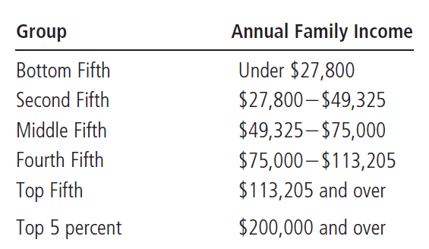
Table 1 The Distribution of Income in the United States: 2008
Notes:
Needs updating

Slide 5
U.S. Income Inequality
Imagine that you. . .
lined up all of the families in the economy according to their annual income.
divided the families into five equal groups (bottom fifth, second fifth, etc.)
computed the share of total income that each group of families received.

Slide 6
U.S. Income Inequality
If income were equally distributed across all families, each one-fifth of families would receive one-fifth (20 percent) of total income.

Slide 7
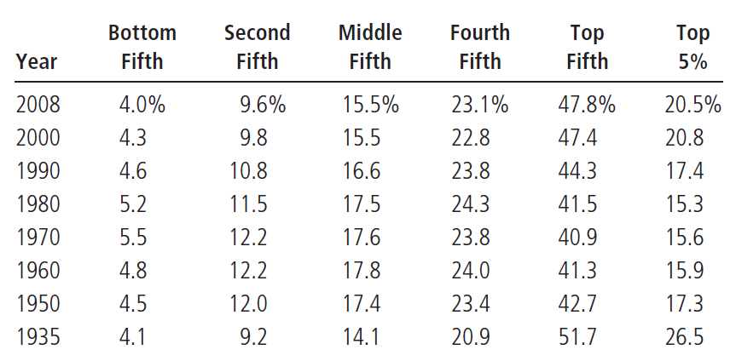
Table 2 Income Inequality in the United States
This table shows the percentage of total before-tax income received by families in each fifth of the income distribution and by those families in the top 5 percent.
Inequality fell till the 1970s. Then it started increasing.
Notes:
Needs updating

Slide 8
U.S. Income Inequality
From 1935-1970, the distribution of income gradually became more equal.
Since then, this trend has reversed itself.

Slide 9
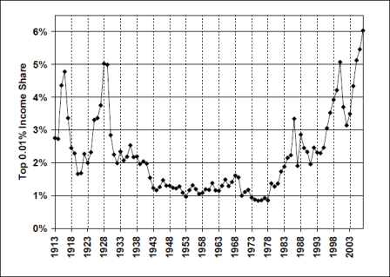

Slide 10
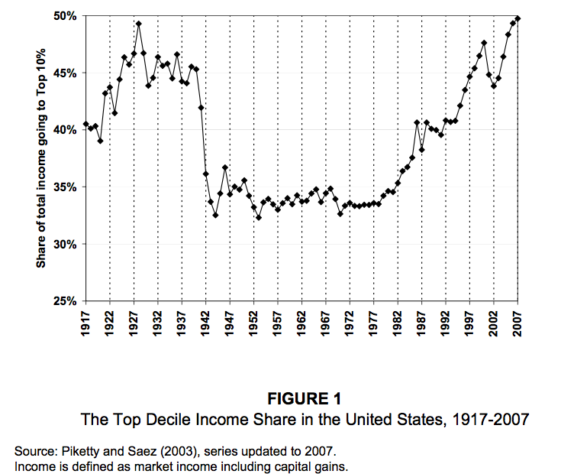

Slide 11
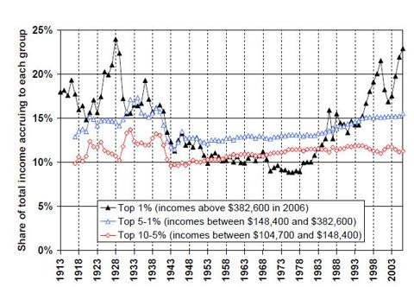

Slide 12
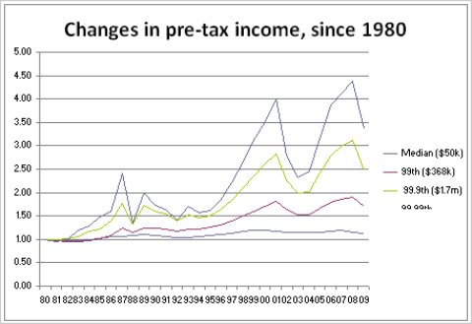
The chart shows the change in the various groups’ pretax income since 1980. A household that has been at the 99.99th percentile of the distribution over this period — that is, making more money than 9,998 out of 10,000 other households and less money than one out of 10,000 — has more than quadrupled its pretax income. Today, this household is making $9.1 million. Income for a household at the median has risen only 13 percent since 1980. Today, it is making about $50,000.
Notes:
Source: http://economix.blogs.nytimes.com/2010/12/03/who-needs-a-tax-cut/

Slide 13
U.S. Income Inequality
The following have tended to reduce the demand for unskilled labor and raise the demand for skilled labor:
Increases in international trade with low-wage countries
Changes in technology
Therefore, the wages of unskilled workers have fallen relative to the wages of skilled workers.
This has resulted in increased inequality in family incomes.
See Chapter 19 for more.

Slide 14
CASE STUDY: The Women’s Movement and the Income Distribution
The percentage of women who hold jobs has risen from about 32 percent in the 1950s to about 54 percent in the 1990s.
This has reduced inequality between men and women.
And it has increased the inequality in family incomes because marriage tends to happen between men and women of the same class.
Moral: we need to be careful not to condemn every social process that increases inequality.
Notes:
This is gone in the fifth edition.

Slide 15
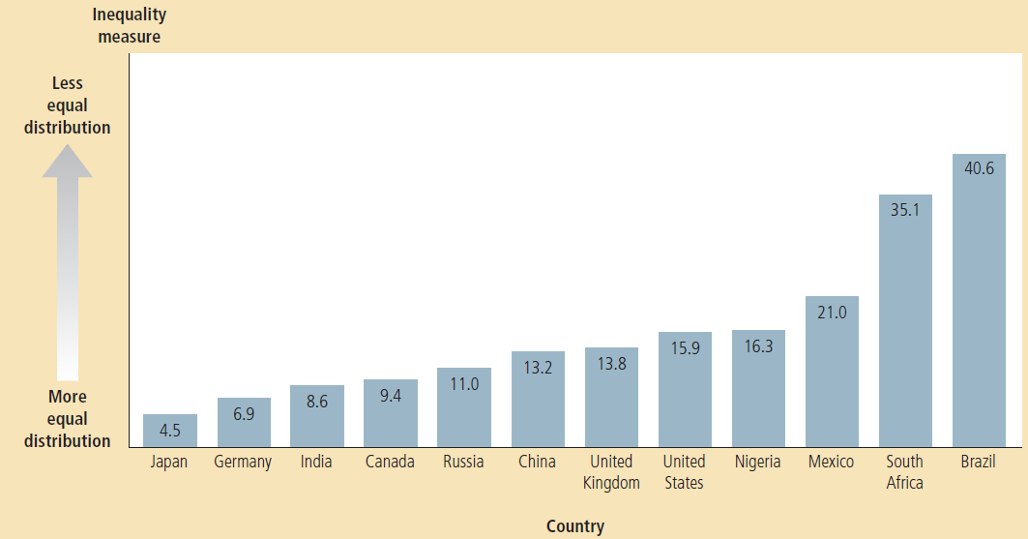
Figure 1 Inequality around the World
This figure shows a measure of inequality: the income (or expenditure) that goes to the richest 10 percent of the population divided by the income (or expenditure) that goes to the poorest 10 percent. Among these nations, Japan and Germany have the most equal distribution of economic well-being, while South Africa and Brazil have the least equal.
Notes:
Source: Human Development Report 2009

Slide 16
The Poverty Rate
The poverty rate is the percentage of the population whose family income falls below an absolute level called the poverty line.

Slide 17
The Poverty Rate
The Poverty Line is an absolute level of income set by the federal government for each family size below which a family is deemed to be in poverty.
It is set at roughly three times the income needed to ensure an adequate diet.

Slide 18
The Poverty Rate
2008
Median family - income of $61,521
Poverty line for a family of four: $22,025
Poverty rate: 13.2%
That is, 13.2% of the population were in families with incomes below the poverty line for their family size
Poverty rate
1959: 22.4%
1973: 11.1%

Slide 19
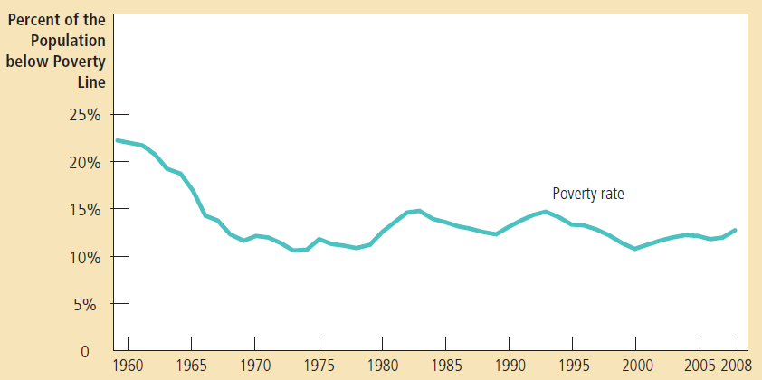
Figure 2 The Poverty Rate
The poverty rate shows the percentage of the population with incomes below an absolute level called the poverty line.

Slide 20
The Poverty Rate
The Poverty Line and Income Inequality
As economic growth pushes the entire income distribution upward, more families are pushed above the poverty line because the poverty line is an absolute rather than a relative standard.
Despite continued economic growth in average income, the US poverty rate has not declined since the 1970s. Why?
Although economic growth has raised the income of the typical family, the increase in inequality has prevented the poorest families from sharing in this greater economic prosperity.

Slide 21
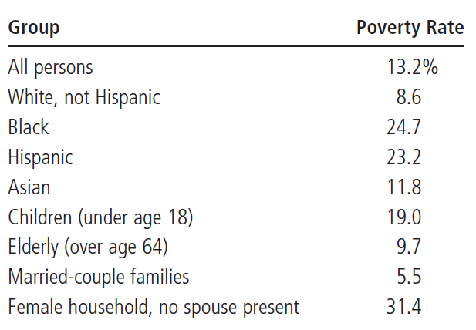
Table 3 Who Is Poor?
This table shows that the poverty rate varies greatly among different groups within the population. Source: U.S. Bureau of the Census. Data are for 2008.

Slide 22
The Poverty Rate
Three Facts About Poverty
Poverty is three times higher for Blacks and Hispanics than for Whites.
Poverty is higher than average for children and lower than average for the old.
Poverty is higher for families headed by a female and without a husband present than for the average family.
It would be tough being a child in a female-headed Black or Hispanic family.
Notes:
The sixth edition has a Case Study on “alternative measures of inequality” and an In The News article by Tyler Cowen.

Slide 23
Problems in Measuring Inequality
Data on income distribution and the poverty rate give an incomplete picture of inequality in living standards because of the following:
In-kind transfers
Life cycle
Transitory versus permanent income

Slide 24
Problems in Measuring Inequality
In-Kind Transfers
Examples: food stamps, housing vouchers, and Medicaid.
Measurements of the distribution of income and the poverty rate are based on families’ money income.
The failure to include in-kind transfers as part of income exaggerates the poverty rate by about 10 percent.

Slide 25
Problems in Measuring Inequality
The Economic Life Cycle
A young worker has a low income at the beginning of his or her career.
Income rises as the worker gains maturity and experience.
Income peaks at about age 50.
Income falls sharply at retirement, around age 65.
A person currently in poverty may end up just fine over his life cycle.

Slide 26
Problems in Measuring Inequality
Transitory versus Permanent Income
Incomes vary because of random and transitory forces.
Acts of nature
Temporary layoffs due to illness or economic conditions, etc.
A family’s ability to buy goods and services depends largely on its permanent income, which is its normal, or average, income.
Permanent income excludes transitory changes in income.

Slide 27
Case Study: Alternative Measures of Inequality
Different ways of measuring inequality lead to dramatically different conclusions about inequality

Slide 28
Case Study: Alternative Measures of Inequality
Average annual income of households in 2006
Poorest fifth of U.S. households = $9,974
Richest fifth of U.S. households = $149,963
About 15 times as much income as poorest fifth
After-tax income of households
Richest fifth earns about 14 times as much after-tax income as poorest fifth
Consumption of households
Richest fifth enjoys 3.9 times as much as the consumption of the poorest fifth

Slide 29
Case Study: Alternative Measures of Inequality
Consumption per person
Correct for differences in number of people in household
Richest fifth - average of 3.1 people per household
Poorest fifth - average of 1.7 people per household
This makes sense: larger families tend to have more income earners
Consumption per person in the richest fifth of households is only 2.1 times as much as consumption per person in the poorest fifth
Notes:
The sixth edition has an “in the news” article by Rebecca Blank on poverty measurement.

Slide 30
Economic Mobility
Economic mobility is substantial in the U.S. economy.
In a typical 10-year period, one in four families falls below the poverty line in at least one year.
Yet fewer than 3 percent of families are poor for 8 or more years.
If a father earns 20% above his generation’s average, his son will likely earn only 8% more than his generation’s average.
Estimates for 1996 suggest that only one in five millionaires inherited their wealth. The rest made it on their own.

Slide 31
Economic Mobility
Movements up and down the income ladder can be due to:
Good or bad luck.
Hard work or laziness.
Persistence of economic success from generation to generation.

Slide 32
POLITICAL PHILOSOPHY OF REDISTRIBUTING INCOME

Slide 33
POLITICAL PHILOSOPHY OF REDISTRIBUTING INCOME
What should the government do about economic inequality?
Economic analysis alone cannot give us the answer.
The question is a normative one facing policymakers.
We need to rely on philosophy.
More precisely, we need to study political philosophy or distributive ethics.

Slide 34
POLITICAL PHILOSOPHY OF REDISTRIBUTING INCOME
Three Political Philosophies
Utilitarianism
Liberalism
Libertarianism

Slide 35
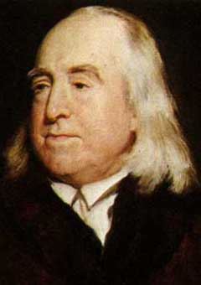
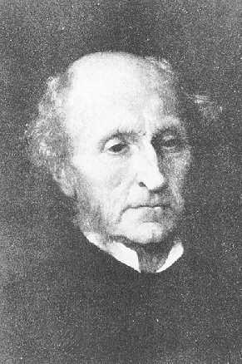
Utilitarianism
Utilitarianism is the political philosophy according to which the government should choose policies to maximize the total utility of everyone in society.
The founders of utilitarianism are the English philosophers Jeremy Bentham (top) and John Stuart Mill (bottom).

Slide 36
Utilitarianism
The utilitarian case for redistributing income is based on the assumption of diminishing marginal utility.
An extra dollar of income to a poor person provides that person with more utility, or well-being, than does an extra dollar to a rich person.
Therefore, total utility of the society is increased by redistribution a dollar from a rich person to a poor person.

Slide 37
Utilitarianism: leaky buckets
However, utilitarianism stops short of advocating complete equality, because
Redistribution reduces the incentive to work hard and hurts society in the end.

Slide 38
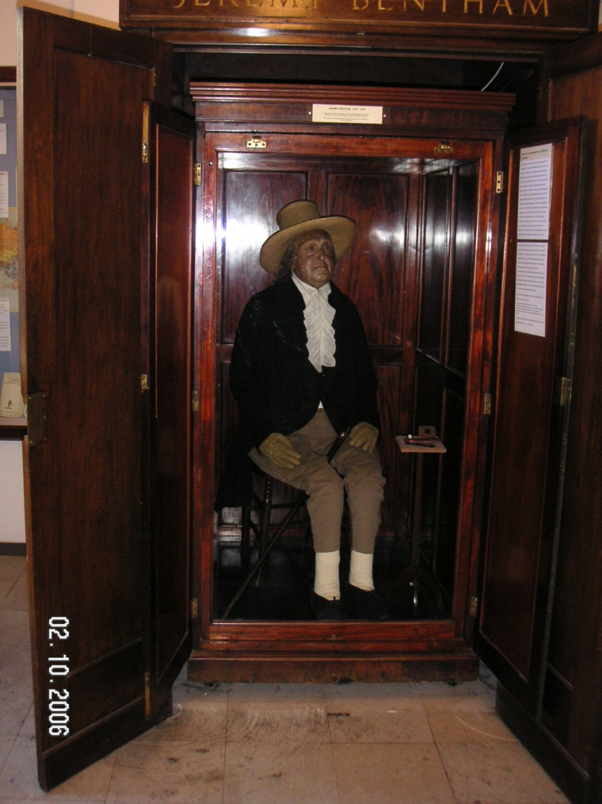
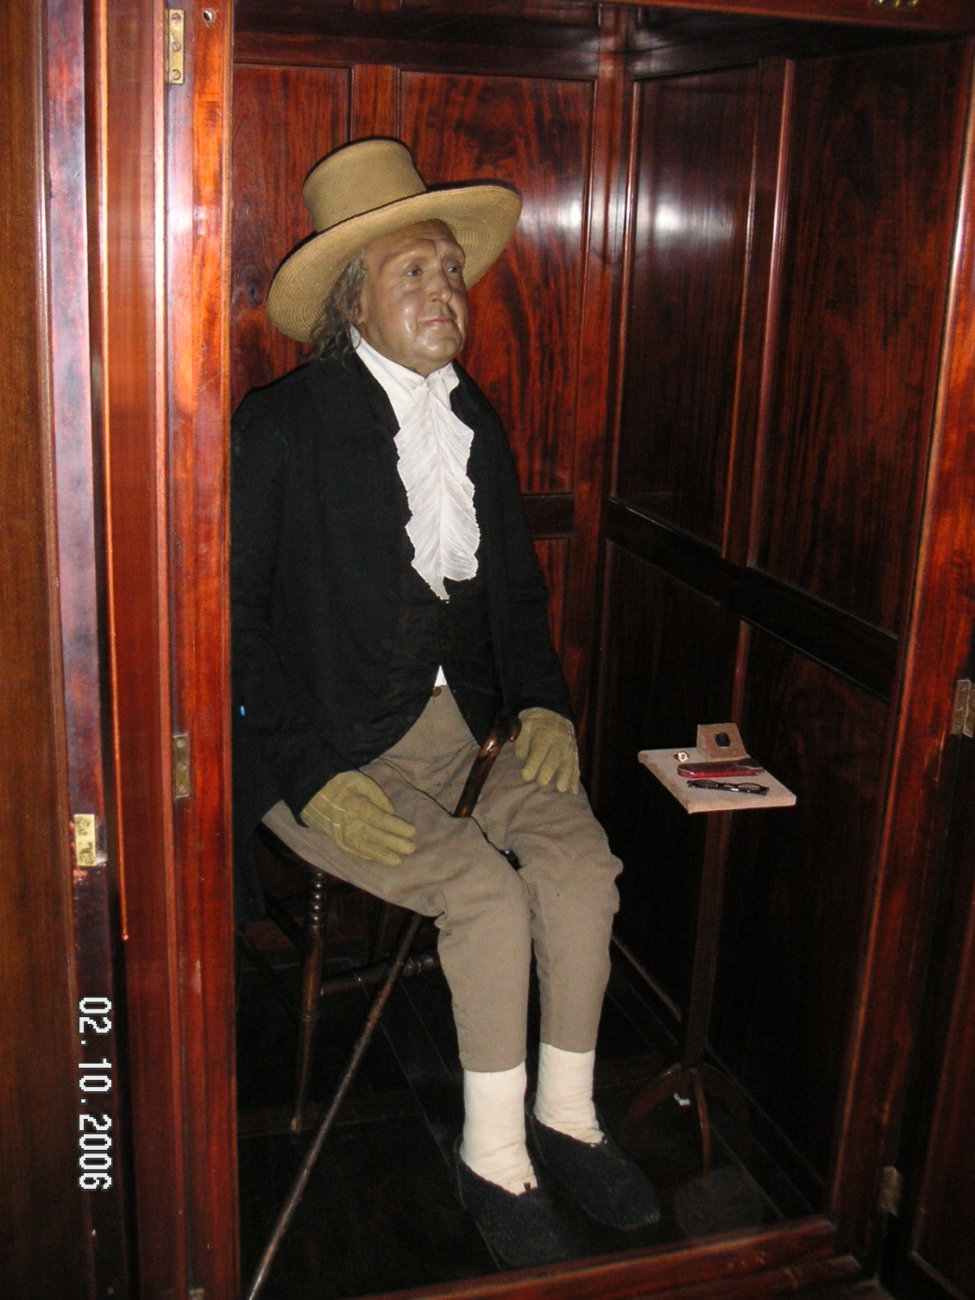
Jeremy Bentham’s preserved body is on view at University College London.
Photos: Udayan Roy

Slide 39
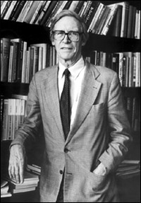
Liberalism
Liberalism is the political philosophy according to which the government should choose policies deemed to be just, as evaluated by an impartial observer from behind a “veil of ignorance.”
This view was originally developed by the philosopher John Rawls.

Slide 40
Liberalism
Public policy should be based on the maximin criterion, which seeks to maximize the utility or well-being of the worst-off person in society.
That is, rather than maximizing the sum of everyone’s utility, one should maximize the minimum utility.
This idea would allow for the consideration of the redistribution of income as a form of social insurance.

Slide 41
Liberalism
Liberalism would accept a policy that leads to an increase in inequality only if the policy is better than others for the well-being of the worst-off person.

Slide 42
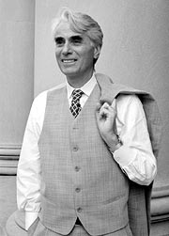
Libertarianism
Libertarianism is the political philosophy according to which the government should punish crimes and enforce voluntary agreements, but should not redistribute income.
Libertarians argue that equality of opportunity is more important than equality of income.
A prominent proponent of libertarianism is the philosopher, Robert Nozick

Slide 43
Libertarianism
One can give away only what one owns.
Society does not own anything, individuals do.
Therefore, a society does not have the right to redistribute income.
What’s important is not whether the outcome of the process by which we run our societies is fair but whether the process itself is fair.

Slide 44
POLICIES TO REDUCE POVERTY

Slide 45
POLICIES TO REDUCE POVERTY
Minimum-wage laws
Welfare
Negative income tax
In-kind transfers

Slide 46
Minimum-Wage Laws
Advocates view the minimum wage as a way of helping the working poor.
Critics view the minimum wage as hurting those it is intended to help.
See Chapter 6.

Slide 47
Minimum-Wage Laws
The magnitude of the effects of the minimum wage depends on the elasticity of the demand for labor.
Low elasticity would be favorable to the minimum wage because few jobs would be lost on account of the minimum wage.

Slide 48
Minimum-Wage Laws
Advocates argue that the demand for unskilled labor is relatively inelastic, so that a high minimum wage depresses employment only slightly.
Critics argue that labor demand is more elastic, especially in the long run when firms can adjust employment more fully.

Slide 49
Welfare
The government attempts to raise the living standards of the poor through the welfare system.
Welfare is a broad term that encompasses various government programs that supplement the incomes of the needy.
Temporary Assistance for Needy Families (TANF)
Supplemental Security Income (SSI)

Slide 50
Welfare: incentives
‘Need’ has to be shown to get TANF, usually small children, absence of a father with an income, or disability.
This may encourage the emergence of female-headed families.

Slide 51
Negative Income Tax
A negative income tax collects tax revenue from high-income households and gives transfers to low-income households.
Example: Taxes owed = (1/3 of income) - $10,000

Slide 52
Negative Income Tax
High-income families would pay a tax based on their incomes.
Low-income families would receive a subsidy—a “negative tax.”
Poor families would receive financial assistance without having to demonstrate need.

Slide 53
In-Kind Transfers
In-kind transfers are transfers to the poor given in the form of goods and services rather than cash.
Food stamps and Medicaid are examples.

Slide 54
In-Kind Transfers
Advocates of in-kind transfers argue that such transfers ensure that the poor get what they most need.
Advocates of cash payments argue that in-kind transfers are inefficient and disrespectful.

Slide 55
Antipoverty Programs and Work Incentives
Many policies aimed at helping the poor can have the unintended effect of discouraging the poor from escaping poverty on their own.

Slide 56
Antipoverty Programs and Work Incentives
An antipoverty program can affect work incentives:
A family needs $20,000 to maintain a reasonable standard of living.
The government promises to guarantee every family a $20,000 income.
Any person making under $20,000 has no incentive to work due to the effective marginal tax rate of 100 percent.

Slide 57
Antipoverty Programs and Work Incentives
Workfare refers to a system that would require any person collecting benefits to accept a government-provided job.

Slide 58
Antipoverty Programs and Work Incentives
A 1996 welfare reform bill advocated providing benefits for only a limited period of time.
“Welfare should be a second chance, not a way of life.”
President Bill Clinton

Slide 59
Any Questions?

Slide 60
Summary
Data on the distribution of income show wide disparity in our society.
The richest fifth of the families earns about ten times as much as the poorest fifth.
It is difficult to gauge the degree of inequality using data on the distribution of income in a single year.

Slide 61
Summary
Political philosophers differ in their views about the role government should play in redistributing income.
Utilitarians would choose the distribution of income to maximize the sum of the utility of everyone in society.

Slide 62
Summary
Liberals would determine the distribution of income as if we were behind a “veil of ignorance” that prevented us from knowing our own stations in life.
Libertarians would have the government enforce individual rights but not be concerned about inequality in the resulting distribution of income.

Slide 63
Summary
Various policies aimed to help the poor include: minimum-wage laws, welfare, negative income taxes, and in-kind transfers.
Although each of these policies helps some families escape poverty, they also have unintended side effects.

