Slide 1
Introduction to Behavioral Economics Predictable Irrationality

Slide 2
In this class, we will learn that our decision-making processes might not be as perfect as we think.
And we will learn how to improve them.

Slide 3
Quick test of speed in answering
Answer the next question as quickly as you can (while still being accurate).
Don’t worry, it is a simple question and it won’t count against you if you get it wrong.
Ready?

Slide 4
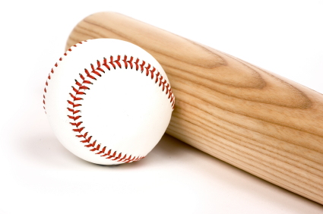
A bat and ball together cost $1.10.
The bat costs $1 more than the ball.
How much does the ball cost?
.05
.10
.55
$1.00
$1.10
.05
Most Common Answer (Wrong)
If the bat costs $1 more than .10 it costs $1.10,
So, the bat and ball TOGETHER would cost $1.20.
Notes:
A: .05 (because .05 + 1.05 = $1.10)

Slide 5
5 machines can make 5 widgets in 5 minutes
100 machines can make 100 widgets in ____ minutes

Slide 6
5 machines can make 5 widgets in 5 minutes
100 machines can make 100 widgets in 100 minutes
This is the most common answer …
… but it is incorrect

Slide 7
5 machines can make 5 widgets in 5 minutes
100 machines can make 100 widgets in 5 minutes
This is the correct answer

Slide 8
Q: A lake has a patch of lily pads. Every day, the patch doubles in size. If it takes 48 days for the patch to cover the entire lake, how long would it take for the patch to cover half of the lake?
A:

Slide 9
Q: A lake has a patch of lily pads. Every day, the patch doubles in size. If it takes 48 days for the patch to cover the entire lake, how long would it take for the patch to cover half of the lake?
A: 47 days

Slide 10
Cognitive Reflection Task
The three questions above are known as the Cognitive Reflection Task (CRT).
Shane Frederick, “Cognitive Reflection and Decision Making,” Journal of Economic Perspectives 19 (2005): 24-42.
After giving the test to nearly 3,500 people, Frederick found that only 17 percent got all three answers right and 33 percent got none right.

Slide 11
Try a letters test
How many times does the letter “F” appears in the following sentence?
FINISHED FILES ARE THE
RESULT OF YEARS OF SCIENTIFIC
STUDY COMBINED WITH THE
EXPERIENCE OF YEARS
Notes:
Most people will say 3 as the F in OF is typically ignored.; Without clickers do a hand raise with “how many counted 1?” 2? 3? OK. Did anyone count 6?

Slide 12
Your ability to identify letters
How many times does the letter “F” appears in the following sentence?
FINISHED FILES ARE THE
RESULT OF YEARS OF SCIENTIFIC
STUDY COMBINED WITH THE
EXPERIENCE OF YEARS
Notes:
Most people will say 3 as the F in OF is typically ignored.; Without clickers do a hand raise with “how many counted 1?” 2? 3? OK. Did anyone count 6?

Slide 13
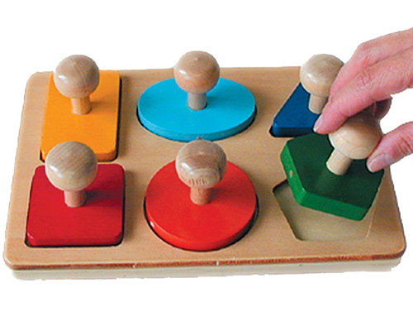
A test of your decision-making skills
Let’s go with something simpler than numbers or letters.
Identifying colors and shapes.

Slide 14
Identifying colors
You will see a mixture of words, non-words, and shapes. Say the COLOR (red, blue, yellow, or green) of each form you see, as quickly as possible.

Slide 15
■

Slide 16
green

Slide 17
blue

Slide 18
yellow

Slide 19
■

Slide 20
cat

Slide 21
red

Slide 22
■

Slide 23
red

Slide 24
blue

Slide 25
bloo

Slide 26
yellow

Slide 27
■

Slide 28
red

Slide 29
blue

Slide 30
blood

Slide 31
grass

Slide 32
bloo

Slide 33
red

Slide 34
■

Slide 35
green

Slide 36
cerulean

Slide 37
red

Slide 38
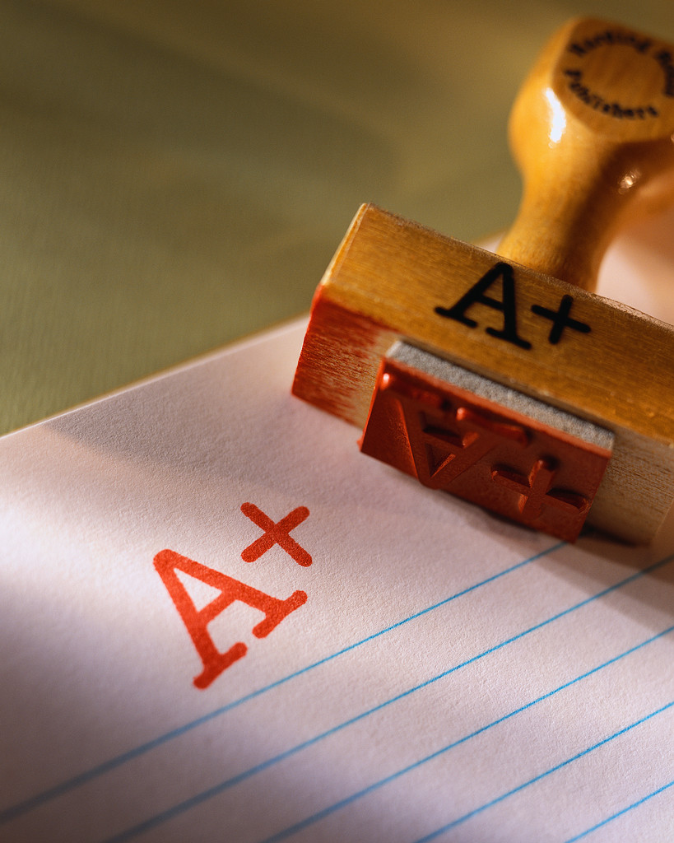
How many of you were able to name each color without any mistakes?

Slide 39
The Stroop Effect
We just saw the following:
When there’s a red disk, people quickly say the color is “red”
But when red font spells out the word blue, some people will incorrectly answer “blue”
This shows that it is difficult to keep irrelevant information from affecting us
For more on the Stroop Effect, see https://en.wikipedia.org/wiki/Stroop_effect

Slide 40
So, instead of numbers, letters, or colors, let’s try shapes.

Slide 41
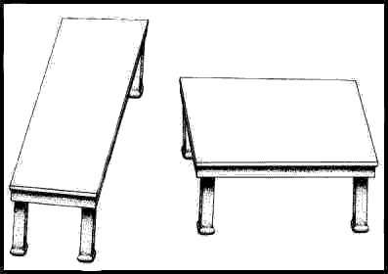
Which table has the longest tabletop?
Table on the left
Table on the right
Neither (both are of equal length)

Slide 42
Which table has the widest tabletop?
Table on the left
Table on the right
Neither (both are of equal width)

Slide 43
Which table has the longest tabletop?

Slide 44
Which table has the longest tabletop?

Slide 45
Which table has the longest tabletop?

Slide 46
Which table has the longest tabletop?

Slide 47
Which table has the longest tabletop?

Slide 48
Which table has the longest tabletop?

Slide 49
Which table has the widest tabletop?

Slide 50
Now that you know, does the illusion go away?

Slide 51
Now that you know, does the illusion go away?

Slide 52
Now that you know, does the illusion go away?

Slide 53
Now that you know, does the illusion go away?

Slide 54
Now that you know, does the illusion go away?
Notes:
You can click these line(boxes) and rotate during class to show that you aren’t faking it.

Slide 55
It’s not just you!
The mistakes you have just seen are common
There are systematic and predictable flaws in the way our minds work

Slide 56
Do we experience “decision illusions” in the same way we experience “optical illusions”?

Slide 57
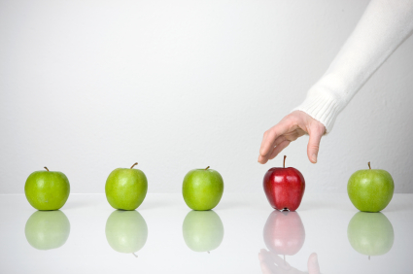
If we make persistent errors in things we are very good at like numbers, letters, colors, and shapes…
how likely is it that we are also subject to persistent, predictable errors in areas of economic
decision-making?

Slide 58
What is ahead
We will learn why some judgment errors occur consistently.
We will learn how these errors can cause serious mistakes.
We will learn strategies to reduce these problems and make better decisions.
And we will see how government policy can help us avoid serious errors
Notes:
What does the subject matter of this presentation have to do with economics? How can people protect themselves from the weaknesses discussed here? How can or should rational actors and policy makers make use of the ideas discussed here?

