Slide 1
Two ways in which psychology is changing economics
Libertarian Paternalism and the Experimental Method
© Udayan Roy

Slide 2
Libertarian paternalism

Slide 3
Libertarianism
The standard assumption of rational choice in economics has led to a deep-rooted view that governments should take a hands-off (or libertarian) attitude towards private enterprise and private choice

Slide 4
Libertarianism: from Adam onwards
“The statesman who should attempt to direct private people in what manner they ought to employ their capitals, would … assume an authority which could safely be trusted, not only to no single person, but to no council or senate whatever, and which would nowhere be so dangerous as in the hands of a man who had folly and presumption enough to fancy himself fit to exercise it.”
Adam Smith, The Wealth Of Nations (1776), Book II, Chapter III

Slide 5
Libertarianism: from Adam onwards
“Every individual... neither intends to promote the public interest, nor knows how much he is promoting it... he intends only his own security; and by directing that industry in such a manner as its produce may be of the greatest value, he intends only his own gain, and he is in this, as in many other cases, led by an invisible hand to promote an end which was no part of his intention.”
The Wealth Of Nations, Book IV, Chapter II

Slide 6
Libertarianism: from Adam onwards
“It is not from the benevolence of the butcher, the brewer, or the baker, that we expect our dinner, but from their regard to their own interest. We address ourselves, not to their humanity but to their self-love, and never talk to them of our necessities but of their advantages.”
The Wealth Of Nations, Book I, Chapter II

Slide 7
Libertarianism: from Adam onwards
“The man of system…is apt to be very wise in his own conceit; and is often so enamoured with the supposed beauty of his own ideal plan of government, that he cannot suffer the smallest deviation from any part of it… He seems to imagine that he can arrange the different members of a great society with as much ease as the hand arranges the different pieces upon a chess-board. He does not consider that in the great chess-board of human society, every single piece has a principle of motion of its own, altogether different from that which the legislature might choose to impress upon it.”
The Theory Of Moral Sentiments (1759), Part VI, Section II, Chapter II

Slide 8
Libertarianism: exceptions
Economists have also understood that governments have a reason to intervene when there is market failure
That is, when free markets do not generate the best attainable outcome

Slide 9
Libertarianism: exceptions
Libertarianism may not be the best approach when
choices made by one person affects bystanders (the externality problem)
private businesses are unable to provide goods that people need (the public goods problem)
the private sector is unable to maintain, preserve, and nurture a necessary resource (the common resources problem)
the free-market outcome provokes moral objections

Slide 10
Paternalism
In addition to our fears of market failure, …
… behavioral economics, with its emphasis on our predictable irrationalities, has begun to make government intervention (or paternalism) seem less unreasonable

Slide 11
Paternalism: implementation
The standard tools of paternalistic control in economics have been
taxes and subsidies (which are economic punishments and rewards, or incentives), and
simple legal prohibitions (regulation)
These are the tools to use if the goal is to influence the choices of rational people

Slide 12
Paternalism: implementation
Behavioral economics has now added a new tool of control: the nudge
This tool uses our predictable irrationalities to influence our choices

Slide 13
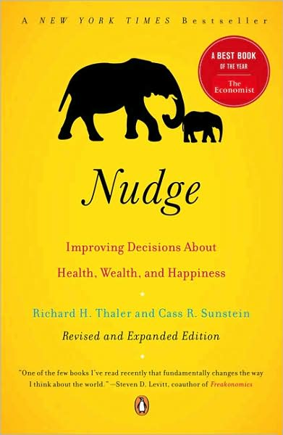
Libertarian Paternalism
This course emphasizes a compromise between libertarianism and paternalism …
… libertarian paternalism!
Under libertarian paternalism, the government nudges private citizens towards rational choices without in any way restricting their freedom to do as they wish

Slide 14
Libertarian Paternalism
Under libertarian paternalism, the policy maker (also called the choice architect) tries to influence people’s choices by changing the context in which choices are made but not by changing the menu of available options
The choice architect tries to nudge people towards choices that are obviously rational without making it harder for people to make other choices if they really want to do so

Slide 15
Reducing spillage in Schiphol urinals
Aad Kieboom, an economist and administrator at Amsterdam’s Schiphol Airport, got the image of a black housefly etched into each urinal
This simple nudge reduced spillage by 80%

Slide 16
Reducing spillage in Schiphol urinals
Nobody’s freedom was reduced
But an understanding of the predictable irrationality of urinating men was utilized to create a better outcome
Another triumph for libertarian paternalism!
One more: http://youtu.be/2lXh2n0aPyw
We will see many other examples of libertarian paternalism in action

Slide 17
Why Libertarian Paternalism?
If people are being irrational what’s wrong with simple paternalism?
Why can’t the choice architect simply prohibit choices he/she considers irrational?

Slide 18
Why Libertarian Paternalism?
Economists are hyperaware that
free-market competition can be surprisingly creative and self-correcting, and
policy makers aren’t perfect; they can screw up
Therefore, it makes sense to preserve free market freedom as far as possible
Besides, some people consider the preservation of maximum freedom to be desirable in and of itself

Slide 19
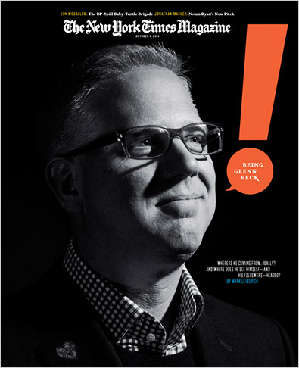
Video
Cass Sunstein
Not everybody likes nudges:
Glenn Beck (1, 2, 3)
Michael Savage

Slide 20
Experimental science

Slide 21
Experiments on human subjects
Behavioral economics uses many of the same tools and frameworks as standard economics
BE assumes
That individuals have well-defined objectives,
That objectives and actions are connected, and
That actions affect well-being
BE relies on mathematical models
BE subjects theories to careful empirical testing
An important difference is that BE often relies on experiments on human subjects
This is a major contribution of psychology to economics
21

Slide 22
Experiments on human subjects
Behavioral economists tend to use experimental data to test their theories (rather than historical data from the real world)
In a typical experiment, subjects (usually college students) make decisions that have monetary consequences, under conditions that the experimenter controls
22

Slide 23
Advantages of Experiments
It is easier to determine whether people’s choices are consistent with standard economic theory by designing experiments that can rule out alternative explanations
The real world is extremely complex and the choices of people that one can observe are often influenced by many factors
So it is hard to use real-world data to understand the precise effect of one particular factor on people’s choices
An experiment, however, can be designed to tease out the effect of any single factor
23

Slide 24
Advantages of Experiments
It is often easier to establish causality
When you see the quantity of ice cream being bought and sold vary with the price of ice cream, you cannot separate out the buyers’ reactions to price changes (demand) from the sellers’ reaction to price changes (supply)
But in an experiment this is not a problem
24

Slide 25
Advantages of Experiments
Researchers can double-check their assumptions and conclusions by testing and debriefing subjects
Careful questioning of the participants in the experiment can shed light on their thought processes and the reasons for their choices
25

Slide 26
Advantages of Experiments
It is often possible to obtain information that isn’t available in the real world
Real-world data will not tell you much about people’s plans and expectations
However, experiments may be able to help
26

Slide 27
Disadvantages of Experiments
Decisions made in the lab can differ from decisions made in the real world
Experiments often involve small amounts of money
In the real world, the stakes may be a lot higher, and, therefore, the choices made may be different
27

Slide 28
Disadvantages of Experiments
Experiments can introduce influences on decision-making that are hard to measure or control
There is strong evidence that subjects often try to conform to what they think are the experimenter’s expectations
28

Slide 29
Disadvantages of Experiments
Most subjects are students, thus not representative of the general population
Also students may be especially inexperienced at making economic decisions
29

Slide 30
Disadvantages of Experiments
The scale of any given experiment is limited by the available resources
When budgets are tight, the experiment may involve relatively few subjects
In that case, the results may not be very reliable
30

Slide 31
Evaluating Experimental Evidence
Behavioral research that appears inconsistent with standard economic theory needs to be cautiously evaluated:
Is the evidence convincing? Was the experiment well-designed?
Is the observed behavioral pattern robust (i.e., true under many different situations)?
What are the possible explanations (of the experiment’s results)? Can we reconcile this with standard theory?
If the standard theory appears to fail in a significant situation, how should we modify the theory?
31

Slide 32
Behavioral Economics on YouTube
Richard Thaler: http://youtu.be/4OdP3IADUVc
Richard Thaler: http://youtu.be/tXuFTuKB8nQ
Richard Thaler: http://youtu.be/zLMephdISTw
Sendhil Mullainathan: http://youtu.be/1NZMNqwfBO4

