Slide 1
Anchoring
Non-standard preferences: How we choose by comparing with a nearby reference point
Notes:
What does the subject matter of this presentation have to do with economics? How can people protect themselves from the weaknesses discussed here? How can or should rational actors and policy makers make use of the ideas discussed here?

Slide 2
Reading
Predictably Irrational
Chapter 1 The Truth about Relativity
Chapter 2 The Fallacy of Supply and Demand
Nudge, “Rules of Thumb” in Chapter 1
Thinking, Fast and Slow, Chapter 11 (“Anchors”)

Slide 3
Willingness to pay
Standard economics assumes that a consumer knows what he/she would be willing to pay for any given commodity
Behavioral economics shows that consumers generally have no clue what a given object is worth to them
Consumers tend to estimate their willingness to pay for an object by using irrelevant information about other objects

Slide 4
Willingness to pay
If there is a disconnect between what we are willing to pay for a commodity and some objective measure of the benefit obtained from that commodity, part of the case for the supremacy of free market-based economic systems loses validity
A government, for instance, could impose price control, arguing that, as prices are arbitrary, price control could not have serious negative effects

Slide 5
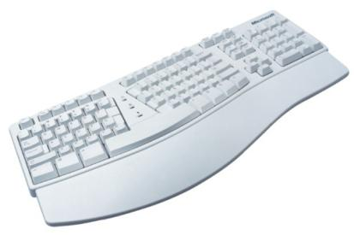
In this experiment, business students were asked if they would pay the last 2 digits of their social security numbers for each of several items (e.g., 34 = $34)
Next, each bid the maximum amount they would be willing to pay for each item. Did the initial “anchor” amount influence each student’s ultimate bids?

Slide 6
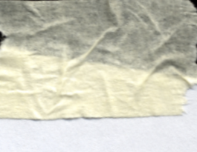
“Although students were reminded that the social security number is a random quantity conveying no information, those who happened to have high social security numbers were willing to pay much more for the products.”
Ariely, D. (MIT), Lowenstein, G. (Carnegie Mellon), & Prelec, D. (MIT), 2006, Tom Sawyer and the construction of value. Journal of Economic Behavior & Organization, 1-10.

Slide 7
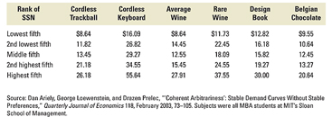
Anchoring experiment

Slide 8
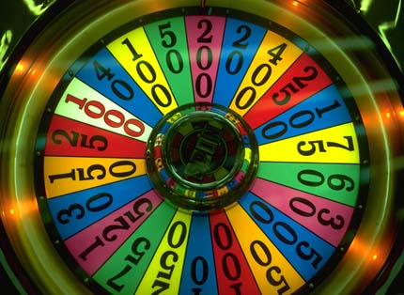
Anchoring: another experiment
Subject witnesses the number that comes up when a wheel of fortune is spun
Is asked whether the number of African countries in the U.N. is greater than or less than the number on the wheel of fortune
Is asked to guess the number of African countries in the U.N.
Result: those who got higher numbers on the wheel of fortune guessed bigger numbers in Step 3
Notes:
D. Kahneman and A. Tversky (1974), “Judgment under uncertainty: heuristics and biases,” Science, 185: pp. 1124-1131.

Slide 9
Anchoring and Adjustment
When asked to estimate the population of Milwaukee, people in Chicago, IL consistently guess more than people in Green Bay, WI
People begin the process of estimation with whatever information readily appears in their minds (anchoring)
They then reassess their initial answers based on rough notions of what is a not-too-silly answer (adjustment)

Slide 10
Anchoring and Adjustment
Statisticians have consistently measured the effect of the anchor value on the estimate that people make
For different anchors, people make different estimates
For any given change in the anchor, the estimate tends to change by 55% of the change in the anchor
See the top paragraph of page 124, Thinking, Fast and Slow

Slide 11
Heuristics Lead to Biases
Unfortunately, we tend to be too cautious in the adjustment phase
As a result, the initial anchor tends to heavily influence our final estimates
Our final estimates tend to get biased by our anchoring heuristics

Slide 12
How happy are you?
College students were asked the following questions in sequence:
How happy are you?
How often are you dating?
The two answers showed a low correlation (0.11)

Slide 13
How happy are you?
Then the question sequence was reversed:
How often are you dating?
How happy are you?
The two answers showed a high correlation (0.62)
The answer to the dating question (objective and easily determined) acted as an anchor to the happiness question

Slide 14
Anchors and nudges
It is possible to influence the figure you will choose in a particular situation by ever-so-subtly suggesting a starting point (anchor) for your anchoring-and-adjustment rule of thumb

Slide 15
Anchors and nudges
People will give more to a charity
if the suggested options are $100, $250, $1,000, and $5,000,
than if the options are $50, $75, $100, and $150
Lawyers suing businesses in product liability cases, can get high jury awards if they succeed in getting jury members to anchor on multi-million dollar figures

Slide 16
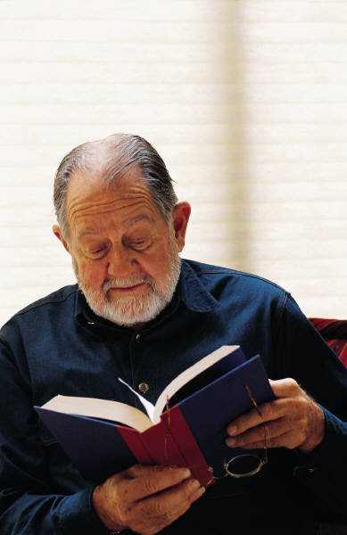
Experiment:
Business students were told their professor would be doing a 15-minute poetry reading. Half were asked if they would be willing to pay $2 to attend and half were asked if they would be willing to attend if they were paid $2. After answering, students were then told that the poetry reading would be free and were asked if they wanted to attend.
Question:
Would the initial anchoring of the experience’s value affect who would attend for free?
Ariely, D. (MIT), Lowenstein, G. (Carnegie Mellon), & Prelec, D. (MIT), 2006, Tom Sawyer and the construction of value. Journal of Economic Behavior & Organization, 1-10.

Slide 17
Ariely, D. (MIT), Lowenstein, G. (Carnegie Mellon), & Prelec, D. (MIT), 2006, Tom Sawyer and the construction of value. Journal of Economic Behavior & Organization, 1-10.

Slide 18
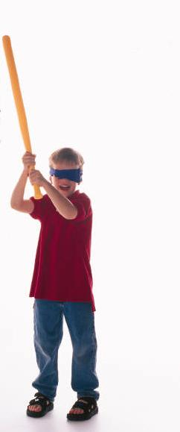
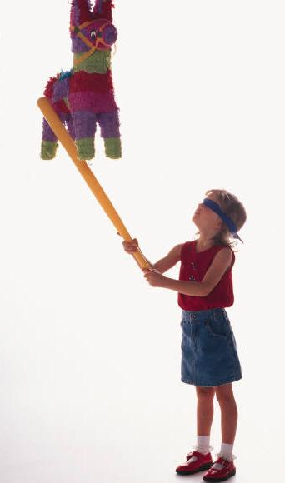
Perhaps students were just using price as an estimate of unknown quality?

Slide 19
Experiment #2:
Now the professor first read poetry for 1 minute so that students actually experienced it. Then one group was asked if they would be willing to pay to attend, the other group if they would be willing to attend if paid.
Question:
Would the anchoring effect go away when people were allowed to sample the experience first?
Ariely, D. (MIT), Lowenstein, G. (Carnegie Mellon), & Prelec, D. (MIT), 2006, Tom Sawyer and the construction of value. Journal of Economic Behavior & Organization, 1-10.

Slide 20
Ariely, D. (MIT), Lowenstein, G. (Carnegie Mellon), & Prelec, D. (MIT), 2006, Tom Sawyer and the construction of value. Journal of Economic Behavior & Organization, 1-10.

Slide 21
Anchors can be sticky
Subjects were made to listen to a slightly annoying sound
Group 1 (2) was asked whether they’d listen to the sound again for 10 (90) cents
Subjects were asked for what payment would they listen to the sound again
Result: Group 1 bid less than Group 2, indicating that anchoring had occurred

Slide 22
Anchors can be sticky
The same subjects were made to listen to a slightly annoying sound
Both groups were asked whether they’d listen to the sound again for 50 cents
Subjects were asked for what payment would they listen to the sound again
Result: Group 1 again bid less than Group 2, indicating that the initial anchoring was still dominant

Slide 23
Anchors can be sticky
The same subjects were made to listen to a slightly annoying sound
Group 1 (2) was asked whether they’d listen to the sound again for 90 (10) cents
Subjects were asked for what payment would they listen to the sound again
Result: Group 1 again bid less than Group 2, indicating that anchoring, once established, can be hard to shake

Slide 24
Starbucks and Dunkin Donuts
Starbucks entered the coffee market after Dunkin Donuts was already established
How were they able to get away with charging a lot more for coffee, given that coffee drinkers were anchored to Dunkin Donuts?
By differentiating themselves from Dunkin Donuts in numerous (largely superficial) ways

Slide 25
Experiment with two types of subscription offers to The Economist magazine.
Which offer do you think was most popular?
The first
The second
The third
All were about equal
The first and third were about equal
Notes:
Ariely, D., TED lecture, http://www.youtube.com/watch?v=9X68dm92HVI

Slide 26
When these three choices were presented…
16%
0%
84%

Slide 27
Some were given only these two choices. Should the preferences be different for those without the second choice?

Slide 28
When only two choices were presented…
16%
68%
0%
X
84%
32%
Notes:
Ariely, D., TED lectures, http://www.youtube.com/watch?v=9X68dm92HVI

Slide 29
Nearby comparison and choice [anchoring and adjustment]
The presence of the comparably worse nearby option, made the third option seem better.
16%
84%

Slide 30
Nearby comparison and choice
Without the comparably worse nearby option, the relative preference reversed.
16%
68%
84%
32%

Slide 31
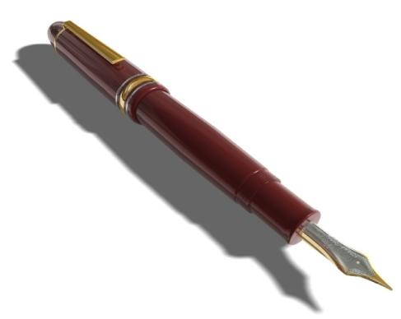
Nearby comparison and choice
First group could have either $9 or a nice pen
Second group could have $9, a nice pen, or an uglier pen

Slide 32
Nearby comparison drives choice [anchoring and adjustment]
 | Group A | Group B
$9 | 64% | 52%
Cross pen | 36% | 46%
Ugly pen |  | 2%
n | 106 | 115
Simonson, I. (UC-Berkeley) & Tversky, A. (Stanford), 1992, Choice in context: Tradeoff contrast and extreme aversion. Journal of Marketing Research, 29, 281-295.

Slide 33
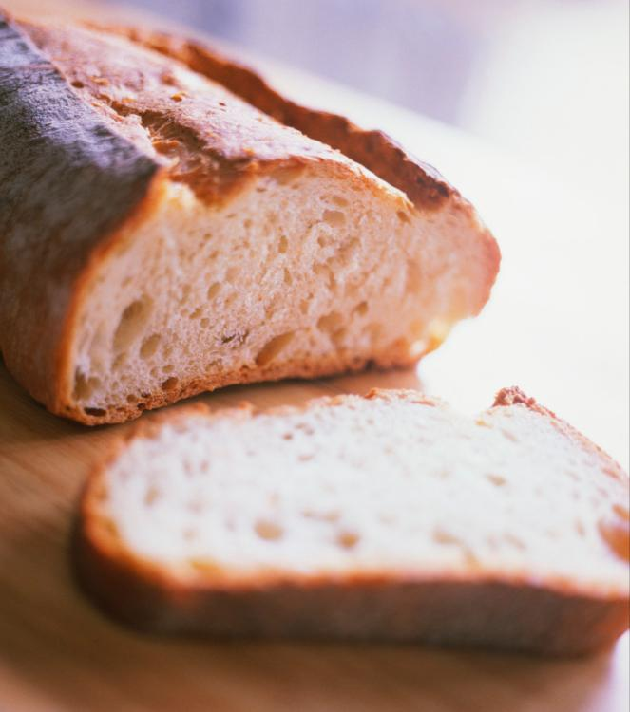
When bread makers were new…
“Williams-Sonoma, a mail-order and retail business located in San Francisco, used to offer one home bread maker priced at $275. Later, a second home bread maker was added, which had similar features except for its larger size. The new item was priced more than 50% higher than the original bread maker. Williams-Sonoma did not sell many units of the new (relatively overpriced) item, but the sales of the less expensive bread maker almost doubled.”
Simonson, I. (Stanford), 1999, The effect of product assortment on buyer preferences, Journal of Retailing, 75(3), 347-370.

Slide 34
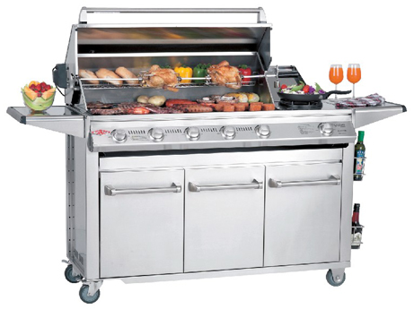
Is this grill expensive?
$5,984.05
from www.barbecue-grill-guide.com
Beefeater Signature SL - 6 Burner BBQ
Notes:
http://www.beefeaterbbq.com/Product-Range/Signature-Series/Signature-SL/6-Burner/6-Burner/default.aspx

Slide 35
How about now?
$5,984.05
$6,299.00
from www.barbecue-grill-guide.com
Beefeater Signature SL - 6 Burner BBQ
Notes:
http://www.beefeaterbbq.com/Product-Range/Signature-Series/Signature-SL/6-Burner/6-Burner/default.aspx

Slide 36
And now?
$5,984.05
$6,299.00
from www.barbecue-grill-guide.com
Beefeater Signature SL - 6 Burner BBQ
Notes:
http://www.beefeaterbbq.com/Product-Range/Signature-Series/Signature-SL/6-Burner/6-Burner/default.aspx

Slide 37
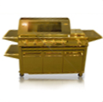
How about now?
$5,984.05
$6,299.00
from www.barbecue-grill-guide.com
Beefeater Signature SL - 6 Burner BBQ
$12,500.00
Beefeater Signature SL - 6 Burner BBQ: Gold Plated Edition
Notes:
http://www.beefeaterbbq.com/Product-Range/Signature-Series/Signature-SL/6-Burner/6-Burner/default.aspx
http://www.beefeaterbbq.com/News/News-Articles/What-The----a-Gold-Barbecue-/default.aspx

Slide 38
The Compromise Effect
[In an] experiment decades ago by Dr. [Itamar] Simonson, then at Duke [but now at Stanford] … some subjects chose among three Minolta cameras: an inexpensive one, a midprice one and an expensive one.
Another group was given a choice of just two of the Minoltas: the midprice one and the less expensive one.
The researchers found that when study subjects had only two choices, most chose the less expensive camera with fewer features.
But when given three choices, most chose the middle one.
Notes:
Source: There’s Power in All Those User Reviews, By MATT RICHTEL, The New York Times, December 7, 2013, http://www.nytimes.com/2013/12/08/business/theres-power-in-all-those-user-reviews.html?smid=pl-share

Slide 39
The Compromise Effect
Dr. Simonson called it “the compromise effect” — the idea that consumers will gravitate to the middle of the options presented to them.
The study showed how marketers could manipulate consumers.
Just by presenting three differently priced options, they could get consumers to gravitate to a midprice one from a less expensive one.
Notes:
Source: There’s Power in All Those User Reviews, By MATT RICHTEL, The New York Times, December 7, 2013, http://www.nytimes.com/2013/12/08/business/theres-power-in-all-those-user-reviews.html?smid=pl-share

Slide 40
The Compromise Effect
This finding further led Dr. Simonson and other scholars to describe widespread “irrational” behavior by consumers who made decisions not based on a product’s actual value but on how the item was presented relative to other products.
Notes:
Source: There’s Power in All Those User Reviews, By MATT RICHTEL, The New York Times, December 7, 2013, http://www.nytimes.com/2013/12/08/business/theres-power-in-all-those-user-reviews.html?smid=pl-share

Slide 41
The Compromise Effect
In a more recent study, Dr. Simonson repeated his experiment but now giving his experimental subjects access to online amazon.com-style product reviews
Now the compromise effect disappeared!
When people have the necessary information, they no longer need to play it safe by picking the middle option
Notes:
Source: There’s Power in All Those User Reviews, By MATT RICHTEL, The New York Times, December 7, 2013, http://www.nytimes.com/2013/12/08/business/theres-power-in-all-those-user-reviews.html?smid=pl-share

Slide 42
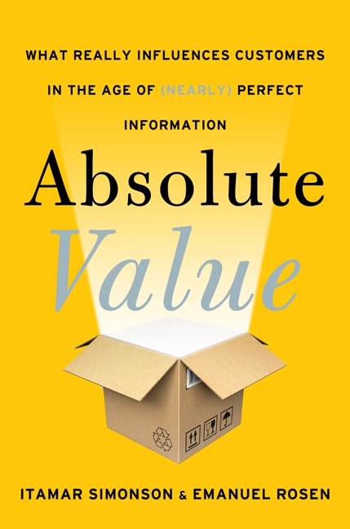
From Compromise Effect to Absolute Value
Absolute Value: What Really Influences Customers in the Age of (Nearly) Perfect Information
By Itamar Simonson and Emanuel Rosen, HarperBusiness, 2014

Slide 43
Producers want to anchor to a higher priced alternative
Even if it means creating an artificial alternative
Producers avoid anchoring to a lower priced alternative
Differentiation is key
If we anchored Starbucks coffee by Dunkin Donuts coffee, would we buy Starbucks?
http://www.youtube.com/watch?v=FaO3aGmuNFc

Slide 44
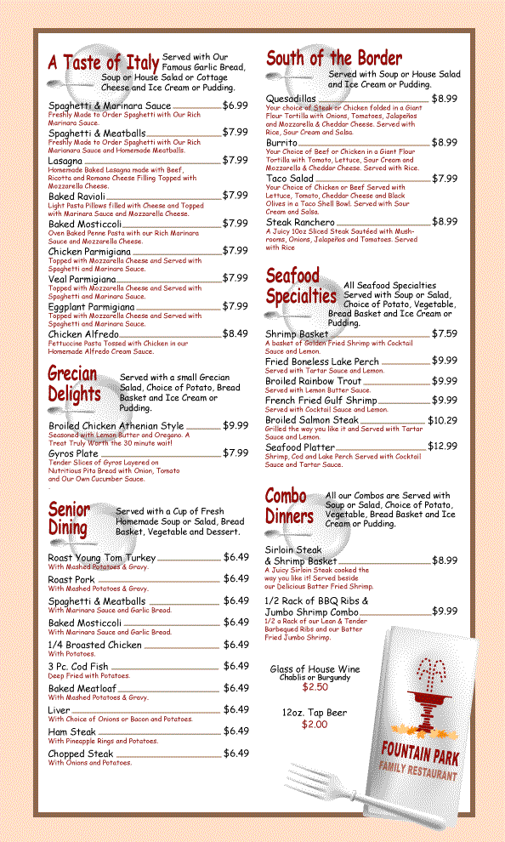
Designing a restaurant’s menu
Expensive items on a restaurant menu can help even if no one orders them; they can steer customers to pricier (but not as expensive) items they were avoiding

Slide 45
Nearby comparisons in college quality
Question: Does having a top public university in your home county make you more likely to attend a higher quality college even if you do not attend college locally?
What do you think?
Yes, but only for families with high wealth and education
Yes, but only for families with moderate or lower wealth and education
Yes, for families of any wealth and education
No.
Do, C. (UC-Santa Barbara), 2004, The effects of local colleges on the quality of college attended. Economics of Education Review, 23, 249-257.
Notes:
Discussion of the effect of example, comparison groups, outreach programs, etc.

Slide 46
Nearby comparisons in college quality
Question: Does having a top public university in your home county make you more likely to attend a higher quality college even if you do not attend college locally?
Yes, but only for families with high wealth and education
Yes, but only for families with moderate or lower wealth and education
Yes, for families of any wealth and education
No.
Why is this “nearby” comparison more important for families with less education?
Do, C. (UC-Santa Barbara), 2004, The effects of local colleges on the quality of college attended. Economics of Education Review, 23, 249-257.
Notes:
Discussion of the effect of example, comparison groups, outreach programs, etc.

Slide 47
Anchoring in physical attraction?
http://www.youtube.com/watch?v=9X68dm92HVI 14:30-15:54

Slide 48
Anchoring shows excessive influence of nearby comparisons
Conclusion

Slide 49
You can change your nearby comparisons by changing your environment or your focus within your environment.

Slide 50
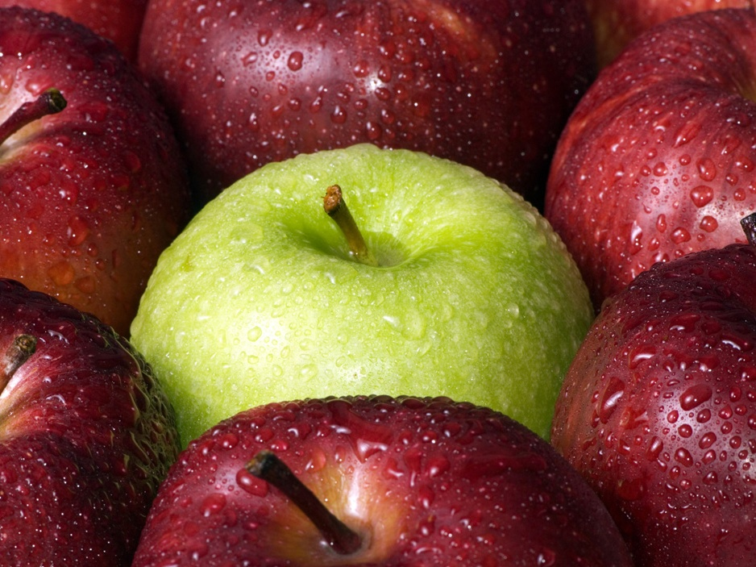
Be intentional about choosing comparisons, instead of automatically using the easy anchor.

Slide 51
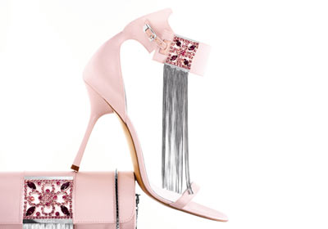
Mary is seriously overspending her income. Today, she buys these Escada shoes because they are marked down from $995 to $895. And also the matching $995 clutch purse, because it is 20% off if purchased as a set.
How might anchoring bias have affected her decision? How might she reframe her view of the price that would make the “good deal” easier to resist?
Notes:
Anchoring on retail price. Consider anchoring on comparable brands at lower price points. Consider if it was marked up from $500 to $895
http://www.forbes.com/2005/12/16/expensive-womens-shoes-cx_sb_1219feat_ls.html

Slide 52
Relativity in earnings
Our happiness tends to depend on relative salary
In 1993, federal securities regulators forced companies to reveal the pay and perks of their top executives.
This accelerated the demand for higher salaries
Perhaps companies should instead be required to reveal the salaries of their rank-and-file workers!
Average CEO pay in the US as a multiple of average worker pay
1976 | 36
1993 | 131
2008 | 369

Slide 53
Relativity in earnings
Standard economics claims that earnings are determined by productivity
The evidence that we have just seen seems to suggest that there are other sociological forces at work that create a disconnect between earnings and productivity

Slide 54
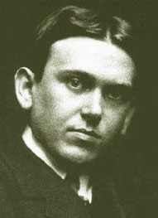
Relativity in earnings
Wealth — Any income that is at least $100 more a year than the income of one's wife's sister's husband.
H.L. Mencken, A Mencken Chrestomathy (1949)

Slide 55
We need to watch ourselves!
Now that we know how easily we’re influenced by obviously irrelevant cues to which we get anchored, we need to develop a habit of constantly asking ourselves tough questions about our economic choices

Slide 56
Video
Anchoring, with Daniel Kahneman: http://youtu.be/HefjkqKCVpo

